Slide 1
Food and Heart Failure
Radhika nandur bukkapatnam md mas facc

Slide 2
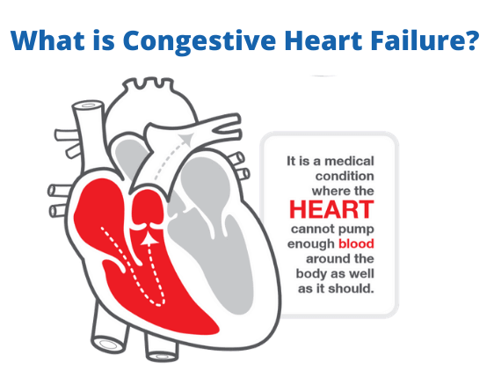
Heart Failure

Slide 3
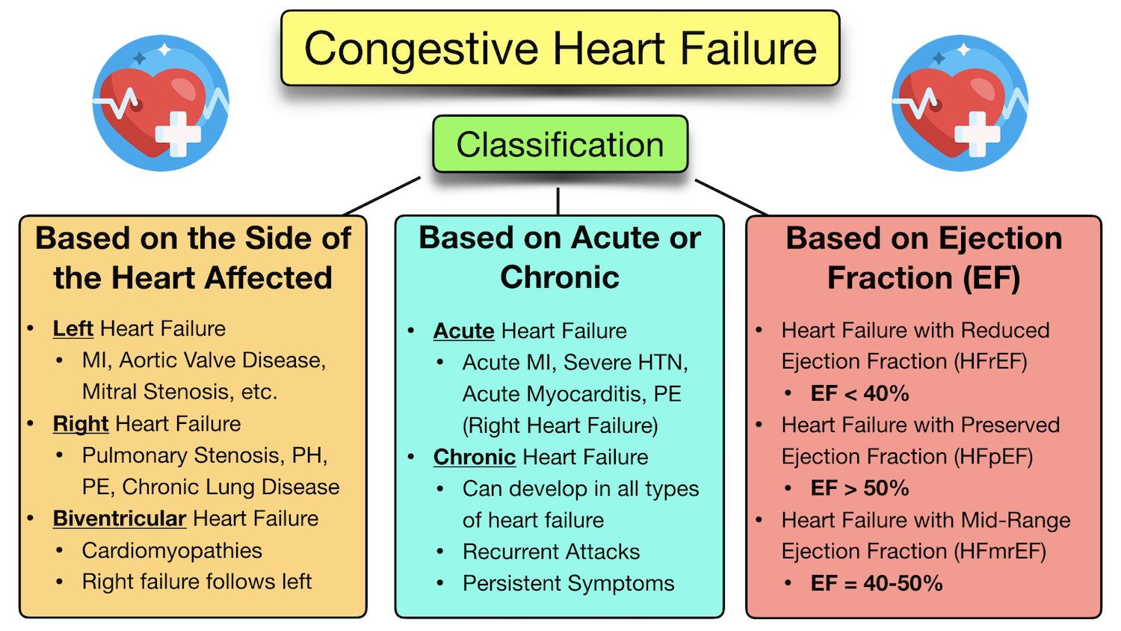
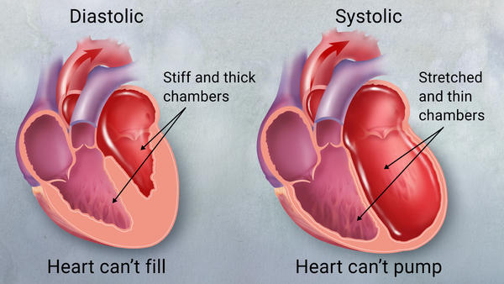

Slide 4
Causes
Heart attack or blocked arteries
Valvular heart disease
Arrhythmias
Age/ obesity/ Diabetes
High blood pressure
Smoking/ Alcohol
Viral
Genetics/ Congenital heart disease
Amyloidosis

Slide 5
Symptoms
Shortness of breath
Fatigue
Weight gain
Leg edema

Slide 6
Treatment
General measures:
  Diet
  Fluid restriction
  Exercise
  Address the cause
Medications
Interventions/ devices

Slide 7
Sodium and CHF
CHF causes a back up of blood that is not circulating through the body as it should which is called congestion. This backup can create a pooling of fluid in the legs and lungs, producing the symptoms of heart failure
Salt (sodium chloride) helps regulate our water balance, namely our thirst and urination. Some salt is necessary, but most of us are getting too much
The American Heart Association recommends limiting daily sodium intake to 1,500 mg for patients with heart disease.
Average American diet contains about 3,400 mg – more than double the recommendation
1 teaspoon of salt has 2,300 mg of sodium which is an acceptable daily amount for people without heart disease, but patients with heart disease should limit their daily intake to 2/3 of a teaspoon of salt which has 1,500 mg of sodium
Sodium level in blood is not indicative of sodium in the body

Slide 8
Certain medications for heart failure work in the kidneys where salt and water are regulated
Similarly, some salt substitutes contain potassium which is known to interact with certain medications for heart failure. Some potassium can be beneficial for high blood pressure, but potassium can also cause heart problems when used in excess. Do not use salt substitutes before discussing it with your provider.
While some sources of salt such as fast food and french fries are more obvious, most of this excess salt actually comes hidden in processed and packaged foods
Salt is hidden in sweets like cookies or foods that are marketed as healthy like salted nuts

Slide 9
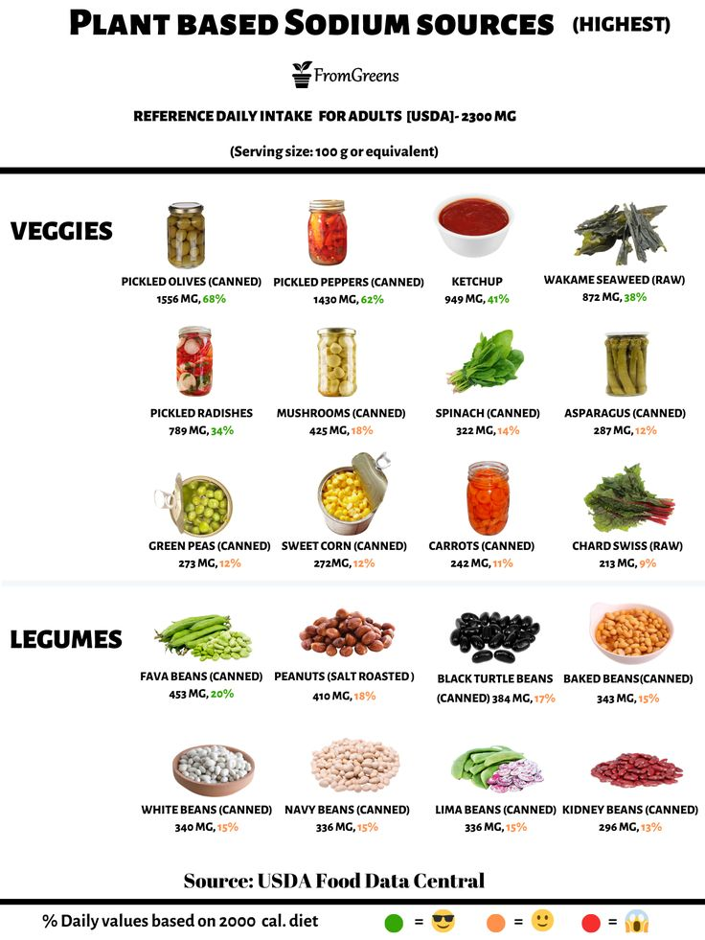
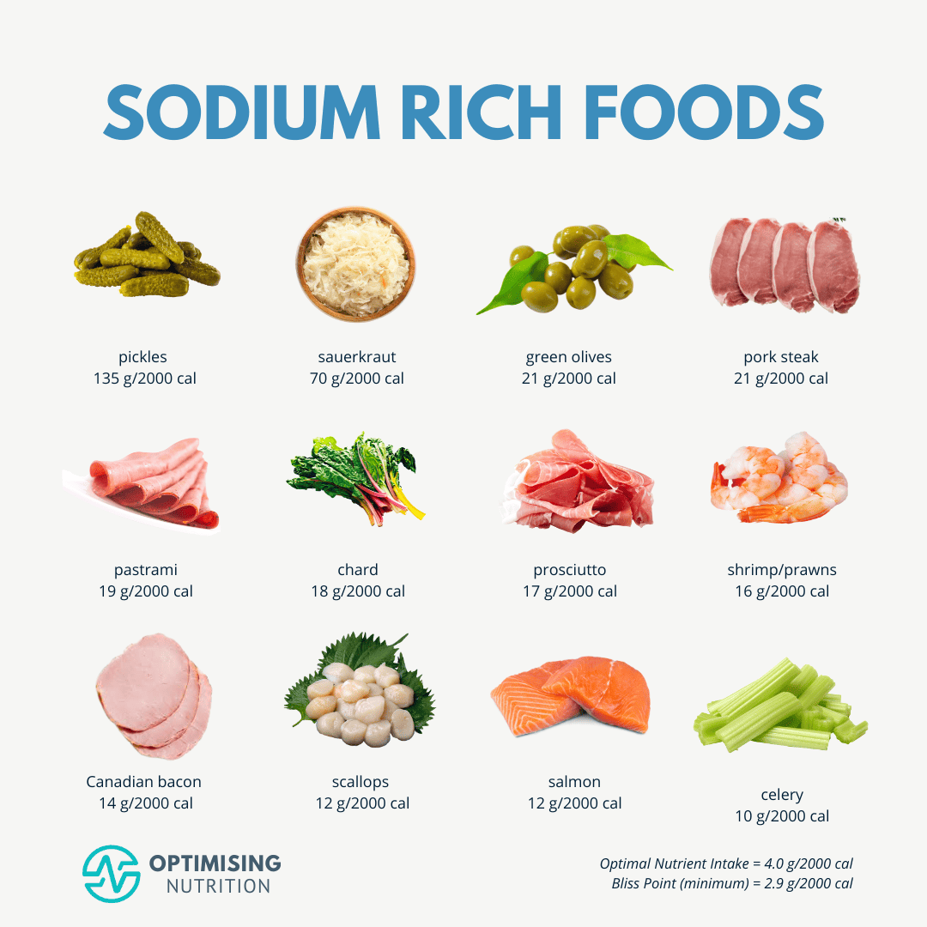

Slide 10
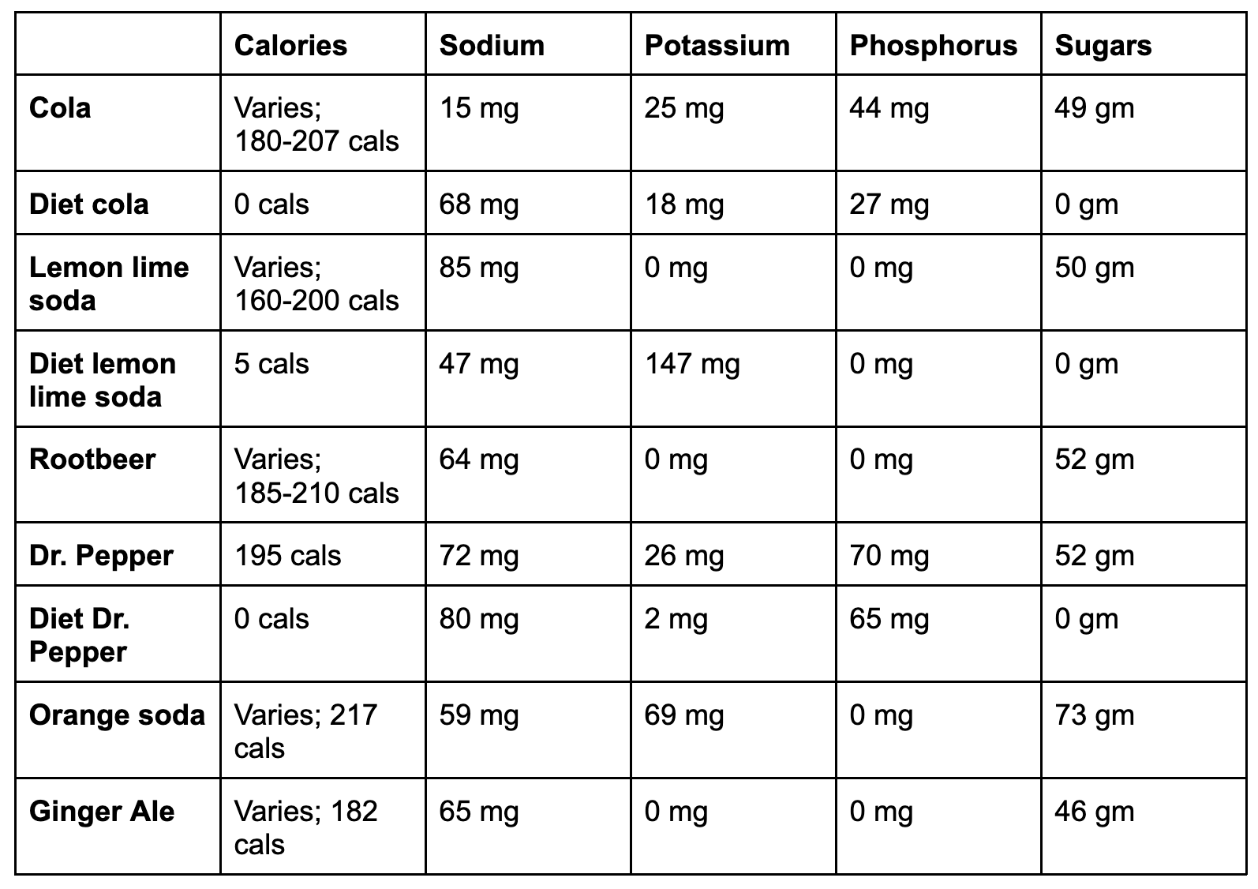
Sodium in Sodas

Slide 11
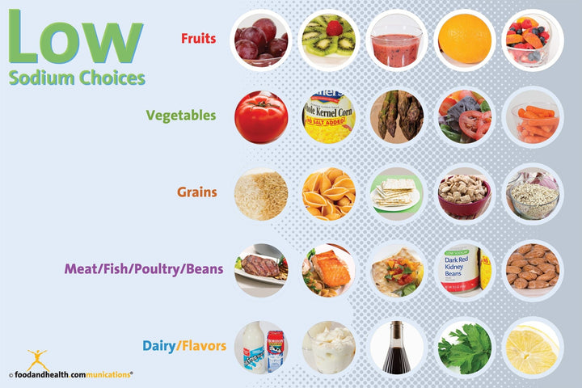

Slide 12
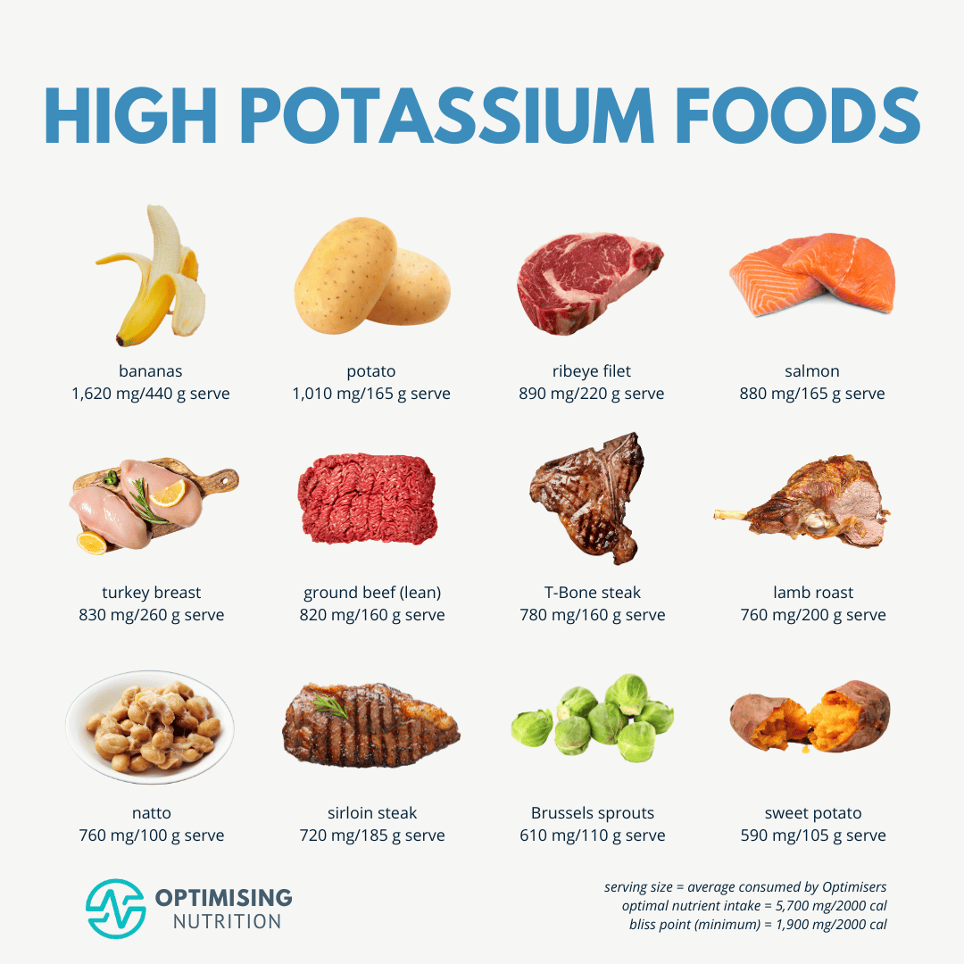

Slide 13
Strategies to reduce Sodium
Remove the saltshaker from the kitchen table
Exchange canned vegetables for fresh or frozen vegetables
Reduce the times per week that you eat out at restaurants by cooking more at home
Add flavor to food with spices and herbs or lemon and vinegar
Limit sodium to 1500-2000mg a day or 500mg/ meal
Limit sodium to 140mg/serving size

Slide 14
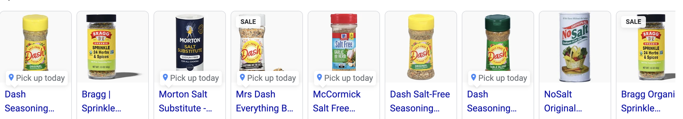
Salt Substitutes

Slide 15
Eating Out
When you are dining away from home:
Put the saltshaker out of sight.
Don’t be afraid to ask for substitutions, such as steamed veggies instead of mashed potatoes and gravy, or a side salad instead of french fries.
Order sauces and dressings on the side.
Ask that no salt be added to your meal.
Look up or ask for nutrition information before ordering, and select a lower-sodium and lower-fat option.
Ask for water instead of soda when asked for your drink of choice.

Slide 16
Shopping
Look for “reduced sodium,” “low sodium,” or “no salt added” varieties of canned and prepackaged foods. And pay attention to the serving size
When buying frozen vegetables, choose those without added sauces or salt.
Read and compare food labels, looking at the amount of sodium in different products. Choose the options with the lowest amounts of sodium and saturated fat.
When possible, choose fresh poultry, fish, and lean meats without a saline or salt solution added, rather than cured, salted, smoked, and other processed meats.

Slide 17
Decoding Nutrient Claims
Low sodium: Contains 140 milligrams (mg) or less of sodium per serving
Very low sodium: Contains 35 mg or less of sodium per serving
Salt/sodium-free: Contains less than 5 mg of sodium per serving
No salt added: No sodium was added to the food. However, the food may still naturally contain sodium.
Reduced sodium: Contains at least 25% less sodium than what the food normally has
Light in sodium or lightly salted: Contains at least 50% less sodium than what the food normally has
Low fat: Contains 3 grams (g) of fat or less than what the food normally has and not more than 30% of calories from fat
Reduced/less fat: Contains at least 25% less fat than what the food normally has
Fat-free: Contains less than 0.5 g of fat per serving

Slide 18
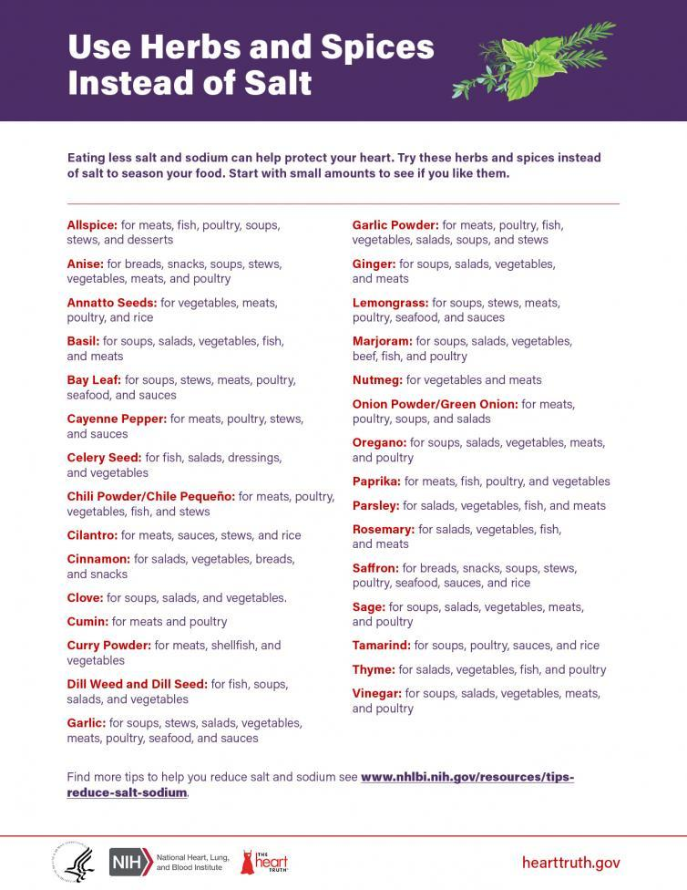

Slide 19
Herbs and Medicinal Plants
Herbal medicine has made many contributions to commercial drug preparations manufactured today including
  Ephedrine from Ephedra sinica
  Digitoxin from Digitalis purpurea
  Salicin (the source of aspirin) from Salix alba and
  Reserpine from Rauwolfia serpentina.
  A naturally occurring β-adrenergic blocking agent with partial agonism has been identified in a herbal remedy

Slide 20
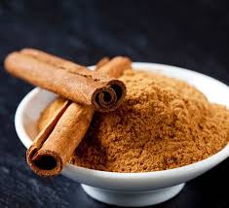
Top Herbs for your heart
Cinnamon
Cinnamon helps the heart in several ways. A 2013 review study of 10 previous studies found that a small daily dose of cinnamon decreased levels of total cholesterol, “bad” LDL cholesterol, and triglycerides, a harmful type of blood fat. It also lowered blood sugar, protecting against diabetes, which increases the risk for heart attacks and strokes.
To use it: Sprinkle on oatmeal, add to smoothies, or mix into meatless or turkey chili.

Slide 21
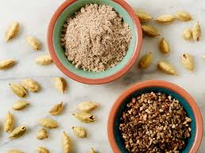
Cardamom
One study found that cardamom, an intense spice often found in Indian dishes, may lower blood pressure. Research also shows it helps lower the risk of blood clots.
To use it: Find this herb ground or in pod form on the spice aisle. You can mix the ground seed into any Asian or Mexican dish. Or eat the whole pods as a snack..

Slide 22
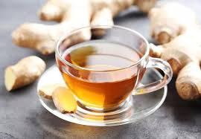
Ginger
Eating this spicy root may reduce your risk for high blood pressure, research shows. People who ate more of it had the lowest risk. The study authors recommend 2-4 grams (or about ½ teaspoon to a teaspoon) a day to prevent this heart problem.
To use it: Chop it up and add raw to salads or toss into stir-fries and Asian dishes.

Slide 23
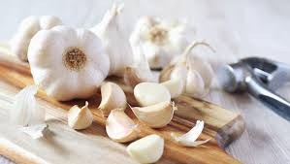
Garlic
If you’re committed to heart health, you can’t go wrong with garlic. In a 2016 article that reviewed 20 prior studies, garlic was shown to significantly lower blood pressure. And another review study involving 2300 people showed it lowered total and LDL cholesterol by as much as 10% in those who had high cholesterol levels to start with.
To use it: Add to soups, stews, and casseroles. Sauté in olive oil with vegetables like spinach or kale. You can also take a garlic supplement.

Slide 24
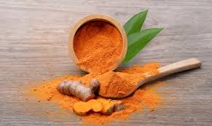
Curcumin
This substance is found in turmeric and gives the spice its rich, yellow color, research shows: preventing dangerous blood clots, lowering cholesterol, and reducing inflammation that leads to heart attacks and strokes. It may also guard against heart failure. And studies show that curcumin may be as effective as medication and exercise at improving the health of blood vessels.
To use it: Toss with roasted vegetables like cauliflower, onions, and carrots, or add to rice or soups. Some people take a turmeric supplement to get the benefit.

Slide 25
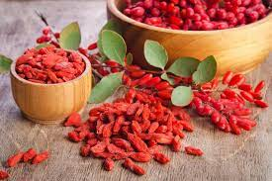
Berberine
A compound that comes from several plants, berberine is used to make a supplement. Research shows it helps the heart in several ways, including lowering LDL cholesterol and triglycerides and increasing HDL cholesterol. It also improves blood sugar.
To use it: Your best bet is a berberine supplement because the compound is hard to get from foods. Some people sprinkle the contents of a berberine capsule into a smoothie.

Slide 26
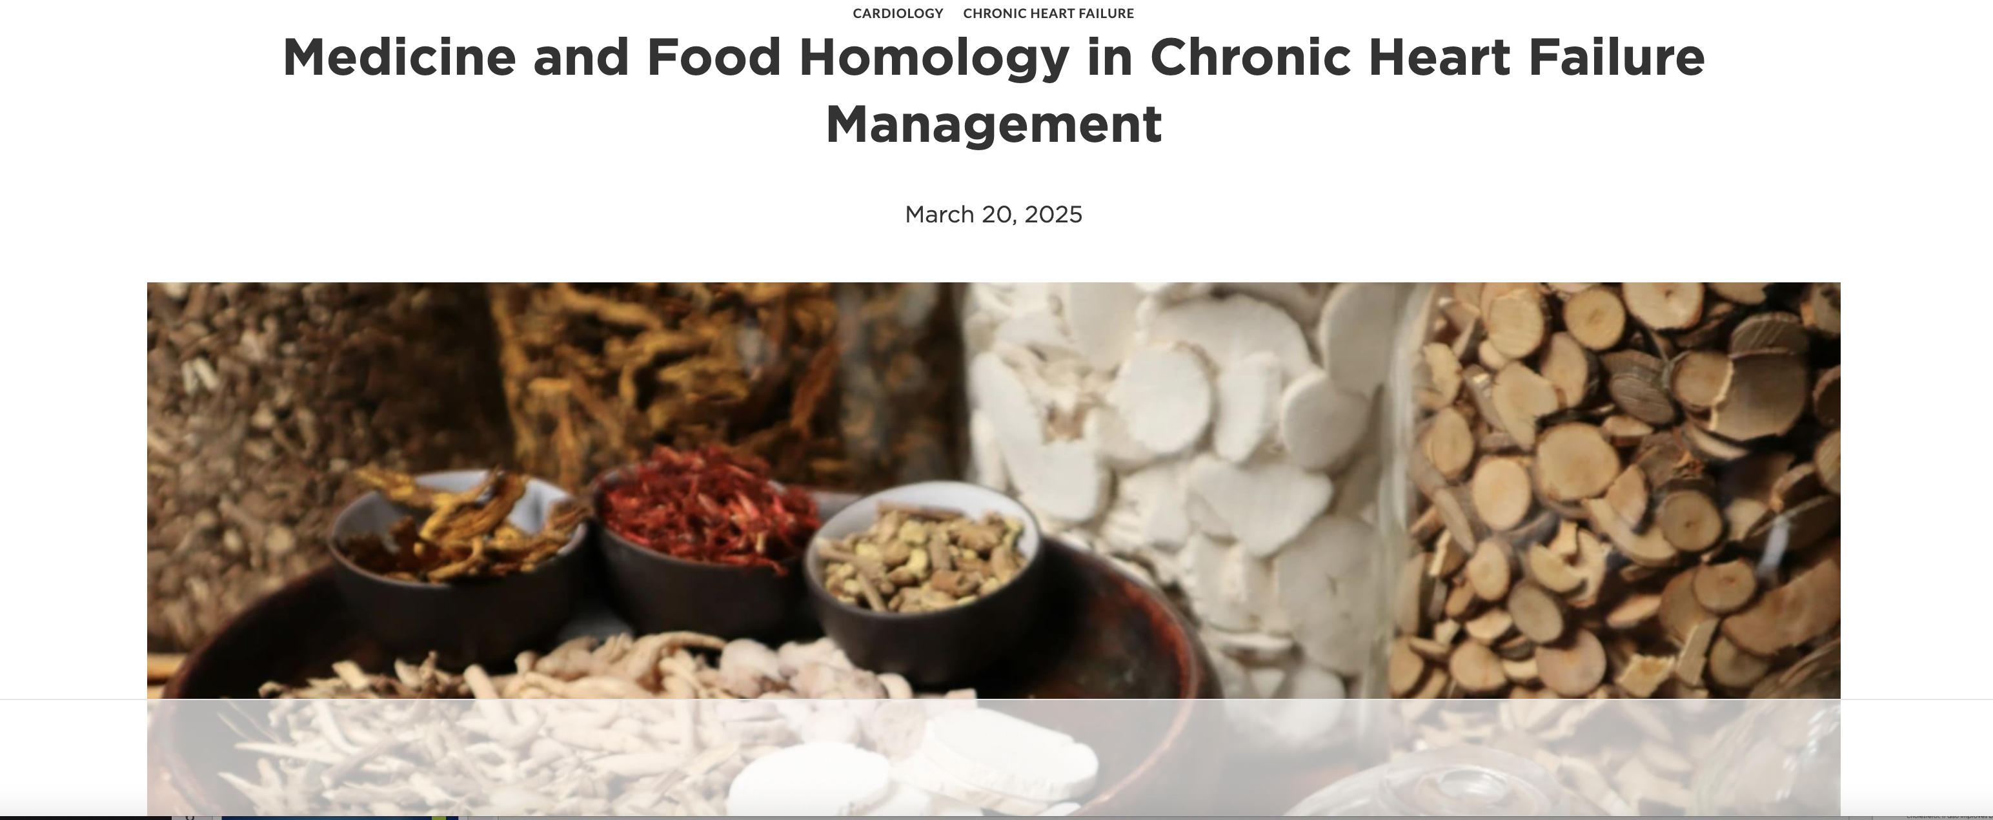

Slide 27
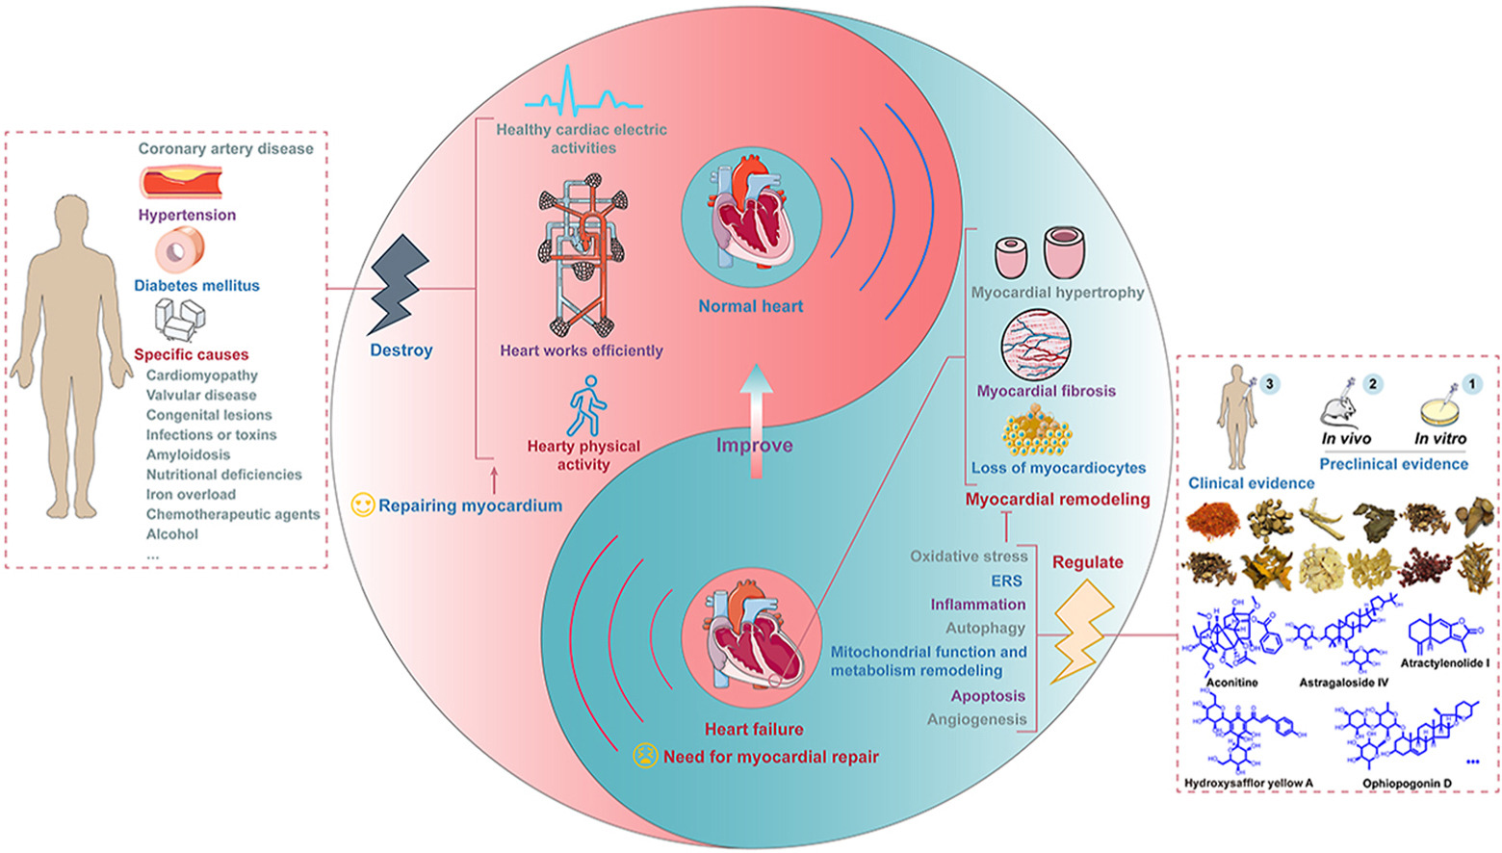

Slide 28
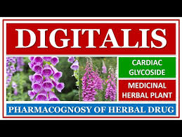
Glycosides
Glycosides reduce cardiomyocyte apoptosis, promote angiogenesis, and alleviate oxidative stress

Slide 29
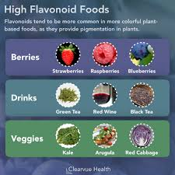
Flavonoids
Improve endothelial function, modulate thrombomodulin activity, and regulate cardiac remodeling

Slide 30
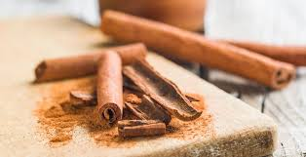
Terpenes and coumarins prevent cardiac injury by suppressing ischemia, reducing inflammation, and mitigating oxidative stress

Slide 31
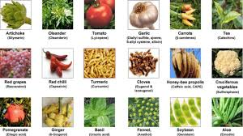
Phenols improve antioxidant activity and regulate lipid and carbohydrate metabolism.

Slide 32
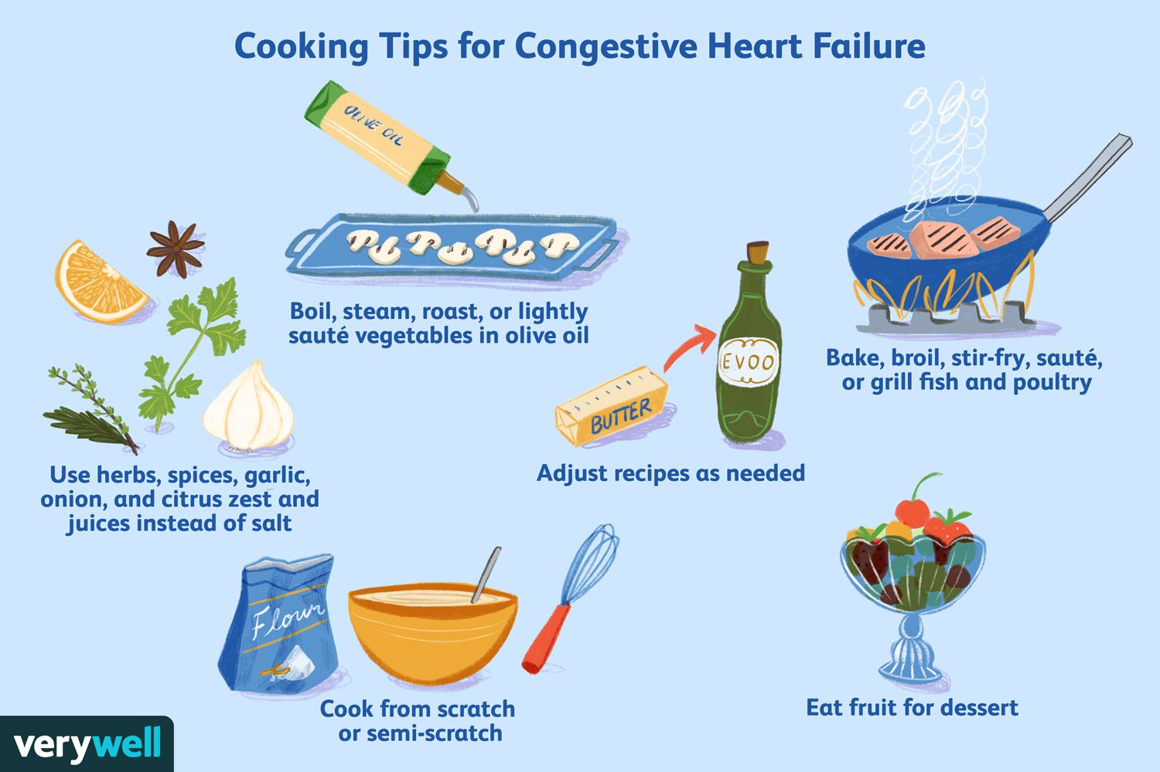

Slide 33
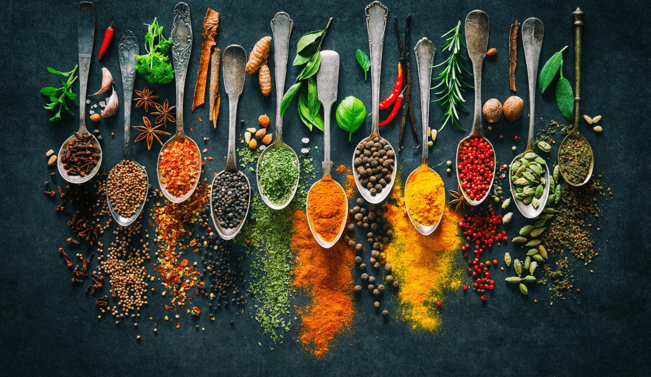
Thank you

