Slide 1

Healthcare Decisions and Living Wills
Cari Shulkin MSN, BC-CV
Notes:
Add in a photograph that best represents class. Use photos in HME Shared Drive

Slide 2
CA-PREPARE-Advance-Directive-English.pdf

Slide 3
Class Topics
End of Life Wishes: Why? When? How?
Chronic illness and your future
What are your end of life wishes?
What is CPR?
Questions about the forms for end of life planning

Slide 4

The Journey

Slide 5
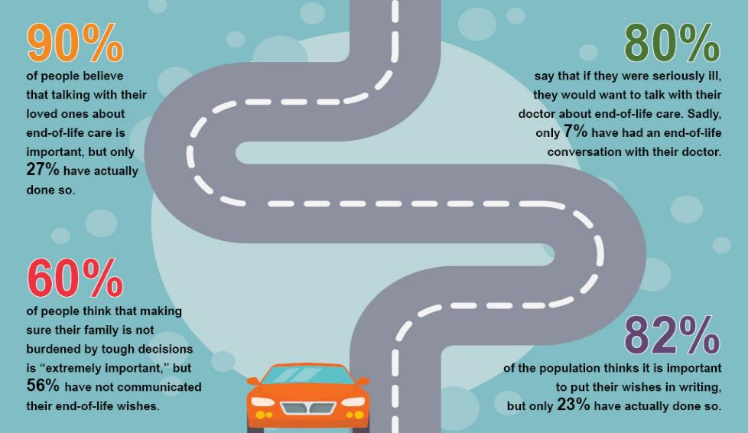
The Journey
3 out of 4 people die in a hospital or assisted living facility
Source: http://www.hrrv.org/advance-care-planning/

Slide 6

The Journey

Slide 7

How will a Chronic Illness Affect You?
Heart Disease
Cancer
Chronic respiratory disease
Cerebrovascular disease
Alzheimer’s disease
Diabetes
Kidney Failure
1 Year?
5 Years?
10 Years?

Slide 8

Advanced Care Planning is NOT
Physician-assisted suicide
A ”death panel”
Written in stone
Age specific

Slide 9

Advance Care Planning IS
Identifying choices for or against medical treatment
Planning for your future care
Choosing someone to speak for you
Writing down your wishes
Letting others know of your decisions

Slide 10
Tools for Advance Care Planning
Durable Power of Attorney
  Allows you to name someone

Slide 11
Tools for Advance Care Planning
Durable Power of Attorney
  Allows you to name someone
Living Will or Advance Directive
  Allows you to document your wishes

Slide 12
Tools for Advance Care Planning
Durable Power of Attorney
  Allows you to name someone
Living Will or Advance Directive
  Allows you to document your wishes
POLST (Physician Order for Life Sustaining Treatment)
  Allows you to have a discussion with your PCP and he/she can document your treatment preferences

Slide 13

What are Your Wishes?

Slide 14


CPR in the Media

Slide 15

Cardio Pulmonary Resuscitation (CPR)
Cardiopulmonary Resuscitation – is an emergency lifesaving procedure performed when the heart stops beating comprised of chest compressions.
It keeps the blood flow active – even partially – extends the opportunity for a successful resuscitation once trained medical staff arrive on site.

Slide 16
Chasm between reality and fiction
In an analysis of 54 scripted television episodes that depicted laypeople responding to cardiac arrests outside of a hospital, most of those responders were shown doing cardiopulmonary resuscitation (CPR) incorrectly.
Nearly half of the episodes featured laypeople giving breaths to a cardiac arrest victim, and 43% showed them checking for a pulse. Neither of those actions are recommended for untrained bystanders performing the currently accepted method of bystander CPR, known as hands-only CPR. Instead, the focus should be on providing hard, fast chest compressions within the first few minutes of a cardiac arrest.
Most of the TV cardiac arrests occurred in remote areas or public spaces. In reality, more than 80% of cardiac arrests that happen outside of a hospital occur at home.
https://www.health.harvard.edu/preventive-care/cpr-on-tv-may-be-misleading

Slide 17
CPR is depicted in approximately 78% of medical emergencies shown on popular TV shows. What’s even more alarming is the outcome: survival rates on screen hover around 70%, with patients frequently regaining consciousness moments after chest compressions begin.
The average bystander CPR survival rate for out-of-hospital cardiac arrest in the United States is approximately 10.6%. Even in-hospital cardiac arrest survival is only about 25.5%.
This chasm between fiction and reality isn’t merely a benign exaggeration — it shapes public perception and behavior in dangerous ways.
https://www.breakouttools.com/physical-health/cpr-in-reality-vs-fiction-how-hollywood-distorts-life-saving-truths-and-misleads-the-public/

Slide 18
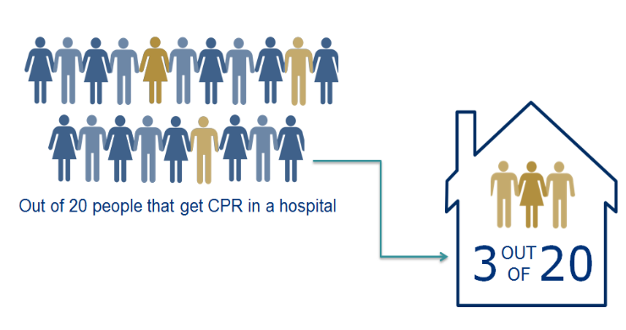
CPR Statistics
In hospital settings, the survival rate for patients who receive CPR is approximately 15-25%. This means that roughly 1 in 4 to 1 in 5 patients may survive after receiving CPR during a cardiac arrest event….but survival does not necessarily mean discharged home.

Slide 19

Important Note
Without healthcare wishes written down and no one to legally speak for you, you will receive the most aggressive care available that gives you the best chance of surviving.
Quality of life is not a consideration.

Slide 20
What questions do you have for me thus far?
    …I know it’s a lot!!!
    So lets talk about “End of Life Option act”
    The End of Life Option Act allows an adult diagnosed with a terminal disease, who meets certain qualifications, to request the aid-in-dying drugs from their attending physician. This act allows terminally ill patients with a life expectancy of six months or less to end their lives peacefully at a time of their choosing.

Slide 21

End of Life Option Act or Medical Aid in Dying (MAID)
General Guidelines
California residency
18 years of age or older
Diagnoses with a terminal disease
Less than 6 months life expectancy
Patient must make three requests for the aid-in-dying drug to their attending physician. Two requests must be made orally (at least 48 hours apart) and one must be in writing on a special form that is witnessed.
Attending physician must be willing to prescribe an aid-in-dying drug and must make sure the patient legally qualifies.
Attending physician must explain all end-of-life options to patient, encourage patient-family discussion and review what it means to ingest an aid-in-dying drug.

Slide 22
End of Life Option Act
General Guidelines - continued
Patient must discuss the decision with their physician without anyone else present (except an interpreter, if needed) to make sure the decision is voluntary.
The patient must see a consulting physician who confirms the terminal diagnosis and that the patient is qualified to receive an aid-in-dying drug according to the law.
If the patient has a mental disorder, they must be evaluated by a mental health specialist to make sure their judgment is not impaired.
Before writing the aid-in-dying drug prescription, the physician must discuss with the patient how to administer the drug, give the patient a chance to withdraw their request and encourage the patient to enroll in hospice. The patient then signs a consent form for the prescription to be sent to the pharmacy.
When ready to use the aid-in-dying drug, the patient or a designated person retrieves the drug from the pharmacy, receives additional education on drug usage and stores it appropriately until used.
The patient ingests the drug according to the instructions. The drug must be ingested while in a private place with another person present.
Any unused drug is disposed of appropriately.

Slide 23
Statistics
Annual Usage and Deaths
2025 Data: Recorded 1,235 doctor-assisted deaths, making it a record year (up from 1,032 deaths in 2024 and 884 deaths in 2023).
2024 Data: 1,591 prescriptions written by 346 physicians; 1,032 deaths from ingestion (36.4 per 10,000 deaths).
Cumulative Totals (2016–2024): 8,242 total prescriptions written with 5,423 recorded deaths from ingestion.
Demographics and Care
Median Age: Typically around 78 years old.
Race/Ethnicity: The majority of users are white (approx. 85%–87%), though participation from Hispanic and other diverse communities has been increasing following bilingual public education efforts.
Hospice and Palliative Care: Over 94%–95% of patients were enrolled in hospice or palliative care at the time of ingestion.
Insurance Coverage: More than 97% of individuals utilizing the act had health insurance.
Location: The vast majority (over 85%) of ingestions took place in a private home.
Primary Terminal Illnesses
Malignant Neoplasms (Cancer): ~60% to 64% of cases
Cardiovascular Disease: ~13.8% of cases
Neurological Conditions (e.g., ALS, Parkinson’s): ~10.3% of cases

Slide 24
Resources for UC Davis
https://health.ucdavis.edu/end-of-life-option-act/
What questions do you have for me?

Slide 25
Advance Care Planning – Let’s Begin
Durable Power of Attorney
  Allows you to name someone

Slide 26
Advance Care Planning – Let’s Begin
Durable Power of Attorney
  Allows you to name someone
Living Will or Advance Directive
  Allows you to document your wishes

Slide 27
Advance Care Planning – Let’s Begin
Durable Power of Attorney
  Allows you to name someone
Living Will or Advance Directive
  Allows you to document your wishes
POLST (Physician Order for Life Sustaining Treatment)
  Orders your doctor follow about healthcare wishes at end of life

Slide 28
What These Forms Do
Advance Directive
  Make informed decisions about your healthcare wishes
  Talk with those who will be involved with your care
  Write down your wishes
  Update your plan as needed
    You can make changes at any time
    If you cannot speak for yourself, your decision maker can do so for you
POLST
  A physician order for treatment near end of life

Slide 29
The Difference: Advanced Directive and POLST
Advance Directive
  Identify a health care agent to be the decision-maker
  Provide guidelines and values underlying a patient’s wishes
POLST
  Physician order
  Based on shared decision with the patient or decision maker
  Used with transfers from hospital to skilled nursing facility or hospice
  For patients with limited life left

Slide 30
Advance Directives and POLST
 | Advance Directive | POLST
Population | Everyone should have one | Serious illness with limited life left
Outcomes | Shared decision making Choosing a health care agent and expressing wishes | Medical orders for treatment Based on shared decision making for end of life
Who is responsible for completing | Patient May be revised as needed | Provider with patient or health care agent Becomes an order for the physician

Slide 31
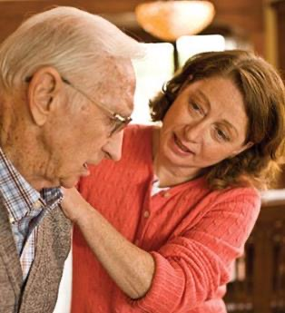
Key Takeaways for the POLST
Provider can recommend a POLST if
  There is a serious change in condition
  Person has a limited life expectancy
Provider responsibility
  Review POLST orders if patient is transferred to a different level of care
    For example, from hospital to nursing home or hospice

Slide 32

When Should I Talk to My Provider?
Your provider is available to help you navigate health care decisions with you.
Insurance may bill for a visit specifically made for advance care planning but this topic can often be discussed during a regular follow-up visit that is covered.
Check with your insurance or provider before making an appointment specifically for advance care planning.
FYI UCD has a program for adv directive assistance. It takes a referral from your primary.

Slide 33
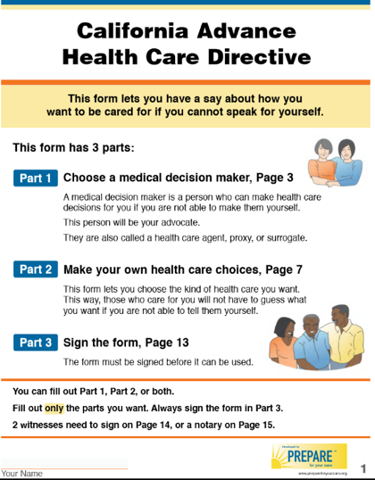
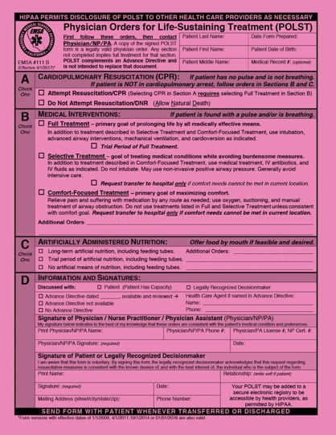
Review forms
Open discussion:
  Advance Directive and POLST forms
  What questions do you have about any part of the forms?

Slide 34

At the Very End
There is always some level of care available
You will always receive
  Control of pain
  Emotional care
  Spiritual care
  Physical care
Ensure quality of life over quantity of care

Slide 35
Summary
Advance care planning makes your wishes known
Consider the reality of medical treatment such as CPR
Communicate healthcare wishes throughout your life
Early goal setting and communication increases chances that your wishes will be understood and respected

Slide 36

Looking Ahead
Continue to learn and explore
  www.coalitionCCC.org
  www.capolst.org

Slide 37
What questions do you have for me?
I’ll be available to answer questions when you fill out your form too!

