Slide 1
Lipid Guidelines 2026
Radhika Nandur Bukkapatnam MD MAS FACC

Slide 2
2026 ACC/AHA/AACVPR/ABC/ACPM/ADA/AGS/APhA/ASPC/NLA/PCNA Guideline on the Management of Dyslipidemia
Focuses on the implementation of new therapies
Evaluation of associated risk for individuals with dyslipidemia in primary and secondary prevention settings.
New approach to risk assessment through a novel risk score
Sets lower low-density lipoprotein cholesterol (LDL-C) and non–high-density lipoprotein cholesterol (HDL-C) treatment goals for patients with established atherosclerotic cardiovascular disease (ASCVD)
recommends measuring lipoprotein(a) [Lp(a)] at least once to identify individuals at higher risk of ASCVD

Slide 3
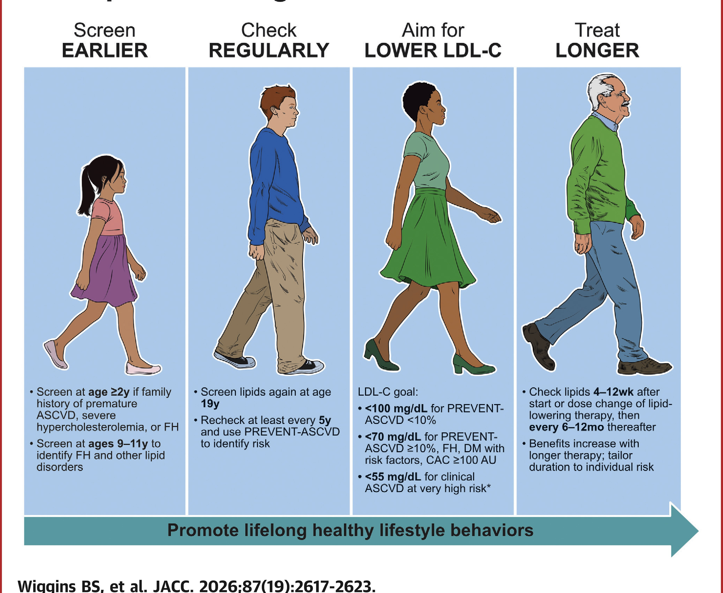

Slide 4
EVENTS (PREVENT) Equation
Estimate 10-year and 30-year risk for total cardiovascular disease (CVD), including atherosclerotic CVD (ASCVD) and heart failure (HF).
The first risk tool to combine cardiovascular, kidney, and metabolic health measures to guide primary prevention-focused treatment decisions.
The PREVENT calculator, based on the PREVENT equations, uses required clinical information to estimate CVD risk.
Three optional predictors, urine albumin-creatinine ratio (UACR), hemoglobin A1c (HbA1c), and social deprivation index (SDI), can further personalize risk estimates.
Use the PREVENT equations for adults ages 30–79 without known CVD.
Do not use the PREVENT equations for adults with known CVD, evidence of severe subclinical CVD (e.g., left ventricular ejection fraction <40%, coronary artery calcium ≥300), positive genetic testing for a variant known to be pathogenic or for an inherited cardiovascular condition, end-stage kidney disease, or limited life expectancy (<1 year).

Slide 5
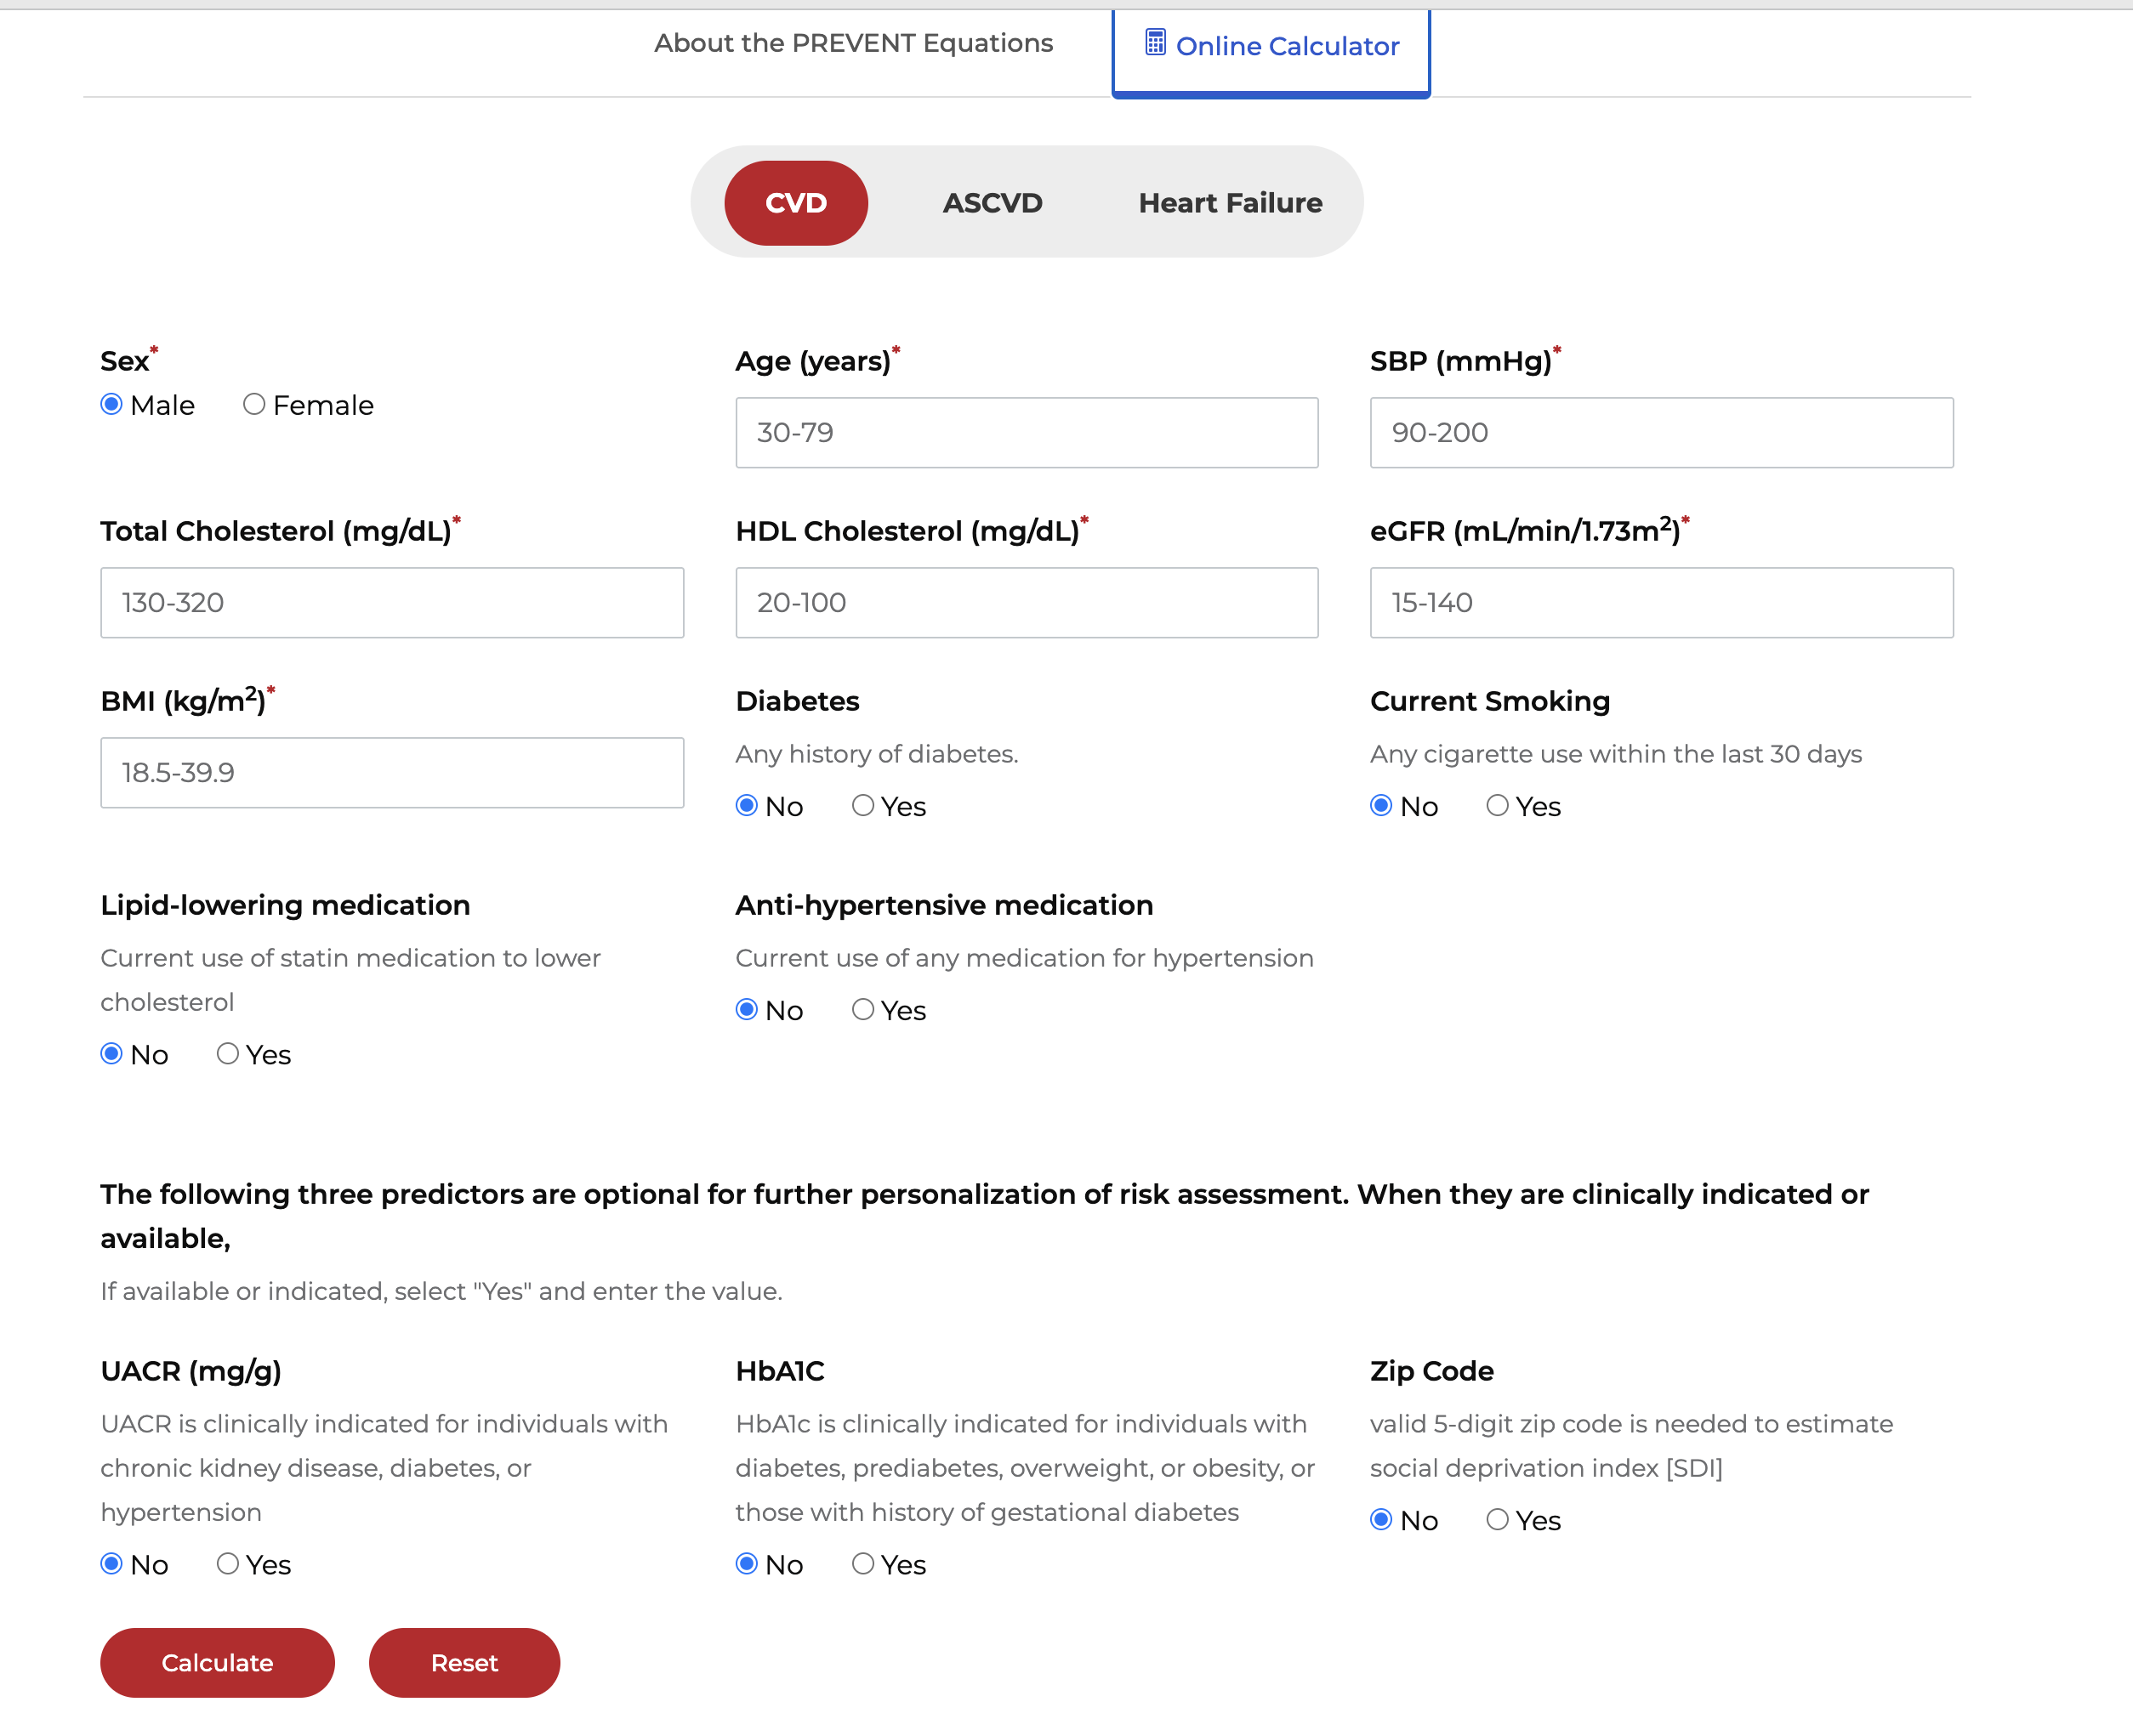
LINK

Slide 6
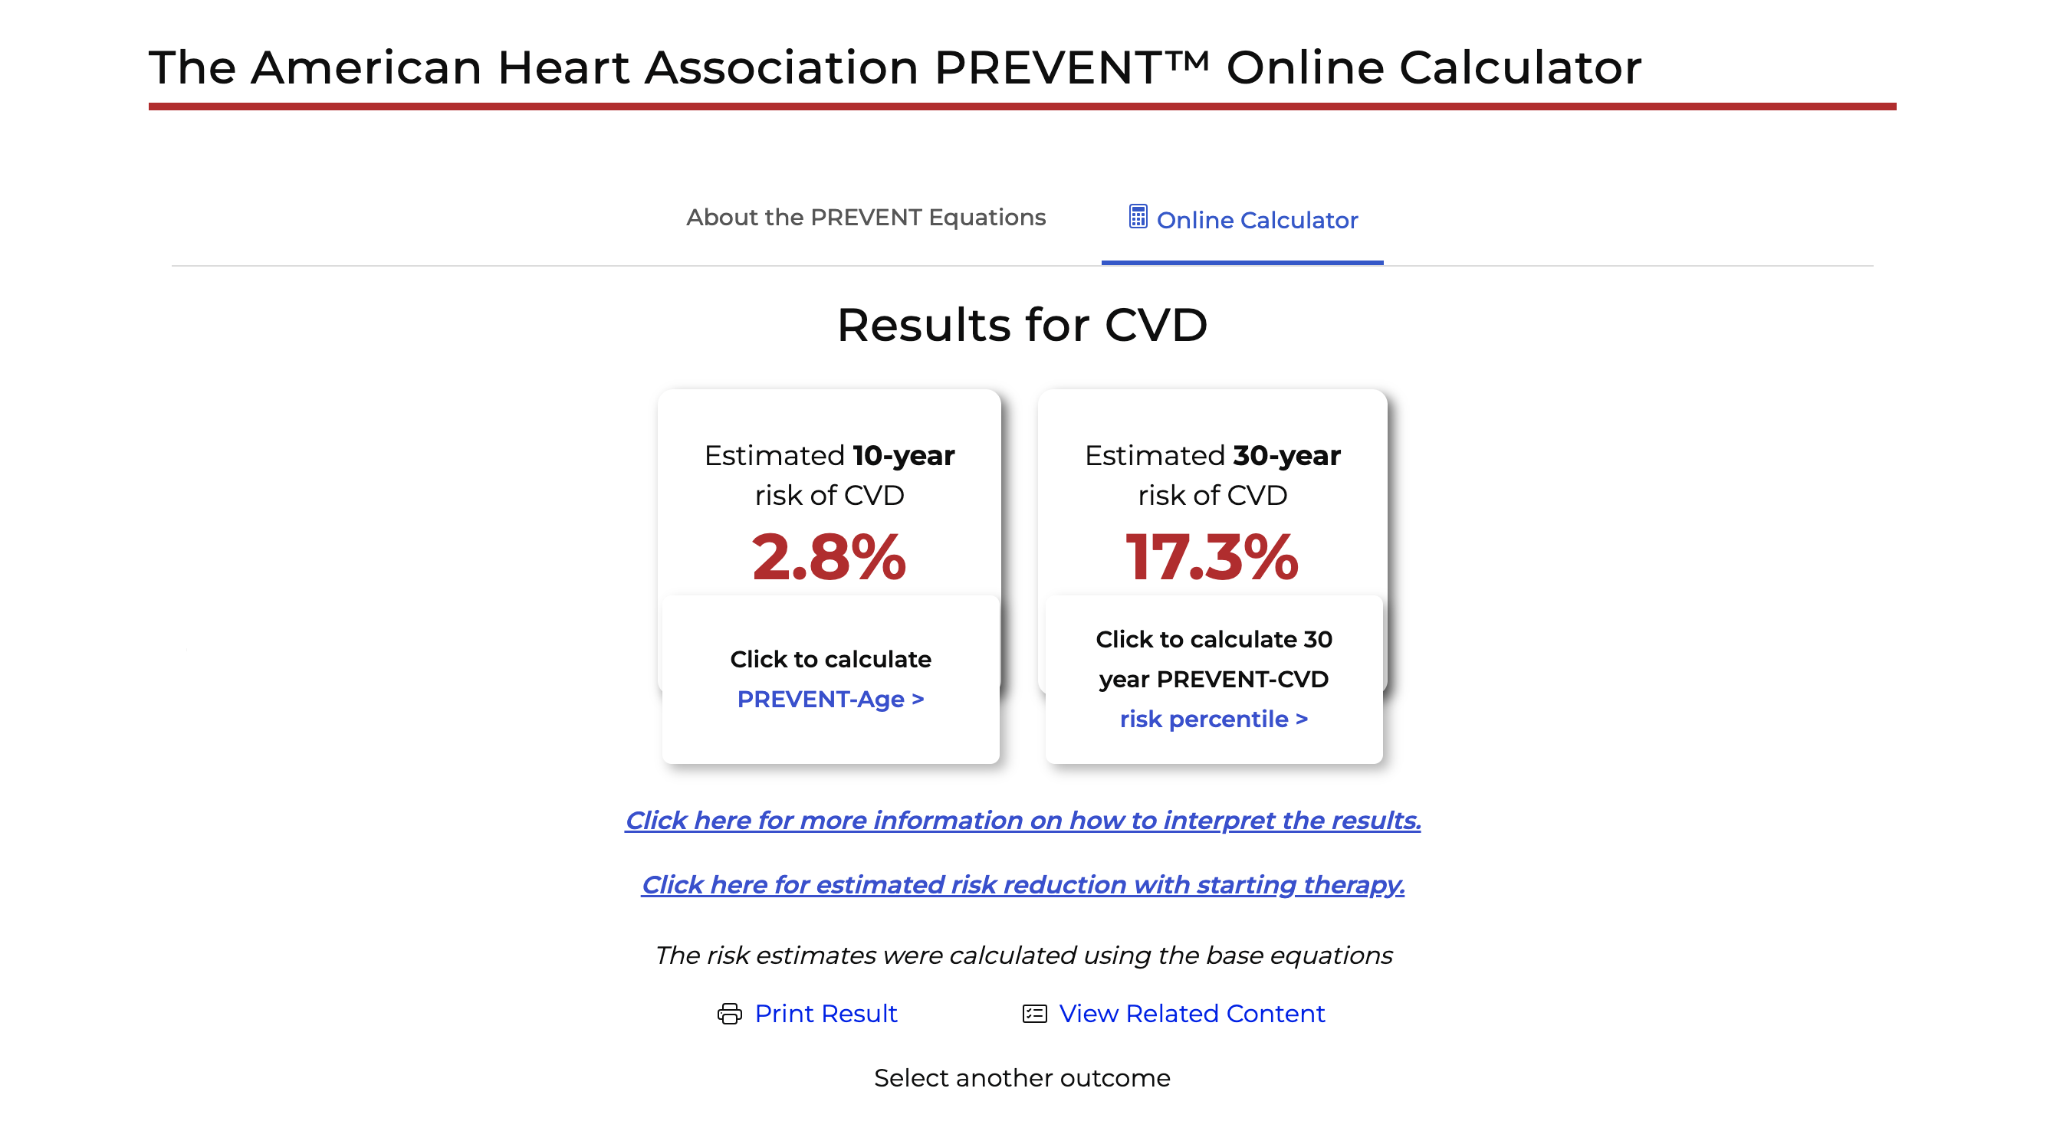

Slide 7
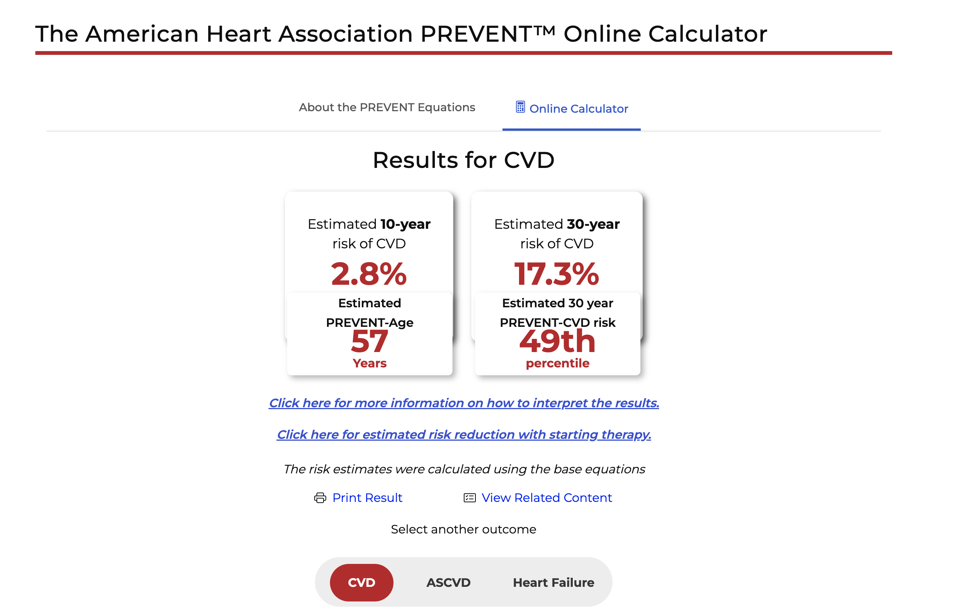

Slide 8
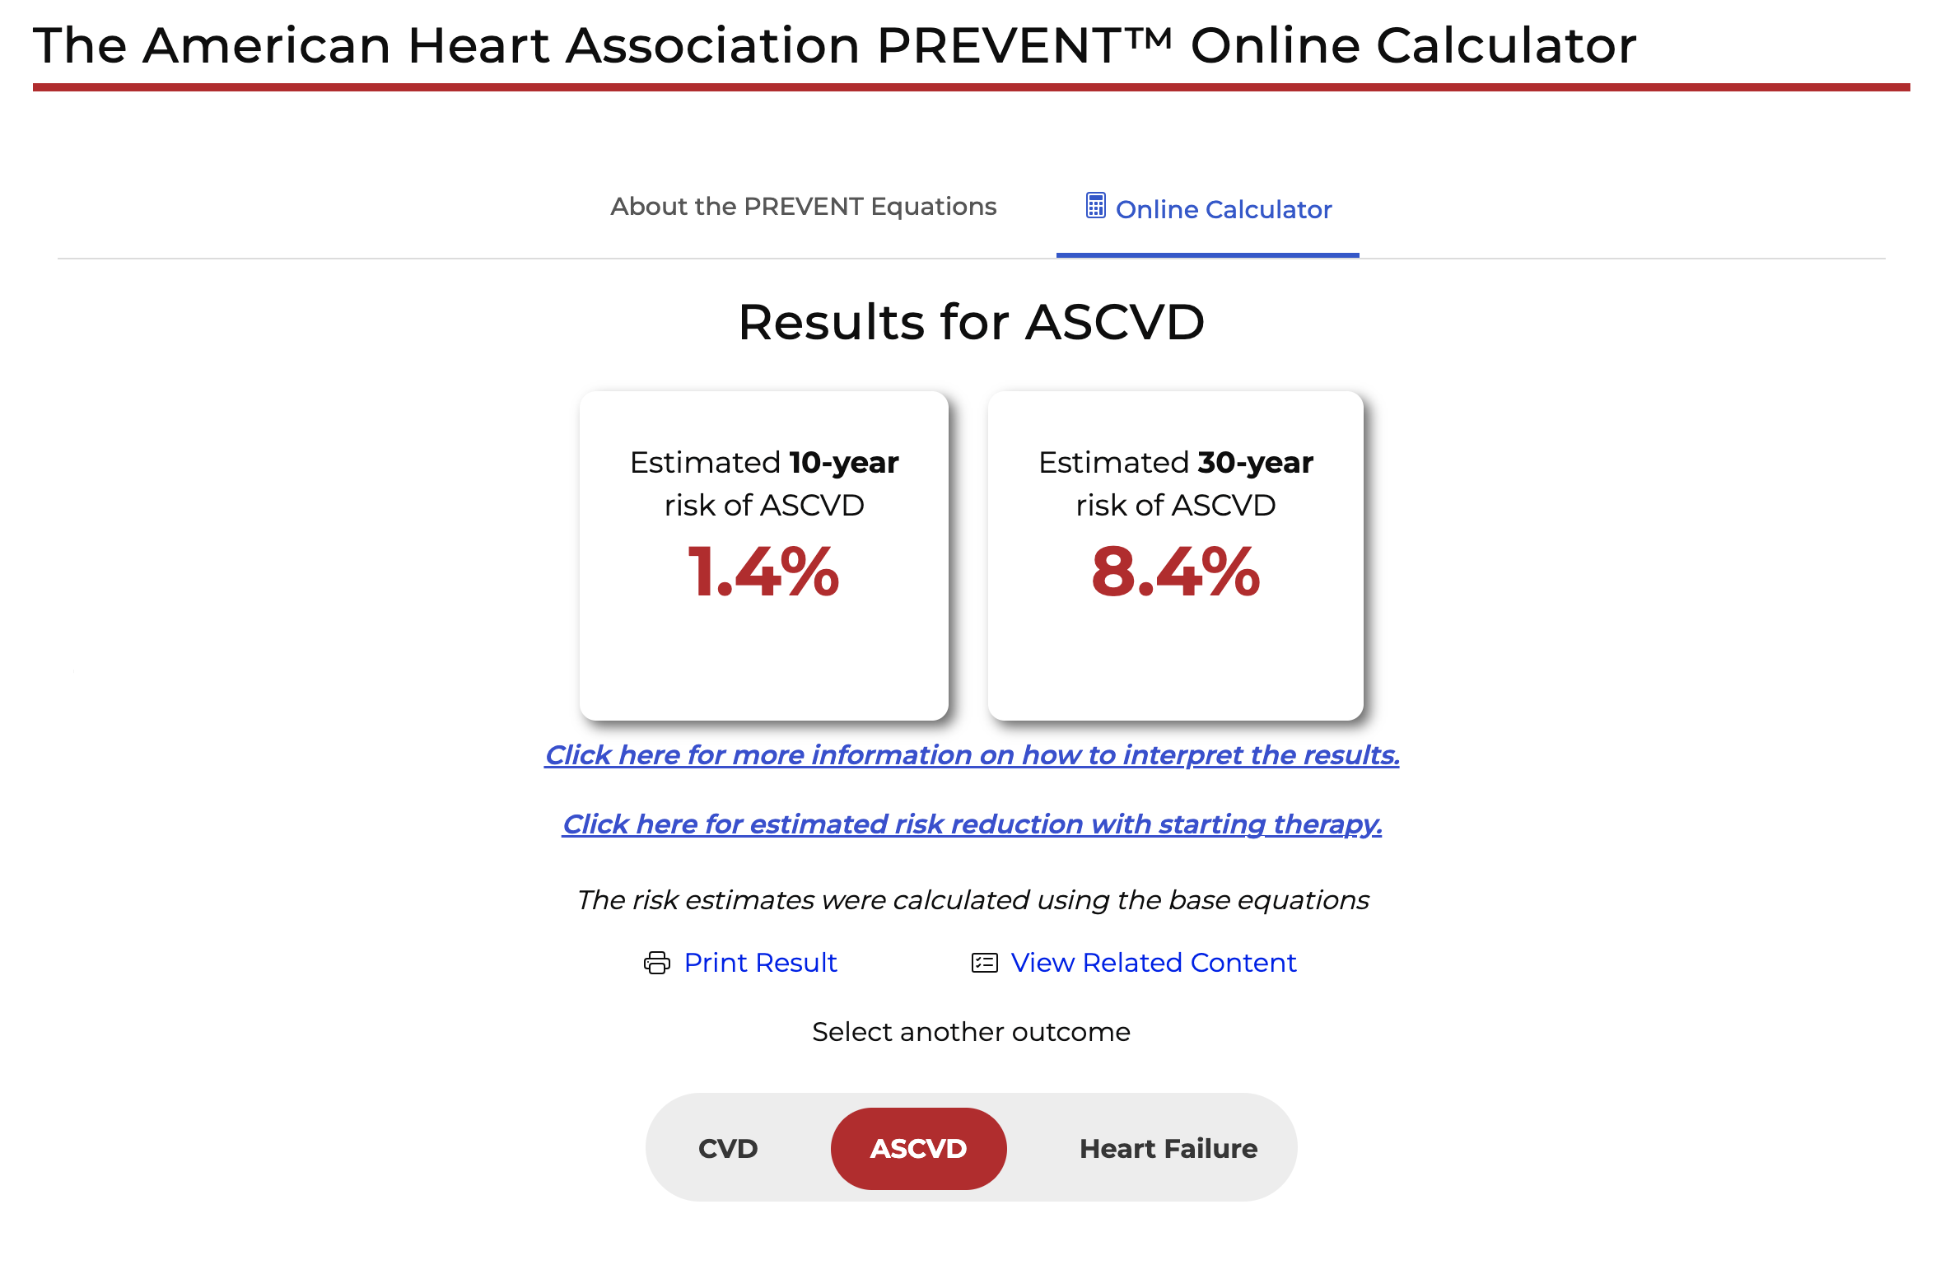

Slide 9
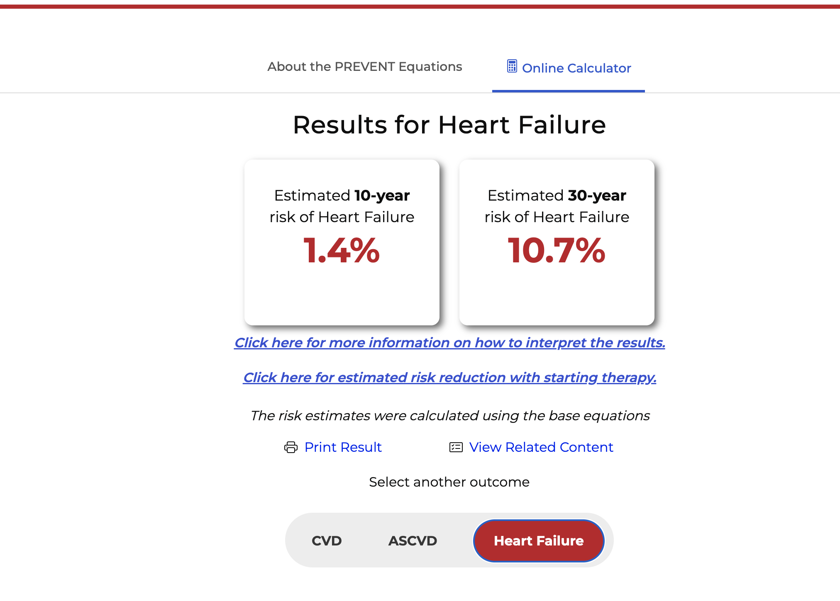

Slide 10
Interpretation of Results
PREVENT-CVD 10-year risk ≥7.5% is categorized as increased risk among adults with diabetes, and initiation of SGLT2i or GLP-1-based therapy is recommended, in addition to lifestyle modification
PREVENT-HF 10-year risk ≥5% is categorized as increased risk of heart failure and biomarkers (e.g., NT-proBNP, BNP, hs-cTn) can be helpful to guide additional testing with echocardiography and coordinated care for HF prevention.

Slide 11
https://professional.heart.org/en/guidelines-and-statements/prevent-calculator#riskreduction

Slide 12
Apolipoprotein B
LDL-C remains the traditional lipid marker for ASCVD risk assessment and treatment targets, but it reflects the cholesterol mass within LDL particles rather than the number of atherogenic lipoproteins.
In contrast, apoB directly measures atherogenic particle number, with 1 molecule per LDL, very-low-density lipoprotein (VLDL), and Lp(a) particle.
ApoB predicts ASCVD risk more accurately than LDL-C in cases of disagreement, or discordance, where LDL-C and apoB provide differing risk estimates.
Clinically significant discordance often occurs when LDL-C is at goal but apoB remains elevated above the treatment goal, indicating persistent atherogenic particle burden and potential need for therapy intensification.
ApoB identifies residual CVD risk in statin-treated populations, including those who have achieved LDL-C goals
Measurement of apoB can support decisions regarding nonstatin therapies, such as ezetimibe, bempedoic acid, proprotein convertase subtilisin/kexin type 9 (PCSK9) monoclonal antibodies (mAb), or inclisiran

Slide 13
Lipoprotein (a)
Lp(a) is an LDL-like particle that is structurally distinct from LDL, as it carries a single apoprotein(a) strand bound to its apoB-100 component. Lp(a) concentrations are mostly genetically determined by the LPA gene, and population distributions vary by ancestry (highest levels in individuals of African ancestry)
As Lp(a) concentrations remain similar over time and are minimally modified by lifestyle factors,¹⁴ a single measurement is generally sufficient. Secondary causes of high Lp(a) include kidney, liver, or thyroid disease; pregnancy; menopause; and some medications.
It is considered as a risk-enhancing factor at levels ≥125 nmol/L (50 mg/dL), which is associated with about a 1.4-fold increased ASCVD risk
Values ≥250 nmol/L (100 mg/dL) are associated with ≥2-fold higher estimated risk
Intensify LDL reduction

Slide 14
Coronary Artery Calcium Score
In men >40 years of age and women at least 45 years of age, it can improve risk assessment and guide LDL-C and non–HDL-C goals
Both the absolute amount of CAC and the corresponding standardized percentile (currently based on age, sex, and race) have prognostic importance and help to reclassify risk in adults.
CAC=0 is strongly associated with a low 10-year risk of ASCVD.It is, therefore, reasonable to defer statin therapy among intermediate- or lower-risk adults with CAC=0. Important exceptions include people with FH or severe hypercholesterolemia >190 mg/dL, diabetes, current tobacco use, and those with a strong family history of premature ASCVD.
In adults at intermediate risk or select adults at borderline risk who undergo CAC testing, if the CAC score is 0 Agatston units (AU), and there is preference to avoid LLT and focus on lifestyle management, and no higher risk conditions (FH or severe hypercholesterolemia >190 mg/dL, diabetes and age >40 years, current cigarette smoking, strong family history of premature ASCVD) are present, it is reasonable to defer therapy and reassess with repeat CAC testing in 3 to 7 years to personalize management.

Slide 15
LDL Reduction in Primary Prevention
In adults aged 40 to 75 years with diabetes, chronic kidney disease stage 3 or 4, or human immunodeficiency virus, regardless of LDL-C level.
After age 75 years, LDL-C–lowering pharmacotherapy can be considered in conjunction with lifestyle interventions to reduce ASCVD risk.

Slide 16
Secondary Prevention
LDL-C <55 mg/dL (1.4 mmol/L) and non–HDL-C <85 mg/dL (2.2 mmol/L) is recommended for those at very high risk of ASCVD events.
Although a smaller number of patients with ASCVD not at very high risk have an LDL-C goal of at least <70 mg/dL, the majority of those with a history of ASCVD events will likely qualify for an LDL-C goal of <55 mg/dL.
In patients with persistently elevated TG, statin therapy remains the foundation of pharmacotherapy as an adjunct to lifestyle intervention to reduce ASCVD risk. Treatment for prevention of pancreatitis may also include TG-lowering therapies, especially in individuals with TG levels ≥1000 mg/dL (11.3 mmol/L).

Slide 17
Special Considerations
Initiating lipid-lowering therapy for people age 40 or older who have chronic kidney disease (stage 3 or higher), HIV or Type 1 or Type 2 diabetes
Continuing lipid-lowering therapy in people being treated for cancer, unless contraindicated
Deferring most lipid-lowering therapies during conception, pregnancy and lactation

Slide 18
CPR model
  A) Calculate 10-year ASCVD risk
  B) Personalize the estimated risk to the specific patient by considering factors not included in PREVENT-ASCVD equations; and
  C) possibly Reclassify with selective use of coronary artery calcium (CAC) and Reassess treatment recommendations.

Slide 19
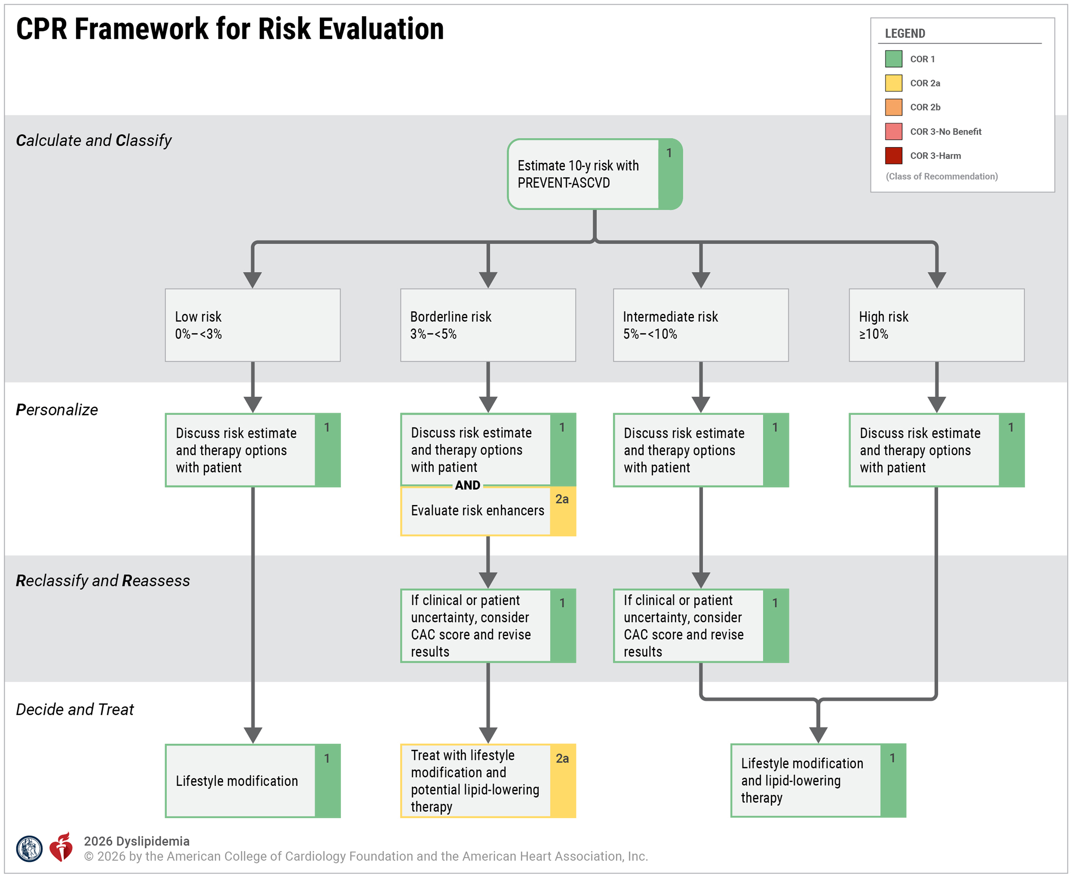

Slide 20
Comparison of Guidelines (Risk Assessment
2018: ASCD risk: MI, stroke, in adults 40-75, without diabetes
with LDL 70-189mg/dL
Low risk <5%
Borderline risk 5-7.5%
Intermediate risk 7.5-20%
High risk >20%
2026: Adults 30-79, without DM, CKD, HIV
LDL 70-189mg/dL
Low risk <3%
Borderline risk 3-5%
Intermediate risk 5-10%
High risk >10%

Slide 21
Risk Enhancers
Borderline risk (3-5%): Check lp (a), Apo B: and if elevated, treat with statins
Intermediate risk (5-10%): CAC score to decide therapy
High risk: treat with high intensity statins

Slide 22
Treatment
In low risk (<3%) individuals between 30-59, with LDL<160mg/dL: Lifestyle management
In borderline risk (3-5%) or intermediate risk (5-10%): LDL goal <100mg/dL and non HDL C<130mg/dL
In high risk (>10%): LDL goal <70mg/dL, non HDL goal <100mg/dL
In very high risk: LDL goal <55mg/ dL, non HDL goal <85mg/dL
Clinical ASCVD includes ACS, those with history of MI, stable or unstable angina or coronary or other arterial revascularization, stroke, TIA, or PAD including aortic aneurysm, all of atherosclerotic origin.
Very high risk includes a history of multiple major ASCVD events (ACS within past 12 months, history of MI [other than ACS above], history of ischemic stroke, symptomatic PAD) or 1 major ASCVD event and multiple high-risk conditions (age >65 years of age, coronary artery revascularization, current smoker, diabetes, history of HF, hypertension, LDL-C >100 mg/dL despite maximally tolerated statin + ezetimibe).

Slide 23
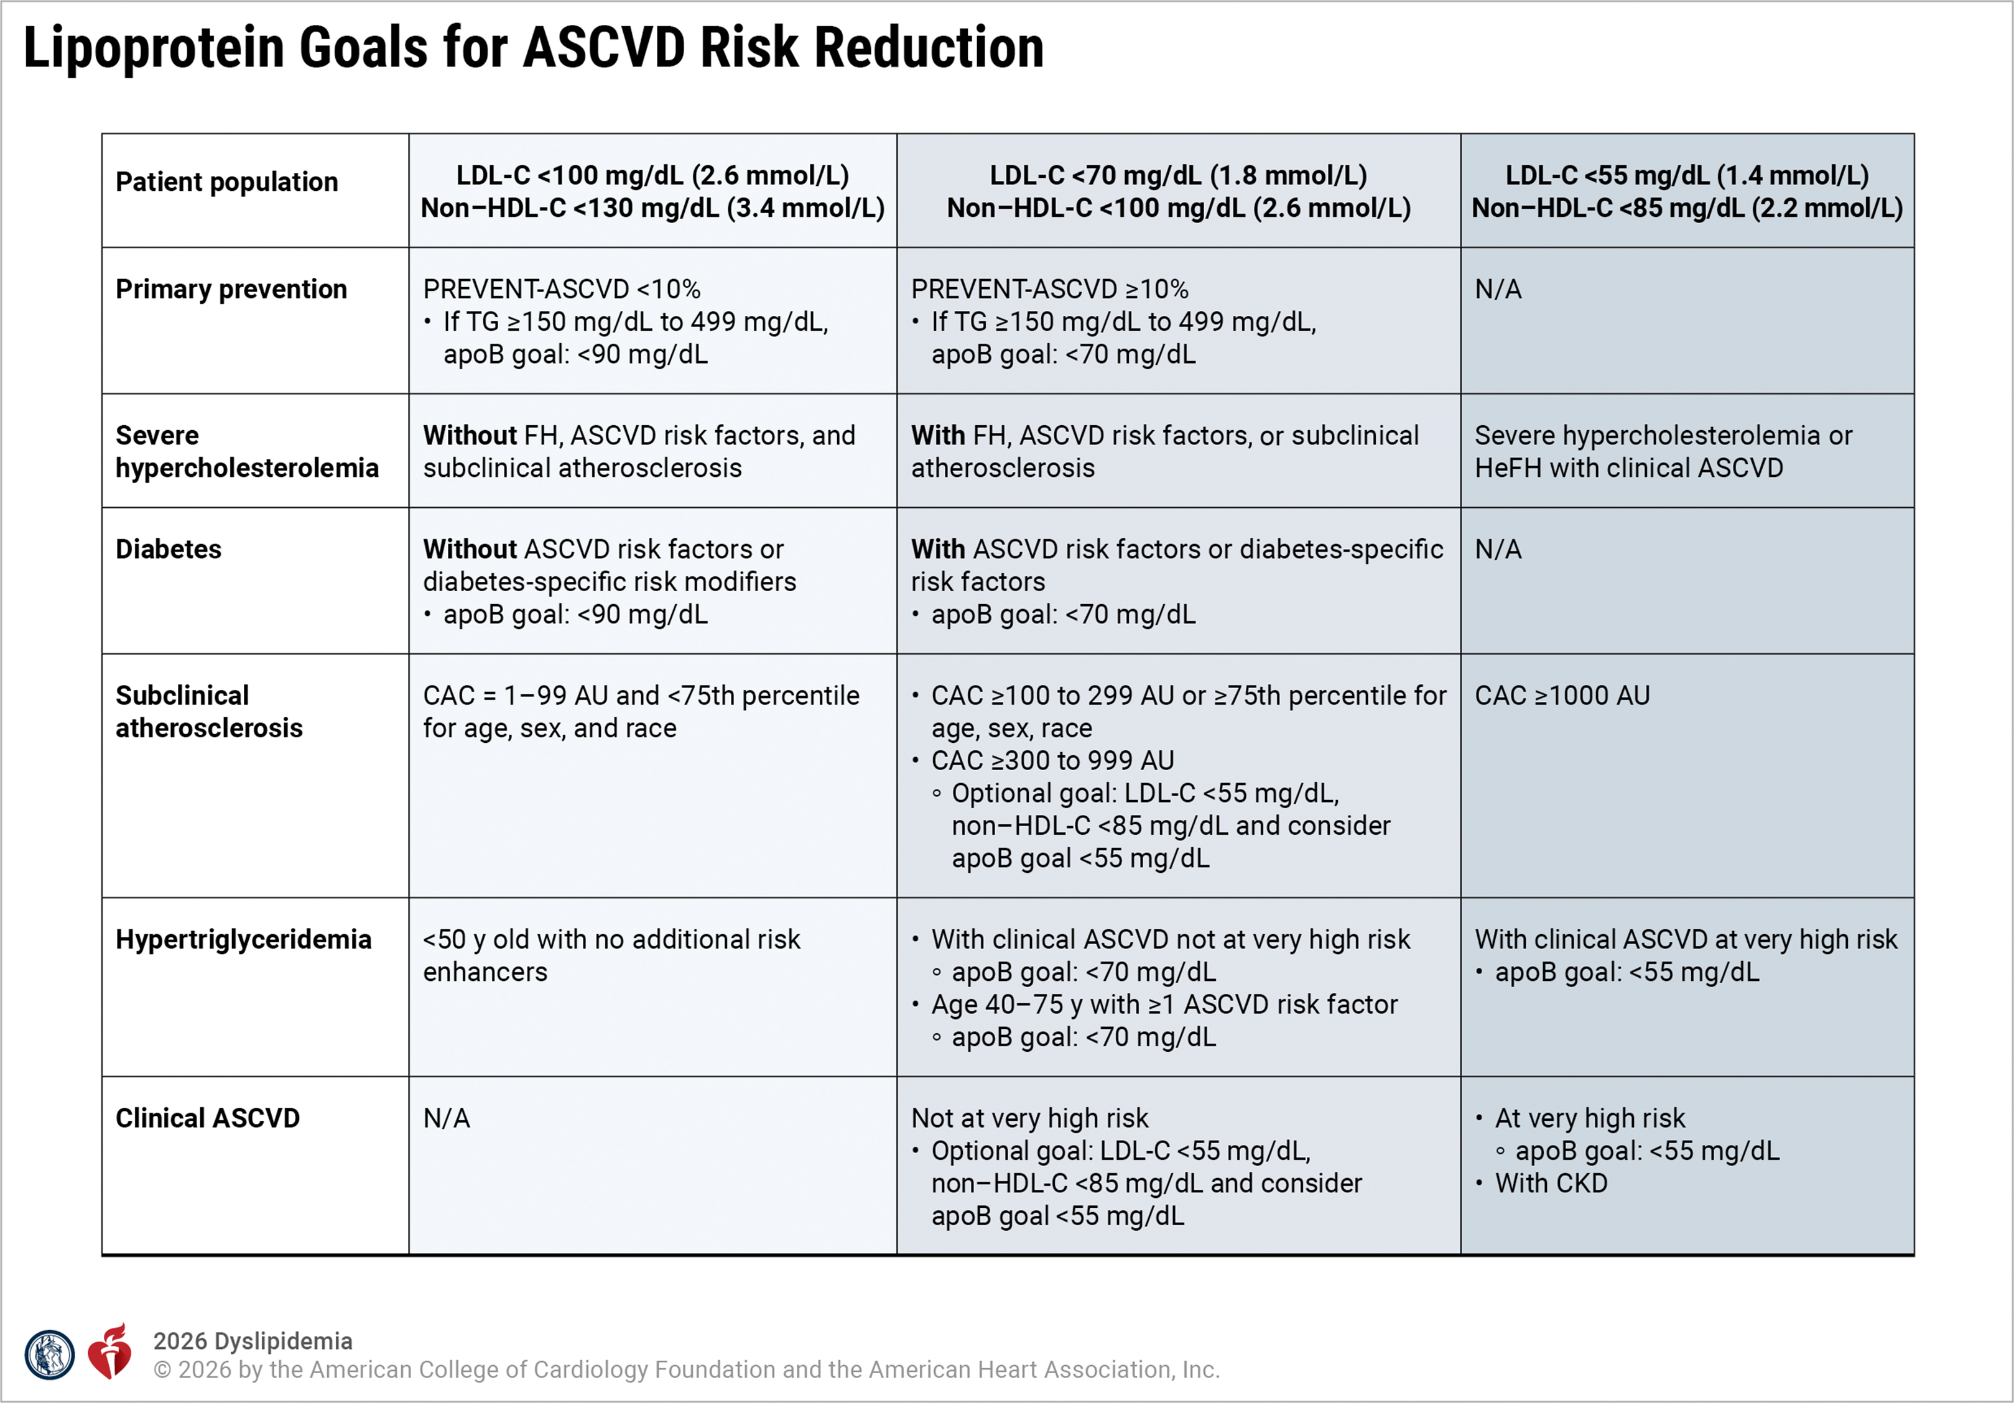

Slide 24
Take Home Messages
Screen earlier, treat earlier
Lifestyle optimization should start in youth, esp with familial hypercholesterolemia
Young adulthood in individuals with LDL-C ≥160 mg/dL or a strong family history of premature ASCVD
Use the more contemporary American Heart Association Predicting Risk of cardiovascular disease EVENTs (PREVENT™) equations instead of the older Pooled Cohort Equations for 10- and 30-year risk assessment to guide lipid-lowering therapy in primary prevention in adults aged 30 to 79 years

Slide 25
THANK YOU

