Slide 1
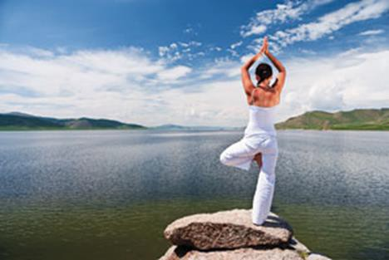
"Happiness is not a matter of intensity but of balance
and order and rhythm and harmony."
Thomas Merton
Importance of Balance
Linda Paumer

Slide 2
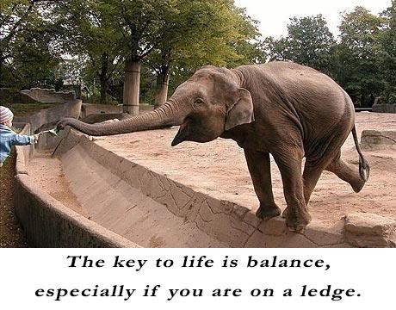
Balance Defined
Definition: a state of equilibrium or equipoise
Life Balance Balanced Diet Bank Balance Physical Balance

Slide 3
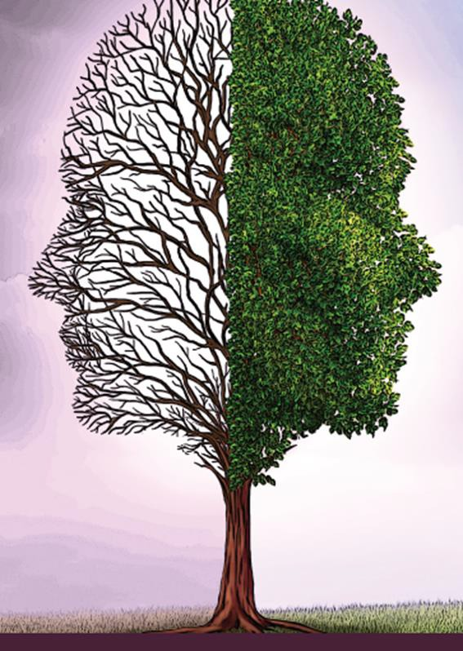
Maintaining balance in our lives
Know yourself and how much rest, food and exercise you need to function at your best
– Decide what works best for you and implement it into your routine.

Slide 4

Maintaining balance in our lives
Keep your mind alert and in shape
try to learn a new piece of information each day
counting can be therapeutic. --memorize the number of steps from your kitchen to your living room, or the birth dates of each of your grandkids,
try new things –try going a new way to the grocery store
Be social, converse with someone -- listening and responding are great ways to keep your brain fit.

Slide 5

Maintaining balance in our lives
Do something spontaneous.
– Our lives can be so regimented it's a good idea to do something out of the ordinary every now and then

Slide 6

Maintaining balance in our lives
Make time for yourself
At the end of each day take time to unwind. If that means leaving the dishes overnight, so be it.

Slide 7
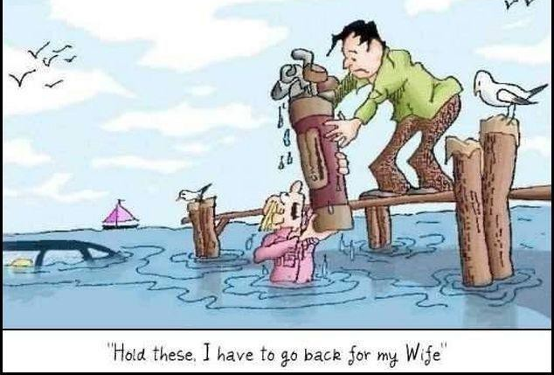
Know what your priorities are
Balance doesn't mean do everything you can. Examine your values and decide what's important to you, then set your boundaries.

Slide 8
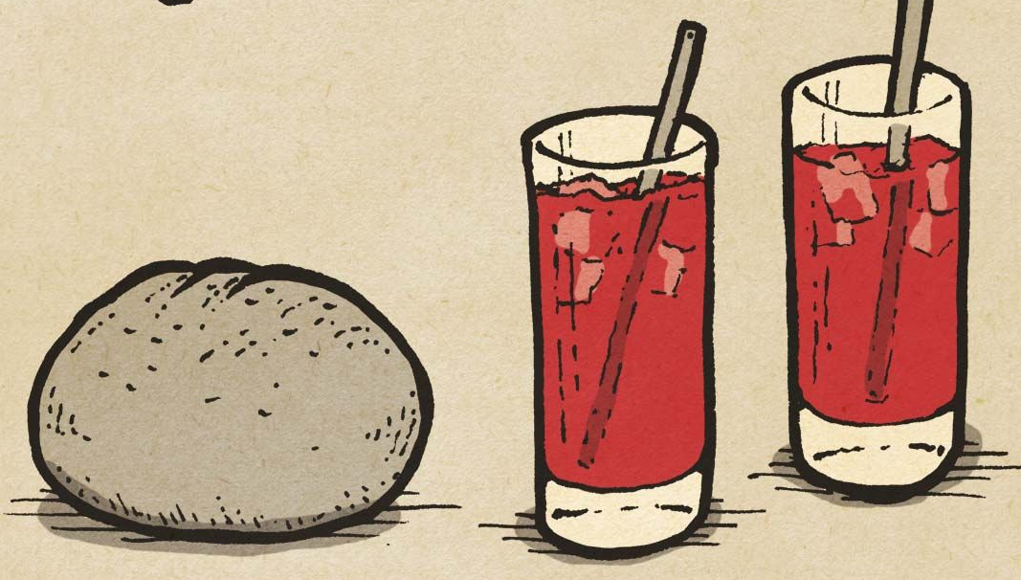
Roll with the Punches
Note that there are times when achieving balance may not be possible. For instance, you may have a family or career crisis that needs immediate/undivided attention. It may require an exceptional amount of time and resources.
When that happens, do whatever it takes. When things go back to normal take time to refresh and rejuvenate yourself.

Slide 9
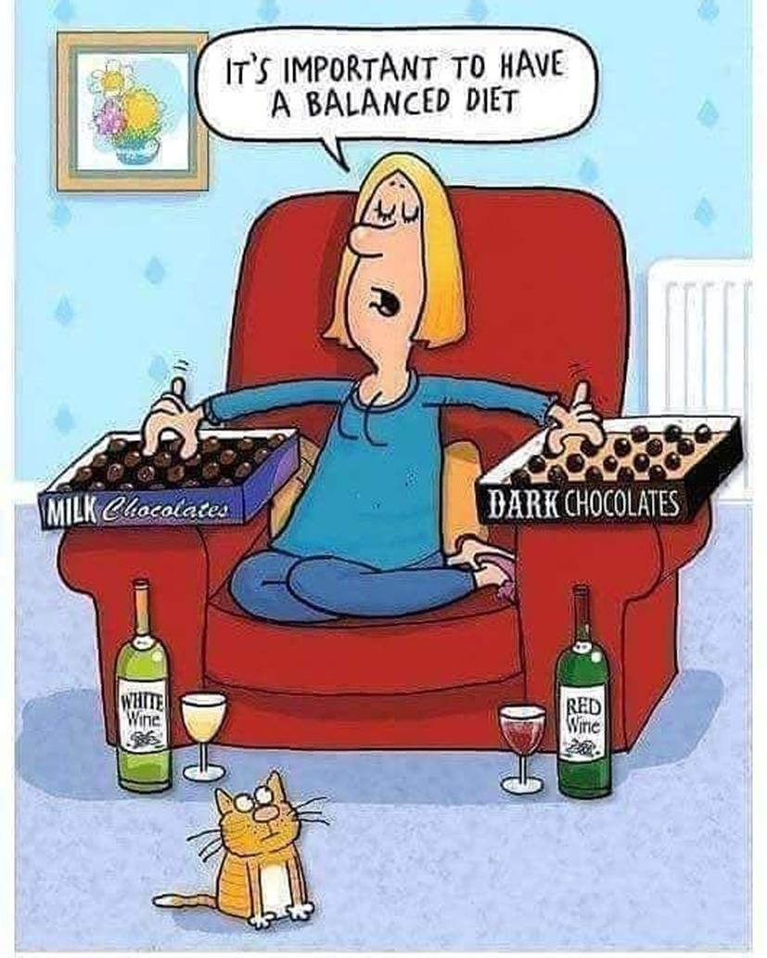

Slide 10
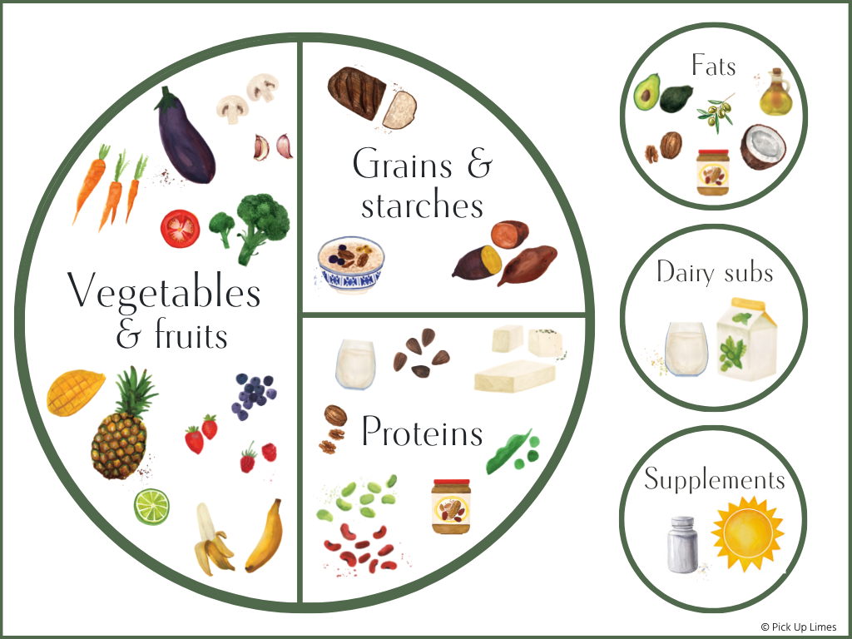

Slide 11
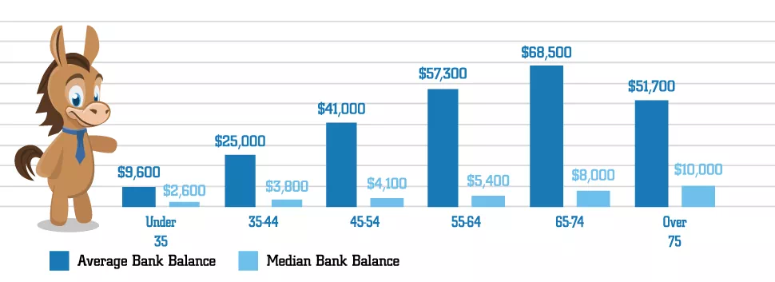
Bank Balance
Recommended to have enough in your savings account to cover 3 - 6 months of expenses.
A general rule- have 8-10 times your salary saved by the time you hit 65 years old. The younger you start saving for retirement, the closer you'll be to this benchmark.
(Source: https://www.creditdonkey.com/average-bank-account-balance.html)

Slide 12

Intergenerational Bank Balance
Beyond the Balance Sheet: Preserving family legacies requires aligning heirs with shared values rather than just managing portfolios.
Are heirs ready for this responsibility?

Slide 13
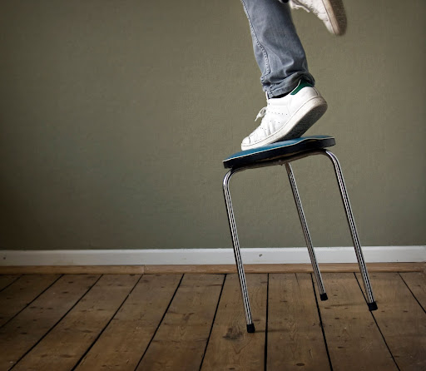
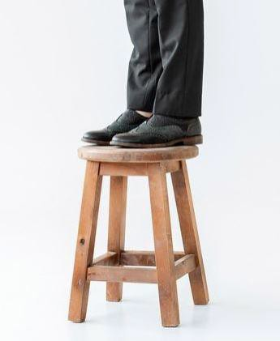
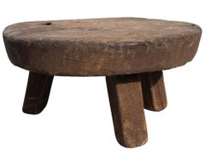

Slide 14


Slide 15
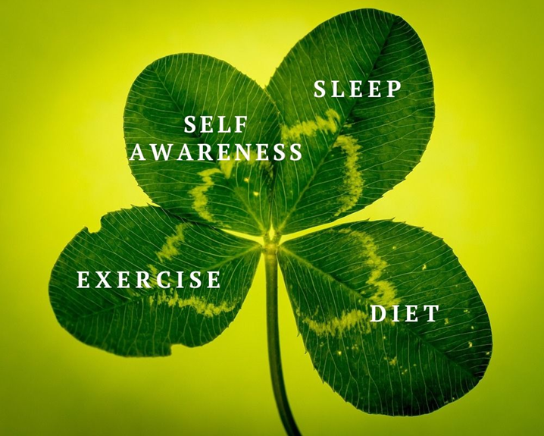
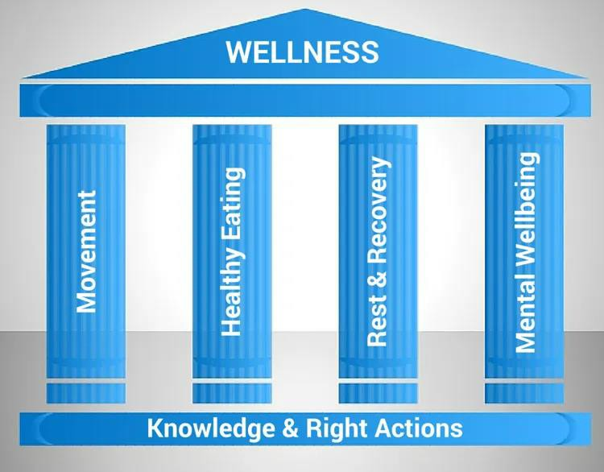
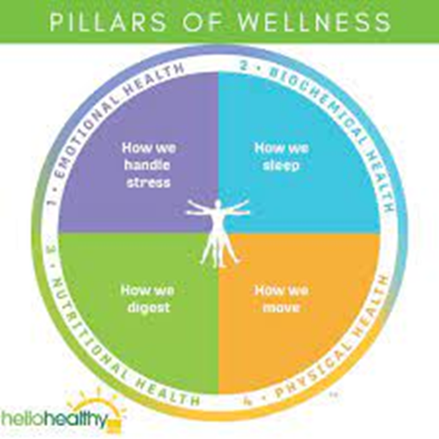
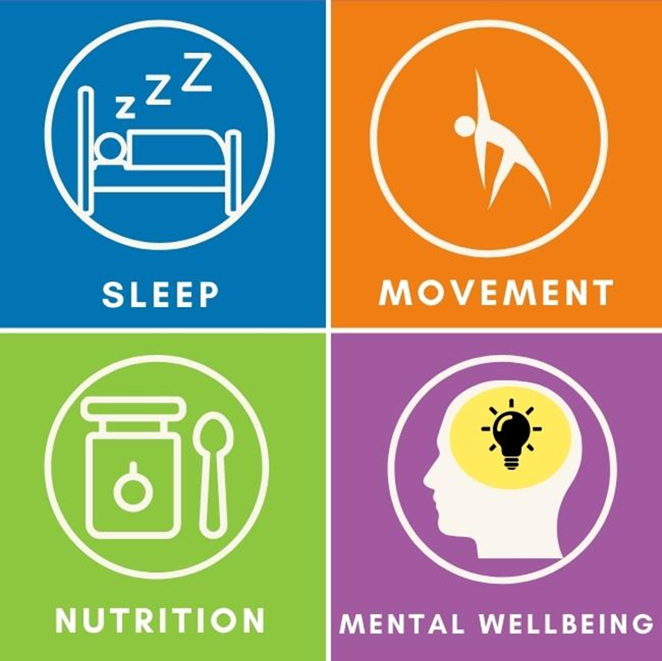
4 Pillars of Health

Slide 16
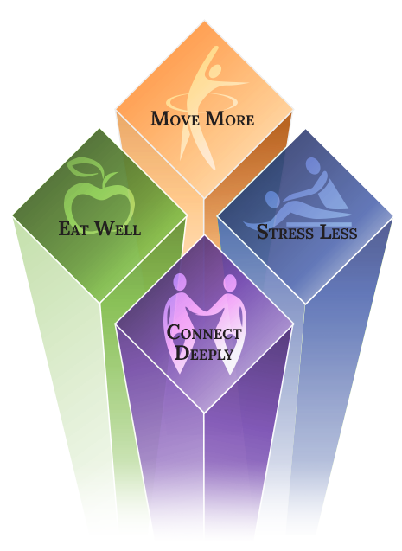
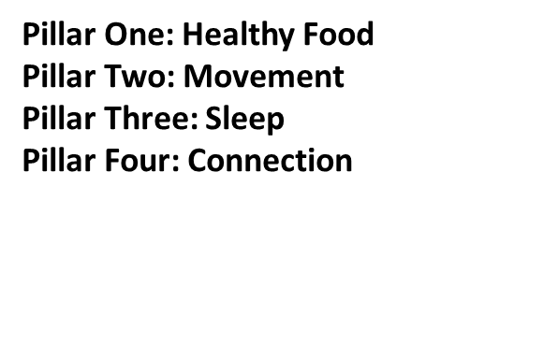

https://www.nbihealth.com/the-four-pillars-of-health/
Bartholomew County Public Library
536 5th Street, Columbus, IN,
https://www.eventslogbook.com/events/four-pillars-to-health-movement-and-community/
https://www.nbihealth.com/73-the-four-pillars-of-health/

Slide 17


Slide 18

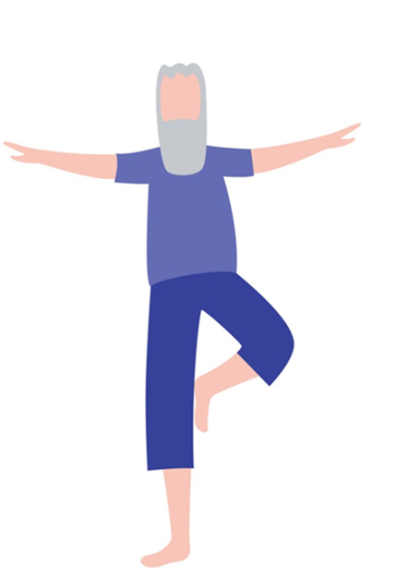
Four Pillars of Health followed by CWP
Physical Fitness
Nutrition
Mindfulness
Social Interaction

Slide 19
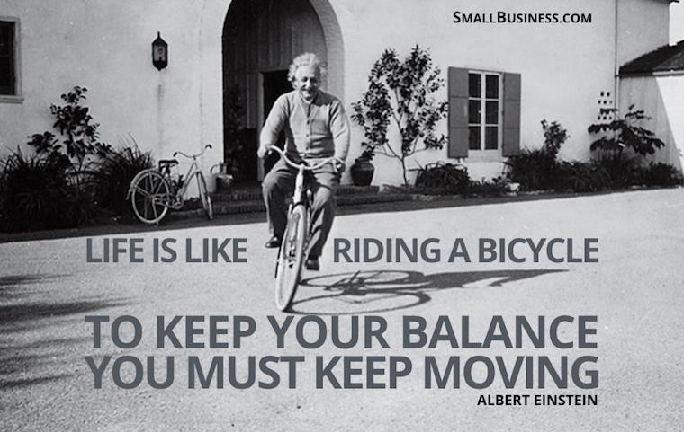

Slide 20
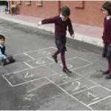
Physical Balance
As children we develop good balance by practicing balancing activities – walking along walls, jumping, spinning and climbing

Slide 21
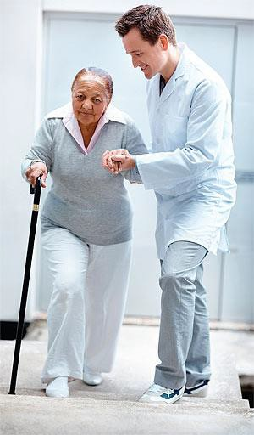
Adult Balance
As adults we tend not to give our balance system the practice it needs.
Health problems can also weaken the balance system. The result is that our balance becomes less good.

Slide 22
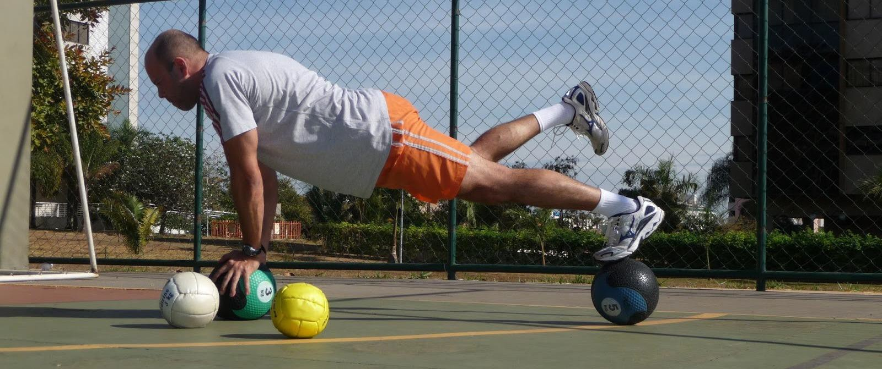
Balance Training
Top athletes in the world recognize that balance training helps them to perform better in their sports and fitness experts know that good balance and a strong core go hand in hand.

Slide 23
How We Balance
Visual inputs
Vestibular Inputs
Muscle & joint reactions
Equilibrioception or sense of balance helps prevent humans and animals from falling over when walking or standing still. Balance is the result of a number of body systems working together: the eyes (visual system), ears (vestibular system) and the body's sense of where it is in space (proprioception) ideally need to be intact.

Slide 24
Input from the Eyes
Sensory receptors in the retina are called rods and cones. When light strikes the rods and cones, they send impulses to the brain that provide visual cues identifying how a person is oriented relative to other objects.
For example, as a pedestrian walks along a city street, the surrounding buildings appear vertically aligned, and each storefront passed first moves into and then beyond the range of peripheral vision.

Slide 25

https://www.youtube.com/watch?v=4JIPke0gOoo

Slide 26
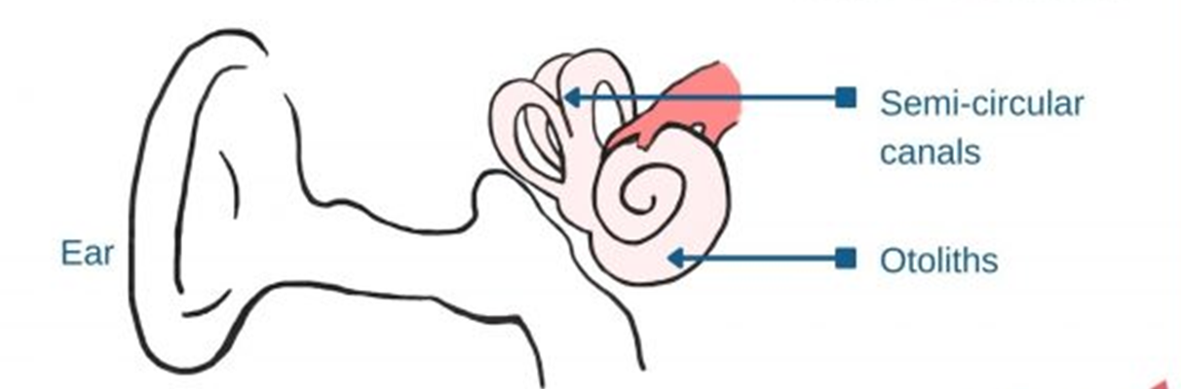
Input from the vestibular system
Sensory information about motion, equilibrium, and spatial orientation is provided by the vestibular apparatus, which in each ear includes the utricle, saccule, and three semicircular canals.
The utricle and saccule detect gravity (vertical orientation) and linear movement.
The semicircular canals detect rotational movement,

Slide 27
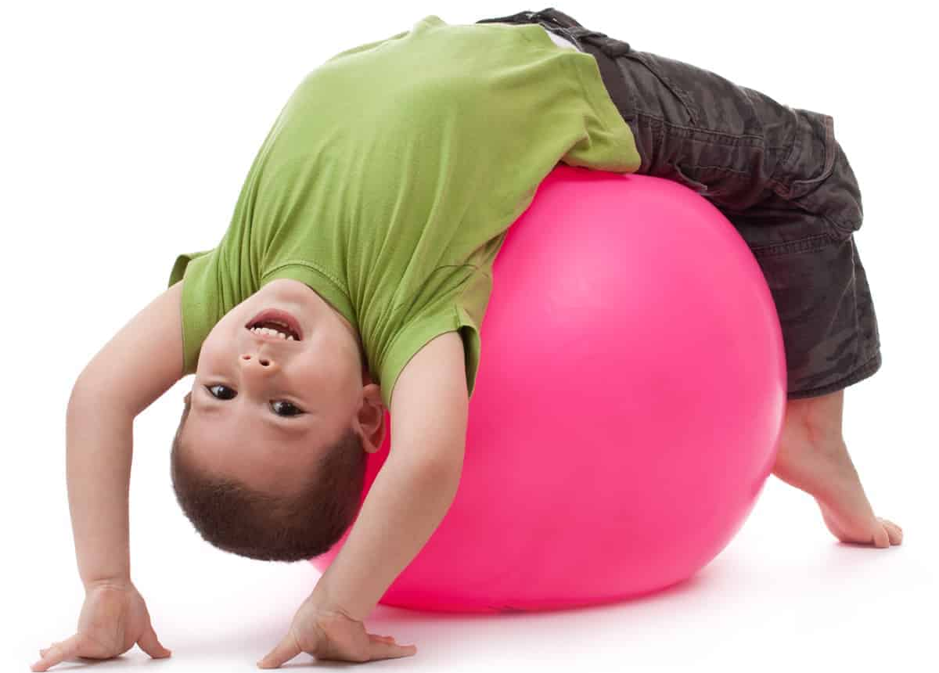
Input from the vestibular system
When the vestibular organs on both sides of the head are functioning properly, they send symmetrical impulses to the brain.
(Impulses originating from the right side are consistent with impulses originating from the left side.)

Slide 28
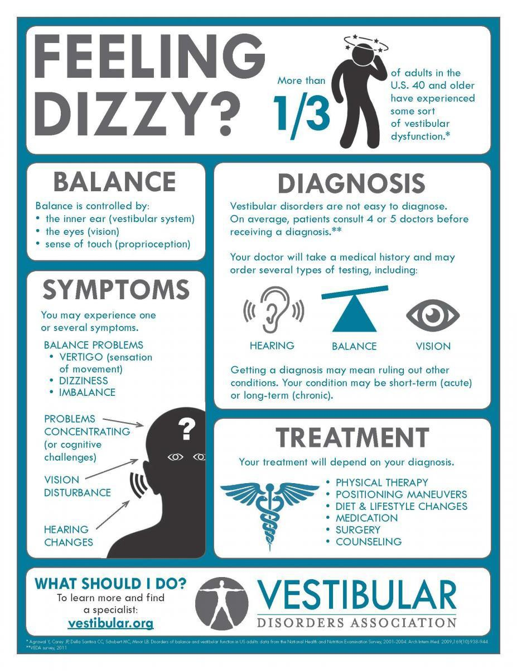

Slide 29
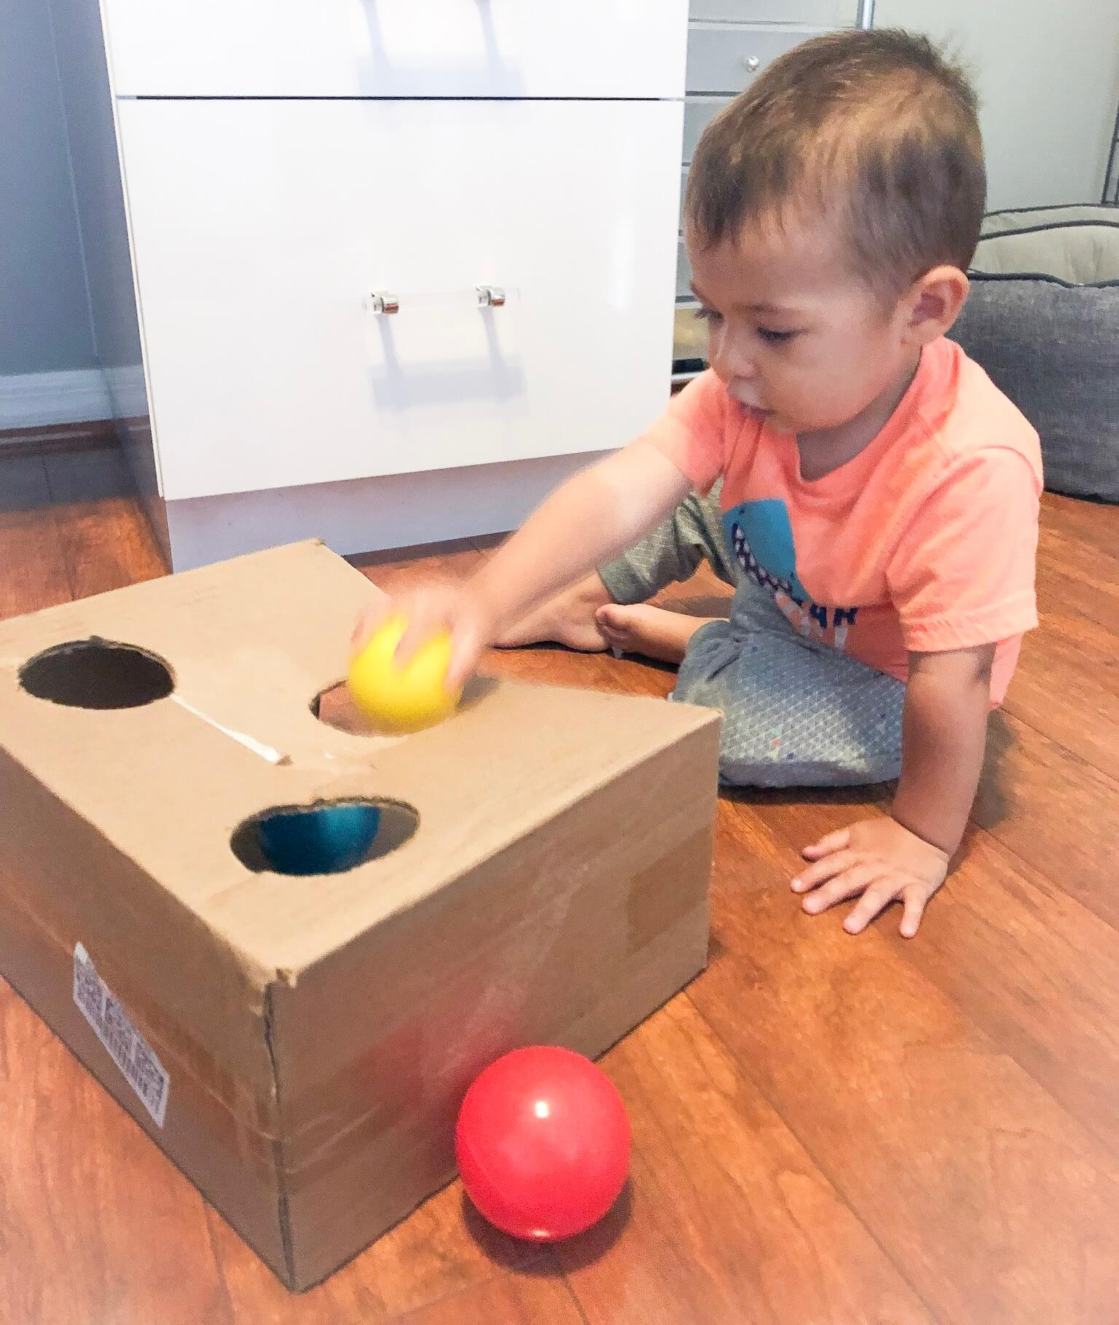
Eye-Hand Coordination Activities
Ball/bean bag tosses
Balloon badminton
Cornhole tosses
Dual-tasking activities
https://cardiovascularwellnessprogram.org/student-projects-1

Slide 30
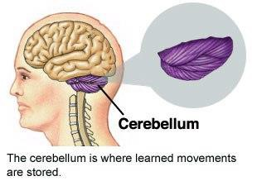
Integration of Sensory Input
Balance information provided by the peripheral sensory organs—eyes, muscles and joints, and the two sides of the vestibular system—is sent to the brain stem. There, it is sorted out and integrated with learned information.
The cerebellum provides information about automatic movements that have been learned through repeated exposure to certain motions.

Slide 31
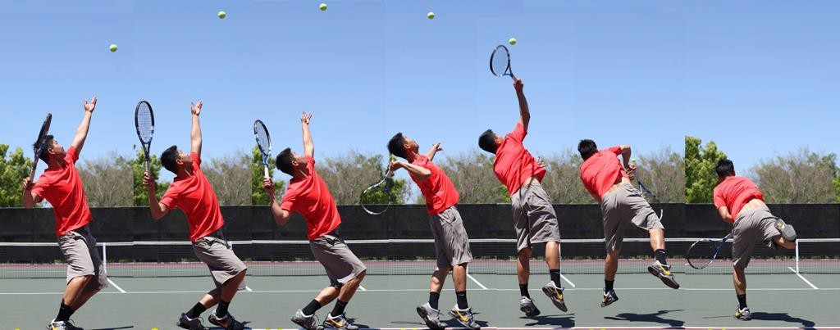
Integration of Sensory Input
For example, by repeatedly practicing serving a ball, a tennis player learns to optimize balance control during that movement.

Slide 32
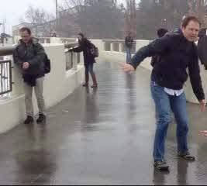
Integration of Sensory Input
Contributions from the cerebral cortex include previously learned information; for example, because icy sidewalks are slippery, one is required to use a different pattern of movement in order to safely navigate them.

Slide 33
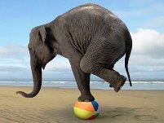
Input from the muscles and joints
Proprioceptive information from the skin, muscles, and joints involves sensory receptors that are sensitive to stretch or pressure in the surrounding tissues. For example, increased pressure is felt in the front part of the soles of the feet when a standing person leans forward.
With any movement of the legs, arms, and other body parts, sensory receptors respond by sending impulses to the brain.

Slide 34
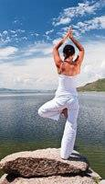
Proprioception
The sensory impulses originating in the neck and ankles are especially important. Proprioceptive cues from the neck indicate the direction in which the head is turned. Cues from the ankles indicate the body’s movement or sway relative to both the standing surface (floor or ground) and the quality of that surface (for example, hard, soft, slippery, or uneven).

Slide 35
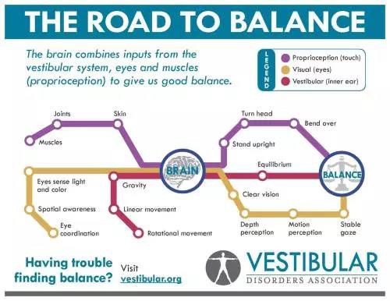

Slide 36
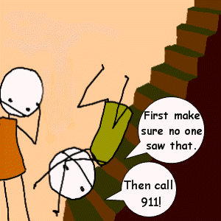
Loss of Balance
When the information received is too complex to translate, the system gets overwhelmed and you lose your balance.

Slide 37
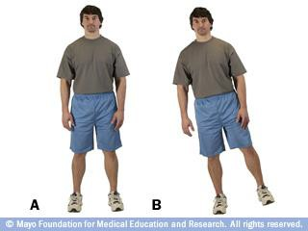
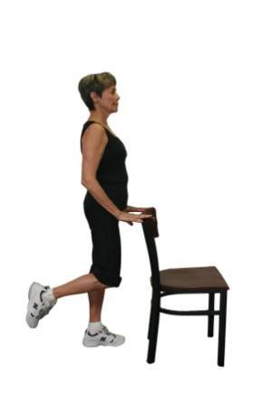
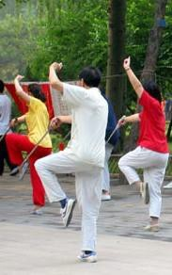
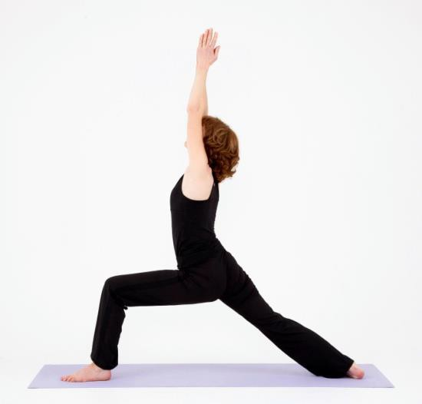
Exercises to improve your balance
Single Leg Stance
Weight Shifts
Yoga and Tai Chi

Slide 38
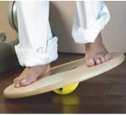
Products for Balance Training
There are balance pads, pillows, and balls on the market to help you incorporate balance work into your fitness routine. Advanced ways to increase balance is doing single leg jumps on a wooden box or elevated step. You might also consider a Wobble board to experiment with balance exercises prescribed specifically for using these products.

Slide 39
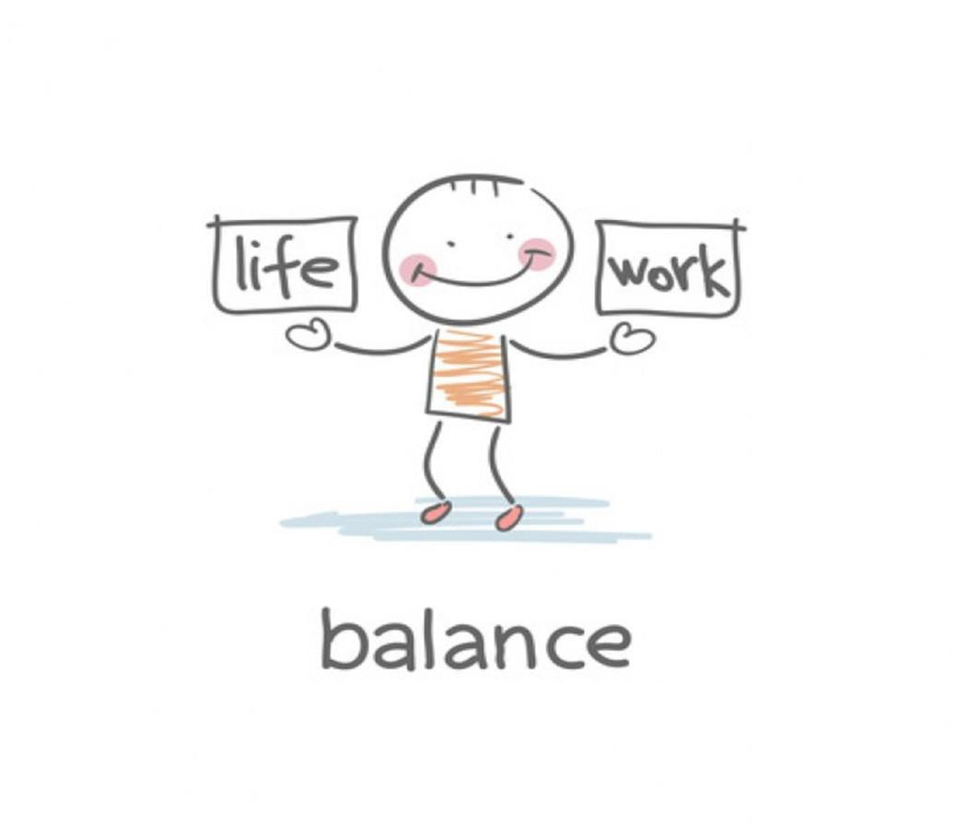
Additional Link
https://www.sacagingresources.org/resources-directory/mobility-fall-prevention

Slide 40

https://youtu.be/aMIvtq2jrDk

Slide 41
We come into this world head first and go out feet first; in between, it is all a matter of balance.
Paul Boese
The key to keeping your balance is knowing when you’ve lost it. Anonymous

