Slide 1


Women and Heart Disease 3/6/25
Radhika Nandur Bukkapatnam MD FACC MAS

Slide 2
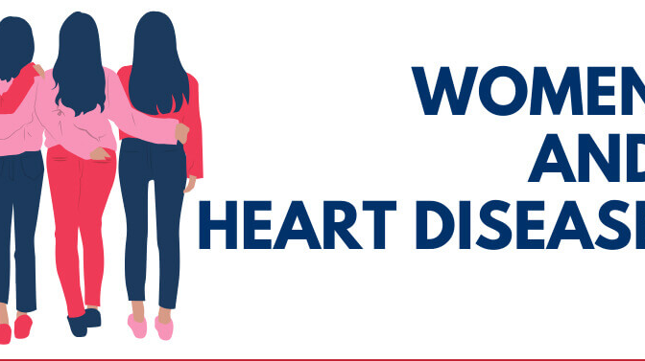

Slide 3
Cardiovascular disease ( CVD) is the leading cause of death for women in the US
Although mortality rates for heart disease in the US have been steadily reducing, women aged 35-44 have not experienced the same decline
This disparity may be explained by unhealthy lifestyle choices, lack of awareness and access to care

Slide 4
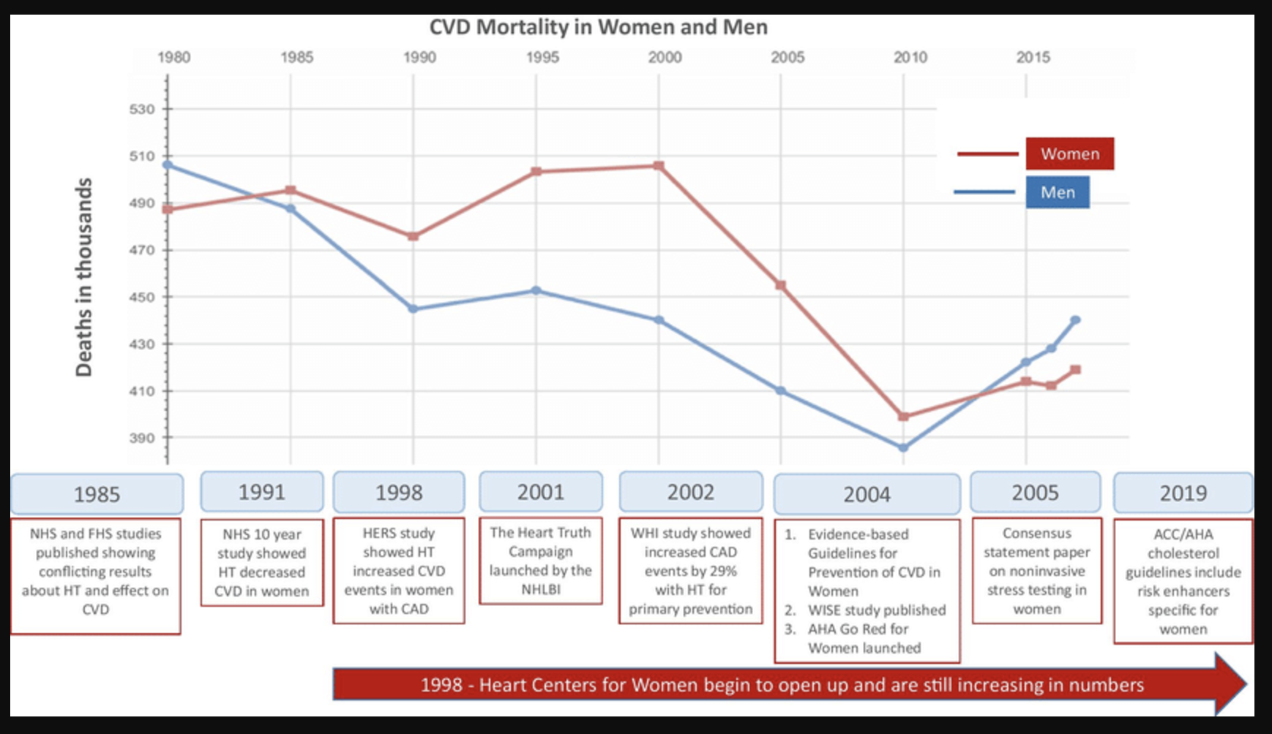

Slide 5

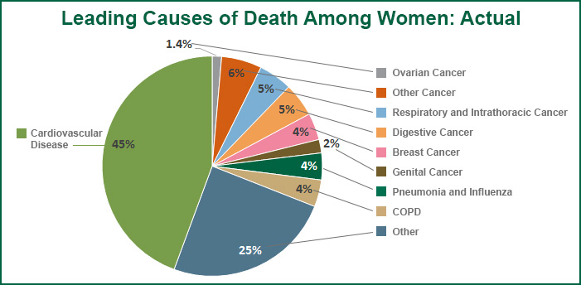

Slide 6
Research
There are few trials that include enough women, so data found in men is applied to men, such assumptions are not always true
Complex relationship between social determinants of health and CV disease.
Increasing awareness of cardiovascular disease in women has stalled with no major progress in almost 10 years, and little progress has been made in the last decade in increasing physician awareness or use of evidence-based guidelines to care for female patients

Slide 7
Role of physicians
Women and physicians do not put enough emphasis on cardiovascular disease in women, and a social stigma regarding body weight may be a primary barrier to these important discussions
Increasing awareness of cardiovascular disease in women has stalled with no major progress in almost 10 years, and little progress has been made in the last decade in increasing physician awareness or use of evidence-based guidelines to care for female patients.

Slide 8
Physicians often did not discuss cardiovascular disease because the patient had a more immediate health issue or did not fully report their symptoms, indicating that prevention prior to symptoms was not a priority.
Only 22 percent of primary care physicians and 42 percent of cardiologists felt well prepared to assess cardiovascular risk in women. Additionally, only 16 percent of primary care physicians and 22 percent of cardiologists fully implemented guidelines for risk assessment

Slide 9
Role of the patient
45 percent of women were unaware that heart disease is the number one killer of women in the U.S.
Awareness level was lower in women with lower levels of education and income and in ethnic minorities.
Nearly 71 percent of women almost never brought up the issue of heart health with their physician, assuming their doctor would raise the issue

Slide 10
While 74 percent reported having at least one risk factor for heart disease, just 16 percent were told by their doctor that they were at risk
Sixty-three percent of women admitted to putting off going to the doctor at least sometimes and 45 percent of women canceled or postponed an appointment until they lost weight
Many women reported being embarrassed or overwhelmed by their heart disease and many also cited difficulties in losing weight or finding time to exercise.

Slide 11
Ischemic heart disease in young women
Heart disease mortality rates in young women (35-54) continue to increase
The burden of cardiovascular disease (CVD) risk factors is disproportionately higher in women of ethnic and racial minorities
Black women have the highest rates of obesity of any racial group in the United States, recently exceeding 50%, as well as a higher prevalence of modifiable CVD risk factors resulting in higher rates of diabetes
Black women also have a persistent, 2-fold increased rate of chronic hypertension during pregnancy compared with White women.³ Compounding the problem, pregnancy-related CVD mortality in the United States is rising compared with other developed nations.

Slide 12
Risk Factors
Some risk factors are more potent for young women; for example, smoking is more strongly associated with STEMI incidence among women aged 18 to 49 years vs similarly aged men and older women.
Young women and men presenting with MI have different psychosocial profiles, with significantly greater prevalence of depression and stress, poorer physical and mental health status, and lower quality of life among young women

Slide 13
Common Risk Factors
High LDL
Smoking
Diabetes
Excess weight
Unhealthy diet
Inactivity
Stress and depression
Alcohol

Slide 14
Sex Specific Risk Factors
Early first period
Early menopause
Polycystic kidney disease
Diabetes or hypertension during pregnancy
Preterm delivery
Low birth weight or high birth weight infant
Lactation

Slide 15
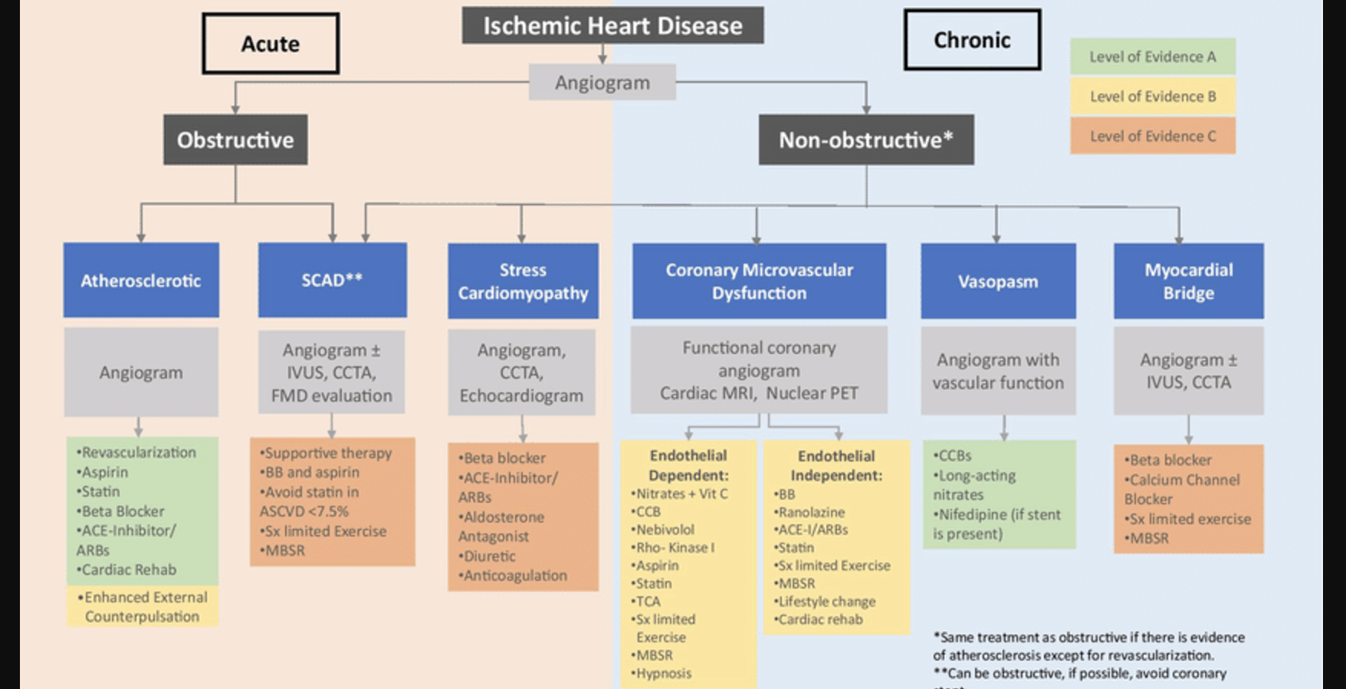

Slide 16
Acute coronary syndromes
The prevalence of acute coronary syndromes is lower among young women than other age groups, but there are concerning trends that merit attention.
Younger patients hospitalized with acute myocardial infarction (AMI) are increasingly prevalent; the proportion attributable to young patients (aged 35 to 54 years) has increased from 27% to 32% over the past 2 decades, with the greatest increase in young women (21% to 31%)

Slide 17
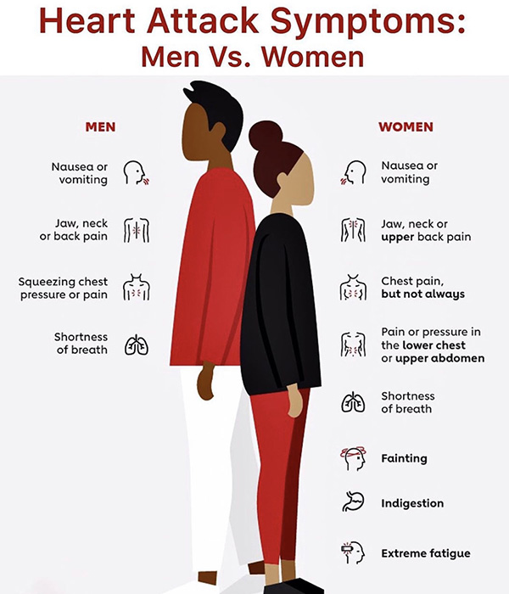

Slide 18
Presentation of Myocardial infarction (MI)
Young women are 50% more likely than similar aged men to present without chest pain when they have MI, with 1 in 5 women perceiving their symptoms as being related to anxiety or stress as opposed to MI.
It is important to stress that although MI presentation without chest pain is more frequent in women than men, most women, and particularly most young women, do experience chest pain with AMI.
Young women admitted with AMI often have more comorbidities compared with similarly aged men, with a higher prevalence of diabetes, hypertension, and/or chronic kidney disease.

Slide 19
Management of mi
Medical and invasive treatment of acute coronary syndromes are underutilized overall in women
Women who receive an invasive strategy are less likely to achieve a door-to-balloon time of <90 minutes
True sex differences may be even larger than reported, considering that young women are less likely to be diagnosed with and treated for AMI even when cardiac troponin is abnormal in the emergency department

Slide 20
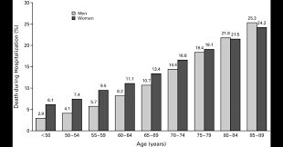
Women hospitalized with MI have consistently been reported to have greater in-hospital mortality rates than men,^{8,17} with these differences being particularly pronounced in the youngest age groups (eg, an ∼2-fold greater odds of mortality in women with STEMI aged <45 years vs only ∼30% in those aged >45 years).

Slide 21
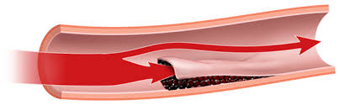
Spontaneous coronary artery dissection
Spontaneous coronary artery dissection (SCAD) is an increasingly recognized cause of AMI and sudden cardiac death in young and middle-aged women who are often otherwise healthy and with few or no conventional HD risk factors
More than 90% of SCAD events occur in women, and although SCAD has been reported in individuals from late teens to the eighth decade, it is the number 1 cause of myocardial infarction (MI) in women <50 years old and the most frequent cause of pregnancy-associated MI.¹⁹ AMI secondary to SCAD complicates 1:16,000 pregnancies in the United States

Slide 22
Undiagnosed AMI can be deadly, and many young women with SCAD often do not “look the part,” leading to delayed or missed diagnoses.
SCAD etiology is confirmed by coronary angiography showing either an intimal flap or, more frequently, abrupt smooth tapering of the vessel due to intramural hematoma
Conservative management now prevails as the recommended approach for patients who are stable. Patients with high-risk anatomy or ongoing ischemia may require revascularization either with percutaneous coronary intervention or coronary artery bypass grafting.
Hypertension has been associated with both initial and recurrent SCAD; blood pressure control and consideration of beta-blockers as agents of choice are routinely recommended and have been shown to reduce recurrent SCAD.

Slide 23
Myocardial infarction with nonobstructive coronary arteries
Definition of MINOCA requires presence of universal AMI criteria in the setting of nonobstructive CAD (defined as ≤50% stenosis), with no overt cause such as pulmonary embolism. About 5% to 15% of AMI patients have MINOCA.
The degree of coronary atherosclerosis may range from none to mild–moderate. MINOCA is more prevalent in women (40%-60%) than MI with obstructive CAD (MI-CAD, ∼25%) and occurs at younger ages than MI-CAD. Approximately one-half of MINOCA patients are aged <60 years at the time of MI, and ∼25% present at <50 years.
Outcomes among MINOCA patients are better than in MI-CAD, but MINOCA may present as a fatal event.²⁸ Recurrent MI occurs in ∼7% of MINOCA patients over 4 years, but only about one-half of recurrent MIs present as MINOCA

Slide 24
There is an ∼40% increase in all-cause mortality vs patients with stable angina who have nonobstructive CAD.³¹ MINOCA patients are not revascularization candidates, so new strategies are needed to improve their quality of life and clinical outcomes
MINOCA has multiple causes, including mild-to-moderate atherosclerosis with positive remodeling of the coronary artery, coronary artery spasm, plaque microrupture and/or erosion, coronary embolism, and microthrombosis, among others
indicate that women with MINOCA are likely to benefit from statins and angiotensin-converting enzyme inhibitor/angiotensin receptor blockers, but not dual antiplatelet therapy.

Slide 25
Coronary artery spasm
Coronary spasm is a cause of MI in young patients (both women and men) but is often challenging to diagnose because it may not be apparent at initial angiography and may present as MINOCA.
Patients with coronary spasm tend to be younger and male, and have more antecedent angina than patients with obstructive CAD, which may be atypical in character.^{34,35} It typically presents as rest angina occurring at night and early morning hours.
The CV health of pre-gestational women in the United States has declined, and that of pregnant women is suboptimal and lower than among age-matched nonpregnant women.

Slide 26
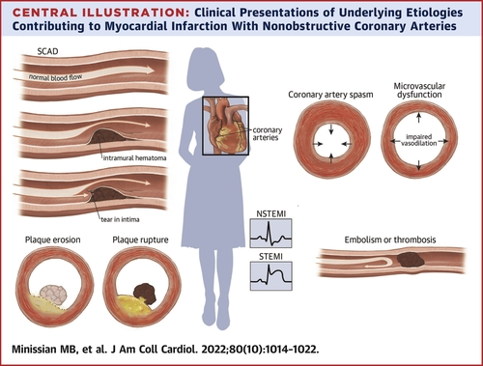
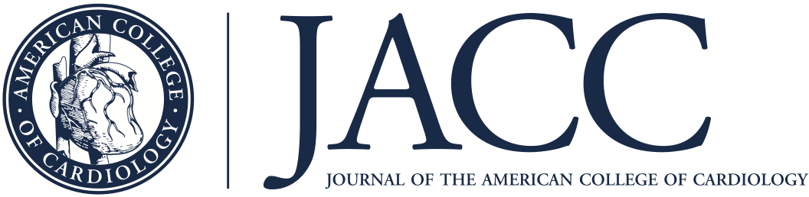
Margo B. Minissian et al. J Am Coll Cardiol 2022; 80:1014-1022.
_{2022 Crown}

Slide 27
Heart disease in postmenopausal women
The risk for cardiovascular disease is much lower in women than men until women reach the age of 50 years of age, then risk rises dramatically after menopause.
Previous studies have demonstrated that higher androgen and lower estrogen levels are associated with risk factors for heart disease in post-menopausal women, affecting lipids, endothelial dysfunction and vasoreactivity

Slide 28
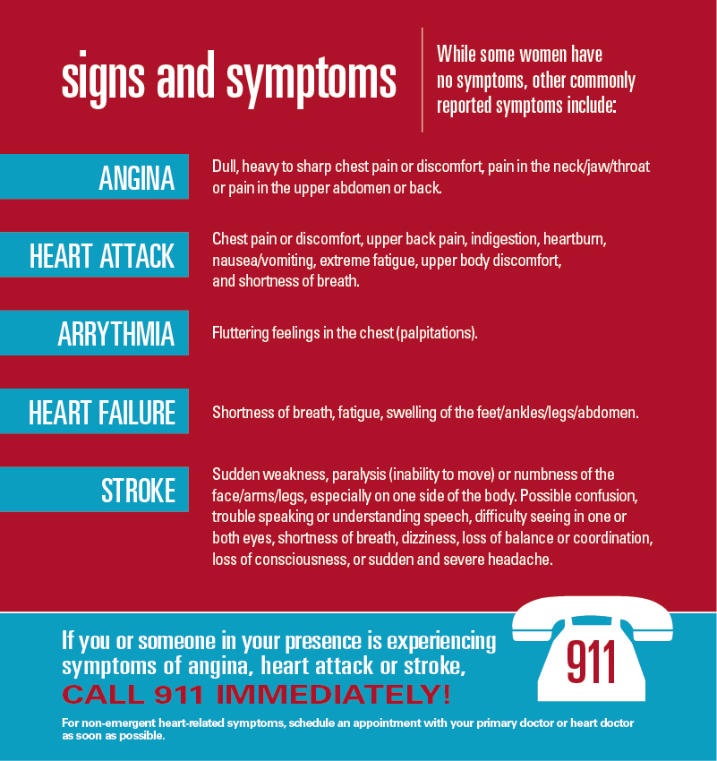

Slide 29
Despite improving trends globally among the general U.S. population, IHD mortality rates in women aged 35 to 54 years continue to stagnate or increase, a trend that is particularly prominent among African American women.
Differences in MI mortality rates between sexes remain, with women receiving less guideline-recommended pharmacotherapy and invasive coronary management.
MI mortality rates in women are potentially modifiable through improved concordance with guideline-indicated care. Although many women will experience obstructive CAD as the etiology for their IHD, women have higher rates of MINOCA, SCAD, coronary vasospasm, and CMD compared with men. Women with pre-existing CAD considering pregnancy need to be appropriately assessed and advised regarding both maternal and neonatal risk before conception

Slide 30
Call to action
Traditional CV risk factors are highly prevalent among US women. Furthermore, racial and ethnic differences exist, with rates of hypertension highest among non-Hispanic Black women, while low-density lipoprotein cholesterol is highest among non-Hispanic White women.
Rates of diabetes are highest among Hispanic women, and rates of overweight and obesity are highest among non-Hispanic Black and Hispanic women. Rates of control for these risk factors are suboptimal.

Slide 31
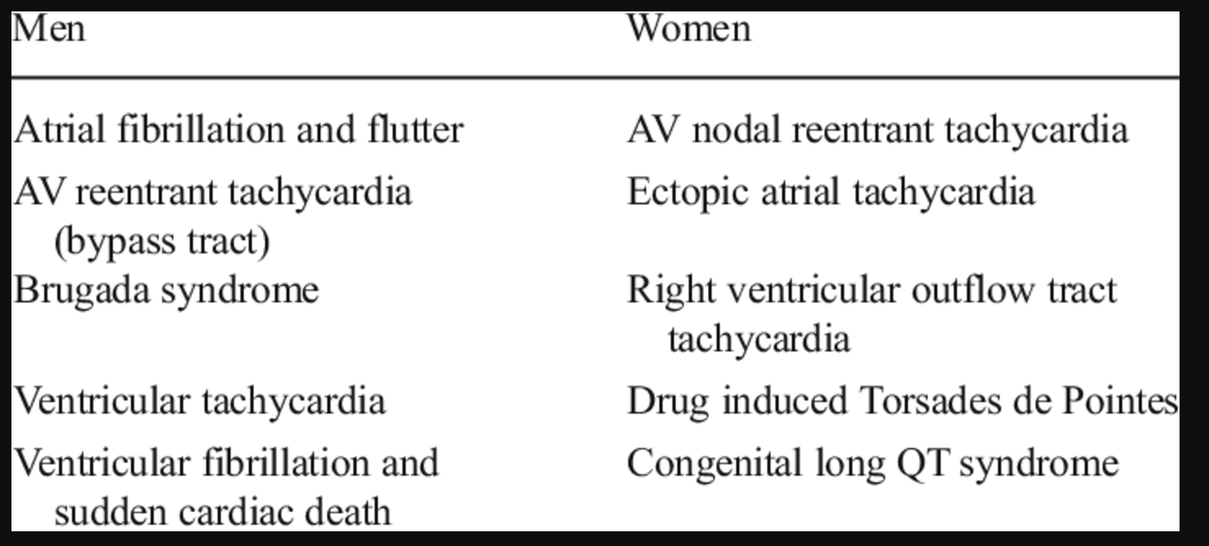
Arrhythmias in Women

Slide 32
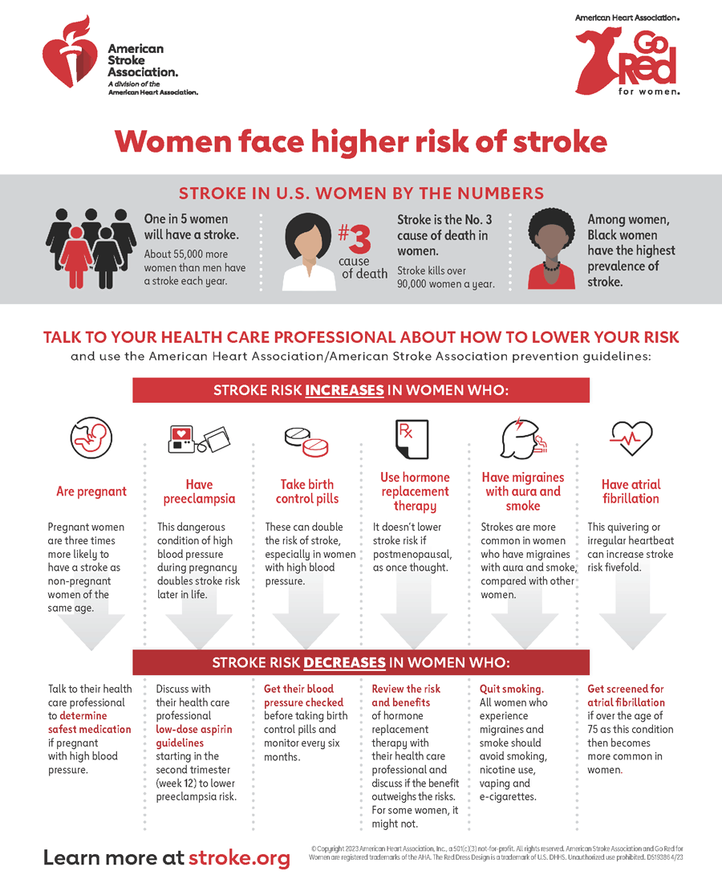

Slide 33
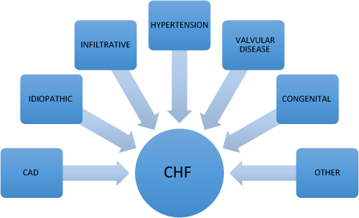
Congestive Heart Failure

Slide 34
Risk factors for women include early menarche (<11 years of age), premature menopause (<40 years of age), polycystic ovarian syndrome, hypothalamic amenorrhea, hypertensive disorders of pregnancy, gestational diabetes, preterm delivery, low– or high–birth weight fetus, oral contraceptives, and hormone replacement
Conditions that disproportionally affect women and are associated with an increased risk for CVD include systemic inflammatory and autoimmune disorders such as systemic lupus erythematosus, rheumatoid arthritis, and scleroderma. Depression and anxiety also carry an increased risk of CVD and are more frequent among women.

Slide 35
Summary
Studies suggest a need to destigmatize cardiovascular disease for women and counteract stereotypes with increased objective risk factor evaluation education to improve treatment by physicians
National action campaigns should work to make cardiovascular disease ‘real" to American women and destigmatize the disease by promoting the use of cardiovascular risk assessment to counter stereotypes with facts and valid assessments
Education must emphasize the benefits of prevention (80-90% of CVD is preventable)

Slide 36
Prevention efforts are recommended to include increased awareness for health professionals regarding the impact of prevention on CVD risk factors as outcomes. Awareness campaigns should be culturally sensitive and appropriate with translations for the relevant audiences.
Interdisciplinary collaboration between cardiologists, vascular neurologists, primary care clinicians, obstetricians, gynecologists, and other relevant health professionals is necessary to improve the recognition of women’s risk for CVD.
Enhancing basic and translational research, which advances knowledge related to women’s CV health, is warranted.
It is important to engage communities to optimize CV health across the life course, including school-based programs involving parents and empowering families and community-based programs including under-represented groups where they live and work.

Slide 37
Only 44% realize that CVD is the highest risk
Maternal mortality, 1/3 of all mortality
Gestational diabetes and hypertension are high risk for future CVD
Most are preventable
52% have hypertensive heart disease
57% stroke deaths are in women
Less likely to receive bystander CPR

Slide 38
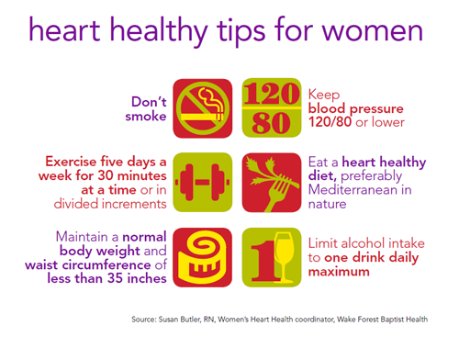

Slide 39


Slide 40
Thank you

