Slide 1
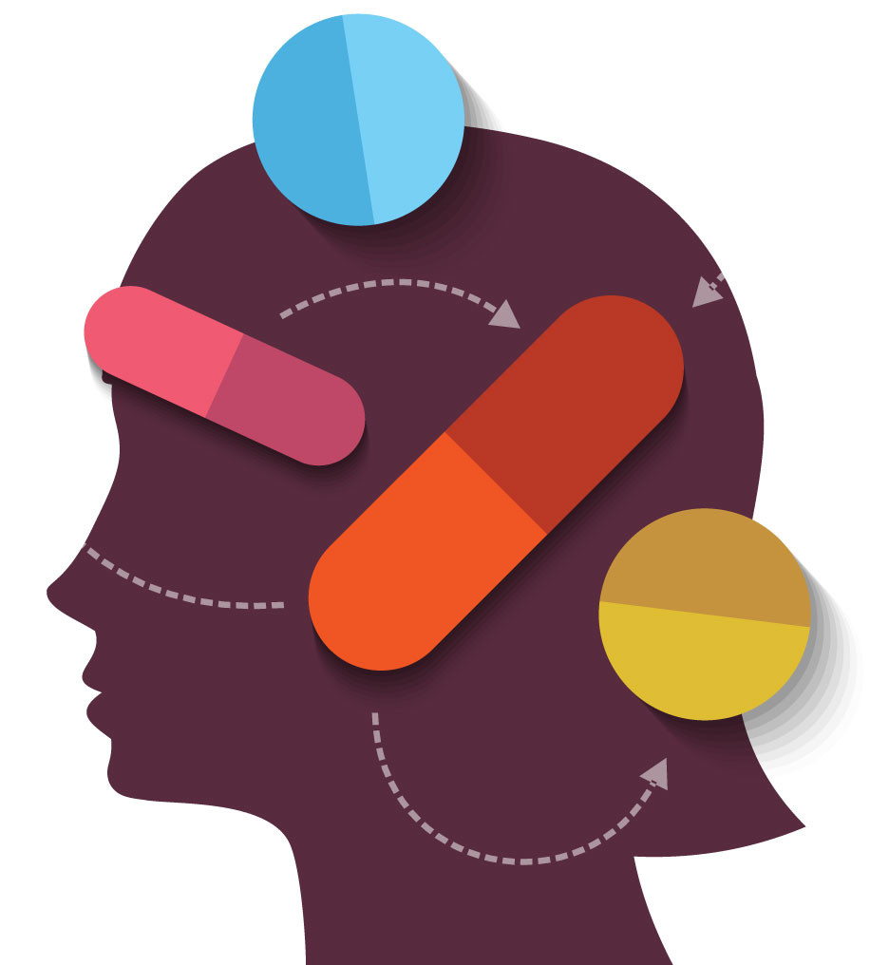
Drugs and Dementia
January 22, 2026
Soumya Bukkapatnam
Radhika Bukkapatnam
Jan 22,2026

Slide 2
Dementia
Significant decline in at least one cognitive domain
Cognitive domains include: complex attention, executive function, learning/memory, language, perceptual-motor, social cognition)
Change from previous functioning
The deficits are large enough to interfere with daily tasks

Slide 3
Types of dementia
Alzheimer's Disease: Characterized by memory loss, thinking, and language issues due to amyloid plaques and tau tangles in the brain.
Vascular Dementia: Occurs from disrupted blood flow to the brain, often after strokes, causing problems with planning, concentration, and sudden drops in ability.
Dementia with Lewy Bodies (DLB): Features visual hallucinations, fluctuating alertness, movement issues (like stiffness), and thinking problems due to alpha-synuclein protein deposits.
Frontotemporal Dementia (FTD): Affects personality, behavior, judgment, and language, with early changes in the frontal and temporal lobes.

Slide 4
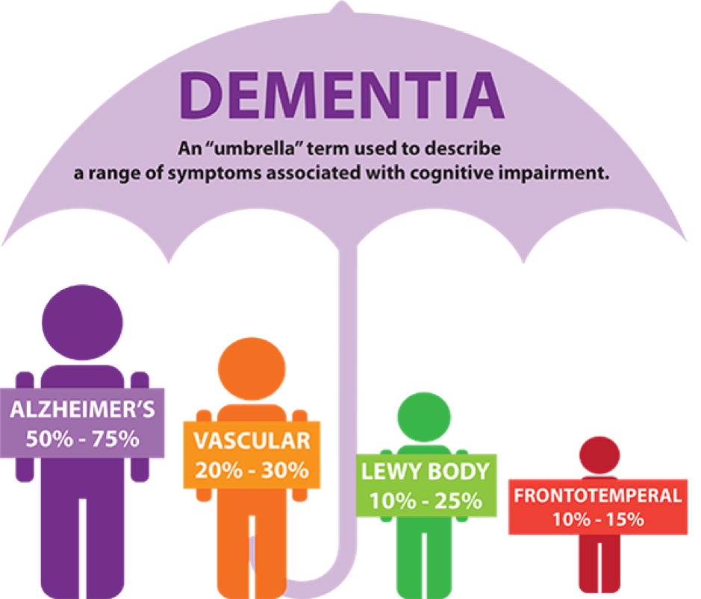
Types of dementia

Slide 5
Rise of Dementia
55 millions people are currently affected by dementia globally.
This number is set to double by 2030 and triple by 2050.
This increase in dementia is linked to many factors including the aging population, rise in the prevalence of other risk factors like cardiovascular disease, and lifestyle changes.

Slide 6
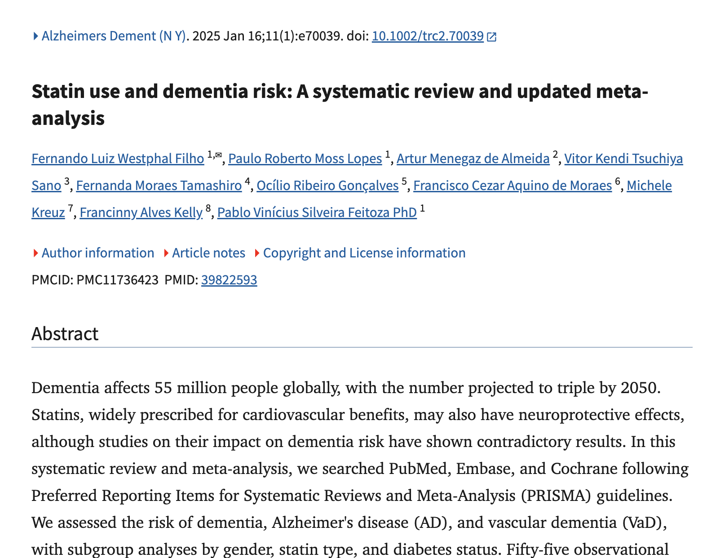
What inspired today’s talk

Slide 7
Statins and dementia
Based on Statin use and dementia risk: A systematic review and updated meta‐analysis published in January 2025 found that statin use actually has NEUROPROTECTIVE effects
It reduced the risk of both Alzheimer's dementia and vascular dementia (other forms not studied)
An analysis published July 15, 2021, in The BMJ supports that conclusion. Study authors looked at 62 trials that included more than 120,000 participants and an average follow-up of about four years. While the authors found that statin use was associated with a small increase in symptoms such as muscle pain, liver dysfunction, kidney problems, and eye conditions, the significantly lower risk of heart attack, stroke and other vascular conditions outweighed these risks. It’s not the first study to examine the risk-to-benefit ratio in people with cardiovascular risk factors.

Slide 8
Statins proposed neuroprotective mechanism
Proposed mechanisms for these neuroprotective effects include anti‐inflammatory properties, modulation of proteins linked to neurodegeneration, enhancement of cerebral blood flow through low density lipoprotein (LDL) reduction, and influence on neurotransmitter activity, all contributing to improved cerebral perfusion and reduced neuronal damage.

Slide 9
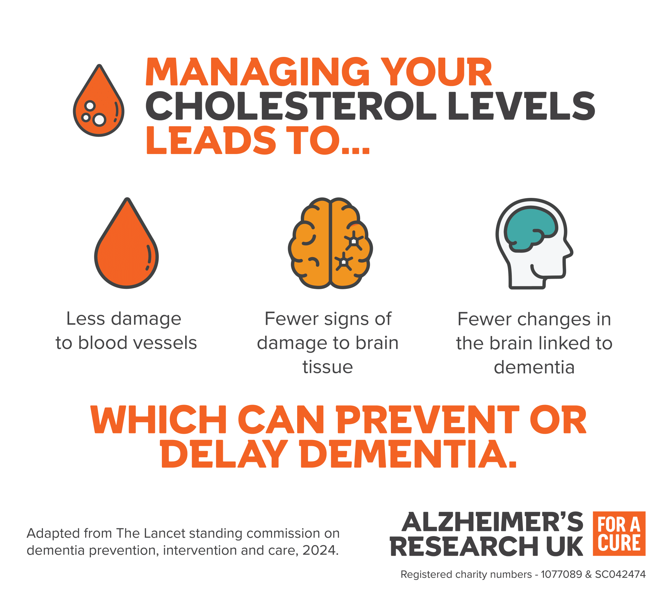

Slide 10
BP Meds and Dementia
Studies have shown a link between keeping blood pressure below 120/80 millimeters of mercury and a lower risk of developing dementia.
A new study has found that blood pressure drugs that stimulate type 2 and 4 angiotensin II receptors in the brain may offer greater protection against Alzheimer’s disease and other dementias. These drugs include angiotensin-receptor blockers, such as valsartan (Diovan) and losartan (Cozaar); dihydropyridine calcium-channel blockers, like amlodipine (Norvasc); and thiazide diuretics, like hydrochlorothiazide (also known as HCTZ).
Researchers speculated that stimulating the angiotensin II receptors might enhance brain blood flow or perhaps reduce amyloid plaque, high amounts of which are linked with Alzheimer’s. The study was published online Jan. 4, 2023, by JAMA Network Open.

Slide 11

Let’s now explore the connection between dementia and other drugs

Slide 12
Over the Counter Medications Affecting Memory
Anticholinergics are a class of drugs that influence or suppress certain cognitive functions, particularly the ability to form and retain memories.
Anticholinergic medications are commonly found in both prescription and over-the-counter drugs. More than 600 medications are tied to some level of anticholinergic effects, eg Benadryl
In many cases, memory impairment caused by anticholinergic medications is reversible upon discontinuation of the drug. However, as we age, the effects of anticholinergics can have a more critical, long-lasting effect. For example, a 2016 study of senior citizens found that all anticholinergics significantly reduced the size of their brains.

Slide 13
Prescription Drugs affecting Memory
Painkillers such as atropine and codeine
Antipsychotics
Antiseizure medications
Incontinence medications such as Oxybutynin and tolterodine
Parkinson’s disease medications such as Benztropine and trihexyphenidyl
Asthma and rheumatoid arthritis medications containing glucocorticoids
Tricyclic antidepressants
Mood stabilizers such as bupropion and haloperidol

Slide 14
Prescription Drugs affecting Memory
Sleep aids containing diphenhydramine
Sleep aids such as alprazolam and amitriptyline
Gastrointestinal medications such as dimenhydrinate and loperamide
Other medications such as Scopolamine, Atropine, Antinicotinic medications, and Glycopyrrolate
Certain tricyclic antidepressants (an older class of antidepressants), such as Amitriptyline and Doxepin, are tied to memory loss.
Opioid studies are ongoing, and there is not enough current information to state, with certainty, that opioids cause memory loss. However, one Yale School of Medicine study found clusters of people with a history of opioid use who were unable to form new memories. Their studies also mentioned swelling in the brain of several overdose patients, amnesia, and permanent memory impairment problems.

Slide 15
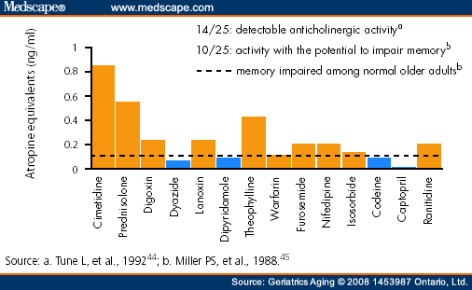

Slide 16
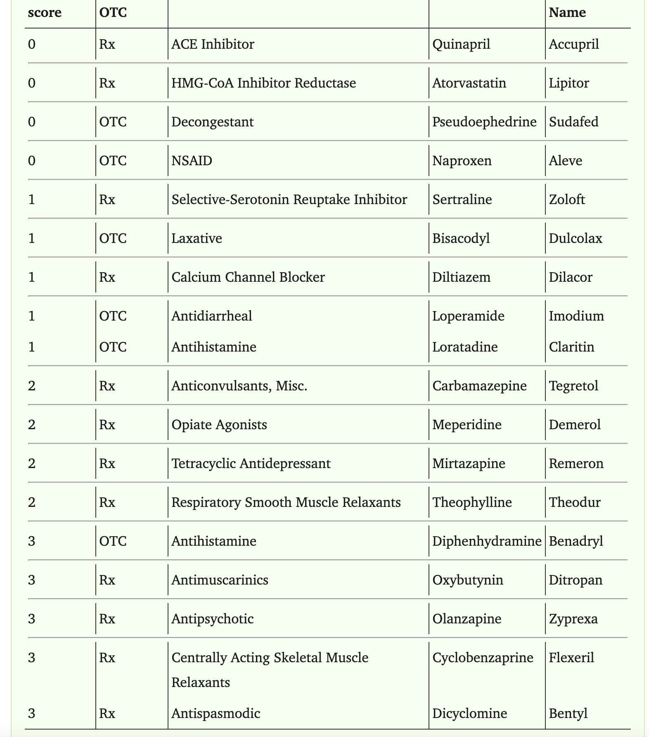

Slide 17
Polypharmacy

Slide 18
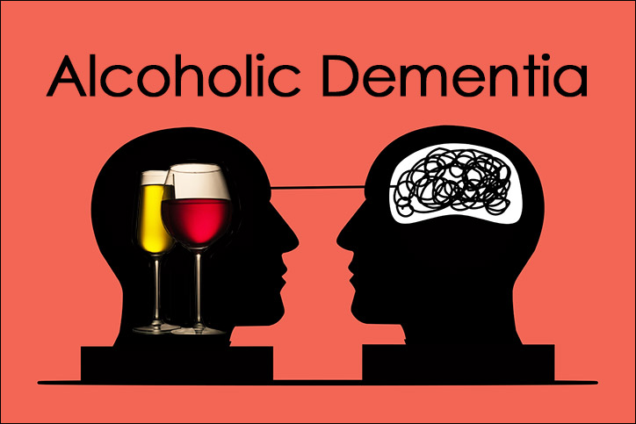

Slide 19
Alcohol and Dementia
No amount of alcohol has neuroprotective effects
Though previous studies may have suggested that alcohol can lower your risk for dementia, this has since been disproven
Studies suggests that alcohol intake protionality increases your risk for dementia, suggesting that even small amounts of alcohol can have neurodegenerative effects

Slide 20
Alcoholic Dementia - Korsakoff Syndrome
Commonly caused by alcohol abuse
Memory loss caused by severe thiamine (vitamin B-12) deficiency
Symptoms include memory issues in both short and long-term memory
This may present as patients who can’t remember conversations a few minutes later
Also patients may make up stories, not to lie, but as invented explanations

Slide 21
Nicotine and Dementia
The exact connection between nicotine and dementia is currently unknown
Smoking is linked to stroke, the most common risk factor for vascular dementia
Nicotine therapy may offer protection against cognitive decline or dementia, though the evidence is mixed

Slide 22
Cannabis and dementia
While the connections between cannabis and dementia is not well studied, cannabis has been shown to affect memory
Cannabis users demonstrated a significant decline in working memory
Long-term cannabis use has also been shown to decline hippocampal brain mass, the region associated with memory

Slide 23
Other Recreational Drugs and Memory Loss
Alcohol: short-term memory disruption and blackouts
Ketamine: short- and long-term memory problems
Marijuana: memory problems (with regular use)
GHB (Gamma-hydroxybutyrate): side effects include memory loss
Psilocybin (Magic Mushrooms/Shrooms): long-term memory problems
MDMA (Ecstasy, Molly): long-term memory problems
PCP (Angel Dust): long-term memory loss

Slide 24
Lifestyle choices
Observational study by the NIH published in June 2020 found 5 good habits that reduce dementia risk by 60%:
At least 150 minutes per week of activity – Physical activity is an important part of healthy aging.
Not smoking – Established research has confirmed that even in people 60 or older who have been smoking for decades, quitting will improve health.
Limiting alcohol intake
A high-quality, Mediterranean-DASH Intervention for Neurodegenerative Delay (MIND) diet, which combines the Mediterranean diet and Dietary Approaches to Stop Hypertension (DASH) diet – The MIND diet focuses on plant-based foods linked to dementia prevention.
Engagement in late-life cognitive activities – Being intellectually engaged by keeping the mind active may benefit the brain. This can include meeting with friends and building new connections.

Slide 25

Lifestyle choices

Slide 26
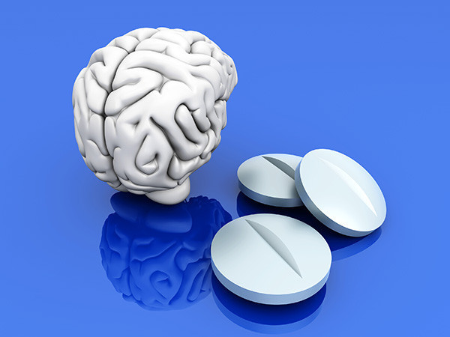
Thank you!

