Slide 1
ATRIAL FIBRILLATION
Radhika Nandur Bukkapatnam MD FACC

Slide 3
DEFINITION
Irregular, chaotic heart rhythm that comes from the left atrium or the pulmonary veins.
Paroxysmal
Persistent
Chronic

Slide 4
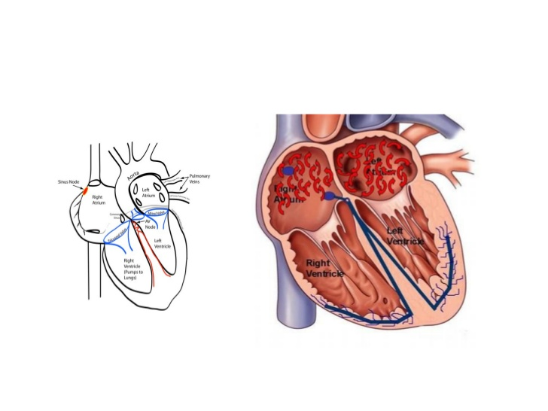

Slide 6
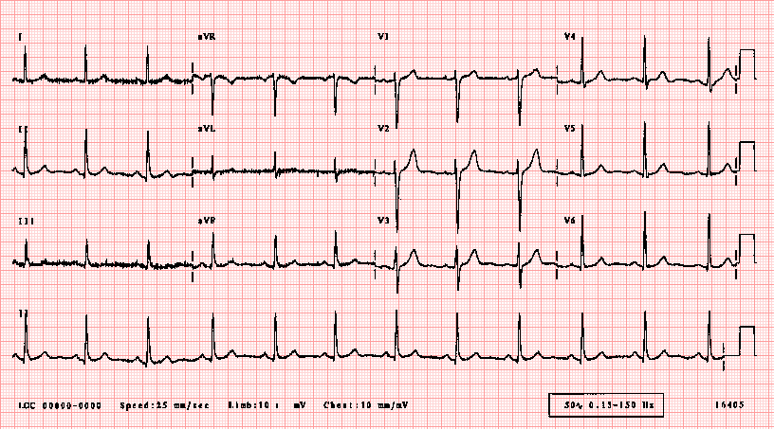
Normal ECG

Slide 7
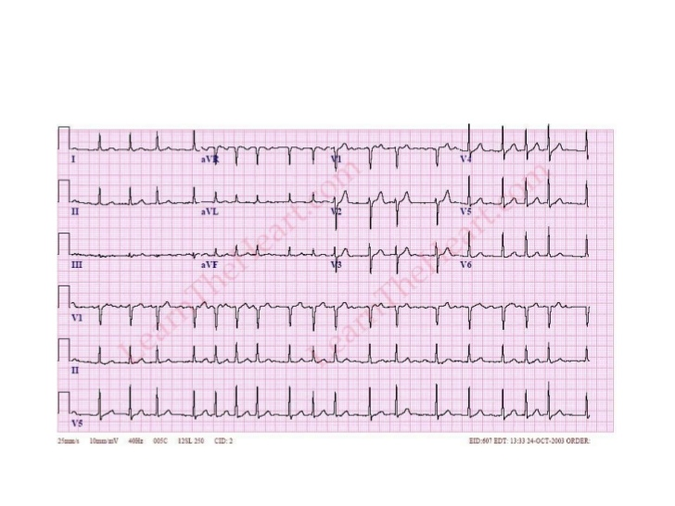
Atrial Fibrillation

Slide 9
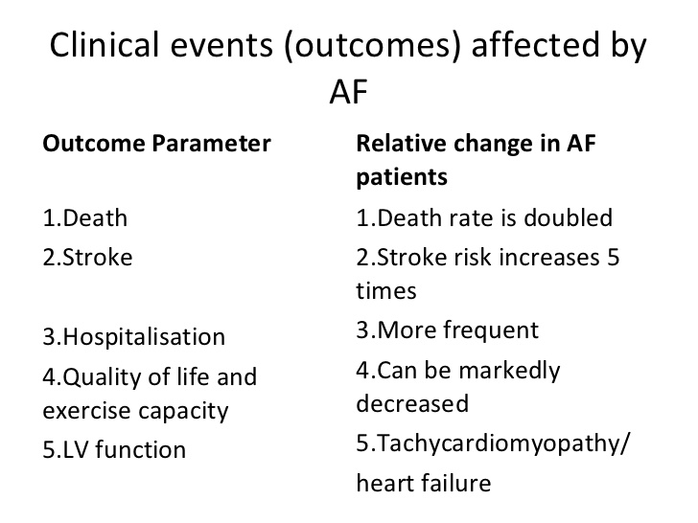

Slide 10
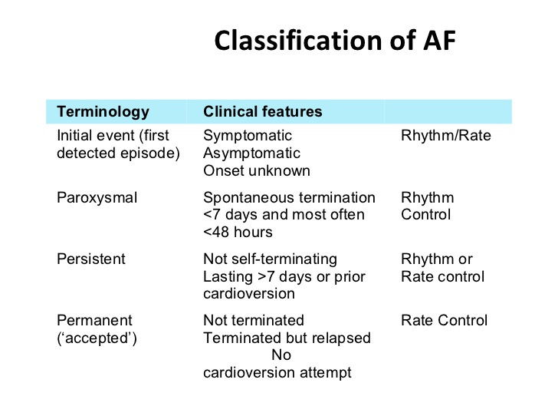

Slide 11
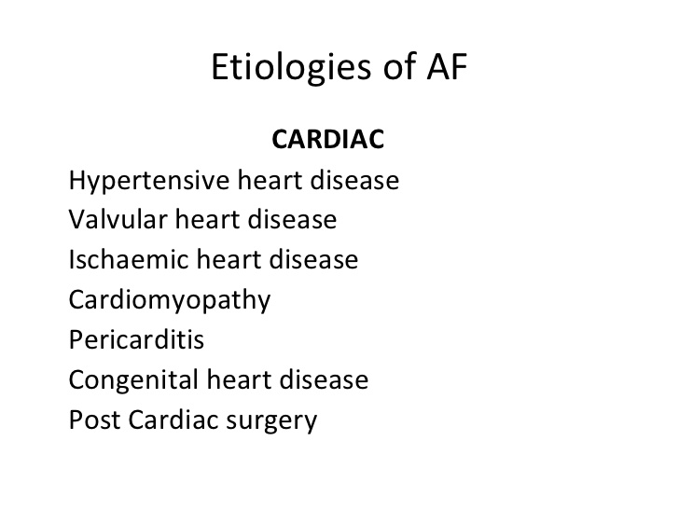
What causes A fib

Slide 14
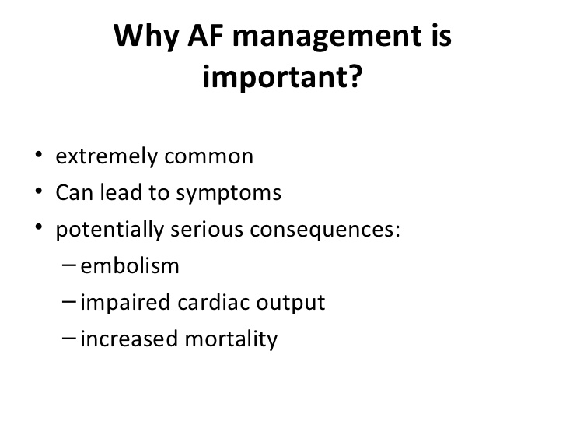

Slide 15
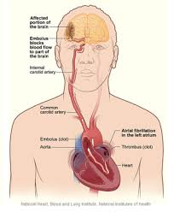

Slide 16
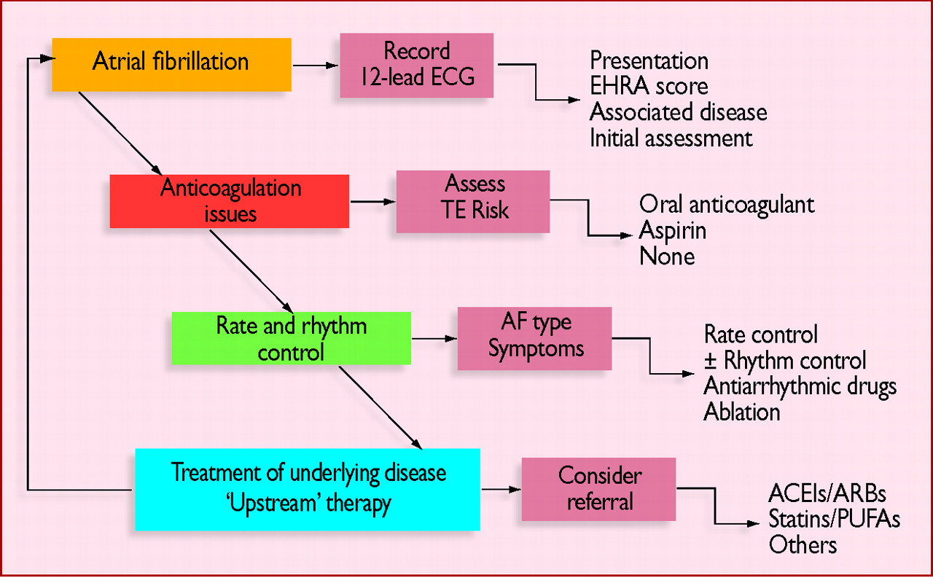

Slide 17
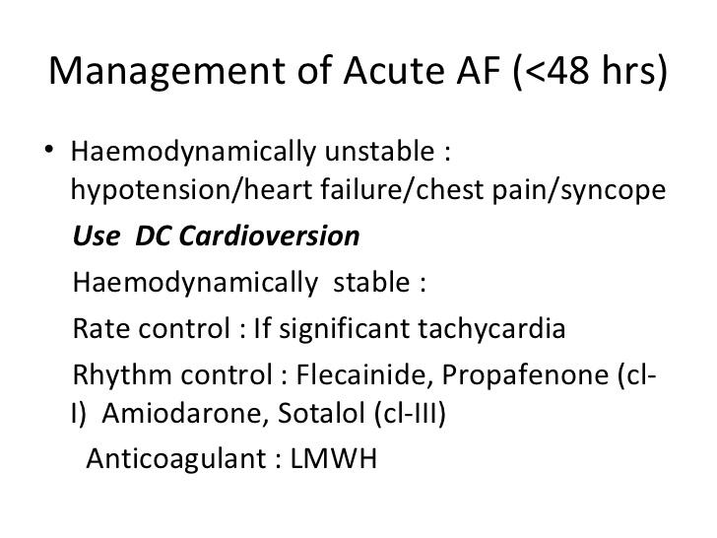

Slide 22
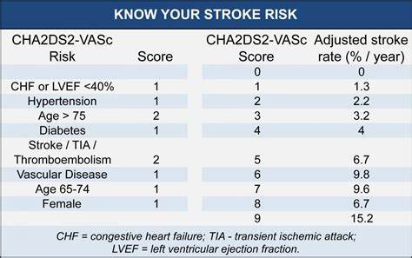

Slide 24
Types of Blood Thinners
z

Slide 26
How do we choose blood thinners

Slide 30
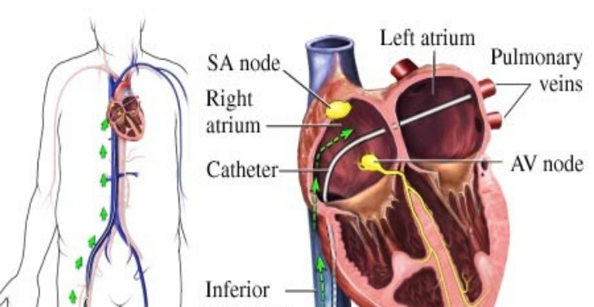
A fib Ablation
z

Slide 31
Pacemaker with AV nodal Ablation
z

Slide 33
Thank You

