Slide 1

Advance Care Planning
Presented By Shellie Young, LVN
Community Educator

Slide 2

Objectives
Identify the importance and relevance of advance care planning in healthcare today.
Define the components of effective advance care planning that help increase the likelihood of wishes being honored.
Explain the Five Wishes framework for conversations.
Learn some different documentations for end-stage conditions.
Identify the necessary steps to properly document and update advance care plans.

Slide 3
About This Course
Communication is one of the most important elements of excellent care. This is especially true when decisions about medical treatments need to be made.
Advance care planning is an ongoing process in which people explore and discuss their goals, values, and understanding of their health to guide future end-of-life treatment decisions.
Unfortunately, most people do not engage in these conversations with their care providers, and end-of-life preferences are often unknown.
It is important that all healthcare staff in all care settings understand how to engage in these conversations so that however a person arrives at the end-of-life, whether through accident or illness, their wishes are known and documented, and their families are well-prepared to make end-of-life decisions.

Slide 4
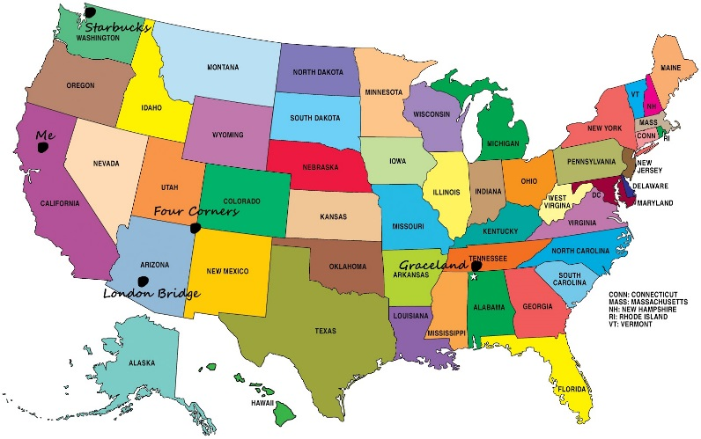
Changing Demographics and Declining Health
According to one Research Center (2010), the number of adults over age 65 is growing. More than 10,000 people turn 65 each day.
Approximately half of all adults, and about 92% of older adults, have 1 or more chronic health conditions (Centers for Disease Control and Prevention [CDC], 2017; National Council on Aging [NCOA], 2017).
The number of Americans with Alzheimer’s disease is projected to triple by 2050 (Population Reference Bureau, 2016).
Advance care planning conversations are becoming increasingly necessary in healthcare delivery for a variety of reasons.
The US population is aging rapidly, and the number of people living with chronic and serious health conditions is increasing.

Slide 5
Different Conversations at Different Times
Young and Healthy- conversations are focused on "what if" scenarios. Decisions to be considered are general and hypothetical and relate primarily to what they would want if an emergency or accident were to occur and cause them to be unable to make their own treatment choices.
Living with a Chronic Illness- conversations are centered on considerations about "what next." These discussions focus on understanding the likely trajectory of their illness and what might occur as the condition progresses.
People living with chronic conditions can develop complications or symptoms. It is important to explore what those might be, what treatments are likely, and how those factors might relate to end-of-life situations and decisions.

Slide 6
Different Conversations at Different Times
Seriously Ill or Nearing the End of Life- conversations are focused on “what now.” Most seriously ill individuals and their families want to be honestly informed about prognosis and discussing goals of care does not cause them to experience anxiety or hopelessness (Bernacki & Block, 2014).
At this stage, there will be more need to refer to other professionals to help clarify prognosis and specific end-of-life choices that may arise.
“What now” conversations focus on how the person would like their last days to be and enable healthcare agents and healthcare team members to make real-time decisions when needed.

Slide 7
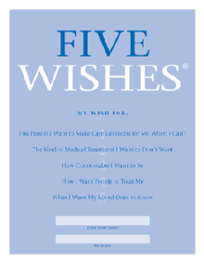
Five Wishes Conversations
Choosing a Healthcare Agent
End-of-Life Treatment Decisions
Physical Comfort and Symptom Management
Dignity and Support
Communication with Loved Ones and Healthcare Team

Slide 8
The Five Wishes
The Five Wishes framework can help you facilitate conversations that address the 5 most important choices to elicit regarding end-of-life preferences.
The framework makes reference to the Five Wishes advance directive document as a tool, but is useful regardless of the advance directive document that might be used.
Addressing these 5 areas helps ensure families and healthcare providers are prepared to know what is most meaningful to individuals at the end of their lives.

Slide 9
Documenting the Plans
The choices the person makes as a result of advance care planning conversations should be documented in advance directives.
It is especially important for a designation of healthcare agent to be documented as a legally valid form is required to give a chosen person authority.
Otherwise state laws determining a decision-maker come into play, as mentioned previously.

Slide 10
Documenting Continued
The Five Wishes document meets the legal requirements for an advance directive in 42 US states and the District of Columbia.
In states where it does not meet the legal requirements, it can be used as a guide for considering and discussing end-of-life wishes. In those states, it can be completed and attached to your state’s required form.
Five Wishes can be used in any setting and is available in 28 languages and in Braille. To see if it meets the requirements of your state, look at the list of states on page 3 of the Five Wishes document.

Slide 11

The documents should be entered into the medical record. Once choices are documented in advance directives, instruct the person to:
Give copies of their advance directives to their healthcare agent, family members, and others who are interested in their wishes.
Provide a copy to all of their healthcare providers.
Keep a list of who has a copy in case they choose to make changes.
Keep the original, signed documents in a safe and accessible place. Do not put them in a safety deposit box. Keep them nearby so that they can be available when needed.
Take a copy of the documents with them when they are admitted to a hospital, long-term care facility, or other healthcare service provider.

Slide 12
Updating the Plans
Advance directive documents should be updated as needed to reflect current choices and circumstances. The American Bar Association provides a helpful way to remember when to update advance directive documents. Plans should be updated when any of the “5 Ds” occur (Sabatino, 2015):
• Every new Decade of life
• After the Death of a loved one
• After a Divorce
• After any significant Diagnosis
• After any significant Decline in functioning

Slide 13
POLST or Physician order for Life Sustaining Treatment
If a person has an end-stage condition or is in the last months of life, they may want to consider adding a DNR order or a POLST form to their documentation. These forms are intended to complement advance directives and translate certain preferences into medical orders.
Each of these documents accomplishes different goals.
Identifies decisions regarding resuscitation
Identifies decisions regarding medical interventions including mechanical ventilation, feeding tubes, intravenous fluids, antibiotics, etc.
Identifies preferences for comfort care
Is useful for adults with end-stage conditions
Is a medical order and must be completed and signed by a physician

Slide 14
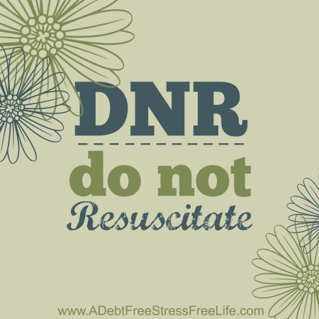
The DNR or Do Not Resuscitate
Identifies decisions regarding resuscitation
Is useful for adults with end-stage conditions
Is a medical order and must be completed and signed by a physician

Slide 15

Things to Consider
Regardless of a person’s age, stage of life, or health status, advance care planning conversations should answer key questions, elicit information about the person’s values and experiences, and assess their understanding of the meaning of the choices.
For advance care plans to be most effective, they must be medically sound, legally sound, and based on the person’s individual goal and values.
Depending on the person’s age and health, advance care planning conversations will focus on different goals and information. Include others in the conversation as the person desires, and provide time for reflection on the decisions to be made.

Slide 16
Summary
The choices that a person makes as a result of advance care planning conversations should be documented in advance directives, which help ensure wishes are honored by those who will need to make real-time decisions.
It is important to tell the person what to do with completed advance directives and to whom they should provide copies.
Healthcare providers should include completed advance directives in the medical record. Advance directives should be updated whenever there are significant changes in the person’s health or circumstances.
Individuals who are seriously ill or nearing the end of life may need additional documentation in medical orders to have their end-of-life preferences properly documented and honored.

Slide 17
Resources
Informational Resources for Patients – The Conversation Project http://theconversationproject.org/starter-kits/
Find out if Five Wishes is valid in your state and find state specific forms if it is not
https://agingwithdignity.org/five-wishes
Find state specific forms other than Five Wishes here http://www.caringinfo.org/i4a/pages/index.cfm?pageid=3289
POLST FAQ
http://www.polst.org/wp-content/uploads/2016/04/2016.04.03-POLST-FAQs.pdf
References
Bernacki, R.E., & Block, S.D. (2014). Communication about serious illness care goals: A review and synthesis of best practices. The Journal of the American Medical Association, 174, 1994-2003.

