Slide 1
Nutrition Tips for a Healthy Brain
Debbie Lucus MS, RD, CDCES
dlucusrd@gmail.com

Slide 2
Brain Health Facts
Alzheimer’s is the 6th leading cause of death in the United States
One in three seniors die with Alzheimer’s or dementia– more than breast cancer and prostate cancer combined.
Deaths from heart disease have declined 7.8% between 2000 and 2018 BUT deaths from Alzheimer’s have increased by 146%
In 2020 alone, estimated costs for Alzheimer’s and dementia will reach $305 billion and by 2050, at the current pace of the disease, costs are expected to be over $1 trillion
Since it is known that once a person has developed AD, there is little that can be done –prevention appears to be the key

Slide 3
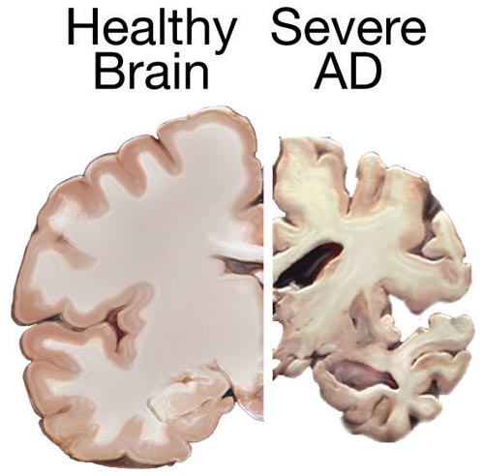
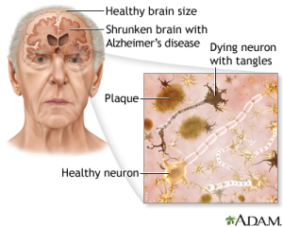
Key factors in brain diseases
Plaques are deposits of a protein fragment called beta-amyloid (BAY-tuh AM-uh-loyd) that build up in the spaces between nerve cells.
Tangles are twisted fibers of another protein called tau (rhymes with “wow”) that build up inside cells.

Slide 4

Overview
Modifiable Risk Factors for Dementia/Alzheimer’s
Hypertension
Diabetes
Obesity
Smoking
Cognitive inactivity (low education)
Physical Inactivity
Social Isolation
Depression
Hearing Loss
These are associated with progressive cognitive decline and Alzheimer’s

Slide 5
Am I at risk for diabetes? Take the quiz!
https://www.cdc.gov/prediabetes/takethetest/
Notes:
3-8 risk for pre-diabetes
>9 high risk of diabetes

Slide 6

Diabetes
Prediabetes: blood glucose (blood sugar) is higher than normal
Diabetes: greatly elevated blood glucose levels
Preventing diabetes OR controlling your diabetes lowers your risk for:
  Heart attack
  Stroke
  Blindness
  Kidney failure
  and may improve brain health

Slide 7

Risk factors for developing diabetes:
Non-modifiable
Modifiable
Family History
Ethnicity (African American, Alaska Native, American Indian, Asian American, Hispanic/Latino, Native Hawaiian, or Pacific Islander)
Older Age (over 45)
Overweight
High blood pressure or history of heart disease or stroke
Physical Inactivity
History of Gestational Diabetes or gave birth to a baby weighing 9 pounds or more
Polycystic Ovary Syndrome (PCOS)
Low HDL (“good”) cholesterol,
High triglycerides
Have acanthosis nigricans (dark, thick, and velvety skin around your neck or armpits)

Slide 8
What to do:
If you have prediabetes:
If you have diabetes:
Increase activity to at least 30 mins 5 times a week
Talk with your doctor to see if you need a medication
Follow a lower fat healthy diet – plant-based is recommended
Lose weight if you need to
Go to a pre-diabetes class!
Work with your doctor or diabetes educator to bring blood glucose to goal
Follow a consistent carbohydrate diet – plant-based preferred
Increase movement at least 30 mins 5 times a week
Ask for a referral to meet with a diabetes educator

Slide 9
Need Help? Ask for a Referral….
Sutter Health System:
  Referral to Diabetes Education
  916-774-8885
Univ. of California Medical Center:
  Referral to Health Management and Education (HME)
  916-734-0718, www.livinghealth.ucdmc.edu
Dignity Health
  Referral to Diabetes Education
  916-733-5798
Kaiser
  Diabetes Care Management Program for all with diabetes
  Also online program available

Slide 10
Hypertension
High Blood pressure is when the force of the blood flowing through your blood vessels, is consistently too high.
Get checked!
The best way to know if your blood pressure is in range

Slide 11

Risk factors for Hypertension
Non-modifiable
Modifiable
Family history
Age and Gender
  Until age 64, men are more likely to get high blood pressure than women are.
  At 65 and older, women are more likely to get high blood pressure
Ethnicity (African-Americans high higher risk)
Chronic Kidney Disease
Lack of physical activity
Unhealthy diet (Diet high in sodium)
Overweight or Obese
Drinking too much alcohol
Sleep apnea
High cholesterol
Diabetes
Smoking and tobacco use
Stress

Slide 12
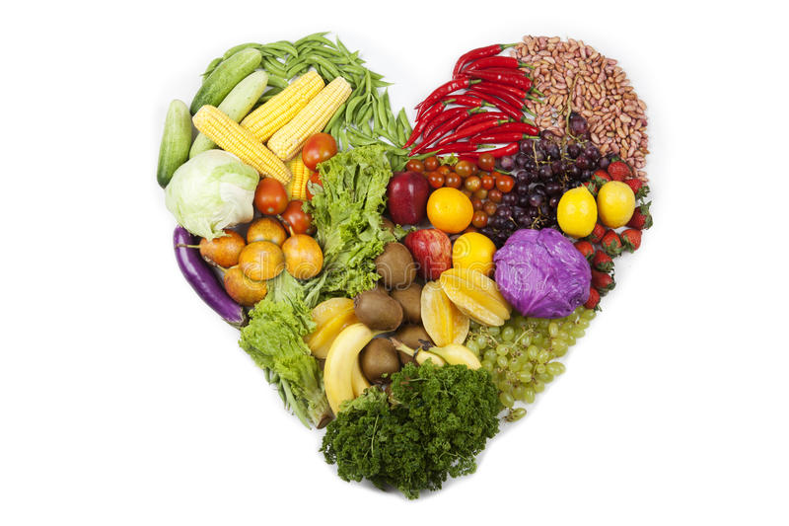
What to do:
Follow a plant-based diet or DASH diet: low sodium, high in fruits and vegetables, whole grains, low in alcohol
Limit your sodium intake (<1500 mg/day)
Lose the processed foods
Stop shaking salt at the table
Increase movement to at least 30 mins 5 times a week
Reduce and manage stress
Quit smoking (1-800-no-butts)
Ask for a referral to meet with a registered dietitian

Slide 13
What are the best eating styles for your brain?
Anti-inflammatory foods (fruits, veggies, whole grains)
Low in saturated and trans fats
Lower in calories (to maintain healthy weight)
High in veggies
Low in animal products
High in spices (cloves, ginger, rosemary, turmeric)
Include vitamin-E rich foods (nuts, seeds, veg oils, greens)

Slide 14
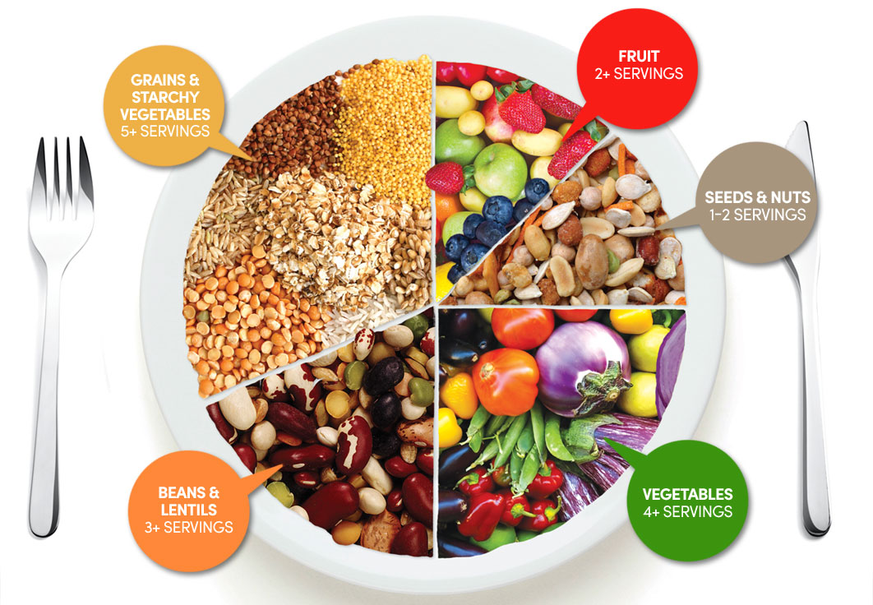

Slide 15
Whole food plant-based diet research
Dr. Dean Ornish
Reversing Alzheimer’s Study
The first randomized control trial looking to see if progression of early stage Alzheimer’s can be reversed by a comprehensive lifestyle medicine program – no drugs, devices or surgery
Eat well, Love more, Stress less, Move more
Whole foods, low fat and sugar, plant-based + moderate activity + stress management techniques including meditation + psychosocial support
Stay tuned…..

Slide 16
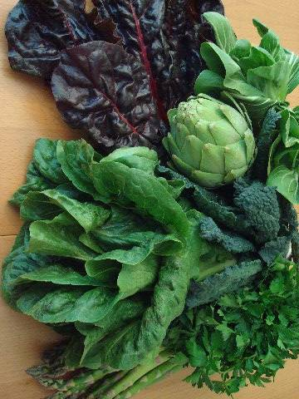

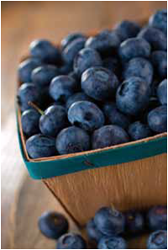
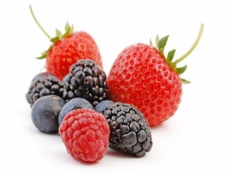
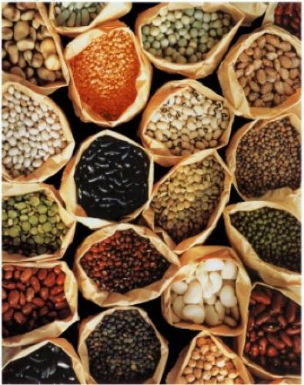
MIND Diet: Mediterranean- DASH Intervention for Neurogenerative Delay
2015 study found a lowered risk of Alzheimer’s disease:
53% in participants who strictly followed the diet
35% in those who followed it moderately well
Eat more often:
Eat less often:
MIND diet associated with reduced incidence of Alzheimer's disease
Morris, Martha Clare et al.
Alzheimer's & Dementia: The Journal of the Alzheimer's Association , Volume 11 , Issue 9 , 1007 - 1014
http://dx.doi.org/10.1016/j.jalz.2014.11.009

Slide 17
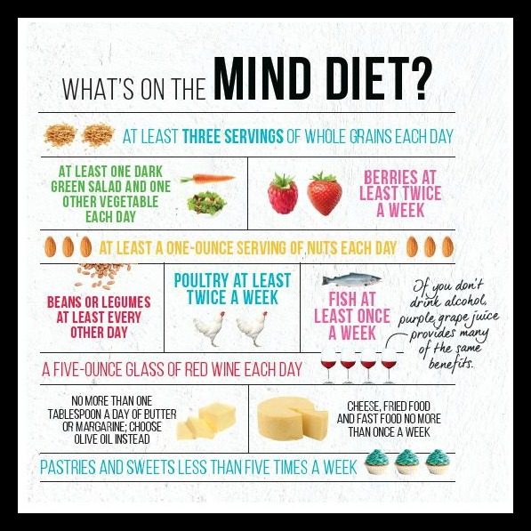

Slide 18
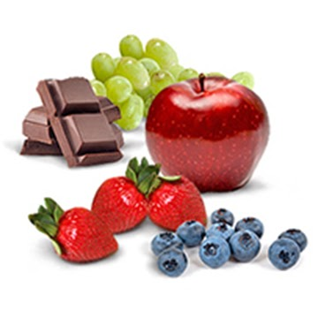
Specific foods that have been studied
Curcumin (compound of Turmeric)
  Antioxidant, anti-inflammatory, antibacterial
  Conflicting results
Flavonoids
  Antioxidants
  Anthocyanins in blueberries
  Cocoa
Caffeine
  May reverse cognitive impairment and lower brain Beta-Amyloid (in mice)
  Human studies conflicting

Slide 19
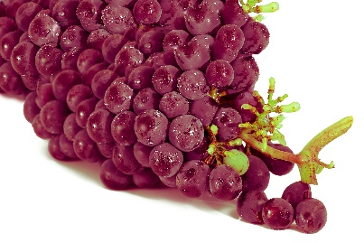
Specific foods….
Resveratrol
  Polyphenol in grapes and red wine
  Strong antioxidant and anti-inflammatory actions
Minerals
  Magnesium deficiency may increase oxidative stress and impairs memory
  Magnesium-rich foods: nuts, seeds, beans, whole grains, soy
Vitamin supplements
  Mixed results

Slide 20
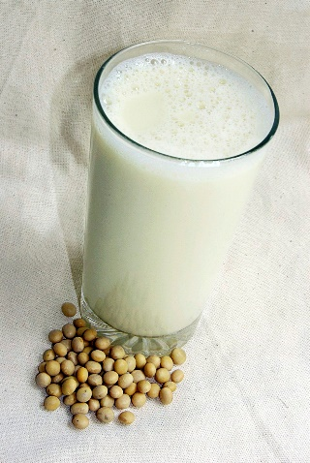
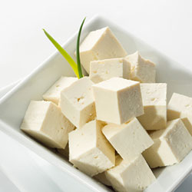
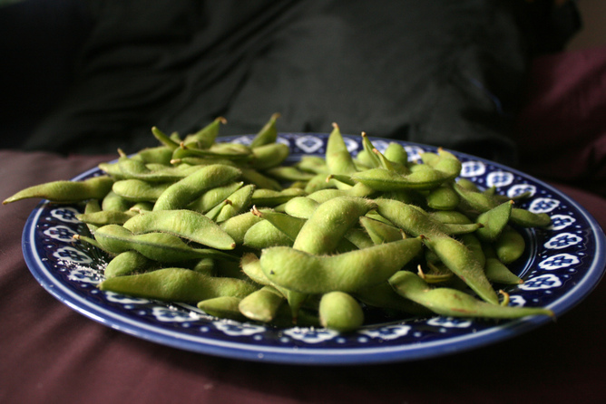
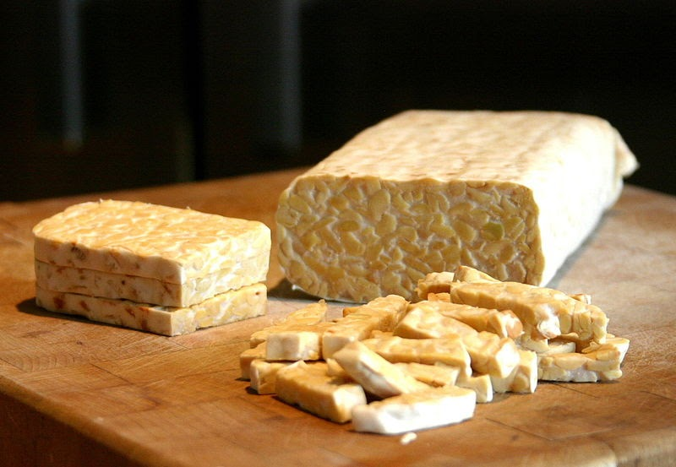
Specific foods….
Soy
  Previous studies have had conflicting results
  New 2020 study found soy isoflavones improve overall cognitive function and memory

Slide 21
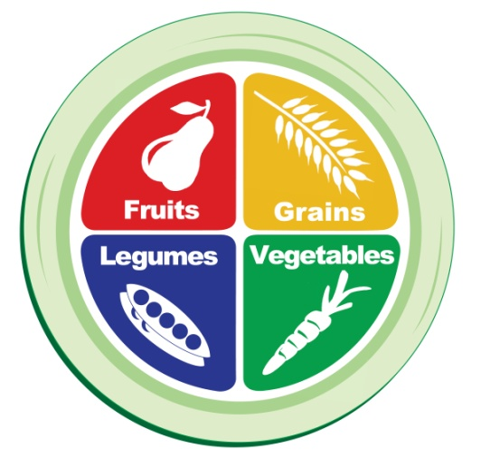
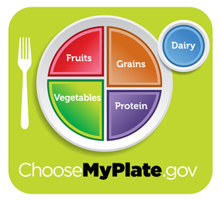
Vegetables
Eat more than 3-5 servings per day
1 serving =
  1 cup raw or ½ cup cooked vegetables
  2 cups leafy greens
Make it routine – every lunch and every dinner!
Notes:
Start the meal with veggies in a soup or salad
Benefits
High in fiber, low in calories, fat-free, packed with vitamins, minerals, antioxidants
Dark Green vegetables
Spinach; kale; Swiss chard; bok choy; collards, mustard, beet, turnip greens; and broccoli
Eat raw (salads) or cooked (sautéed or steamed)
Add to soups, salads, grain dishes

Slide 22


Fruit
Eat 2-4 servings per day
1 serving =
1 cup of fruit
1 medium sized fruit
Notes:
Choose a variety
Fresh or frozen is best
Limit juice to <1 cup/day
Limit dried fruit to ¼ cup/day
Benefits
High in fiber, low in calories, fat free, rich in vitamins, minerals, and antioxidants
Include more berries!
Buy fresh or frozen (no added sugar)
Great substitute for dessert!
Add to yogurt

Slide 23
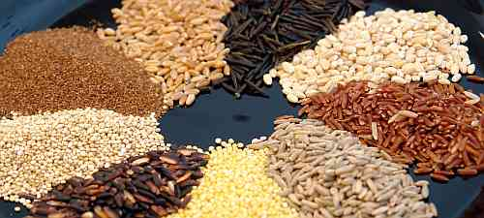
Whole Grains
Aim for 2-3 servings of whole grains/day
1 serving =
  1 slice of bread
  1 cup of ready-to-eat cereal
  ½ cup of cooked rice, cooked pasta, or cooked cereal
Intact grains preferred
Notes:
Choose whole grains
Barley, bulgur, farro, brown rice, wild rice, oatmeal, quinoa, whole wheat bread, whole grain cereals
Limit to one-quarter of the plate
Benefits:
Fiber rich - contributes to GI health, lower cholesterol levels, and healthy weight
Provides vitamins and minerals
Provides energy
Include beans and lentils
Add to soups, salads, and whole grain dishes
Combine whole intact grains with beans and veggies
Wild rice and edamame salad

Slide 24
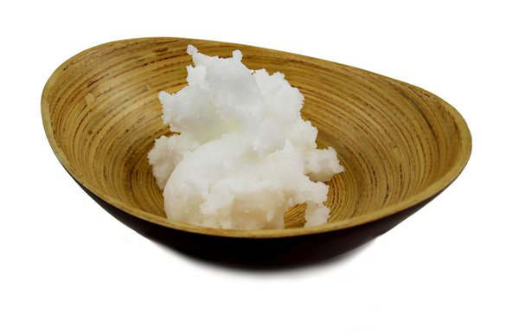


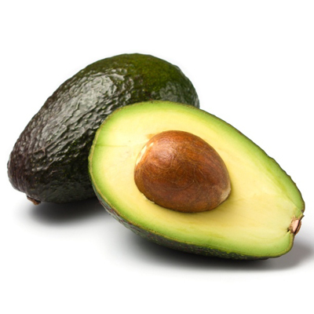
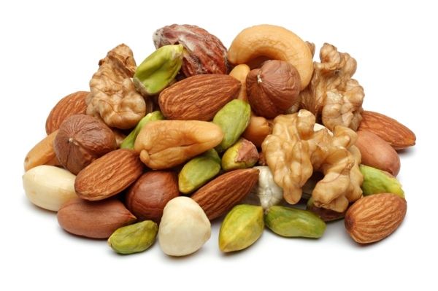

Choose fats wisely
Limit Saturated fats and avoid all Trans Fats
Replace with Monounsaturated and Polyunsaturated fats – and watch portions
Notes:
Trans fats:
Hydrogenated or partially hydrogenated oils
Stick (Hard) margarines
Shortenings
Baked products
Crackers, Cookies, Pastries, Doughnuts, Cupcakes, Etc.
Fried foods
French fries, Fried chicken, Etc.
Saturated fats:
Meat, cheese, cream, butter
Hydrogenated oils, processed foods
Coconut oil, palm oil, cocoa butter
Fish sources
Salmon
Mackerel
Albacore tuna
Sardines
Lake trout
Plant sources
Walnuts and other nuts/seeds
Canola oil
Ground Flaxseed
Flaxseed oil
Chia and Hemp seeds
Olive oil
Peanut oil

Slide 25








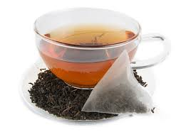

Stay Hydrated
Limit alcohol, high sugar, high salt, & caffeinated beverages
Replace with water, decaffeinated tea
Notes:
Trans fats:
Hydrogenated or partially hydrogenated oils
Stick (Hard) margarines
Shortenings
Baked products
Crackers, Cookies, Pastries, Doughnuts, Cupcakes, Etc.
Fried foods
French fries, Fried chicken, Etc.
Saturated fats:
Meat, cheese, cream, butter
Hydrogenated oils, processed foods
Coconut oil, palm oil, cocoa butter
Fish sources
Salmon
Mackerel
Albacore tuna
Sardines
Lake trout
Plant sources
Walnuts and other nuts/seeds
Canola oil
Ground Flaxseed
Flaxseed oil
Chia and Hemp seeds
Olive oil
Peanut oil

Slide 26
Meal Guidelines
Eat more often:
  Green leafy vegetables (other vegetables too)
  Berries (and other fruits)
  Nuts and seeds
  Whole grains
  Beans and lentils
  Use heart healthy fats in moderation: olive oil
  If you must: Fish & lean poultry (but plant foods preferred)
Eat less often:
  Red meats
  Butter and stick margarine
  Cheese
  Pastries and sweets
  Fried foods
  Alcohol

Slide 27

10 Ways to Love your Brain
(from alz.org)
1. Break a sweat
2. Hit the books
3. Butt out
4. Follow your heart (take care of your heart and your brain might follow)
5. Heads up (avoid head injury)
6. Fuel up right
7. Catch some zzz’s
8. Take care of your mental health
9. Buddy up
10. Stump yourself – challenge your mind

Slide 28


