Slide 1




Mastering Stress and Boosting Resiliency
Themis A. Yiaslas, PsyD
PreventionForward Clinic
Cardiac Rehabilitation Program

Slide 2
Welcome and Orientation
Welcome to the “Mastering Stress and Boosting Resiliency” series!
  Tuesdays, 5:00 - 6:00 pm, Zoom Meeting
  “Managing Stress” is part of reversing heart disease, hypertension, and diabetes
  Bolster one’s mental and physical resiliency to the coronavirus
Clinical Psychologist, Sacramento VA Medical Center
Director, Heart Disease Reversal Program (Sac VAMC)
Volunteer Assistant Clinical Professor, UC Davis Psychiatry
A Clinical Leader for Prevention Forward Program, UC Davis
Notes:
We aim to reverse cardiometabolic disease, which also happens to be the kind of disease that places one at higher risk for severe COVID-19 (never a better time to reverse disease!!!)

Slide 3
What is stress?

Slide 4
What is Stress?
Stress = “Condition or feeling experienced when a person perceives that demands exceed the personal and social resources the individual is able to mobilize” (Richard Lazarus)
Perceived Stress = Demands
Resources
Notes:
Either decrease the demands, or increase the coping resources

Slide 5
What does stress do to the mind and body?
High blood pressure
High blood sugar
Speeds up clogging of coronary arteries
Increases chance of heart attack
Depression
Anxiety
Poor sleep
Weight gain
Weakened immune system (get sick easier)
Digestive problems (e.g., ulcers, worsened IBS)
Headaches and worsened chronic pain
Memory and concentration and other cognitive impairment
Sexual problems (e.g., erectile dysfunction, low sex drive)
Social isolation and relationship problems
Unhealthy coping habits: alcohol, smoking, eating junk or comfort foods
Not taking care of your health: not taking medications as prescribed, missing doctors' appointments

Slide 6
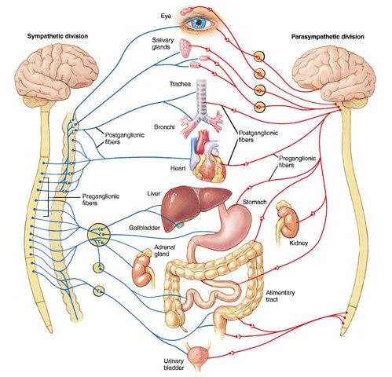
Autonomic Nervous System
“Fight or
Flight
Response”
“Relaxation
Response”

Slide 7
Acute Cardiovascular Risk Factors
Psychosocial:
  Stress
  Anger (going into a rage → doubles risk of a heart attack over the next 2 hours)
Standard:
  Exercise
  Cardiovascular Reactivity
Notes:
Triggers of an adverse cardiovascular event, like a heart attack, right now or in the very near future (acute)

Slide 8
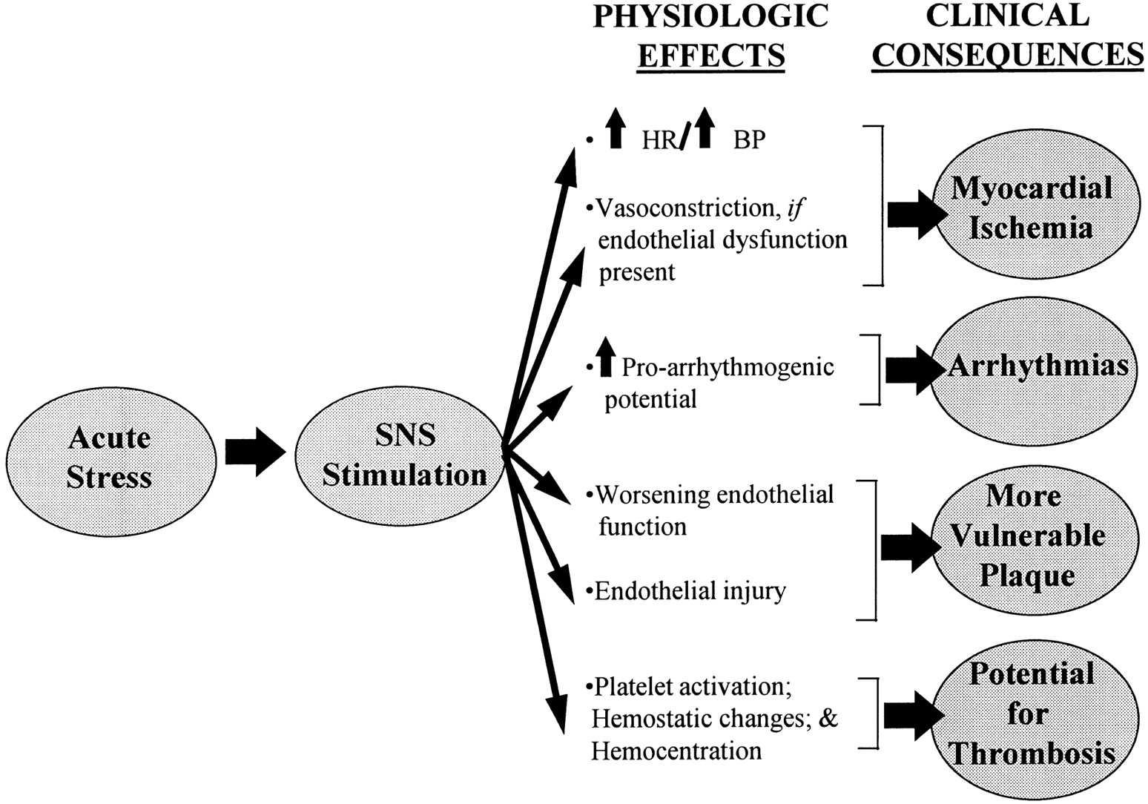
Acute Stress
Rozanski et al, Circulation 1999;99(16):2197–2217

Slide 9
Chronic Cardiovascular Risk Factors
Psychosocial
Standard
  Depression
  Stress
  Hostility/Anger
  Low Social Support, Loneliness
  Low socioeconomic status
  Age
  Sex
  Family History
  Smoking
  Overweight/Obesity
  Cholesterol
  Hypertension
  Diabetes
  Sedentary/Inactive
  Poor Diet

Slide 10
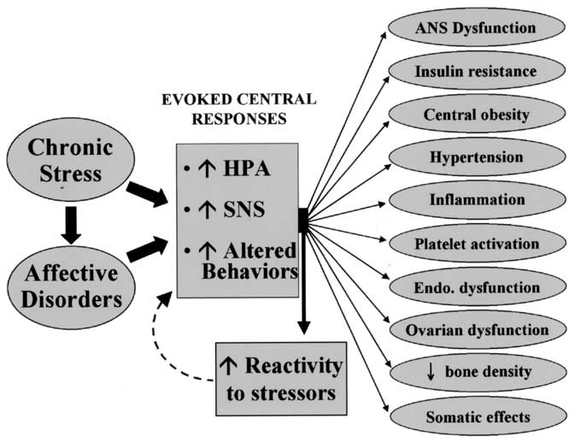
Rozanski et al, J Am Coll Cardiol 2005;45:637–51

Slide 11
Risk for Adverse Cardiac Events
Adverse
Cardiac
Event
Threshold for Adverse Cardiac Events
Time (days)
Acute Risk Factors
Chronic Risk Factors

Slide 12
Stress Affects Diabetes
Directly
  Increases blood glucose
  Changes effectiveness of medication/ insulin
Indirectly
  Disrupts routine
  Might change
    Diet
    Exercise
    How/when you take meds
Notes:
Human body stores up energy in the blood to prepare to fight or run
Changes that happen in body very important for survival
In a real life-or-death situation, it is vital that when faced with some danger, an automatic response takes over causing us to take immediate action (attack or run)
Our bodies react the same way to an approaching speeding car and to anxiety caused by a deadline

Slide 13
Life As We Knew It Has Changed
Pandemic: worldwide spread of coronavirus threatens our health, especially older adults and those with chronic conditions (heart disease, diabetes, hypertension, COPD, weakened immune system), possible quarantine, 24/7 cataclysmic news
  Threat to self
  Threat to loved ones
Work: Unexpectedly unemployed, furloughed, or working from home, essential workers scared of possible exposure, inability to provide for basic needs, government help is still pending
Parenting: school/daycare closed, kids at home, lack of childcare, grandparents may not be able to help
Home: trying to all be home at the same time
Relationships: disconnected physically from others
Shut Downs: Restaurants, bars, and other public venues and events closed
Routines disrupted
Grief: life as we knew it has changed, with many losses

Slide 14
For people who have been released from quarantine
Being separated from others if a healthcare provider thinks you may have been exposed to COVID-19 can be stressful, even if you do not get sick. Everyone feels differently after coming out of quarantine. Some feelings include :
Mixed emotions, including relief after quarantine
Fear and worry about your own health and the health of your loved ones
Stress from the experience of monitoring yourself or being monitored by others for signs and symptoms of COVID-19
Sadness, anger, or frustration because friends or loved ones have unfounded fears of contracting the disease from contact with you, even though you have been determined not to be contagious
Guilt about not being able to perform normal work or parenting duties during quarantine
*Altruism of self-isolation (love thy neighbor)*

Slide 15
Crisis
“No map in an unknown territory”
Ambiguity; Uncertainty; Destabilization
1st Step: identify specific problems that we need to solve, get help/resources
2nd Step: make concrete plans of action for each problem
3rd Step: Establish, through trial and error, a new way of life in the unknown territory we now inhabit, managing our emotions and stress

Slide 16
The Basics
List adapted from Regina Koepp, PsyD, ABPP, www.drreginakoepp.com
Acknowledge how you feel, and validate your emotions (anxiety is normal when threatened)
Address basic needs: concrete plans for employment, finances, housing, childcare, health care
Reach out to and stay connected with friends and family (routinely!)
Keep a daily routine (wake time, 3 meals/day, sunlight exposure, social connection, exercise/walks; new household routines/boundaries for use of space and time)
Maintain a healthy diet: Debbie Lucus’ info, increase whole, unprocessed, plant-based foods
Stay physically fit: daily walks, Linda Paumer’s classes, Dave’s Tai Chi
Get fresh air, be in nature (walk/read outside, drink tea outside, gardening)
Spend time on a hobby, new or old
Complete projects around your home (including organize and declutter your home, for ideas watch “Tidying Up with Marie Kondo,” free on Netflix Streaming, Spring Cleaning)
Instead of TV, try listening to a podcast (e.g., On Being, TED Talks, This American Life)
  Virtual tour of a museum: https://www.pbs.org/newshour/arts/19-immersive-museum-exhibits-you-can-visit-from-your-couch
Stimulate your mind (e.g., PUZZLES, Book Club and discuss over video conferencing, practice or learn a new language)
Notes:
One list summary of strategies for promoting well-being during COVID-19 situation

Slide 17
Too Much COVID-19 Media Exposure
Recent study reported that exposure to 24/7 COVID-19 media coverage leads to:
  Increased perception of threat
  Activated “fight or flight response”
  Increased physical and mental health symptoms
Recommendations
  Choose 1 or 2 trusted sources of information (e.g., CDC, WHO, local authorities), check 1-2 times per day, 15 minutes per day, to stay informed
  Limit repetitive exposure to media stories
  Beware of reports on social media whose authenticity/accuracy cannot be ensured
Garfin, Silver, & Holman, 2020, Health Psychology

Slide 18
Managing Uncertainty and Worry
Schedule “Worry Time”
  Block time every day to engage with your worries (e.g., COVID-19)
  Write them down
  At the same time and in the same “non-fun” place
  If you find yourself worrying at other times:
    Remind yourself of your scheduled worry time
    Acknowledge the issue
    Redirect your attention to whatever you were doing before worry interrupted you (focusing on the present moment)
Signs of Unproductive Worry
  Worry about unanswerable questions (“spinning your wheels”)
  Worry about a chain reaction of events (e.g., “what if this, then what if that?!?”)
  You think you should worry until you feel less anxious
  You think you should worry until you control everything
Signs of Productive Worry
  You recognize what you can control and what you cannot
  Specific problems, brainstorming solutions, concrete plan of action
  You are willing to accept imperfect solutions
  There is a question that has an answer
Notes:
Importance of dealing with a problem directly and productively. Also critical to express your genuine emotions about a problem, too

Slide 19
Positive Measures
Gratitude Journal: identify 3 things every day that you are grateful for, then write them down, close your eyes and imagine them at the end of the day (“hunt for the good”)
Gratitude Letter: Write a letter to someone in your life that you are grateful for, telling them why. Then, read them the letter by telephone or video chat
Acts of Kindness: find one thing you can do every day to help or express kindness to another person, animal, plant, tree (i.e., any living thing)
Support Healthcare Professionals: volunteer to help make face shields (an important type of personal protective equipment or PPE) for local hospitals that have shortages (https://teamshieldnorcal.squarespace.com/)
Notes:
Strategies that reduce negative emotions are not always the same as those that increase positive emotions

Slide 20
What is Stress Management?
Stress Management Training = Enhancing skills to withstand adverse situations by directly addressing problems, improving emotional flexibility, increasing the sense of control, cultivating optimism, and possibly finding greater meaning in life
Stress management training is NOT:
  Just for “mentally weak people”
  Helpful only if you are overwhelmed

Slide 21
Stress Management Training
1. Build stress awareness
2. Identify and change unhelpful thinking
3. Use coping strategies tailored to the problem causing stress
4. Learn to relax on demand
5. Boost positive support, decrease negative support
6. Nurture healthy sleep
7. Seek help when needed
Notes:
We will turn to all of these in this class series

Slide 22
1. Awareness
Identify your Triggers/Stressors
Identify Your Specific Symptoms of Stress
  Physical: tension, fatigue, teeth grinding, stomachache, sweating, awareness of heart beating or palpitations
  Emotional: anxiety, irritability, depressed, sad, grief/loss
  Cognitive: worry, fearful predictions, poor concentration
  Social: avoiding others, isolating, venting, snapping at others
  Behavioral: alcohol, drugs, junk food, sleep disruption, crying, smoking
Identify Your Unhelpful Coping Strategies
  Drinking alcohol, smoking, drug use, too much coffee
  Emotional/binge eating
  Distraction/procrastination/avoidance
  Neglecting your needs, not managing chronic conditions, avoiding doctor appointments (phone/video!), not taking your medications properly

Slide 23
2. Dealing with Unhelpful Thinking
“People are disturbed not be a thing, but by their perception of a thing.” Epictetus
Sometimes our thinking about a problem is making that problem worse – so checking our thoughts and automatic assumptions can help
“The 3 C’s”
  Catch It: identify automatic thoughts when they occur
  Check It: Ask yourself, “Is this thought helpful or harmful?”
  Change It: find a more helpful, adaptive, positive way to think about your problem (e.g., reframe the issue)

Slide 24
Notice Your Thoughts
Are you overestimating the likelihood of something bad happening?
Are you catastrophizing?
Are you thinking in “all or nothing” terms?
Are you thinking in a way that is making a bad situation worse?
Is there another way to think of this?
What would I tell a friend who had this thought?

Slide 25
3. Coping
Problem-Focused Coping: strategies that try to fix or resolve the problem that triggered the stress
Emotion-Focused Coping: strategies that help one manage the emotions that are triggered by the problem, rather than trying to fix the problem
Meaning-Focused Coping: trying to understand why a problem/stressor happened, the impact it has on oneself, and finding meaning and importance in one’s life

Slide 26
Problem-Focused Coping
Define the problem (e.g., unemployed/loss of income)
Break the problem into smaller parts, if possible
Clarify which parts of the problem are controllable by you, and those that are not
Get high quality information (from trusted experts, high-quality website)
Brainstorm ways to solve the problem
Identify resources that can help you (friends, family, professionals, local/national organizations, church, veterans organization)
  Employment Development Department (EDD) COVID-19: https://www.edd.ca.gov/about_edd/coronavirus-2019.htm
Make a specific plan
Afterward, evaluate how well your plan worked, and next steps
Notes:
Many have already been making plans for dealing with shelter in place, school closures, e.g., trying to work from home, alternate childcare,

Slide 27
Emotion-Focused Coping
Identify your emotions
  What am I feeling?
  Is it familiar? How intense is that feeling (0-10 scale)?
  Is this feeling covering another feeling?
  Do I need to do anything about the feeling or can I just "be" with/tolerate/accept it?
Share/express your emotions with someone you trust
Self-talk (statements that help you cope)
Do a relaxation exercise
Pray or meditate: connect to your spiritual/religious practices/traditions/community
Engage in pleasant activities and hobbies (the things that bring us reward, pleasure, joy, positive distractions): “The behavioral antidepressant”
Engage the senses
Change the setting
Keep your sense of humor

Slide 28
Keys to Successful Coping
Active (rather than passive) coping
Clarify Controllable vs. Uncontrollable stressors
The key is the goodness-of-fit between the problem/stressor and the coping strategy
  Confront and fix the problems you can control
  Accept the problems/people/situations you cannot control
  Serenity Prayer

Slide 29
4. Relaxation
Learn to relax on demand
Wide range of relaxation exercises exist, try a variety and use whatever works best for you:
  Breathing Exercises (diaphragmatic, deep)
  Guided Imagery (Visualization)
  Progressive Muscle Relaxation
  Autogenic Relaxation
Numerous resources available for free online (e.g., guided recordings on YouTube)
Mobile phone applications
  Breathe2Relax
  Mindfulness Coach
  Virtual Hope Box

Slide 30

Mindfulness
Mindfulness defined: “paying attention, on purpose, to the present moment without judgment” –Jon Kabat-Zinn, PhD
Mindfulness Based Stress Reduction (MBSR): 8-session program incorporating sitting meditation, mindful movement like yoga, body scan meditation, research supporting its use for many health conditions
Mindfulness Coach Mobile Phone App (by Dept. Veterans Affairs)
Mindfulness Training benefits:
  Reduce stress, irritability/anger, and worry
  Improve sleep and blood pressure
  Less reactive and more flexible
  Decrease anxiety and depression
  Improve ability to cope with chronic pain and other chronic health problems
  Improve cognitive function (concentration, memory)
Notes:
Being ok with the present, what we are feeling, what we are experiencing. Start with the assumption that “human suffering is normal”

Slide 31
5. Boost Positive Social Support, Decrease the Negative
Connect to family and friends – every day
  Telephone calls and text messaging
  Video Calls: Zoom, Skype, FaceTime, WhatsApp, and others
Need Ideas? Be Creative!
  Virtual “shared” meal (cook together or separately, then place your device on the table and “eat together”)
  Virtual dance party
  Watch a television series together, and discuss
  Virtual book club
  Invite family/friends to read an entire book aloud, together
  Host a series of evening virtual gatherings called “Seven Songs” – each guest has one evening to share and play the 7 songs that have most shaped them in their life
  Older generation shares their life stories, lessons learned
Notes:
Be bold, experiment, and anticipate it will feel weird – through repetition and familiarity, social connectedness can be significant despite being apart

Slide 32
6. Nurture Healthy Sleep
Healthy Sleep Habits
  Wake up around the same time every day
  Get out of bed and get light exposure in the morning
  Avoid or limit daytime naps
  Don’t spend long periods of time in bed awake
  Avoid caffeine, especially past 12 noon
  Avoid alcohol within at least 3 hours of bedtime
  No screen time in bed/bedroom! No news before bed!
If you have sleep apnea, treat it
  STOP-BANG Screening: Snoring (loudly), Tired/fatigued, Observed you stop breathing, treated for high blood Pressure, BMI > 35, Age > 50, Neck Circumference > 16 inches, male Gender
  PAP is treatment of choice (CPAP or BiPAP)
  If you have a claustrophobic reaction to the mask, ask for help
Clinical Insomnia: best treatment is Cognitive Behavioral Therapy for Insomnia (CBT-i)

Slide 33
7. Seek Help When Needed
Significant depression, anxiety, anger, and significant relationship problems can be difficult to deal with on your own
Seeking treatment from a professional can help:
  Counseling (marital)
  Psychotherapy
  Psychiatric medication
UC Davis Behavioral Health Center (Adult/EDAPT Clinic): (916)734-3574
UC Davis Children’s Behavioral Health Center: (916)734-3574
Psychology Today Find a Therapist: https://www.psychologytoday.com/us/therapists
Association for Behavioral and Cognitive Therapies, Find a Therapist: http://www.findcbt.org/FAT/
Therapy Apps: Talkspace, BetterHelp, Regain – Couples Therapy

Slide 34
Hotlines
Friendship Line (Institute on Aging)
  Toll Free 800-971-0016
  Friendship and support for older adults who may be lonely, isolated, grieving, depressed, or anxious
Services & Advocacy for LGBT Elders (SAGE) Hotline
  Toll Free 877-360-5428
  Offer support without judgment, answer questions factually and confidentially
  Provide info about community resources such as healthcare, transportation, counseling, legal services, and emotional support programs
  Available in English and Spanish, in 180 languages
  sageusa.org
National Suicide Prevention Lifeline
  800-273-8255, or online chat
Veterans Crisis Line (confidential, 24/7)
  www.veteranscrisisline.net
  800-273-8255 (Press 1 at the prompt if you are a veteran)
  Text 838255
  Chat (connect online)
  Support for deaf and hard of hearing: 800-799-4889

Slide 35
Other Resources
For Caregivers
  CaregiverAction.org, free hotline 855-227-3640. Lots of resources related to caregiving during COVID-19
  The Family Caregiver Alliance: 800-445-8106
  Alzheimer’s Association: if you are caring for someone with Alzheimer’s or any type of dementia, they can help (24/7 Helpline: 800-272-3900)

Slide 36
My challenge to you:
What are at least 1-2 things you can do (from today’s presentation, or your own ideas) to help you better manage stress, and/or help you be resilient moving forward?
How can you use this time to make your life better, in some way?

Slide 37
Your Stress Management Plan
What are my most common sources of stress (triggers)?
What are the signs and symptoms I get when stressed?
What are my helpful ways of coping?
What are my unhelpful ways of coping?
What problem or source of stress have I been avoiding dealing with? Is it time to deal with it more actively?
What resource(s) could I turn to for help with this problem?
What are 1-2 practices I could start doing, to help me cope better with stress?

Slide 38
Questions and Comments?

