Slide 1
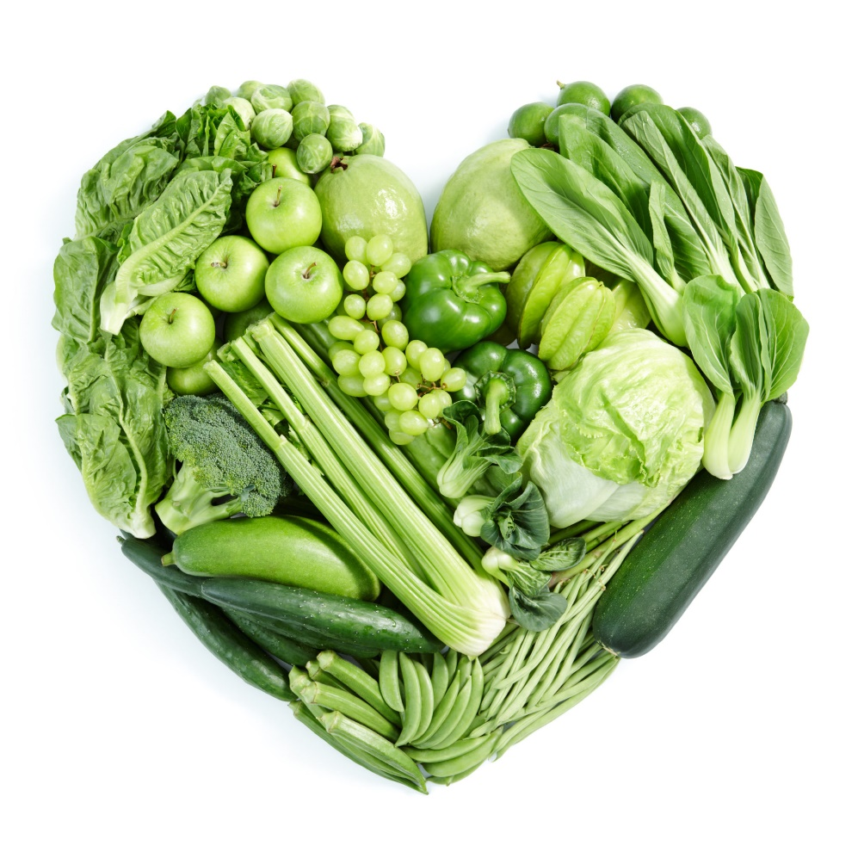
Go green!
Debbie Lucus, MS, RD, CDCES
03.02.21
dlucusrd@gmail.com
Notes:
On the next few slides we’ll look at a few common varieties of beans and discuss their shape, size, and flavor.

Slide 2
Happy National Nutrition Month!

Slide 5
My Winter Garden

Slide 6
How many shades of green are there?
Numerous leafy greens
Green foods
Saving ‘green’ $$$
Going green for the environment
Being green – new, inexperienced

Slide 8
Name that Green
Kohlrabi
Bok choy
Spinach
Broccoli Raab
Chard
Collards
Mustard greens
Beet greens
Kale (curly & Tuscan)
Sorrel

Slide 9
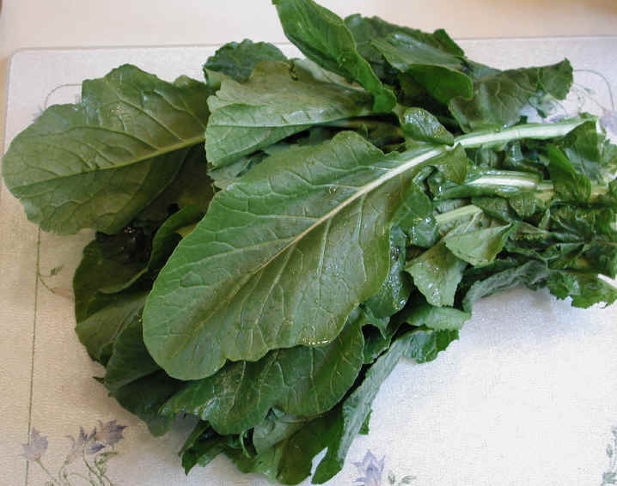
Go with Greens
Rich in antioxidants – beta carotene, lutein, anthocyanins
Excellent source of folate, iron, Vitamins A & C, Vitamin K
Associated with strongest protection against chronic diseases
20% reduction for heart attacks and strokes for every add’l serving/day
Reduced risk of cancer

Slide 10
More reasons to go green….
May help with weight loss by increasing feeling of fullness and curbing desire for junk foods
Reduce risk of macular degeneration & glaucoma
Good source of nitrates – turn to nitric oxide which is associated with lower CVD risk and lower BP
Low in calorie density, high in nutrient density
Mix with healthy fat to increase nutrient absorptions
Nuts & seeds, avocado, olives

Slide 11
And if that wasn’t enough…Calcium!
Dark greens are excellent source of calcium
High oxalates – which may block the absorption of calcium and increase risk of kidney stones
Beet greens
Chard
Spinach
Rhubarb (but John has taught me these are toxic!)
Choose variety of greens

Slide 12
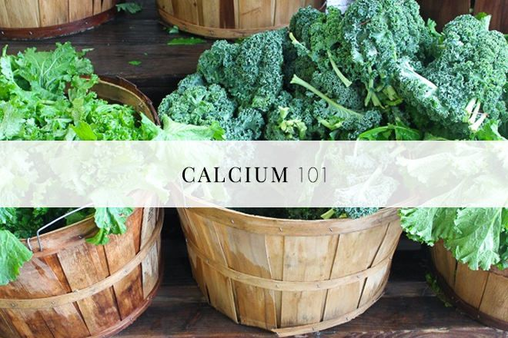
Other plant-based calcium foods
Broccoli
Tofu – if set with calcium
Tempeh
Tahini
Almonds
Black beans
Oranges
Seeds
Blackstrap molasses

Slide 13
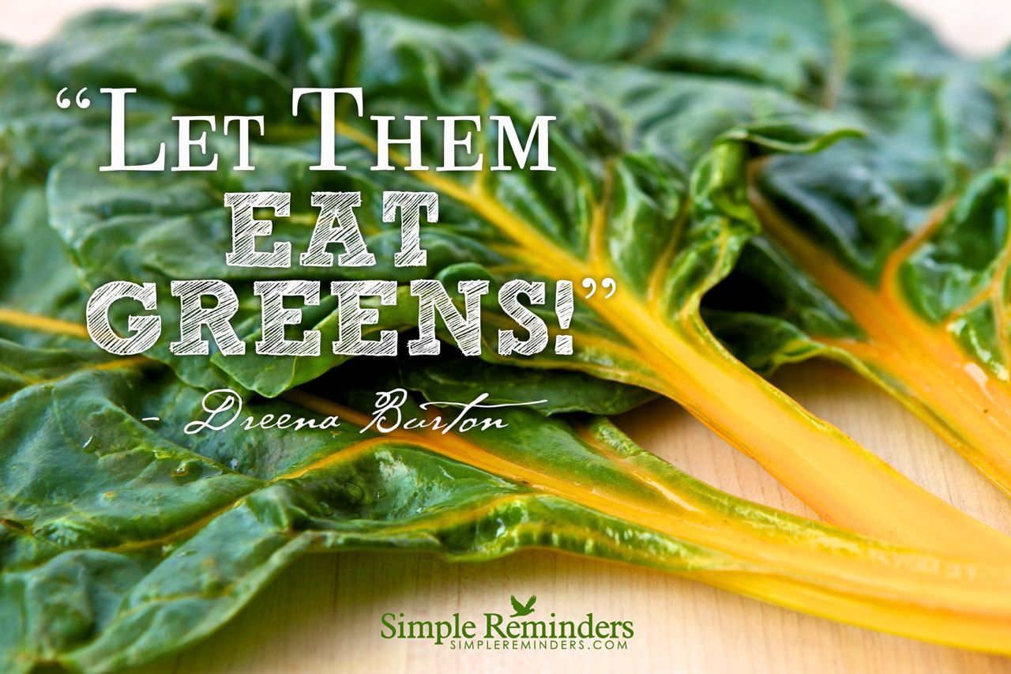
How many?
2-5+ servings daily
This is in addition to your cruciferous veggies and other veggies
Serving size:
1 cup raw
½ cup cooked

Slide 14
Caution with Coumadin
Greens are source of Vitamin K – helps with clotting
If on Coumadin, trying to avoid clots
Doesn’t mean you can’t eat greens – just need to be consistent with them
Protimes will indicate how to adjust Coumadin level
Don’t use it as an excuse not to eat greens

Slide 15
10 ways to eat more greens
Make savory oats. Cook oats with savory ingredients: mushrooms, garlic, onion, turmeric. Stir in greens at the end of cooking time.
Saute: In a hot pan, add several handfuls of greens. Leave it be until the greens wilt. With a pair of tongs, turn over. Stir in some minced fresh garlic. Sprinkle with fresh lemon juice or a bit of vinegar. Season with salt and pepper.
3. Add it to Quesadillas: Finely chop greens. Add half a cup to white bean spread and put on each quesadilla before cooking.

Slide 16
More greens….
4. Add it to Soup or chili: Greens are a great way to up the nutritional value of canned soup. Just put a couple of handfuls in the bowl or pan before adding soup and heating on stovetop or in microwave.
5. Hide it in Spaghetti sauce: roughly chop and stir into warmed sauce.
6. Kale chips. Mix with a little seasoned hummus and lay out on cookie sheet. Bake at 250 for about 1 ½ to 2 hours.
7. Make Pesto: With ﬁve minutes and a food processor, you can whip up a quick fresh, green pesto (nutritional yeast instead of cheese, tofu instead of oil)

Slide 17
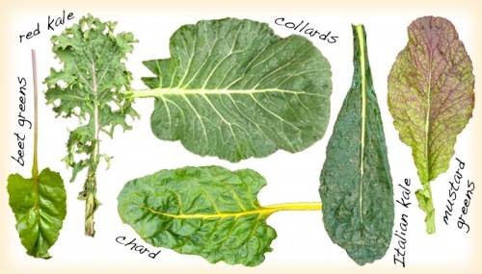
And more…
8. Use collard green as wrap
9. Scramble it in tofu.
10. Use it as your salad base: Top with mandarin oranges, red onions, toasted pecans and a balsamic vinaigrette.

Slide 18
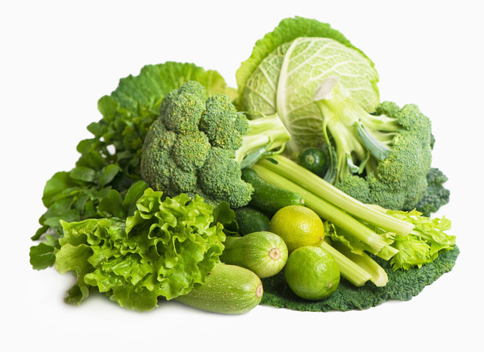
Other green foods…..
Eat your colors
The more color, the more antioxidants & nutrients
Broccoli, cabbage, Brussels
Cruciferous veggies
Help reduce risk of cancer
Split peas, peas, soy beans
High in fiber
Green peppers, hot peppers, chilies
Great source of Vitamin C
Asparagus, celery, green beans, zucchini
Herbs: parsley, basil, oregano, etc.
Avocado
M&Ms ☺

Slide 19
Saving ‘Green’
Eating plant-based can help your budget
Buy in bulk
Big box stores often have best deals
Planned-overs
Cook extra and freeze or re-purpose
Cook more from scratch
Farmers’ Markets and CSAs
Limit convenience foods (you do the cooking instead)
Eat at home more
Start a garden
Try www.plantbasedonabudget.com

Slide 20
Go green for the planet

Slide 23
Meatless Monday

Slide 24
What if you are ‘green’?
Purchase the basics – grains, beans, produce
Look up recipes:
ForksoverKnives.com
Cardiac Wellness Program
PCRM.org
UCDIntegrativeMedicine.com
Try a 21 day Kickstart
Hang out with Cardiac Wellness Program a lot!!

Slide 25
My Recipes today
Kale Salad
▪ 6 cups kale, de-stemmed and thinly sliced
▪ 1 cup thinly-sliced red cabbage
▪ 1 carrot, grated or julienned
▪ 1⁄2 red pepper, thinly sliced
▪ 2 Tablespoons chopped cilantro or parsley
▪ 2 Tablespoons mint, chopped (optional)
▪ 1⁄4 cup raw sunflower, sesame or chia seeds (optional)

Slide 26
Citrus Dressing
Orange Ginger Dressing
▪ 1 orange, peeled and seeded
▪ 1 1⁄2 Tablespoons tahini
▪ 2 pitted soft dates
▪ 1 tablespoon minced, fresh ginger
▪ 1 1⁄2 teaspoons light miso
▪ 1 tablespoon apple cider vinegar
▪ 1 1⁄2 teaspoons tamari (or light soy sauce)
▪ Pinch Cayenne or black pepper, to taste

Slide 27
Curry in a Hurry
Ingredients:
4 cups water or vegetable broth
1 onion, diced
1 cup dried red lentils
2 cups stemmed and chopped kale or spinach, packed
14 ounces canned stewed or crushed tomatoes
1 1⁄2 Tablespoons mild Indian curry paste (more as needed)
1⁄2 tsp salt (optional)
Freshly ground black pepper

Slide 28
Go Green!!
Whether you are trying to:
Get healthy
Stay healthy
Feel better
Look better
Save the planet
Save money
Plant-based eating can help you achieve your goals!

