Slide 1
What do the studies say about diet?
Debbie Lucus, MS, RD, CDCES
03.16.21
dlucusrd@gmail.com
Notes:
On the next few slides we’ll look at a few common varieties of beans and discuss their shape, size, and flavor.

Slide 2
Continuing with our ‘green’ theme:

Slide 3
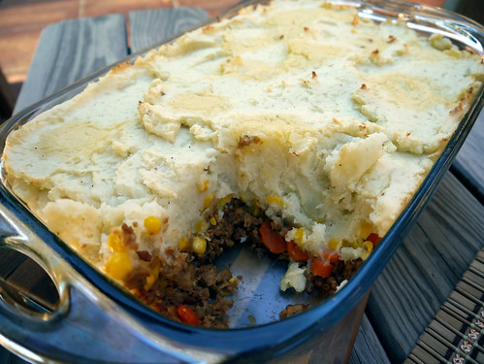
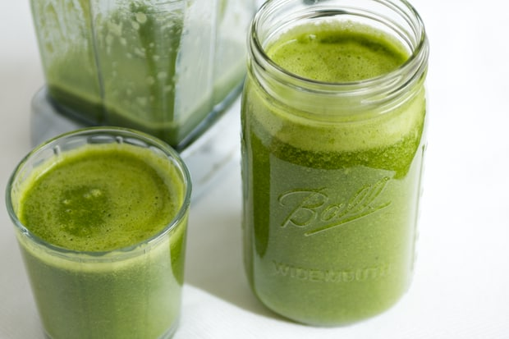
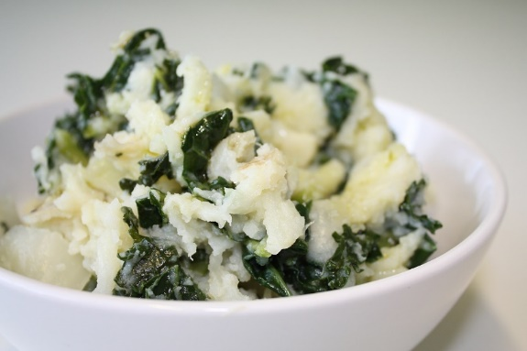
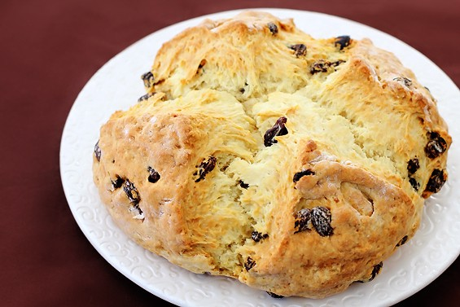
Plant-based St. Patrick’s day foods
Green smoothie
Irish soda bread
Irish stew
Shepherd’s pie
Colcannon
Corned Jackfruit & cabbage

Slide 4
March is Colon Cancer Awareness Month
50,000 people will die this year from colon cancer (2nd most deadly cancer)
Other countries don’t have as much colon cancer – Western Diet contributing?
Dr. Will Bulsiewicz:
1. Get colonoscopy – every 10 years starting at 45 yo, unless first degree relative history
2. Eliminate red meat and processed meat
WHO states processed meat is carcinogenic and red meat probably is
3. Choose plant-based diet
AHS-2 found diet reduced risk of colon cancer
Vitamins, minerals, fiber, phytochemicals, antioxidants – all cancer protective
4. Crank up the fiber
Every 8 grams of fiber reduces risk 8%
Fiber is preferred fuel of the gut microbiome
95% of Americans don’t meet fiber recommendations

Slide 5
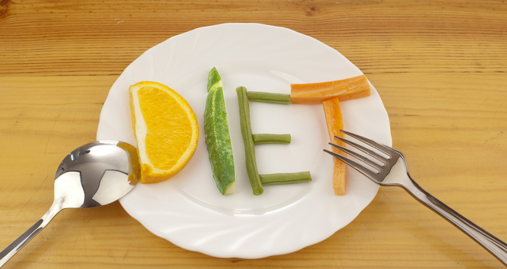
What is the best diet for health?
Mediterranean?
DASH?
MIND?
Paleo?
Keto?
Vegetarian?
Time-restricted eating?
Only a whole food plant-based diet has been shown to reverse disease
Are you willing to make some adjustments?

Slide 6
What do the studies say?
Mediterranean vs Low fat vegan
MIND vs Mediterranean vs DASH
Plant based protein + post-menopausal women + CVD
Meat consumption and common diseases
Healthy plant-based diet and CVD

Slide 7
Tips to evaluate a nutrition study
Who funded the study?
Potential bias?
Published in peer-reviewed journal?
Subjects
Human? Animal? Cells?
Number of subjects
Are the subjects like you?
Type of study:
Randomized control trial, Double blind = Gold standard
Observational
Cross-over, case control, intervention
Statistical significance

Slide 8
Mediterranean vs Low-fat Vegan
A Mediterranean Diet and Low-Fat Vegan Diet to Improve Body Weight and Cardiometabolic Risk Factors: A Randomized, Cross-over Trial
n=62
16 weeks on each diet with 4 week ‘wash out’
Vegan diet lost ~13# vs no significant change on Medi
7.5 more pounds fat mass loss with the vegan diet
Vegan diet lowered Total and LDL cholesterol by 18.7 mg/dl and 15.3 mg/dl vs no significant change on Medi
Blood pressure decreased on both diets, but more on the Mediterranean diet (6.0 mm Hg, compared to 3.2 mmHg on the vegan diet).

Slide 9
Protein Source
Association of Major Dietary Protein Sources With All‐Cause and Cause‐Specific Mortality: Prospective Cohort Study – JAHA, 2/24/21
102,000+ postmenopausal women
Women’s Health Initiative
Those eating the most plant protein had the least death from any cause, or from CVD or from dementia
The most red meat (processed and unprocessed), eggs, and/or dairy products were more likely to die of cardiovascular disease
Processed meat was linked to a 20 percent higher risk of dying from dementia.
These associations were found after adjusting for age, ethnicity, and lifestyle factors (including other dietary factors).

Slide 10
Review of 56 studies
Mediterranean, Dietary Approaches to Stop Hypertension (DASH), and Mediterranean-DASH Intervention for Neurodegenerative Delay (MIND) Diets Are Associated With Less Cognitive Decline and a Lower Risk of Alzheimer's Disease-A Review. Advances in Nutrition, 2019.
Mediterranean-DASH Intervention for Neurogenerative Delay (MIND) = Hybrid of DASH and Mediterranean
Dietary Approach to Stop Hypertension (DASH)= Huge study encouraging fruits and veggies, low fat dairy, nuts and seeds
Mediterranean = Mostly plant-based with wine and olive oil
All 3 rich in plant foods, healthy fats and little processed foods

Slide 11
 | Mediterranean Diet | DASH Diet | MIND Diet
High Amounts | Olive oil | − | Olive oil
 | Fish | − | Fish
 | Breads and other forms of cereals | Grains | Whole grains
 | Fruits | Fruits | Berries
 | Vegetables | Vegetables | Green leafy vegetables
 | − | − | Other vegetables
 | Legumes | Legumes | −
 | Nuts | Nuts | Nuts
 | Beans | − | Beans
 | Seeds | Seeds | −
 | − | Low-fat dairy | −
 |  |  | Poultry
Moderate Amounts | Dairy products | − | −
 | Poultry | Poultry | −
 | Alcohol | − | Alcohol/wine
 | − | Fish | −
Restricted Amounts | Red meat | Red meat | Red meat and products
 | Processed meat | − | −
 | Sweets | Sweets | Pastries and sweets
 | − | Saturated fat | −
 | − | Total fat | −
 | − | Cholesterol | −
 | − | Sodium | −
 | − | − | Cheese
 | − | − | Butter/margarine
 | − | − | Fast fried foods

Slide 12
Meat consumption and disease
Meat consumption and risk of 25 common conditions: outcome-wide analyses in 475,000 men and women in the UK Biobank study. BMC. 3/2/21
Followed for 8 years
Used online questionnaire
Eating meat 3 or more times/week had more health problems than <3x/week
Every 70 grams/d unprocessed red and processed meat increased risk of Ischemic heart disease (15%), pneumonia, diabetes (30%), colon polyps, diverticular disease
Every 30 grams/d poultry increased risk of GERD (17%), diabetes (14%), diverticular disease, gall bladder disease, but less iron deficiency anemia
Higher BMI contributed to disease states so was accounted for

Slide 13
Healthy plant-based diet lowers risk for CVD mortality, morbidity Kim H, et al. J Am Heart Assoc. 2019;doi:10.1161/JAHA.119.012865. August 7, 2019
Healthy plant-based diet →19% lower risk for CVD and an 11% lower risk for all-cause mortality
Highest overall plant-based diet or pro-vegetarian:
a 16% lower risk for CVD;
a 31% to 32% lower risk for CVD mortality; and
an 18% to 25% lower risk for all-cause mortality (P < .05 for trend for all).

Slide 14
So what diet is best?
Overall:
No processed foods
Limit or eliminate meat
With the right diet style (using whole real food, plant-based) you can reverse/improve/lower risk of:
High blood pressure
Heart disease
Diabetes
Obesity
Dementia!

Slide 15
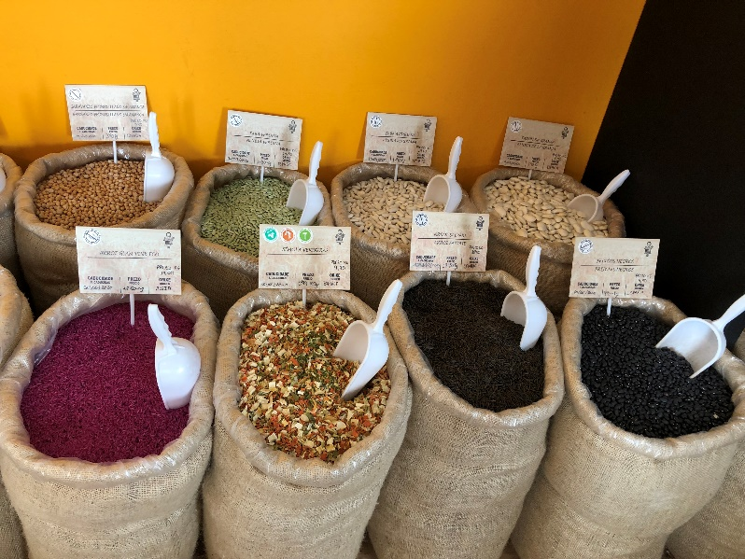
Beans
Reduce risk of heart disease
People who eat beans four or more times per week have a 22% lower risk of coronary heart disease.
High soluble fiber
Lower LDL, triglycerides
Associated with lower blood pressure
Improves blood sugar control
Low glycemic index

Slide 16
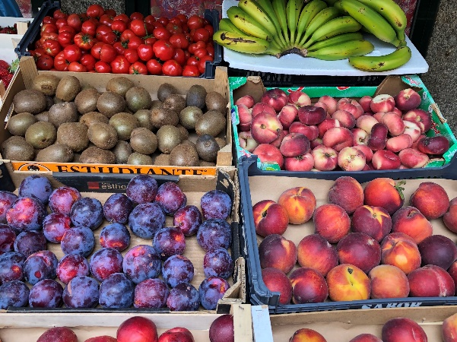
Berries
Reduce heart disease risk: study of 100,000 found that those who ate the most berries were less likely to die from CVD
Prevent cancer: inhibit cancer cell growth
Shown to cause polyps progression in colon and reverse esophageal cancer (strawberries)
Improve memory
Slow brain decline (anti-aging)
Help with sleep – melatonin in cherries and goji berries
Treat Gout by reducing inflammation – Cherries
Vision – zeaxanthin in gojis (can purchase in Asian markets as lyceum berries)
Reduce hormones that help fat to be stored

Slide 17
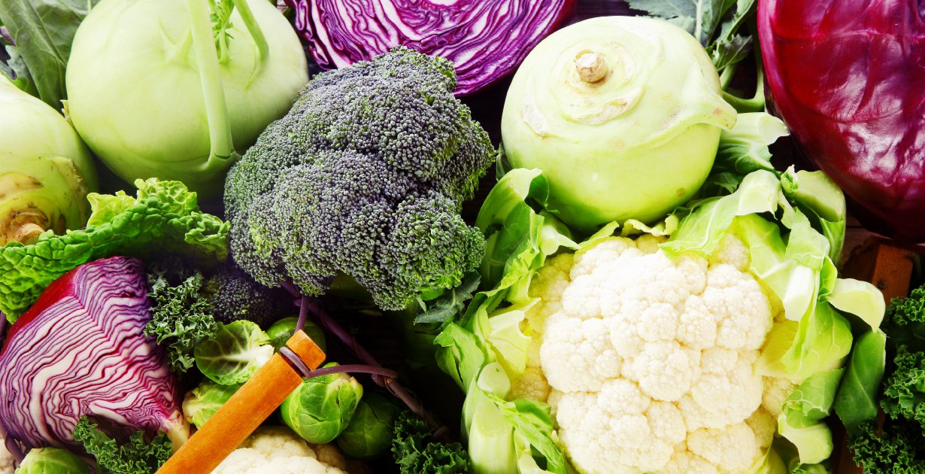
Cruciferous veggies
Prevent DNA damage and cancer spread
Improve immunity
Prevent lymphoma
Improve liver enzymes
Reduce prostate cancer progression
Contains sulforaphane
Arugula, bok choy, broccoli, Brussels sprouts
Cabbage, cauliflower, collard greens
Horseradish, Kale
Mustard greens, turnip greens
Radishes
Watercress

Slide 18
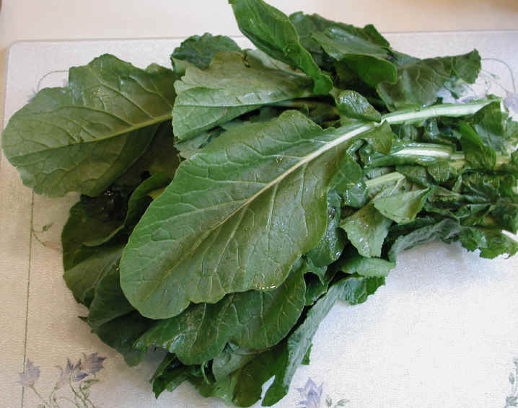
Greens
Rich in antioxidants – beta carotene, lutein, anthocyanins
Excellent source of folate, iron, Vitamins A & C, Vitamin K
Associated with strongest protection against chronic diseases
20% reduction for heart attacks and strokes for every add’l serving/day
Reduced risk of cancer
May help with weight loss by increasing feeling of fullness and curbing desire for junk foods
Low in calorie density, high in nutrient density
Mix with healthy fat to increase nutrient absorption
Nuts & seeds, avocado, olives

Slide 19
Nuts & seeds
1 handful of nuts, 5+ days/week may increase life span by 2 years
Fewer cancer deaths in those who eat nuts (suppress cancer growth)
High in antioxidants
Reduce cardiovascular disease
Can cut stroke risk by half
Walnuts contain Omega 3 fatty acids
PREDIMED study found that nuts were not just associated with better health, but were the cause of it
3 + servings walnuts/week cut risk of dying from cancer in half
Nurses Health Study – replacing carbs with same calories from nuts lowered CVD risk by 30% and if replaced saturated fat with nuts lowered by 45%

Slide 20
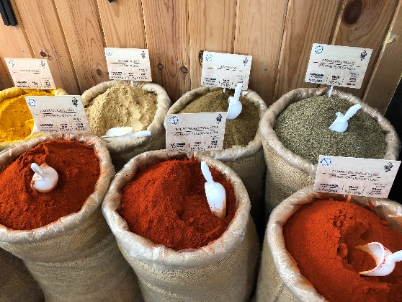
Flaxseeds
High blood pressure
Study found improved BP compared to placebo (similar or better to effects of hypertension meds)
Breast cancer
Reduced risk among postmenopausal women
Among Breast cancer survivors – improved longevity
Created less aggressive cancers in those with cancer
Prostate cancer
Slow progression

Slide 21
Onions
In the Allium family of veggies:
Onions, garlic, leeks, chives, shallots and scallions
Contain compounds that slower tumor growth and kill cancer cells
Associated with lower risk of oral, esophageal, colorectal, laryngeal, breast, ovarian and prostate cancers (study found this in those who ate the most onions and garlic)
To get the most effect, eat raw and chew well OR chop finely before cooking (this helps to form the cancer protective sulfur compounds)

Slide 22
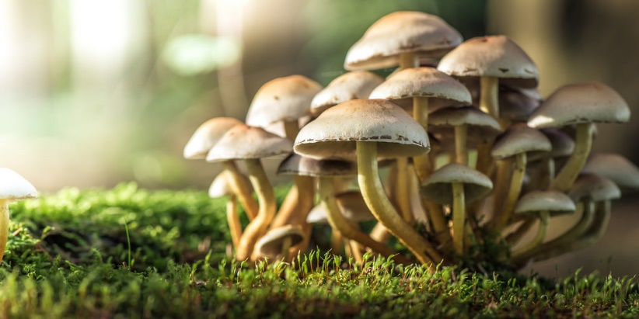
Mushrooms
Anti-cancer effects:
Bind to abnormal cells and cancer cells and then they are labelled for destruction by immune system
Especially effective in stomach, colorectal, breast and prostate cancers
Anti-obesity effects:
Help to limit fat cell storage
Anti-diabetes effects:
Lower blood sugar
Block enzymes that break down carbs into sugars, so they help to maintain lower sugar levels when eating carbs
Help maintain healthy gut
Vitamin D in some

Slide 23
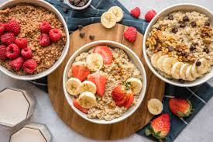
Make healthy foods part of your day!
Breakfast ideas:
Smoothie with berries, kale, flax (my new favorite: 1 banana, 1 cup blueberries, 1 cup greens, 1 T flax, dash of Turmeric, 1/3 block tofu)
Tofu scramble with mushrooms, onions, spinach, sprinkled with seeds and berries on the side
Oats/barley made with soy milk, berries, flaxseeds, pumpkin seeds

Slide 24
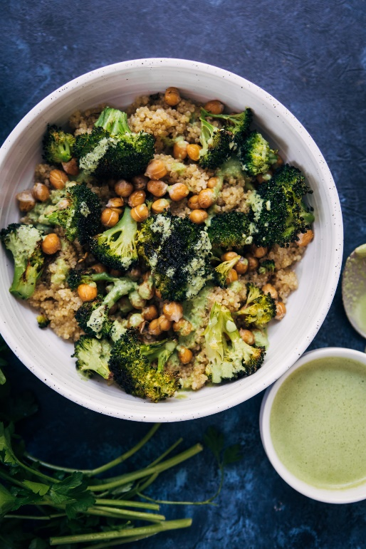
Get your GBOMBS/Daily Dozen/4 Always every day
Lunch/Dinner ideas:
Chili with beans, greens, onions, mushrooms, spices
Veggie stir fry with tofu over quinoa or brown rice
Tacos with corn tortillas, lentil/mushroom ‘meat’, lots of veggies
Power bowl: Rice/grain + beans + corn + greens in a bowl
Bean burrito: whole wheat tortilla + beans + peppers/onions/mushrooms + greens
Whole wheat pasta with onions, mushrooms and greens

Slide 25
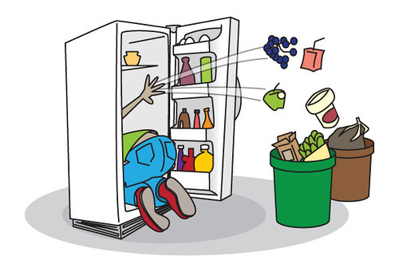
How to get started or continue your healthy lifestyle?
Change one meal at a time
One week focus on breakfast
The next – try lunch
The next – try dinner
OR
Change all at once
Get the animal foods out of the house
Get processed foods out of the house
What do you eat now that is already meatless or could easily be?
Turn your favorite dishes into meatless dishes

Slide 26
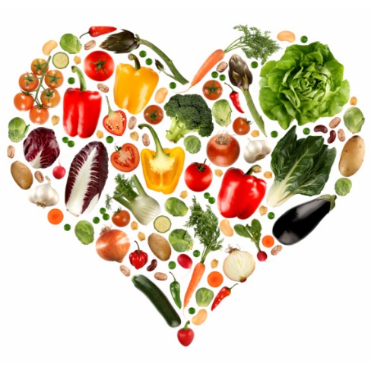
Use the studies to determine your lifestyle
What health risks are you concerned about?
What is your why?
What changes do you want to make to achieve that?
“Don’t make any changes to your diet that don’t support your long-term health, and don’t make any changes to your diet that you don’t believe you can maintain for the rest of your life.” Joel Fuhrman

