Slide 1
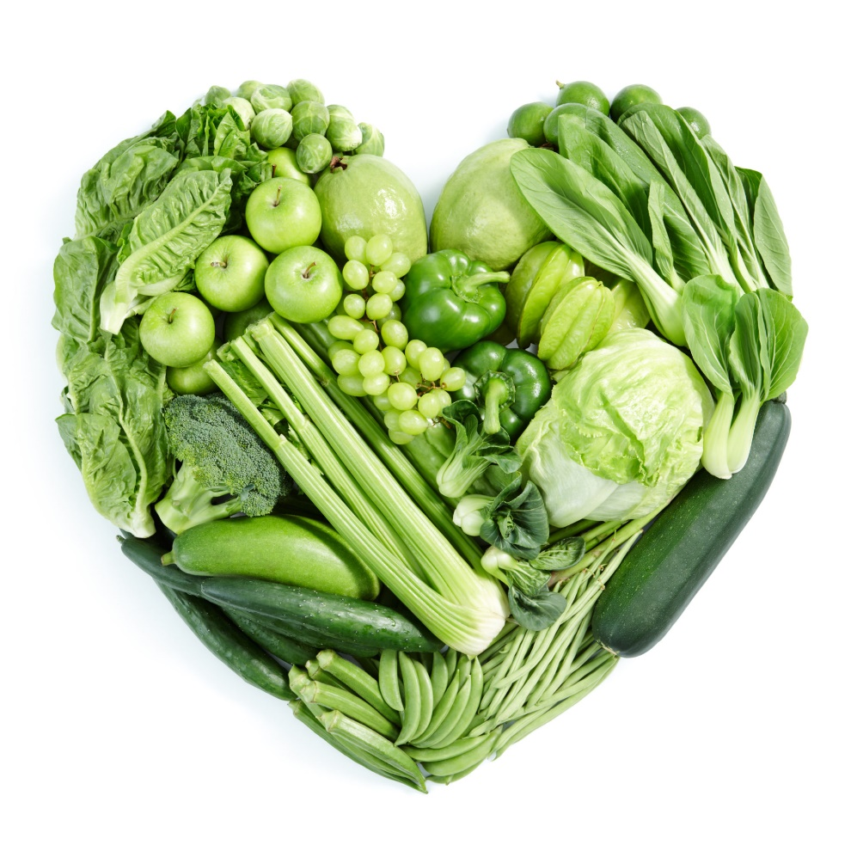
Practice Earth Day every Day
Debbie Lucus, MS, RD, CDCES
04.19.22
dlucusrd@gmail.com
Notes:
On the next few slides we’ll look at a few common varieties of beans and discuss their shape, size, and flavor.

Slide 2
Hot off the Press: Egg Consumption Increases Risk of Death From Heart Disease
Zhao B, Gan L, Graubard BI, Männistö S, Albanes D, Huang J. Associations of dietary cholesterol, serum cholesterol, and egg consumption with overall and cause-specific mortality, and systematic review and updated meta-analysis. Circulation. Published online April 1, 2022. doi:10.1161/CIRCULATIONAHA.121.057642
Zhao B, Gan L, Graubard BI, Männistö S, Albanes D, Huang J. Associations of dietary cholesterol, serum cholesterol, and egg consumption with overall and cause-specific mortality, and systematic review and updated meta-analysis. Circulation. Published online April 1, 2022. doi:10.1161/CIRCULATIONAHA.121.057642
Zhao B, Gan L, et al. Associations of dietary cholesterol, serum cholesterol, and egg consumption with overall and cause-specific mortality, and systematic review and updated meta-analysis. Circulation. Published online April 1, 2022.
Researchers compared egg and cholesterol consumption and blood cholesterol levels with death from cardiovascular disease
N = over 27,000 participants
Review of existing research
Eating one egg per day significantly increased the risk of dying from heart disease.
Higher blood cholesterol levels and higher intakes of dietary cholesterol were also associated with an elevated risk of death from heart disease.

Slide 3
Happy Earth Day!
Invest in our planet

Slide 4
What can we do for our Earth?
The 5-R’s
Shop local
Eat what’s in season
Waste less food
From Meatless Monday (to start) up to Meatless EVERYday
Follow ‘climate-friendly’ eating style

Slide 5
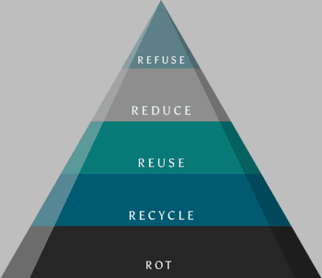
The 5 R’s

Slide 6
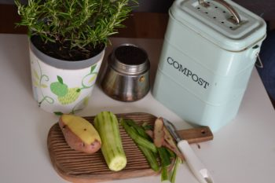
Recycle & Rot
EPA states only 8.7% of plastics are recycled – so focus on refuse, reduce/repurpose are especially important
Rot – food waste at the dump produces methane (GHGE) – so be mindful of what you put in the trash
https://www.youtube.com/watch?v=J9tmw9KBCKo

Slide 7
Shop Local – Reduce your carbon footprint

Slide 8
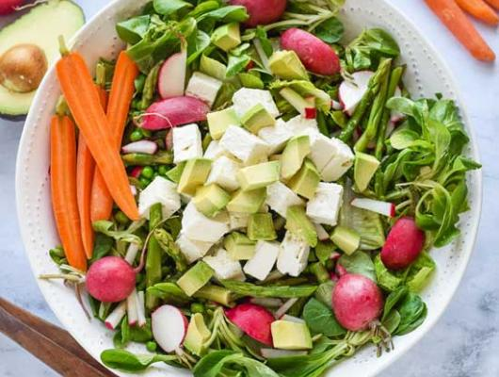
What’s in season this spring?
Asparagus
Leaf Lettuces & Spinach
Peas
Green & Yellow Beans
Mushrooms
Cabbage
Carrots
Leeks
Strawberries

Slide 9
Cut food waste
40% of food in our country is never eaten
Use all parts of the food
Accept less than perfect produce
Make shopping list from meal plan, and only get what you can use before it goes bad:
Be aware of your frig and pantry inventory
Eat foods in order of age
Freeze before going bad
Wrap up leftovers
https://www.fda.gov/food/consumers/food-waste-animations

Slide 10
Decrease waste: expiration dates
Best if used by/before” indicates when a product will be of best flavor or quality. It is not a purchase or safety date.
“Sell by” tells the retailer when it’s time to rotate a product off store shelves. It is not a safety date.
“Use by” is the last date recommended for the use of the product while at peak quality. It is not a safety date except for when used on infant formula.
“Freeze by” indicates when a product should be frozen to maintain peak quality. It is not a purchase or safety date.

Slide 11
What is climate change?

Slide 12
Go green for the planet

Slide 13
¼ pound hamburger uses 425 gallons of water and enough energy to
charge your phone for 6 months

Slide 15
Meatless Monday
Swapping out plant-based foods for meat and dairy just one day a week reduces climate-change emissions more than eating locally every day
#MeatlessMonday

Slide 16
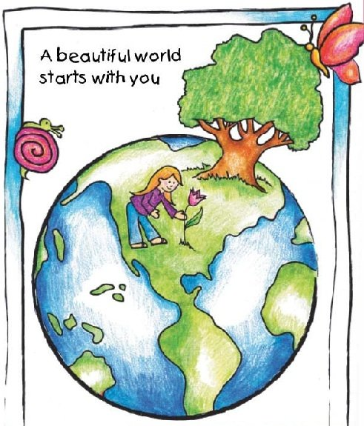
Eating for our health and for the planet’s
Less meat & more produce
Saves water and carbon
Less green house gases
Better for our health
Animals love it

Slide 17
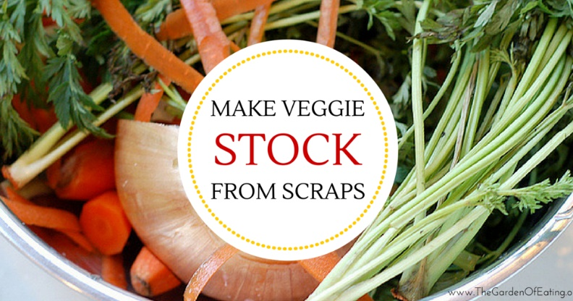
Scrappy Cooking
Recycle your scraps into meals
Mix citrus peels with vinegar to make cleaner
Vegetable scraps to make broth
Potato peels to make nachos
Stale bread? Make croutons
Apple peels? Roast them, add cinnamon/sugar and add to oatmeal or top your nice cream
Vegetable odds & ends? Make soup
Banana peels? Make bacon, or a cake!

Slide 18
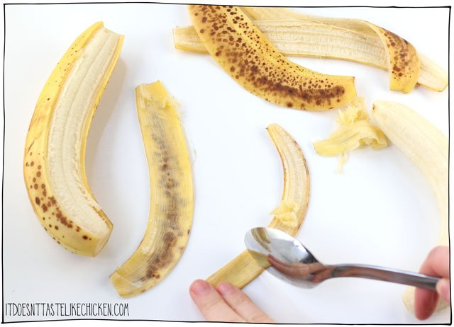

Slide 19
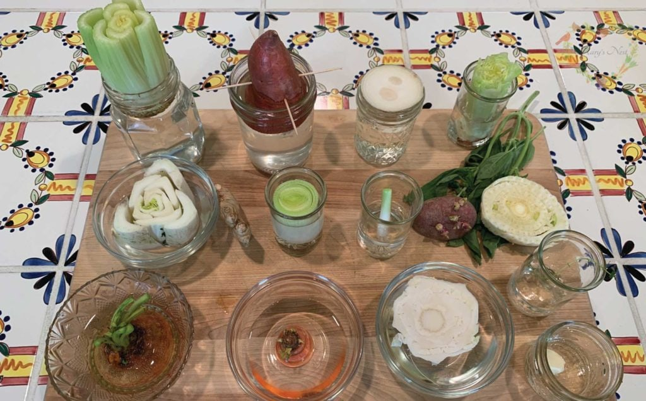
Grow your own food – from scraps
Ginger
Green onions
Celery
Lettuce
Avocado
Potatoes
Sweet potatoes
Marysnest.com

Slide 20
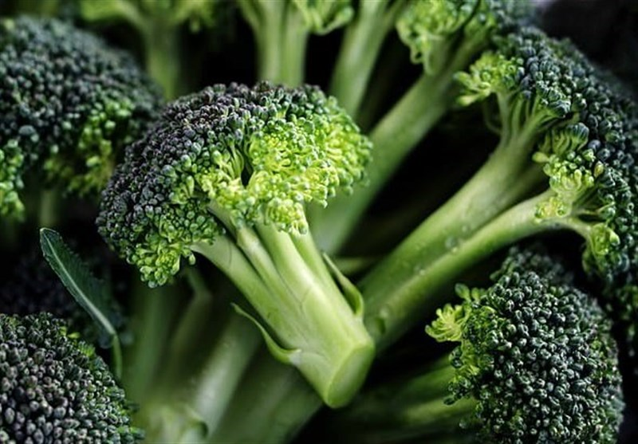
Our recipe today
Broccoli stem tater tots:
2 broccoli stems grated
1 broccoli head finely chopped
1 potato grated
1 tbsp flax meal mixed with 2 1/2 tbsp water
1 tbsp nutritional yeast
1/2 tsp sea salt
1 tbsp olive oil spray

Slide 21
Clean out the frig vegetable soup
4 cloves garlic minced
1 yellow onion diced
2 carrots diced
1 tbsp oregano
2 celery ribs diced
4 cups vegetable broth
2 1/2 cups diced tomatoes canned
1 1/2 cups white beans drained & rinsed (or any beans)
1/2 lemon squeezed
1 1/2 cups basmati rice cooked (or any leftover)
2 cups kale chopped (or any green)
1/4 cup fresh parsley (or any herb)

Slide 22
Save our planet!
What will you do?
Recycle?
Reduce?
Reuse?
Rot?
Cook with scraps?
Shop at Farmers’ Market?
Every change can help!

