Slide 1
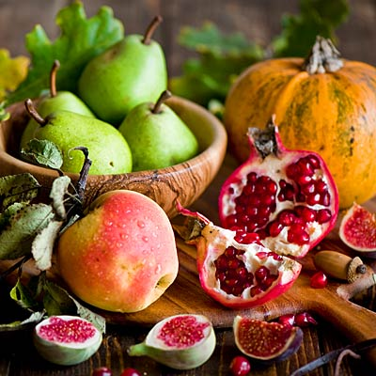
Fall Foods
Debbie Lucus, MS, RD, CDCES
10.06.20
dlucusrd@gmail.com
Notes:
On the next few slides we’ll look at a few common varieties of beans and discuss their shape, size, and flavor.

Slide 2
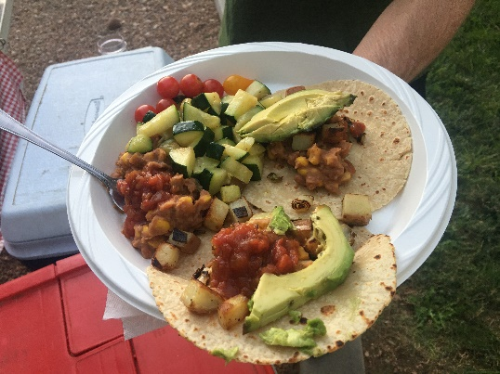
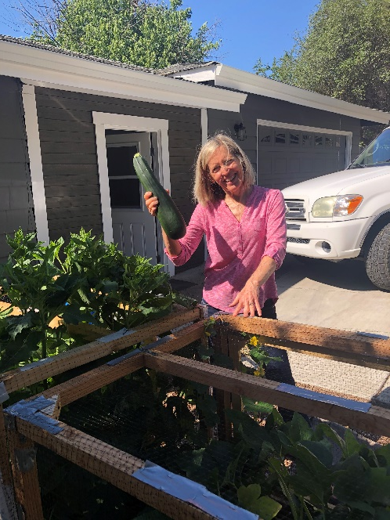
What did you do this summer?

Slide 3
What’s in season?
Apples
Pears
Greens
Winter Squash
Beets
Sweet potatoes
Turnips
Parsnips
Brussels Sprouts

Slide 4
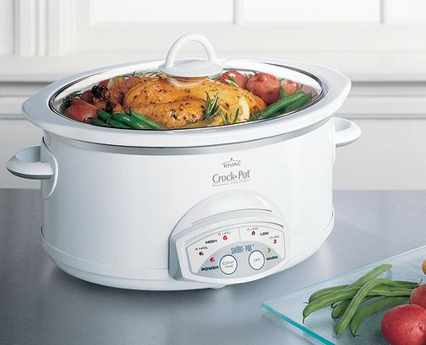
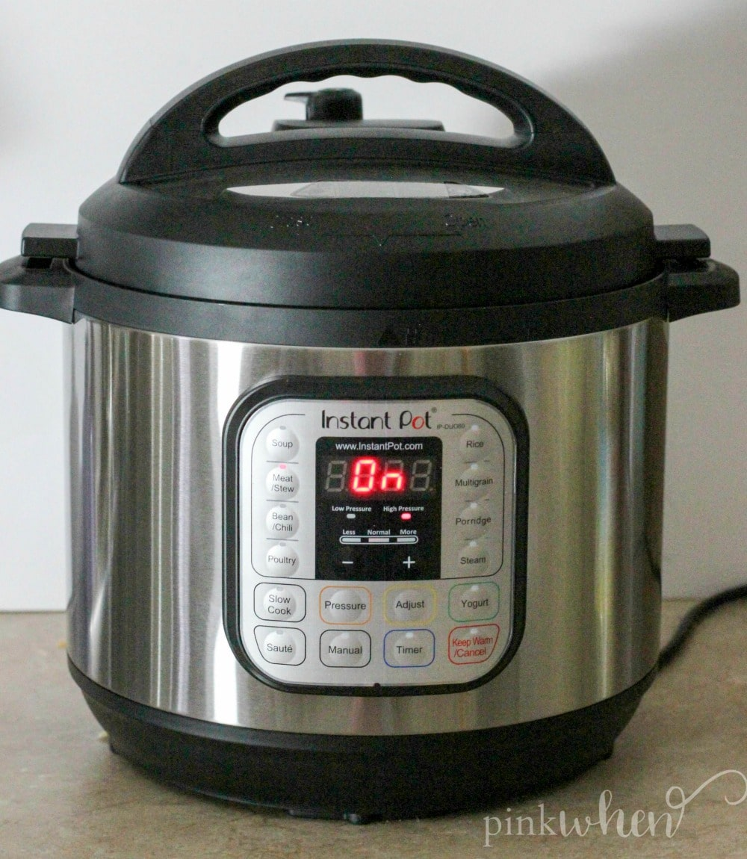
Helpful tools
Crockpot
Pressure cooker
Rice cooker
iPot
Blender/Vitamix
Chopper
Sheet pan
Grill basket
Veggie peeler
Excellent knife

Slide 5
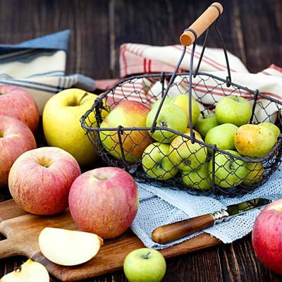
Benefits of eating apples & pears?
Good source of soluble fiber (helps to lower cholesterol)
Antioxidants
Many ways to enjoy them:
Raw, snacks
Applesauce
Baked apples or pears
Apple/pear crisp/cobbler
Salads
Soups/stews
Add to oatmeal

Slide 6
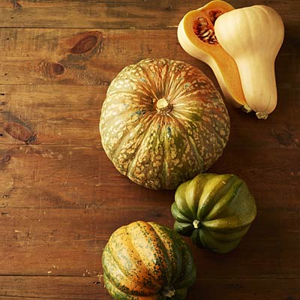
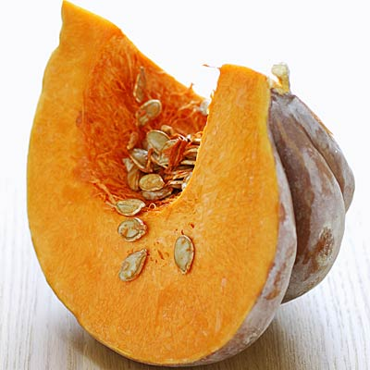
Winter Squash
Good source of fiber
Vitamins A & C
Antioxidants
Versatile
Acorn
Butternut
Delicata
Kabocha
Pumpkin
Spaghetti

Slide 7
Name that Squash

Slide 8
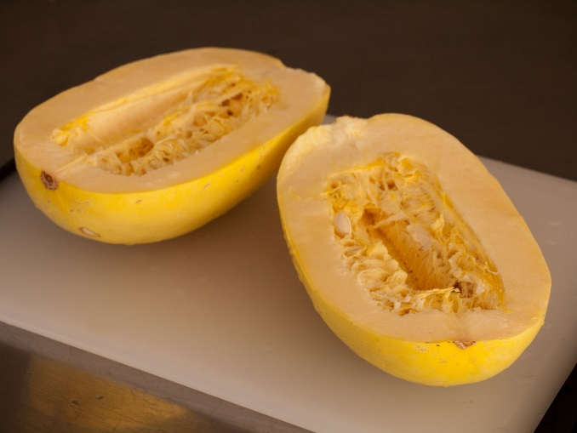
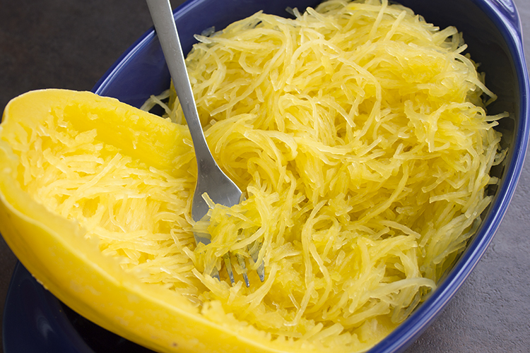
What to do with squash
Roast it
Grill it
Stuff it
Chop it (and add to soups/stews)
Puree it
Scrape it (spaghetti)

Slide 9
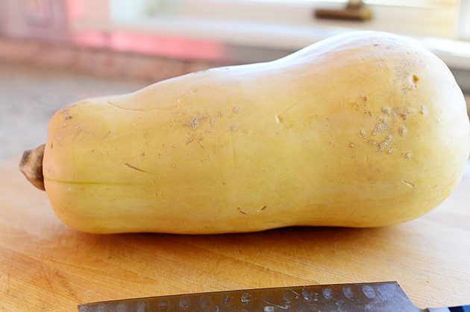
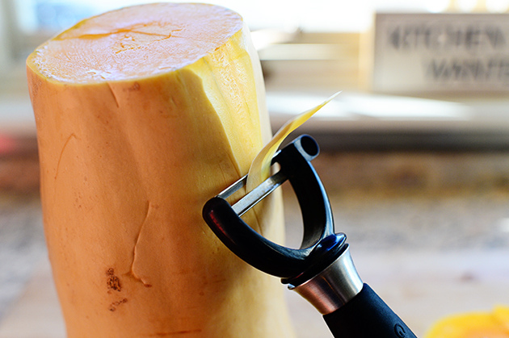
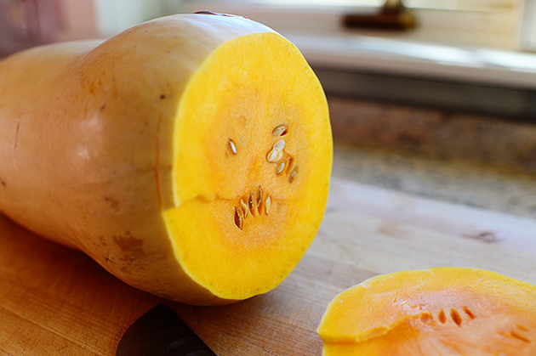
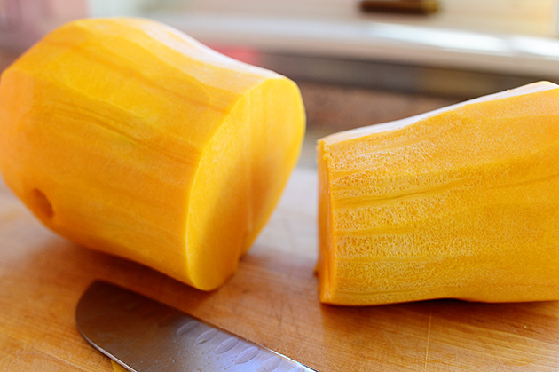

Slide 10
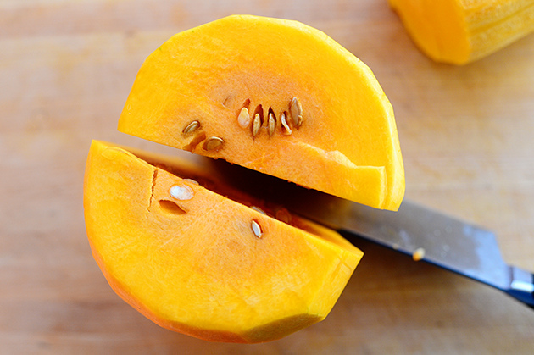
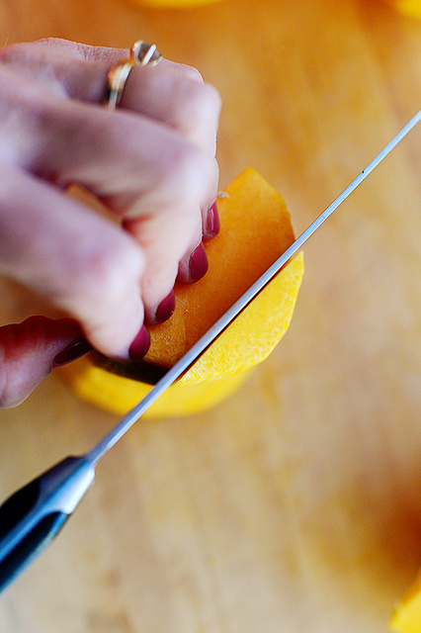
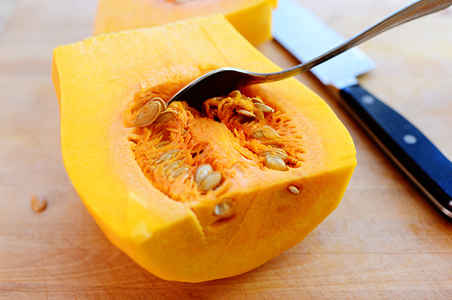
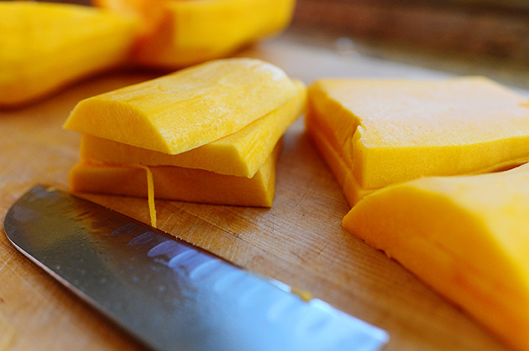

Slide 11
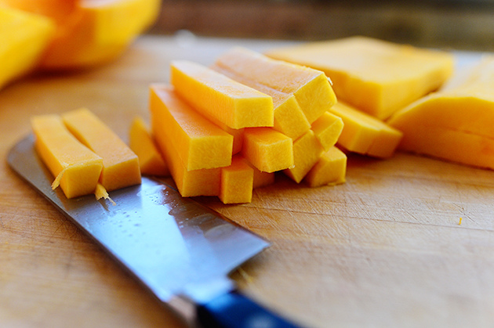
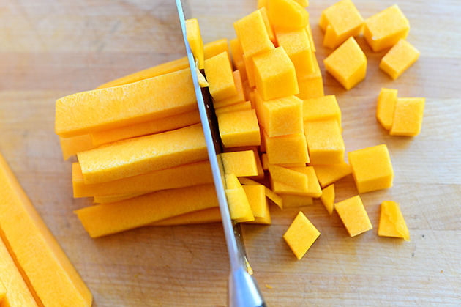
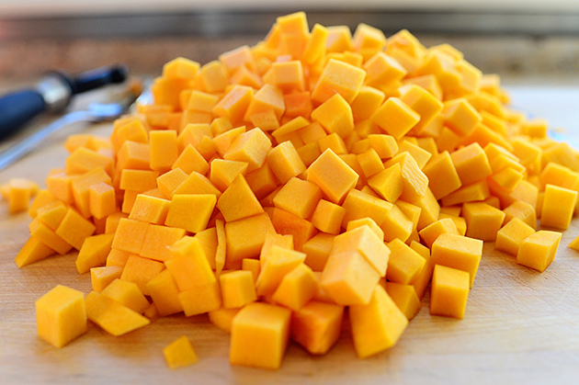

Slide 12
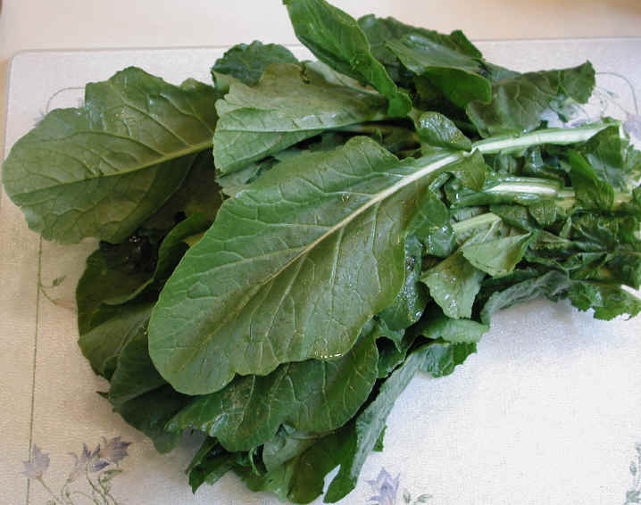
Go with Greens
Greens may help with weight loss by increasing feeling of fullness and curbing desire for junk foods.
Excellent source of folate, iron, Vitamins A & C, iron
Spinach
Collards
Mustard greens
Kale
Chard
Lettuce (darker the better)
Watercress
Beet

Slide 13
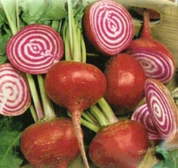
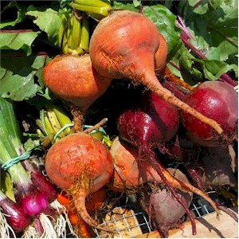
Beet it!
Two veggies in one – beets and greens
Eat raw – grate and make into a salad
Roast
Microwave
Soups and stews
Try red or golden beets or Chioggia

Slide 14
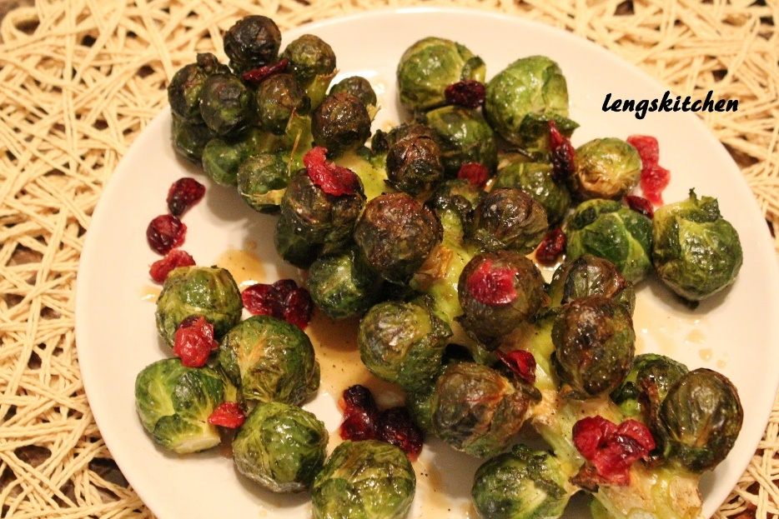
Brussels Sprouts
Cruciferous veggie family
Strong cancer fighter
Good source of Vitamin C & K
Full of antioxidants
Higher in fiber
Roast
Grill
Shred and put on salad

Slide 15
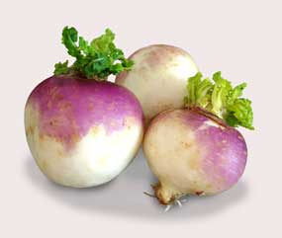
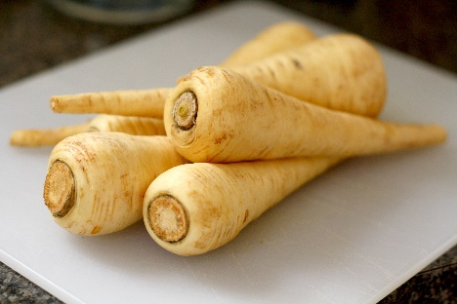
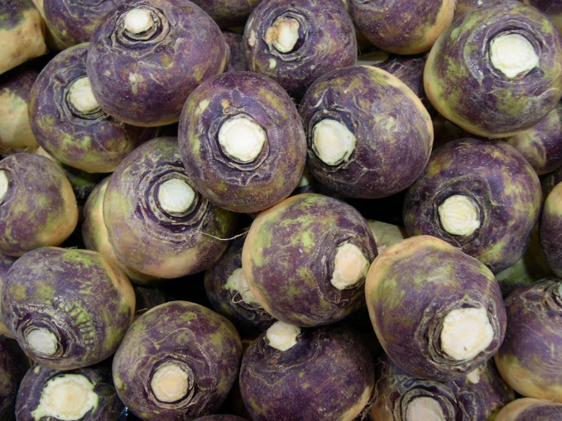
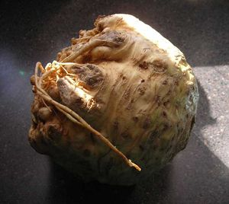
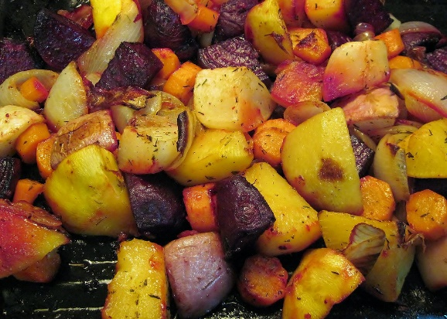
Root veggies: turnip, rutabaga, parsnip, celeriac
Rich in antioxidants, high in fiber, Vitamin C
Turnips often have the greens, too
Parsnips are great pureed

Slide 16
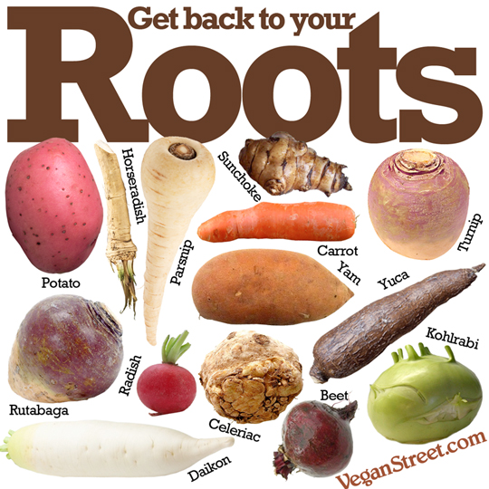
What to do with root veggies
Roast ‘em
Chop ‘em
Put in soup/stew
Sautee ‘em
Puree ‘em
Grill ‘em

Slide 17
10 ways to eat more fall foods
Make a baked apple for dessert: core an apple, fill center with a little sugar, raisins, cinnamon, whatever – then cover and microwave for 5 min.
Wilt greens: In a hot pan, add several handfuls of greens. Leave it be until the greens wilt. With a pair of tongs, turn over. Stir in some minced fresh garlic. Sprinkle with fresh lemon juice or a bit of apple cider vinegar. Season with salt and pepper.
3. Beet salad for one: peel a raw beet, grate it and add a little balsamic vinegar, mustard, salt/pepper, garlic.

Slide 18
More fall foods….
4. Make a soup: throw some greens and winter squash into any of your favorite soup recipes
5. Use spaghetti squash as your spaghetti noodles: top with your favorite sauce
6. Poach pears: I like it with red wine, a little sugar, cinnamon and pressure cook in the instant pot.
7. Stuff a winter squash: my favorite is acorn squash – cut in half and bake face down in baking dish with a little water for 20 min at 400. While it is cooking, saute a diced apple with dried apricots and some orange peel. Place in hollow of squash and cook another 30 min covered – top with some chopped nuts.

Slide 19
And more…
8. Roast: cut up any root veggie or winter squash and place on cookie sheet – roast at 425 for about 20 min.
9. Make homemade applesauce.
10. Make a salad: top with any of your fall fruits and veggies

Slide 20
Imperfect Foods

Slide 21
Are you up for a challenge?
Aim for 2 cups veggies at lunch and dinner daily
Eat what is in season – try a new fall fruit or veggie
Buy local
Choose organic when you can
Support Farmers’ Markets/CSAs
Try a box of ‘Imperfect Foods’
The benefit:
Heart health
Weight loss
Better diabetes control
Great tasting foods!

Slide 22
Make a Fall Bucket List

Slide 23
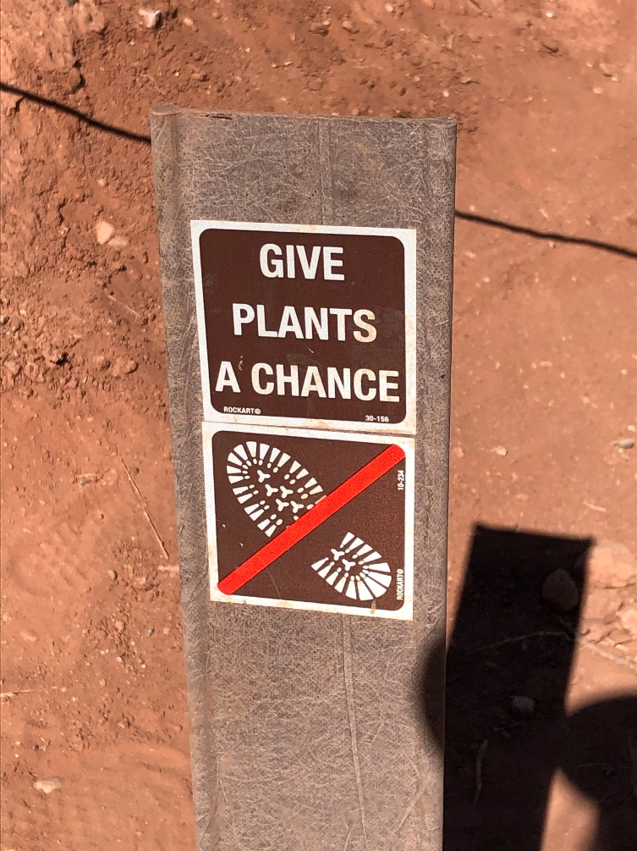
Thank you!

