Slide 1
Food and Mood
Getting the most from what you eat!
Debbie Lucus, MS, RD, CDCES

Slide 2
The How
Glucose levels affect brain function and energy level
  High and low blood sugars cause mood changes
Certain foods give longer lasting calories for use
Nutrients in foods seem to have a positive affect on energy level and maintenance
Nutrients may truly elevate your mood

Slide 3
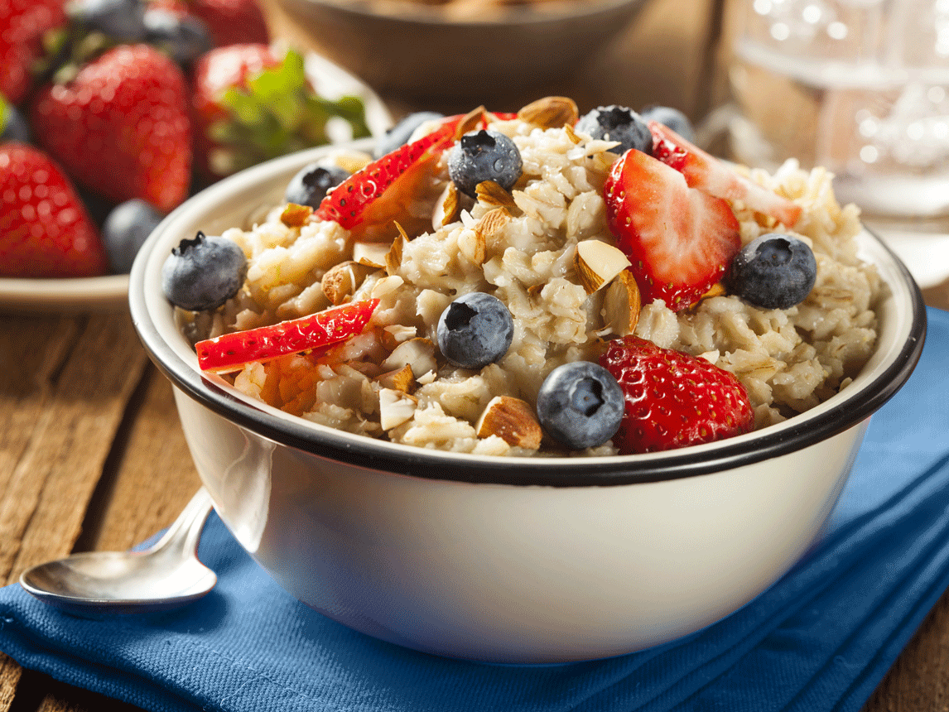
The Basics
Include a variety of foods
Enjoy some protein (preferably plant-based)
Enjoy some carbohydrates (whole grain, less processed)
Enjoy some healthy fats
Coffee and tea are ok!
Eat Breakfast
Drink water
Spread calories thru the day

Slide 4
What do we know for sure?
Water
Well-spaced meals
Omega 3 fatty acids
Selenium
Magnesium
Tryptophan
Balance of fats, carbs, and protein
Eating breakfast

Slide 5

Omega-3 fatty acids
Flaxseeds, flax oil
Walnuts
Canola oil
If still eating animals: Fatty Fish – salmon
Associated with improvements in depression

Slide 6
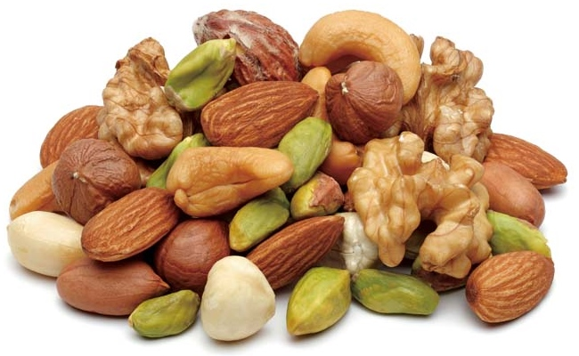
Selenium
Helps immune system function
Antioxidant: prevents free radical damage
Low levels associated with depression, irritability or mood swings
Whole grains
Beans
Vegetables
Nuts

Slide 7

Magnesium
Low magnesium levels found in people who are depressed
Almonds
Spinach
Avocado
Cocoa powder
Quinoa, brown rice
Lentils, beans
Whole grain cereals: Oatmeal, Shredded Wheat
Bananas

Slide 8
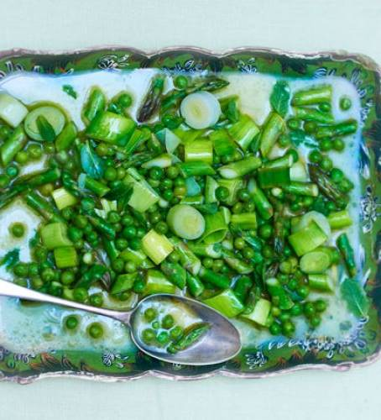
Tryptophan
Oats
Soy
Cashews, walnuts
Peas
If eating animals:
  Turkey, chicken, pork, salmon, tuna
  Eggs
  Milk products
Aids with sleep cycle
Helps with PMS
Reduces Seasonal Affective Disorder
Improves depression and anxiety symptoms – converts to serotonin – the feel good neurotransmitter in brain

Slide 9

When we are anxious, stressed, sad or glad…
Severe depression may lead to not eating
Mild stress or depression often leads to overeating or emotional eating
Sometimes - we celebrate with food!
What are your comfort foods?

Slide 10
Be in the moment
Make healthier food decisions each time you eat
Find activities you enjoy to boost your mood
Friends, family, coworkers
Make connections
Workplace connections

Slide 11
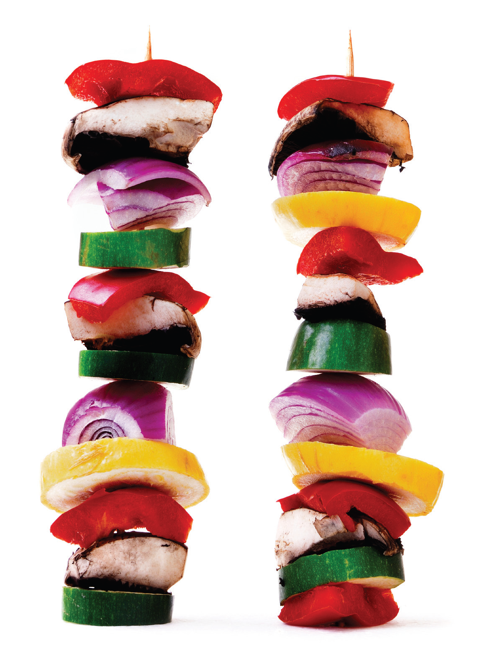
Healthy Balanced Eating
Vegetables
Fruits
Whole Grains
Beans and Legumes
Plant based fats
Water (limit alcohol)
Milk or dairy alternatives
(Animal Protein – if you must!)

Slide 12
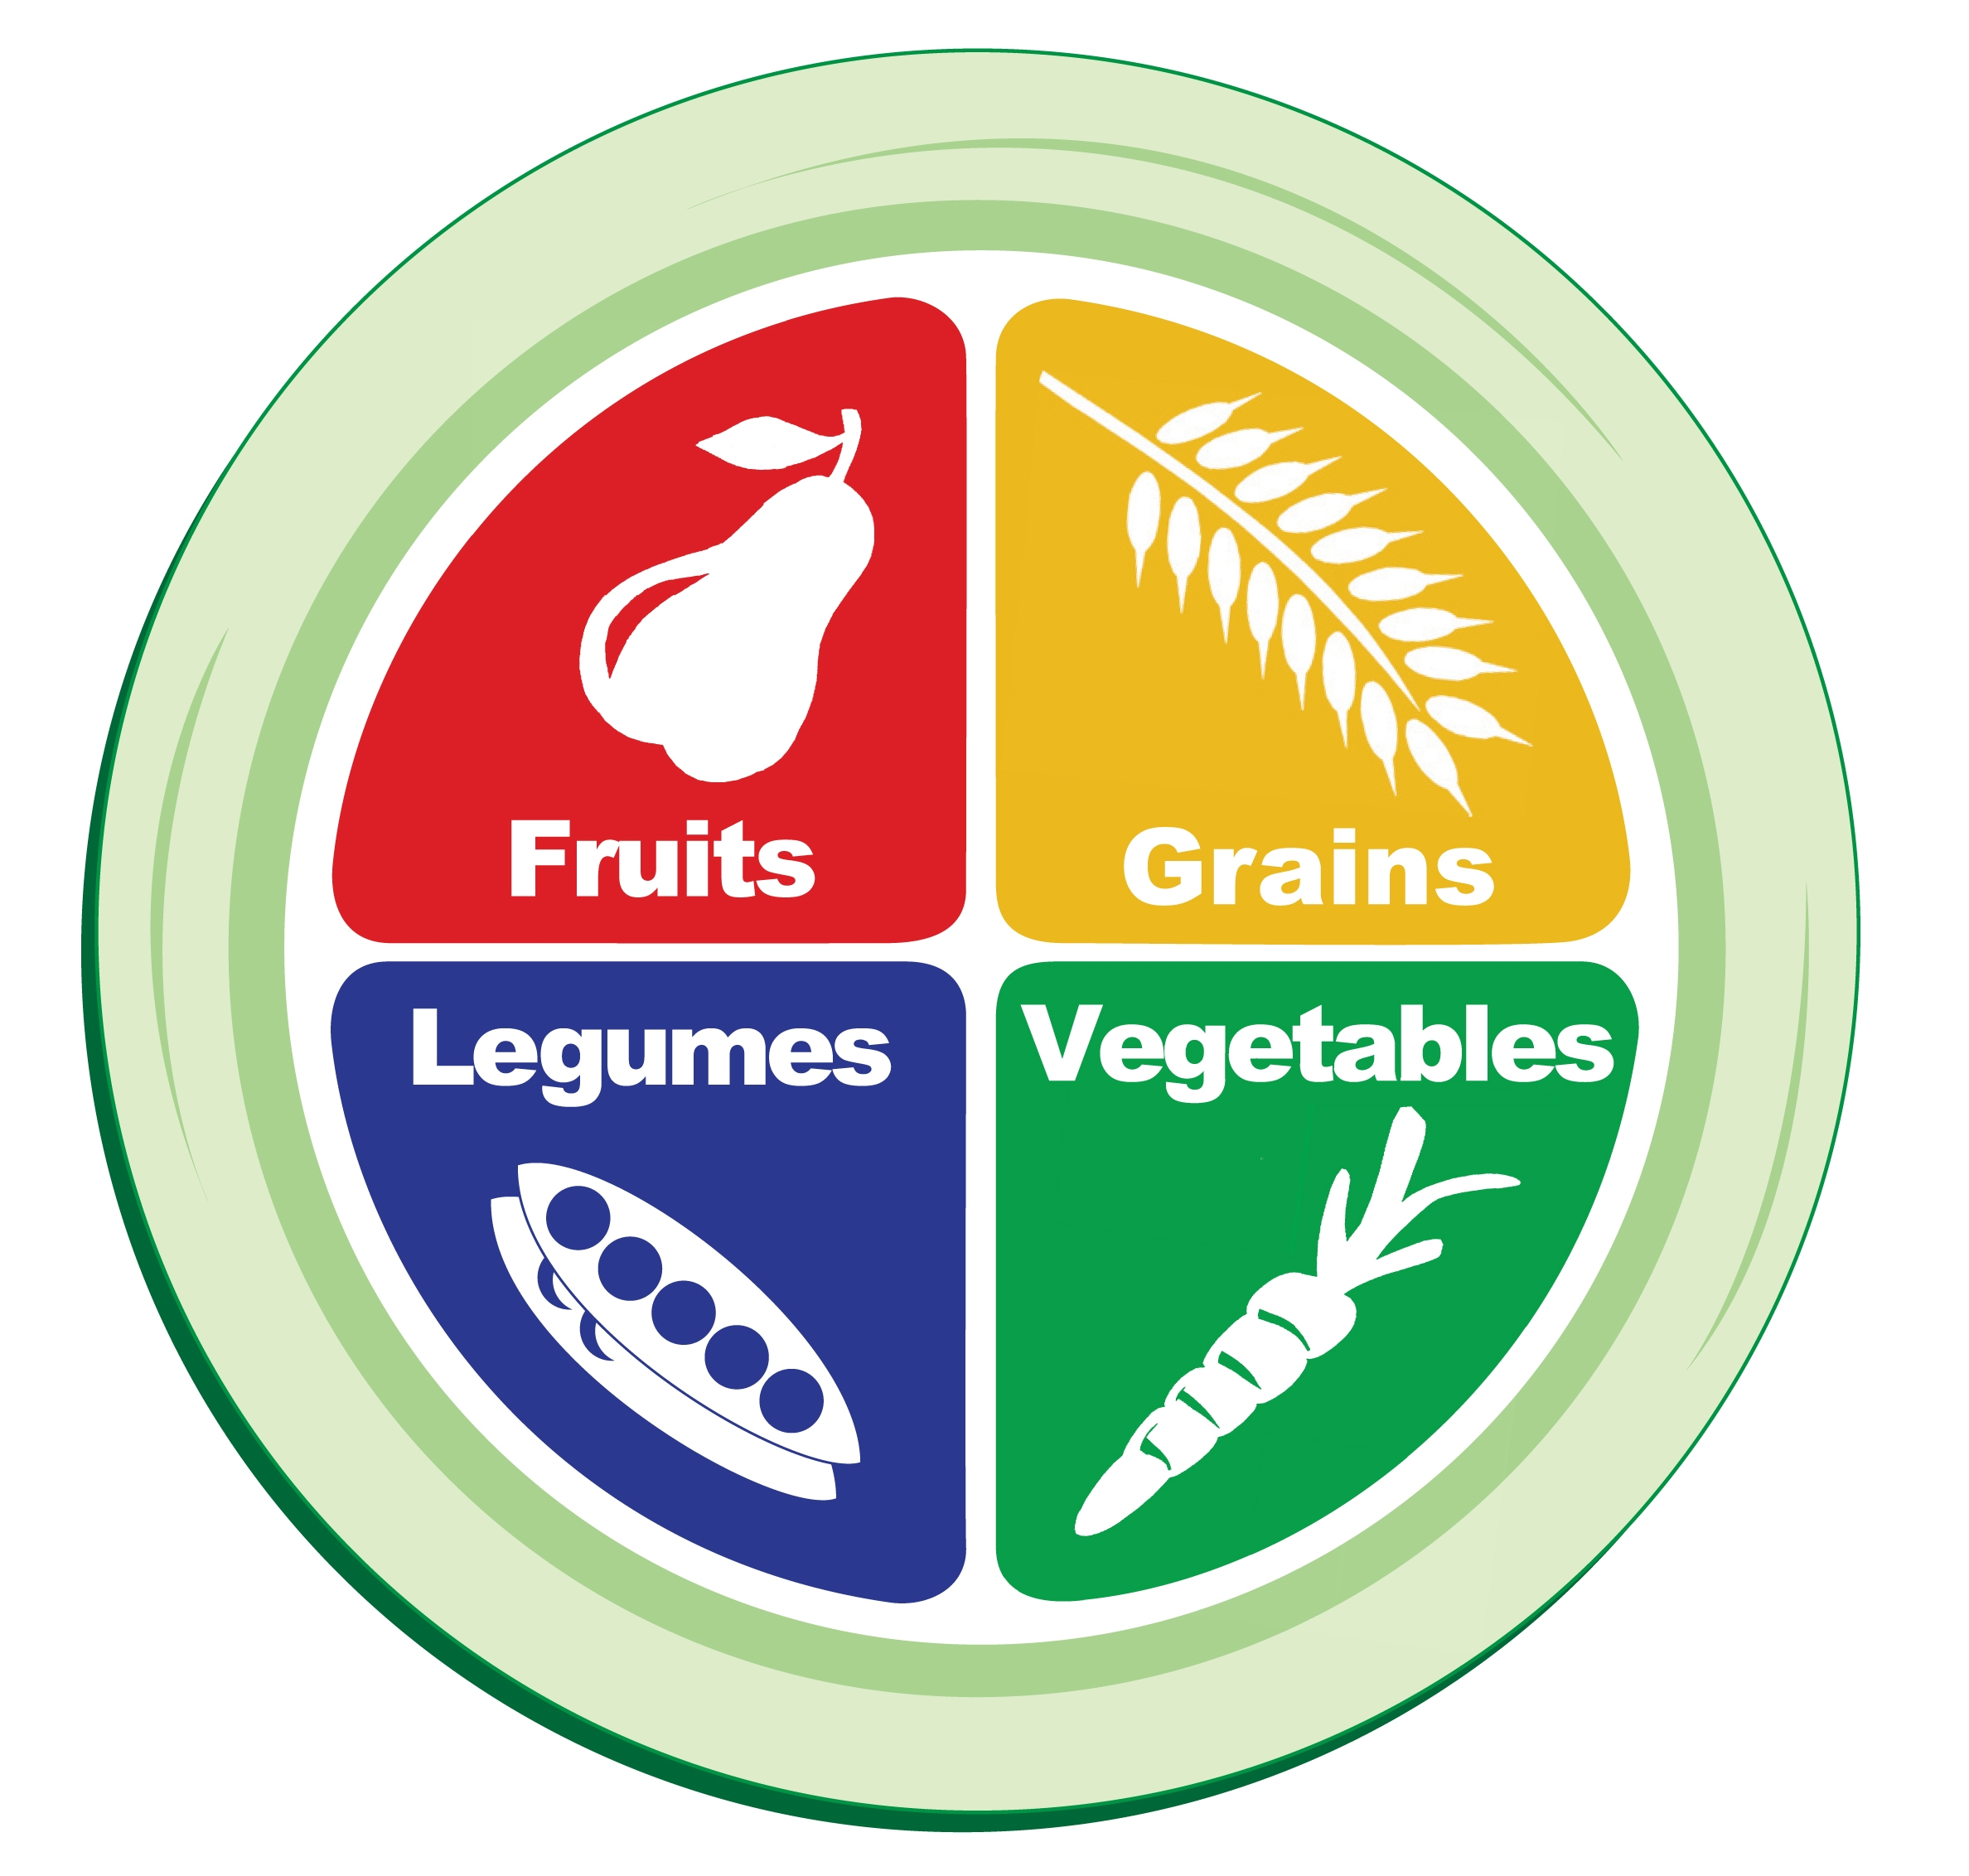
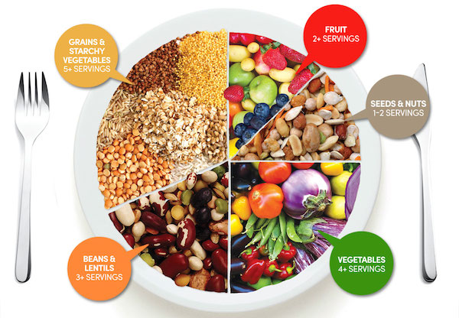
The Plate Method
GBOMBS
Daily Dozen

Slide 13
What does a daily menu look like?
Breakfast
  Protein, starch, veggie, fruit
  Whole grain hot or cold cereal, plant milk, fruit (maybe add some sweet potato or spinach?
  Scrambled tofu, toast, fruit
  Whole grain waffle with peanut butter and fruit

Slide 14
Lunch & Snack
Lunch
  Protein, starch, veggie, fruit
  Sandwich with hummus & veggies, fruit
  Salad with beans & lots of veggies, fruit
  Soup & salad, fruit
Snack: hummus and veggies

Slide 15
Dinner
Dinner
  Protein, starch, vegetable, fruit
  Burrito, salad, vegetable, fruit
  Pasta with sauce, salad, fruit
  Tofu stir fry over brown rice, fruit
  Bean & Veggie soup, bread, fruit

Slide 16

Moving more to improve mood
More moving, less sitting
Hydrate
Recognize feelings and mood – before, during, and after activity
Aim for at least 150+ minutes/week
Make it fun – play music, take a class, walk with a friend
Track steps with technology

Slide 17
Sleep
Hunger - increased with less sleep
Benefits of improved sleep:
Lower stress
Improve muscle recovery
Improved immune function
Improved food choices???

Slide 18
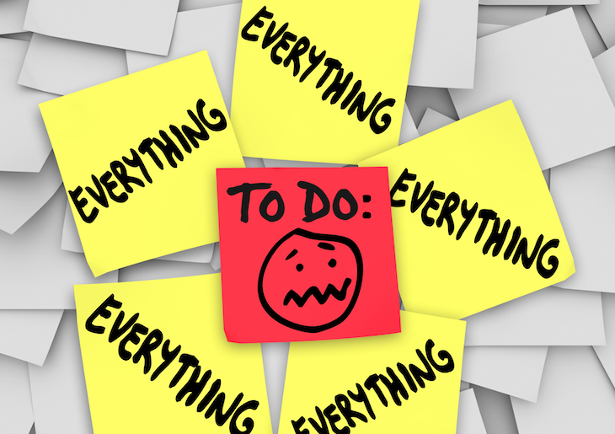
Lower Stress
Healthier foods=better decisions
Balanced intake vs. overeating or undereating
Cortisol levels (hormones) increase with stress which may make healthy eating more challenging and may lead to more belly fat

Slide 19

Environmental Control
What can you do to improve your environment in order to promote your success at keeping a positive outlook?
  Home
  Work
  Travel
  Social events

Slide 20
Consistency in Behaviors
Create positive habits and routines
Make meals easy – grab and go foods can be healthy too!
Plan 3-4 standard breakfasts, lunches, and dinners, have ingredients on hand

Slide 21
Check in!
Weekly
Daily
Mood Journal
Other indicators of change?
What changes in your mood have you noticed?

Slide 22
Personal goals
I will eat 5 servings of fruits and vegetables every day.
I will walk 5 days for 30 minutes each day.
I will write down everything I eat or drink for 3 days this week. (Mon.,Tues.,Wed.)
Make a plan and follow it
What will I need to do to reach this goal?
What problems might I encounter and how will I solve them?

Slide 23


Slide 24

When we feel self-confident, we are free to choose foods based on taste and their value to our body, soul, and mind.

Slide 25
My Recipes today
Sweet potato bisque – Forks over Knives
https://www.forksoverknives.com/recipes/vegan-soups-stews/sweet-potato-bisque/
Sweet potato pie Oatmeal

Slide 26

Thank You!

