Slide 1
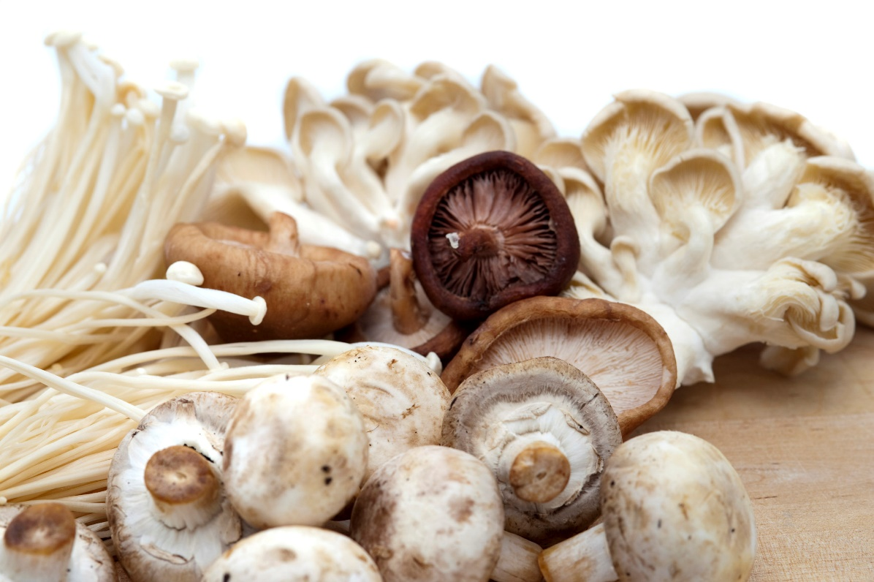
Fungus among us
Debbie Lucus, MS, RD, CDCES
04.06.21
dlucusrd@gmail.com
Notes:
On the next few slides we’ll look at a few common varieties of beans and discuss their shape, size, and flavor.

Slide 2
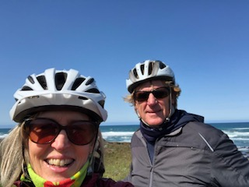
Happy Spring!
New activities for spring?
Gardening?
New and different walks/hikes?
Biking?
How are you doing with challenges?
What are you doing on our beautiful longer days?

Slide 3
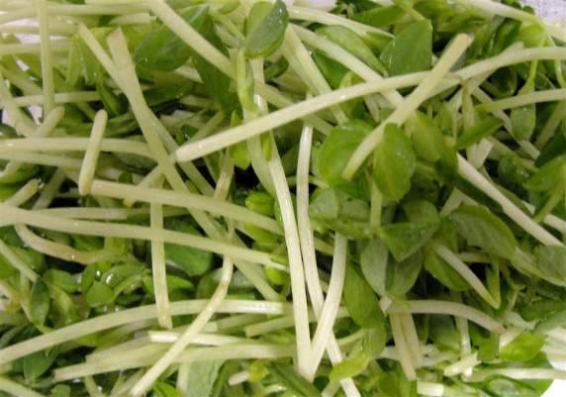
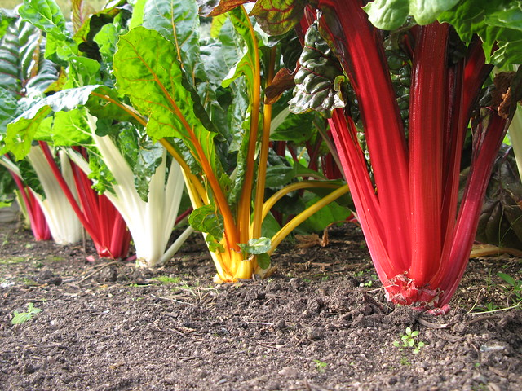
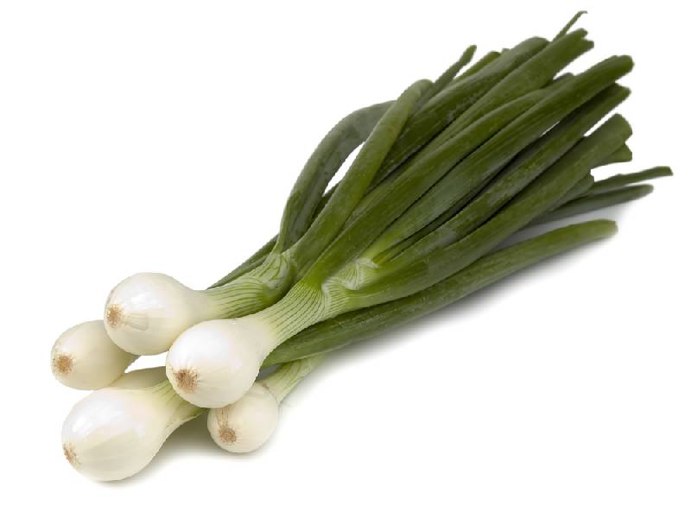
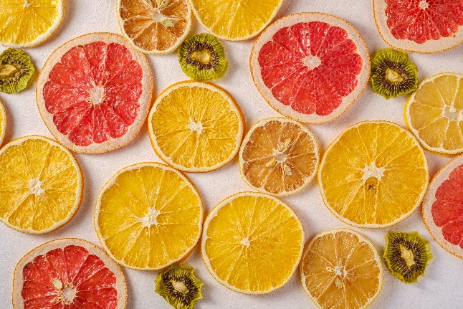
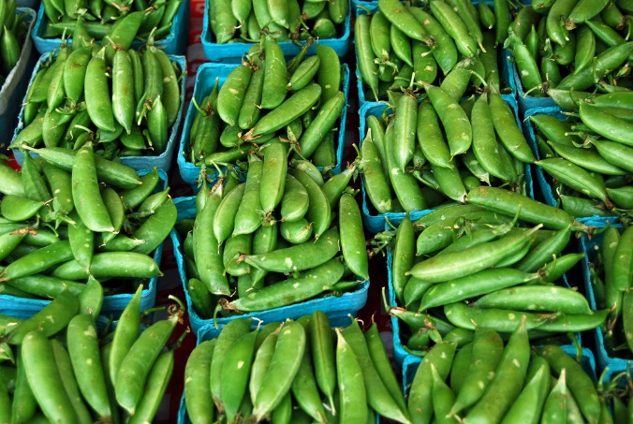
Spring Foods – what have you been trying?
Trying any new spring produce?
Spring pea shoots
Spring onions
Grapefruit
Chard, kale
Sugar snap peas

Slide 4
Association of nut intake with risk factors, cardiovascular disease, and mortality in 16 countries from 5 continents: analysis from the Prospective Urban and Rural Epidemiology (PURE) study – American Journal of Clinical Nutrition – July 2020
Looked at association of nut intake and cardiovascular disease and mortality
5 continents, low-, middle-, and high income countries
124,000+ participants followed for 9.5 years
>4 ounces/week (compared to <1 oz/week) had lower CVD and non-CVD mortality and less cancer death
Not significant reduction in major cardiac events (stroke, MI

Slide 5
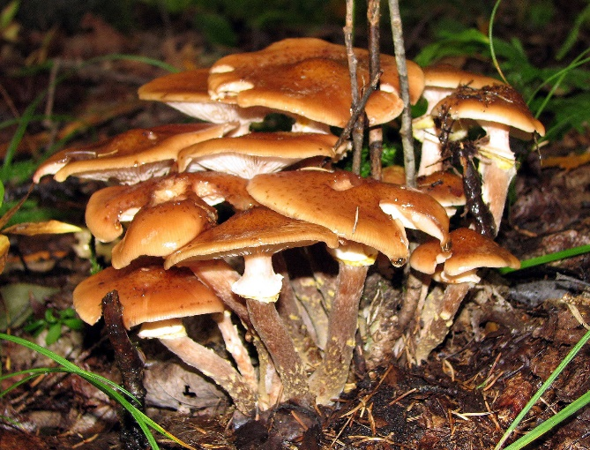
What’s up with mushrooms?
A mushroom or toadstool is the fleshy, spore-bearing fruiting body of a fungus, typically produced above ground, on soil, or on its food source. Wikipedia
Multiple health benefits
Historically used as medicine in Eastern medicine
Dr. Weil has lots of info
Cooking breaks down cell walls, which are tough and resistant to digestion, and many species contain toxins that cooking destroys.

Slide 6
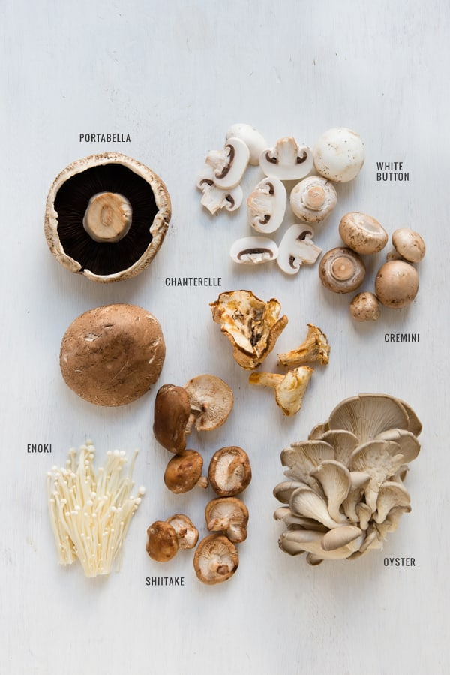
Contain:
16 calories/cup
Protein (3 grams/cup raw)
Carb (3 grams/cup)
Fiber
Antioxidants
Vitamin C
B vitamins
Potassium
Vitamin D

Slide 7
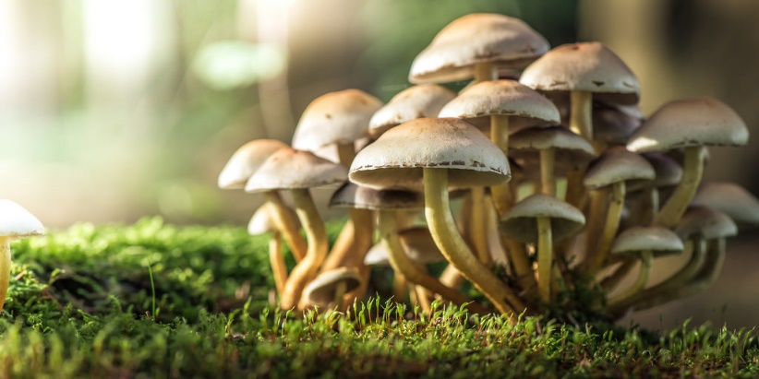
Mushrooms Benefits
Anti-cancer effects:
Bind to abnormal cells and cancer cells and then they are labelled for destruction by immune system
Contain aromatase inhibitors – block production of estrogen: lowers breast cancer risk
Especially effective in stomach, colorectal, breast and prostate cancers
Anti-obesity effects:
Help to limit fat cell storage
Anti-diabetes effects:
Lower blood sugar
Block enzymes that break down carbs into sugars, so they help to maintain lower sugar levels when eating carbs
Help maintain healthy gut

Slide 8
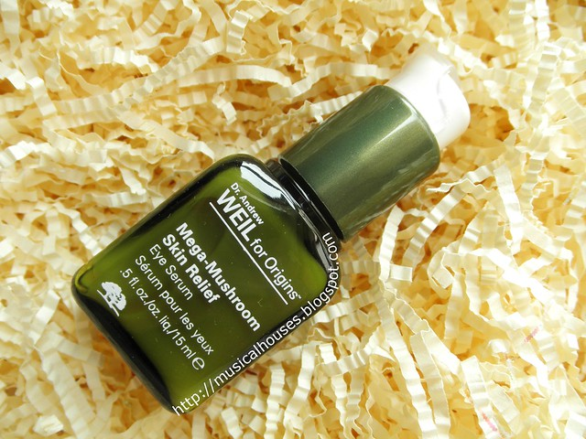
More Benefits of Mushrooms
Memory
>2 portions/week (3/4 cup = 1 svg) reduced MCI by 52%
1-2 portions/week reduced by 43%
Study in Singapore, 600 participants
Golden, oyster, shitake, white, cooked, dried, canned
May be related to ergothioneine (ET) found in almost all types of mushrooms
Skin Care products
Mega Mushroom by Origins
Reishi mushroom – anti-inflammatory

Slide 9
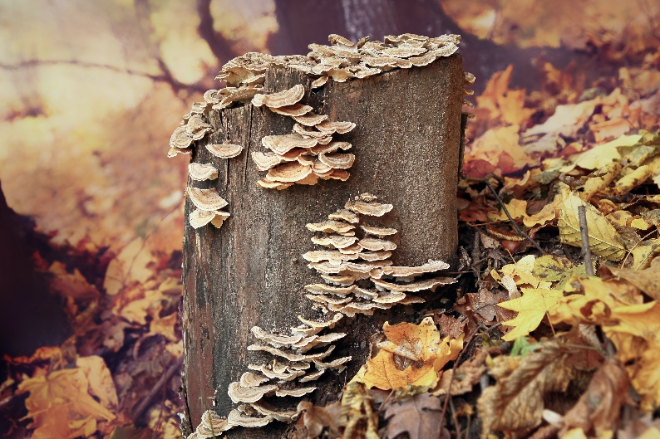
Other benefits
For the planet
Mycelium = the network of fungal threadlike cells in soil that interfaces between plant roots and nutrients
Mushrooms = reproductive structure or fruiting body of the mycelium
Cellular web creates new soil as it breaks down and recycles plant and animal debris
Aids in communication sharing of nutrients between plants
Helps decompose toxic waste
Enhances health of forest
Natural recycler

Slide 10
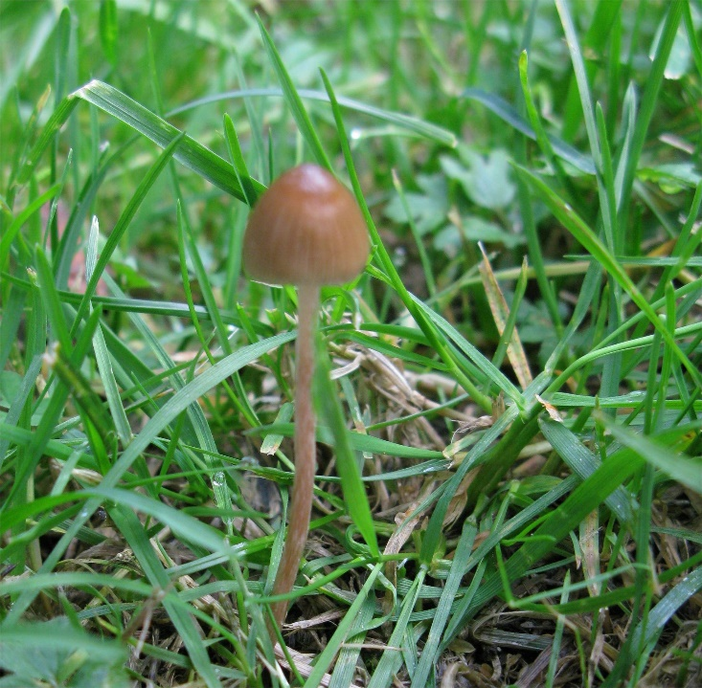
Magic Mushrooms
Liberty Cap mushroom (Psilocybe semilanceata) - psychoactive species in Oregon
Owe their magic to the psychedelic compound, psilocybin
For more info on these – check out Dr. Weil’s writings

Slide 11
G-BOMBS
Dr. Joel Fuhrman
The End of Dieting (and also The End of Diabetes)

Slide 12
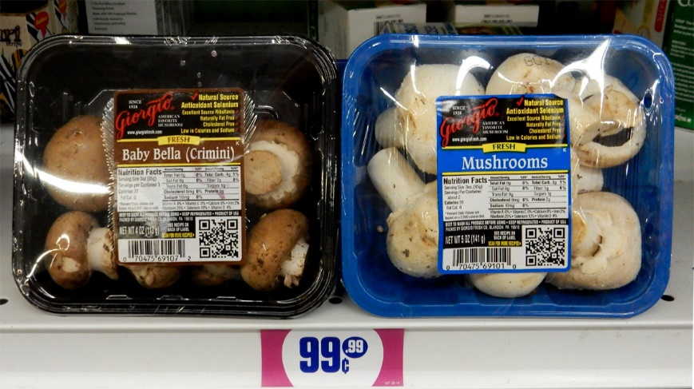
Mushroom preparation in general
Wash or not wash?
When they get wet, hard to dry
Typical button/crimini – can clean with dry cloth
Others need to wash before serving
Per Cook’s Illustrated:
Ethylene gas is released from mushrooms
Store loose mushrooms in slightly open ziplock
Store prepackaged mushrooms in original container

Slide 13
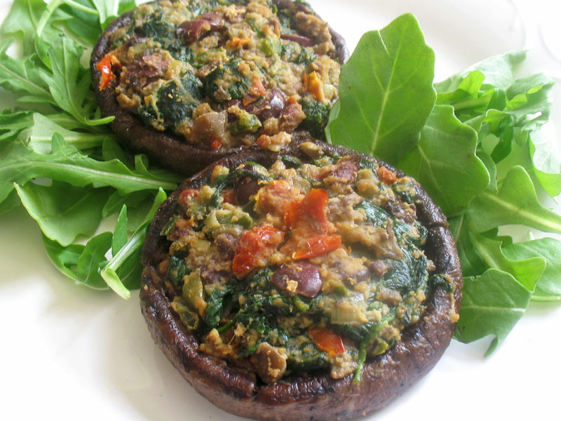
White Button, Cremini and Portobello
All in the Agaricus bisporus species
White are youngest, Portobello are oldest and brown
Cremini are baby portobellos
Anti-cancer effects
Preparation ideas:
Versatile
Soups, stews, salads, stuffed, sliced, burgers

Slide 14
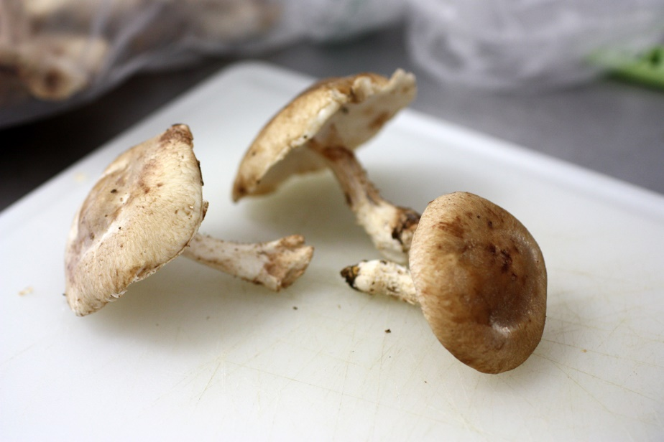
Shiitake Mushrooms
Possible benefits:
lower cholesterol
boost immune function
combat viruses
reduce the risk of several kinds of cancer
Preparation ideas:
Risotto or rice dishes
Sauté alone or with other mushrooms/veggies
Stir fry

Slide 15
Mushrooms exposed to UV light

Slide 16
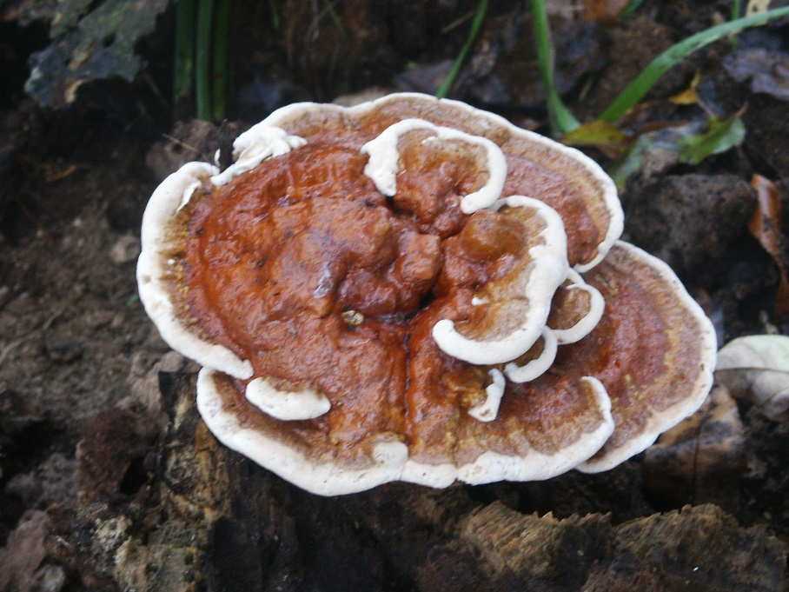
Reishi
Not for eating – very woody
Okay in teas, liquids, topical (skin care)
Possible health benefits:
Lower BP
Immunity
Allergy prevention
Cancer reduction
Anti-inflammatory

Slide 17
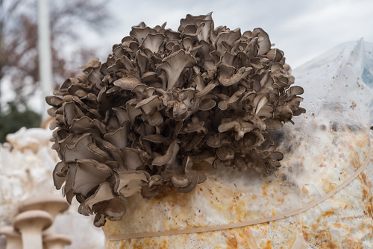
Maitake Mushrooms
Also called Hen of the Woods
Look like tail feathers of a nesting hen
Tasty, available at many markets
Possible benefits:
Anticancer and antiviral
Help control high blood pressure,
Help with blood sugar control
Enhance immune system power
Preparation: Cut into steaks and grill/saute; add to soups/stews

Slide 18
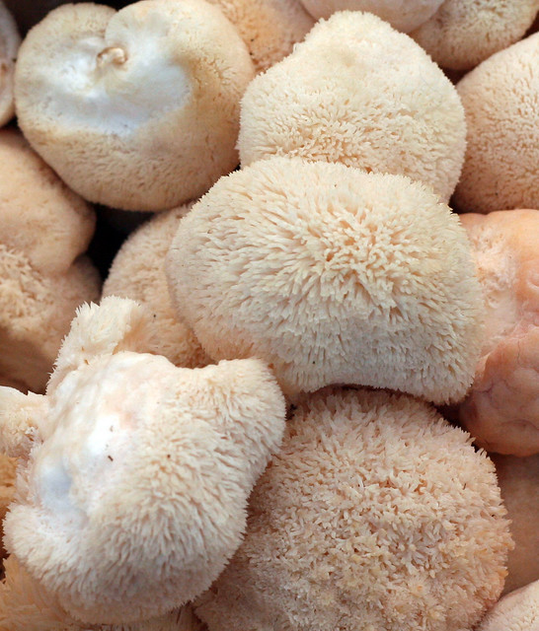
Lion’s Mane
Possible benefits:
Improve mild cognitive impairment
Promote nerve growth
Reduce anxiety and enhance sleep
Available at Farmers’ market and some stores
Can be in dried powders
Preparation: Slice into ‘steaks’ and sauté

Slide 19
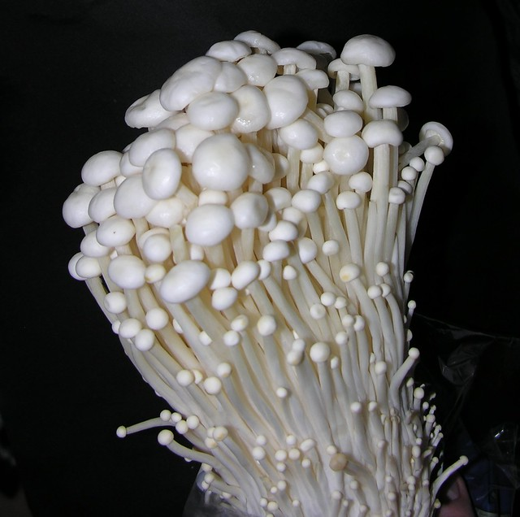
Enoki mushrooms
Looks like long strings
Popular in Japanese cuisine
Possible benefits:
Immunity
Anti-cancer (flammulin has anti-tumor properties)
Preparation ideas:
Sauté, stir fry, salads

Slide 20
King Trumpet/Oyster Mushroom
Longer stem than cap
Use as usual in recipes or try shredded for pulled ‘pork’
Shred the stems with tines of fork
Soak in marinade about 1 hour
Heat on skillet and add a little BBQ sauce
Turn into sliders
NOTE: $9.99/pound at Whole Foods and Farmers’ Market. 1# shreds makes
About 3 sandwiches

Slide 21
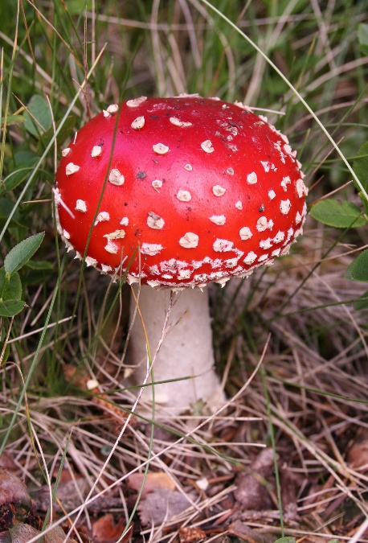
Mushrooms – Bottom Line
Great addition to whole food, healthy meals
Multiple health benefits
Super cancer fighters
Nutrient-dense (not calorie dense)
Versatile in recipes
Good meat replacement or meal expander in recipes
What will you do this week?
Go to Farmers’ Market or favorite store and check out the mushroom varieties
Try a new mushroom!!

