Slide 1
Where do you get your protein?
Debbie Lucus, MS, RD, CDCES
02.02.21
dlucusrd@gmail.com
Notes:
On the next few slides we’ll look at a few common varieties of beans and discuss their shape, size, and flavor.

Slide 2

February is Heart Month
Heart disease kills more people every year than all cancers combined
One person dies every 36 seconds in US from heart disease
83% believe that they can do something to reduce risk, but don’t feel motivated to do so
58% don’t do anything to lower risk

Slide 3
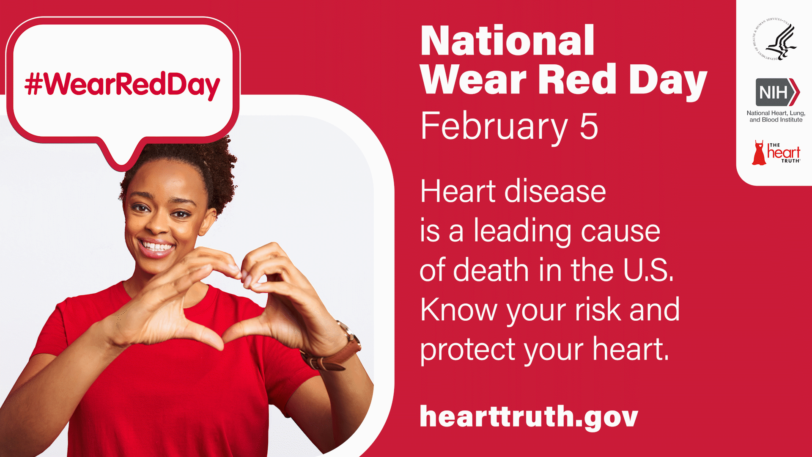

Slide 4

Heart Disease is #1 killer of women & men
G: GET YOUR NUMBERS
Talk to your doctor
O: OWN YOUR LIFESTYLE
Stop smoking, lose weight, exercise, and eat healthy.
It’s up to you. No one can do it for you.
R: REALIZE YOUR RISK
We think it won’t happen to us, but heart disease kills one of three women.
E: EDUCATE YOUR FAMILY
Make healthy food choices for you and your family.
Teach your kids the importance of staying active.
D: DON’T BE SILENT
Tell every woman you know that heart disease is our No. 1 killer.

Slide 5
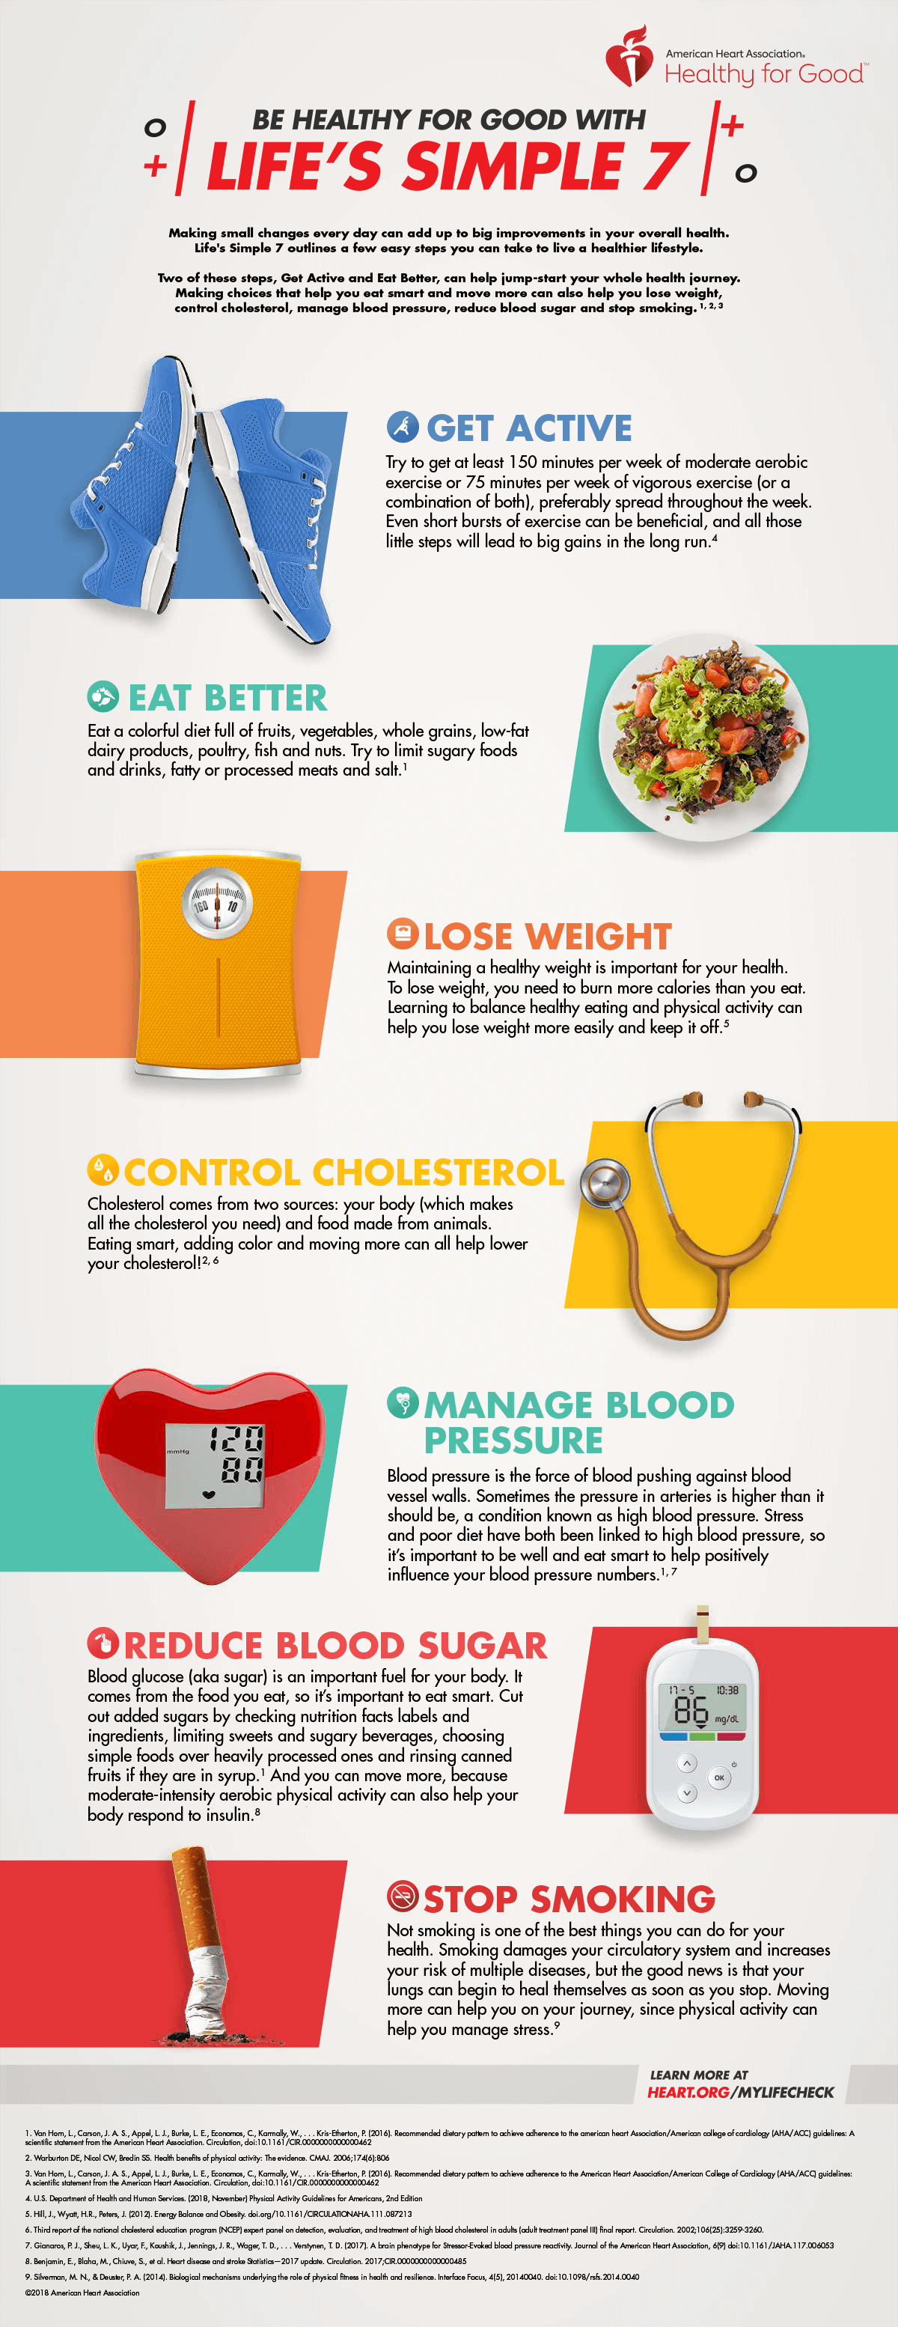
Only 3% of Americans achieve all 7

Slide 6
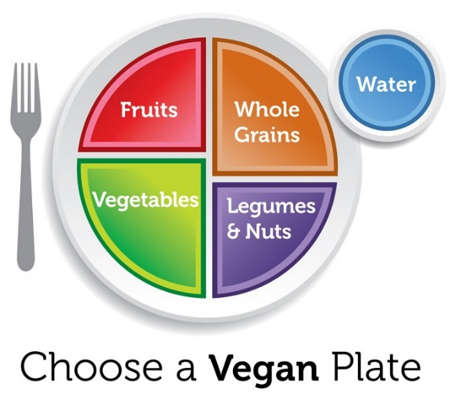
Meal Planning - Macronutrients

Slide 7
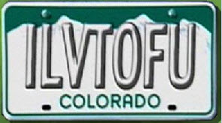
Where’s the Beef?
Meal planning basics:
  Plant protein
  Unprocessed carbs
  Healthy Fats

Slide 8
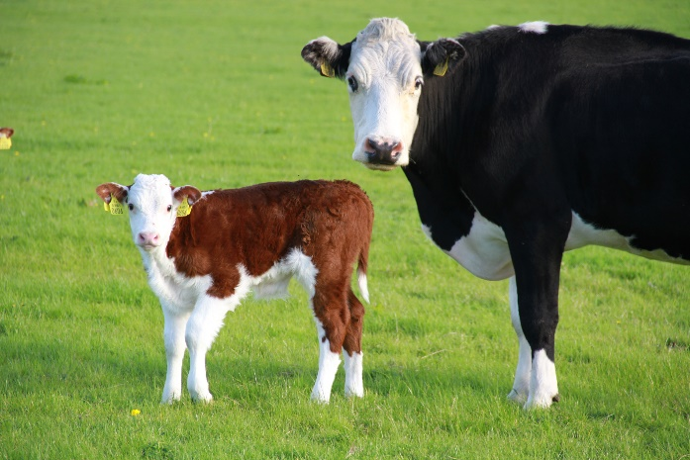
Why are plant protein sales on the rise?
Benefits of plant-based proteins showing improvement in:
  Heart disease
  Obesity
  Hypertension
  Type 2 diabetes
  Some cancers
Environmental impact
  Meat production contributes to greenhouse gas emissions
Concern over treatment of farm animals

Slide 9

Why Protein?
Essential for body’s structure and movement
  Building & repair of tissues and cells
  Antibodies
  Enzymes
  Hormones
  Carriers (moves oxygen and electrons)
Important for weight loss
  Satiety
  Preserves lean muscle mass

Slide 10
How much protein do I need?
0.8 – 1.0 grams protein per kilogram (OR 0.36 – 0.45 grams per pound)
Most vegans need about 1.0 grams/kg (0.45 grams/pounds)
Uses our current/ideal body weight – extra body fat doesn’t need more protein
200# x 0.36 grams/pounds = 72 grams protein/day
  For most, the range is 40-80 grams
  About 10-20 percent of your calories from protein

Slide 11

Protein quality
Building blocks of protein are amino acids
  Animal protein = all of the essential amino acids (also called indispensable)
  Plant protein = all the essential amino acids, but not all in large quantities
Combining a variety of plant foods will ensure adequate amino acids
Beans are low in methionine, grains are low in lysine
Don’t need to combine at same meal

Slide 12
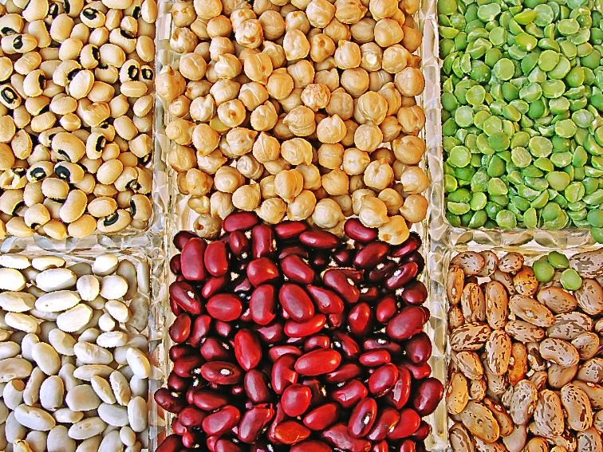
Lysine
Most limited amino acid in vegan diet
Tofu, tempeh, soy, lentils, seitan and other beans
Quinoa, pistachios, amaranth, pumpkin seeds
Have legumes (beans, peas, peanuts), soy every day

Slide 13
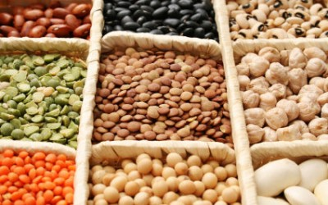
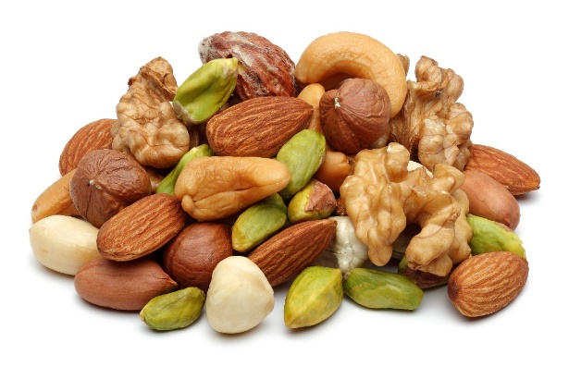
Protein power from plants
Beans and legumes
  7-9 grams/1/2 cup serving
  Cooked, dried beans
  Lentils
  Soy beans
  Split peas
  Beans provide the most lysine
Nuts & Seeds
  5-8 grams/1/4 cup serving
  Nut butters (2 Tbsp serving)
  Flax/Hemp/Sesame/Sunflower seeds

Slide 14
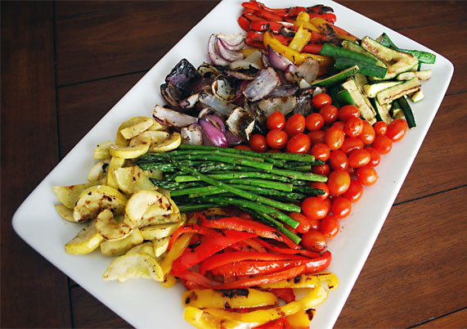
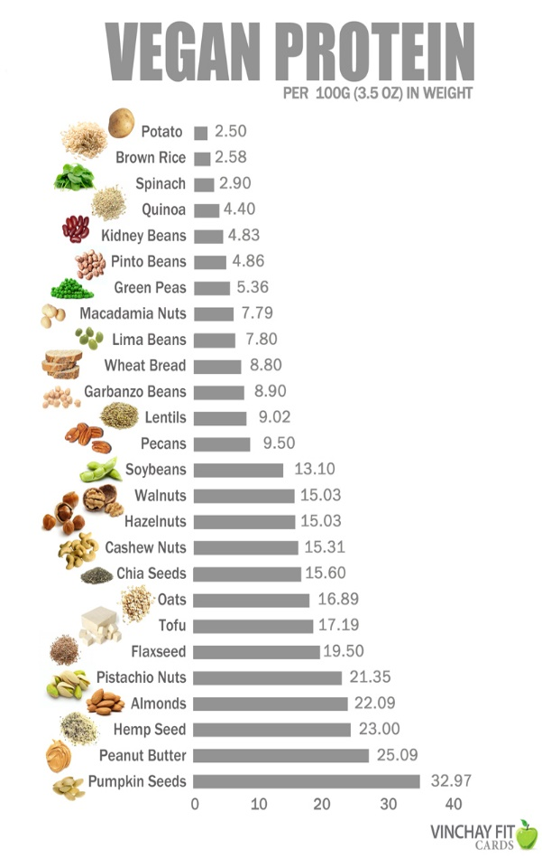
Protein power from plants
Grains
  2-6 grams/serving
  Quinoa
  Oats (oat groats are highest protein of the oats)
  Wheat & Wheat berries
  Wheat sprouts
Veggies
  1-3 grams/serving for most veggies

Slide 15
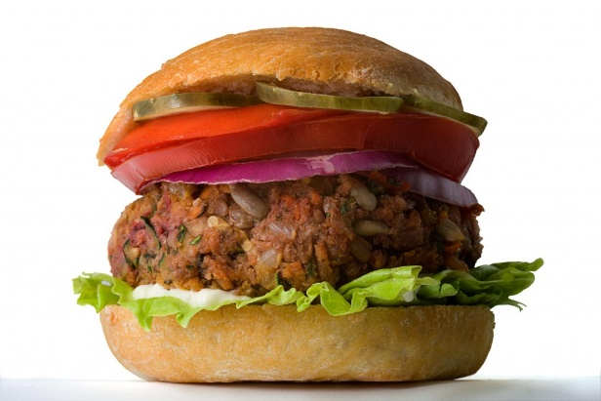
Back to ‘where’s the beef?’…
  Unprocoessed Soy: Tofu, Tempeh (fermented soy), edamame, soy milk
  Seitan (wheat meat)
  Beans & other legumes
  Faux meats are easy options (but more processed)
  Make your own veggie burgers
  Nuts & seeds
  Veggies, whole grains
  Soy milk, soy curls
  Jackfruit (meat-like, but low in protein – 3g/cup))

Slide 16
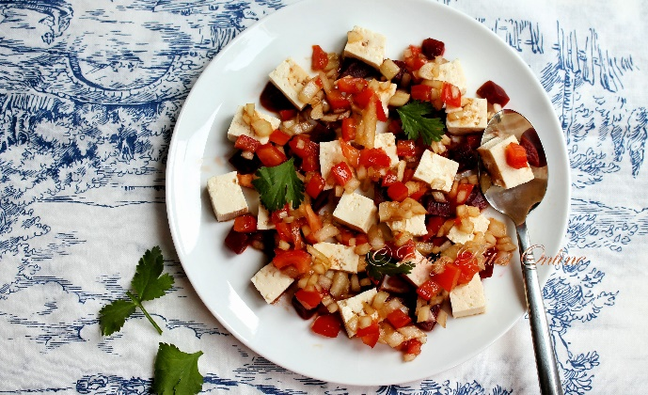
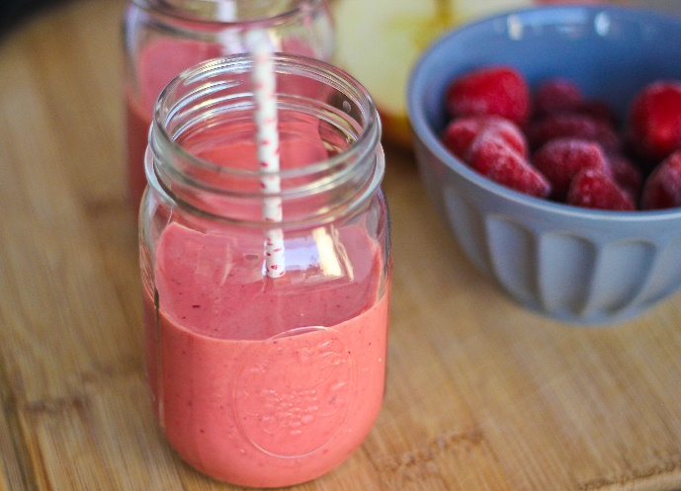
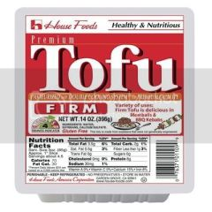
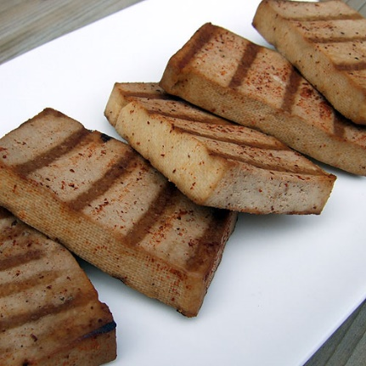
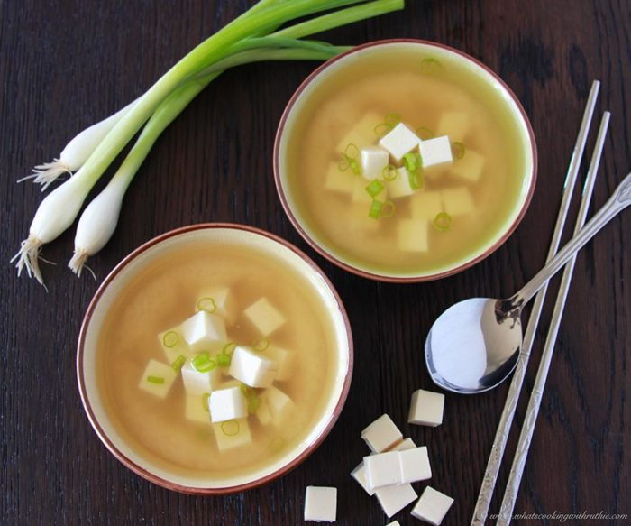
What to do with: Tofu?
Curdled soy milk, pressed into ‘cake’
Press out liquid
Slice, cube, crumble
Bake, grill, sauté, stir fry
Blend into smoothie, dips, sauces
Egg replacer
Add to salad, sandwich, soups
Or just eat the soy bean

Slide 17
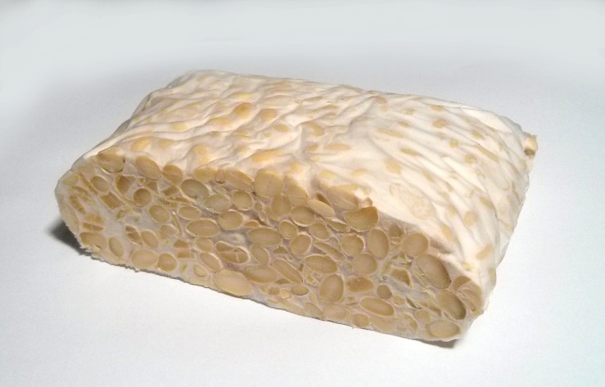
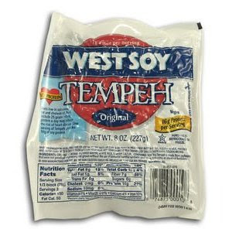
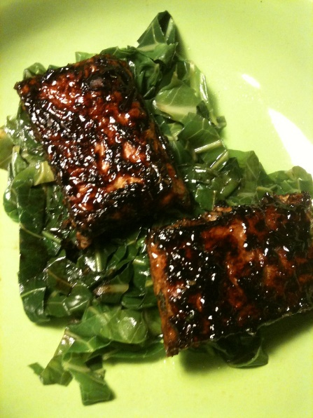
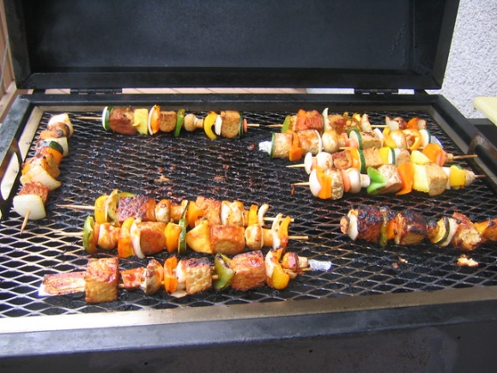
What to do with: Tempeh?
Fermented soy with a grain
17 grams protein/serving
Steam for 15 minutes to mellow flavor (Dr. Greger)
Cut into chunks
Add to soups, stews, stir fry
Grill and add to salads, sandwiches
Grate and put into soups

Slide 18
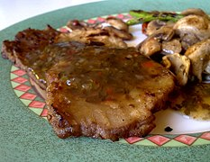


What to do with: Seitan
Wheat meat – gluten (protein) in flour
  Wash the flour until starch is gone and protein remains
Meat-like texture
Bake, broil, grill
Add to soups, stews

Slide 19
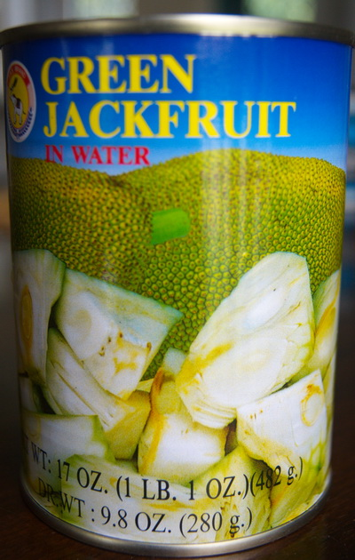
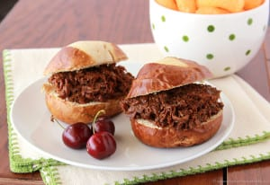
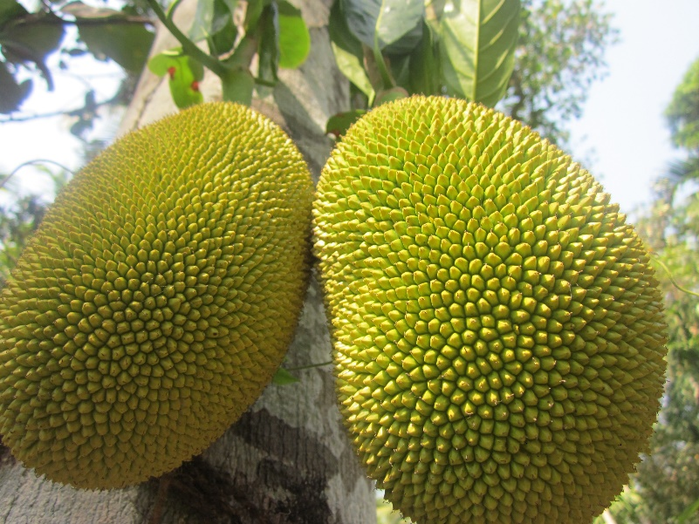
What to do with: Jack Fruit
Meat-like texture, but not high in protein
Cut into chunks, heat and shred the little triangles
BBQ ‘pork’ sliders

Slide 20
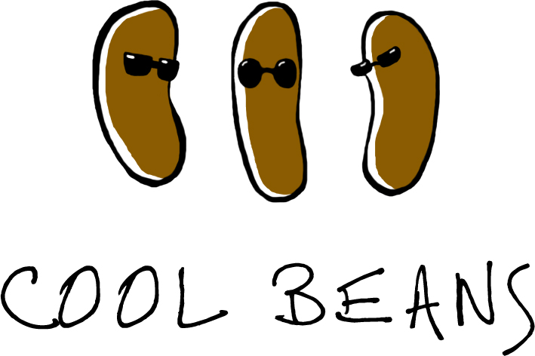
Can I use canned beans? YES!
Bean salad
Hummus/spreads
Top a salad
Add to pasta
Tacos/burritos
Buddha bowls
Soups, chili, stews
Side dish
????

Slide 21
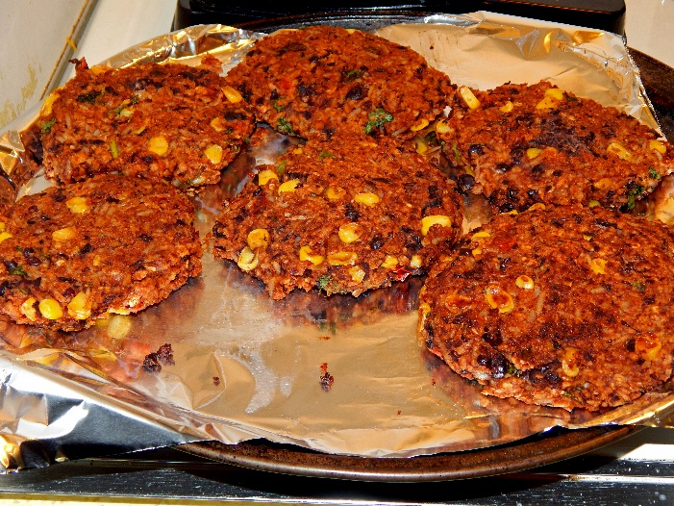
Make your own veggie burgers
Beans + whole grains + veggies
For example:
  Black/kidney beans + oatmeal + brown rice (cooked) + BBQ sauce
  Sweet potato + garbanzo bean + oats + quinoa

Slide 22
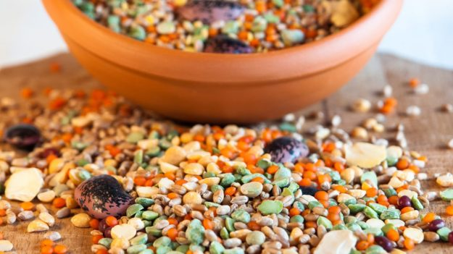
Protein – bottom line
It is easy to get enough plant-powered protein
Choose whole, real foods
Get a variety of plant foods throughout the day
Choose 3-4 servings of protein food daily:
  ½ cup cooked beans
  ½ cup tofu or tempeh
  ¼ cup peanuts
  1 cup soymilk
  2 tablespoons peanut butter

Slide 23
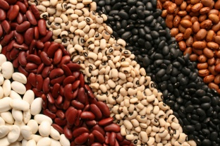
What new protein will you try this week?

