Slide 1
Let’s Batch Cook!
Debbie Lucus, MS, RD, CDCES
07.21.20

Slide 2
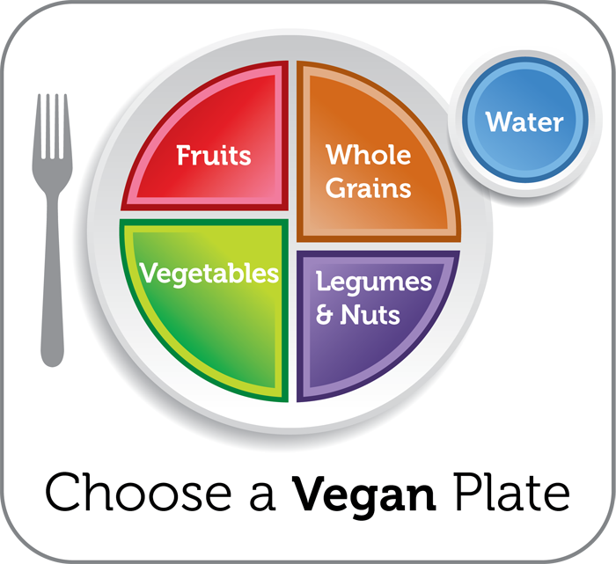
Meal Planning with 4 food groups
Fruit (3/day) + Vegetable (4+/day)
Aim for fruit &/or veg at every meal
A whole grain (5/day) or starch with every meal
A protein (3/day) or with every meal

Slide 3
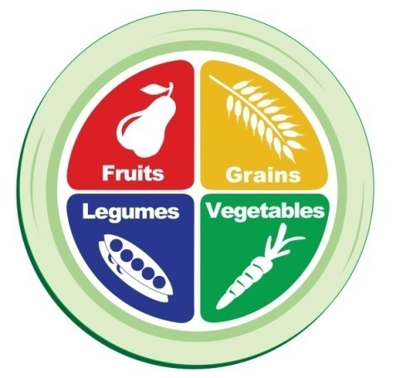
Sample meals
Breakfast
Fruit + Grain + Protein/Dairy sub
Lunch
Vegetable + Grain + Protein
Dinner
Vegetable + Grain + Protein + Fruit
Snack(s)
Fruit or veggie or protein or healthy fat
Snacks appropriate if hungry or will be long time until next meal
Notes:
Breakfast Ideas:
Oatmeal + BB + walnuts + non-fat milk
Toast + grapefruit + 1 egg
Yogurt + granola + berries
Lunch Ideas:
Salad with a grain + lentils
Sandwich + lean meat + side salad
Pasta + chicken + veggies
Leftovers
Snack
Handful of almonds + dried fruit
Apple with PB
Yogurt + flaxseed
Dinner
NS veggie + grain + lean meat
NS veggie + grain + lentils

Slide 4
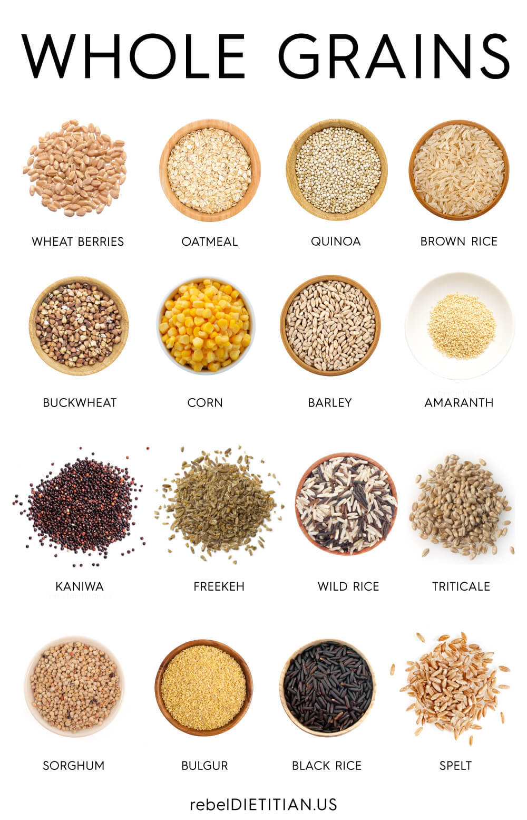

Slide 5
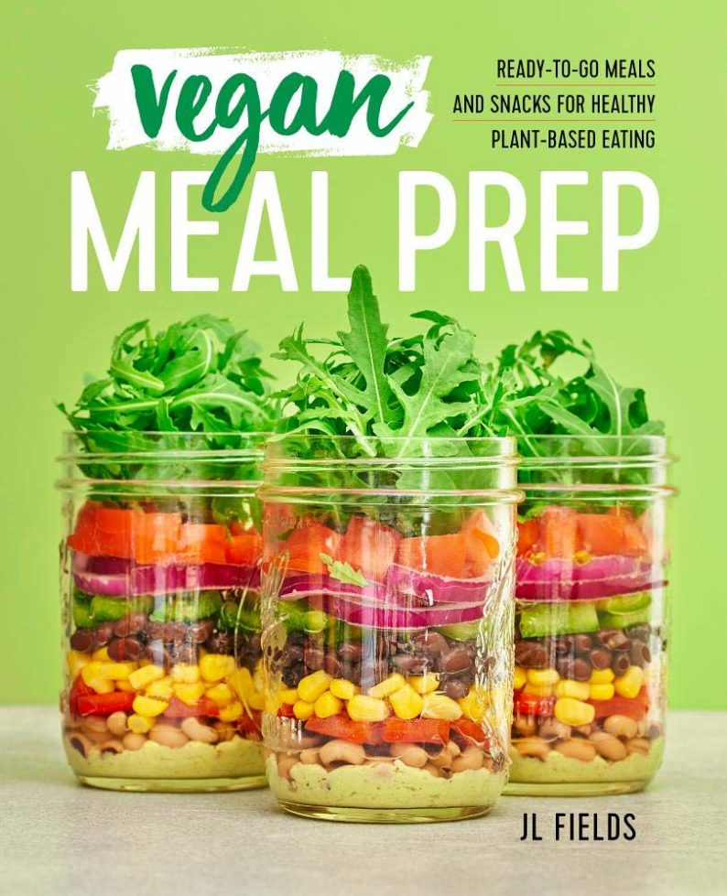
Tips for Batch Cooking
What’s in season?
What is your week going to be like?
Pick out a few recipes
Make a menu
Make a shopping list
Get to know your store/farmers’ market
Stock the pantry
Prep foods for the week
Make your meal components that you can recycle into other items

Slide 6
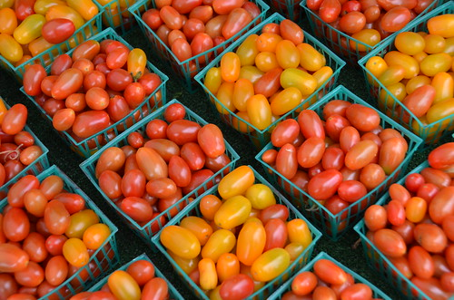
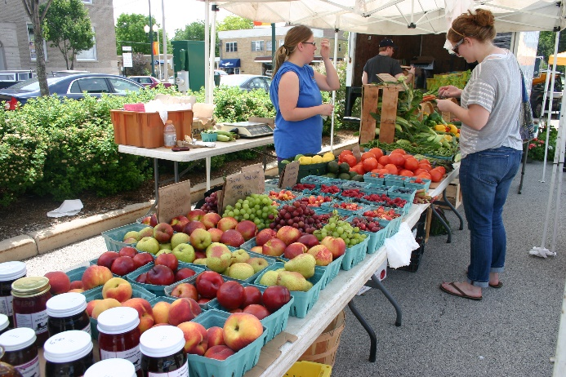
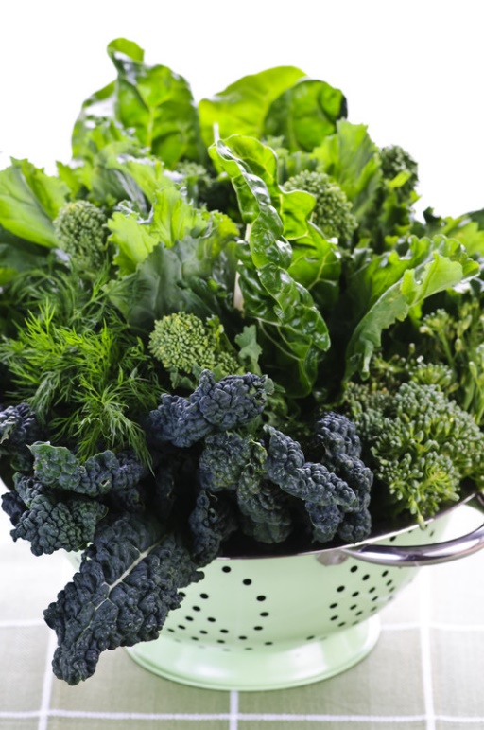
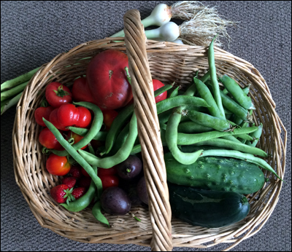
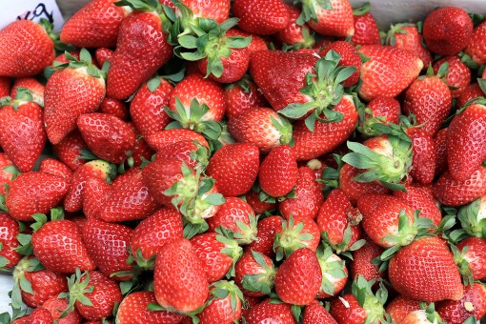
What’s in season now?

Slide 7
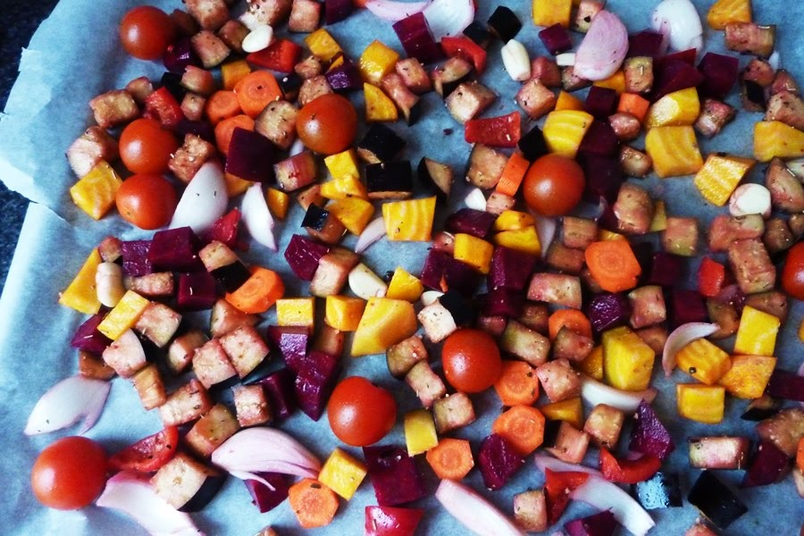
What can I prep for the week?
Oats
Grains/rice/quinoa/pasta
Beans/Lentils
Tofu/tempeh – baked, scrambled
Baked or roasted potatoes
Chop veggies/fruits for the week’s recipes:
Diced, sliced, wedges, chopped
Roast some, leave some raw for recipes
Prep quick-grab fruits and veggies

Slide 8
What’s on the menu this week?
Oatmeal or quinoa
Lentils
Sweet potatoes
Brown Rice
Make some sauces (see handout)
Extras: greens, chopped veggies, roasted veggies (ie. cauliflower, peppers, onions)

Slide 9
Batch cooking fun
https://www.youtube.com/watch?v=oL2rCOOECQ0
https://www.youtube.com/watch?v=24-pIuXQ290

Slide 10
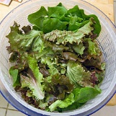
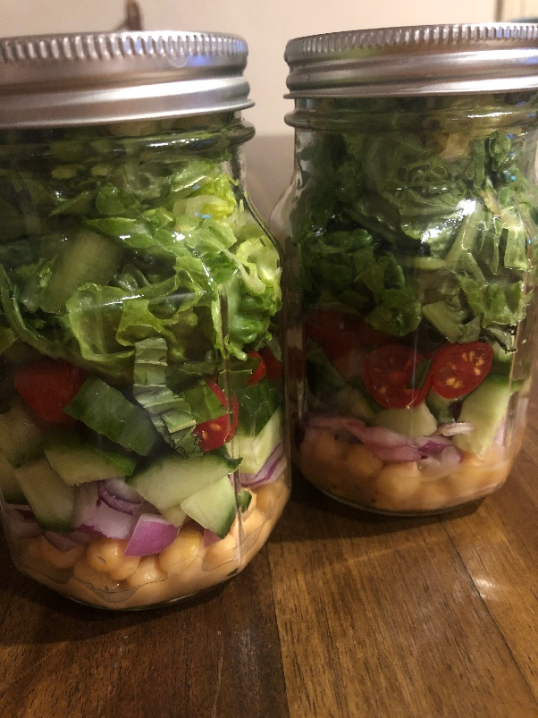
Make a big salad
Chop lots of dark greens
Add other favorite chopped veggies
Top with your batch items:
Rice or quinoa
Lentils
Nuts/seeds
Fruit

Slide 11
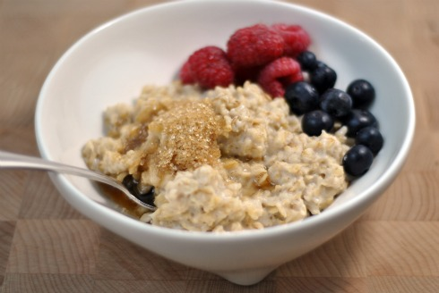
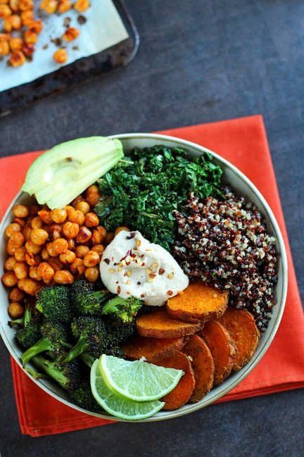
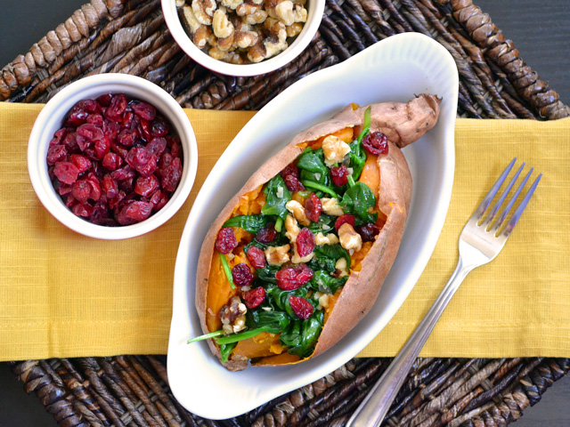
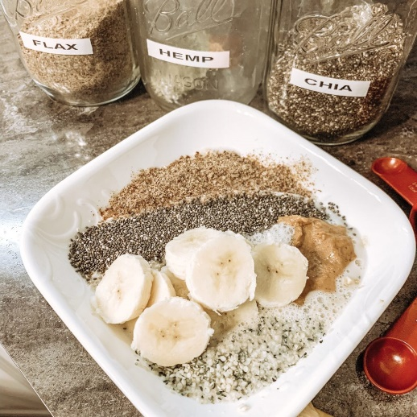
Put together some meals
Oatmeal or quinoa bowl for breakfast
Power bowl for lunch
Different flavored bowl for dinner or serve items over your sweet potato
Stuff your items into pita, tortilla, bread

Slide 12
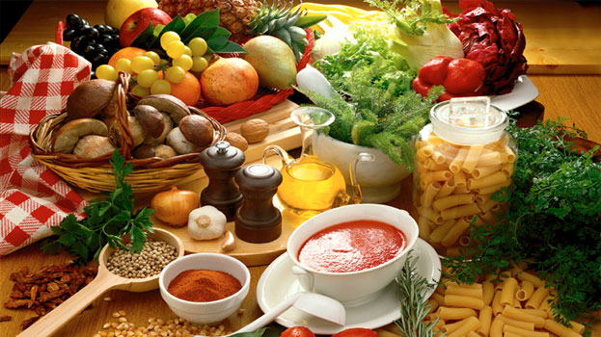
What will you try this week?
Pick an item or two you’d like to try batch cook this week
What will be on your menu?
What will be on your shopping list?
When will you do some prep…and make your meals quick and easy for the week?

Slide 13
Notes:
All I wish, is that people would eat as if their life depended on it!

