Slide 1
Let’s BBQ during quarantine (AKA – where’s the beef?)!
Debbie Lucus, MS, RD, CDCES
05.12.20
dlucusrd@gmail.com
Notes:
On the next few slides we’ll look at a few common varieties of beans and discuss their shape, size, and flavor.

Slide 2
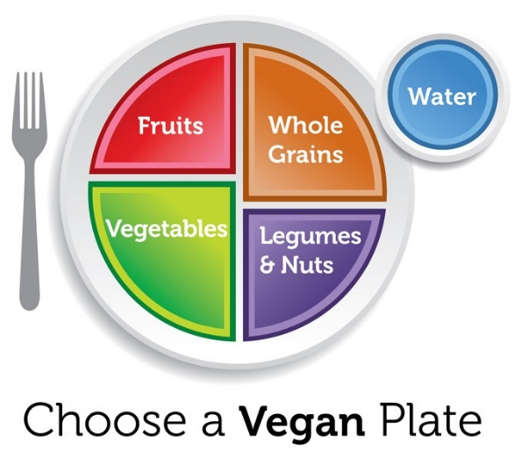
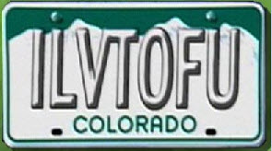
Where’s the Beef?
Meal planning basics:
  Plant protein
  Unprocessed carbs
  Healthy Fats

Slide 3
Why Protein?
Essential for body’s structure and movement
  Building & repair of tissues and cells
  Antibodies
  Enzymes
  Hormones
  Carriers (moves oxygen and electrons)
Important for weight loss
  Satiety
  Preserves lean muscle mass

Slide 4
How much protein do I need?
0.8 – 1.0 grams protein per kilogram (OR 0.36 – 0.45 grams per pound)
Most vegans need about 0.9 grams/kg (0.4 grams/pounds)
Uses our current/ideal body weight – extra body fat doesn’t need more protein
200# x 0.36 grams/pounds = 72 grams protein/day
  For most, the range is 40-80 grams
  About 10-20 percent of your calories from protein

Slide 5

Protein quality
Building blocks of protein are amino acids
  Animal protein = all of the essential amino acids (now called indispensable)
  Plant protein = all the essential amino acids, but not all in large quantities
Combining a variety of plant foods will ensure adequate amino acids
Beans are low in methionine, grains are low in lysine
Don’t need to combine at same meal

Slide 6
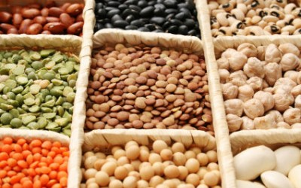
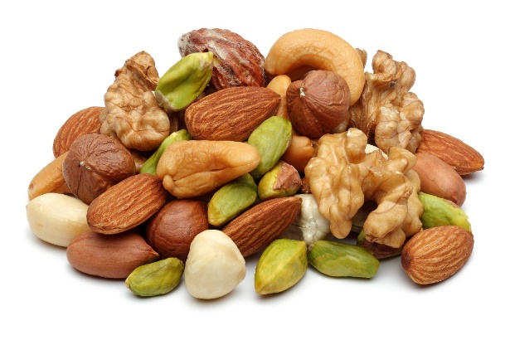
Protein power from plants
Beans and legumes
  7-9 grams/1/2 cup serving
  Cooked, dried beans
  Lentils
  Soy beans
  Split peas
  Beans provide the most lysine
Nuts & Seeds
  5-8 grams/1/4 cup serving
  Nut butters (2 Tbsp serving)
  Flax/Hemp/Sesame/Sunflower seeds

Slide 7
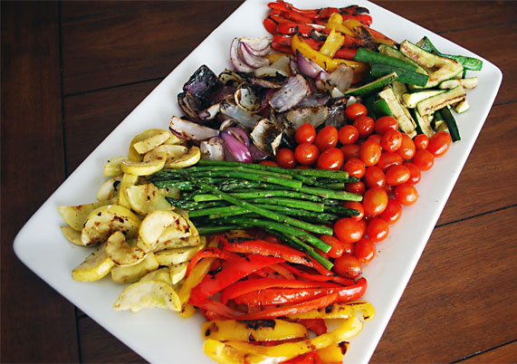
Protein power from plants
Grains
  2-6 grams/serving
  Quinoa
  Oats (oat groats are highest protein of the oats)
  Wheat & Wheat berries
  Wheat sprouts
Veggies
  1-3 grams/serving for most veggies

Slide 8
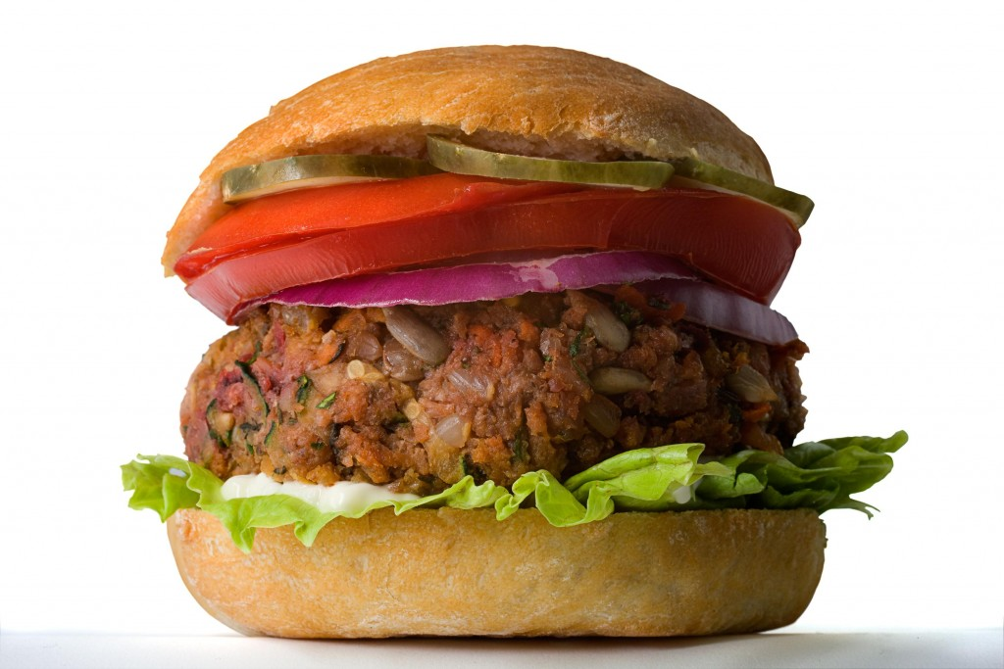
Back to the BBQ…
  Veggies burgers/sausages are easy options (but more processed)
  Make your own veggies burgers
  Tofu (squeeze out the liquid, cut into slices, marinate and grill)
  Tempeh (fermented soy)
  Seitan (wheat meat)
  Portobello mushroom ‘burger’
  Veggies
  Pizza or flatbreads
  Jackfruit
  Fruit (doesn’t contribute protein, but is tasty)

Slide 9
Make your own veggie burgers
Beans + whole grains + veggies
For example:
  Black/kidney beans + oatmeal + brown rice (cooked) + BBQ sauce
  Sweet potato + garbanzo bean + oats + quinoa

Slide 10

What can you do with canned beans?
Bean salad
BBQ beans
Top a salad
Add to pasta
Tacos/burritos
Bowls
Soups, chili, stews
????

Slide 11
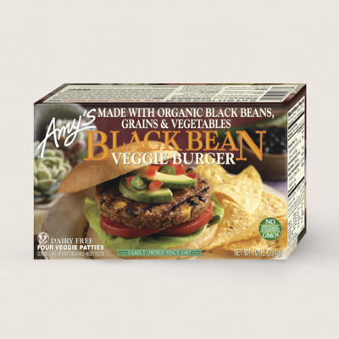
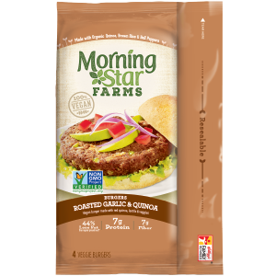
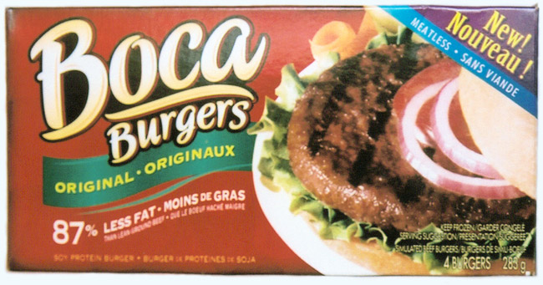
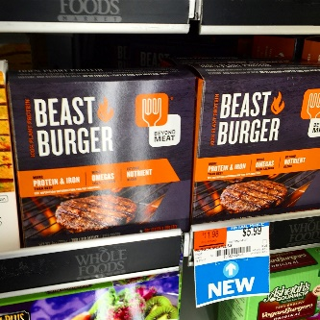
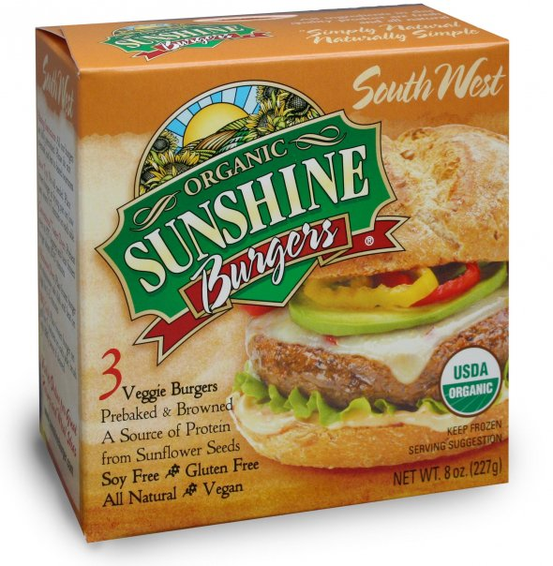
Pre-made Veggie burgers
An Insanely Good Burger Made From Sanely Good Ingredients – Impossible Burger

Slide 12
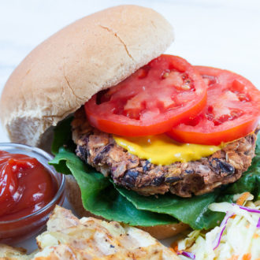
Baked BBQ burgers
Ingredients:
2 15-oz cans black beans, rinsed and drained
1 15-oz can kidney beans, rinsed and drained
1 c rolled oats
1 c cooked brown rice – prepare in advance
½ cup barbecue sauce
1 Tbsp onion powder

Slide 13
BBQ Side Dish – Cowboy Caviar
Ingredients:
  1.5 cups black eyed peas (canned okay)
  1.5 cups corn kernels
  2/3 cup green onions
  2/3 cup cilantro
  1.5 cups tomatoes
  2 cups shredded cabbage (can shred your own or by a slaw mix – I use Rainbow Broccoli Slaw
  For the dressing: red wine vinegar, hot sauce (ie. Tabasco), garlic, pepper,

Slide 14
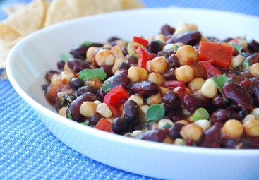
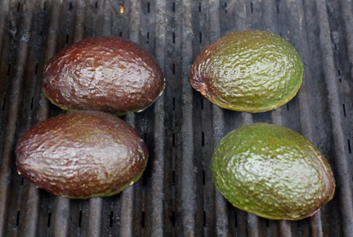
BBQ side dishes providing protein power
Beans
  Baked beans
  3 bean salad
  Cowboy caviar
    Add some broccoli slaw to volumize this awesome bean salad (found in the CWP cookbook)
Dips
  Hummus =beans + tahini (sesame seed paste)
Veggies
  Corn
  Avocado
  Mixed veggies/potatoes (cook potatoes in microwave a little first)

Slide 15
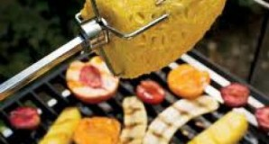
Fun things to grill that aren’t protein powerhouses
Fruit
  Pineapple
  Peaches/nectarines/plums
  Watermelon
  Fruit kebabs
S’mores
Portobello mushrooms (marinate first – make great ‘burgers’)
Quesadilla
  Instead of cheese, use hummus or bean spread as the spread with a bunch of veggies
  Dessert quesadilla: spread PB on tortilla, top with sliced banana and vegan mini chocolate chips, fold tortilla in half and lay on grill pan

Slide 16
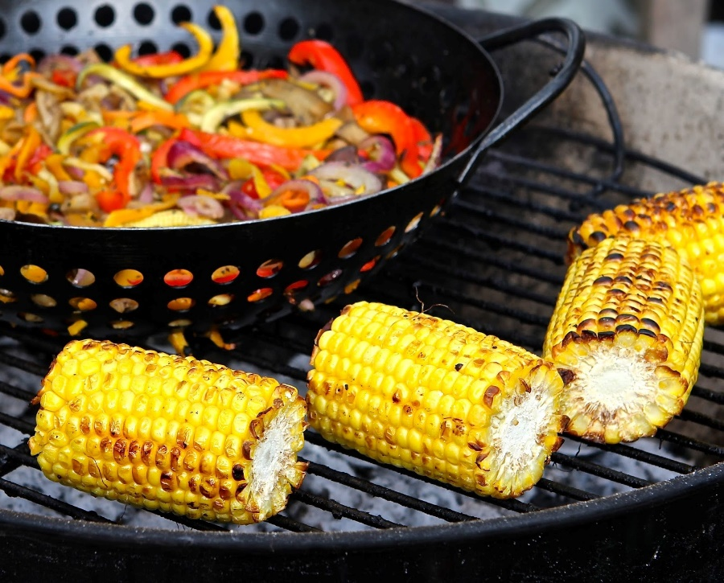
Helpful BBQ Tools
Besides the grill, tongs and spatula-
BBQ Wok
BBQ flat grill
Pizza grill pan
Quesadilla grill pan

Slide 17
Protein – bottom line
It is easy to get enough plant-powered protein
Choose whole, real foods
Get a variety of plant foods throughout the day
Choose 3-4 servings of protein food daily:
  ½ cup cooked beans
  ½ cup tofu or tempeh
  ¼ cup peanuts
  1 cup soymilk
  2 tablespoons peanut butter

Slide 18
BBQ Bottom line
Veggie ‘meats’ are an option
  Make your own or buy pre-made
  Responsible eating and living (REAL) https://responsibleeatingandliving.com/category/blogs/recipes/holidays/summer/
Add healthful sides
  Beans
  Grilled veggies
  Dips with veggies or crackers
Have grilled fruit for dessert (unless you are going for the s’mores)

Slide 19
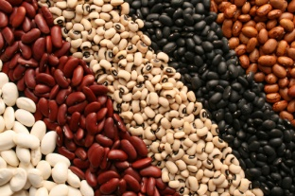
What will you do with beans this week?

