Slide 1
Making Carbs Count
Debbie Lucus, MS, RD, CDCES
Sutter Medical Foundation
Patient Education
lucusds@sutterhealth.org

Slide 2
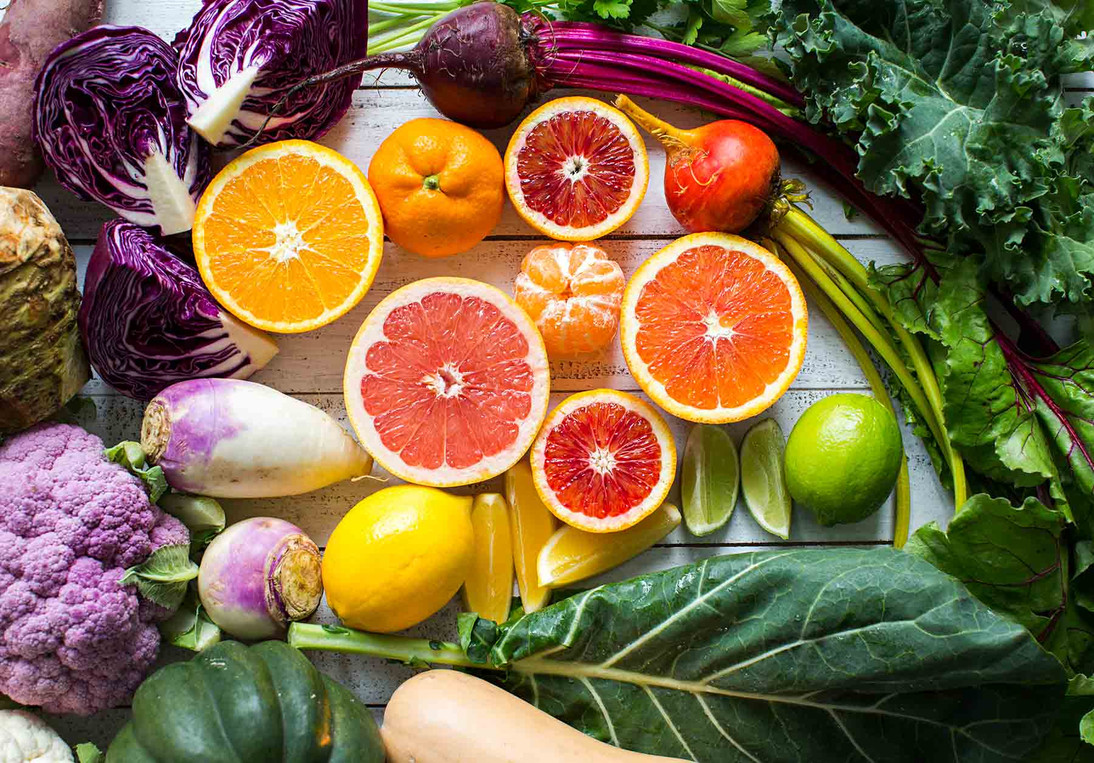
What’s in Season?
Citrus:
  Lemons, oranges, grapefruit
  Cara Cara oranges
  Blood oranges
  Pomelos
Root Vegetables:
  Beets, turnips, celery root
  Rutabaga, parsnips
Veggies in Brassica family:
  Cabbage, kale, collards, broccoli, cauliflower
  Try different color cauliflower
Winter Squash:
  Butternut Squash, acorn squash
  Delicata, spaghetti, kabocha

Slide 3
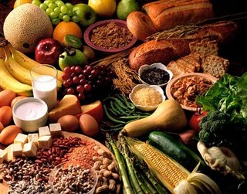
Carbohydrates
Carbohydrates = long strings of sugar
Turn into sugar in the bloodstream
Carbs with fiber turn into sugar slowly
4 calories in every gram of carb
  4 calories/g in protein
  9 calories/g in fat
Brain, heart, nervous system love carbs

Slide 4
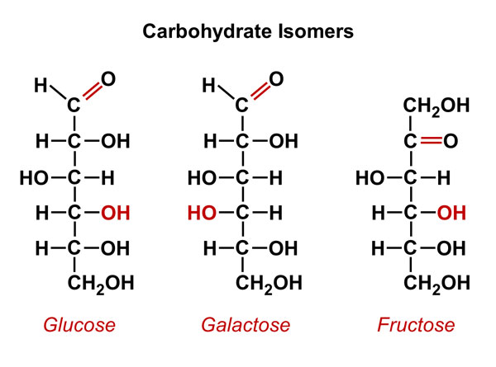
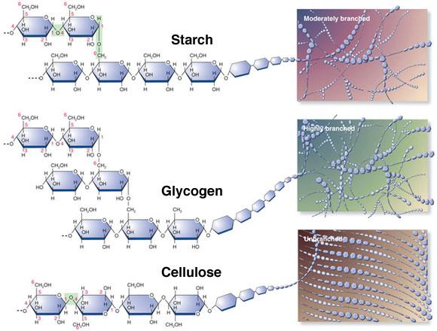
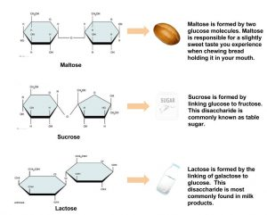

Slide 5
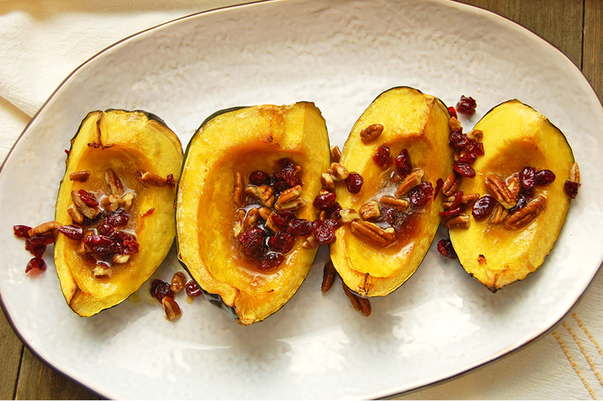
Which foods are carbs?
Healthy carbohydrates:
  Fruits & veggies
  Starchy Vegetables
    Corn, peas, potatoes
    Sweet potatoes, yams, winter squash
  Whole grains
  Some low-fat proteins
    Beans, lentils, non/low-fat dairy & dairy substitutes
Carb choices to limit:
  Processed; white flour & products; sweets

Slide 6
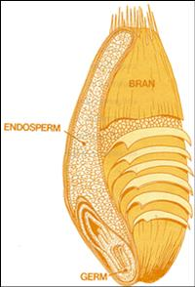
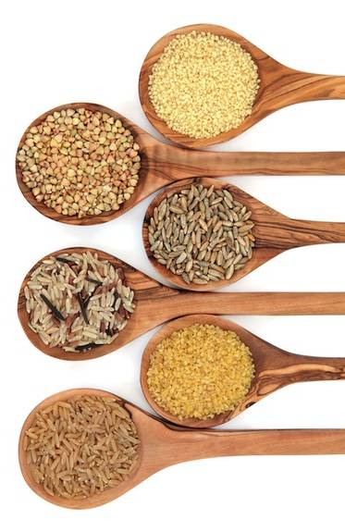
Whole Grains

Slide 7
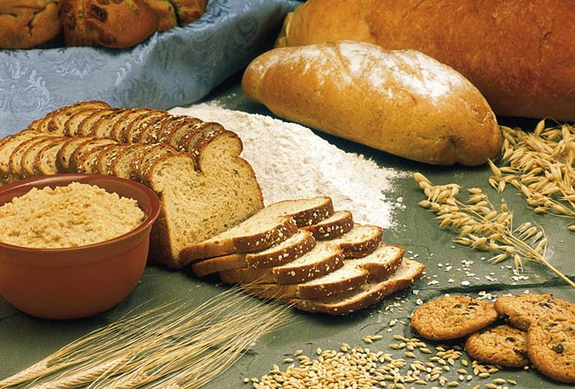
What is an Intact Whole Grain?
Hierarchy of whole grains:
Intact whole grain (i.e. oat groats, quinoa, barley)
  Broken Whole grains (ie bulgur)
  Rolled Whole Grains (oatmeal)
  Shredded Whole Grains (shredded wheat)
  Ground Whole grains (whole wheat flour)
  Flaked Whole Grains (flaked cereals)
  Puffed Whole Grains (puffed cereals)

Slide 8
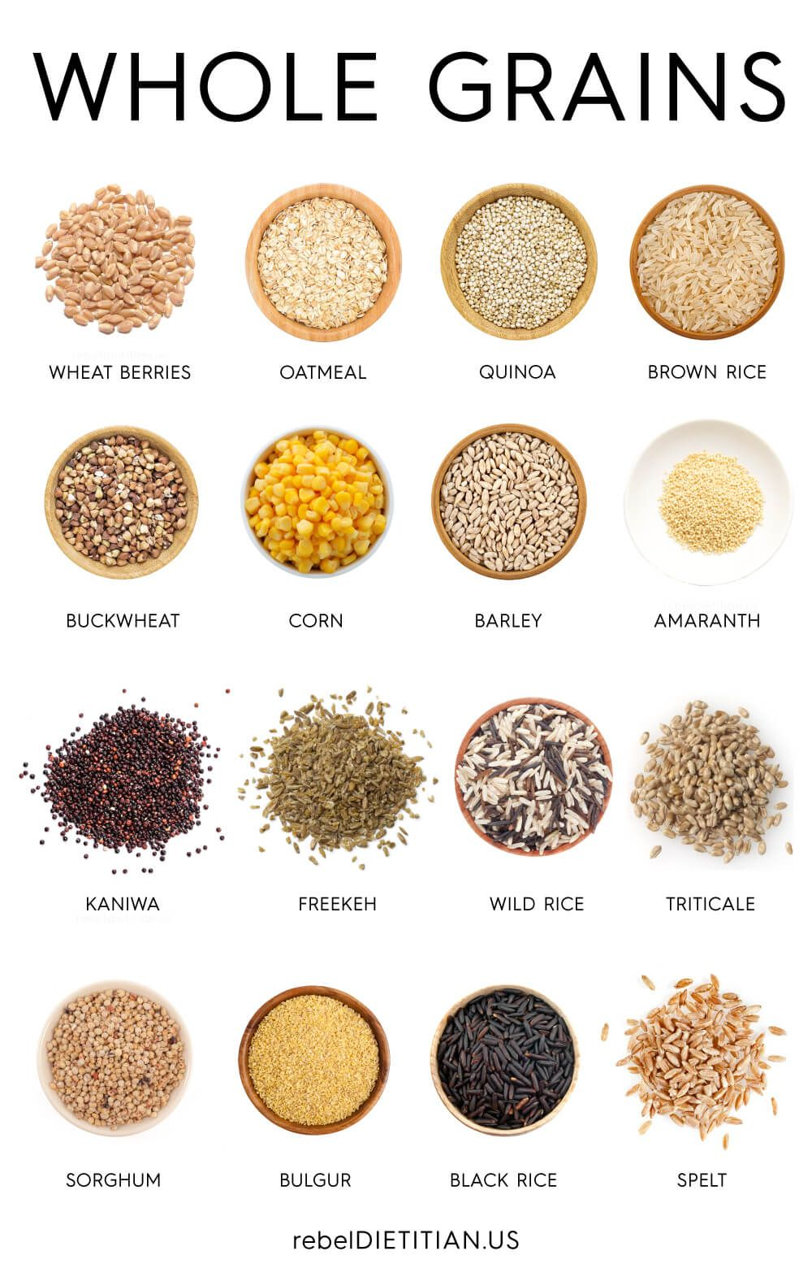
Try some new whole grains
  Bulgur
  Farro
  Millet
  Quinoa
  Buckwheat
  Barley

Slide 9
Fiber is a Carb
Indigestible part of plants
  Fruits & veggies
  Beans, lentils, & peas
  Nuts & seeds
  Whole wheat bread/pasta
  Wild/brown rice
  Barley, bulgur, quinoa, Israeli couscous & farro
  Bran, wheat, & oats
Two types of fiber:
  Insoluble
  Soluble
Notes:
9
Monounsaturated fat, some protein.
Some nuts and seeds (flax, walnuts) are excellent sources of essential fatty acids, and some (sunflower seeds, almonds, hazelnuts) are good sources of vitamin E.
Note: a handful is small portion.

Slide 10
Benefits of Fiber
Lowers cholesterol (soluble)
Reduces constipation, hemorrhoids (insoluble)
Increases feeling of fullness (helps with weight loss)
Slows blood sugar rise (helps with diabetes)
Lowers risk of some cancers
  Colon (decreases transit time, breaks down to butyrate in colon – inhibits tumor growth)
  Breast (binds to estrogen)
  Prostate
  Mouth, esophageal, throat

Slide 11
Soluble Fiber
Benefits
  Dissolves into a gel-like substance in the intestines
  Blocks cholesterol from being absorbed from intestines into blood stream
Sources
  Oats
  Beans
  Barley
  Pears
  Apples
  Psyllium (Metamucil)

Slide 12
Insoluble Fiber
Benefits
  G.I. health
    Travels through the digestive tract & creates bulk
    Helps the colon function properly
Sources
  Whole grains (wheat)
  Fruit & Vegetables
  Beans, lentils, peas
  Nuts and seeds

Slide 13
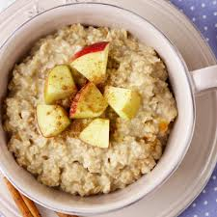

Serving sizes = 15 grams carb
Starches/Grains:
  1 slice bread
  ½ hamburger bun, hot dog bun, English muffin
  1/3 cup cooked rice, pasta, quinoa, barley
  ½ cup cooked oats or other hot cereal
  ¾ cup (1 oz) of cold cereal
Fruit:
  1 small piece fruit (= tennis ball)
  ¾-1 cup cut up fruit
  ½ cup juice
  2 Tbsp dried fruit

Slide 14

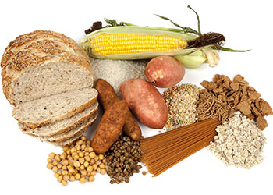
Serving sizes = 15 grams carb
Dairy:
  1 cup milk or plain yogurt
  1 cup soy milk
  ¾ cup light yogurt
Starchy vegetables:
  ½ cup corn, peas, potatoes
  1 cup winter veggies
  ½ cup beans, lentils

Slide 15

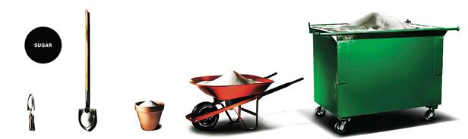
Sweets
Americans eat too much refined sugar!
On average we eat:
  20 teaspoons of added sugar per day
  6 lbs of added sugar per month
  68 lbs per year
20 tsp./day per week 6#/month 68# per year per lifetime

Slide 16

Carbohydrates
How much do you need?
  Women
    30-45 grams per meal
    0-15 grams per snack
  Men
    45-60 grams per meal
    15-30 grams per snack
How do you count carbs?
  Nutrition fact labels
  Calorieking.com or Calorieking smart phone app or Calorie King book
NOTE: WFPB plan often don’t require counting carbs

Slide 17
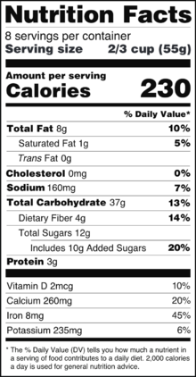
Nutrition Facts Label

Slide 18
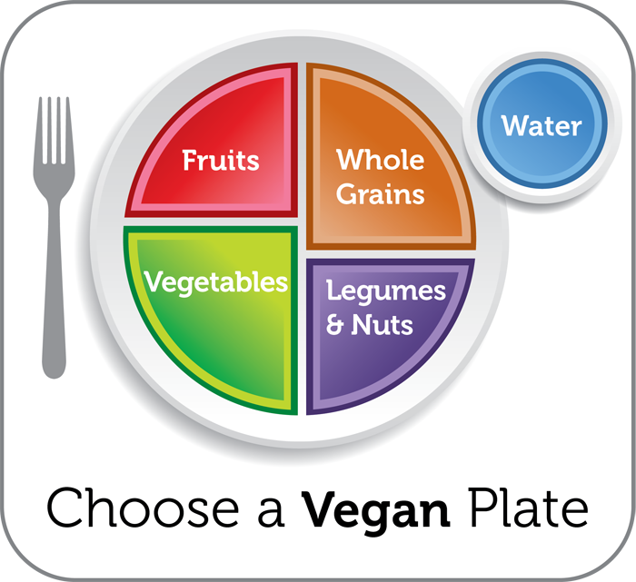
Carbs in your Meal Planning
Fruit and/or a vegetable with every meal
An intact whole grain or starch with every meal
A protein with every meal

Slide 19
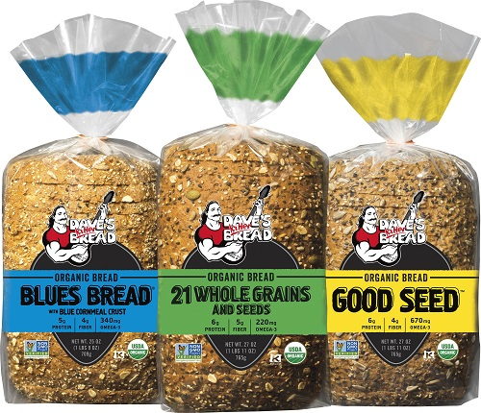
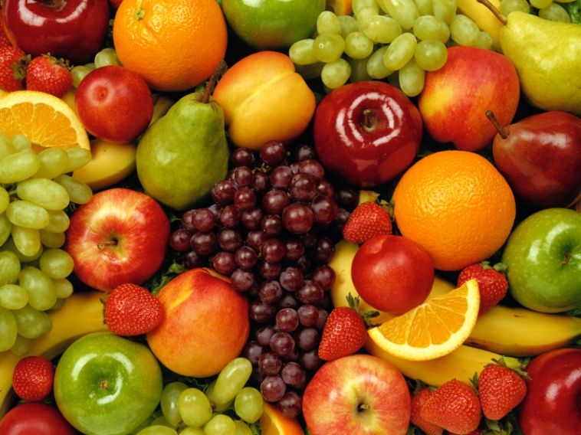
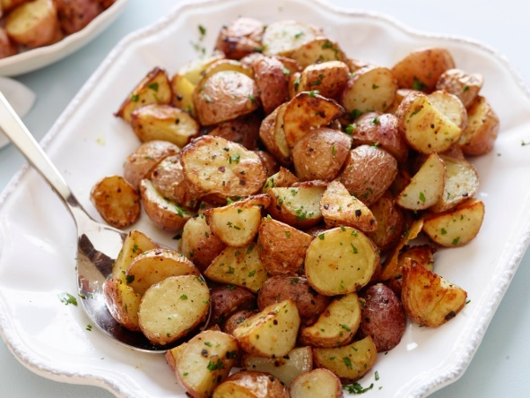
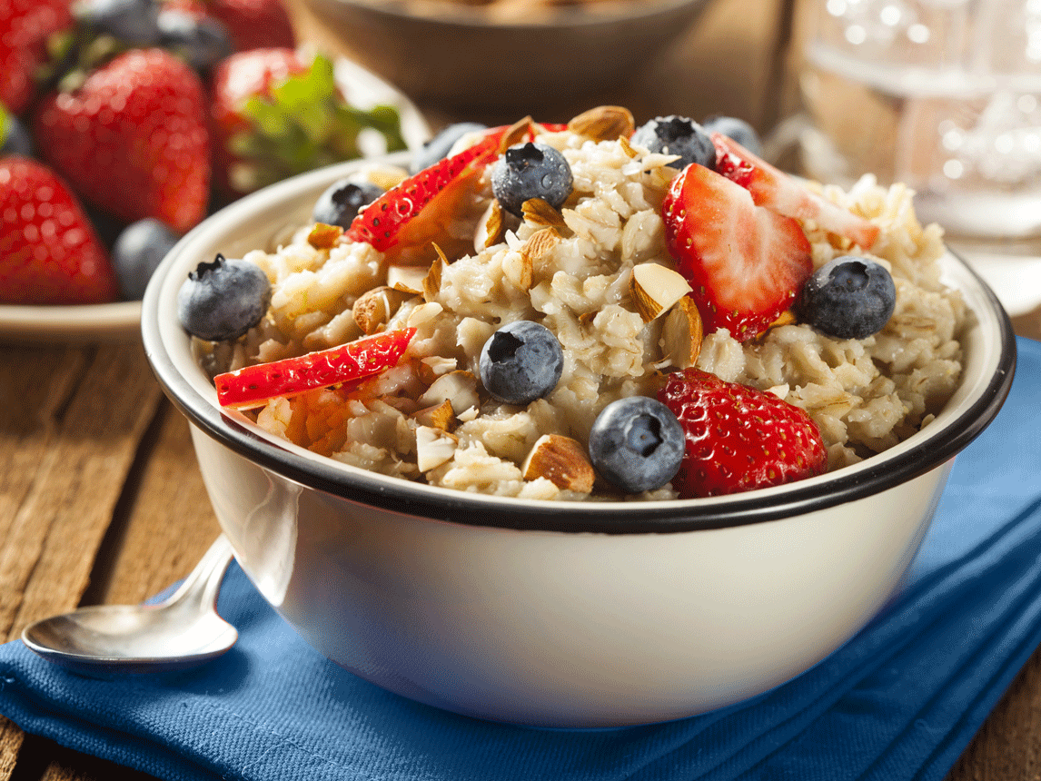
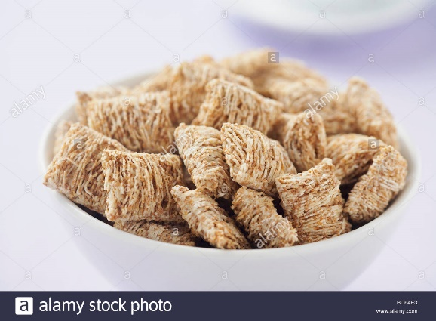
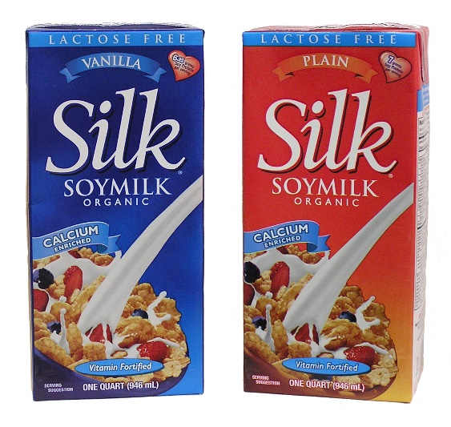
Breakfast Carbs

Slide 20
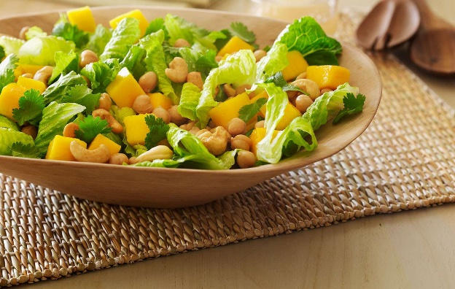
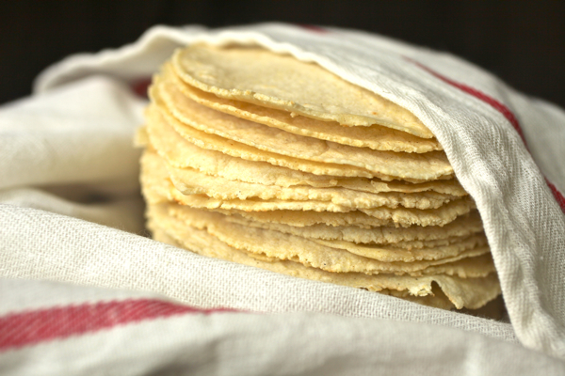
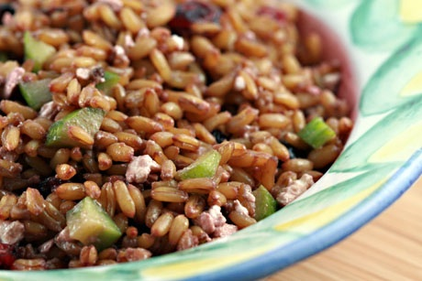
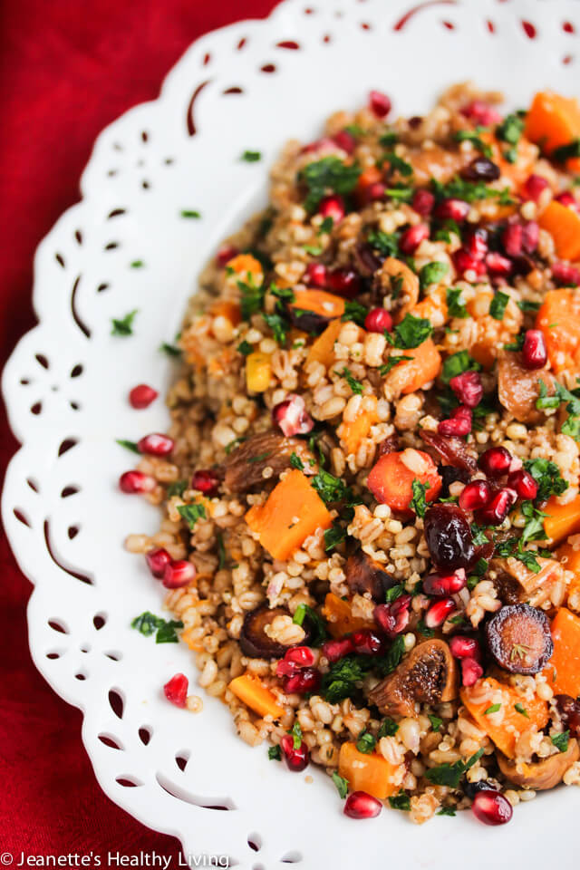
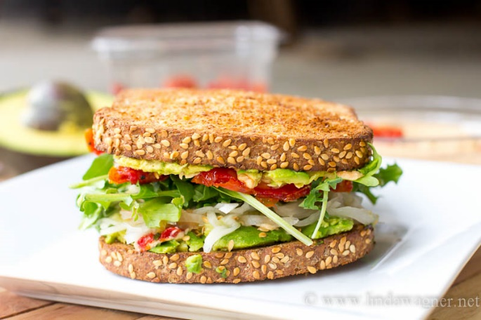
Lunch Carbs

Slide 21
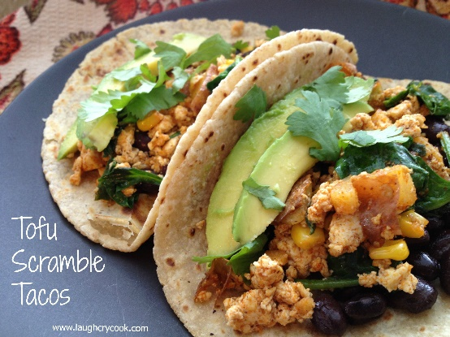
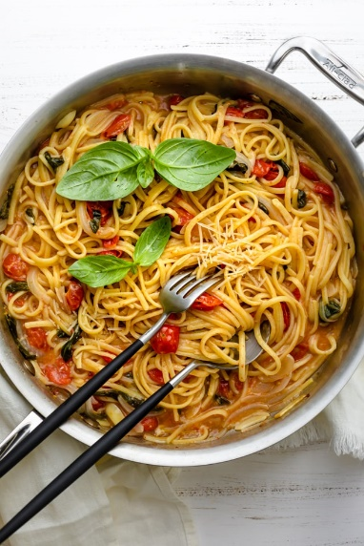
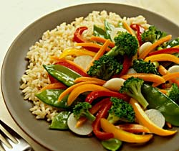
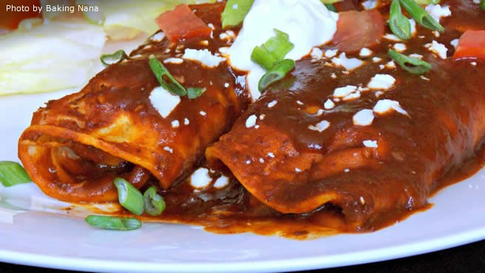
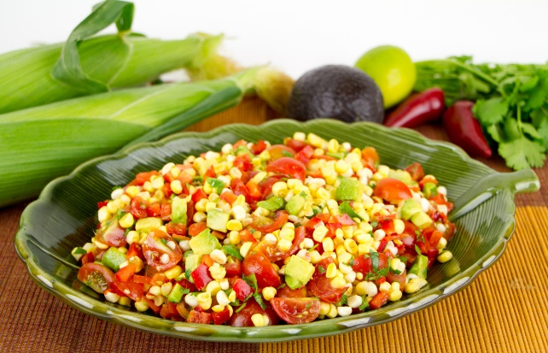
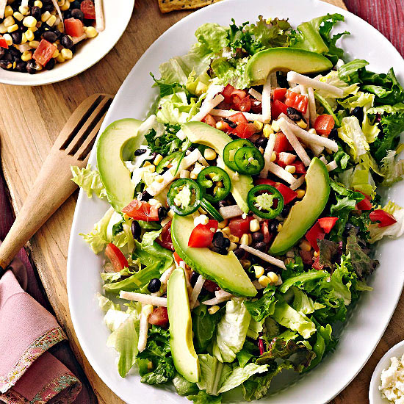
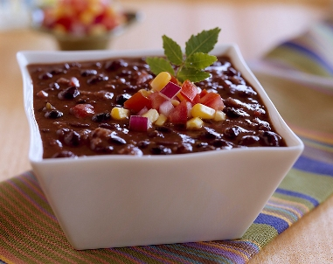
Dinner Carbs

Slide 22
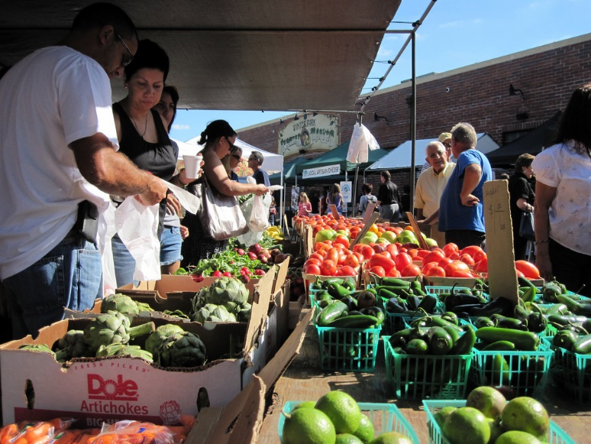
Bottom Line
Good quality carbs are important part of diet
Aim for whole, real-food carbs
High fiber, intact grains are slow to raise blood sugars
For diabetes, you may need to budget carbs
  Test before and after a meal to see the effects of carbs on blood sugars
Be carb careful

Slide 23
Macaroni & Cheese
INGREDIENTS
1 large russet potato, peeled and cut into ½-inch cubes (1½ cups)
1 cup chopped carrots
½ cup chopped yellow onion
1 teaspoon ground turmeric or 1 tablespoon finely chopped turmeric root
3 cloves garlic, minced
½ cup raw cashews
½ cup nutritional yeast
1 teaspoon sea salt (optional)
4 ounces dried whole-wheat or gluten-free pasta
Freshly ground black pepper

Slide 24
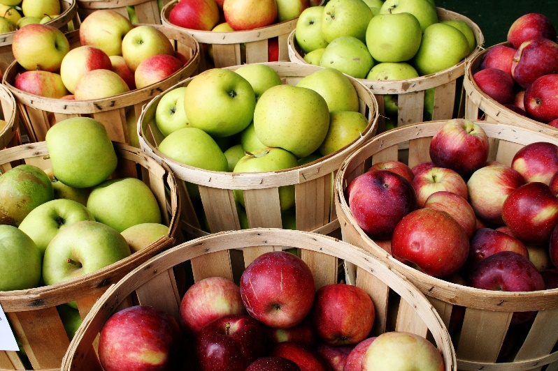
Thank you!
Debbie Lucus, MS, RD, CDCES
dlucusrd@gmail.com

