Slide 1
Meal Planning for a Healthy Heart
Debbie Lucus, MS, RD, CDE
02.14.20

Slide 2
February is Heart Month
Heart disease kills more people every year than all cancers combined
Heart attacks affect more people every year than the entire population of Dallas
83% believe that they can do something to reduce risk, but don’t feel motivated to do so
58% don’t do anything to lower risk

Slide 3
Heart Disease is #1 killer of women & men
G: GET YOUR NUMBERS
Talk to your doctor
O: OWN YOUR LIFESTYLE
Stop smoking, lose weight, exercise, and eat healthy.
It’s up to you. No one can do it for you.
R: REALIZE YOUR RISK
We think it won’t happen to us, but heart disease kills one of three women.
E: EDUCATE YOUR FAMILY
Make healthy food choices for you and your family.
Teach your kids the importance of staying active.
D: DON’T BE SILENT
Tell every woman you know that heart disease is our No. 1 killer.

Slide 4
Only 3% of Americans achieve all 7

Slide 6
Your Farmacy:

Slide 8
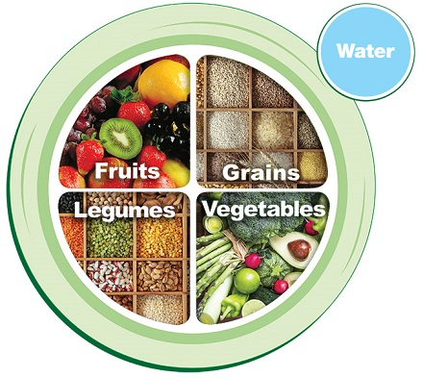
Whole food plant-based eating for heart health
1. Aim for at least 4-5 cups fruits & veggies daily - every color, organic when you can
2. Dump refined carbs – sugar and starch
We rarely eat a bowl of white flour – usually have oil, sugar or salt added
3. Boost fiber – aim for 15 grams/meal
Choose soluble (viscous) fiber as much as possible (oats, beans, barley)
4. Aim for low glycemic carbs
Non-starchy veggies and legumes
Carefully select grains
Granola bar ≠ oatmeal
Choose intact whole grains

Slide 9
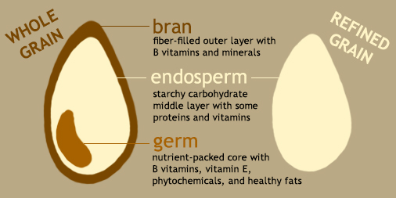

Slide 10
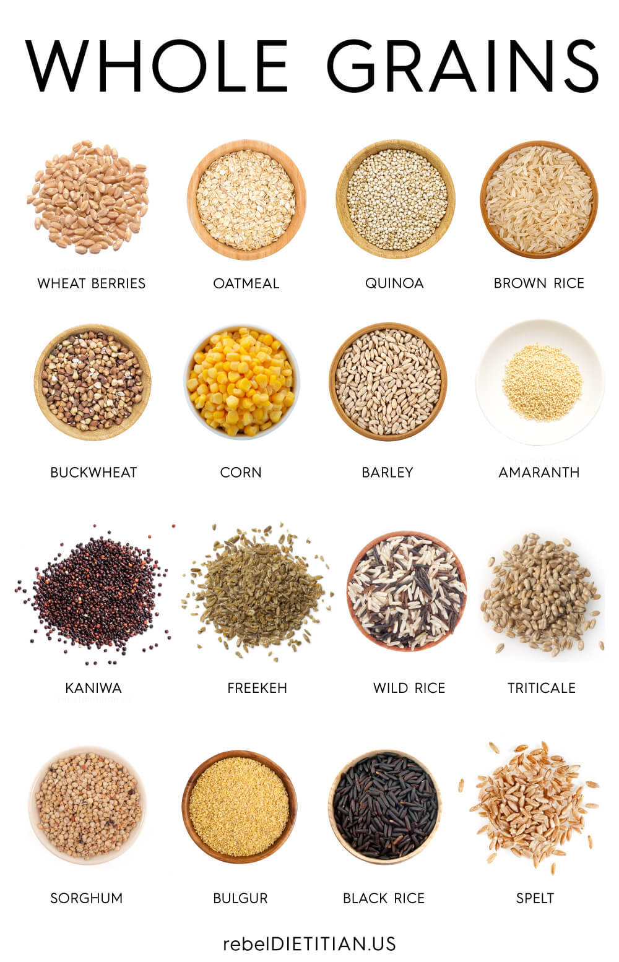

Slide 11
10 diet tips (con’t)
5. Eliminate animal products (or at least processed and red meats)
6. Eat beans/legumes every day
7. Stick to whole foods
Fat = olives, soy beans, nuts, seeds
8. Maximize antioxidants & anti-inflammatory foods
Fruits and veggies
Sprouts (50-100x the antioxidant power)
Herbs & spices
9. Minimize diet pro-oxidants
Oxidized fats (ie. fried foods)
10. Achieve and maintain a healthy body weight

Slide 12
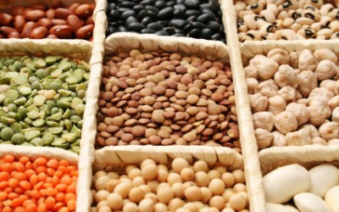
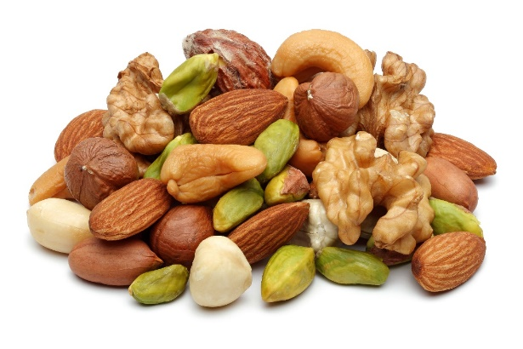
Protein power from plants
Beans and legumes
7-9 grams/1/2 cup serving
Cooked, dried beans (canned okay)
Lentils
Soy beans
Split peas
Nuts & Seeds
5-8 grams/1/4 cup serving
Nut butters (2 Tbsp serving)
Flax/Hemp/Sesame/Sunflower seeds

Slide 13
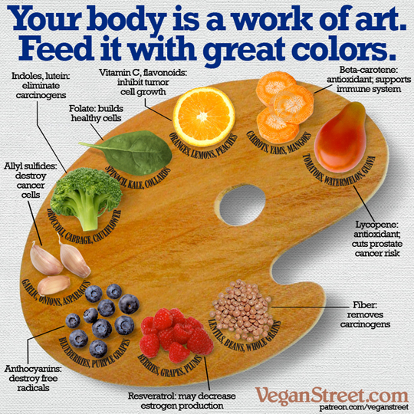
Resources & recipes
Google
Cookbooks
Websites/apps:
ForksoverKnives.com
Plantstrong.com
Nutritionfacts.org
PCRM.org

Slide 14
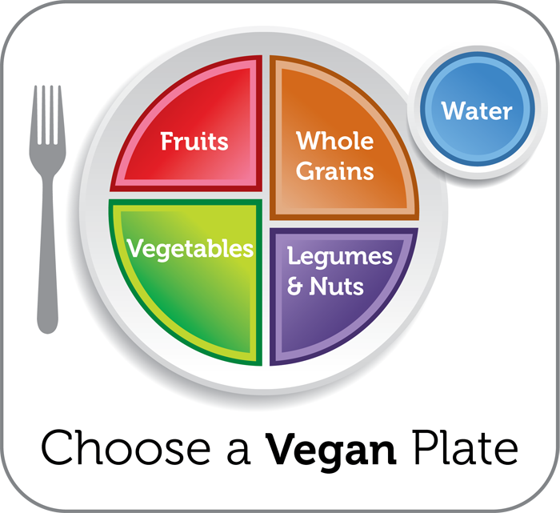
Meal Planning with 4 food groups
Fruit (3/day) + Vegetable (4+/day)
Aim for fruit &/or veg at every meal
A whole grain (5/day) or starch with every meal
A protein (3/day) or with every meal

Slide 15
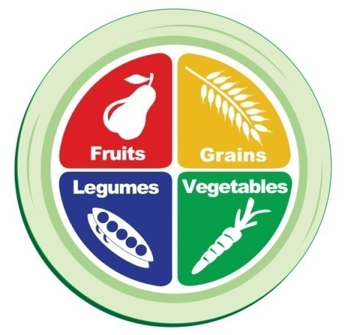
Sample meals
Breakfast
Fruit + Grain + Protein/Dairy sub
Lunch
Vegetable + Grain + Protein
Dinner
Vegetable + Grain + Protein + Fruit
Snack(s)
Fruit or veggie or protein or healthy fat
Snacks appropriate if hungry or will be long time until next meal
Notes:
Breakfast Ideas:
Oatmeal + BB + walnuts + non-fat milk
Toast + grapefruit + 1 egg
Yogurt + granola + berries
Lunch Ideas:
Salad with a grain + lentils
Sandwich + lean meat + side salad
Pasta + chicken + veggies
Leftovers
Snack
Handful of almonds + dried fruit
Apple with PB
Yogurt + flaxseed
Dinner
NS veggie + grain + lean meat
NS veggie + grain + lentils

Slide 16
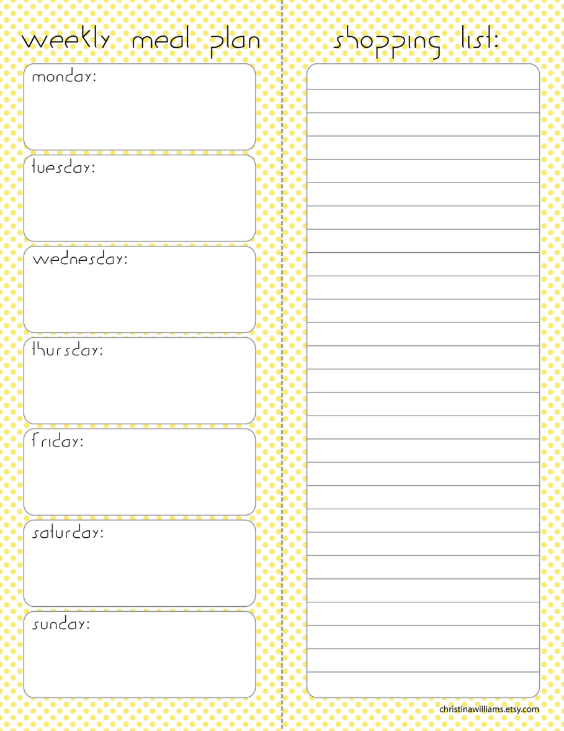
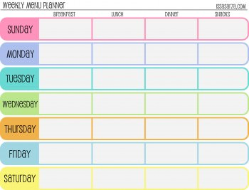
How do I plan meals?

Slide 17
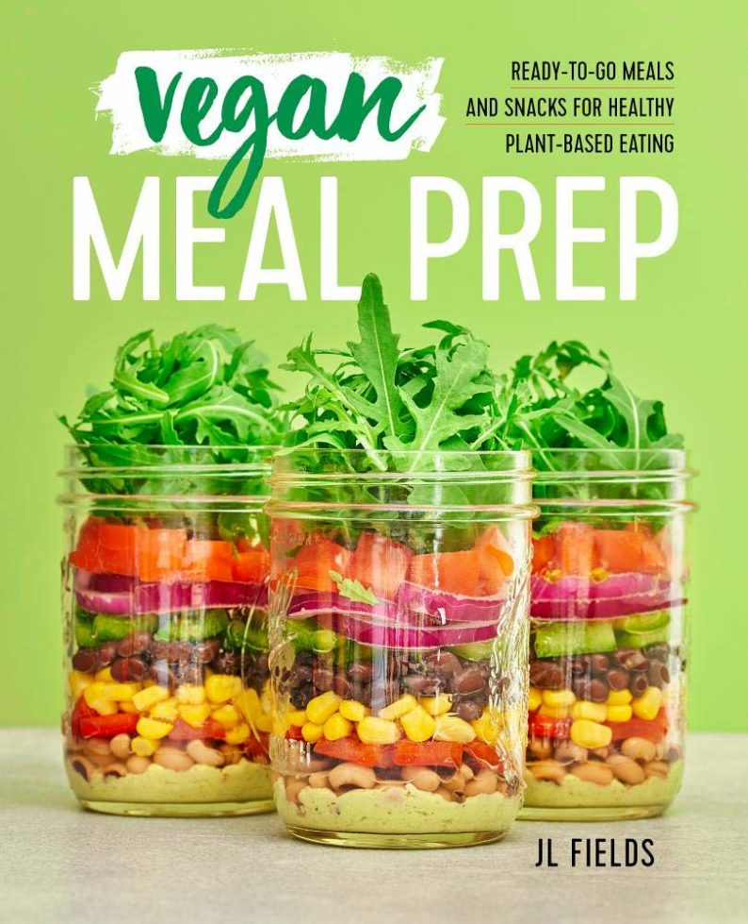
Tips for Meal Planning
What’s in season?
What is your week going to be like?
Pick out a few recipes
Make a menu
Make a shopping list
Get to know your store/farmers’ market
Stock the pantry
Prep foods for the week
Make your meal components that you can recycle into other items
Batch cook

Slide 18
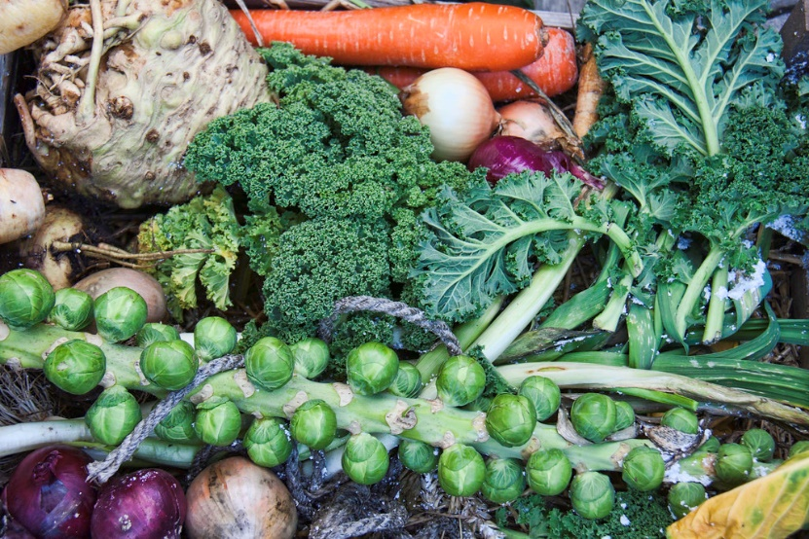
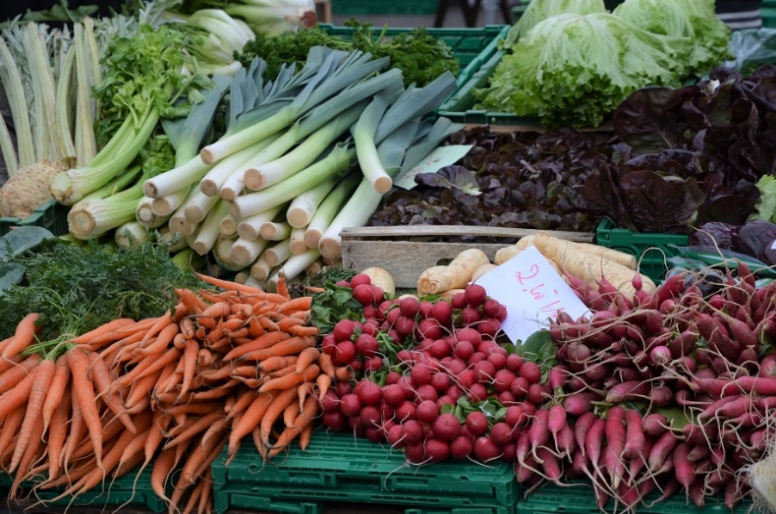
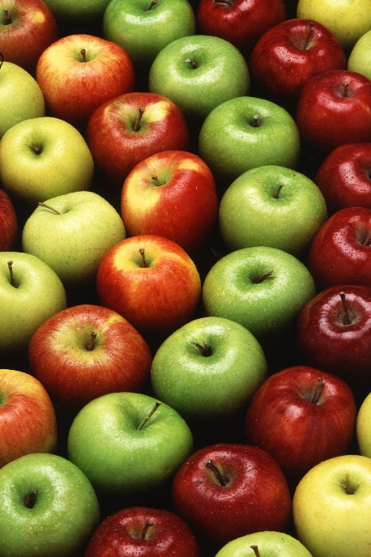
What’s in season now?

Slide 19
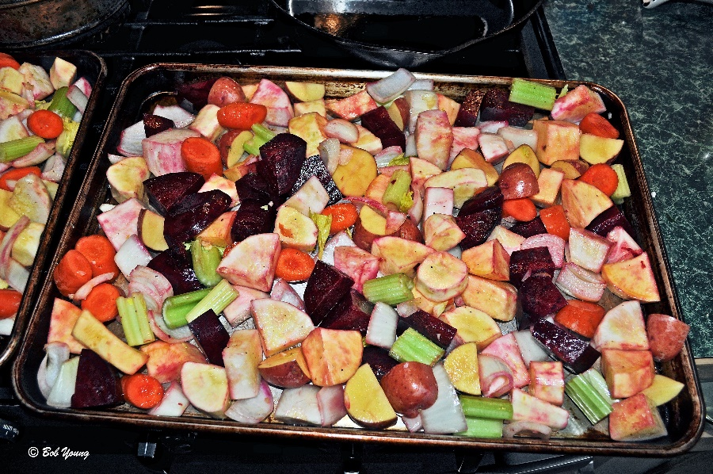
What can I prep for the week?
Oats – overnight or one big batch
Grains/rice/quinoa/pasta
Beans/Lentils
Tofu/tempeh – baked, scrambled
Baked or roasted potatoes
Soups/stews
Chop veggies/fruits for the week’s recipes:
Diced, sliced, wedges, chopped
Roast some, leave some raw for recipes
Prep quick-grab fruits and veggies

Slide 20
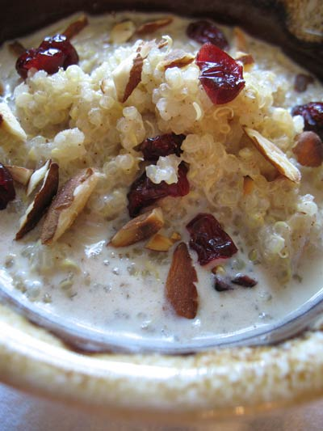
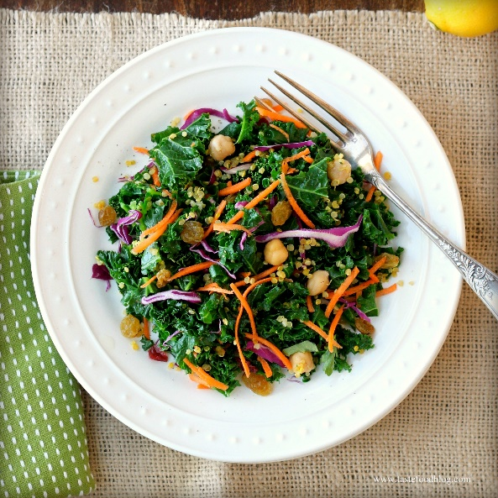
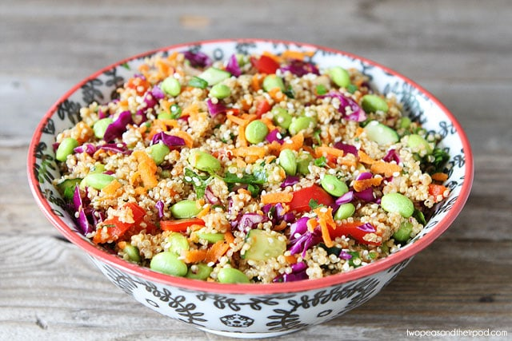
Cook up a pot of …quinoa
Serve as side dish with your meal
Heat left overs up for breakfast – add a little sweetener, milk, fruit (just like oatmeal)
Take cold leftovers and add chopped veggies and vinaigrette
Take cold leftovers and add fruit and sweet vinaigrette
Throw leftovers into soup, stew, on top of salad

Slide 21
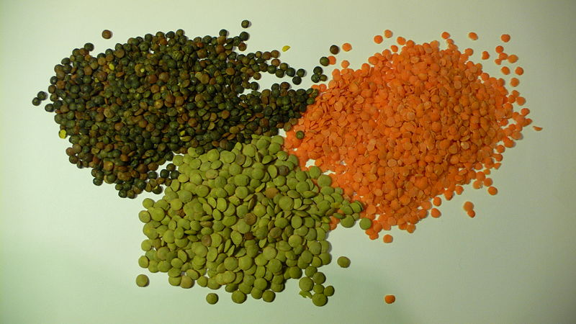
Whip up a batch of ….Lentils

Slide 22
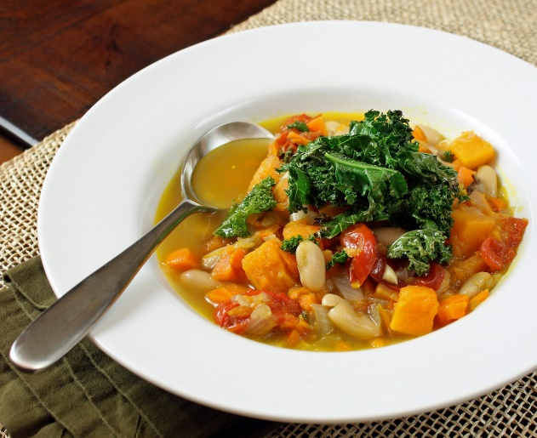
Make a batch of…. soup
Serve over different grains.
Try farro, quinoa, barley, bulgur or brown rice.
Add a big handful of green leafys!
Instead of having your salad on the side, heat up your soup with a generous serving of baby kale, spinach or arugula.
Try a potato.
Put a baked potato or sweet potato in the bottom of your bowl
Make a pita or burrito!
If thick enough, add leftover soup to a whole wheat pita or tortilla. Drain off a little of the liquid if needed then add in lots of greens and other vegetables.

Slide 23
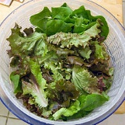
Make a big salad
Chop lots of dark greens
Add other favorite chopped veggies
Over the week, top with:
Leftover grains
Beans
Nuts/seeds
Fruit

Slide 24
Make a Buddah bowl with your prepped items

Slide 25
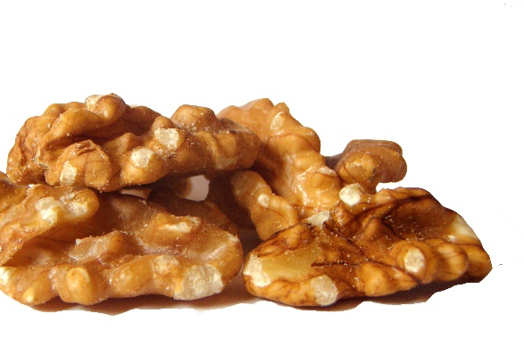
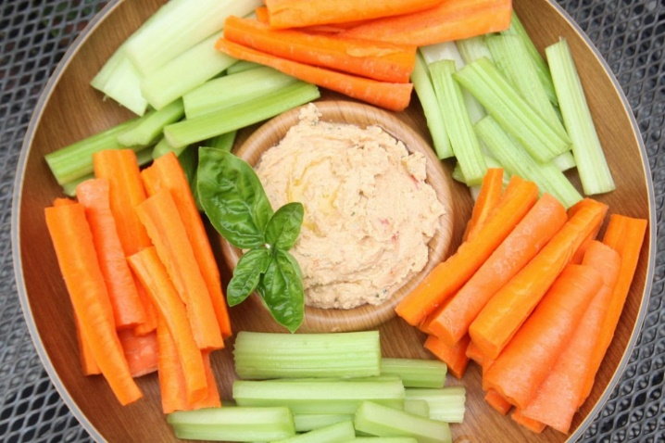
Choose better snacks
Fresh fruit
Nuts or seeds
Fresh veggies

Slide 26
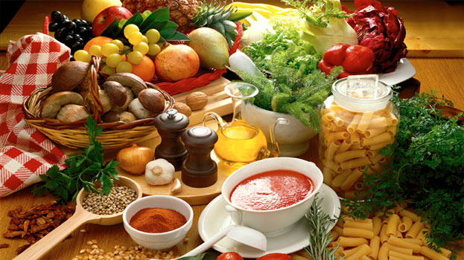
What will you try this week?
Pick a recipe or two you’d like to try this week
What will be on your menu?
What will be on your shopping list?
When will you do some prep…and make your meals quick and easy for the week?

Slide 27
“When you have your health, you have 1000 dreams….when you don’t, you have only one”
Bob Breakey, MD

Slide 28
Eat as if your life depended on it!
Notes:
All I wish, is that people would eat as if their life depended on it!

