Slide 1
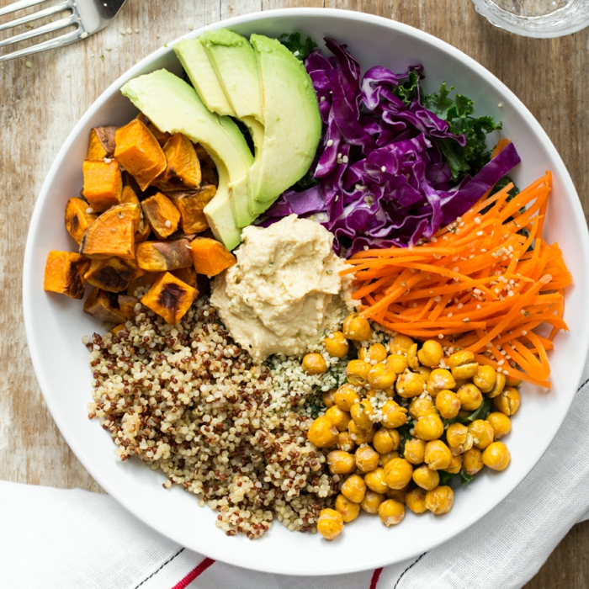
Where are your Micronutrients?
Debbie Lucus, MS, RD, CDCES
dlucusrd@gmail.com

Slide 2
Happy Heart Month!
What have you been doing for your heart?
Any new recipes?
How are you doing with the challenges this month?

Slide 3
Heart studies this month
Association Between Coffee Intake and Incident Heart Failure Risk
Higher coffee intake was found to be associated with reduced risk of HF in all three studies. Further study is warranted to better define the role, possible causality, and potential mechanism of coffee consumption as a potential modifiable risk factor for HF.
A Mediterranean Diet and Low-Fat Vegan Diet to Improve Body Weight and Cardiometabolic Risk Factors: A Randomized, Cross-over Trial
A low-fat vegan diet improved body weight, lipid concentrations, and insulin sensitivity, both from baseline and compared with a Mediterranean diet. Blood pressure decreased on both diets, more on the Mediterranean diet.

Slide 4
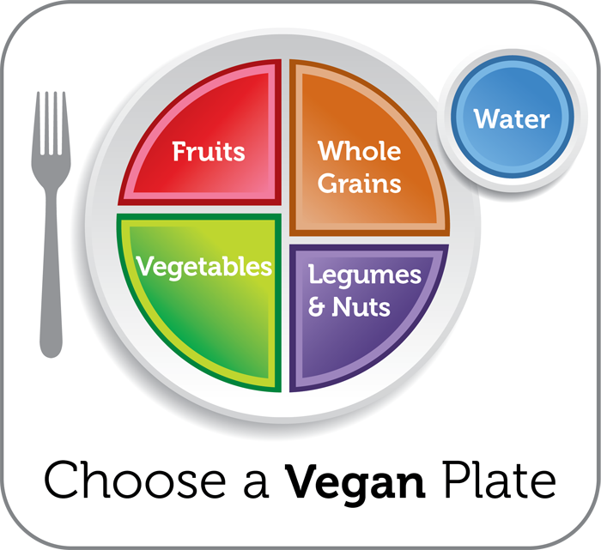
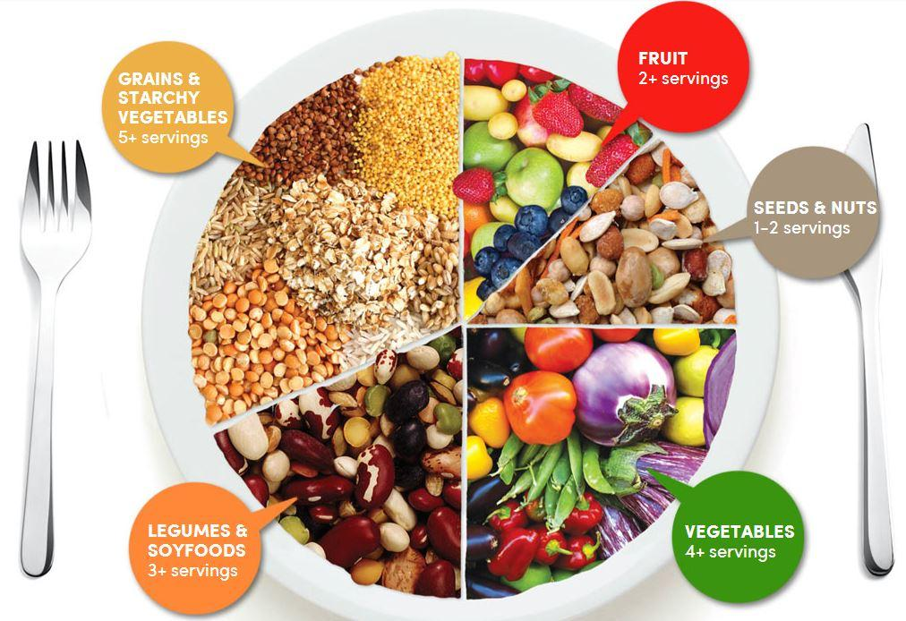
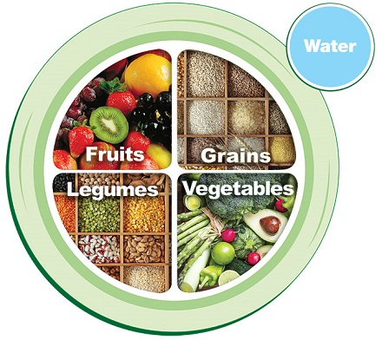
What is best for our heart? Whole Foods, Plant-based Eating Style
Whole foods, plant-based diet is only plan to show reversal of chronic disease
Notes:
Plant foods fight disease.

Slide 5
Nutrients in a WFPB diet
Macronutrients:
Carbs
Grains
Fruits
Veggies
Beans
Protein
Beans, legumes
Nuts, seeds
Fats
Avocado, olives
Nuts, seeds
Micronutrients & water
Vitamins
Help release energy from macros
Help functions in body
13 vitamins
Minerals
Structure: bones & teeth
Found in our body fluids
16 minerals
Water
All our bodily functions need water
60% of our body

Slide 6
To maximize micronutrients: Eat Whole Foods instead of Food Products
Vegetables
Fruits
Beans
Nuts and Seeds
Whole intact grains
Herbs and spices
Notes:
Plant foods fight disease.

Slide 7
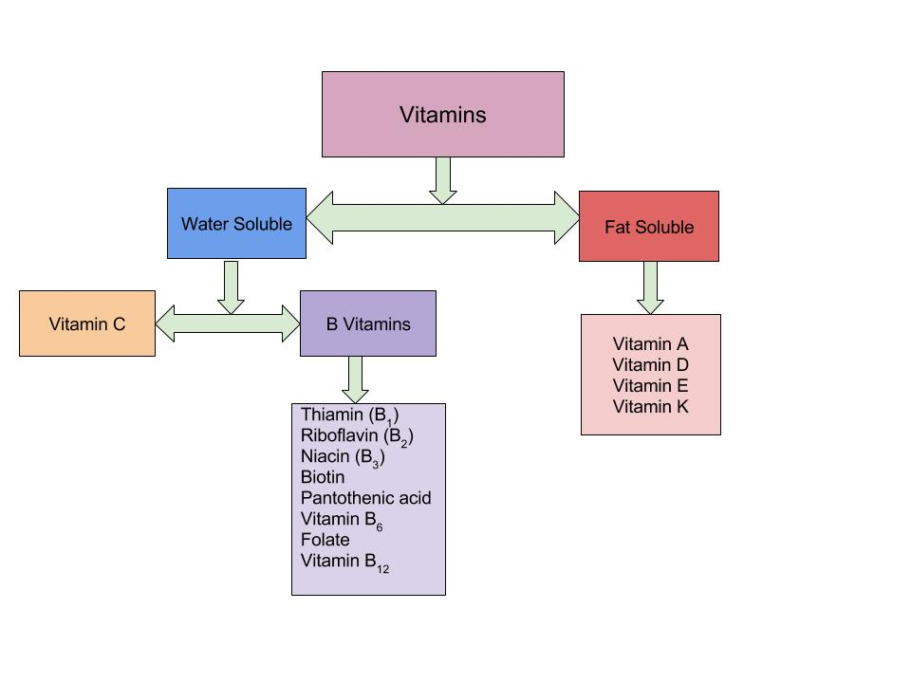
Vitamins

Slide 8
Minerals

Slide 9
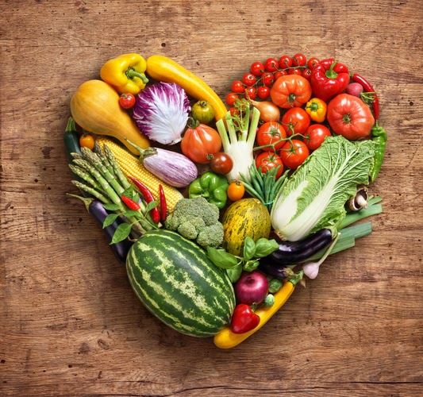
WFPD – Nutrients to consider
Vit B12
Vit D
Calcium
Iron
Zinc
Iodine

Slide 10
Vitamin B12 – RDA = 2.4 ug/d
Function: Helps with making red blood cells, DNA, nerve function
At risk for deficiency: vegans, elderly
Signs of deficiency: tingling, numbness, fatigue, memory loss, falling
NOTE: Metformin may lower B12 – have it checked at least every 3 years
Not made by plants or animals – only by microbes
Food sources: only animal products or fortified foods
Supplement if WFPB – 2000 mcg/week, cyanobalamin (if >65 yo, 1000 mcg/day)

Slide 11
Calcium – RDA = 1200 mg/d (men 51-70 = 1000 mg/d)
Function: 99% of calcium in body is in bones and teeth, 1% for muscle contraction, nerve function, blood clotting, blood pressure
Signs of deficiency: weak, brittle bones = osteoporosis
At risk for deficiency: growth periods, elderly, low calcium and Vit D intake, sedentary lifestyle, female
NOTE: Oxalates in dark greens may inhibit absorption
Kale, collards, mustard greens are well absorbed
Spinach, chard, rhubarb, beet greens not well absorbed
Food sources: dairy products and multiple plant-based foods (aim for at least 600 mg/d)

Slide 12
Calcium Sources

Slide 13
Vitamin D – RDA 15 mg/d (51-70), 20 mg/d >70
Function: help with bone health by regulating calcium
Deficiency: bone loss, osteomalacia, Rickets in children
Vit D2 & D3: D2 is plant-based, D3 is from lanolin (sheep’s wool) – but they do make D3 that is vegan
Sources: sunlight, fatty fish, eggs, fortified foods, some mushrooms
How much sunlight?
If latitude of LA and south: 15 min/day (30 min darker skin or older)
If more north, dark skinned or winter months – may need supplement (2000 IU Vit D3)
May be associated with reduced progression to type 2 DM

Slide 14
Mushrooms exposed to UV light

Slide 15
Iron – RDA = 8 mg/d
Functions: Helps red blood cells carry oxygen to muscles and tissues, immunity, DNA synthesis
Deficiency = Anemia
Signs of anemia: Fatigue
Heme vs non-heme iron
Phytates (in nuts, seeds, grains) – may bind iron
Eat with Vit C foods – helps absorption
Vegetarians store less iron – this might be good
Coffee/tea and calcium decrease absorption
Sources: beans/legumes, whole grains

Slide 17
Zinc – RDA 11 mg/d (men), 8 mg/d (women)
Function: helps enzymes do their job, wound healing, taste perception
Deficiency: lowers immunity, hair loss, loss of taste/smell
Half of zinc intake in US is from meats
Vegetarians may need 50% more than RDA
Phytates inhibit absorption
Sources: animal foods, fortified cereals, whole grains, beans, tofu, nuts/seeds

Slide 18
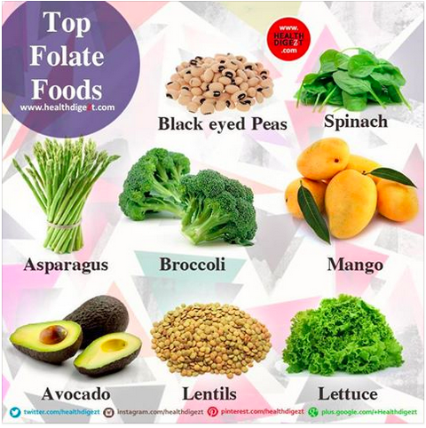
Folate – RDA 400 ug/d
Function: DNA synthesis, new cell formation (red blood cells), breakdown homocysteine
Deficiency: Anemia, fatigue, weakness, neural tube defects, elevated homocysteine
Elevated homocysteine increase atherosclerotic lesions
Sources: think ‘foliage’, beans, whole grains, seeds

Slide 19
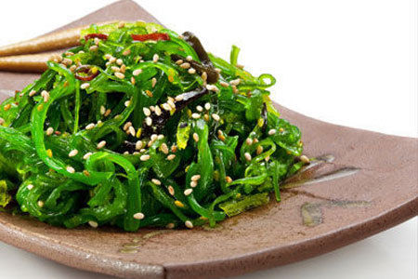
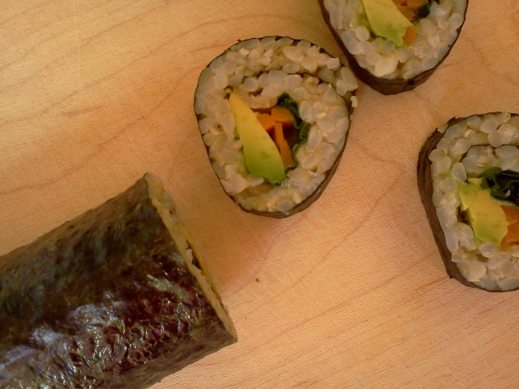
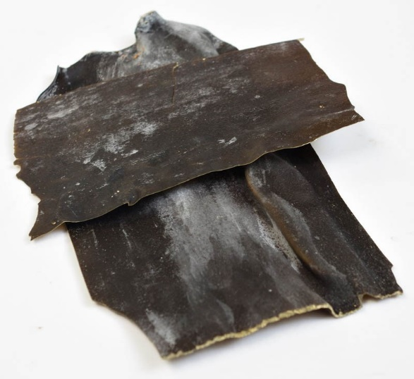
Iodine – RDA 150 ug/d
Function: Part of thyroid hormones, help regulate growth, development and metabolic rate
Deficiency: Goiter (hypothyroid)
Food sources: iodized salt, seafood, dairy, sea vegetables (seaweed, nori, kombu – edible kelp), plants from iodine-rich soil

Slide 20
Nutrients to consider for COVID
Vitamin D3
From Chrisbeatcancer.com
4000 IU/day
80% of COVID patients are deficient
Vitamin D3 nearly doubled survival rate in nursing homes
Vitamin C
Zinc
Help to improve immune system

Slide 21
Meal Planning to get your micronutrients
Fruit (3/day) + Vegetable (4+/day)
Aim for fruit &/or veg at every meal
A whole grain (5/day) or starch with every meal
A protein (3/day) or with every meal

Slide 22
To maximize micronutrients: eat these multiple times a day
Vegetables – include variety dark greens
Fruits – with skin
Beans/lentils/peas
Nuts and Seeds
Whole intact grains
Herbs and spices
Notes:
Plant foods fight disease.

Slide 23
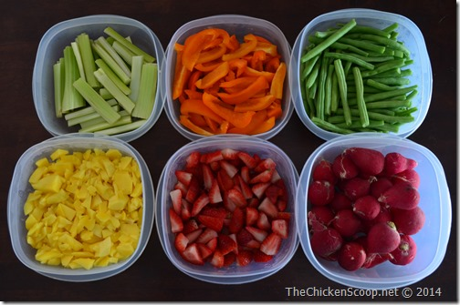
Planning Ahead
Think about what you want for the upcoming week
Batch cook a few items:
Oatmeal?
Beans/lentils?
Quinoa/brown rice?
Sweet potatoes?
Roasted veggies?
Cut your veggies into the shapes you will need for the week:
Diced or sliced
Sticks

Slide 24
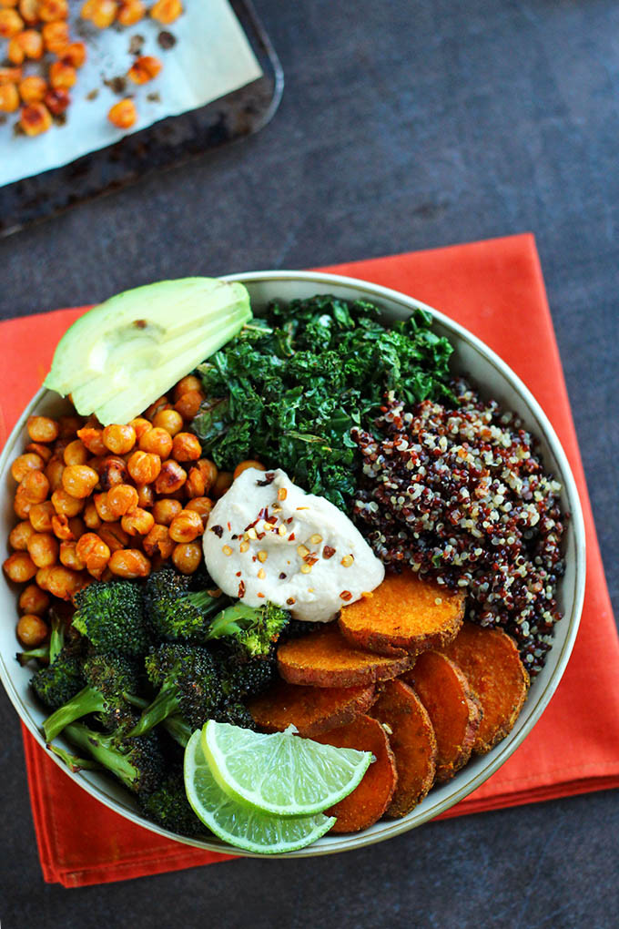
Build a better Power bowl
1-2 cups raw and/or cooked veggies
½ -1 cup tofu or beans or lentils
½ cup cooked whole grain
2-3 cups salad greens/kale/spinach
1 Tbsp nuts or seeds
Dressing or sauce
Extras: herbs, fruit, avocado

Slide 25
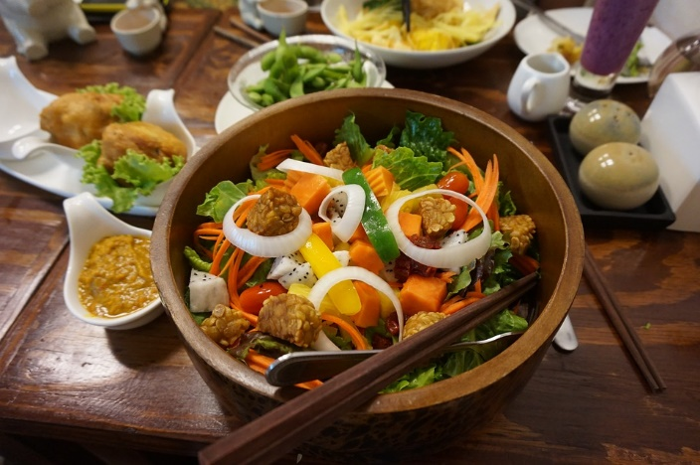
Build a better salad
Base of dark greens
Top with favorite veggies
Add leftover grains or veggies
Add fruit
Add a protein: beans, tofu, lentils, tempeh
Add nuts/seeds
Add a dressing (keep it on the side)

Slide 26
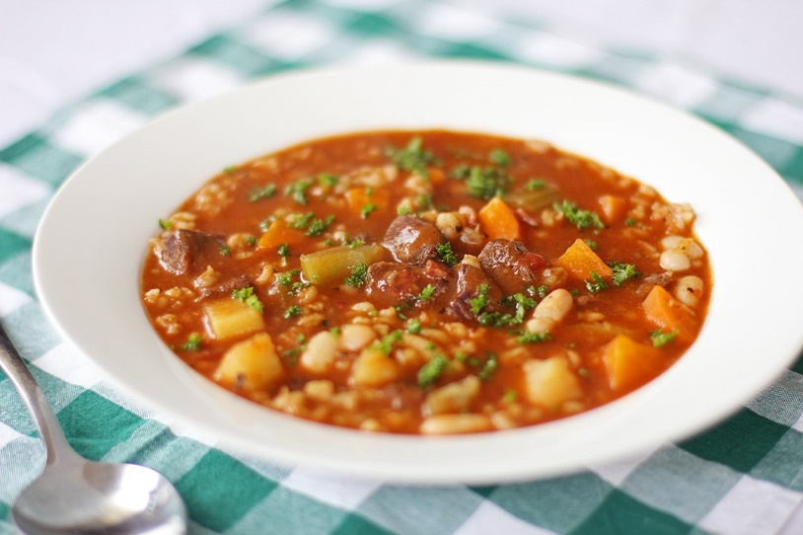
Build a better soup
Start with aromatics: carrots, onion/leeks, celery, garlic - sauté in pan coated with cooking spray
Add other veggies: mushrooms or cauliflower or squash or potatoes or peppers
Add beans/lentils and low sodium veggie broth and cook for about 20 - 45 min
Add seasonings of choice
Add 2 -3 cups raw greens until wilted and serve.

Slide 27
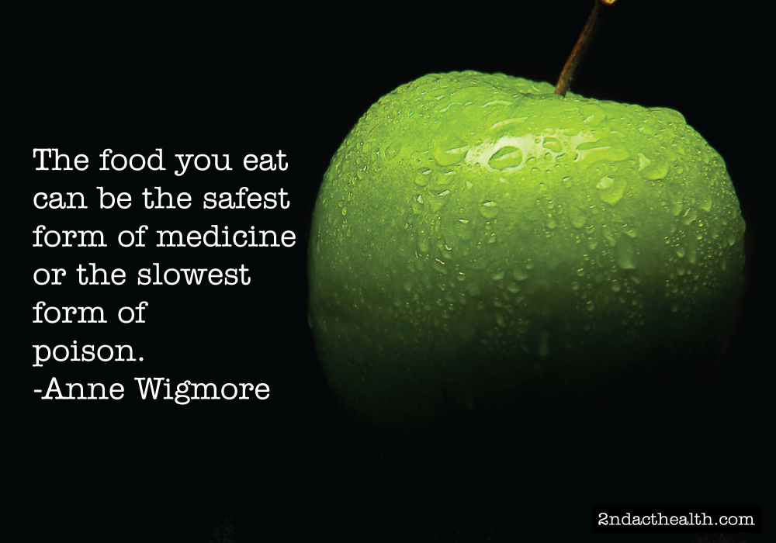
Remember your Why

Slide 28
Eat as if your life depended on it!
Notes:
All I wish, is that people would eat as if their life depended on it!

