Slide 1
Sheltering in Place – and staying plant strong with Fiber
Debbie Lucus, MS, RD, CDE
04.07.20
dlucusrd@gmail.com
Notes:
On the next few slides we’ll look at a few common varieties of beans and discuss their shape, size, and flavor.

Slide 2
What a crazy world it is….
What a change!!
Who knew we would be waiting in line for toilet paper
How are you handling this brave new world?
Some things I’m doing
  Puzzles! Reading! Trying to limit the TV
  Staying in touch with Zoom
  Walking, taking advantage of lots of non—gym workouts
  Throwing meals together with whatever is in my cupboard
  Cleaning out cupboards and closets
  Catching up on podcasts
  Watching Vegan cooking YouTubes: Try Jane & Ann Esselstyn’s

Slide 3





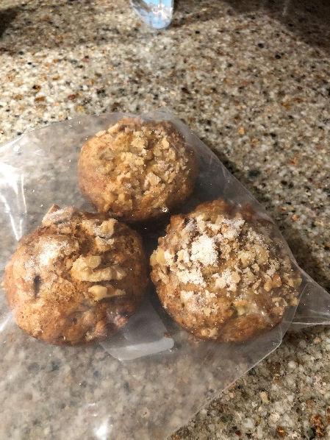
I

Slide 4
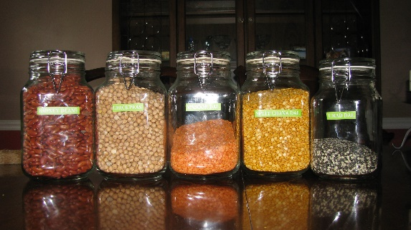
Stocking your kitchen - Pantry
Beans
  Add to soups & stews
  Use in salads, side dishes, even desserts
  Dried seem to be more available and save you $$$
Lentils
  Soup, salads, bowls
Whole grains – most are interchangeable
  Barley, millet, brown rice, couscous, quinoa, etc.
Potatoes, onions, garlic
  The base of most recipes

Slide 5
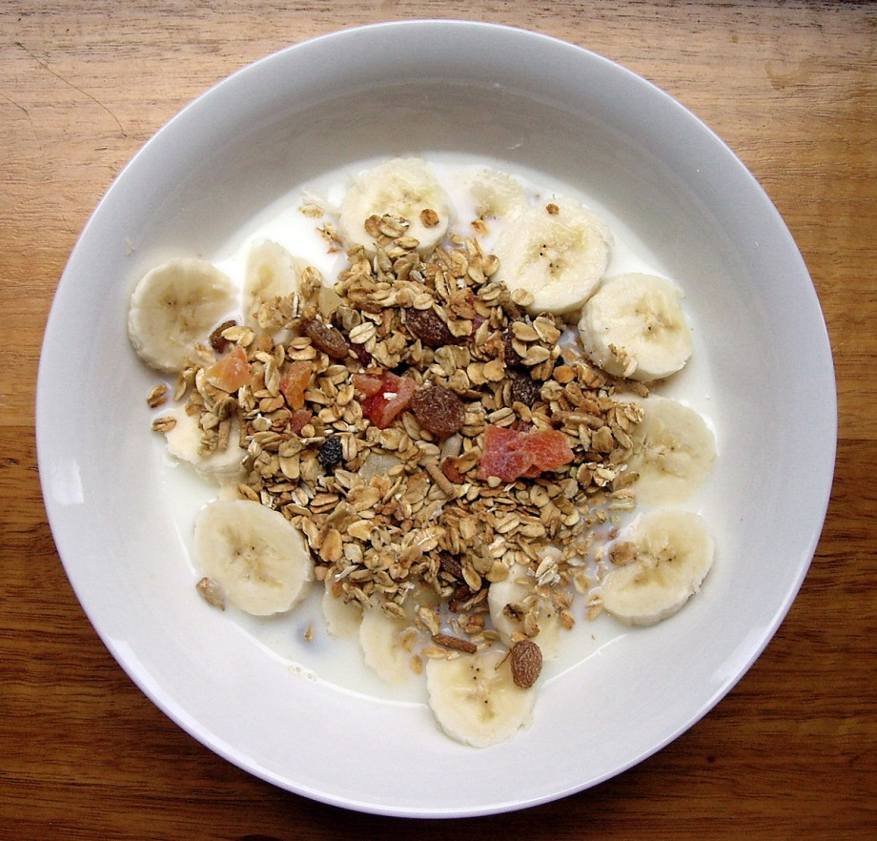
More pantry items/canned goods
Beans
  Low Sodium
Canned tomatoes
  All shapes and sizes
Sun-dried tomatoes
Plant-based milks
Pastas
Oats, cereals
Nuts/seeds

Slide 6
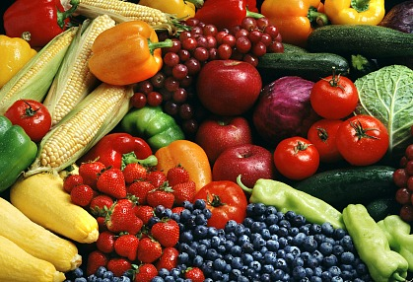
Stocking the kitchen – Frig/Freezer
Fruits
  Citrus, apples– last a long time
  Bananas – freeze them as they get too brown
  Frozen fruit
Veggies
  Winter squash last all season
  Greens
  Carrots, celery
  Frozen veggies

Slide 7
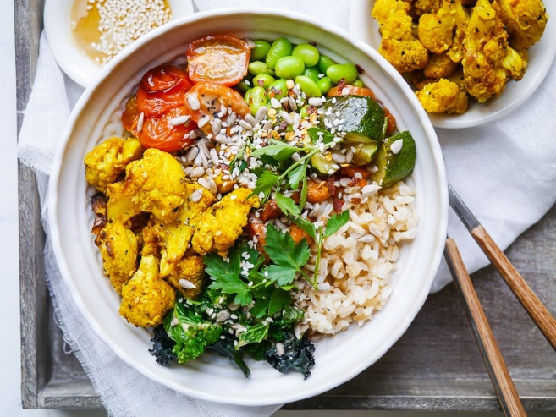
Meal ideas – You’ve been training for this!
Batch cooking
Buddha bowls
Smoothies
Cook up pot of beans and a grain – use them all week
Try new recipes
Watch those cooking videos on YouTube
Get a cookbook and cook your way through it!

Slide 8
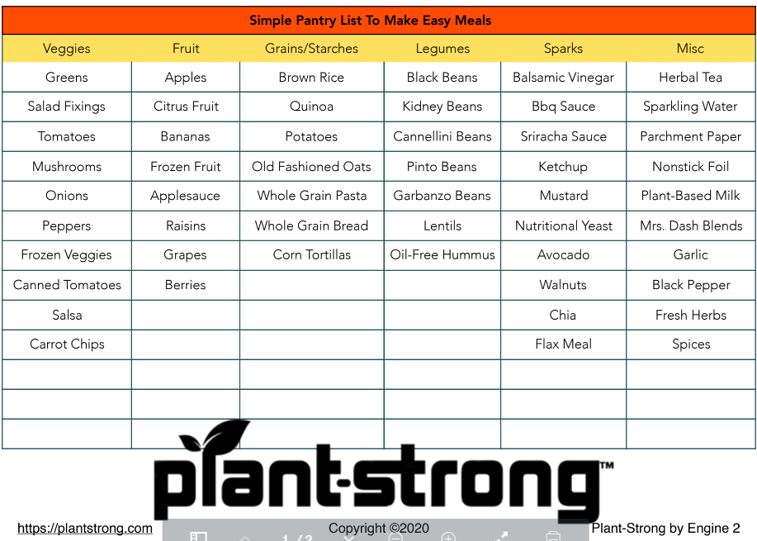

Slide 9
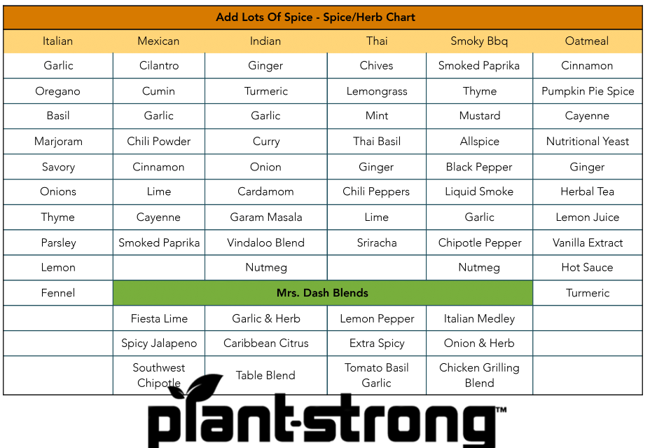

Slide 10

Build your Immunity
Eating whole food, plant based
  Full of disease-fighting nutrients
Move your body
Stress less
  Yoga
  Meditation
  Prayer
Social distancing yet stay connected
Get enough sleep

Slide 11
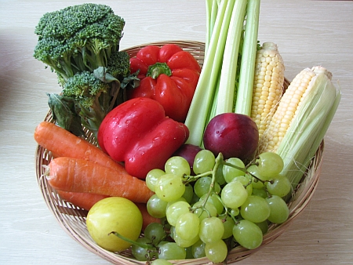
What is Fiber?
Indigestible part of plants
  Fruits & veggies
  Beans, lentils, & peas
  Nuts & seeds
  Whole wheat bread/pasta
  Wild/brown rice
  Barley, bulgur, quinoa, Israeli couscous & farro
  Bran, wheat, & oats
Two types of fiber:
  Insoluble
  Soluble
Notes:
11
Monounsaturated fat, some protein.
Some nuts and seeds (flax, walnuts) are excellent sources of essential fatty acids, and some (sunflower seeds, almonds, hazelnuts) are good sources of vitamin E.
Note: a handful is small portion.

Slide 12
Benefits of Fiber
Lowers cholesterol (soluble)
Reduces constipation, hemorrhoids (insoluble)
Increases feeling of fullness (helps with weight loss)
Slows blood sugar rise (helps with diabetes)
Food for good bacteria in gut – helps microbiome
Lowers risk of some cancers
  Colon (decreases transit time, breaks down to butyrate in colon – inhibits tumor growth)
  Breast (binds to estrogen)
  Prostate
  Mouth, esophageal, throat

Slide 13
How much fiber do you need?
Depends on who you ask
RDA
  21-25 grams/day for women
  30-38 grams/day for men
American Cancer Society
  25-35+ grams per day
Try for 15 grams/meal
Some encourage as much as 50 grams daily
Average American eats 10-15 grams!

Slide 14
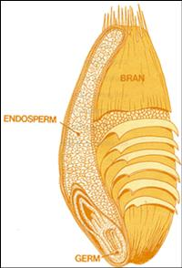
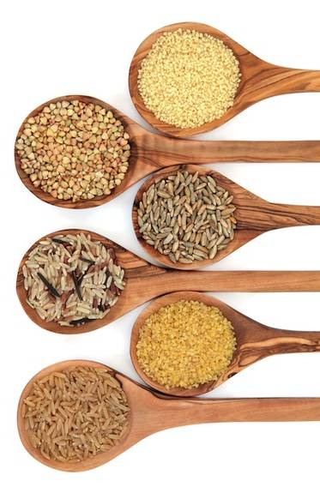
Whole Intact Grains

Slide 15
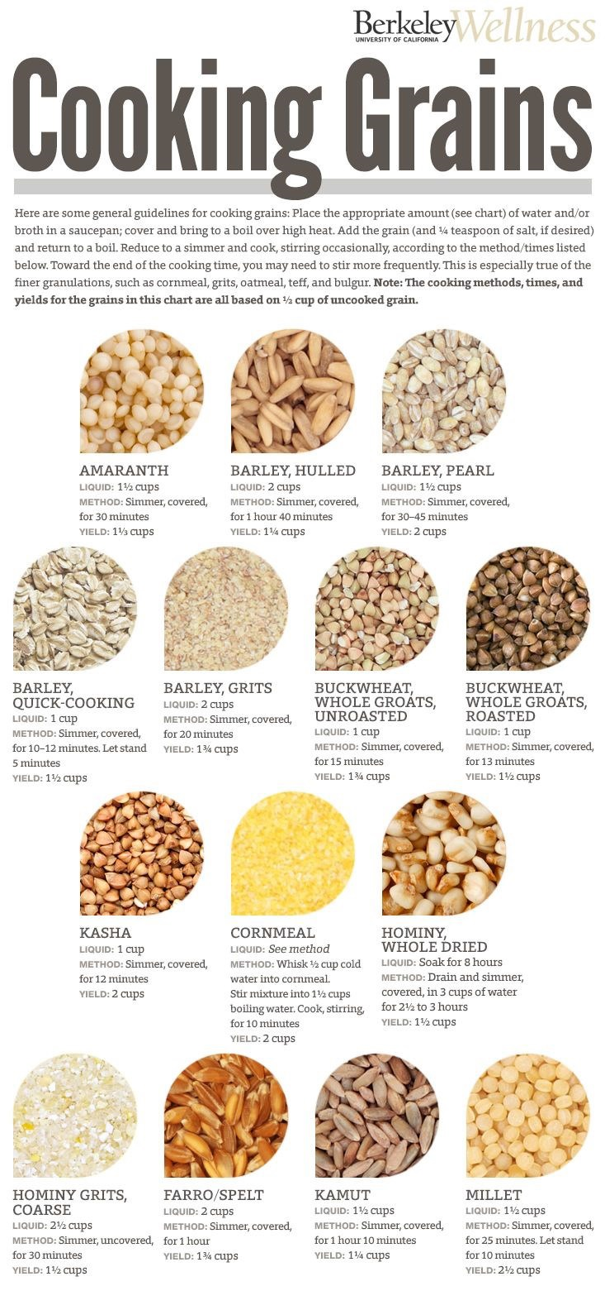

Slide 16
What is an Intact Whole Grain?
Hierarchy of whole grains:
Intact whole grain (i.e. oat groats, quinoa, barley)
  Broken Whole grains (i.e. bulgur)
  Rolled Whole Grains (oatmeal)
  Shredded Whole Grains (shredded wheat)
  Ground Whole grains (whole wheat flour)
  Flaked Whole Grains (flaked cereals)
  Puffed Whole Grains (puffed cereals)

Slide 17

Insoluble Fiber
Benefits
  G.I. health
    Travels through the digestive tract & creates bulk
    Helps the colon function properly
Sources
  Whole grains (wheat)
  Fruit
  Vegetables
  Beans, lentils, peas
  Nuts and seeds
Notes:
17
“Fiber is the indigestible part of plants. There’s 2 types…soluble & insoluble.
Soluble fiber means it mixes with water, while insoluble fiber repels water. Both types of fiber help with a healthy GI tract –they increase bulk and motility.
Soluble fiber has been shown to have chol lowering properties. No one knows for sure how, but it might work by blocking absorption of dietary cholesterol, some fatty acids, and bile acids. So if the bile acids are passed out of the body, then your body’s cholesterol will be used to build more of them, thus indirectly helping to lower your cholesterol.”

Slide 18
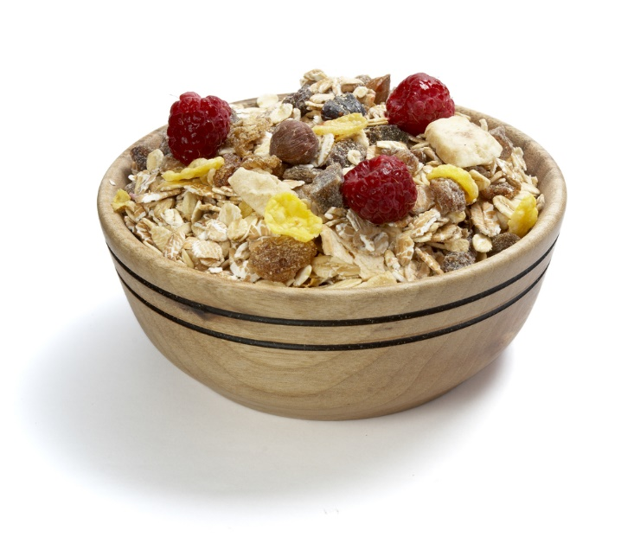
Soluble Fiber
Benefits
  Dissolves into a gel-like substance in the intestines
  Blocks cholesterol from being absorbed from intestines into blood stream
Sources
  Oats (oatmeal, Oat Bran)
  Beans, barley
  Citrus fruits (orange, grapefruit)
  Pears
  Psyllium - Metamucil
Notes:
18
“Fiber is the indigestible part of plants. There’s 2 types…soluble & insoluble.
Soluble fiber means it mixes with water, while insoluble fiber repels water. Both types of fiber help with a healthy GI tract –they increase bulk and motility.
Soluble fiber has been shown to have chol lowering properties. No one knows for sure how, but it might work by blocking absorption of dietary cholesterol, some fatty acids, and bile acids. So if the bile acids are passed out of the body, then your body’s cholesterol will be used to build more of them, thus indirectly helping to lower your cholesterol.”

Slide 19
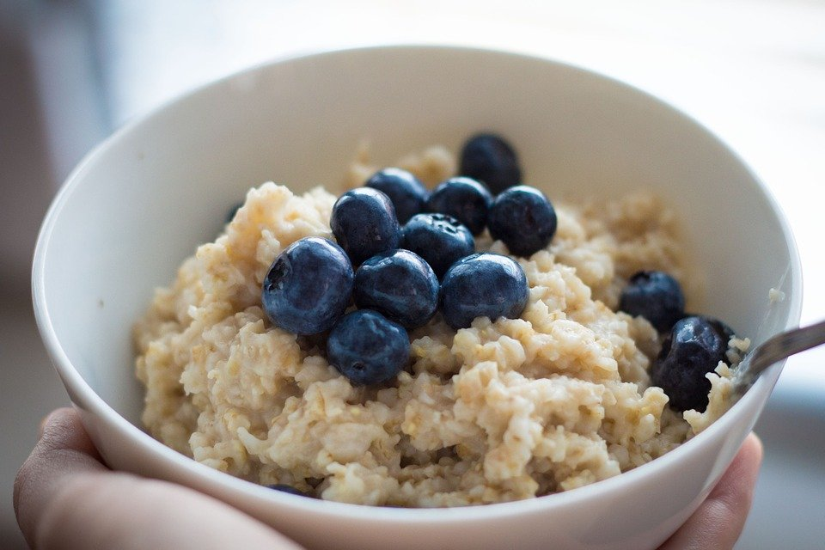
High fiber meal plan - Breakfast
Whole-grain cereal or oatmeal (5-10 grams of fiber)
Topped with ½ cup blueberries (2 grams of fiber)
1 Tablespoon flax seeds (2 grams fiber)
Plant milk (1 gram fiber)

Slide 20
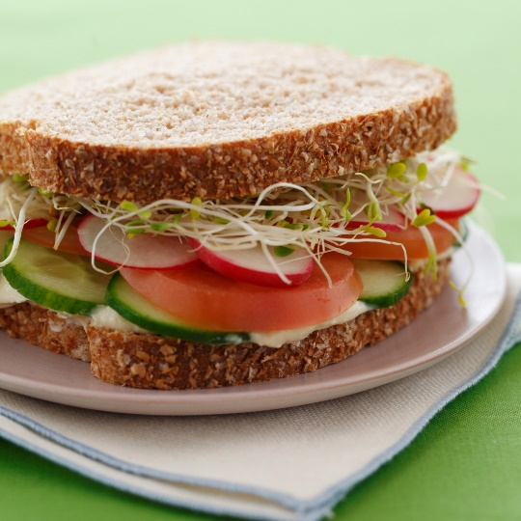
High fiber meal plan - Lunch
Sandwich:
2 Tablespoons Hummus (2 grams fiber)
2 slices of whole wheat bread (6 grams fiber)
Lots of lettuce, cucumber and tomato (2 grams fiber)
Orange (3 grams fiber)

Slide 21
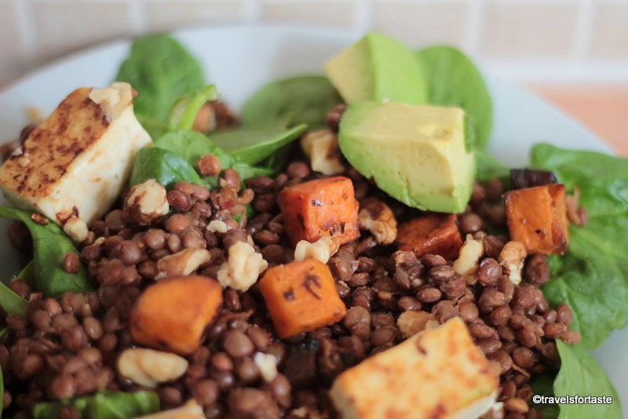
High fiber meal plan - Dinner
Grilled tofu
On salad made with romaine lettuce and carrots/cucumber/mushrooms/tomatoes (5 grams of fiber)
Half a cup of cooked roasted sweet potato (3 grams of fiber)
Half a cup of lentils (7.5 grams of fiber)
1/8 Avocado (2 grams fiber)

Slide 22
High fiber meal plan - Snacks
Morning snack: quarter cup of raisins (1.5 grams of fiber)
Afternoon snack: half a cup of blueberries (2 grams of fiber)
After-dinner treat: 3 cups popped popcorn (3.5 grams of fiber)

Slide 23
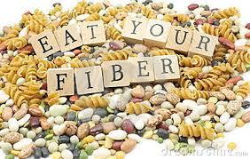
Daily fiber intake
Breakfast: 13 g
Lunch: 13 g
Dinner: 17 g
Snacks: 7 g
Total: 50 grams!!!!

Slide 24
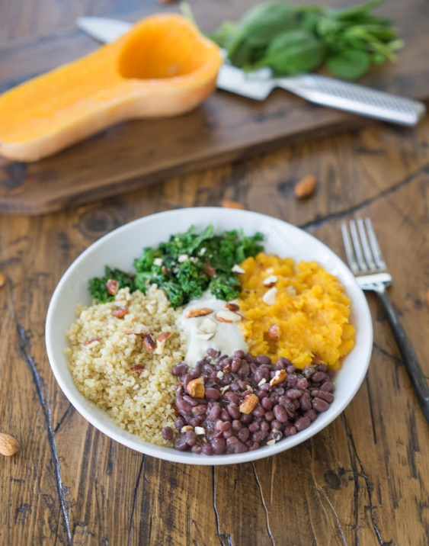
Plan ahead for fiber-rich meals:
Batch cook
Hot cereal for breakfast
High fiber waffles/pancakes
Grains & protein for power bowls: lentils/beans; quinoa/brown rice/barley;
Grilled or roasted veggies
Pre-chop greens for salads or bowls to eat raw or cook
Soups with beans &/or grains & lots of veggies

Slide 25
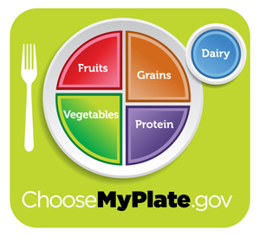
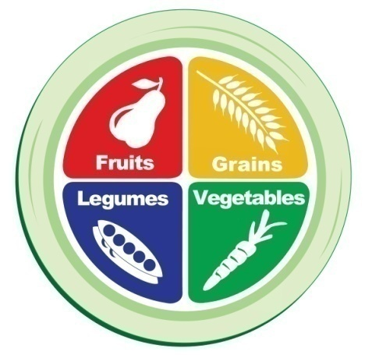
High Fiber Meal Guidelines – Bottom Line
Lots more vegetables & greens
Fruit and/or vegetable with every meal and snack
Whole grains--dump refined grains
Eat beans (legumes) every day
Add 1 Tbsp nuts daily
Cut out the processed foods, don’t eat junk!
Only purchase whole grains that have 5 grams fiber per serving or more (especially cereal, bread, pasta, rice, other grains)
Notes:
Breakfast Ideas:
Oatmeal + BB + walnuts + non-fat milk
Toast + grapefruit + 1 egg
Yogurt + granola + berries
Lunch Ideas:
Salad with a grain + lentils
Sandwich + lean meat + side salad
Pasta + chicken + veggies
Leftovers
Snack
Handful of almonds + dried fruit
Apple with PB
Yogurt + flaxseed
Dinner
NS veggie + grain + lean meat
NS veggie + grain + lentils

Slide 26

Stay healthy, safe and sanitized

Slide 27
Adding Fiber
Eat fruit and/or vegetables with EVERY meal
Start dinner with a salad or vegetable soup. Eat another vegetable with dinner.
Have beans every day
Add beans or lentils to salads, pastas, soups, bowls
Choose intact whole grains
Notes:
27
Ask for suggestions.
Aim for 5 grams per serving on a label
Try whole grain breads (> 5g per serving is high fiber)
High fiber ready-to-eat cereals (All-bran, Fiber-one)
Add berries, or other fruit to your cereal
Add oats or flaxseed to various foods
Diversify your grains: barley, whole wheat pasta, bulgur, oats, whole wheat couscous, quinoa, brown rice, wild rice.
Eat the whole fruit instead of drinking its juice
Add shredded carrot or zucchini to ground meat dishes
Fill omelet with vegetables
Stuff a sandwich with vegetables
Add black, kidney, white, pinto, or other beans, or lentils to salads
How does it stack up? Fiber (grams/serving)
Breakfast choose high fiber breads and/or cereal plus whole fruit 10-15
Choose whole grain bread (≥ 5 grams fiber/servings) at lunch, or have a big salad with kidney beans 10-15
Have a piece of fruit for an afternoon snack 3-5
Eat 1 cup of cooked vegetables at dinner
(or 2 cups of raw vegetables) 3-5
Drink plenty of fluid to prevent abdominal cramping, bloating, constipation. 2 Nalgene bottles per day = 8 cups of

Slide 28
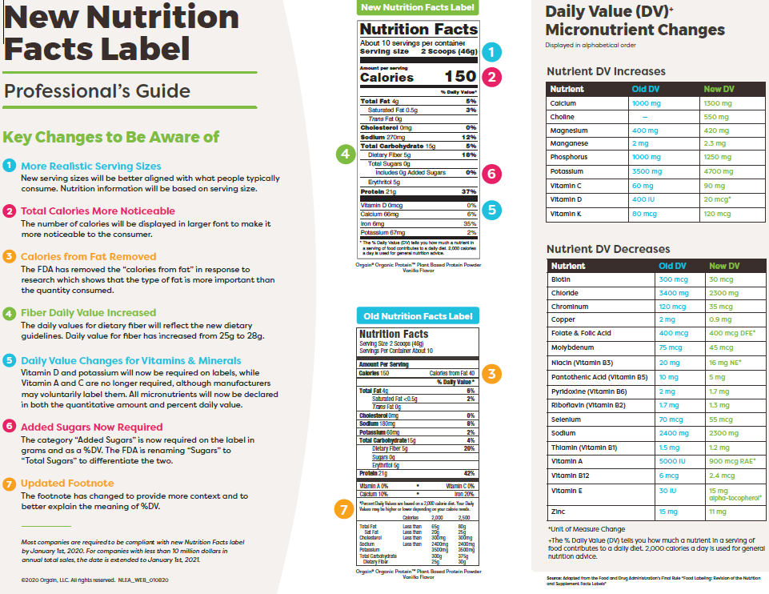
Notes:
28
This example shows 3 grams of fiber per ½ cup serving.

Slide 29





Beans are a member of the legume family.
LEGUMES
LENTILS
PEAS
BEANS
PEANUTS
SOY BEANS
Black Beans
Kidney Beans
Navy Beans
Pinto Beans
Notes:
Beans are members of the legume family.
Legumes are plants whose seeds dry in the seed pod.
Other members of the family include lentils, peas, peanuts, and soybeans.
Beans vary in size, but they have a consistent kidney or oval shape, which distinguishes them from other legumes such as peas, which are round, and lentils, which are flat and disk-like.
Green beans are not considered legumes because they are harvested when they are green or immature, and their nutritional profile is quite different from legume beans.

Slide 30
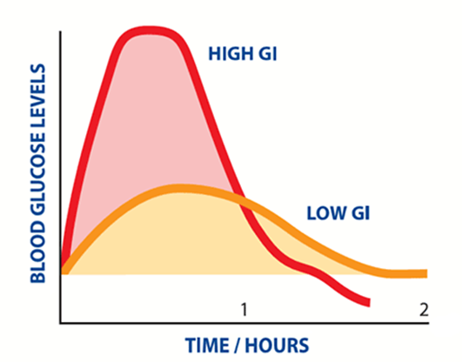
Low GI foods like beans increase blood sugar slowly.
Notes:
As you can see on this chart, low GI foods like beans increase blood sugar level much less than high GI foods.
A high GI food will increase blood sugar very quickly. The pancreas reacts to this by putting out insulin, which causes inflammation and hunger as blood sugar levels begin to drop.
It is better to increase blood sugar levels more gradually. The body experiences less inflammation and less hunger.
Inflammation is related to increased risk of many diseases, including coronary heart disease or blocked arteries.
Low GI foods promote weight management because they decrease feelings of hunger, and increase feelings of satisfaction/satiety after food is eaten.

Slide 31
Reading Nutrition Labels
GUIDE PER FOOD LABEL
Serving Size
Limit total fat - <5 grams/serving
Limit saturated fat - low as possible
Avoid trans fats - 0 grams
Limit added sugar - <5 grams/serving
Limit sodium – 500 mg per meal max
Choose fiber – 5+ grams/serving
Notes:
Recs are per serving.

Slide 32
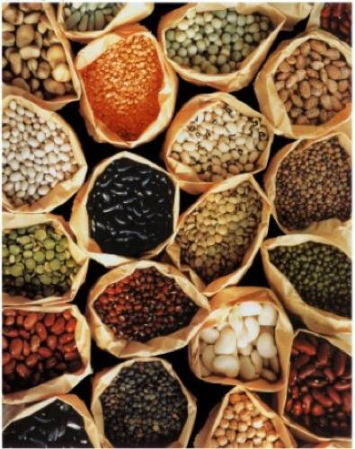
Beans and Lentils
Benefits:
  High in antioxidants
  Source of protein
  High in iron, zinc, folate
  High in fiber
Add to soups, salads, bowls, and whole grain dishes
Canned beans are okay –
buy low sodium

Slide 33
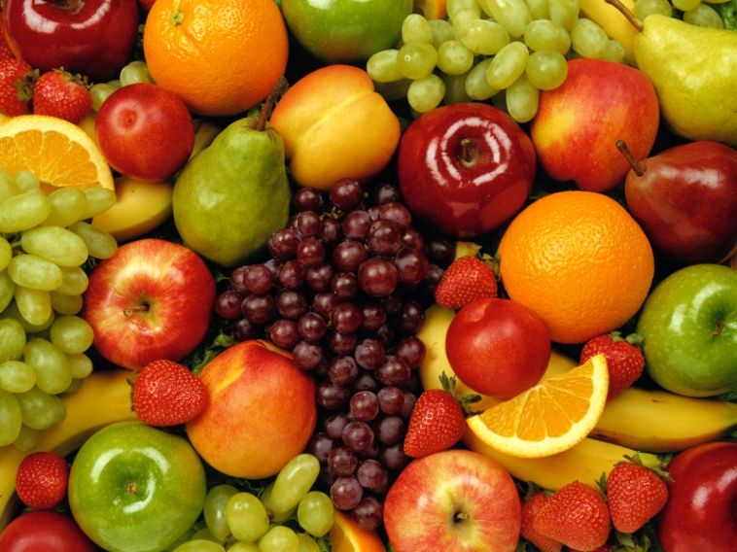
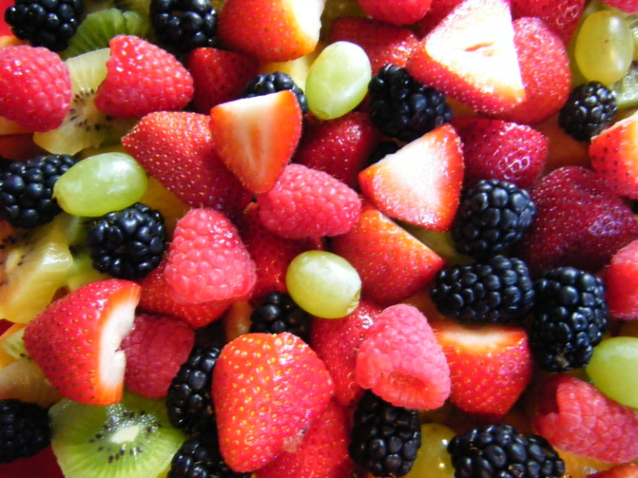
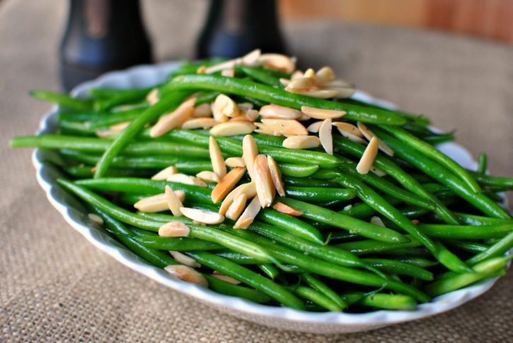
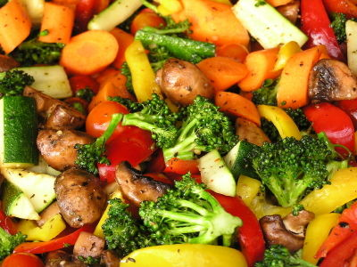
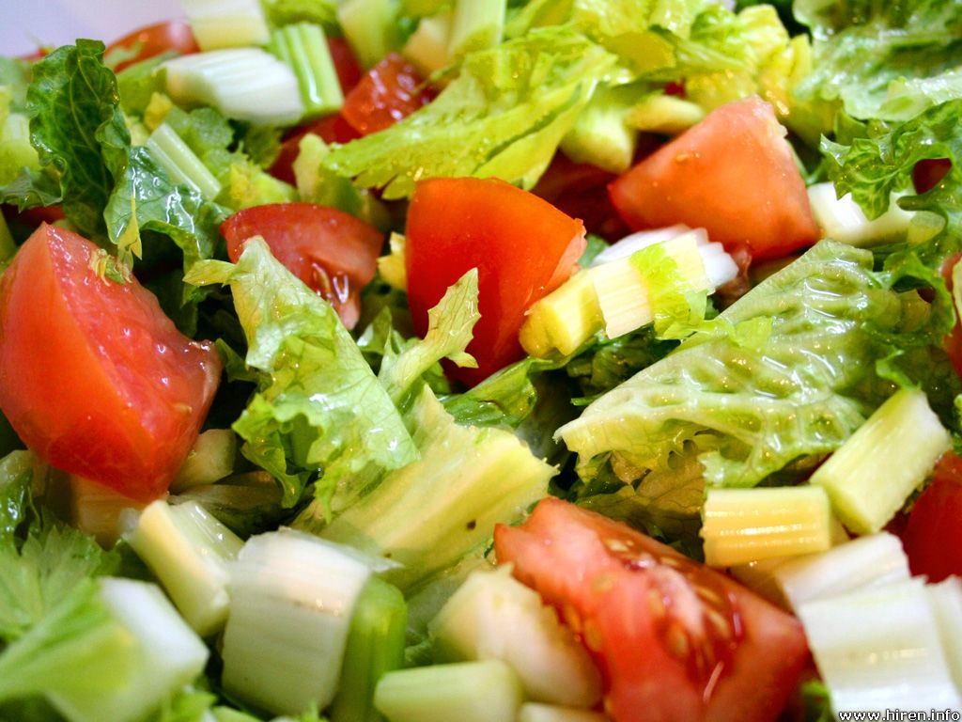
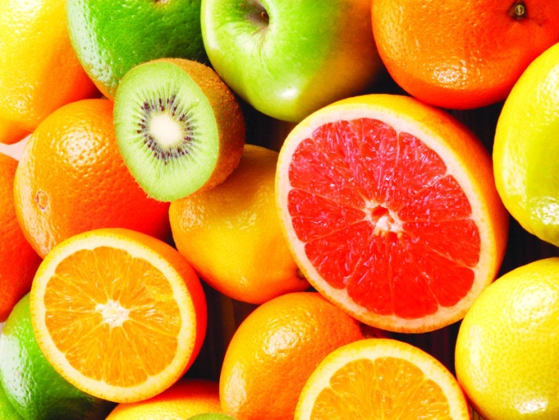
Fruits and Vegetables

Slide 34
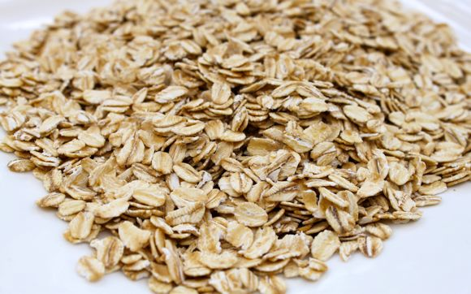
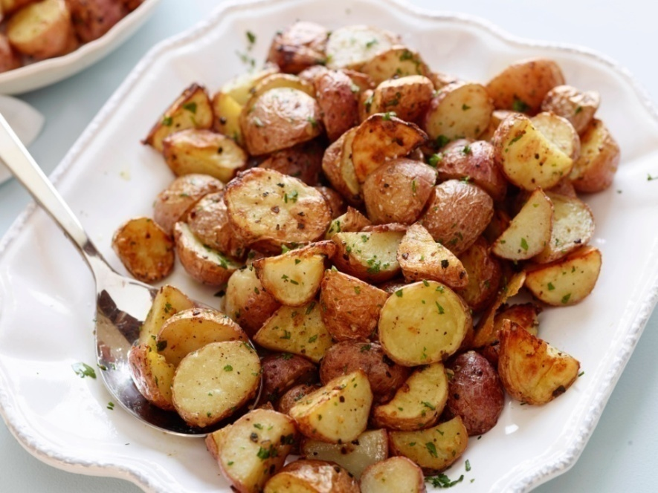
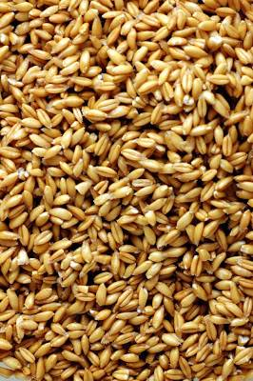
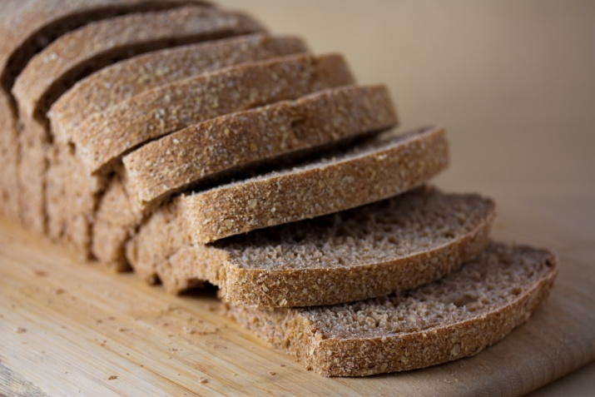
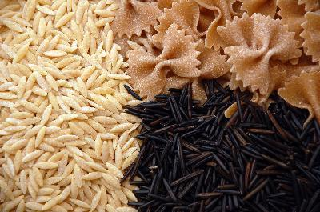
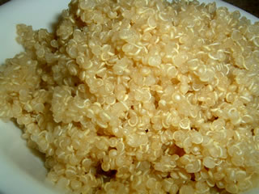
Whole grains/Starches

Slide 35
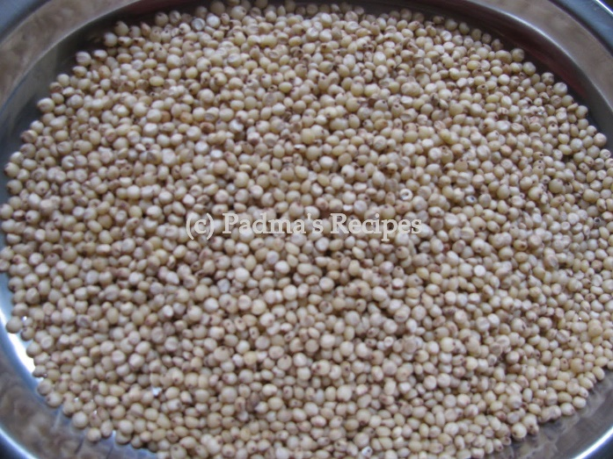
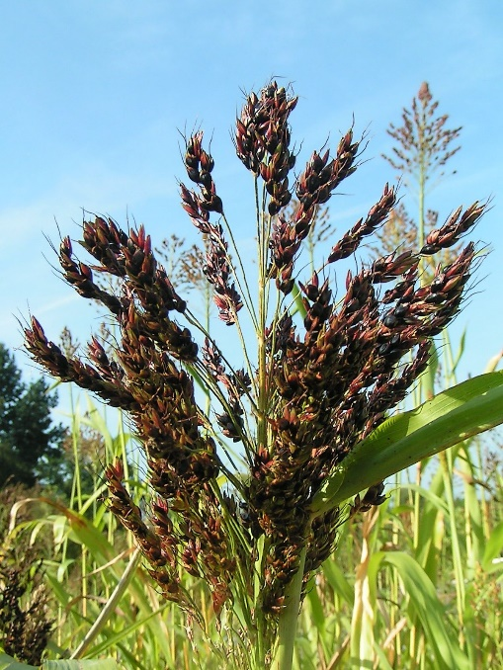
Sorghum
Whole grain cereal
Similar to barley or wheat/rye berries
Grows in stalks like corn
Grains/kernels eaten as whole grain or cooked into syrup
Gluten free
Cooked 1 part grain to 2 parts fluid
Can pop like popcorn
Sprout
Turn into mush

