Slide 1
Cardiovascular Wellness Program Cooking Demo
Caitlin and Jamee

Slide 2
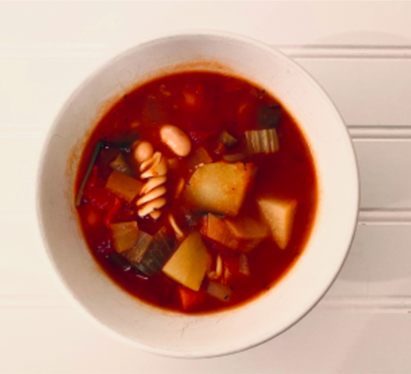
Minestrone Soup
Serving Size: 2-4
Ingredients:
Directions:
½ onion
1 carrot (or handful of baby carrots)
1 Celery stalk
2 cloves garlic, minced or chopped
2 tbs tomato paste
1 cup vegetables
¼ tsp oregano
¼ tsp thyme
¼ tsp black pepper (and more to taste)
1 14 oz can of tomatoes
2 cups vegetable broth
1 cup water
1 bay leaf
½ cup pasta
¾ cup cooked beans
In a large pan, on medium heat, dry sauté chopped onion, carrot, celery, and garlic, until tender or about 5 minutes.
Stir in tomato paste or alternative, and let cook for about 3-5 minutes, stirring occasionally.
Add vegetables and herbs. Continue cooking, stirring occasionally for an additional 3-5 minutes.
Add canned tomatoes, broth, water, and bay leaf. Stir and bring stove to medium/high heat, until soup is at a light bubble. Cook for 15 minutes, stirring occasionally.
Add pasta and cooked beans. Cook for the time recommended for the pasts.
Add greens, if on hand.
Serve and enjoy!

Slide 3
Spaghetti Squash with Vegan Sauce
Serving Size: 4|Prep Time: 15 mins. |Cook Time: 30-45 mins.
Ingredients:
Directions:
2 spaghetti squashes
1 15 oz. can of tomato sauce
¼ cup raw cashews
salt
1 tsp. avocado oil
Nutritional Yeast + Pine Nuts (for toppings)
Set your oven to bake at 350 degrees F.
Cut squashes in half vertically, scrape out the seeds, and coat the insides with the avocado oil and salt.
Roast squash for 30 to 45 minutes.
Blend the tomato sauce, cashews and salt in a blender.
Scrape the insides of the squash creating a spaghetti-like texture and toss with the blended cashew sauce.

Slide 4
Shelf-Stable Food Items
Cereals
Pastas
Rice
Granola bars
Crackers
Dried beans and legumes
Nuts
Applesauce
Nut butters
Canned tuna, salmon, or sardines
Boxed or shelf-stable milk
Low or reduced sodium soups

Slide 5
Shelf-Stable Produce
Dried, frozen, or canned
Bananas
Apples
Oranges
Grapefruit
Broccoli
Cauliflower
Brussel sprouts
Carrots
Potatoes
Squash
Notes:
https://www.nbcnews.com/better/lifestyle/staying-home-due-coronavirus-here-s-what-stock-your-fridge-ncna1155791

Slide 6
Useful Resources
Safeway
  Tuesdays and Thursdays 7:00 – 9:00 am
Whole Foods
  Everyday 8:00 – 9:00 am
Smart & Final
  Everyday 8:30 – 9:00 am
Walmart
  Everyday 7:00 – 8:00 am
Target
  Everyday 8:00 – 9:00 am
Raley’s
  “Senior Essentials” available for curbside or in-store pick-up
Notes:
https://www.kcra.com/article/norcal-stores-offer-special-hours-for-seniors-coronavirus-outbreak/31786475#

Slide 7
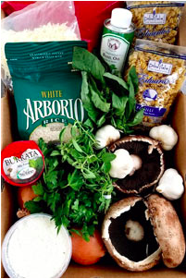
Useful Resources
Produce Express*
  $20 - $50 per box
  Place order by calling (916) 446-8918
  M-F 11 am – 2pm
  Sat 10 am – 1pm
Instacart App
  Costco
  Sprouts
  Sam’s Club
  Sacramento Co-Op
  Petco
Notes:
https://www.instacart.com/grocery-delivery/sacramento-ca

