Slide 1
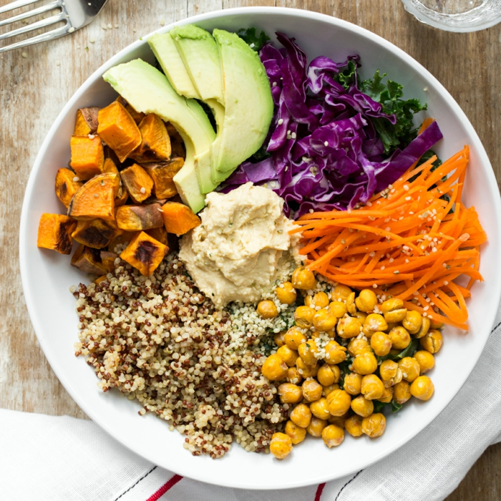
Power of Plant-Based Diets
Debbie Lucus, MS, RD, CDE
Sutter Medical Foundation
Patient Education Department

Slide 2

Go Red for Women Day
Heart disease is #1 kill of women
1 in 3 deaths/year
1 women dies every minute from heart disease
Yet only 1 in 5 think heart disease is her greatest threat
AHA Life’s simple 7 (for heart and brain):
  1. Get active
  2. Control cholesterol
  3. Eat better
  4. Manage blood pressure
  5. Lose weight (if you need to)
  6. Lower blood sugar
  7. Stop smoking

Slide 3
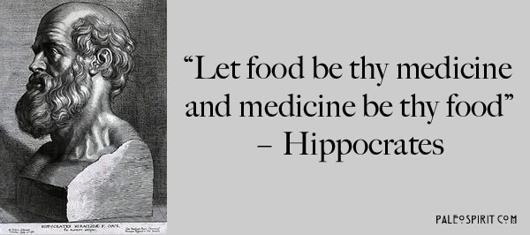

Slide 4


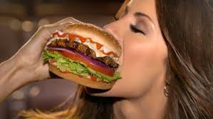


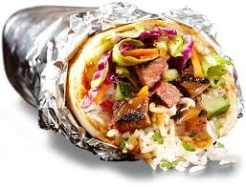
Our toxic food environment!

Slide 5

Our lifestyle is killing us!
Lifestyle factors (including DIET) pay a BIG role in chronic disease
FACT:
  Chronic diseases cause ~70-90% of all deaths
    50% of all adults had one or more chronic health conditions
    1 in 3 adults have high blood pressure
  2 in every 3 adults is overweight or obese (35% are obese)
  1 in every 3 children is overweight or obese (17% are obese)
  29 million Americans have diabetes
  86 million Americans have pre-diabetes
Notes:
Chronic disease consumes 75% of all healthcare dollars

Slide 6
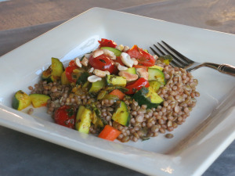
Benefits of Plant-Based Meals
Vegetarian diets are:
  Lower in saturated fat and cholesterol.³
  Higher in in fruit, vegetables, whole grains, nuts, soy, fiber, phytochemicals. ³
2018 Study at Harvard found that 1/3 of early deaths could be prevented (about 200,000 lives/year) if people moved towards plant-based eating
Vegetarians have a significantly less:
  Heart disease mortality.¹
  Cancer incidence.^{1, 3}
  High blood pressure.²
  Type 2 diabetes. ^{3,6}
Vegetarians also have lower
  LDL cholesterol levels
  BMIs.³

Slide 7
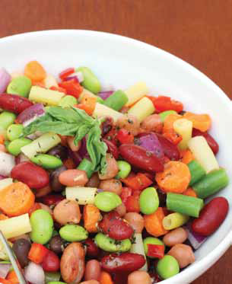
Diabetes and Plant-Based Diets
Vegetarian and vegan diets: ⁵
  Are a healthy option for people with diabetes
  Can help prevent and manage diabetes
  Promote weight loss and lower A1C levels without carbohydrate and calorie restriction
Vegans had a 60% lower risk of developing diabetes than non-vegetarians in the Adventist Health Study 2. ⁶
Greater improvement seen with a low-fat vegan diet vs. ADA diet in achieving glycemic control and lipid control. ⁷

Slide 8

Why health benefits?
Whole intact plant foods are:
Low in saturated fat
Low in caloric density
High in fiber
Low in glycemic response
High in phytonutrients that reduce risk of chronic disease.
Whole foods, plant-based diet is only plan to show reversal of chronic disease
Notes:
Plant foods fight disease.

Slide 9
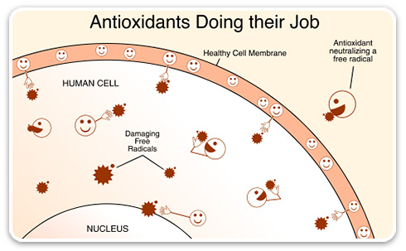
Phytonutrients Help Prevent Disease
Plant foods contain thousands of phytonutrients that protect your body from oxidative stress and the harmful invasion of free radicals.
Without enough phytonutrients your body ages faster and breaks down, is more at risk from chronic diseases.
Notes:
Phyto refers to the Greek word for plant. These chemicals help protect plants from germs, fungi, bugs, and other threats.

Slide 10
Examples of Phytonutrients
Carotenoids – carrots, sweet potatoes, winter squash
Lycopene – tomatoes, watermelon, pink grapefruit
Lutein and zeaxanthin – spinach, kale, collards
Flavonoids – blueberries, cranberries
Resveratrol – grapes, grape juice and red wine
Glucosinolates – cabbage, broccoli, cauliflower
Ellagic acid – strawberries, raspberries, pomegranates
Phytoestrogens – soy milk, tofu, edamame

Slide 11

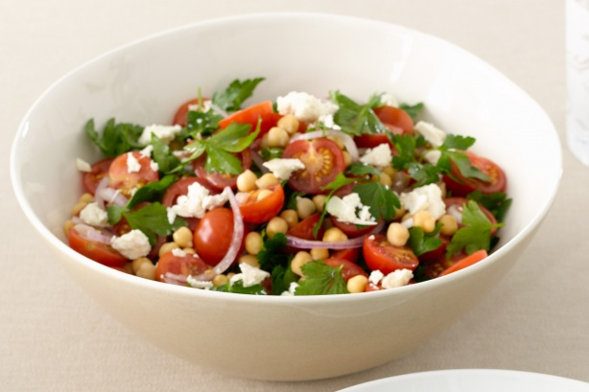
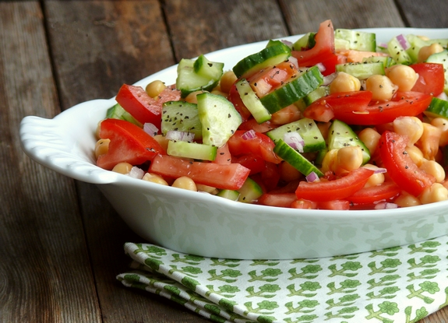
Spectrum of Plant-Based Diets
Where do you want to be on the plant-based diet spectrum?
Vegetarian
Vegan
Flexitarian
Notes:
Watch a short video on flexitarianism, click on the link. Fast forward to 1:40 into the video.
Watch the video on veganism.

Slide 12
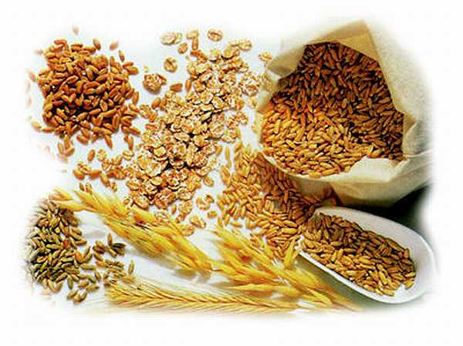

Vegan vs. Plant-based
Whole food, plant-based = whole real food that is not (or minimally) processed.
Vegan = contains no animal products – not necessarily whole real food

Slide 13
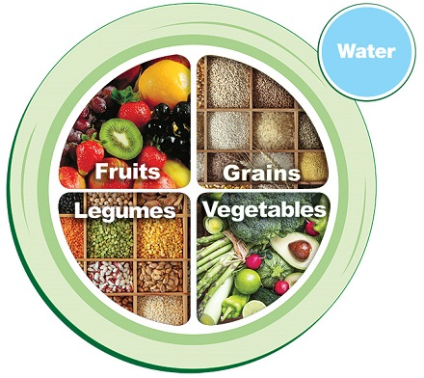
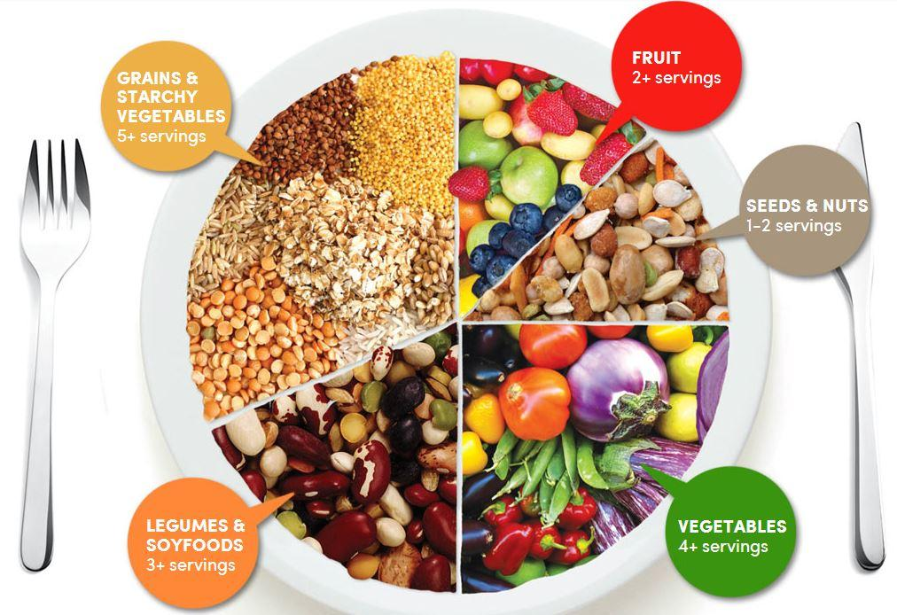
Power Plate

Slide 14
Whole Intact Plant Foods
Eating foods instead of food products:
Vegetables
Fruits
Beans
Nuts and Seeds
Whole intact grains
Herbs and spices
Notes:
Plant foods fight disease.

Slide 15
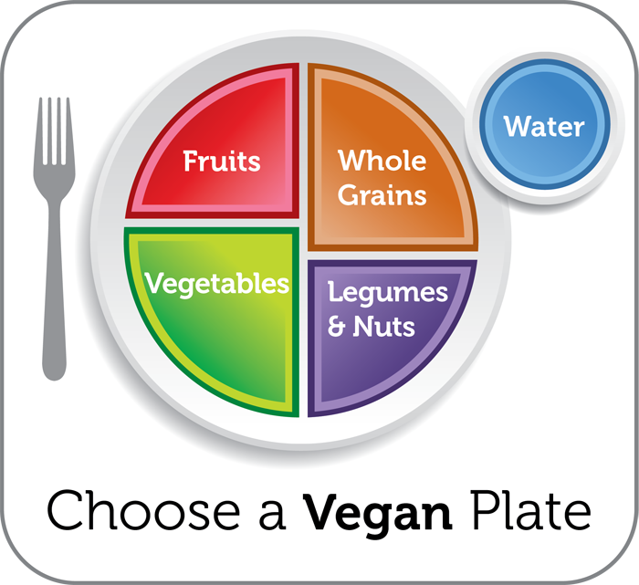
Food Groups
Fruit (3/day)
Vegetable (4+/day)
A whole grain (5/day) or starch with every meal
A protein (2/day) or with every meal

Slide 16
Meal Planning
Fruit and/or a vegetable with every meal
A whole grain or starch with every meal
A protein with every meal

Slide 17
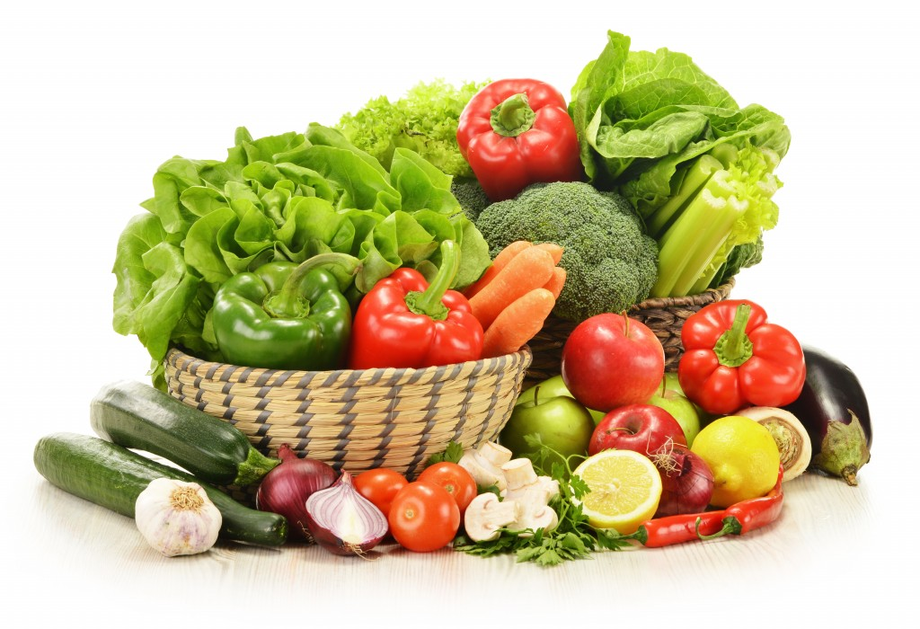
Vegetables
Recommended minimum intake: 2.5 to 3 cups per day
Only 9% of Americans meet this goal

Slide 18
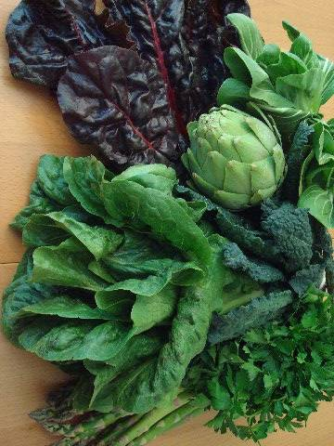
Dark Green Vegetables
Benefits:
  High in Antioxidants
  High in beta carotene, vitamin C, calcium, iron, B-Vitamins and fiber
  Low in calories
Spinach; kale; Swiss chard; bok choy; collards, mustard, beet, turnip greens; and broccoli
Eat raw (salads) or cooked (sautéed or steamed)
Add to soups, salads, grain dishes

Slide 19
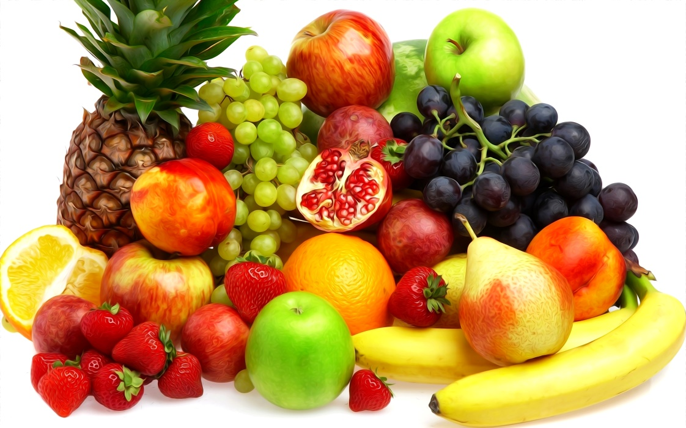
Fruits
Recommended intake: 2-3 cups per day
Only 13% of Americans meet this goal
Choose whole, intact fruits

Slide 20
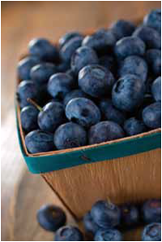
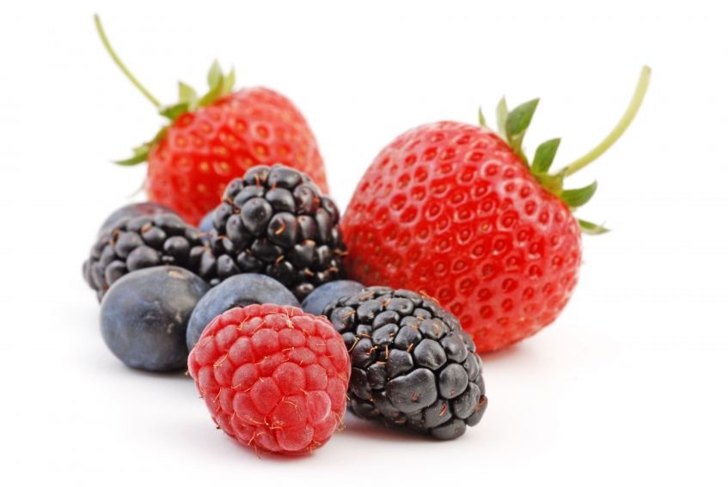
Berries
Benefits
  High in antioxidants
  High in vitamins, minerals and fiber
  Low in calories
Buy fresh or frozen
Great substitute for dessert !

Slide 21

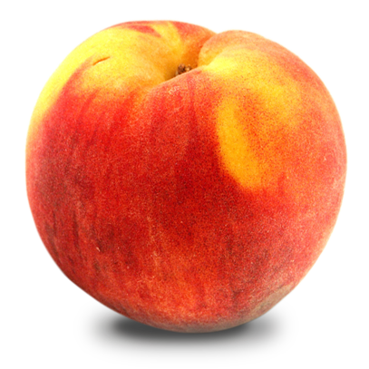
Fruit is nature’s candy
15 grams carbohydrate
45 grams carbohydrate

Slide 22
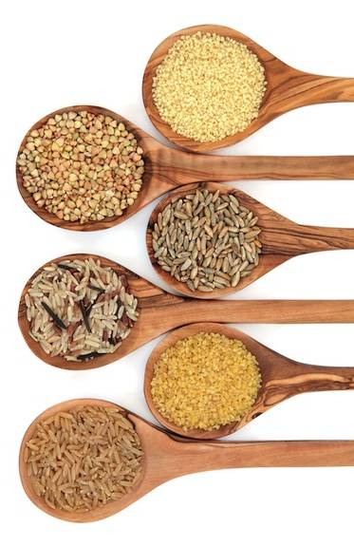
Whole Intact Grains
Benefits:
  High in antioxidants
  High in fiber, lots of minerals, lots of B vitamins
  20 nutrients in total
Examples:
  Hulled barley, brown rice, farro, oat goats, quinoa, wheat berries, wild rice
Replace flour products with whole intact grains. Steel cut oats and cracked wheat are close to intact grains.

Slide 23
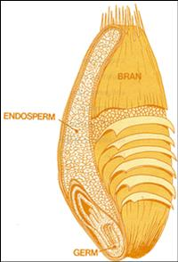
Whole Intact Grains

Slide 24
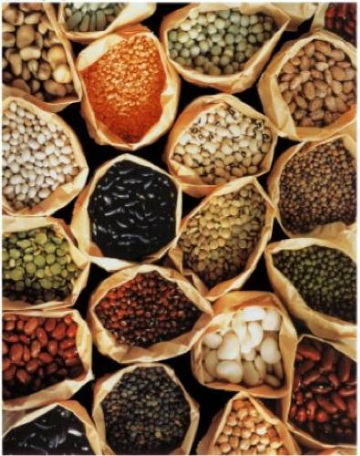
Beans and Lentils
Benefits:
  High in antioxidants
  Source of protein & fiber
  High in iron, zinc, folate
  Associated with lower risk of cancer, diabetes, obesity, heart disease
Add to soups, salads, and whole grain dishes
Canned beans are okay – buy low sodium

Slide 25
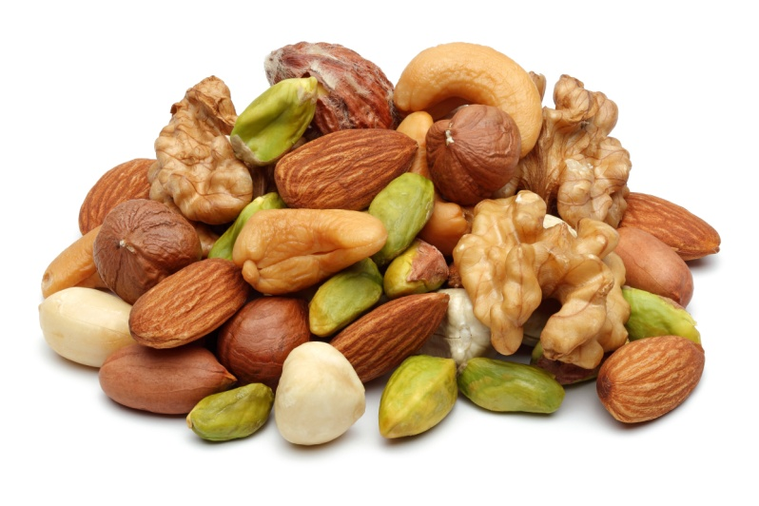
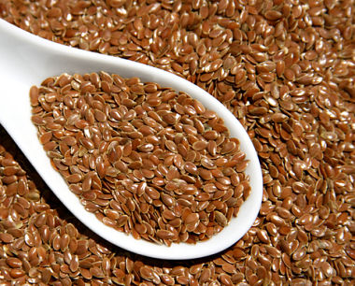
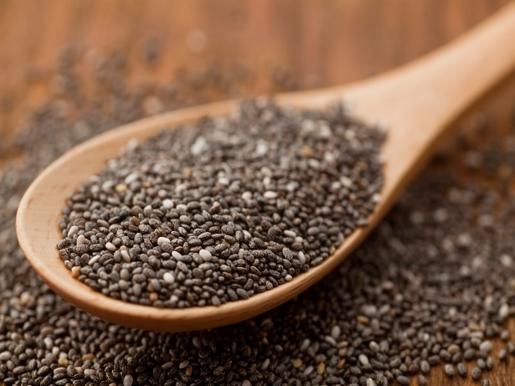
Nuts and Seeds
Benefits:
  Naturally occurring plant stanols
  Heart-healthy omega-3 fatty acids (flax, chia, walnuts)
  High fiber, protein, magnesium
Eat 2-4 tablespoons everyday
Watch portions – they are high in calories and fat

Slide 26
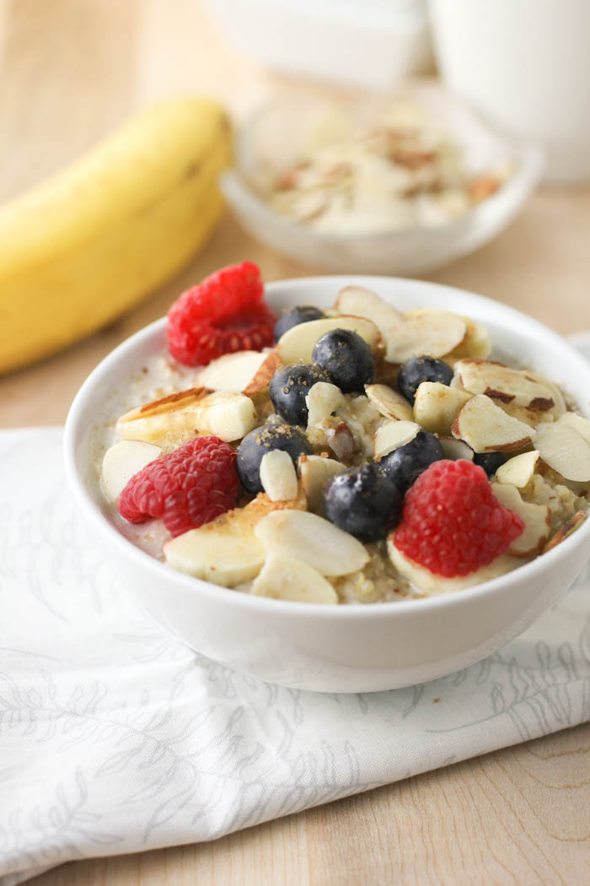
Herbs and Spices
Herbs and spices are possibly the most antioxidant-rich food ingredients in our diet
Spices such as cinnamon, cloves, bay leaves, and turmeric display insulin-enhancing activity
Cinnamon may help reduce fasting blood sugars, lipids, triglycerides, LDL, and total cholesterol
As little as ¼ tsp of cinnamon per day had beneficial effects

Slide 27
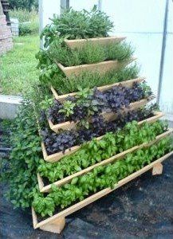
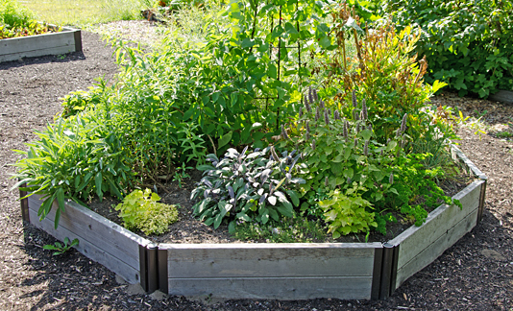
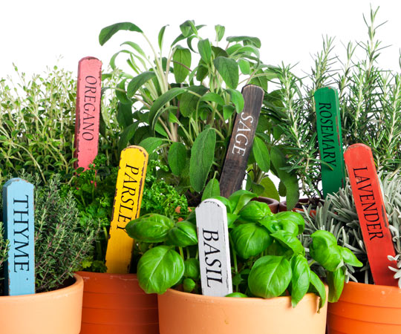
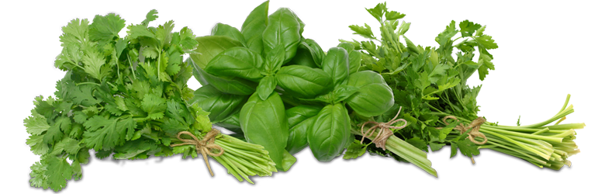
Herb Gardens

Slide 28
Plant-based Breakfast
Remember,
  Fruit and/or a vegetable
  A whole grain or starch
  A protein
Ideas?

Slide 29

Plant-Based Lunch
Remember,
  Fruit and/or a vegetable
  A whole grain or starch
  A protein
Ideas?

Slide 30
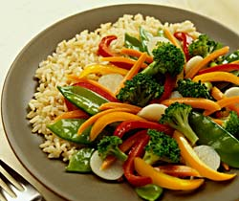
Plant-Based Dinner
Remember,
  Fruit and/or a vegetable
  A whole grain or starch
  A protein
Ideas?

Slide 31
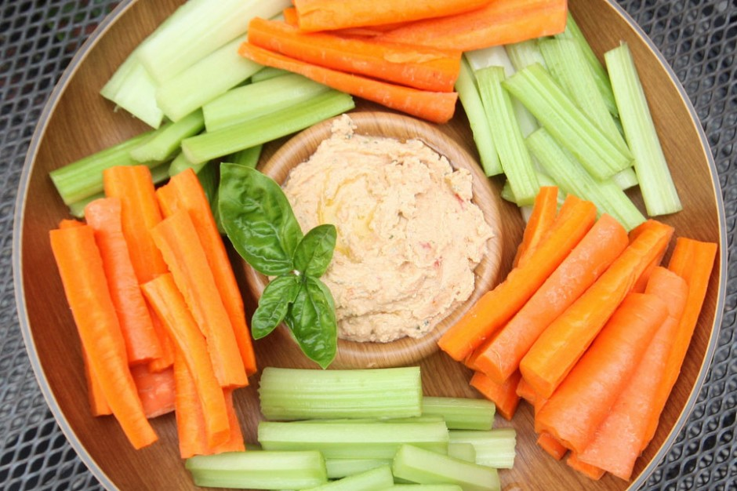
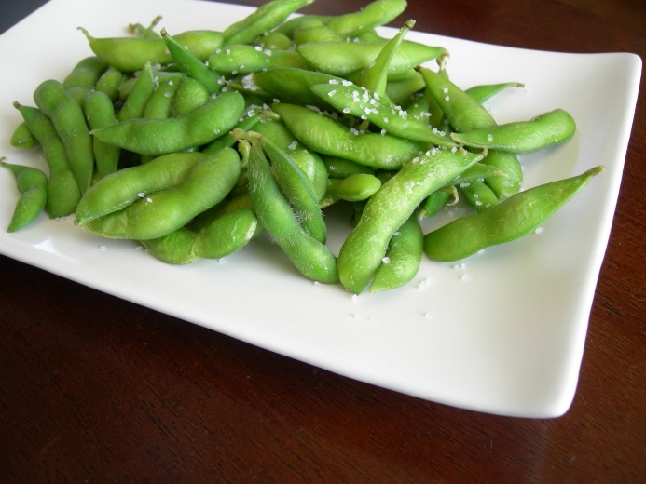
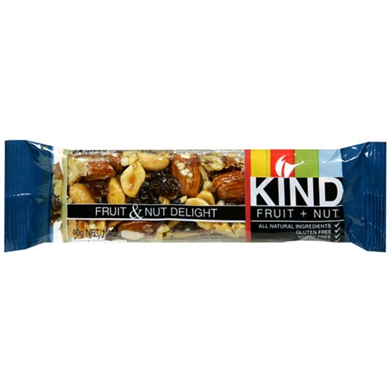
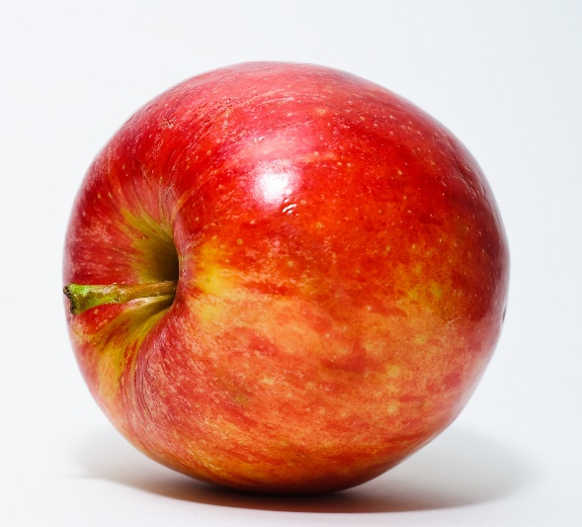
Plant-Based Snacks
Ideas?

Slide 32
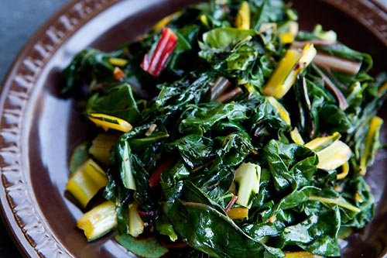
Considerations
Vitamin B₁₂ supplementation for vegans:
  It is recommended that children and adults take a daily multivitamin or B₁₂ supplement of at least 5 micrograms per day.⁸
Plenty of calcium is eaten in green leafy vegetables and legumes.
Notes:
http://www.veganhealth.org/b12/rec

Slide 33

Theme of Good Health
If you have no desire to go 100% plant-based, that’s completely fine!
These are the most important goals upon which we all agree:
1. More vegetables
2. Less refined sugar
3. Less salty foods
4. Less refined grains
5. Less fried foods
6. Less solid fats (butter, margarine)
a.k.a. less processed foods!
Notes:
9% of Americans eat 2-3 cups of vegetables per day, Americans consume 3,400 mg sodium per day

Slide 34
Only profound lifestyle changes can reverse diseases

Slide 35
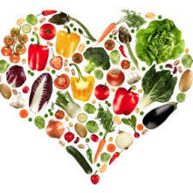
Eat as if your life depended on it!
Notes:
All I wish, is that people would eat as if their life depended on it!

