Slide 1
Use it or Lose it

Slide 2
Calcium and Bone Health
Cari Shulkin MSN, RN-BC

Slide 3
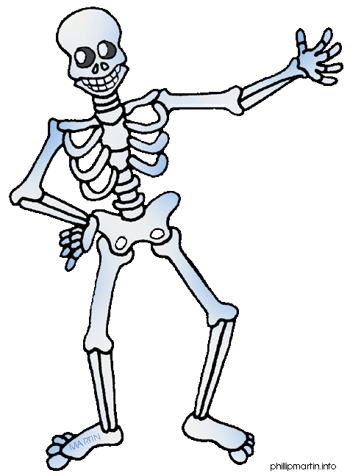
Bones play many roles:
Provide structure
Protect organs
Anchor muscles
Stores calcium
Who takes a calcium supplement?

Slide 4
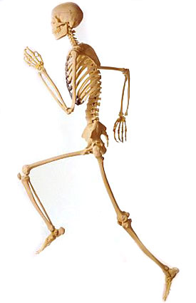
Strong bones?
Adequate calcium consumption
Weight bearing physical activity
This optimizes bone mass and may reduce the risk of osteoporosis

Slide 5
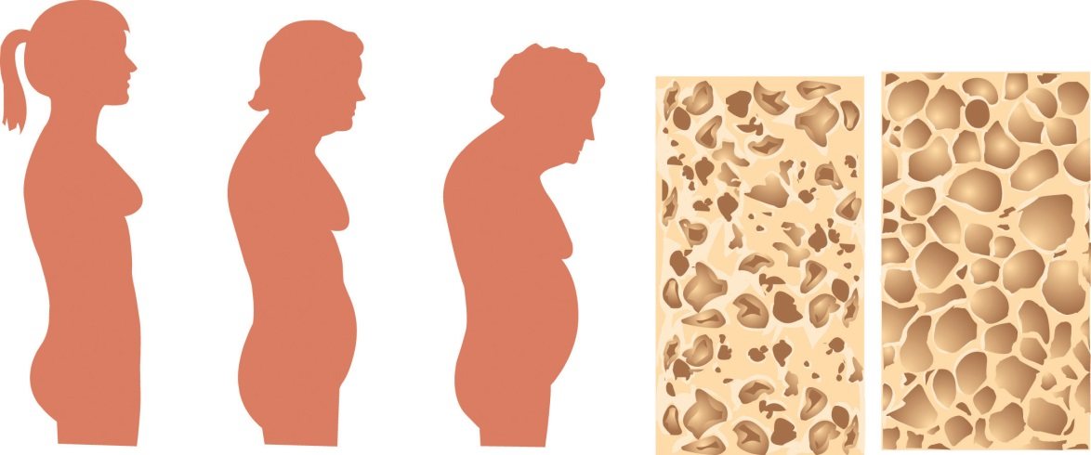
Peak bone mass
Refers to the genetic potential for bone density. By the age of 20, the average woman has acquired most of her skeletal mass.
Decline in bone mass occurs around the time of menopause

Slide 6
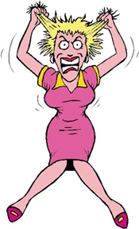
Childhood to adulthood
A person with high bone mass as a young person will be more likely to have a higher bone mass later in life. Inadequate calcium consumption and physical activity early on could result in a failure to achieve peak bone mass in adulthood.
Drink your milk!
Go outside to play!

Slide 7
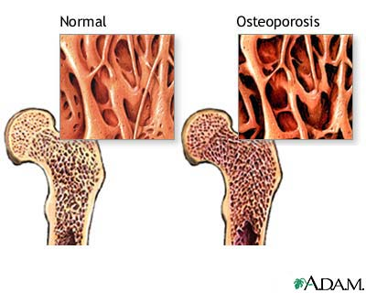
Osteoporosis
Osteoporosis or "porous bone" is characterized by low bone mass and deterioration of bone tissue. It leads to an increase risk of bone fractures typically in the wrist, hip, and spine.

Slide 8
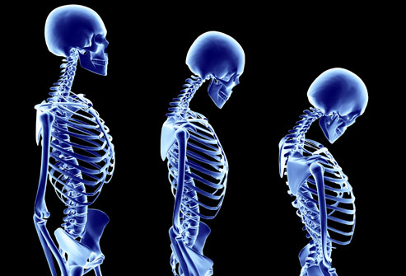
Risk factors
Female
White/Caucasian
Post menopausal women
Older adults
Small in body size
Eating a diet low in calcium
Physically inactive

Slide 9
Calcium
Calcium is a mineral needed by the body for healthy bones, teeth, and proper function of the heart, muscles, and nerves. The body cannot produce calcium; therefore, it must be absorbed through food.

Slide 10
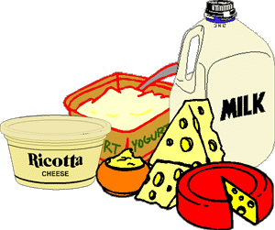
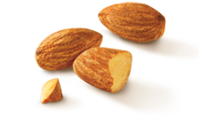
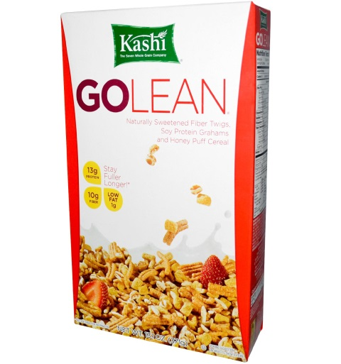
Sources of calcium
Dairy products—low fat or nonfat milk, cheese, and yogurt
Dark green leafy vegetables—bok choy and broccoli
Calcium fortified foods—orange juice, cereal, bread, soy beverages, and tofu products
Nuts—almonds

Slide 11
Recommended calcium intake??
Ask your doctor

Slide 12
What’s the deal with Vit D
Vitamin D also plays an important role in healthy bone development. Vitamin D helps in the absorption of calcium (this is why milk is fortified with vitamin D).

Slide 13
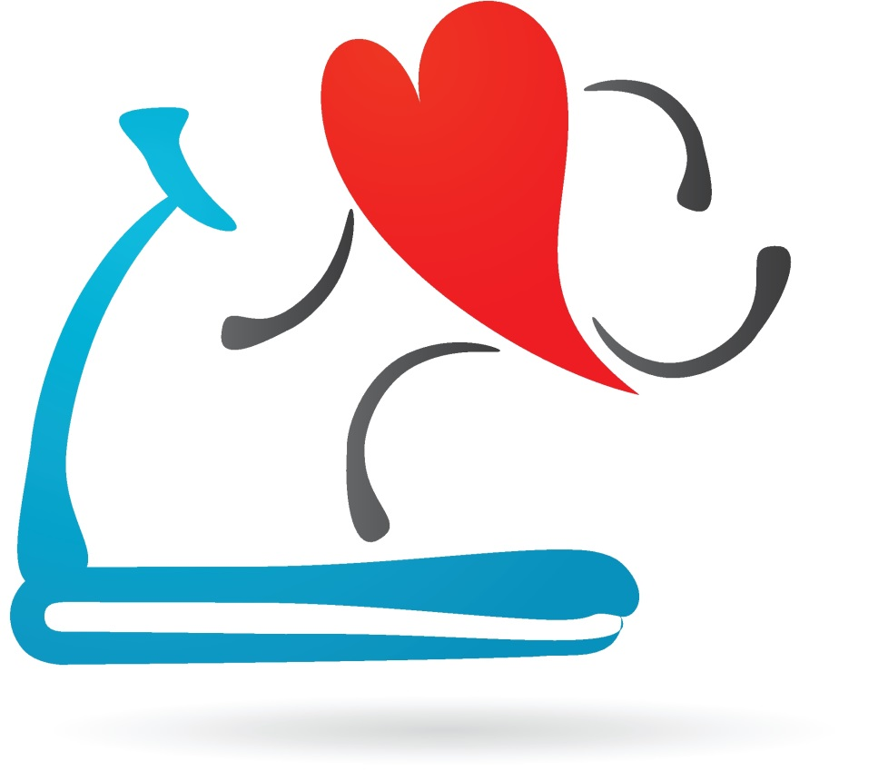
Weight bearing physical activity
Adequate weight-bearing physical activity early in life is important in reaching peak bone mass. Weight-bearing physical activities cause muscles and bones to work against gravity.

Slide 14
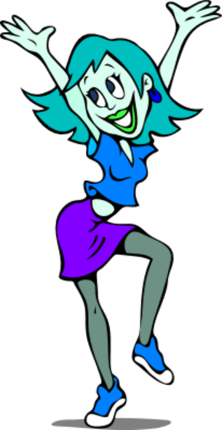
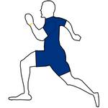
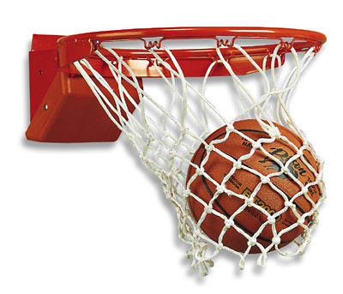
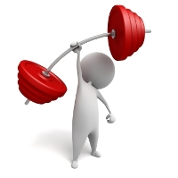
Weight bearing exercises
Walking, Jogging, or running
Tennis or Racquetball
Field Hockey
Stair climbing
Jumping rope
Basketball
Dancing
Hiking
Soccer
Weightlifting

Slide 15
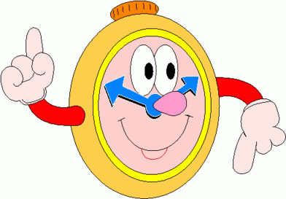
Adults: Engage in at least 30 minutes of moderate physical activity [on] most, preferably all, days of the week
Children: Engage in at least 60 minutes of moderate physical activity [on] most, preferably all, days of the week

Slide 16
Poll time
Let's see what you have learned

Slide 17
Questions? Comments?
Thank you!!!
One more brain teaser….

