Slide 1
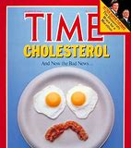
ACC/ AHA Cholesterol Guidelines 2018
Radhika N Bukkapatnam Md FACC
Jan 21, 2020

Slide 2
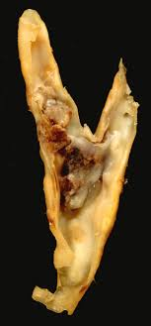
Cholesterol and Atherosclerotic Cardiovascular Disease (ASCVD)
S. Cholesterol, LDL Cholesterol and VLDL cholesterol are atherogenic
Animal studies, epidemiological studies, genetic forms of hypercholesterolemia and RCTs
Optimal total cholesterol levels are about 150 mg/dL, which corresponds to an LDL-C level of about 100 mg/dL correspond to low rates of ASCVD
Although LDL-C is a primary cause of atherosclerosis, other risk factors contribute, as well.
Notes:
The major risk factors include cigarette smoking, hypertension, dysglycemia, and advancing age, a person’s age also counts as a risk factor. By combining all major risk factors into a prediction equation, an individual’s probability of developing ASCVD can be estimated.

Slide 3
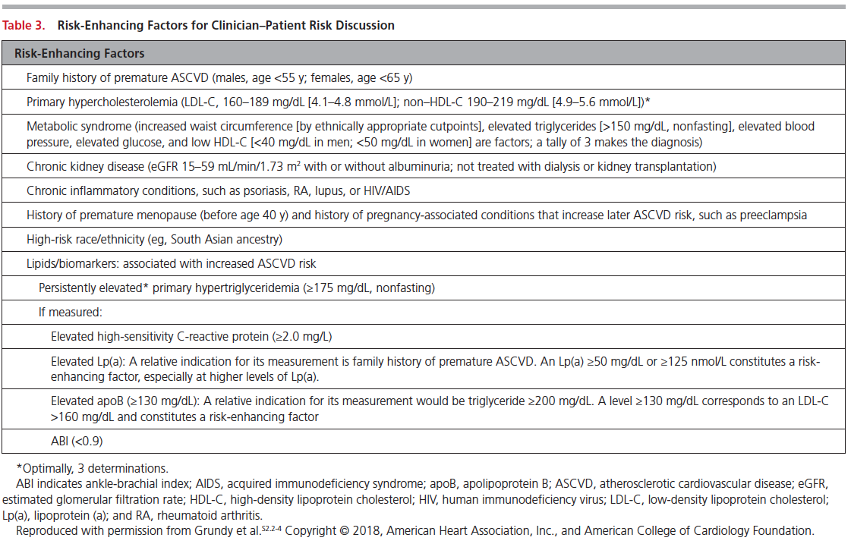
Risk Increasing Factors
▪ Family history of premature ASCVD (males, age <55 y; females, age <65 y)
▪ Primary hypercholesterolemia (LDL-C, 160–189 mg/dL [4.1–4.8 mmol/L); non–HDL-C 190–219 mg/dL [4.9–5.6 mmol/L])∗
▪ Metabolic syndrome (increased waist circumference, elevated triglycerides [>150 mg/dL], elevated blood pressure, elevated glucose, and low HDL-C [<40 mg/dL in men; <50 in women mg/dL] are factors; tally of 3 makes the diagnosis)
▪ Chronic kidney disease
▪ Chronic inflammatory conditions such as psoriasis, RA, or HIV/AIDS
▪ History of premature menopause (before age 40 y) and history of pregnancy-associated conditions that increase later ASCVD risk such as preeclampsia
▪ High-risk race/ethnicities (e.g., South Asian ancestry)

Slide 4
Lipid Biomarkers
1. Elevated high-sensitivity C-reactive protein (≥2.0 mg/L)
2. Elevated Lp (a): A relative indication for its measurement is family history of premature ASCVD. An Lp(a) ≥50 mg/dL or ≥125 nmol/L constitutes a risk-enhancing factor especially at higher levels of Lp(a).
3. Elevated apo B ≥130 mg/dL: A relative indication for its measurement would be triglyceride ≥200 mg/dL. A level ≥130 mg/dL corresponds to an LDL-C >160 mg/dL and constitutes a risk-enhancing factor
4. ABI <0.9

Slide 5
What should we Measure?

Slide 6
When should we start screening

Slide 7
Diet and Lifestyle

Slide 8
Balance of Lipids
Bad:
LDL Cholesterol
Triglycerides
Sugars
Good
HDL Cholesterol
Fiber
Foods that increase metabolism
Proteins

Slide 9
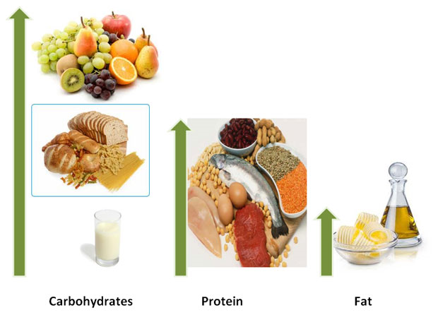
What the Various Food Groups Contain

Slide 11
Lipid Transport

Slide 12
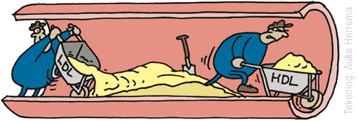

Slide 13
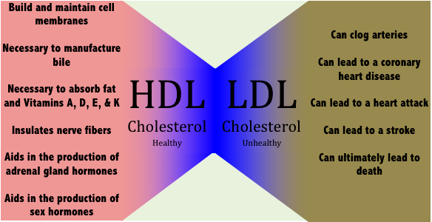

Slide 14
Foods that Increase LDL Cholesterol

Slide 15
More Foods that Increase LDL Cholesterol

Slide 19
Foods that Raise HDL

Slide 21
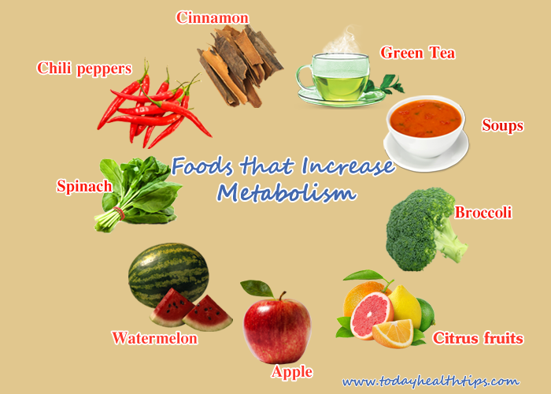
Foods that Increase Metabolism

Slide 22
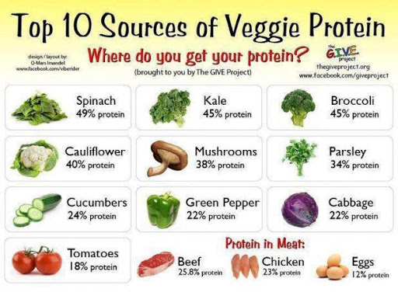
Proteins and Vitamins

Slide 23
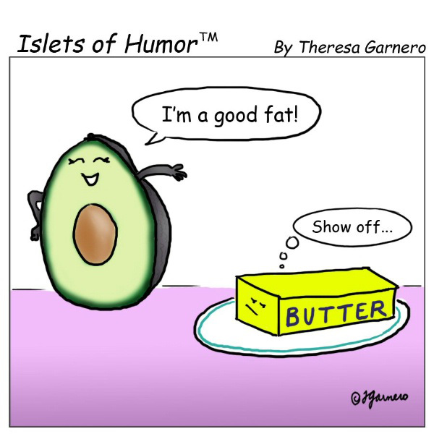

Slide 24
Lifestyle Measures
Exercise 150 minutes a week
Weight control
No smoking
Avoiding sugary drinks, salt rich snacks
Alcohol
Avoid sedentary lifestyle

Slide 25
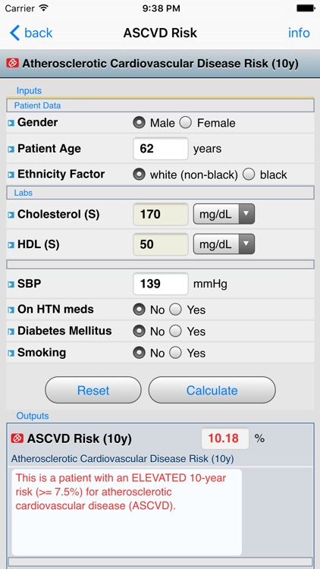

Slide 26
Primary Prevention

Slide 27
Medical Therapy

Slide 28
Categories of Intensities of Statins
Drug | Low-Intensity 20-25% ↓ LDL-C | Moderate-Intensity 30-49%↓ LDL-C | High Intensity >50%↓ LDL-C
Lovastatin | 10-20 mg | 40-80 mg
Pravastatin | 10-20 mg | 40-80 mg
Simvastatin | 10 mg | 20-40 mg
Fluvastatin | 20-40 mg | 80 mg
Pitavastatin |  | 1-4 mg
Atorvastatin | 5 mg | 10-20 mg | 40-80 mg
Rosuvastatin |  | 5-10 mg | 20-40 mg

Slide 29
Non Statin Therapies
Drug Class | Mechanism of Action | Effects on Plasma Lipids | LDL-C lowering | Side effects
Bile acid sequestrants | Impairs reabsorption of bile acids Raise LDL receptor activity | Reduces LDL Raises VLDL Minimal effect on HDL | 15-25%, depending on dose | Constipation GI distress Increases TG
Ezetimibe | Impairs absorption of cholesterol Raises LDL receptor activity | Reduces LDL Reduces VLDL Minimal effect on HDL | 15-25% | Rare
Niacin | Reduces hepatic secretion of VLDL | Reduces VLDL Reduces LDL Raises HDL | 5-20% | Flushing, rash, raise plasma glucose, hepatic dysfunction, others

Slide 30
Novel Agents
PCSK 9 inhibitor
CETP inhibitors
Vascepa for Triglycerides

Slide 35
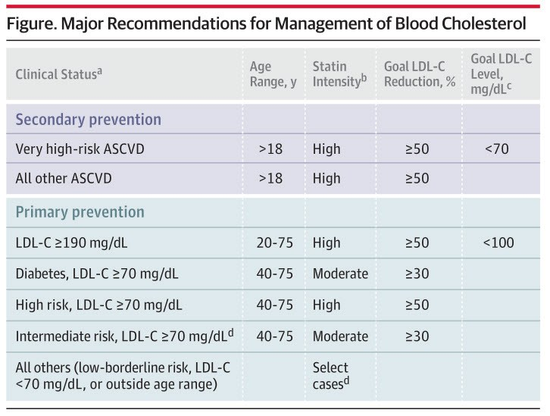
How low should the Cholesterol be?

Slide 36
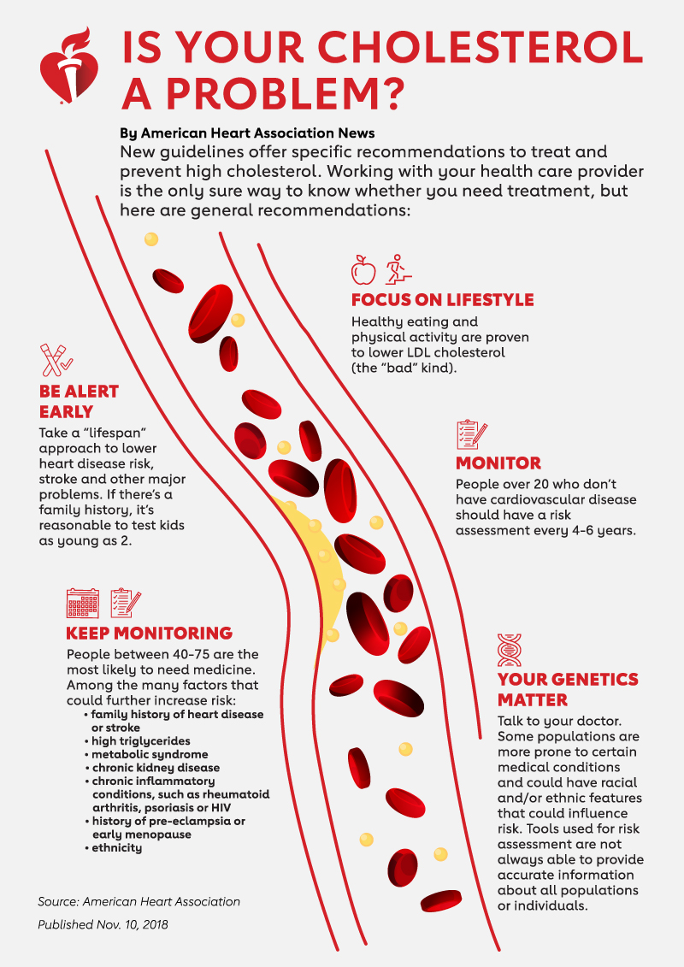

Slide 37
Thank you

