Slide 1
Congestive Heart Failure
Radhika Nandur Bukkapatnam MD FACC

Slide 2
Magnitude of the Problem
5 million Americans with CHF
More than a million Hospital admissions/ year
>550k new patients a year
>300k deaths every year
>40% mortality in severe CHF
One in 9 deaths in 2009 included heart failure as contributing cause.¹
About half of people who develop heart failure die within 5 years of diagnosis.¹

Slide 3
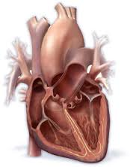
HEALTHY HEART
The heart's left side pump sends oxygen-rich blood throughout the body.
The heart's right-side pump moves "used" blood to the lungs to get more oxygen.

Slide 4
Congestive Heart Failure
Congestive heart failure, occurs when your heart muscle doesn't pump blood as well as it should.
It can also occur if the heart pumps fine but cannot relax properly
Right sided: Leg swelling, fluid in the abdomen
Left sided: Inability to breathe and fatigue

Slide 5
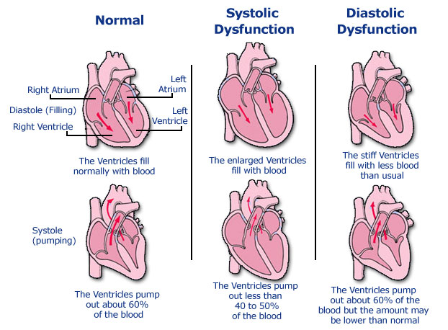

Slide 6
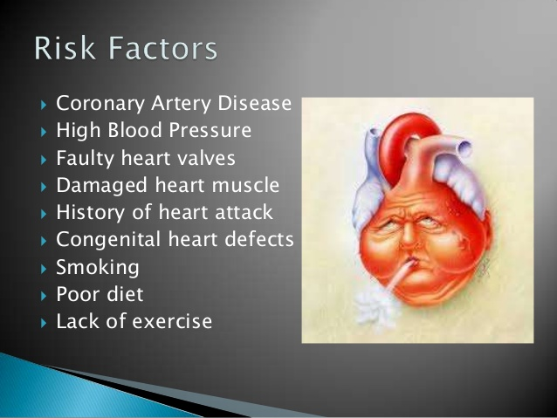

Slide 7
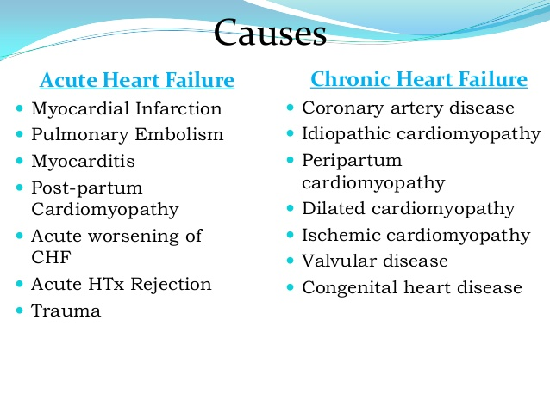

Slide 8
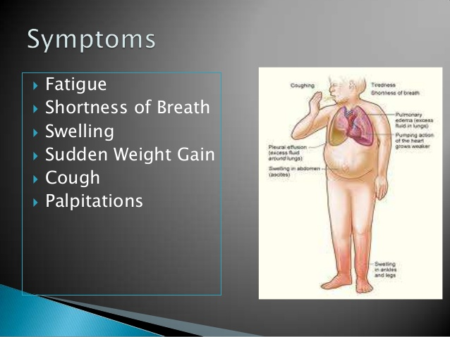

Slide 9
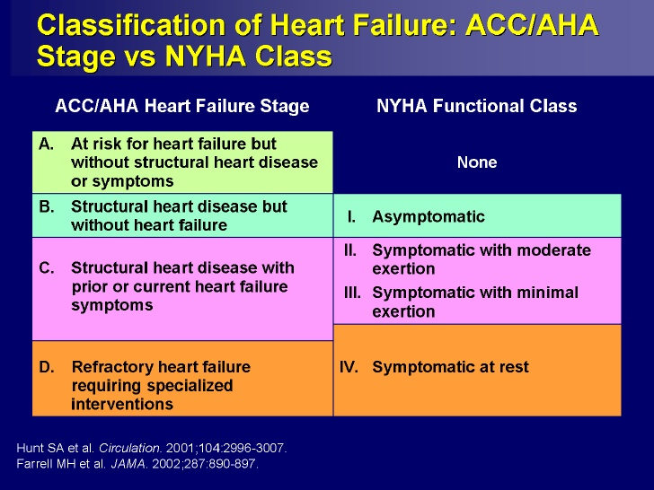

Slide 10
Diastolic Heart Failure
Diagnosis is based on the finding of typical symptoms and signs of heart failure in a patient who has a normal LVEF and no valvular abnormalities on echocardiography.
Insufficient data from randomized trials to assess the effects of various treatment modalities.

Slide 11
Diagnosis
History and Exam
EKG
Echocardiogram
Labs: Biomarkers, e.g. BNP
Cardiac catheterization or stress test
Follow up labs

Slide 12
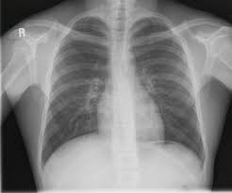
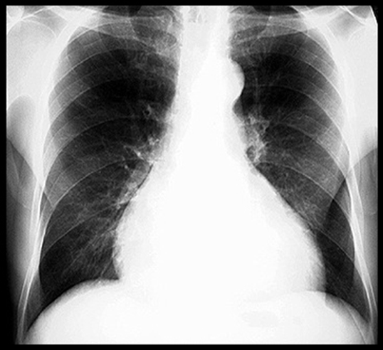
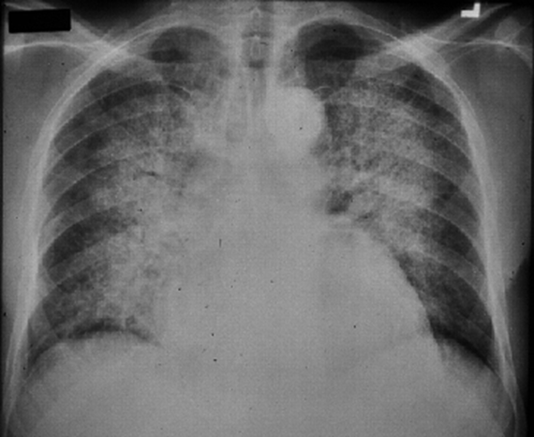

Slide 13
Treatment of CHF
Correction of systemic factors
      Thyroid dysfunction
      Infections
      Uncontrolled diabetes
      Hypertension
Lifestyle modification
      Lower salt intake
      Alcohol cessation
      Medication compliance
Maximize medications
      Discontinue drugs that may contribute to heart failure (NSAIDS, antiarrhythmics, calcium channel blockers)

Slide 14
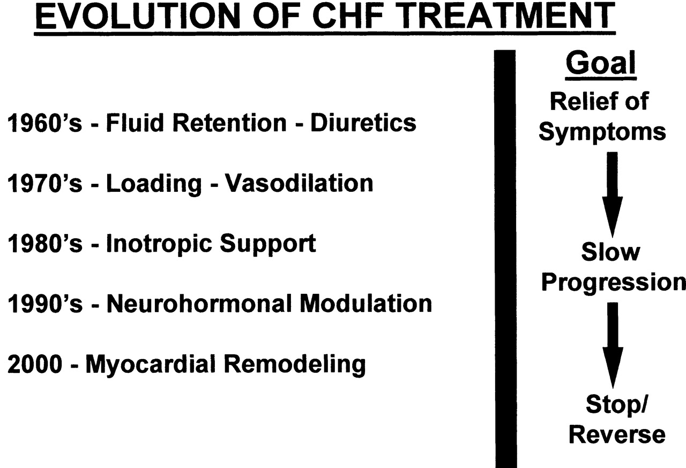

Slide 15
Pharmacological Therapy
  Help the heart muscle pump better
  Keep your blood from clotting
  Lower your cholesterol levels
  Open up blood vessels or slow your heart rate so your heart does not have to work as hard
  Reduce damage to the heart
  Reduce the risk of abnormal heart rhythms
  Replace potassium
  Rid your body of excess fluid and salt (sodium)

Slide 16
Non Pharmacological Treatments
Exercise training for stable HF patients increased exercise capacity, decreased hospitalization rate, increased quality of life, decreased symptoms.
Weight loss in obese patients
Dietary Na restriction (≤ 2 g/day)
Fluid and free water restriction (≤ 1.5 L/day) especially if hyponatremic
Minimize medications known to have deleterious effects on heart failure (negative inotropes, NSAIDs, over-the-counter stimulants)
Oxygen
Fluid removal (dialysis, thoracentesis, paracentesis)

Slide 17
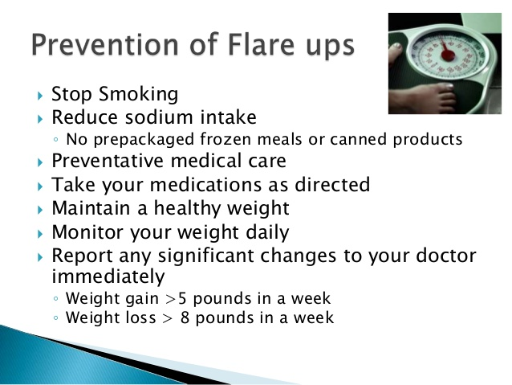

Slide 18
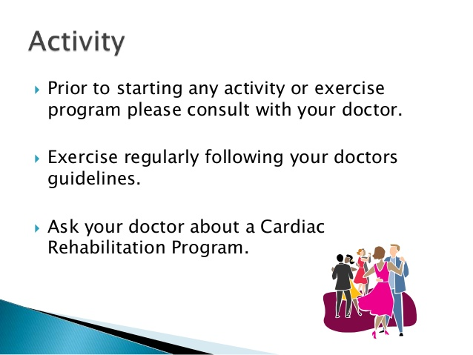

Slide 19
Fluid Restriction
Usually restricting ALL fluids to 64 ounces or lower 1.5- 2 L
  Milk
  Yogurt
  Jello
  Alcohol
  Sodas
  Watermelon
  Soups

Slide 20
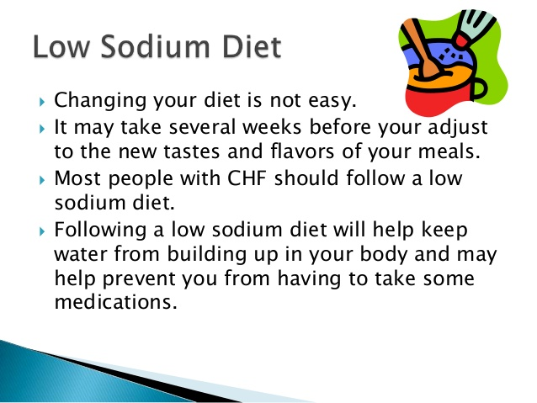

Slide 21


Slide 22
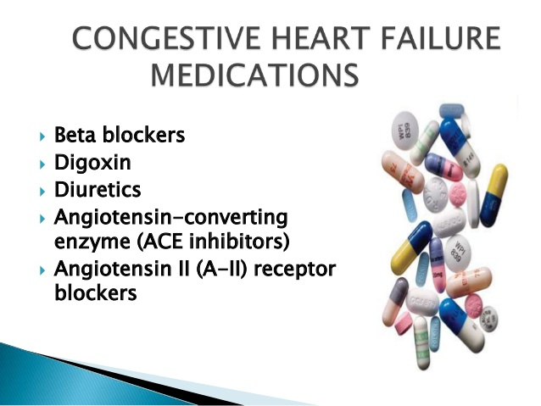

Slide 23
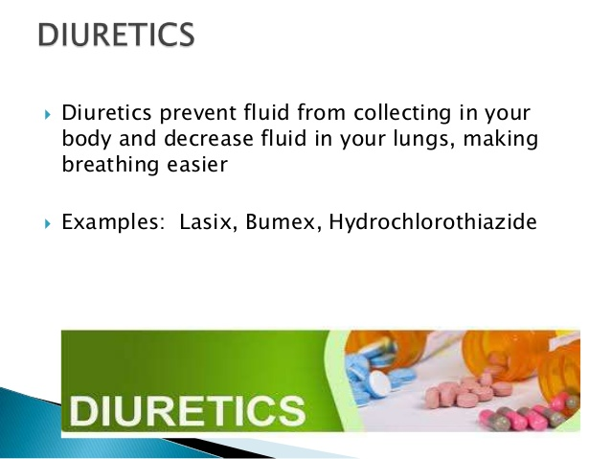

Slide 24
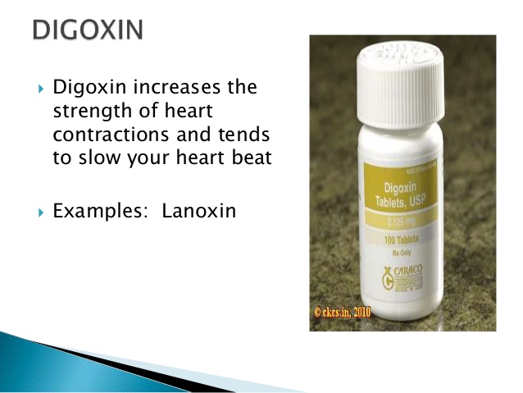

Slide 25
LV Remodeling agents
Improve survival and reduce hospitalization

Slide 26
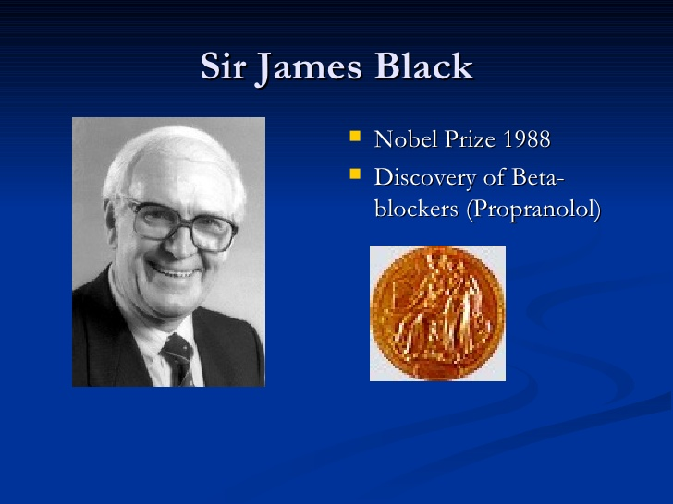

Slide 27
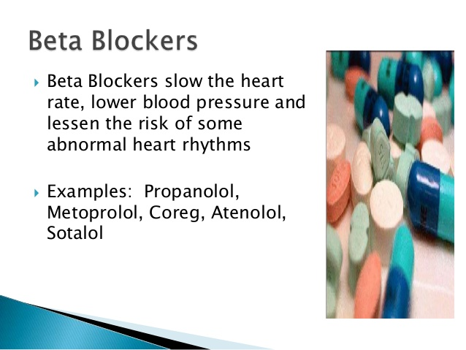

Slide 28
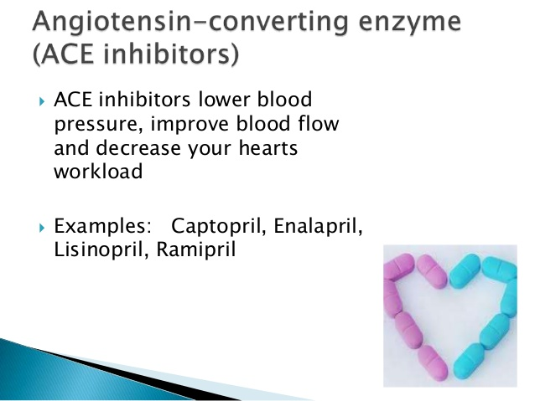

Slide 29
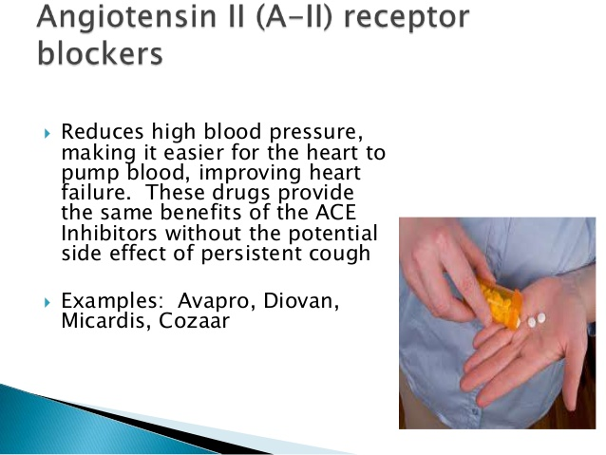

Slide 30
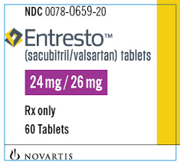
Other Agents
Aldosterone Antagonists: Spironolactone, Eplerenone
Isordil + Hydralazine
Angiotensin-Receptor Neprilysin Inhibitors:
  Entresto
Blood thinners
Cholesterol medications
CHF Management Program

Slide 31
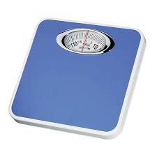

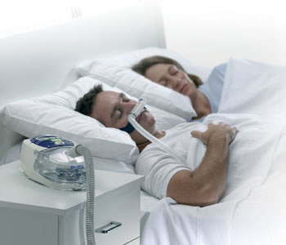
Equipment

Slide 32

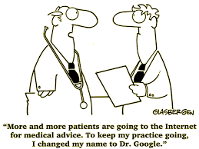

Slide 33
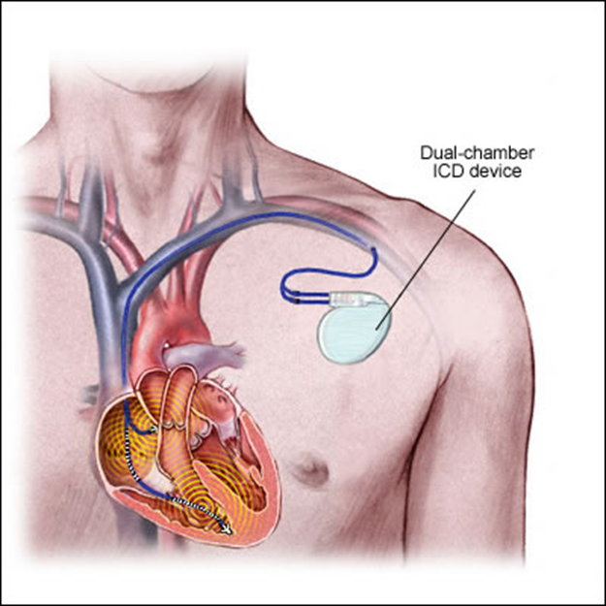
Implantable Cardioverter-Defibrillators for HF
About one-third of mortality in HF is due to sudden cardiac death.
Survival benefit from an implantable cardioverter-defibrillator (ICD) for the primary prevention of SCD.

Slide 34
Refractory Heart Failure
Inotropic drugs:
  Dobutamine, dopamine, milrinone, nitroprusside, nitroglycerin
Mechanical circulatory support:
  Intraaortic balloon pump
  Left ventricular assist device (LVAD)
Cardiac Transplantation
      A history of multiple hospitalizations for HF
      Escalation in the intensity of medical therapy
      A reproducable peak oxygen consumption with maximal exercise (VO2max) of < 14 mL/kg per min. (normal is 20 mL/kg per min. or more) is relative indication, while a VO2max < 10 mL/kg per min is a stronger indication.

Slide 35
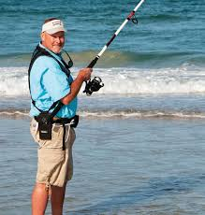
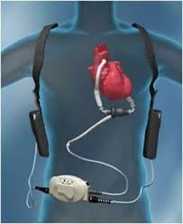
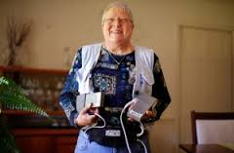
LVAD

Slide 36
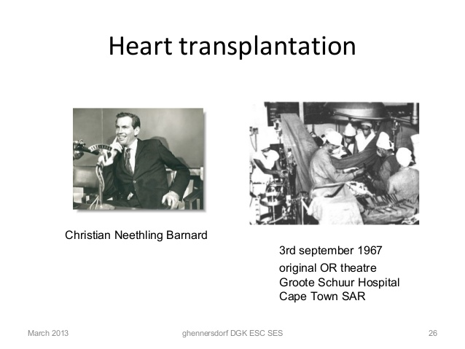

Slide 38
Why do feet swell in hot weather?
Swollen feet frequently occur during hot weather since your veins expand as part of your body's natural cooling process.
However, sometimes your veins aren't able to bring blood back to the heart. This results in fluid collecting in the ankles and feet
Drink plenty of water
Keep feet elevated
Avoid sodium rich foods
Stay Active

Slide 39
Take home messages
5 Things that precipitate CHF:
-Too little or too much water: Limit to no less than 40 ounces and no more than 50 ounces of all fluids in 24 hours
-Sodium: No more than 2000 mg
-Anemia
-Arrhythmias
-Infection

Slide 40
Management of CHF
1. Get a daily diary and keep logs of weight
Weigh every day: Ideal weight should be between 3 pounds of the discharge weight
Continue the current dose of Lasix unless weight goes up 3 pounds or drops 3 pounds, then call your Cardiologist or CHF team
Keep a container and mark 40-60 ounces and keep all fluids in between, to avoid dehydration and overhydration
2. Sodium: No more than 2000mg/day, read sodium per serving size and calculate.
3. Anemia: Watch for black stools or bleeding and report to doctor
4. Arrhythmias: Keep track of BP and Heart Rate, and report HR <50 or more than 90
5. Infections: When any signs of infections, increase fluids but cut back on sodium some more to avoid fluid retention
When in doubt, reach out to your Cardiologist.

Slide 41
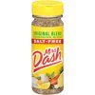
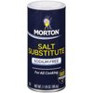
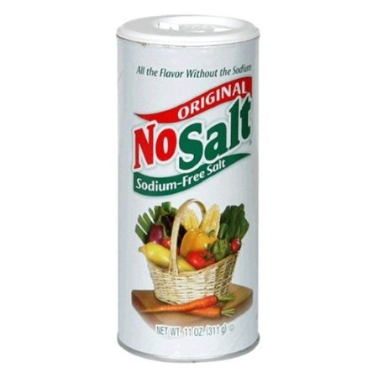

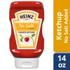
Low sodium/ Low Potassium

Slide 42
Thank you

