Slide 1
Congestive Heart Failure
Radhika Nandur Bukkapatnam MD FACC

Slide 2
Magnitude of the Problem
5 million Americans with CHF
More than a million Hospital admissions/ year
>550k new patients a year
>300k deaths every year
>40% mortality in severe CHF
One in 9 deaths in 2009 included heart failure as contributing cause.¹
About half of people who develop heart failure die within 5 years of diagnosis.¹

Slide 3
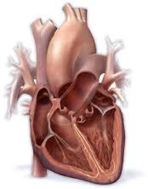
HEALTHY HEART
The heart's left side pump sends oxygen-rich blood throughout the body.
The heart's right-side pump moves "used" blood to the lungs to get more oxygen.

Slide 4
Congestive Heart Failure
Congestive heart failure, occurs when your heart muscle doesn't pump blood as well as it should.
It can also occur if the heart pumps fine but cannot relax properly
Right sided: Leg swelling, fluid in the abdomen
Left sided: Inability to breathe and fatigue

Slide 5
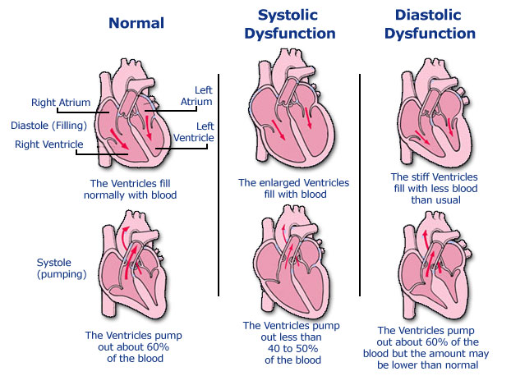

Slide 10
Diastolic Heart Failure
Diagnosis is based on the finding of typical symptoms and signs of heart failure in a patient who has a normal LVEF and no valvular abnormalities on echocardiography.
Insufficient data from randomized trials to assess the effects of various treatment modalities.

Slide 11
Diagnosis
History and Exam
EKG
Echocardiogram
Labs: Biomarkers, e.g. BNP
Cardiac catheterization or stress test
Follow up labs

Slide 12
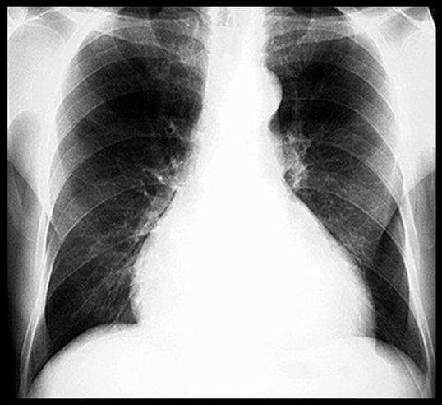
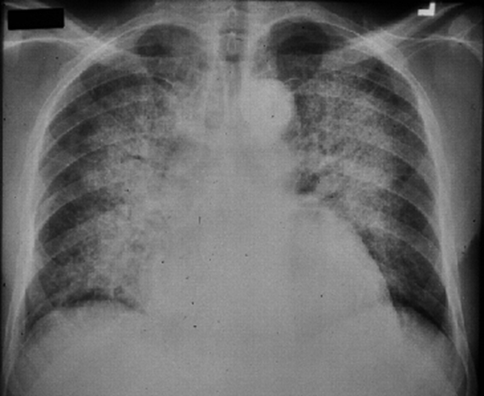

Slide 13
Treatment of CHF
Correction of systemic factors
Thyroid dysfunction
Infections
Uncontrolled diabetes
Hypertension
Lifestyle modification
Lower salt intake
Alcohol cessation
Medication compliance
Maximize medications
Discontinue drugs that may contribute to heart failure (NSAIDS, antiarrhythmics, calcium channel blockers)

Slide 15
Pharmacological Therapy
Help the heart muscle pump better
Keep your blood from clotting
Lower your cholesterol levels
Open up blood vessels or slow your heart rate so your heart does not have to work as hard
Reduce damage to the heart
Reduce the risk of abnormal heart rhythms
Replace potassium
Rid your body of excess fluid and salt (sodium)

Slide 16
Non Pharmacological Treatments
Exercise training for stable HF patients increased exercise capacity, decreased hospitalization rate, increased quality of life, decreased symptoms.
Weight loss in obese patients
Dietary Na restriction (≤ 2 g/day)
Fluid and free water restriction (≤ 1.5 L/day) especially if hyponatremic
Minimize medications known to have deleterious effects on heart failure (negative inotrops, NSAIDs, over-the-counter stimulants)
Oxygen
Fluid removal (dialysis, thoracentesis, paracentesis)

Slide 19
Fluid Restriction
Usually restricting ALL fluids to 64 ounces or lower 1.5-2 L
Milk
Yogurt
Jello
Alcohol
Sodas

Slide 25
LV Remodeling agents
Improve survival and reduce hospitalization

Slide 30
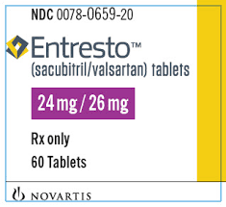
Other Agents
Aldosterone Antagonists: Spironolactone, Eplerenone
Isordil + Hydralazine
Angiotensin-Receptor Neprilysin Inhibitors:
Entresto
Blood thinners
Cholesterol medications
CHF Management Program

Slide 31
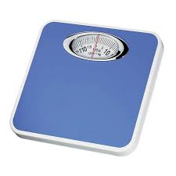
Equipment

Slide 32
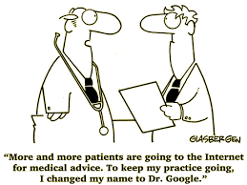

Slide 33
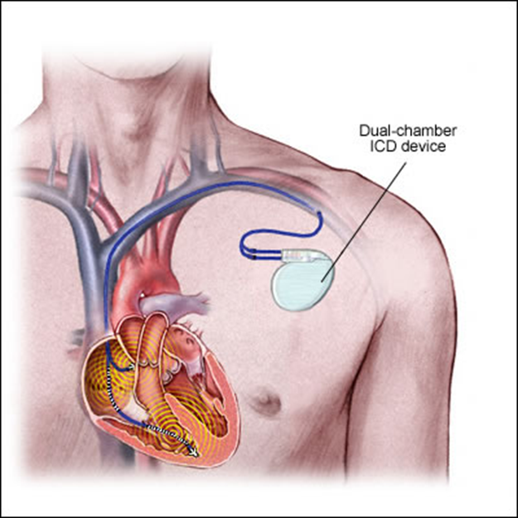
Implantable Cardioverter-Defibrillators for HF
About one-third of mortality in HF is due to sudden cardiac death.
Survival benefit from an implantable cardioverter-defibrillator (ICD) for the primary prevention of SCD.

Slide 34
Refractory Heart Failure
Inotropic drugs:
Dobutamine, dopamine, milrinone, nitroprusside, nitroglycerin
Mechanical circulatory support:
Intraaortic balloon pump
Left ventricular assist device (LVAD)
Cardiac Transplantation
A history of multiple hospitalizations for HF
Escalation in the intensity of medical therapy
A reproducable peak oxygen consumption with maximal exercise (VO2max) of < 14 mL/kg per min. (normal is 20 mL/kg per min. or more) is relative indication, while a VO2max < 10 mL/kg per min is a stronger indication.

Slide 35
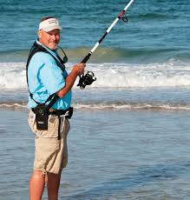
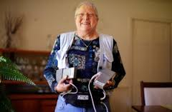
LVAD

Slide 37
Summary
Risk of CHF is 25% at age 40.
Disease modification earlier than it manifests.
Aim for Class C->B.
Key to therapy is salt and fluid restriction, activity.
Take medications as directed.
Be aware of symptom flare ups and ask your CARDIOLOGIST for help early.

Slide 39
Thank you

