Slide 1
Cardiac Rehabilitation
Constipation

Slide 2
Constipation & CVD Health
This Photo by Unknown Author is licensed under CC BY
Margie Junker MS, RDN, CDCES
This Photo by Unknown Author is licensed under CC BY-NC
This Photo by Unknown Author is licensed under CC BY-NC-ND

Slide 3
Consider what nutrition SMART goal you can make to improve your health and reduce your cardiac risk.
This Photo by Unknown Author is licensed under CC BY-NC-ND

Slide 4
Cardiac Risk & Chronic Constipation
Straining due to constipation can increase blood pressure & trigger heart failure, arrhythmia, and acute coronary disease.
Constipation can cause inflammation that accelerates
heart disease risk.
Those with chronic constipation tend to have more risk factors for heart disease: low fiber diet, too little exercise, high blood pressure, and high cholesterol

Slide 5
Link Between Constipation & Heart Attacks
According to the National Heart, Lung, and Blood Institute
factors that Link Constipation to a Heart Attacks:
Increase Age
African America or Hispanic
Diabetes
High Cholesterol
Family hx of Heart Attack
HTN
Smoking
Depression
Low Physical Activity
Low Fiber Intake

Slide 6
What is Chronic Constipation
People think constipation is not having a bowel movement for a few days. Instead, look for a range of indicators including:
•Form: Hard stools (Bristol Type 1 & 2, See chart on next slide)
•Frequency: <1 bowel motion per day
• Pain: Abdominal pain or discomfort associated with defecation
•Sensation: Incomplete evacuation or feelings of obstruction
•Straining: Difficult to pass stools
•Laxatives: Reliance on laxatives

Slide 7
This Photo by Unknown Author is licensed under CC BY

Slide 8
Causes Of Constipation
Low fiber diet
Inadequate fluid intake
Too many high fiber foods at one time
Progression to a high fiber diet too quickly
Mental health, stress, depression, anxiety, eating disorders
Medications: sedatives, antidepressants, pain killers,
Diabetes
Irritable Bowel Syndrome or Small Intestinal Bacterial Overgrowth
Torturous Colon
Weak pelvic muscles
Internal or external hemorrhoids
Narrowing of colon
Cancer
Neurological problems associated with a disease like Parkinson's
Hormone imbalances

Slide 9
Common Side Effects of Chronic Constipation
FATIGUE
WEIGHT GAIN
BAD SKIN
SMALL INTESTINE BACTERIAL OVERGROWTH
BRITTLE NAILS AND THINNING HAIR
POOR IMMUNITY
STRUCTURAL CONDITIONS
FECAL IMPACTION
ANXIETY AND DEPRESSION
This Photo by Unknown Author is licensed under CC BY-NC-ND

Slide 10
How to Smooth Your Move
High Fiber diet
Drink Plenty of Fluids
Stay Active
Manage Stress
Don’t Ignore the Urge to Pass Stool
Try to Create a Regular Schedule for Bowl Movements (usually after a meal)

Slide 11
The Importance of Fiber
Eating a High Fiber Diet
Fiber is found in plant foods. There are two types of fiber: soluble and insoluble. Both fibers are important for health, digestion, and preventing diseases. More fiber is generally recommended to relieve constipation, improve heart health, & support an overall healthier diet .
This Photo by Unknown Author is licensed under CC BY-NC-ND

Slide 12
Recommended Daily Fiber Intake
Age Female Male
1-3 years 19 grams 19 grams
4-8 years 25 grams 25 grams
9-13 years 26 grams 31 grams
14-18 years 26 grams 38 grams
19-50 years 25 grams 38 grams
> 51 years 21 grams 30 grams
This Photo by Unknown Author is licensed under CC BY

Slide 13
More Tips to Add Fiber to Your Diet
Read the Nutrition Facts Label on packaged foods.
Good sources of fiber have >3 or grams fiber per serving.
Choose whole grains: Choose brown or wild rice instead of white rice or potatoes. Choose high fiber cereals like whole grain oat cereal, bran flakes, shredded wheat, and granola.
Bake with whole wheat flour – try replacing half of all-purpose flour with whole-wheat flour in recipes.
Eat more beans. Serve baked beans as a side to meals, sprinkle on top of salads, and add dried beans and peas to soups and casseroles.
Choose fresh fruits and vegetables instead of juices, and eat raw fruits and vegetables with skins on.
Choose high fiber snacks such as popcorn, whole grain crackers, fruits, vegetables, bean dips

Slide 14
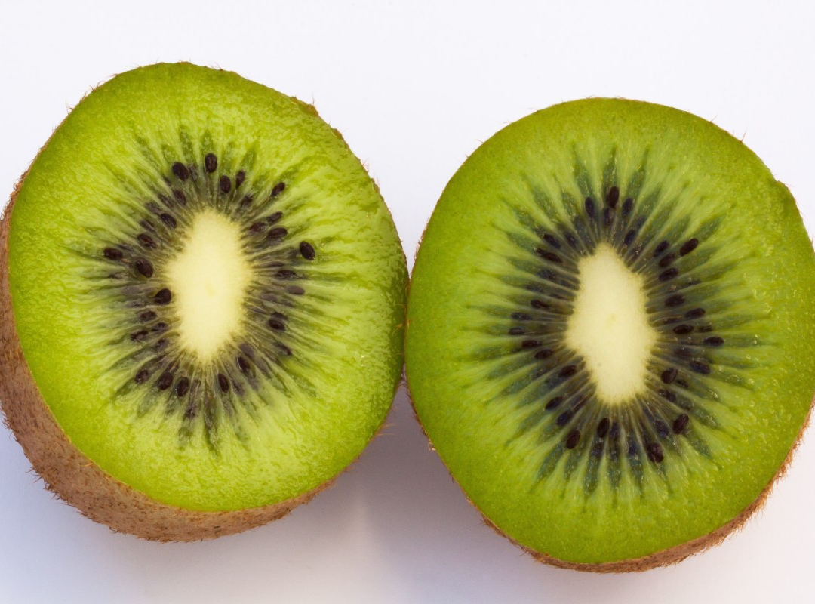
Study form the Association of Gastroenterology
79 adults with chronic constipation were recruited and then assigned to consume 100 grams of pitted prunes, 12 grams of psyllium or two peeled kiwifruits daily for four weeks.
psyllium was more effective than prunes although the rates of dissatisfaction among study participants were 2x as high compared to prunes.
5x higher than kiwifruit

Slide 15
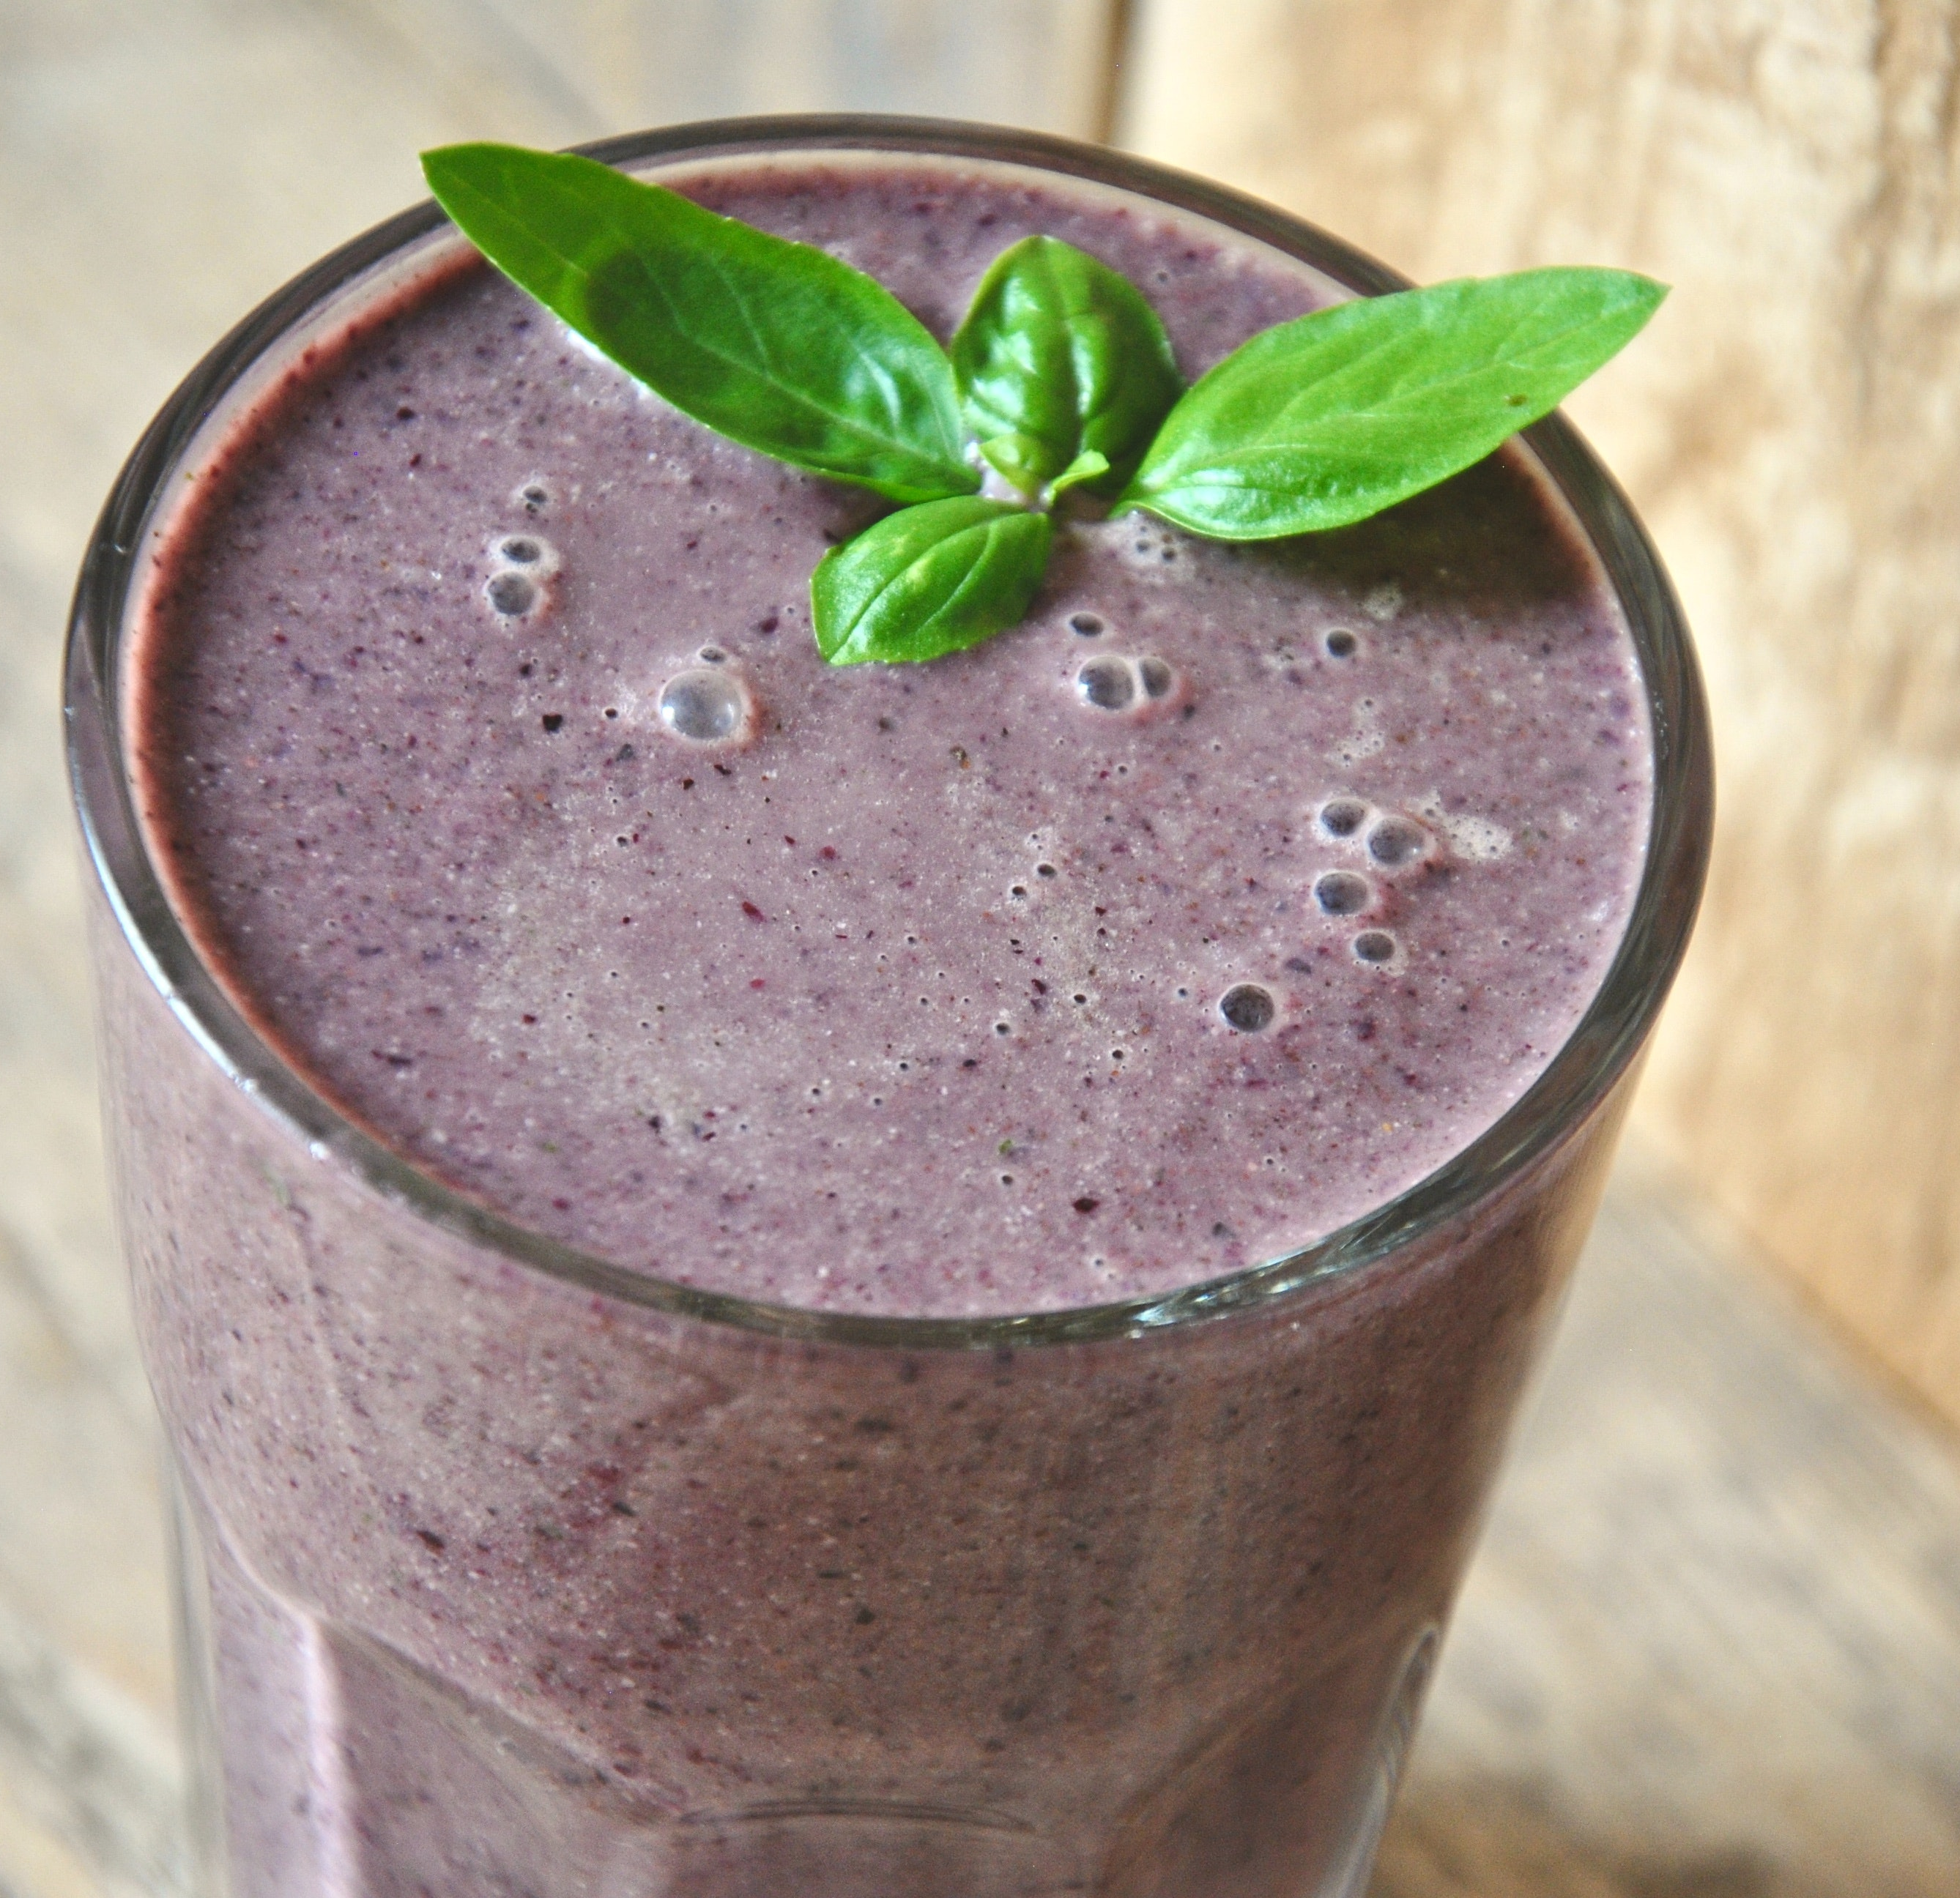
Margie’s High Fiber Morning Smoothie
Ingredients
1 handful of spinach or kale
2 kiwifruit or papaya, skin removed and sliced into quarters
½-1 cup fresh or frozen berries
1 scoop protein powder
1 heaped teaspoon nut butter, powdered peanut butter or avocado
1 cup unsweetened almond, coconut milk, or non-fat cow’s milk
Extra water as required to reach a smoothie like consistency
Place ingredients in a blender
Blend for 30 seconds and serve

Slide 16
Tips to Add Fiber to Your Meal Plan
Drink a hot beverage or eat hot whole grain cereal in the morning.
Add unprocessed bran to foods. Start with 1 teaspoon bran added to whole grain cereal.
Add ﬂaxseed to foods. Start with 1 tablespoon ground ﬂaxseed added to cereal, nonfat Greek yogurt or plant- based yogurt alternative. Titrate up to 2 tablespoons as needed.
Eat a few dried, stewed prunes, or 2-3 kiwi to your morning routine
Slowly increase the amount of ﬁber that you eat. Over the span of a few days, you should increase ﬁber by no more than 5 grams (g).
Talk with your Dr about the use of stool softeners and laxatives
Drink smooth move tea before bed.

Slide 17
Medicine or Supplement Management of Constipation
Talk With Your Healthcare Professional
Suppository or enemas work within 1 hour
A bulk forming product like Metamucil takes several days
An osmotic-type laxative like MiraLAX takes several days
Magnesium Citrate with a full glass of water
can take a few hours
Pelvic floor exercises or biofeedback takes days to weeks
Stimulant laxative which takes a few hours (use cautiously)
Always take to a Dr. if you need to self treat
constipation more than 1-2 weeks
.
This Photo by Unknown Author is licensed under CC BY-NC-ND

Slide 18
Drink Enough Fluids
How much fluid is recommended daily?
15.5 cups, 3.7 litters, 124 fluid oz, or approx.1 gallon of fluid per day for men
11.5 cups, 2.7 liters, 92 fluid oz, or approx. ¾ of a gallon of fluid per day for women
*If you have heart failure, please ask your cardiologist how much fluid
you should have each day.

Slide 19
Stay Active to Keep it MOVING…………..
Exercise gets going… ☺
Downtime increases your risk of constipation
Your body needs to be generally active
Plus 150-300 minutes of continuous movement per week
This Photo by Unknown Author is licensed under CC BY

Slide 20
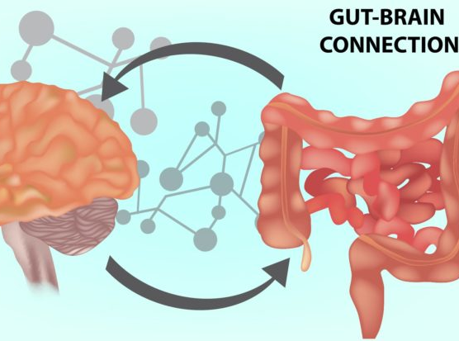
Stress & Constipation – The Vicious Circle
Most of your bodily functions are controlled by:
The autonomic nervous system, a network of nerves connecting the brain to major organs. This system prepares your body for fight-or-flight emergencies and high-anxiety situations.
Another part of autonomic nervous system helps calm your body down after anxiety. It also prepares your body for digestion by signaling the enteric nervous system located in your gastrointestinal tract.
Stress can cause constipation.
constipation can cause stress.
This Photo by Unknown Author is licensed under CC BY

Slide 21
Don’t Be Too Busy To Poop!
Do you feel too busy to go?
Ignoring the urge can make constipation worse.
Set aside time after breakfast or another meal for a bowel movement, when these signals are strongest.
No matter when nature calls, answer.
This Photo by Unknown Author is licensed under CC BY-SA-NC

Slide 22
What will your post presentation SMART Goal be?
This Photo by Unknown Author is licensed under CC BY-NC-ND

