Slide 1
Fall PREVENTION
Radhika Nandur Bukkapatnam
July 24, 2020

Slide 2
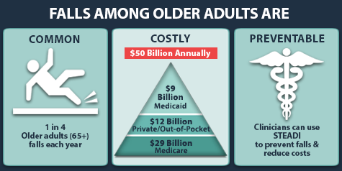

Slide 3
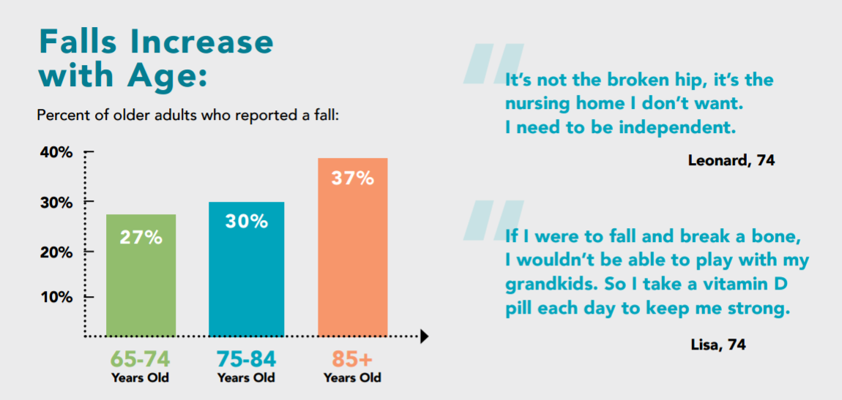

Slide 4
What causes falls?
Imbalance
Dizziness
Decreased strength
Mechanical factors: Home safety, uneven surfaces

Slide 5
Imbalance
Inner ear dysfunction
Poor depth perception
Getting up/ leaning forward suddenly from sitting position
Reaching beyond safety range
Muscle strength: Not using aids

Slide 6
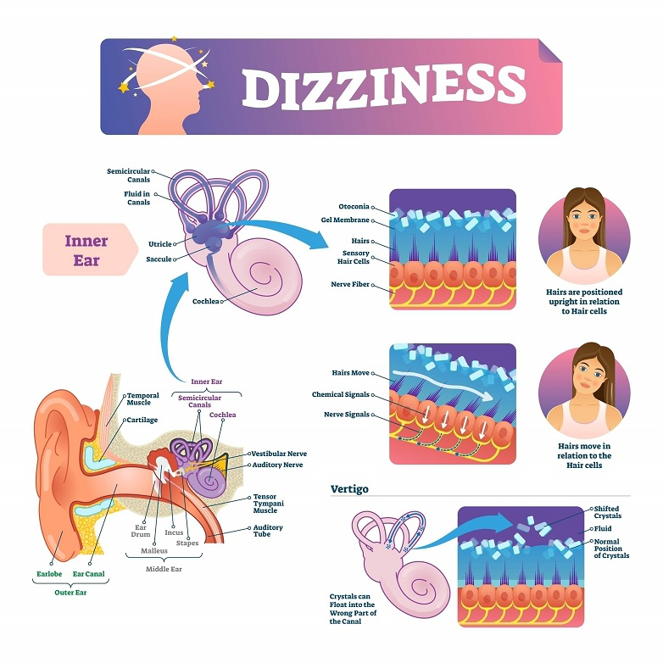
Inner ear

Slide 7
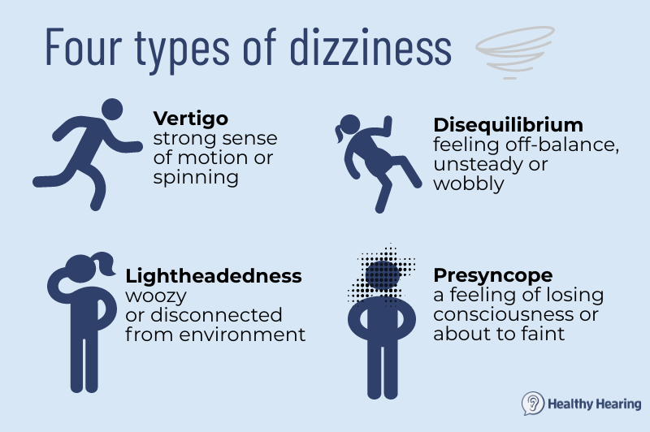

Slide 8
Sudden onset of dizziness
Bleeding
Low blood sugar
Dehydration/ overheating
Infections
Strokes
Arrhythmias and Heart attacks

Slide 9
Insidious causes of dizziness
Medications
Chronic anemia
Low Sodium, Low Potassium
Diseases of the brain: Post stroke, Parkinsons disease, dementia, Meniere’s disease, tumors
Benign Positional Vertigo

Slide 10
Medications causing dizziness
Antibiotics, including gentamicin and streptomycin
Anti-depressants
Anti-seizure medications
Blood pressure medicine, Arrhythmia medications
Sedatives
Antihistaminic
Acid reducing agents

Slide 11
When do you call 911
a head injury
a headache
a neck ache
a high fever
blurred vision
hearing loss
difficulty speaking
numbness or tingling
of the eye or mouth
loss of consciousness
chest pain
ongoing vomiting

Slide 12
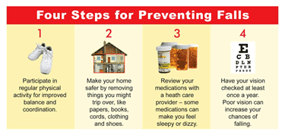

Slide 13
Exercises to prevent falls
Core muscle exercises
Lifting up you feet while walking
Recognizing that our muscles become weaker at the later part of the day, so using canes and walkers
Avoid ladders when on blood thinners
Walking with aids, especially cell phones when going to unfamiliar places
Always keep your cell phone on and make sure you can access it when you fall

Slide 14
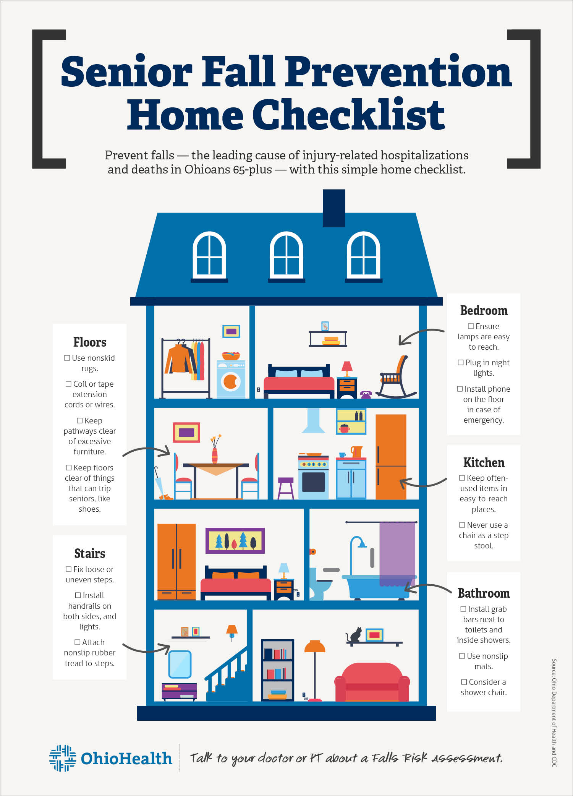

Slide 15

Medications
Minimize sleep/ pain medications
If dizzy from BP meds, discuss with your doctor, and let BP run high
Avoid too much water and diuretics late in the day, to avoid getting up in the middle of the night
Always review drug interactions when starting new medications to avoid dizziness and falls
Alert your doctor if any medication makes you dizzy

Slide 16


Slide 17
THANK YOU

