Slide 1

Healthy Fats are hot!
Debbie Lucus, MS, RD, CDE
01.05.21
dlucusrd@gmail.com
Notes:
On the next few slides we’ll look at a few common varieties of beans and discuss their shape, size, and flavor.

Slide 2

Happy New Year!!
Resolutions?
Any new holiday gifts you want to share?
New habits you’d like to start in 2021?
What is your ‘why’?

Slide 3

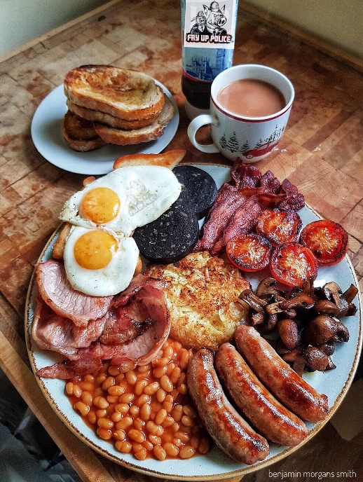
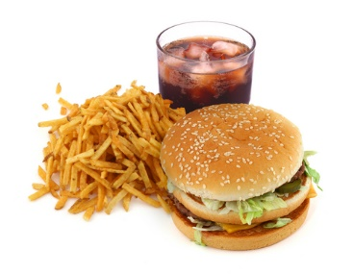
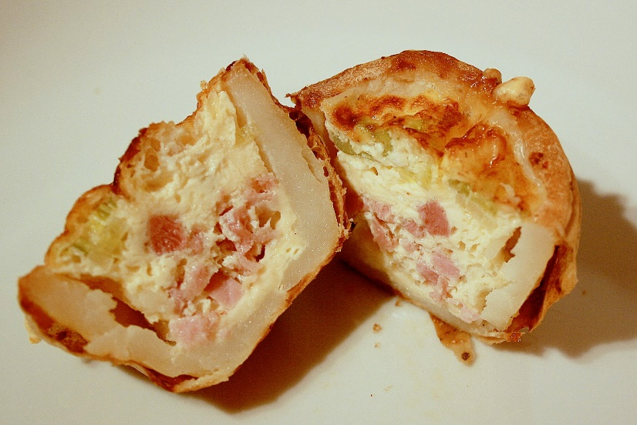
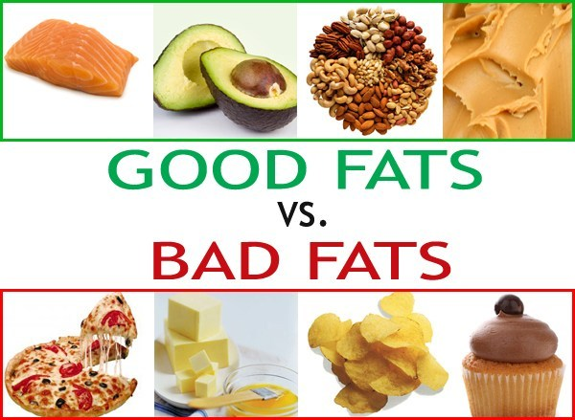
What do you comes to mind when you hear ‘dietary fat’?

Slide 4
What is role of fats in foods?
Provide texture, flavor, aroma to foods
Provide energy – 9 calories in every gram
Some have good effects on health, others not so much

Slide 5
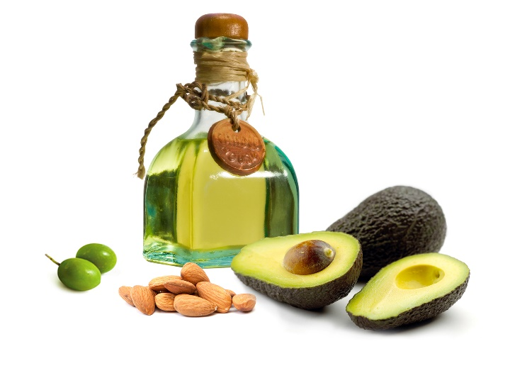
Sources of dietary fats
Animal sources: meat, cheese, dairy
Plant sources: vegetable oils, nuts, avocados, seeds
“Hidden” dietary fat: French fries, pizza, pasta dishes, baked goods, salad dressings

Slide 6
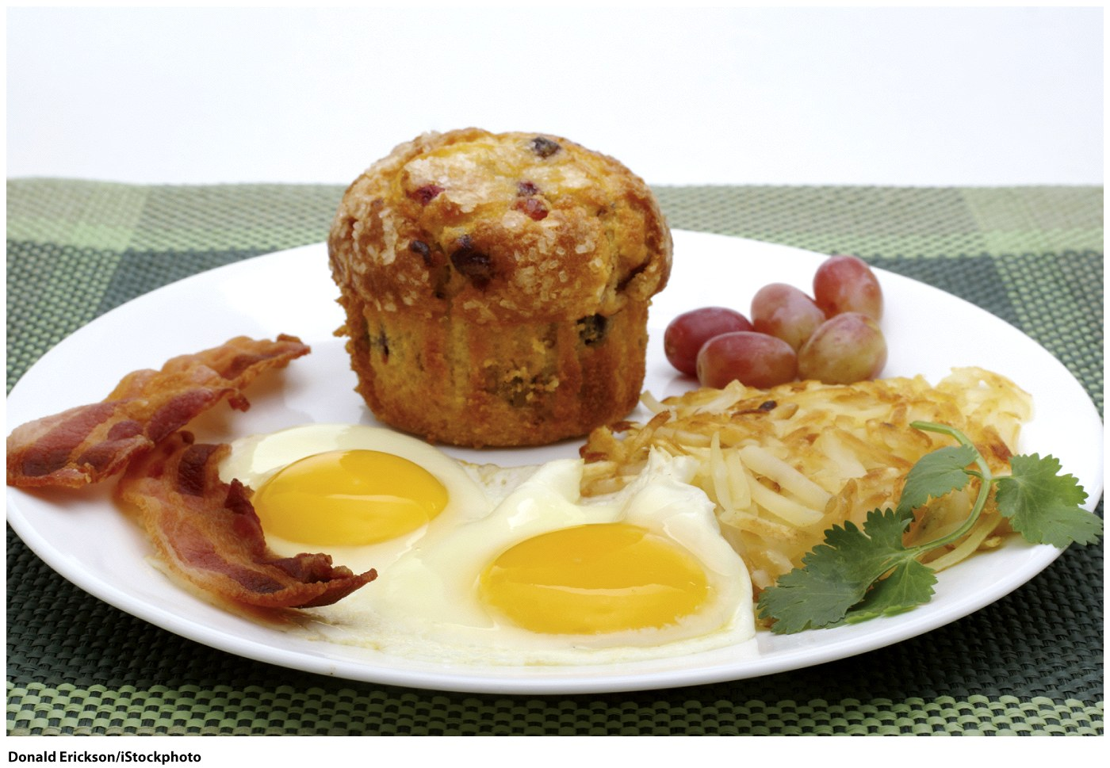
Visible and hidden fats
Which food on this plate has the most fat?
Bacon?
Eggs?
Hashed Browns?
Muffin?
Bacon = 7 g
Eggs = 14 g
Hashed Browns = 15 g
Muffin = 32 g (600 kcal)

Slide 7
Fats
Limit/Avoid
Saturated Fat
Cholesterol
Trans Fat
Moderation
Monounsaturated Fat
Polyunsaturated Fat
Omega-3 Fatty Acids

Slide 8
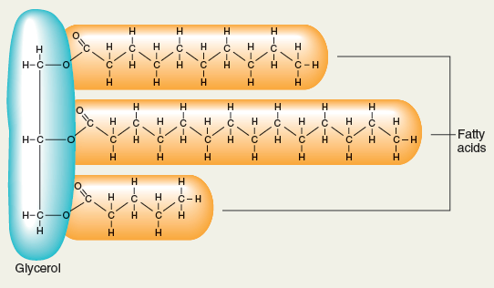
Triglycerides and fatty acids

Slide 9
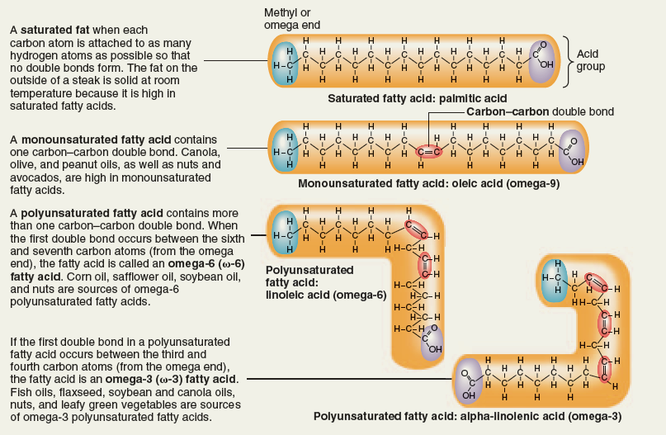
Triglycerides and fatty acids

Slide 10
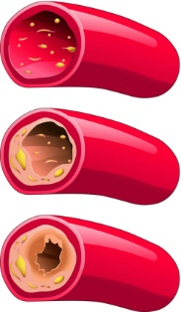
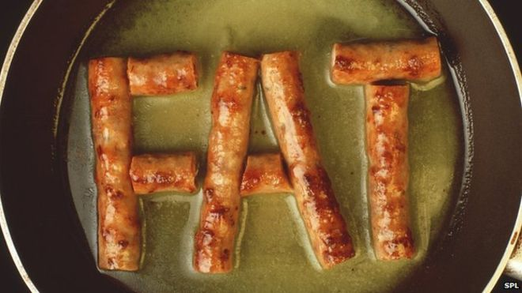
Saturated Fats
  Solid at room temperature (lard, butter)
  Mostly in animal foods: meat, dairy
  Tropical oils (coconut, palm kernel)
  Long-chain saturated fats:
    Increase LDL
    Associated with heart disease

Slide 11
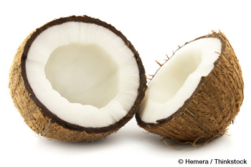
Saturated Fats - Coconut
Medium-chain saturated fats:
  May not have all negative effects
    Shorter chain
    Quickly digested and absorbed into the blood stream
    Bypass peripheral fat tissue
    Less likely to be stored as fat
    This doesn’t make it a health food

Slide 12
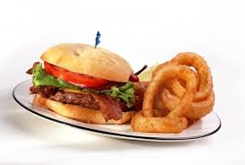
Common sources of Saturated Fat
Butter
Ground meat / sausage / fried meat / steaks
High-fat milk, cheese, yogurt, cottage cheese
Egg yolks
Fried foods
Sour cream
Chips / Crackers
Pizza
Ice cream / Desserts / Candy

Slide 13
How to reduce saturated fats
Switch to plant-based milks (or use non-fat dairy)
Limit animal foods – substitute beans/lentils, meat alternatives, nuts, soy
Don’t add fat to recipes
Swap eggs with plant foods: scrambled tofu, flax in place of eggs in recipes
If having fat – choose whole foods that have healthy fat

Slide 14
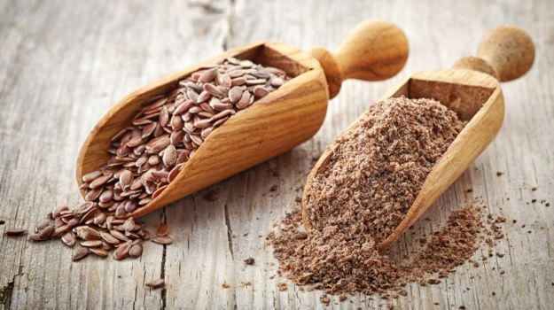
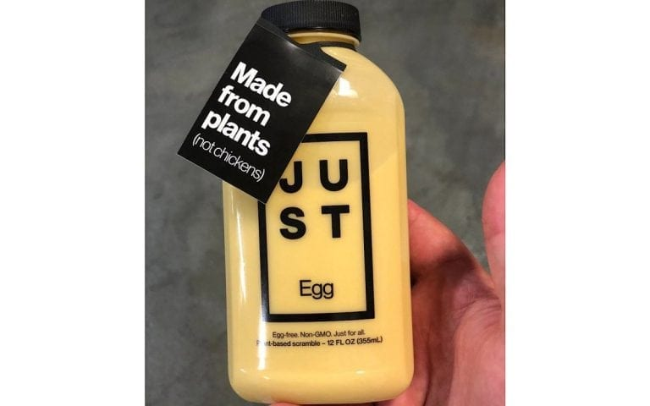
Egg Replacers
1 T flax plus 3 T water
½ mashed banana
¼ cup applesauce
¼ cup silken tofu
Ener-G egg replacer
Just Egg

Slide 15
Ingredients
Water, Mung Bean Protein Isolate, Expeller-Pressed Canola Oil, Contains less than 2% of Dehydrated Onion, Gellan Gum, Natural Carrot Extractives (color), Natural Flavors, Natural Turmeric Extractives (color), Potassium Citrate, Salt, Soy Lecithin, Sugar, Tapioca Syrup, Tetrasodium Pyrophosphate, Transglutaminase, Nisin (preservative). (Contains soy.)
Serving size 3 Tbsp (44mL) | Amount | % Daily Value*
Calories | 70
Calories from Fat | 45
Total Fat | 5g | 8%
Saturated Fat | 0g | 0%
Trans Fat | 0g
Polyunsaturated Fat | 1.5g
Monounsaturated Fat | 3g
Cholesterol | 0mg | 0%
Sodium | 170mg | 7%
Total Carbohydrate | 1g | 0%
Dietary Fiber | 0g | 0%
Sugars | 0g
Protein | 5g
Vitamin A |  | 0%
Vitamin C |  | 0%
Calcium |  | 0%
Iron |  | 4%

Slide 16
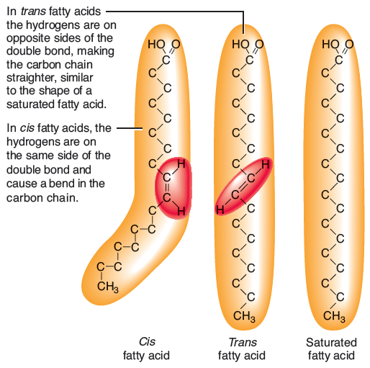
Trans fatty acids
a. The orientation of hydrogen atoms around the double bond distinguishes cis fatty acids from trans fatty acids. Most unsaturated fatty acids found in nature have double bonds in the cis configuration.

Slide 17
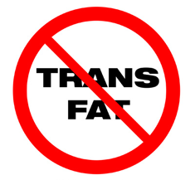
Trans Fats
Sources:
  Baked products
    Crackers, cookies, pastries, doughnuts, cupcakes, pie crusts, cake frosting, baking mixes, biscuits and dough
  Hard margarines, shortening
  Fried foods
    French fries, Fried chicken,
  Check ingredient lists for hydrogenated or partially hydrogenated oil - put it back!
Notes:
17
--impact lipid profile negatively. Hydrogenation is a process of heating and compressing an oil to make it more saturated.
-portion sizes of the foods that will contain trans fatty acids (or any fats for that matter) should be small anyway! So intake will be low.
Unsaturated oils that have become hardened to make it more stable, saturated, and solid at room temperature.
Partially hydrogenated means the oils are only partly hardened.
Manufacturers use hydrogenated fat to extend shelf life.
Contain high levels of trans fatty acids, which are linked to heart disease.
Can be found naturally in animal fats, such as dairy products and some meats
Raise blood cholesterol similarly to saturated fat
Can raise LDL and lower HDL levels
Not included in the less than 7 percent of calories you can have from saturated fat
Bring an example food label to next class

Slide 18
Triglycerides and fatty acids
Monounsaturated fatty acids: one double bond
  Found in avocado, olives, nuts (and their oils)
  Reduce risk of heart disease
  Lower LDL cholesterol
Polyunsaturated fatty acids: more than one double bond
  Found mainly in plant sources (and fatty fish)
    Vegetable oils
    Soy
    Nuts/seeds
    Improve heart health

Slide 19
Unsaturated Fat
Polyunsaturated
  Safflower oil
  Sunflower oil
  Corn oil
  Soybean oil
  Nuts
  Seeds
Monounsaturated
  Olive oil
  Peanut oil
  Canola oil
  Nuts
  Seeds
  Avocados
Notes:
19
--impact lipid profile negatively. Hydrogenation is a process of heating and compressing an oil to make it more saturated.
-portion sizes of the foods that will contain trans fatty acids (or any fats for that matter) should be small anyway! So intake will be low.

Slide 20
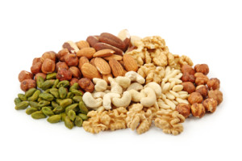
Unsaturated Fat
Nuts and Seeds
Very healthy
Eat 1 serving daily
1 serving = 2-4 Tablespoons
Good source of plant stanols and sterols
Caution: high in calories!
Notes:
20
--impact lipid profile negatively. Hydrogenation is a process of heating and compressing an oil to make it more saturated.
-portion sizes of the foods that will contain trans fatty acids (or any fats for that matter) should be small anyway! So intake will be low.

Slide 21
Omega-3 Fatty Acids
May help prevent heart disease
Reduce triglyceride levels
Help brain health
Rec: 250 mg/day yeast or algae-derived EPA/DHA
Fish sources
  Salmon
  Lake trout
  Mackerel
  Tuna
  Sardines
Plant sources
  Walnuts
  Canola oil
  Ground Flaxseed
  Flaxseed oil
  Chia & hemp seeds
Notes:
21
May help prevent blood clots from forming and inflammation from affecting artery walls
Give handout for sources and amount of omega-3 fatty acids.

Slide 22
Omega-3 seeds
Flax:
  Reduce inflammation, high blood pressure, blood sugars, improve survival of breast and prostate cancer
Chia:
  Good source of protein, fiber, magnesium, iron
  Powerful antioxidant
Hemp:
  Protein, fiber, nutrients
  Anti-inflammatory

Slide 23
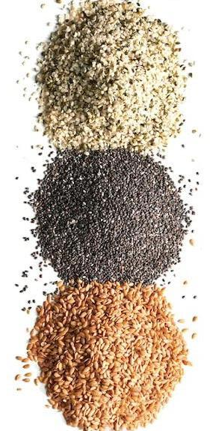
What to do with Flax/Hemp/Chia?
Put on oatmeal
Shake onto salads
Add to smoothies
Use as a binder in recipes
Make crackers
Add to breakfast bites
Sprinkle on soups or grain dishes
Use as thickener

Slide 24
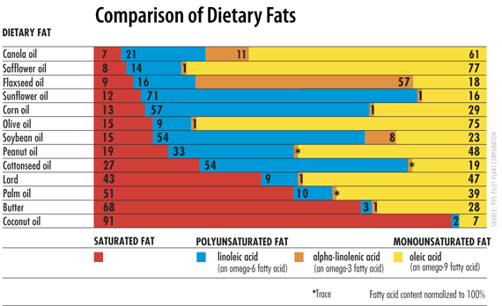

Slide 25
How to reduce fat in your diet
Less or no meat
No or non-fat dairy
Limit high fat condiments - ie. secret sauce, mayo,
Bake, broil, grill instead of fry
Cut added fats in recipes
Swap high fat toppings for low fat or plant sources(sour cream, cream cheese, butter/margarine)
Other ideas?

Slide 26
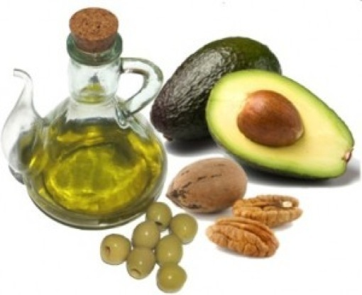
Bottom line
Choose healthy fats
  Nuts & seeds
  Avocado
  Olives
  Plant oils
Limit saturated and trans fats
  Animal foods
  Processed foods
  Fast foods

Slide 27
What will you do?
What fats do you eat right now that you could eat less of or substitute with a healthier fat?
How will you use healthy fats?
  Sprinkle nuts and seeds on cereal, salads, bowls?
  Cashew cream instead of cream to thicken soup?
  Switch to plant-based milks?
  Use flax for egg replacer?
Make a goal today of one change to your fat intake ☺

Slide 28
What will you do in 20-20-won?
What nutrition behavior change do you want to make in 2021?
What physical activity achievement would you like to complete in 2021?

Slide 29

Thank you!

