Slide 1
ACC AHA Guidelines for Prevention of Cardiovascular Disease by Lifestyle Management
Radhika Nandur Bukkapatnam
Jan 18 2020

Slide 3
2013 AHA/ACC Guideline on Lifestyle Management to Reduce Cardiovascular Risk
Endorsed by the American Association of Cardiovascular and Pulmonary Rehabilitation, American Pharmacists Association, American Society for Nutrition, American Society for Preventive Cardiology, American Society of Hypertension, Association of Black Cardiologists, National Lipid Association, Preventive Cardiovascular Nurses Association, and WomenHeart: The National Coalition for Women with Heart Disease
© American College of Cardiology Foundation and American Heart Association, Inc.

Slide 4
Charge of Lifestyle Work Group
Lifestyle Recommendations
Evidence Review on Diet and Physical Activity (in the absence of weight loss) to be integrated with the recommendations of the Blood Cholesterol and High Blood Pressure Panels

Slide 5
Lifestyle Workgroup Critical Questions
CQ1 | Among adults*, what is the effect of dietary patterns and/or macronutrient composition on CVD risk factors, when compared to no treatment or to other types of interventions?
CQ2 | Among adults, what is the effect of dietary intake of sodium and potassium on CVD risk factors and outcomes, when compared with no treatment or with other types of interventions?
CQ3 | Among adults, what is the effect of physical activity on blood pressure and lipids when compared with no treatment, or with other types of interventions?
*Those ≥18 years of age and <80 years of age.

Slide 6
Lifestyle Topics: Dietary Patterns
Mediterranean Diet
BP and lipids
DASH and DASH variations
BP and lipids,
and in subpopulations
High- vs. Low-Glycemic Diets
BP and lipids

Slide 7
Mediterranean-Style Dietary Pattern Description
There is no uniform definition of the Mediterranean-style dietary pattern diet in the randomized trials and cohort studies examined.
The most common features in these studies were diets that were:
high in fruits (particularly fresh) and vegetables (emphasizing root and green varieties)
high in whole grains (cereals, breads, rice, or pasta)
fatty fish (rich in omega–3 fatty acids)
low in red meat (and emphasizing lean meats); substituted lower-fat or fat-free dairy products for higher-fat dairy foods

Slide 8
Mediterranean-Style Dietary Pattern Description (cont.)
used oils (olive or canola), nuts (walnuts, almonds, or hazelnuts), or margarines blended with rapeseed or flaxseed oils in lieu of butter and other fats
The Mediterranean-style dietary patterns examined tended to be:
moderate in total fat (32%–35% of total calories)
relatively low in saturated fat (9%–10% of total calories)
high in fiber (27–37g/day)
high in PUFA
particularly omega–3s

Slide 9
Mediterranean Diet and BP
Counseling to eat a Mediterranean-style dietary pattern compared to minimal advice to consume a low-fat dietary pattern, in free-living middle-aged or older adults (with type 2 diabetes mellitus or at least 3 CVD risk factors):
↓BP by 6–7/2–3 mm Hg
In an observational study of healthy younger adults, adherence to a Mediterranean-style dietary pattern was associated with:
↓BP 2–3/1–2 mm Hg
Strength of Evidence: Low

Slide 10
Mediterranean Diet and Lipids
Counseling to eat a Mediterranean-style dietary pattern compared with minimal or no dietary advice, in free-living middle-aged or older adults (with or without CVD or at high risk for CVD) resulted in no consistent effect on plasma LDL-C, HDL-C, and TG; in part because of substantial differences and limitations in the studies.
Strength of Evidence: Low

Slide 11
What does the Typical Plate look like?

Slide 12
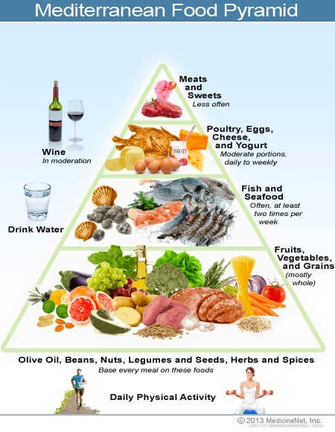

Slide 13
DASH DIET
Dietary Approaches to Stop Hypertension

Slide 14
DASH: Dietary Approaches to Stop Hypertension
DASH dietary pattern description:
high in vegetables, fruits, and low-fat dairy products
high in whole grains, poultry, fish, and nuts
low in sweets, sugar-sweetened beverages, and red meats
low in saturated fat, total fat, and
cholesterol
high in potassium, magnesium,
calcium
rich in protein and fiber

Slide 15
DASH and BP
When all food was supplied to adults with BP 120–159/80–95 mm Hg and both body weight and sodium intake were kept stable, the DASH dietary pattern, compared with a typical American diet of the 1990s:
↓BP 5–6/3 mm Hg
Strength of Evidence: High

Slide 16
DASH and Lipids
When food was supplied to adults with a total cholesterol level <260 mg/dL and LDL-C level <160 mg/dL and body weight was kept stable, the DASH dietary pattern, compared with a typical American diet of the 1990s:
↓LDL-C by 11 mg/dL
↓HDL-C by 4 mg/dL
• no effect on TG
Strength of Evidence: High

Slide 17
DASH Subpopulations, BP, and Lipids
In patients who would benefit from ↓ in BP and lipids, the DASH dietary pattern, when compared with the typical American diet of the 1990s, ↓ BP and ↓ LDL-C similarly in:
women and men
African-Americans and non–African-American adults
Older and younger adults
Hypertensive and nonhypertensive adults
Strength of Evidence: High

Slide 18
What does DASH diet look like?

Slide 19
Lifestyle Topics: Dietary Fat and Cholesterol
Saturated Fat - Lipids
Replacement of SFA with carbohydrates, MUFA, or PUFA - Lipids
Replacement of carbohydrates with MUFA or PUFA - Lipids
Replacement of trans fatty acids with carbohydrates, MUFA, or PUFA, SFA - Lipids
Dietary Cholesterol - Lipids

Slide 20
LDL-C: Advise adults who would benefit from LDL-C lowering
I
IIa
IIb
III
Aim for a dietary pattern that achieves 5% to 6% of calories from saturated fat.
Reduce percent of calories from saturated fat.
Reduce percent of calories from trans fat.
A
I
IIa
IIb
III
A
I
IIa
IIb
III
A
*Refer to 2013 Blood Cholesterol Guideline for guidance on who would benefit from LDL-C lowering.

Slide 22
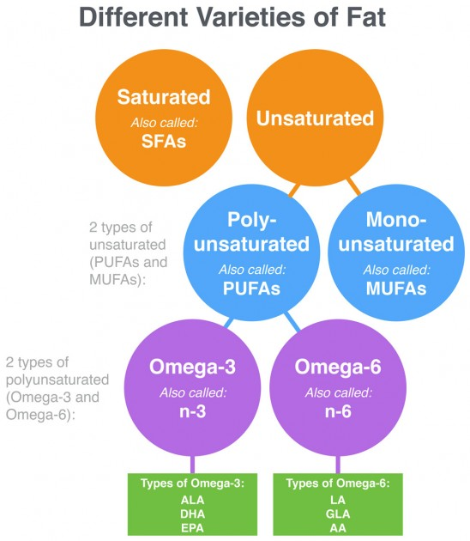

Slide 23
Lifestyle Topics: Sodium
BP:
Sodium Reduction - BP
Sodium Levels/ - BP and subpopulations
Sodium Reduction + DASH - BP
Sodium/ Other Minerals - BP
CVD Outcomes:
Sodium Reduction - CVD events
Sodium Intake - Stroke, CVD Risk
Sodium Intake - HF

Slide 25
BP: Advise adults who would benefit from BP lowering to:
I
IIa
IIb
III
Lower sodium intake.
Consume no more than 2,400 mg of sodium/day;
Further reduction of sodium intake to 1,500 mg/day can result in even greater reduction in BP; and
Even without achieving these goals, reducing sodium intake by at least 1,000 mg/day lowers BP.
A
I
IIa
IIb
III
B

Slide 26
Sodium and BP: Overall Results
In adults aged 25–80 years with BP 120–159/80–95 mm Hg, reducing sodium intake lowers BP.
Strength of Evidence: High
In adults with prehypertension or hypertension, reducing sodium intake lowers BP in women and men; African-American and non–African-American adults; and older and younger adults.

Slide 27
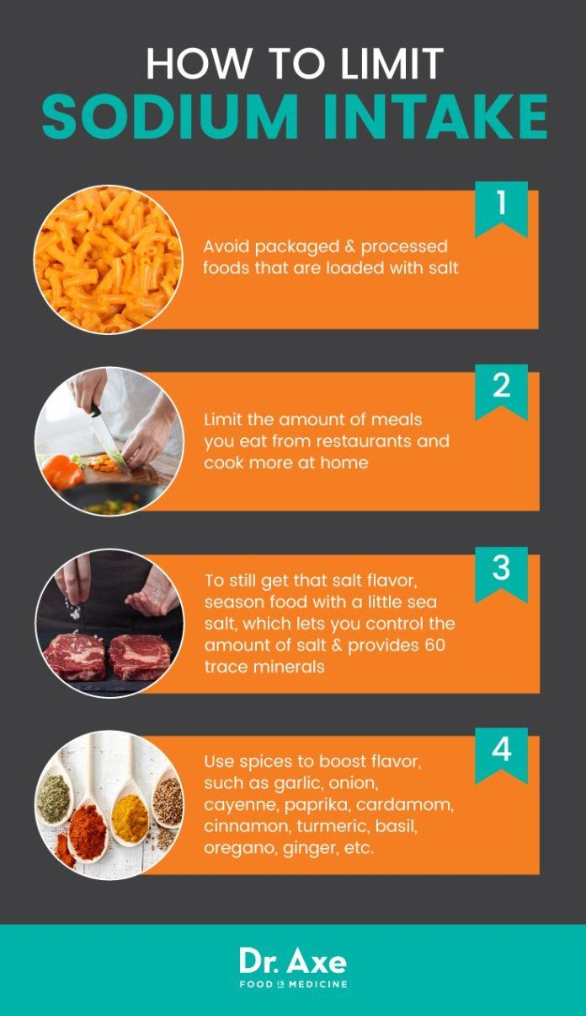

Slide 28
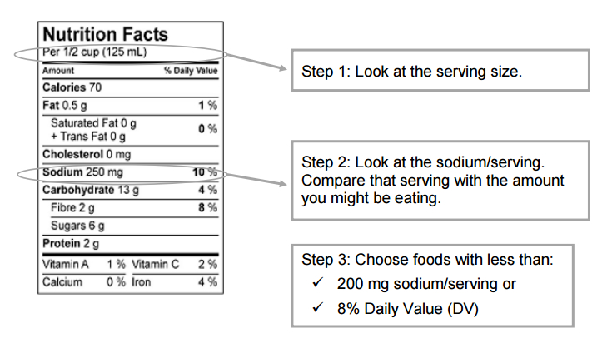
Reading Labels

Slide 29
Potassium and BP and CVD Outcomes
There is insufficient evidence to determine whether ↑ dietary potassium intake ↓ BP.
In observational studies with appropriate adjustments (BP, sodium intake, etc.), higher dietary potassium intake is associated with ↓ stroke risk.
Strength of Evidence: Low

Slide 30
Potasium

Slide 31
In 2020, Moving to Plant Based Diet

Slide 32
Effect of Exercise

Slide 33
Physical Activity
Aerobic exercise – Lipids
Resistance training – Lipids
Aerobic exercise – BP
Resistance training – BP

Slide 34
Effect of Exercise on CVD

Slide 35
Effect of Physical Activity on Lipids
Among adults, aerobic physical activity, as compared to control interventions:
↓ LDL-C 3.0-6.0 mg/dL on average
↓ non–HDL-C 6.0 mg/dL on average
has no consistent effect on HDL-C or TG
Strength of Evidence: Moderate

Slide 36
Effect of Resistance Training on Lipids
Among adults, resistance training, as compared to control interventions that average 24 weeks in duration and include ≥3 days/week, 9 exercises performed for 3 sets and 11 repetitions at an average intensity of 70% of 1-maximal repetition:
↓ LDL-C, TG, and non–HDL-C by 6.0-9.0 mg/dL
No effect on HDL-C
Strength of Evidence: Moderate

Slide 37
Physical Activity
I
IIa
IIb
III
Lipids:
In general, advise adults to engage in aerobic physical activity to reduce LDL-C and non–HDL-C: 3 to 4 sessions a week, lasting on average 40 minutes per session, and involving moderate- to vigorous-intensity physical activity.
BP:
In general, advise adults to engage in aerobic physical activity to lower BP: 3 to 4 sessions a week, lasting on average 40 minutes per session, and involving moderate- to vigorous-intensity physical activity.
A
I
IIa
IIb
III
A

Slide 38
Table 4. Definitions and Examples of Different Intensities of Physical Activity
Intensity | METs | Examples
Sedentary behavior* | 1–1.5 | Sitting, reclining, or lying; watching television
Light | 1.6–2.9 | Walking slowly, cooking, light housework
Moderate | 3.0 –5.9 | Brisk walking (2.4–4 mph), biking (5–9 mph), ballroom dancing, active yoga, recreational swimming
Vigorous | ≥6 | Jogging/running, biking (≥10 mph), singles tennis, swimming laps
*Sedentary behavior is defined as any waking behavior characterized by an energy expenditure ≤1.5 METs while in a sitting, reclining, or lying posture. Standing is a sedentary activity in that it involves ≤1.5 METs, but it is not considered a component of sedentary behavior.
MET indicates metabolic equivalent; mph, miles per hour.

Slide 39
Hours Per Day Spent in Various States of Activity
U.S. adults spend >7 h/d on average in sedentary activities. Replacing sedentary time with other physical activity involves increasing either moderate- to vigorous-intensity physical activity or light-intensity physical activity.

Slide 40
Integrating different Lifestyle Measures

Slide 41
Best Proven Nonpharmacological Interventions For the Prevention and Treatment of Hypertension
 | Nonpharmacological Intervention | Goal | Approximate Impact on SBP
 |  |  | Hypertension | Normotension | Reference
Weight loss | Weight/body fat | Best goal is ideal body weight, but aim for at least a 1-kg reduction in body weight for most adults who are overweight. Expect about 1 mm Hg for every 1-kg reduction in body weight. | -5 mm Hg | -2/3 mm Hg | (S4.4-2)
Healthy diet | DASH dietary pattern‡ | Consume a diet rich in fruits, vegetables, whole grains, and low-fat dairy products, with reduced content of saturated and total fat. | -11 mm Hg | -3 mm Hg | (S4.4-7, S4.4-8)
Reduced intake of dietary sodium | Dietary sodium | Optimal goal is <1500 mg/d, but aim for at least a 1000-mg/d reduction in most adults. | -5/6 mm Hg | -2/3 mm Hg | (S4.4-12, S4.4-10)
Enhanced intake of dietary potassium | Dietary potassium | Aim for 3500–5000 mg/d, preferably by consumption of a diet rich in potassium. | -4/5 mm Hg | -2 mm Hg | (S4.4-14)

Slide 42
Best Proven Nonpharmacological Interventions For the Prevention and Treatment of Hypertension (cont’d)
 | Nonpharmacological Intervention | Goal | Approximate Impact on SBP
 |  |  | Hypertension | Normotension | Reference
Physical activity | Aerobic | 90–150 min/wk 65%–75% heart rate reserve | -5/8 mm Hg | -2/4 mm Hg | (S4.4-19, S4.4-20)
 | Dynamic resistance | 90–150 min/wk 50%–80% 1 rep maximum 6 exercises, 3 sets/exercise, 10 repetitions/set | -4 mm Hg | -2 mm Hg | (S4.4-19)
 | Isometric resistance | 4 × 2 min (hand grip), 1 min rest between exercises, 30%–40% maximum voluntary contraction, 3 sessions/wk 8–10 wk | -5 mm Hg | -4 mm Hg | (S4.4-21, S4.4-63)
Moderation in alcohol intake | Alcohol consumption | In individuals who drink alcohol, reduce alcohol† to: Men: ≤2 drinks daily Women: ≤1 drink daily | -4 mm Hg | -3 mm Hg | (S4.4-20, S4.4-24, S4.4-25)

Slide 43
Top 10 Take Home Messages
The most important way to prevent atherosclerotic vascular disease, heart failure, and atrial fibrillation is to promote a healthy lifestyle throughout life.

Slide 44
Top 10
All adults should consume a healthy diet that emphasizes the intake of vegetables, fruits, nuts, whole grains, lean vegetable or animal protein, and fish and minimizes the intake of trans fats, red meat and processed red meats, refined carbohydrates, and sweetened beverages. For adults with overweight and obesity, counseling and caloric restriction are recommended for achieving and maintaining weight loss.

Slide 45
Top 10
Adults should engage in at least 150 minutes per week of accumulated moderate-intensity physical activity or 75 minutes per week of vigorous-intensity physical activity.

Slide 46
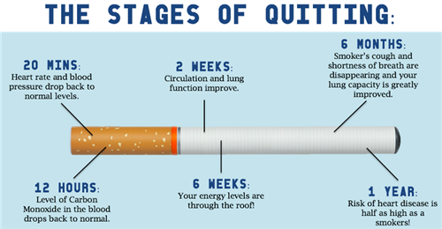
Top 10
All adults should be assessed at every healthcare visit for tobacco use, and those who use tobacco should be assisted and strongly advised to quit.

Slide 47
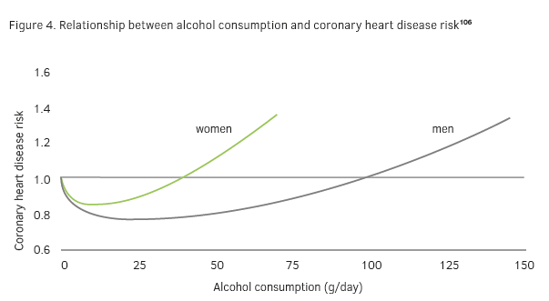
Effect of Alcohol on CHD

Slide 48
All Spirits are Not Equal

Slide 49
Top 10
Aspirin should be used infrequently in the routine primary prevention of ASCVD because of lack of net benefit.

Slide 50
Thank you

