Slide 1
Mindful Eating vs. Mindless Eating
Debbie Lucus, MS, RD, CDCES
dlucusrd@gmail.com
Notes:
1
Prior to class, ensure you have a patient roster, a copy of each patient’s labs, adequate supplies (patient handouts “High Blood Cholesterol: What you need to know”, any questionnaires, food diary forms, extra pens…). Be sure the room is arranged and clean prior to anyone arriving. Check audiovisual equipment. Have visual aides such as food models and food labels.
Introduction
- Three class series, one class per month
-Describe what you will be providing those participants who attend follow-up classes (food diary analysis, labs, other incentives you may have in your program). The second class provides more information on food label reading, fiber, and soy foods. The third class covers dining out and recipe modifications.

Slide 2
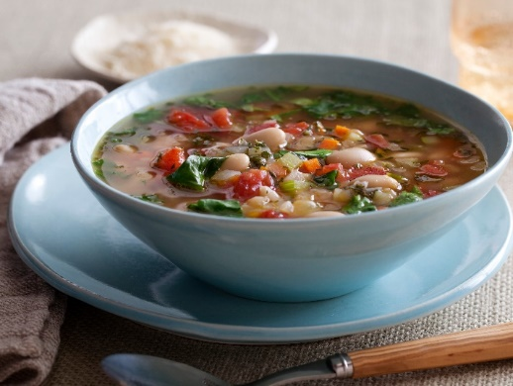
Question 1
How much more soup did people eat when their soup bowl kept filling up without their knowledge?
A. 13%
B. 53%
C. 73%
Answer: C – just like if you were eating out of bag or box, without signal of how much, we can overeat

Slide 3
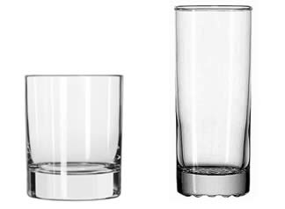
Question 2
When 2 glasses had the same capacity, into which glass did people pour the most liquid?
A. short, wide glass
B Tall, narrow glass
Answer: A – 25-30% more into short, wide tumblers – in tall, skinny glass, looks like more

Slide 4
Question 3
How did the size of plate or bowl influence people’s perception of amount when they were offered the same portion size?
A. Made no difference in the amount they thought they ate
B. Thought they ate more when served on large plate or bowl
C. Thought they ate more when served on small plate/bowl
Answer: C – large dish makes portions look smaller

Slide 5
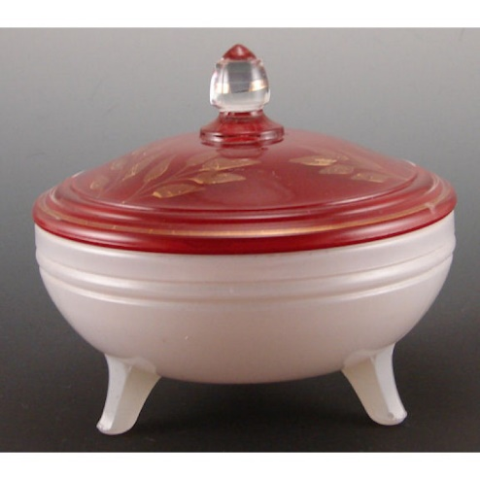
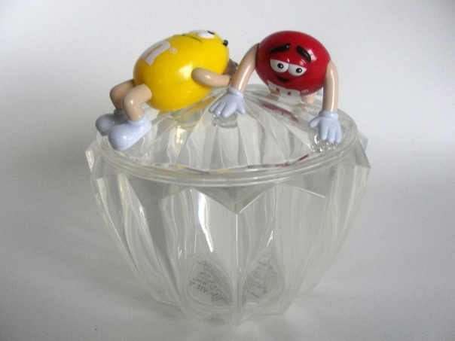
Question 4
How did the number of chocolates people ate from covered, desktop candy dishes compare when the dishes were clear vs. when the dishes were white?
A. Same from both dishes
B. Ate more from white dish
C. Ate more from clear dish
Answer: C 71% more (7.7 vs 4.6 candies) from clear dish

Slide 6
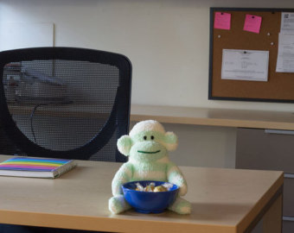
Question 5
At which location did people eat the most candy from a clear, lidded candy dish?
A. corner of desk
B. Top left-hand desk drawer
C. On a file cabinet six feet from the desk
D. They ate the same amount from all locations
Answer: A 9 candies vs 6 (in drawer) vs 4 across room

Slide 7
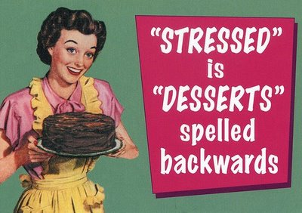
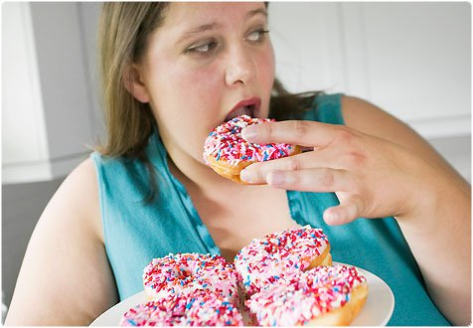
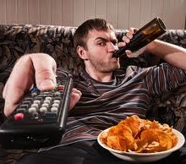
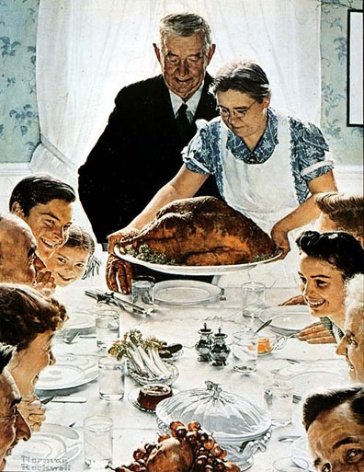
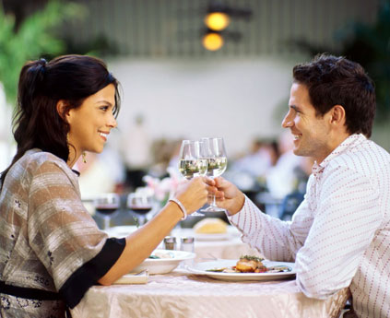
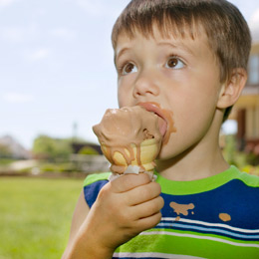
We eat for many reasons…
Pleasure
Stress
Cultural Norms
Comfort
Fatigue
Anger
Boredom
Social
Anxiety
Habit

Slide 8
What is the one reason why we should eat?

Slide 9
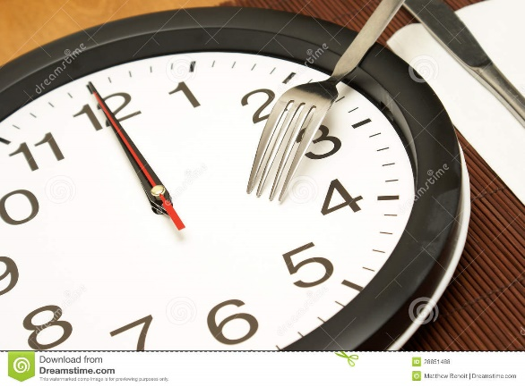
MindLESS Eating
Using external cues to shape our food choices and timing
Eating because…
It’s noon
I see it – it looks good
It smells good
I haven’t finished what I was served
It’s free (or to get my money’s worth)
It is what I always do (i.e. go to the movies, need popcorn)

Slide 10
MindLESS Eating
Focuses on the next bite and the environment
Lowers awareness of amount of food you consume
Can’t assess hunger/fullness
Disrupts mind/body connection
Signals that regulate intake aren’t sensed
Leads to overeating

Slide 11
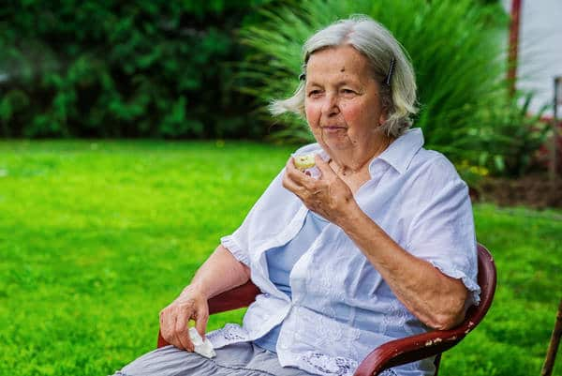
MindFUL Eating
Eating with intention while paying attention
Choosing foods you enjoy and that nourish your body
Tuning all your senses into that food
Aware of level of hunger and satiety
Get more satisfaction out of less food
Awareness of why I am eating:
Comfort
Emotions
Sad, glad, mad….
= Emotional eating

Slide 12
Eating Mindfully
Mindful ‘Eat-Mojis’
Rank your level of hunger before you eat and half way through the meal
If you are a 6 or greater, then stop eating
If <6, then eat slowly until you are satisfied

Slide 13
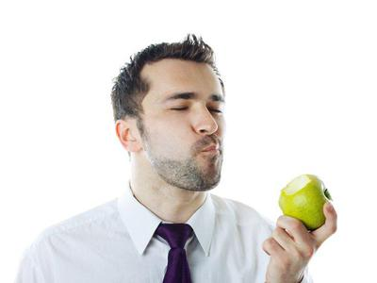
Slow down
Give brain time to register that you are full
Put utensils down between bites
Sip water between bites
Take small bites and chew thoroughly
Finish chewing and swallowing before filling up fork again

Slide 14
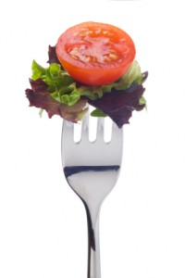
Practice Mindful Bites
Look at the food before you eat it
Think about what it is, where it came from
Note the color, texture, temperature
Intentionally put it in your mouth
Notice how it feels and tastes in your mouth
Start to chew and notice how it changes
Think about swallowing it before your swallow
The experience is this bite – not the next one

Slide 15
Environmental Control – What are your cues?
Chips in cupboard
Goodies at the movies
Drinks at social events
Snacking after dinner
Game night/Bunko
Finger foods
Dessert after dinner
Boredom
TV
Buffets
Options:
Stay away from cue?
Find a replacement?
Get rid of the trigger food?
Respond differently to cues?
Notes:
Discussion:
Ask participants about situations that make them eat or drink more than they should. Which of the items on the left are they familiar with? Are there others that are not on the list? Go though each item on the left and discuss options.

Slide 16
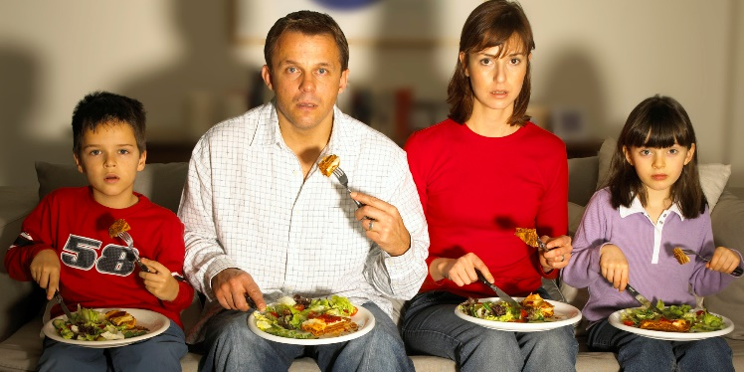
Strategies to avoid mindless eating
Set up your world to support your healthy eating behaviors
Keep high fat/high calorie foods out of your house and work place
At least keep them out of sight
Keep lower fat/calories choices easy to reach, in sight and ready to eat
Limit your eating to just one place
Limit other activities when you eat

Slide 17
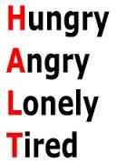
Strategies for Emotional Eating
Be aware of why you are eating
H A L T!
Take a 10 minute ‘time out’
Pause and observe
Distract
Express the emotion
Learn your triggers
Move
Practice deep breathing

Slide 18
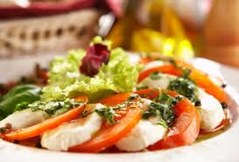
Respond in healthy way & create new habit
Implementation Intention – have a replacement for the unhealthy habit: if….then
Feeling sad?
I used to have Ben & Jerry’s
Now I listen to music
Mad at my spouse? boss? BFF?
I used to eat cookies
Now I go for a walk
Notes:
That produces the best kind of positive feedback system where we get the healthy and mood boosting nutrients we need as well as adequate calories and hydration and we continue the cycle of good health, and good mood and energy to do more of the things we enjoy most!

Slide 19
Stress & You
Stress hormone, cortisol – affects appetite-control chemicals and compromises the immune system
Often turn to sweets/salty snacks
Fuel with foods that build immune system:
Reduce high fat foods (low fat, vegetarian diet can lower cortisol levels)
Limit caffeine
More vitamin B & C foods
Whole real foods vs processed, sugary foods
Exercise – lowers cortisol levels

Slide 20
Tips to reduce stress
Keep things in perspective – don’t sweat the small stuff, and it’s all small stuff
Deep breathing, meditation, prayer
Move your body, go outside, enjoy nature
Problem solve
List the chain of events leading up to the stress
How can you break the chain?
Get support, call a friend, journal

Slide 21
Always ‘hungry’?
Is it real hunger?
Be sure meals are well balanced
Small meals/snacks every 2-3 hours may work for you
Limit processed foods
Keep healthy snacks on hand and visible (i.e. veggies, fruits)
Track your foods and mood (MyFitnessPal online)
Have a signal that your meal is over – ‘close the kitchen’
Get moving
Drink plenty of water

Slide 22
What is the bottom line?
Set up your world to reduce chance of mindless eating
Practice mindfulness:
Listen to hunger & satiety
Have mindful bites
Recognize emotional eating and respond in more healthy way
Eat more whole, real foods
Move more!
Notes:
22

Slide 23
Where to start?
Choose 1-2 habits to change at a time
Do you have a problem food cue you could get rid of?
Do you have a positive cue you could add?
Implementation intention:
If _________, then I will _____________
When? ____________ Why? _______________
How will I make this happen? _______________
What will stand in my way? _________________
How will I get around that? __________________
Notes:
23

Slide 24
SMART Goal
Specific, Measurable, Achievable, Realistic, Time-bound
I will eat mindfully ≠ SMART goal
If I want to snack after dinner, then I will only eat it at the kitchen table
When? After dinner Why? Reduce mindless eating in other areas of the house
How will I make this happen? Talk to the family so they know we are only eating at the table
What will stand in my way? Watching TV & eating
How will I get around that? ‘close the kitchen’ after dinner by brushing my teeth and flossing

Slide 25
Happy Summer!
Debbie Lucus, MS, RD, CDCES
dlucusrd@gmail.com
Notes:
field any questions
-remind them of their next appointment, any lab draws (if part of your protocol), any records they need to keep (for example 3-day food diary), how to reschedule the class if there is a conflict.

