Slide 1
Cardiac Rehabilitation
Margaret Junker MS, RDN, CDE
Preventative Cardiology

Slide 2
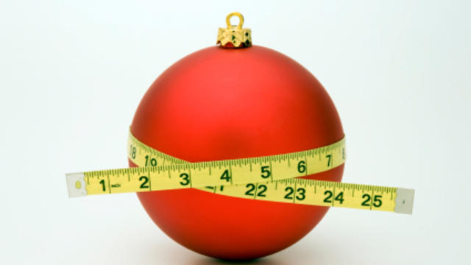
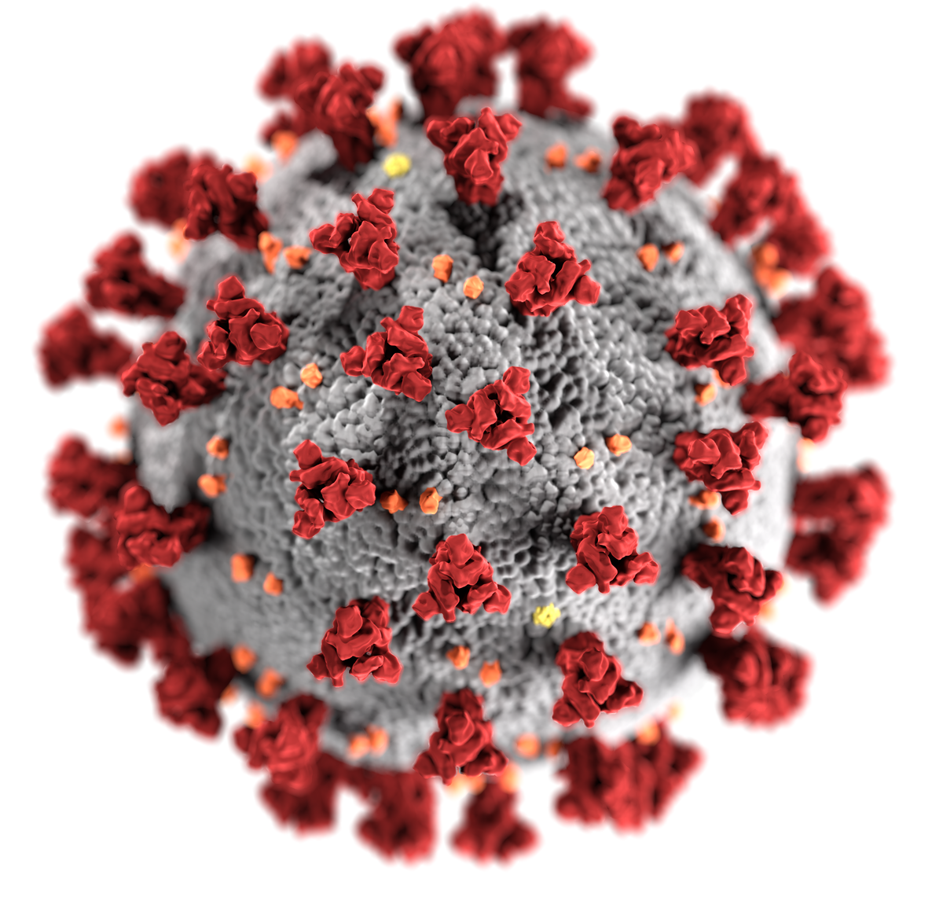
Nutrition & Weight Management
This Photo by Unknown Author is licensed under CC BY
COVID & The Holidays
This Photo by Unknown Author is licensed under CC BY-SA
This Photo by Unknown Author is licensed under CC BY-NC-ND
is Photo by Unknown Author is licensed under CC BY-NC-ND

Slide 3
Presentation Objectives
1) Identify what lifestyle habits have changed negatively since COVID
2) Verbalized what lifestyle habits you are doing well with
3) List lifestyle risk factors for COVID complications
4) State how to boost your immune system during COVID
5) Explain ways to maintain a healthy weight during COVID
6) Identify lifestyle habits that typically change during the Holidays
7) Verbalize tips to stabilize weight during the Holidays
8) Develop SMART goals to improve your health though COVID and the Holidays

Slide 4
Consider what nutrition SMART Goal can you make to reduce your cardiac risk?
This Photo by Unknown Author is licensed under CC BY-NC-ND

Slide 5
Changes in You Lifestyle Habits Since COVID?
Eating Habits: meals timing, nutritious choices, snack habits?
Physical Activity: general activity, aerobic exercise, stretching, strengthening?
Brain Stimulation: mental engaged in activities?
Sleep Habits: 7-8 hours of restful sleep a night?
Bowel Habits: are you going enough?
Stress Management: is stress building up?
Hydration: 64-110 oz of water daily, limited alcohol, limited caffeine?
Social Connectiveness: connecting with someone in a positive way daily?
Medication Adherence: taking medications without skipping does

Slide 6
Weight Gain During COVID
More than ½ of the population find weight management during the lockdowns difficult
Causes:
Stress Eating
Snacking Out of BORDEM
Challenges to Finding Healthy Food
More Time Spent Sedentary

Slide 7
COVID and CVD
Weight gain puts patients with cardiovascular disease at even greater risk of COVID complications.
This Photo by Unknown Author is licensed under CC BY

Slide 8
Good Nutrition to Fight COVID
Eat to Strengthen Your Immune System
Adequate Intake of:
Vitamins C, A, B12 B6,E
Zinc
Iron
Vitamin

Slide 9
Eat Daily
Vegetables – some fresh
Fruits
Whole Grains
Nuts – small portion
White meats or plant- based protein
Snack on fruits & vegetables – reduce added sugars
Eat Plant Based Fats –small portion
Limit salt, sugar & white flour

Slide 10
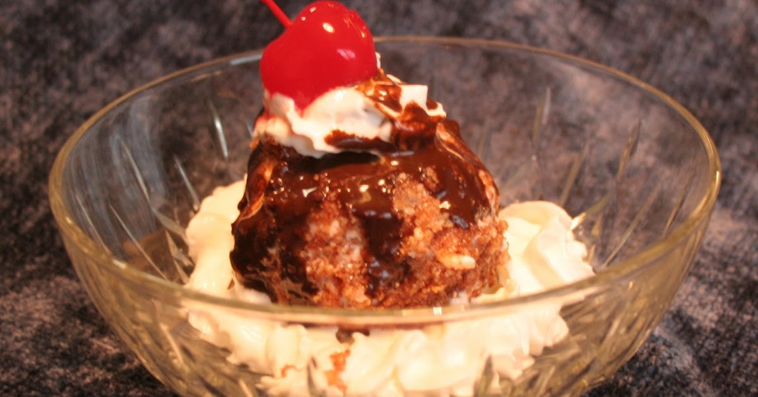
The Quarantine 15
More Sugar
More carbs with snacking & meals
More Alcohol
This Photo by Unknown Author is licensed under CC BY-NC
This Photo by Unknown Author is licensed under CC BY-SA

Slide 11
The Holiday 2-5!
Sugar and Butter
This Photo by Unknown Author is licensed under CC BY-SA-NC

Slide 12
Evaluate & Get On Track with a Plan
1. Positive self talk. What have you done well?
2. What needs improvement?
3. Does your home environment support success?
4. Focus on easy meals & preplanned snacks.
5. Plan ahead and shop smart.
6. Spend time outside daily.
7. Ask for support & assistance.

Slide 13
Stock Up On These Foods:
Seasonal flavors like canned pumpkin
Seasonal spices like pumpkin pie spice or cinnamon
Winter squashes
Citrus, apples, pears, persimmon, pomegranates
Frozen berries or mixed fruit
Frozen spinach, broccoli, green beans, frozen vegetable blends
Egg whites, tuna in water, frozen chicken, ground turkey
Popcorn, humus & whole grain crackers, or carrots
Black bean tortillas & salsa
Non-fat Greek yogurt. Laughing Cow Lite, high protein NF milk like FairLife
Herbal Teas like mint, ginger, Meyer lemon, breath right or smooth move

Slide 14
Choose Your Hard
Eating nutritiously is hard. Illness is hard.
Choose your hard.
Regular physical Activity is hard. Physical weakness is hard.
Choose your hard.
Drinking enough fluids is hard. Constipation is hard.
Choose your hard.
Obesity is hard. Living fit is hard.
Choose your hard.
Stress management is hard. Anxiety & depression is hard.
Choose your hard.
Taking medications is hard. Cardiac procedures are hard
choose your hard.

Slide 15
Choose the Happier Hard
This Photo by Unknown Author is licensed under CC BY-NC

Slide 16
Where do you want to start?
Fun Goal
Challenging Goal
This Photo by Unknown Author is licensed under CC BY-NC-ND

