Slide 1
Lipid Lowering Medications
Melinda Nguyen

Slide 2
Outline
Background
Lipid Lowering Medications
Lifestyle Modifications

Slide 3
What are lipids?
Lipids include cholesterol and triglycerides
Lipids are essential for human life
Energy
Cells
Hormones
Vitamins
Unsaturated vs. saturated lipids
Notes:
Lipids are fats that include cholesterol and triglycerides
Cholesterol is produced by our bodies and can come from the fatty foods we eat and are used as building blocks for our cells and hormones.
Triglycerides are produced by our bodies and store fat for energy.
Although we tend to think that lipids and cholesterol are bad for our health, we actually do need some in order for our body to function properly. Lipids are important components of our cells (lipid bilayer). They are also a source of steroids, hormones (testosterone, estradiol), and Vitamin D that our body needs.
Unsaturated fats are the “good fats” including oils. Saturated fats are “bad fats” like butter. You want to try to limit the amount of saturated fats you consume.

Slide 4
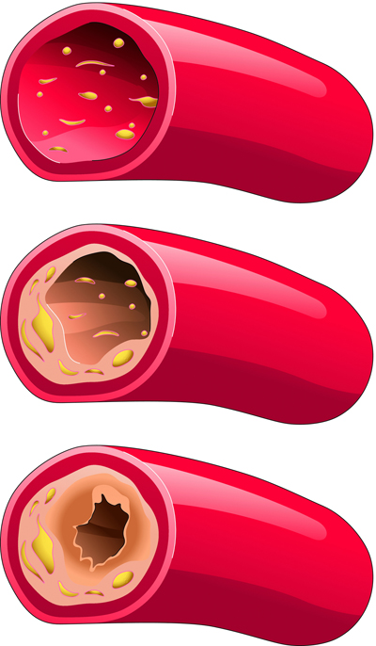
Why is high cholesterol bad?
Clogged arteries increase your risk of developing heart disease such as:
Diseases of blood supply
Coronary artery disease
Peripheral artery disease
High blood pressure
Heart attacks
Strokes
Notes:
As I mentioned before, lipids and fats are essential for everyday life. However, if we eat foods that are high in fat too often, or if we have conditions which prevents our body from breaking down fats, the fat starts to collect in our arteries. Overtime, as more fat deposits, our arteries become clogged and prevent blood from flowing from our heart to the rest of our body.
This can lead someone to develop heart diseases including:
Diseases that prevent your heart from supplying blood to the rest of your body
CAD – this is where your heart cannot supply blood and oxygen to itself, which can result in chest pain or even worse, heart attack
PAD – this is where your heart cannot supply blood and oxygen to other parts of you body such as your limbs, which can result in leg pain
High blood pressure
Heart attacks
Strokes – parts of the clogged artery can break off, travel to your brain, and prevent your brain from receiving blood and oxygen

Slide 5
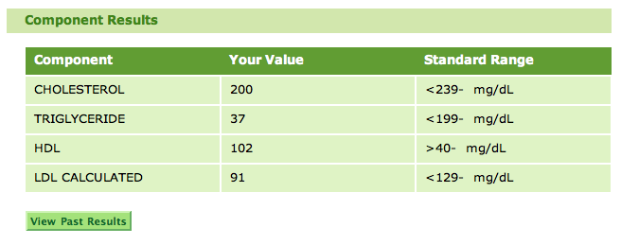
How do I know if my cholesterol is too high?
Risk Factors
Smoker
History of heart disease
High blood sugar
65 years or older
Family history
Notes:
There are certain risk factors that can cause you to have high cholesterol. Some of these risks include:
Being a smoker
Having a history of heart disease including heart failure, high blood pressure, diabetes, or certain heart surgeries (CABG). Having kidney disease may also be a risk factor.
Being 65 YO or greater
And having a family history of high cholesterol, especially if that family member was diagnosed or passed at an early age due to heart disease
If you have some of these risk factors, your doctor may ask to run a blood test on you. This blood test is called a lipid panel and will tell you how much good and bad cholesterol is in your blood.
Use garbage collector analogy to explain the difference between LDL and HDL
Cholesterol is the trash
LDL is the garbage can that transports the trash
HDL is the garbage collector that removes the trash from clogging up the streets the streets
Normal levels:
Total cholesterol < 200
TG < 150
LDL < 160
HDL > 40 (men), > 50 women
Regular lipid screens are recommended every 3-5 years depending on risk factors
Depending on the results of your lipid panel and considering some of your risk factors, your doctor may choose to put you on medications that lower your cholesterol in order to prevent you from having a life threatening CV event, such as heart attack or stroke.

Slide 6
Lipid Lowering Medications

Slide 7
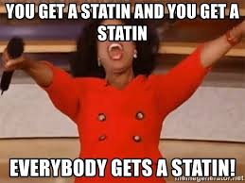
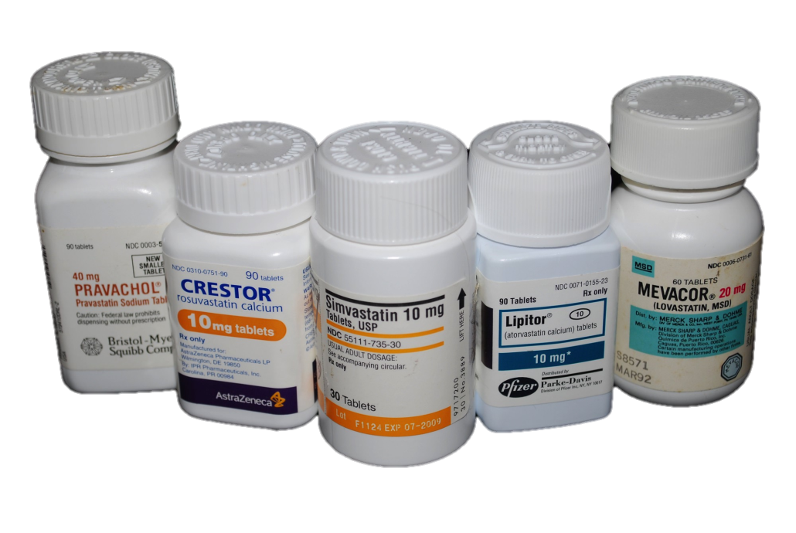
Statins
Atorvastatin (Lipitor)
Fluvastatin (Lescol)
Lovastatin (Altoprev, Mevacor)
Pitavastatin (Livalo)
Pravastatin (Pravachol)
Rosuvastatin (Crestor)
Simvastatin (Zocor)
Notes:
Statins are among the most commonly used drugs for lowering cholesterol and are the most effective for preventing CVD (coronary heart disease, heart attack, stroke, death)
MOA: Statins work by decreasing your bodies production of cholesterol and increases the removal of cholesterol by the liver. They can reduce your cholesterol by 25-55%
It comes as a tablet and is taken by mouth. Some statins are better taken at bed time while other are best taken with meals. This is why it is important to follow instructions on the label.

Slide 8
Statins
Side effects:
Nausea, diarrhea, abdominal pain
Muscle aches, pain, weakness
Kidney damage
Liver damage – avoid alcohol
Diabetes
Drug-Drug Interactions
Heart medications (amiodarone, diltiazem, verapamil)
Antibiotics, antivirals, antifungals
Grapefruit juice
Notes:
Generally, statins are well tolerated and most people don’t have issues taking statins. However, as with any medication, there are a few side effects I want you guys to be aware of. These side effects aren't always common, and may be mild. But if you notice any of them, it’s a good idea to let your doctor know so they can switch you to a different statin or lower your dose if needed.
More common side effects nausea or stomach pain.
A more serious side effect is muscle pain, aches, weakness. You can be predisposed to this side effect if you have low levels of thyroid. So before you begin taking statins, its important that your doctor check you thyroid levels first.
Serious muscle pain can lead to kidney damage. Its very important to let your doctor know if you experience muscle pain
Liver damage can also occur since statins are metabolized in the liver. To reduce this risk, avoid alcohol. Let your doctor know right away if you have any signs of liver problems including upper abd pain, dark urine, yellow skin, fatigue)
Statins have been associated with risk of T2DM due to insulin resistance.
Statins can also interact with other medications. Therefore it is important to always let your doctor and pharmacist know if there are any changes to your medication. These interactions include:
Some heart medications can interact with statins including amiodarone (rhythm), diltiazem (rhythm, HTN, tachy, CABG, angina), and verapamil (A fib, htn, tachy, angina)
Certain abx like clarithromycin, erythomycin, rifampin; azole antifungals (fluconazole, posaconazole, voriconazole); HIV medications
Statins can also interact with grapefruit juice. Try to limit grapefruit to no more than 1 L per day

Slide 9
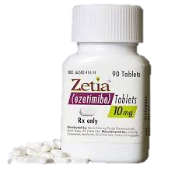
Ezetimibe (Zetia)
Side effects
Diarrhea
Muscle pain (with statin)
Take with or without food
Take at the same time as statin
Take 2 hours before or 4 hours after bile acid medication
Notes:
Eeztimibe is another medication that can be used to control cholesterol. It has been shown to lower cholesterol by 20-25%. Usually it is prescribed in combination with statins, but can be used by itself for patients who do not tolerate statins.
MOA: inhibits body’s ability to absorb cholesterol from food and cholesterol that is produced by the body
Ezitimibe has relatively few side effects
Administration:
Dose is 10 mg everyday
Take with or without food
Can take it at the same time as statin or fenofibrate
If on BAS too, take 2 hr before or 4 hr after BAS

Slide 10
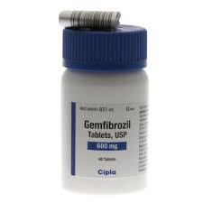
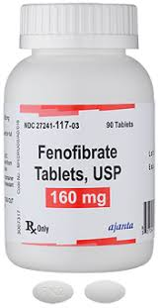
Fibrates
Fenofibrate (Tricor, Triglide, Fenoglide)
Gemfibrozil (Lopid)
Side effects
Upset stomach
Gall stones
Liver damage
Muscle pain – do not take with statins
Drug-Drug Interaction
Warfarin
Notes:
Fibrates can lower triglyceride levels by 50%.
MOA: Decreases triglyceride levels and increases HDL
Some side effects of fibrates include:
Upset stomach (abd cramps, nausea, constipation, diarrhea)
Development of gall stones – let your doctor know if you experience upper abd pain, vomitting, fever, yellowing of skin
Liver damage – avoid alcohol
Muscle pain – similarly to statins. Therefore you should not be taking both at the same time
There is a DDI with warfarin. Doctor may reduce your dose of warfarin.
Administration
Fenofibrate – meal depends on the brand/formulation, follow instructions on label
Fenoglide/Tricor QD with food
Triglide – daily w or w/o food
SWALLOW WHOLE DO NOT CRUSH, CHEW, DISSOLVE
Gemfibrozil – take 30 mins before breakfast and dinner (BID)

Slide 11
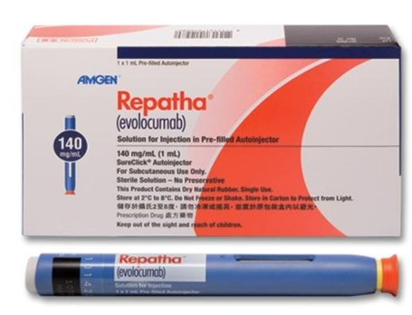
PCSK9 Inhibitors
Alirocumab (Praluent)
Evolocumab (Repatha)
Side effects
Injection site reaction
Suppressed immune system
Notes:
PCSK9 inhibitors are a new class of injectable medications that are given in combination with statins. They are given once every 2-4 weeks and administered into arm, leg or abd. They have been shown to reduce LDL cholesterol by 60-70% and substantially reduce the risk of CV events.
MOA: PCSK9 is an enzyme in your liver that actually increases the amount of LDL in your body. These drugs stop this enzyme to reduce the amount of LDL.
Some side effects that may occur with these medications include:
Allergic reaction at the site of injection (swelling, itching, redness)
Suppressed immune system – may be more susceptible to colds or infections
No major DDIs (other drugs that suppress immune system)

Slide 12
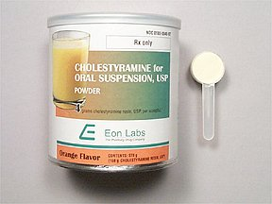
Bile Acid Sequestrants
Cholestyramine (Questran)
Colesevelam (Welchol)
Colestipol (Colestid)
Side effects
Nausea, constipation, flatulence - take with lots of fluids or stool softener
Drug-Drug Interaction
Digoxin
Warfarin
Vitamins A, D, E, K
Dissolve powder in beverage
Take with food
Notes:
MOA: Bile acid sequestrants increase the amount of cholesterol that is broken down to bile acid which is removed from the body as stool
Side effects of BAS can be bothersome. Theses side effects include:
Upset stomach, NVC, flatulence – drinking lots of fluids or taking fiber supplements may help with these side effects
Docusate
DDI
Digoxin (arrhythmia)
Wafarin – report signs of bleeding
Vitamins
Take these medications at different times of the day – take other meds 1 hr before or 4 hrs after taking BAS
Take with meals, fluids
If powder, dissolve in liquid before taking
Do not sip or hold in mouth for prolonged periods because it can cause discoloration of teeth

Slide 13
Niacin (Niaspan)
Rarely used
Side effects
Flushing – take with aspirin
Worsens gout or diabetes
Liver damage – requires regular blood tests
Drug-Drug Interactions
Blood thinners or dilators
Take with food
If you miss a dose for several days, contact your doctor
Notes:
Niacin is rarely used for high cholesterol. We don’t get a lof rx for this one. Ezetimibe or PCSK9 inhibitors are usually tried before niacin.
MOA: reduces the amount of LDL your body produces while increasing HDL
Niacin is associated with a few side effects:
Flushing (when your body becomes red or warm) – doctor may recommend aspirin to reduce flushing
It can worse gout
It can cause damage to your liver. Therefore, your doctor will require to come in for regular blood tests to make sure your liver is working just fine.
These side effects usually improve after about a week. Avoid alcohol
Niacin should not be taken if you are on a blood thinner such as warfarin or certain blood pressure medications that dilate your blood vessels such as nitroglycerin (angina), because it can cause low blood pressure.
Take with food
If you miss your dose for several days, contact your doctor, as you may need to adjust your dose.

Slide 14
GoodRx.com
Drug | Price
Simvastatin (Zocor) | $11
Rosuvastatin (Crestor) | $11
Lovastatin (Mevacor) | $14
Atorvastatin (Lipitor) | $18
Fluvastatin (Lescol) | $53
Gemfibrozil (Lopid) | $15
Fenofibrate (Tricor, Fenoglide) | $18
Niacin (Niaspan) | $19
Ezetimibe (Zetia) | $27
Cholestipol (Colestid) | $31
Cholestyramine | $47
Colesevelam (Welchol) | $153
Alirocumab (Praluent) | $452
Evolocumab (Repahta) | $492

Slide 15
Lifestyle Modification
Notes:
IMPORTANCE OF ADHERENCE
Lifestyle changes can help not only help control your cholesterol, but it can also help you decrease the dose of the lipid mediation, or even remove the need for medication altogether

Slide 16
Lifestyle Modification
Diet changes
Reduce foods that are high in saturated fats and cholesterol
Increase oily fish
Physical exercise – 30 minutes per day
Losing weight
Quit smoking
Notes:
The first step to reducing you cholesterol is limiting the amount of foods that are high in cholesterol such as red meats, full-fat dairy, butter,
Having 1-2 servings of oily fish per week has been shown to lower triglyceride levels and the risk of heart disease (mackerel, herring, bluefish, sardines, salmon, anchovies. They contain important fatty acids calls DHA and EPA.
Fish oil – unclear if they have the same benefit
Physical activity for at least 30 minutes per day for most days of the week

Slide 17
