Slide 1
Holiday tips & tricks – modifying your favorite recipes
Debbie Lucus, MS, RD, CDCES
11.17.20
dlucusrd@gmail.com
Notes:
On the next few slides we’ll look at a few common varieties of beans and discuss their shape, size, and flavor.

Slide 2
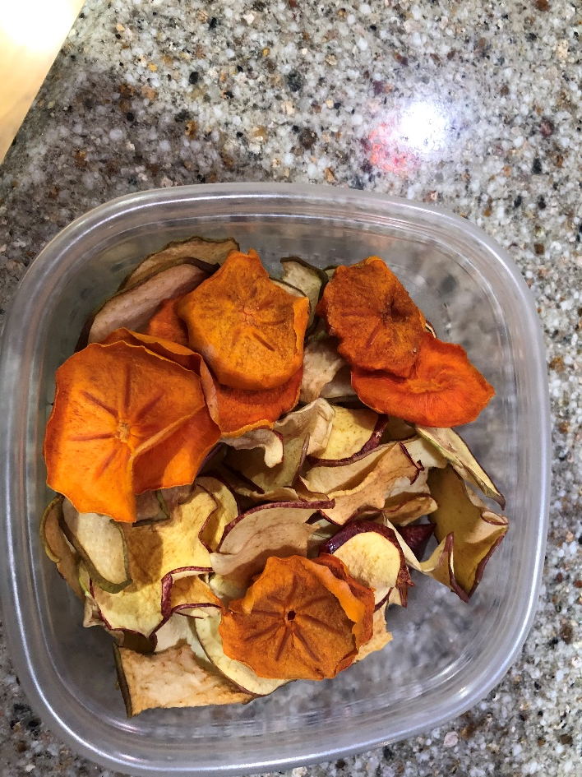
My new toy

Slide 3
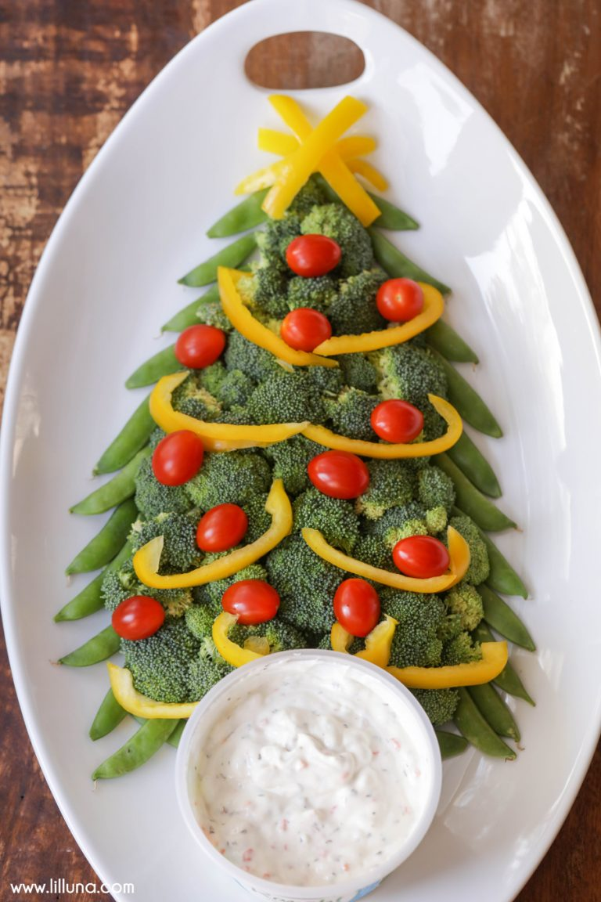
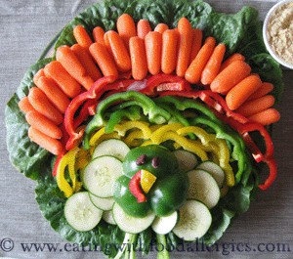
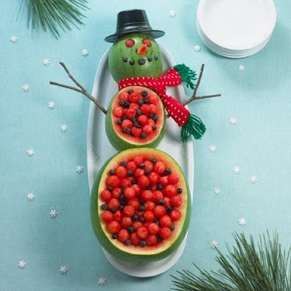
Why Modify?
Lower fat
Lower salt
Lower sugar
Increase fiber
Add more produce
Turn into healthier option
Lower calories
Eliminate animal products
To highlight how great healthy food can taste!
Because you love yourself, your family, your guests

Slide 4
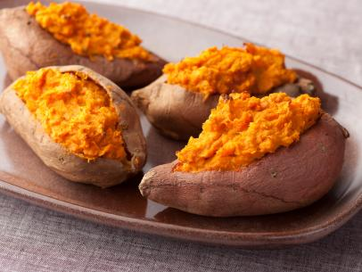
How to handle the holiday favorites
What is your plan? Stick with plan? Splurge?
Modify to a lower fat, lower calorie version
Have smaller portion of the real deal
Try a new favorite
Ie. Traditional Sweet potatoes with brown sugar and marshmallows
What would be another form of sweet potato that would be healthier?

Slide 5
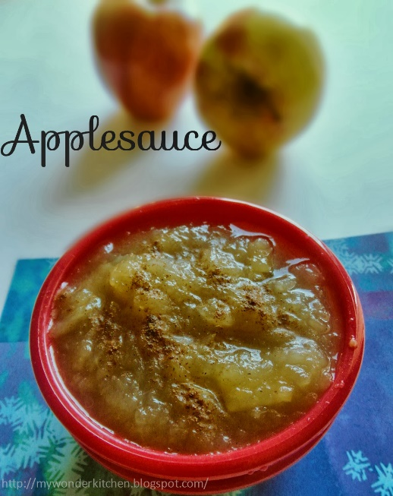
Reduce the fat
Use half or even less
Use vegetable oil spray
For baked goods:
Sub butter, shortening or oil with unsweetened applesauce, mashed banana or prune puree, or even canned pumpkin
Sub egg with ‘flax egg’ (3 T water + 1 T flaxmeal) or pureed tofu (1/4 cup)
Coconut milk: 1 cup plant milk + ½ tsp coconut extract

Slide 6
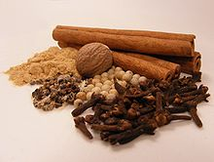
Reduce the sugar
Reduce the amount of sugar by one-third to one-half.
Use dates for sweetener
Add spices for sweetness:
Cinnamon
Cloves
Allspice
nutmeg
Add flavorings such as vanilla extract or almond flavoring to boost sweetness.

Slide 7
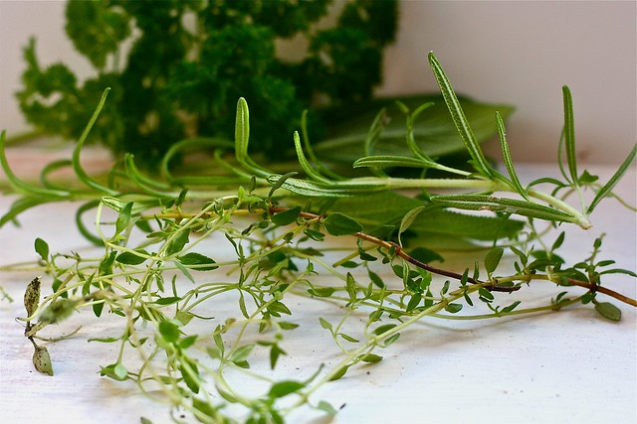
Reduce the salt
Reduce the salt by half or just leave it out
Cut salt in half in baked goods that don't require yeast
Use low sodium items in your recipes – ie. broth, beans, tomatoes
Spice foods up with seasonings other than salt
Traditional seasonings: bay leaves, parsley, sage, rosemary & thyme
Make more foods from scratch

Slide 8
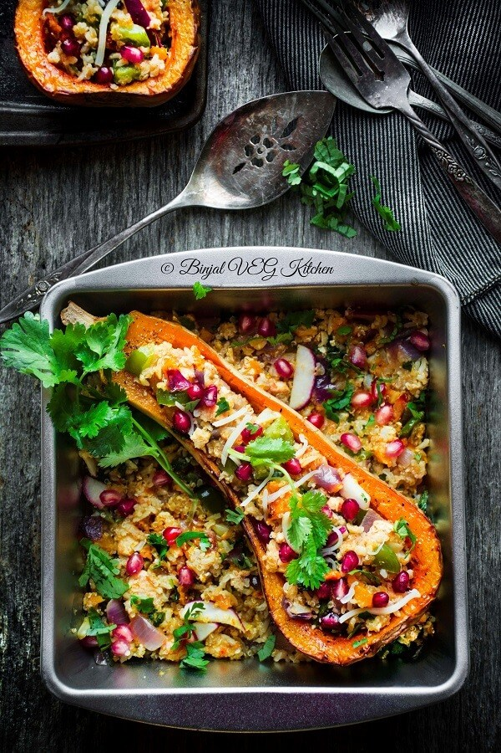
Reduce the animals
Vegetable broth instead of chicken or beef
Liquid smoke instead of bacon
Beans instead of meat
Plant-based milks
Thanksgiving entrée ideas:
Stuffed Portobello mushrooms
Portobello mushroom ‘roast’
Stuffed squash
Veg pot pie
Shepherd’s pie
Field Roast ‘roast’

Slide 9
Healthy Substitutions
For meat
Use beans or tofu instead of meat (or use less meat)
Adding beans increases fiber and reduces unhealthy fats
Try meat substitutes?
Add expanders
Foods filled with water and fiber that expand the portion of food without adding many calories: veggies, mushrooms, broccoli slaw, beans.

Slide 10
Healthy Substitutions
Pasta/Rice
Use whole-wheat pasta instead of enriched pasta.
Brown rice or barley or quinoa instead of white rice
Try cauliflower rice or veggie noodles
Milk
If including dairy, use fat-free milk instead of whole milk to save 66 calories and almost 8 grams of fat per cup.
Choose plant-based milks– soy milk, almond milk, rice milk, oat milk
Nut cheeses

Slide 11
Reduce high calorie ingredients
Toppings
Make a lighter gravy or skip it
Condiments
Cut condiments, such as pickles, olives, butter, mayonnaise, syrup, jelly and mustard, which can have large amounts of salt, sugar, fat and calories
Use low-sodium soy sauce in a smaller amount than a recipe calls for to decrease the amount of salt.
Cheese.
Eliminate cheese? Nut cheese?

Slide 12
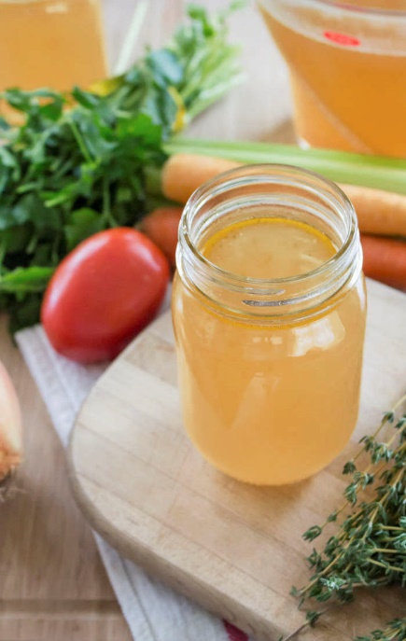
Change cooking methods
Cooking method
Instead of frying, try braising, broiling, grilling, poaching, sautéing and steaming
Saute/Basting liquid
Instead of oil or drippings, use a small amount of wine, fruit juice, vegetable juice or fat-free vegetable broth
Use nonstick spray
Air fryer for fried recipes?

Slide 13
Reduce the portion size
Slow down
Eat your meals more slowly:
Takes 20 min to figure out you are full
Put fork down between bites
Have a conversation
Savor each bite
Check portion sizes
Use smaller plates, spoons and cups.
Remember ½ plate should be veggies – even on Thanksgiving

Slide 14
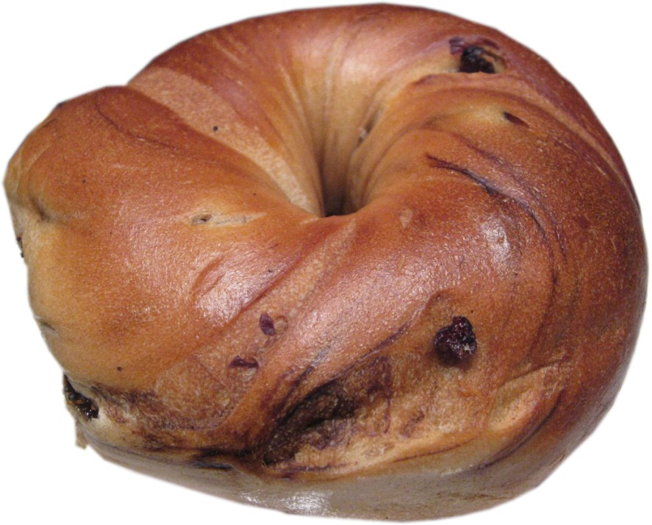
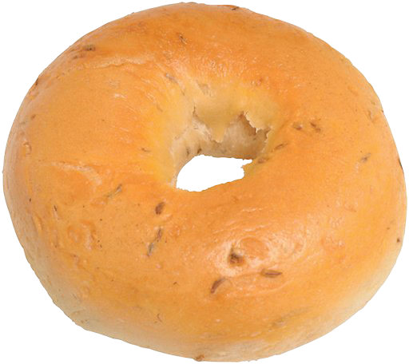
Guess the calorie difference!
20 Years Ago
Today
3-inch diameter
6-inch diameter
Blueberry bagel photo courtesy of pengrim™ at http://flic.kr/p/41qvEZ under a Creative Commons Attribution-NonCommerical license: http://creativecommons.org/licenses/by-nc/3.0/
Notes:
Blueberry bagel image courtesy of pengrim™ at http://flic.kr/p/41qvEZ under a Creative Commons Attribution-NonCommerical license: http://creativecommons.org/licenses/by-nc/3.0/

Slide 15
Guess the calorie difference!
140 calories
350 calories
210 more calories
Notes:
Blueberry bagel image courtesy of pengrim™ at http://flic.kr/p/41qvEZ under a Creative Commons Attribution-NonCommerical license: http://creativecommons.org/licenses/by-nc/3.0/

Slide 16
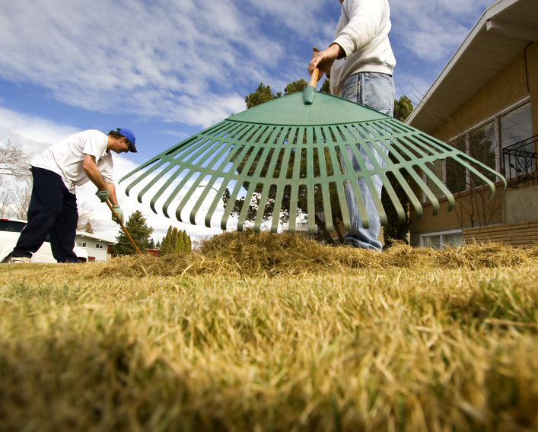
How long would you have to rake leaves to burn 210 more calories?
Notes:
Blueberry bagel image courtesy of pengrim™ at http://flic.kr/p/41qvEZ under a Creative Commons Attribution-NonCommerical license: http://creativecommons.org/licenses/by-nc/3.0/

Slide 17
How long would you have to rake leaves to burn 210 more calories?
50 minutes
Based on 130-pound person

Slide 18
Typical Thanksgiving foods
Turkey – sub a yummy plant dish
Mashed potatoes – Vit C, fiber – make with skin, use plant milk
Sweet potatoes – Beta carotene, Vit A, B, C & E – tasty as is
Stuffing – can be high fiber if using WW bread, veg broth, add veggies & herbs
Mac ‘n Cheese – use whole grain, add sweet potato
Gravy – use mushroom base
Green bean casserole – try plain old green beans
Greens – awesome choice!
Cranberry sauce – Vit C - use juice or dates for sweetener
Rolls – sub no-knead bread
Pumpkin pie – lower calorie than most, make with plant-based ingredients

Slide 19
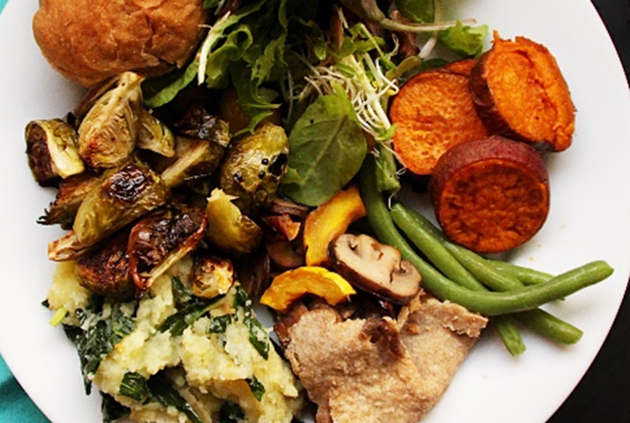

Slide 20
Take care of yourself during the holidays
Get enough sleep
Don’t skip meals
Choose healthy snacks
Lighten your holiday favorites
Make a plan for your food choices
Careful with portions
Put leftovers away immediately
Careful with your alcohol &/or beverages with calories
Keep up with your activity
Practice stress management techniques
Be grateful every day!

Slide 21
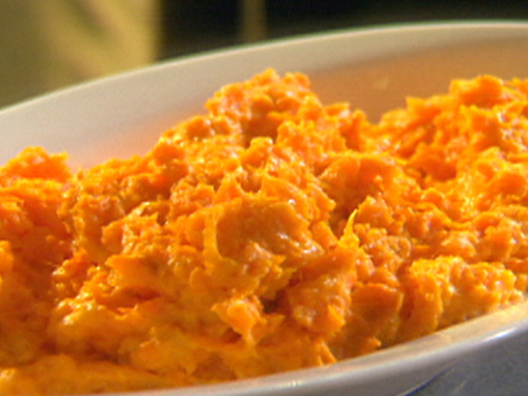
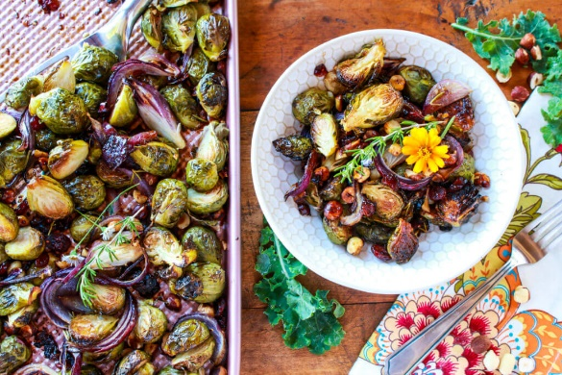
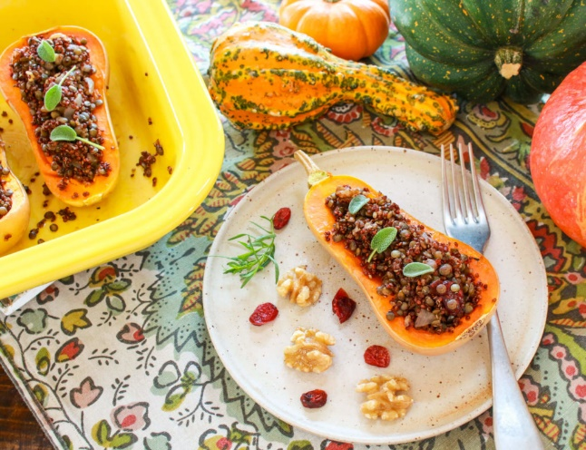
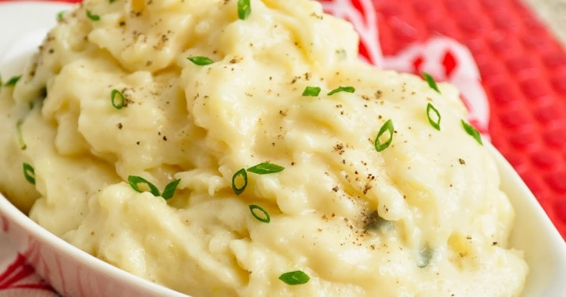
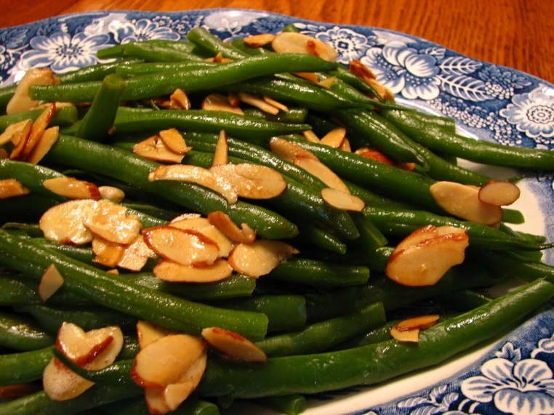
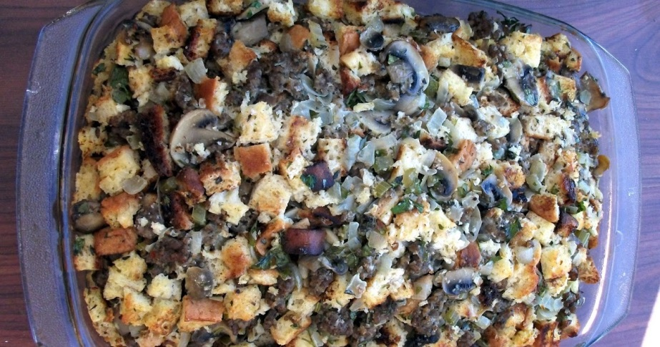
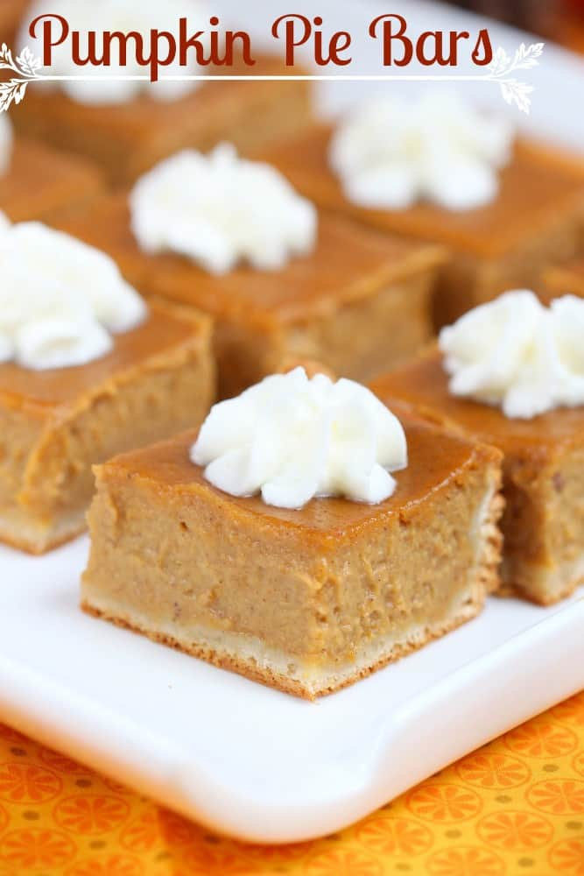
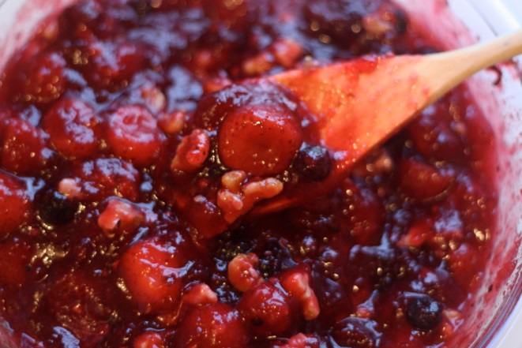
Happy Thanksgiving

