Slide 1
Research at the CWP
Kim Roberts & Linda Paumer

Slide 2
My Research Background
PhD & MS at Washington State University 1988-1993
Neuroscience & Behavior –Novel neuropeptide improves Memory in rats
Post-Doctoral Fellowship at UC Davis
Dr. Rutledge 1993-1996- Effects of Secondhand smoke or cholesterol
CSUS 1997-present
Effects of exercise on Memory & Cortisol levels (moderate vs. intense)
Community based Wellness programs & Health* collaborate with Linda
Sleep issues during the pandemic in young & older age individuals

Slide 3
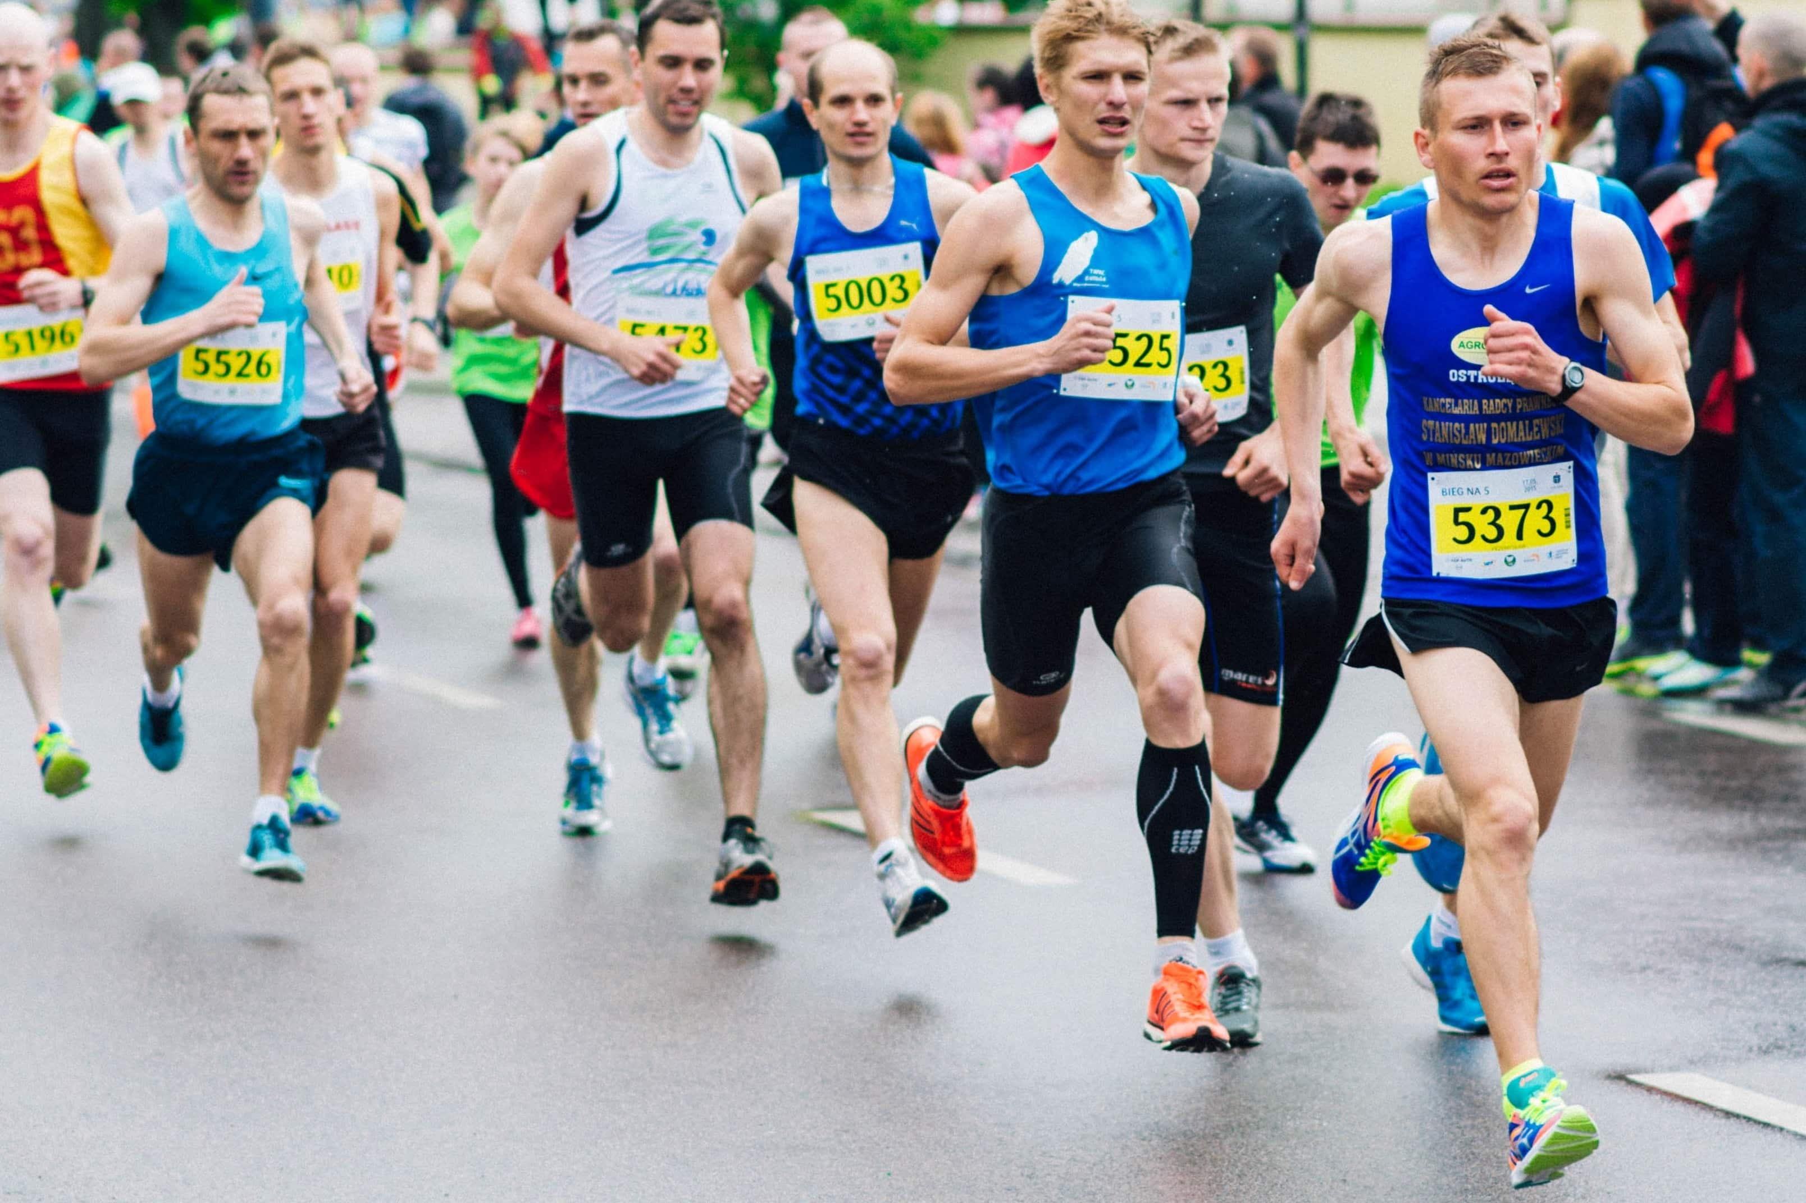
Is too much exercise bad for your memory?
Moderate exercise seems to improve short-term memory (Tomporowski et al., 2008)
Several studies have indicated that exercise that is too intense, like running a marathon, is detrimental to cognitive function (Eich &Metcalfe, 2009).
Intense exercising increases in the stress hormone cortisol occur (Hill et al., 2008).
Notes:
What hormone effects memory & involved in stress? Cortisol

Slide 4
Changes in Cortisol levels and Cognitive function in Runner’s and Cyclists

Slide 6
Does a 10-week exercise program improve mental health & cognition in older age individuals-2017
Test 1 day per week for 10 weeks
Heart Rate
Blood Pressure
Depression & Anxiety questionnaire
Mini-Cog test
Control Group BP only
Educational group
Exercise Group
Test 1 day per week for 10 weeks
Heart Rate
Blood Pressure
Depression & Anxiety questionnaire
Mini-Cog test

Slide 7
Results
Notes:
Small sample size

Slide 8
Heart Rates after 10 weeks

Slide 9
Research At Cardiovascular Wellness Program CSUS-2018-19!
Pretest:
Heart Rate
Blood pressure
Competitive Questionnaire
Mnemonic Memory Similarity Task
Posttest: Alone Condition
Memory Similarity Task
(MST)
Posttest: Social Condition
Memory Similarity Task
(MST)

Slide 10
Elderly improved on Memory tests if they exercised socially vs. Alone

Slide 11
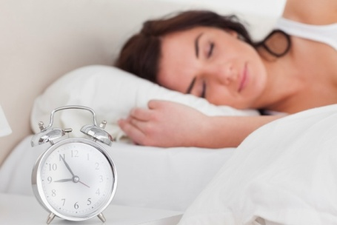
Results Sleep
During the Pandemic 2020-2021

Slide 12
Thank you for participating in our study!
Sleep is important at any age but deep sleep decreases as we age!
Good sleep habits discussed include
Going to bed at the same time every night
Reduce light (computer or cell phone)
Relax before sleeping (exercise earlier in the day no caffeine after 3pm)
Exercise & Get vitamin D & Fresh air!

Slide 13
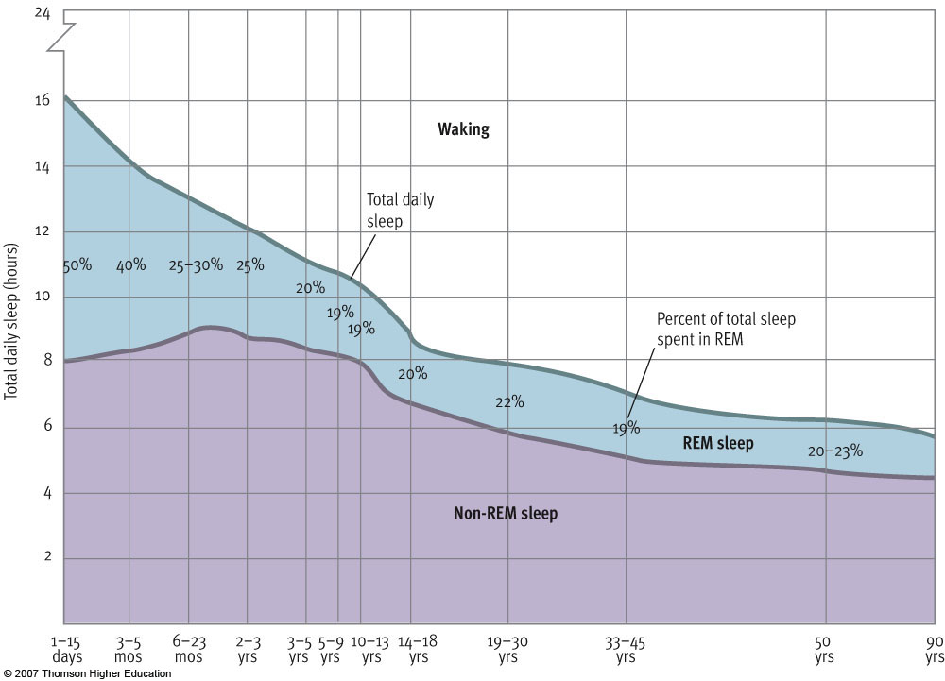
Figure 5.4 Changes in sleep patterns over the life span

Slide 14
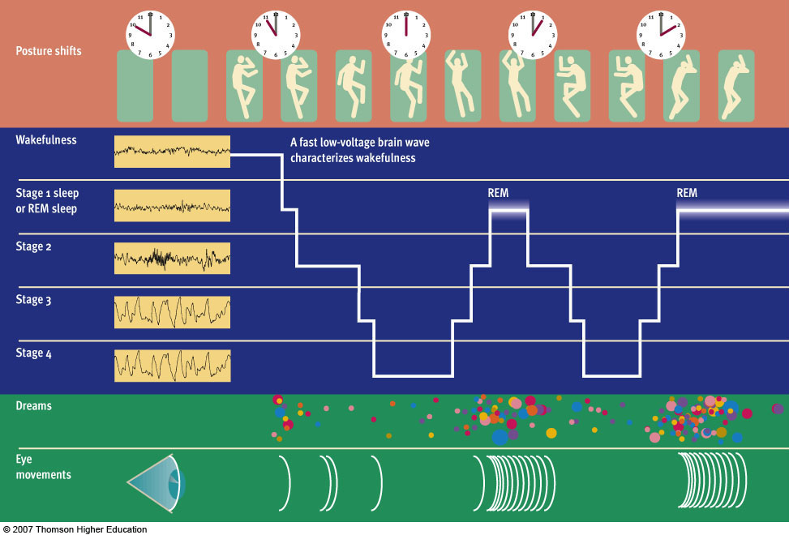
Figure 5.3 An overview of the cycle of sleep

Slide 15
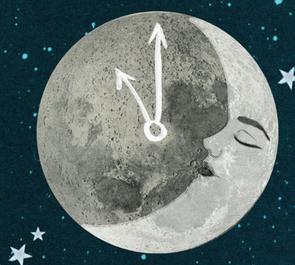
Descriptive Statistics
Mean SD N
GDSsum 3.71 3.09 41 Geriatric depression scale(score great than 5 depressed
EPSsum 14.50 5.10 202 Epworth Sleepiness 0-24 Range (high score sleepy)
PSQI-Global 10.05 9.79 202 Pittsburgh Sleep Quality Index ( 0-21)
Physical/Func 66.95 33.89 41
Limitations/PHY 63.41 40.34 41
Limitations/EM 53.75 28.42 41
Energy/Fatigue 39.14 25.63 41
Emotion/WELL 53.75 28.24 41 Short form Health Questions SF-36
Higher scores better health
SocialFC 67.9878 35.02775 41
Pain 58.5366 29.95296 41
GeneralHealth 49.02 26.83 41
Notes:
EPS 10 is average so you experience a little more daytime sleepiness than average These 36 items, presented here, are identical to the MOS SF-36 described in Ware and Sherbourne (1992).

Slide 16
Descriptive Statistics
Survey Mean SD N____________
PSleep 10.057 9.76 35 Pittsburgh Sleep survey
(Range 0-21)
RS25 55.18 9.07 35 Resilience 25 Survey
Education level: 2.97 .875 31 (Range 25-175)
Exercise per week 3.34 1.471 29
What is your age? 70.69 14.026 31
Hours Sleep 4.80* 1.16 35 (recommend 7-8hrs sleep)
(per night)

Slide 17
Notes:
Ex 3hrs PSB=10.5 GH =49 GSD= 3.08 Epworth 14 Resilience =55

Slide 18
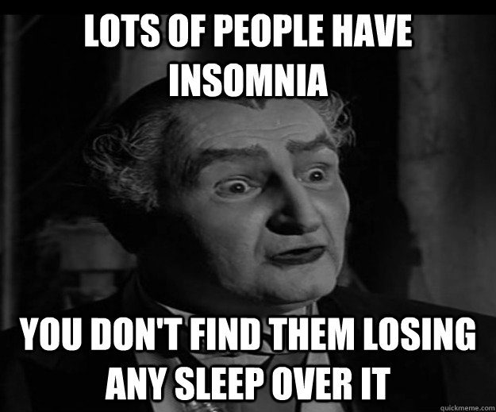
Geriatric Depression Scale
GDS Correlations Significance level
EP .327 .045
Physical Functioning ns
Role limitations due to physical health -.368 .021
Role limitations due to emotional problems -.431 .006
Energy/fatigue -.561 .000
Emotional well-being Social functioning -.515 .001
Pain -.495 .001
General health -.398 .001
Resilience -.506 .003
Exercise per week -.395 .034

Slide 19
Epworth Sleepiness
Geriatric Depression Scale

Slide 20
General Health SF-36
Geriatric Depression Scale

Slide 21
Exercise per Week
Exercise per week Correlations Significance level
EP NS
Physical Functioning .447 .015
Role limitations due to physical health NS
Role limitations due to emotional problems NS
Energy/fatigue .459 .012
Emotional well-being Social functioning NS
Pain .417 .024?
General health NS
Resilience NS
GDS -.395 .034

Slide 22
Geriatric Depression Scale
Exercise per week

Slide 23
What does the data tell us?
That if you exercise you are less depressed according to the Geriatric Depression Scale (GDS)
No one in this group is significantly depressed (based on GDS)!
Neither Age nor gender had a significant impact on your sleep habits.
You do experience some Sleepiness during the day (Groups mean was M =14 average is 10) especially if you scored high on the GDS (Positive correlation)
No Major sleep issues within your group based on Pittsburgh Sleep scale
Mean number hours you sleep as a group is 4.80. Try to add 2 more hours for a healthy sleep cycle!

Slide 24
Descriptive Statistics
 | Mean | Std. Deviation | N
Please indicate your fitness level: | 2.45 | 1.312 | 31
Please indicate your stress level: | 2.55 | 0.995 | 31
Association with CSUS Cardiovascular Wellness Program | 2.06 | 0.512 | 31
What is your age? | 70.69 | 14.026 | 31
Hours of Sleep per Night. During the past month, how many hours of actual sleep did you get at night? (This may be different thatn the numbers of hours you were in bed). | 4.80 | 1.106 | 35

Slide 25
How do Older adults compare to young?
Older Adults Young Adults
Mean SD
Mean SD
GDSsum 3.43 2.00
EPSsum 14.5 5.10
PSQI-Global 10.98 2..79
Physical/Func 66.9512 33.89097
Limitations/PHY 63.4146 40.34909
Limitations/EM 60.9744 43.39911
Energy/Fatigue 39.1463 25.63938
Emotion/WELL 53.7561 28.2425
GeneralHealth 49.0244 26.83793
SocialFC 67.9878 35.02775
Pain 58.5366 29.99
Resilience 55.09 9.07
GDSsum 6.43 4.00
BDI 11.79 8.34
EPSsum 6.43 4.00
PSQI-Global 6.98 2..79
Physical/Func 44.95 14.40 health
Limitations/PHY 64.495 38.80
Limitations/EM 51.84 30.32
Energy/Fatigue 38.97 20.7
Emotion/WELL 51.84 30.32
General Health 46.23 28.17
SocialFC 73.84. 33
Pain 58.54 29.2
Resilience 124.49 38.89

Slide 27
Natural Sleep Aids
Tryptophan and serotonin foods
Calcium (yogurt Milk)
Magnesium (walnuts, cherries, bananas, kiwi, Pistachios)
Essential oils
Melatonin (gummies 2.5mg) St. John’s wort * Ask Doctor before taking anything
Weighted Blankets? (Interesting discussion)

Slide 28
Too many cats1

Slide 29
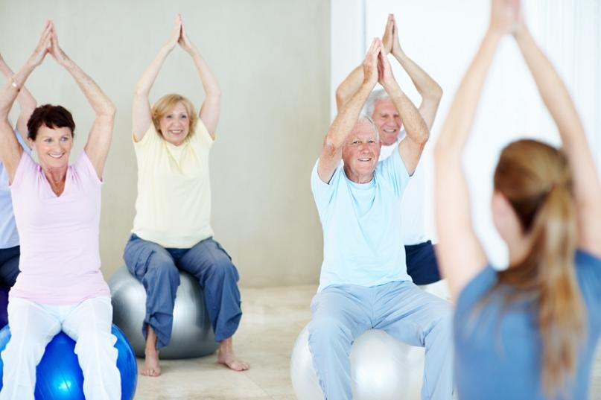
Future Studies
Does balance exercises reduce the participants fear of falling?
What Exercises that work most effectively for balance?
Does the lack of Sleep reduce your balance significantly?
Weighted Blankets and sleep?
This Photo by Unknown Author is licensed under CC BY-NC-ND

Slide 30
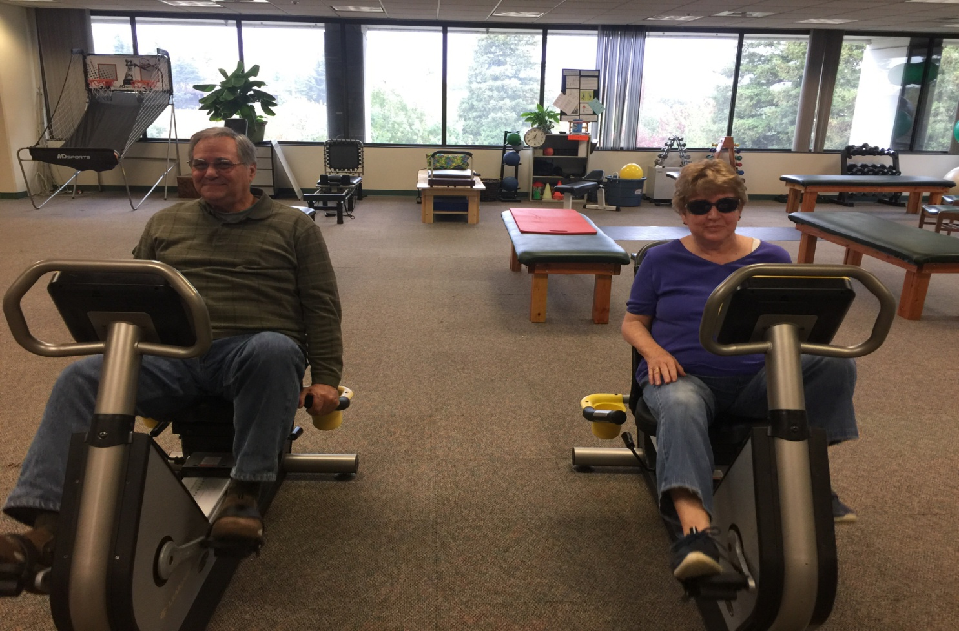
Keep Exercising!
It will help you sleep & improve your memory!
Thank you again for your participation!
You are all amazing!

