Slide 1
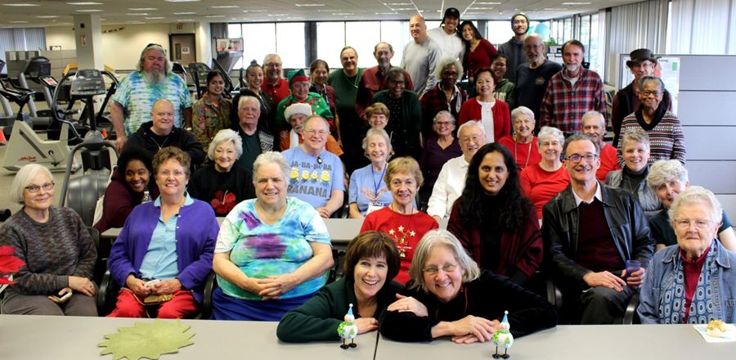
Cardiovascular Wellness Program
Summary of Participation
Program Start: November 2013
Assessment Date: January 2020

Slide 2
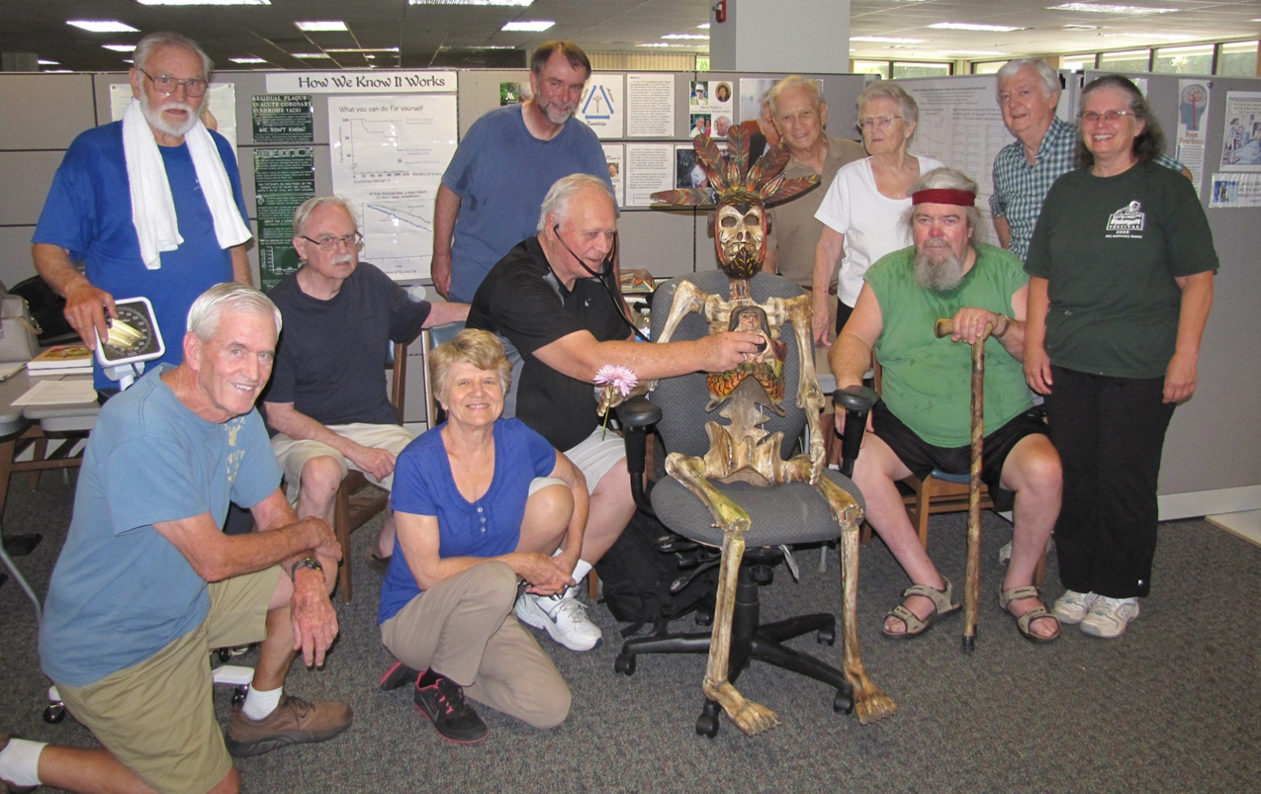
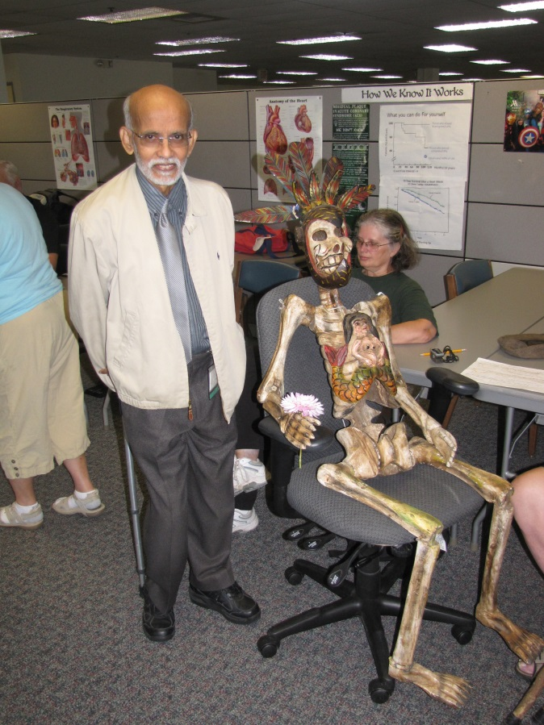

Slide 3
Enrollment Numbers
 | Start of Year | Added | Dropped | End of Year
Start Nov 2013 |  | 8 | 1 | 7
2014 | 7 | 19 | 0 | 26
2015 | 26 | 5 | 2 | 29
2016 | 29 | 18 | 8 | 37
2017 | 37 | 20 | 7 | 50
2018 | 48 | 38 | 12 | 64
2019 | 64 | 24 | 3 | 88
 | TOTALS | 132 | 33

Slide 4
Enrollment Demographics
 | #men | total n | %men |  | Cardiac Rehab Dx | % | Risk Factors | %
2013 | 6 | 8 | 75% |  | 7 | 87% | 1 | 13%
2014 | 15 | 19 | 79% |  | 14 | 74% | 5 | 26%
2015 | 3 | 5 | 60% |  | 3 | 60% | 2 | 40%
2016 | 11 | 18 | 61% |  | 11 | 61% | 7 | 39%
2017 | 8 | 20 | 40% |  | 10 | 50% | 10 | 50%
2018 | 14 | 38 | 37% |  | 12 | 32% | 26 | 68%
2019 | 7 | 24 | 29% |  | 4 | 17% | 20 | 83%

Slide 5
Average Participant Age
 | men | women | range
2013 | 72 | 68 | 60-82
2014 | 75 | 71 | 56-90
2015 | 66 | 76 | 60-77
2016 | 72 | 72 | 54-86
2017 | 69 | 72 | 51-90
2018 | 72 | 75 | 59-90
2019 | 72 | 75 | 58-91

Slide 6
Dr. B Referrals (2015)
Renaissance Society
Here comes Kaiser (2015-2016)
2014 Friends & family
2019
132 enrolled
~80 regular attendees
2013
8 UCDMC cardiac rehab grads
Notre Dame /College Green Neighbors
new referrals (Mercy/Sutter/Kaiser/UCD
Campus Commons Neighbors

Slide 7
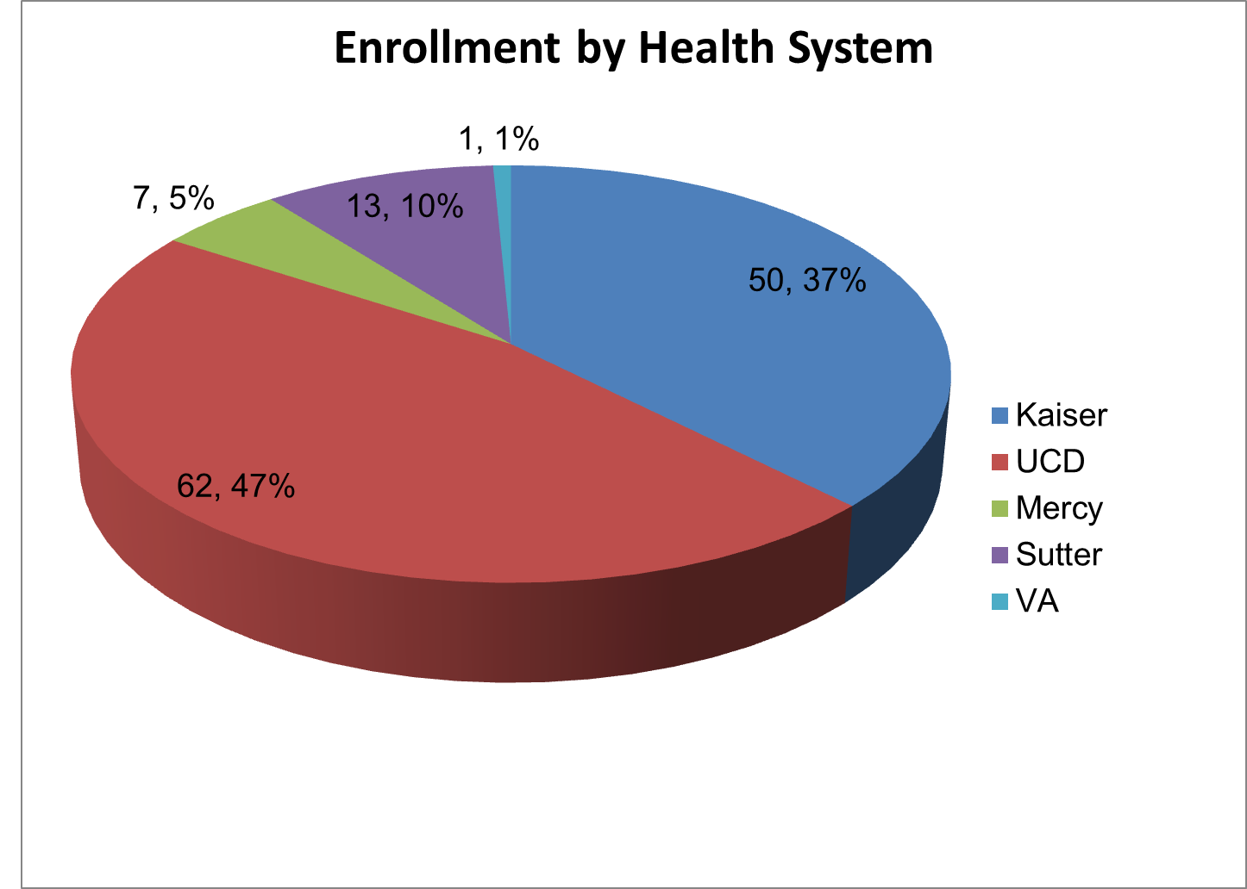

Slide 8
Attendance Data
 |  |  | Average Pre-Exercise Vital Signs
 | # participants | #exercise sessions | #/person | HR (bpm) | BP (mmHg)
2014 | 26 | 1160 | 44 | 70 | 119/65
2015 | 32 | 1882 | 58 | 71 | 121/67
2016 | 45 | 2349 | 52 | 74 | 116/65
2017 | 59 | 2828 | 48 | 75 | 119/67
2018 | 77 | 3338 | 43 | 74 | 124/64
2019 | 92 | 4433 | 48 | 74 | 120/62

Slide 9
# students receiving academic credit = 101

Slide 10
$$$ Finances $$$
Program free to participants
Staffed by volunteers
University provides space/resources pro bono
University provides faculty stipend to program coordinator
Supporting Foundation (“Foundation for Health”) provides equipment, supplies, minor stipend to program assistant

Slide 11
Ongoing Programs
Group exercise
Tai chi thanks to David & students
Cooking classes Friday afternoons
Educational classes Tu/Th/Fr 11:45 am
“Open Hearts” discussion groups once/month
Cardiac Yoga once/month
Outcome assessments – 6 min walk, et al
Student-client interactions

Slide 13
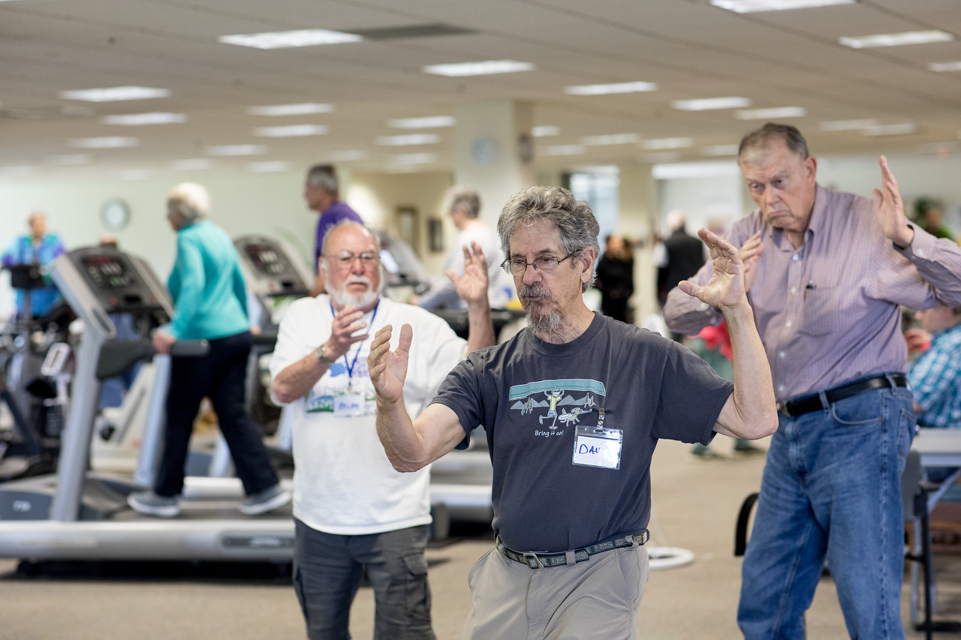

Slide 14
Cheo’s slide show https://ucdavis365-my.sharepoint.com/:v:/g/personal/etvazquez_ucdavis_edu/ETxZ5sZ3pIxIjxaLOpxzMXsBC1xJMY-XLpQAmNy-iu1Jkw?e=lIIc7j

Slide 15
Upcoming Programs
“Prevention Forward” clinic run by Dr. López
Extra medical education
New psychology education – including stress management lectures, offered by Dr. Yiaslas
Fall Prevention/Awareness classes, research project run by Dr. Kim Roberts – will include balance testing & training twice/week
Kinesiology project – assisted rowing with people with Parkinsons (Dr. Matt Brown)
Summertime high school student training program
Quarterly stakeholders meetings
What else do you want???

