Slide 1
Risk Factors for
Atrial Fibrillation
Radhika Nandur Bukkapatnam
July 10, 2020

Slide 2
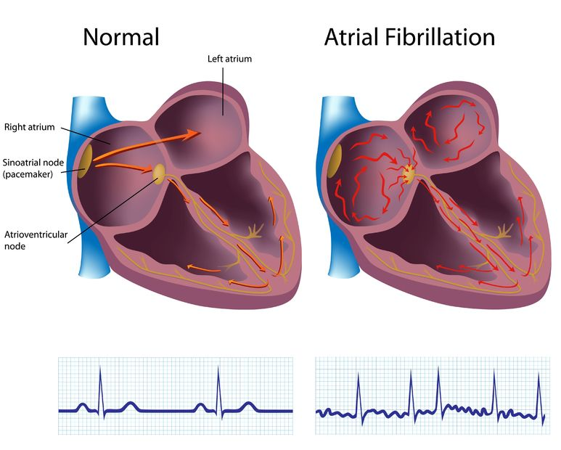



Slide 3
History
The legendary emperor physician is believed to have ruled China between 1696 and 2598 BC
William Harvey in 1628 was probably the first to describe “fibrillation of the auricles” in animals.
In clinical practice and with the aid of Laennec's recently invented stethoscope, Robert Adams reported in 1827 the association of irregular pulses with mitral stenosis.
The discovery of the therapeutic properties of digitalis leaf (Digitalis purpurea) in 1785 by William Withering brought some relief to patients with severe heart failure

Slide 4
Atrial Fibrillation: Clinical Significance
Most common sustained arrhythmia
Important cause of stroke
– 20% attributable risk in elderly
Significant morbidity from symptoms
– Palpitations, malaise, loss of exercise tolerance, reduced QOL
Tachymyopathy may result in CHF
Associated with increased mortality (1.2 -2x)

Slide 5
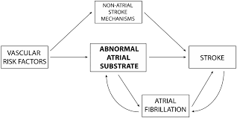
How Atrial Fibrillation Causes Stroke

Slide 6
Causes of Atrial Fibrillation
Family history
Congenital Heart Disease: Abnormal or damaged structure of the heart either at birth or during the life time
Sick Sinus Syndrome: Improper functioning of the heart's natural pacemaker, the sinus node
High blood pressure
Congestive Heart Failure
Coronary heart disease or disease of blood vessels of the heart
Abnormal heart valves
Metabolic disorders such as overactive thyroid gland, diabetes

Slide 7
Causes of Atrial Fibrillation (contd)
Exposure to stimulants including certain medications and tobacco
Previous heart surgeries
Stress
Sleep apnea or sleep disorders
Lung and kidney diseases
Viral infections
Obesity
Alcohol consumption

Slide 8
Classification of Atrial Fibrillation
Permanent (decision not to convert)
AF first detected
Persistent (continuous and > 7 days)
Paroxysmal (< 7 days)
Longstanding Persistent
Nonvalvular AF: “AF in the absence of rheumatic mitral stenosis, a mechanical or bioprosthetic heart valve, or mitral valve repair”

Slide 10
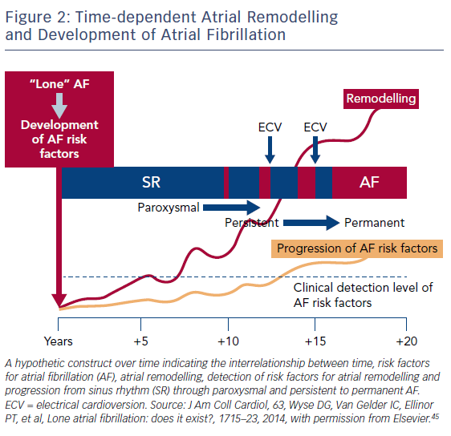

Slide 11
Goals of Clinical Management
Reduce risk of Stroke and Thromboembolism
Preserve heart function
Minimize symptoms
Maximize quality of life
Prevent recurrence or progression to permanent AF

Slide 12
Prevention of Atrial Fibrillation
Cardiac risk factor reduction
– Treat hypertension, diabetes, dyslipidemia
– Smoking cessation, moderation of alcohol
Identify and treat hyperthyroidism (1%)
Proper pacemaker programming
– Avoid unnecessary RV pacing
? ACE-I / ARBs / lipid-lowering agents – Several recent negative randomized trials
Identify and treat sleep apnea
Weight loss

Slide 13
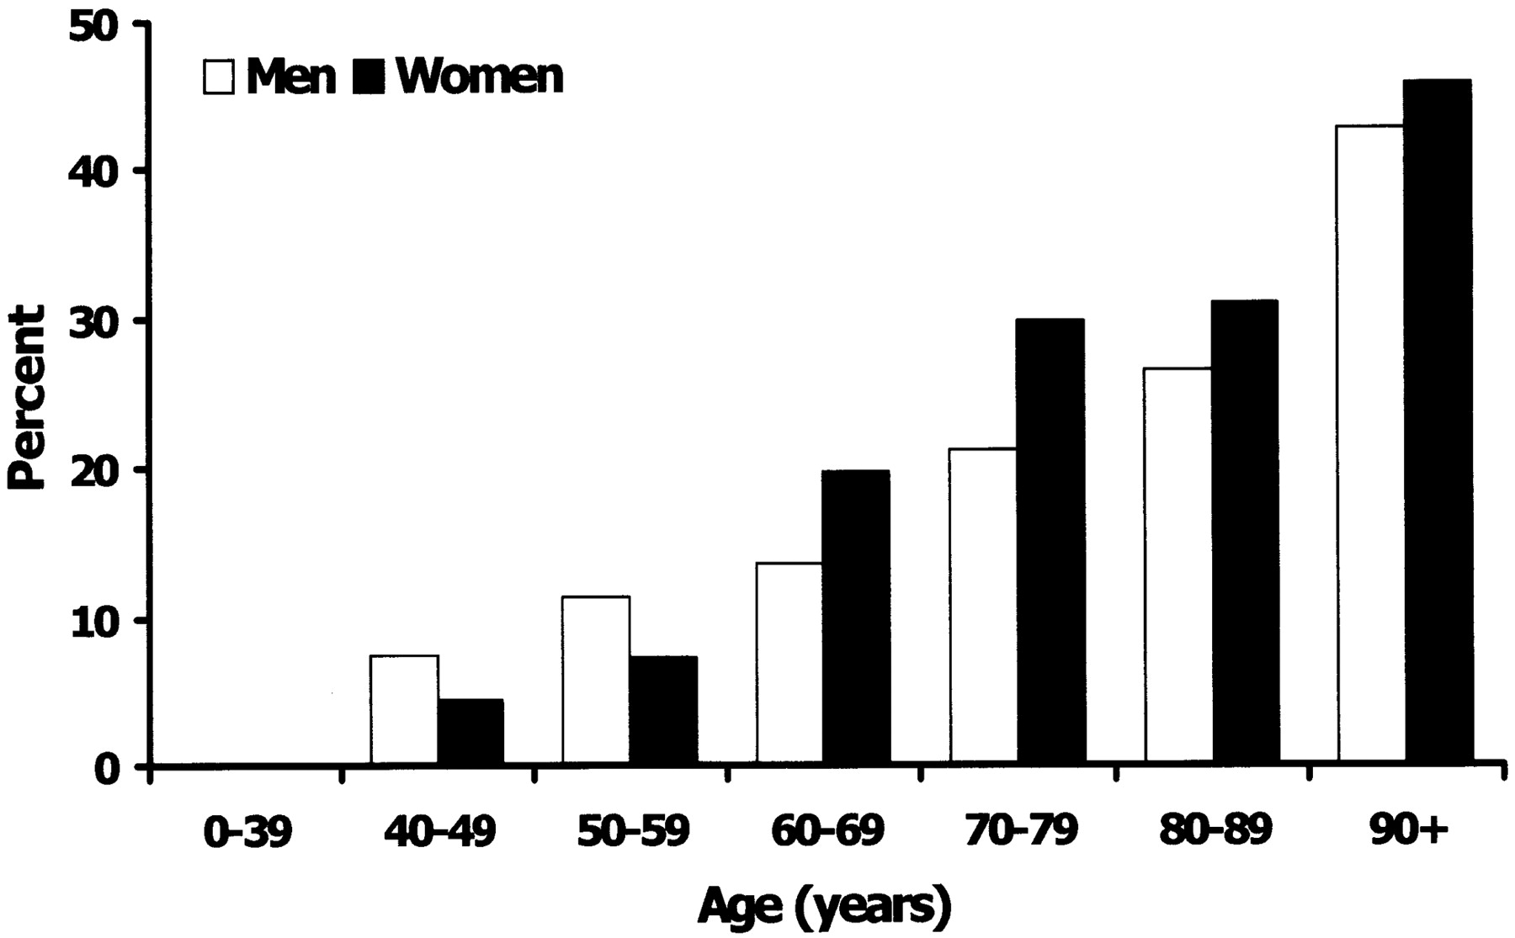
Prevalence of Atrial Fibrillation with Age
ATRIA: Cross-sectional study 1.9 M Kaiser members in CA1996-97 -About 18,000 (1%) AF
Nearly exponential increase with age – 10% prevalence over age 80 yrs
Prevalence in USA: 2.5 -5.0 million – Expected to double by 2040
Notes:
Prevalence of AF classified by age and sex. The prevalence of AF increased with aging, which was significant in very elderly people. A higher prevalence was seen among women, especially in more elderly individuals aged > 70 y. *P for trend < .001. See Figure 1 legend for expansion of abbreviation.

Slide 14
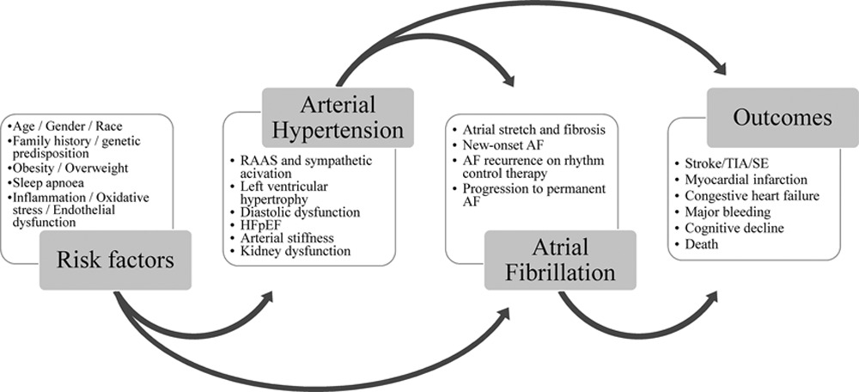
Mechanism of Hypertension

Slide 15
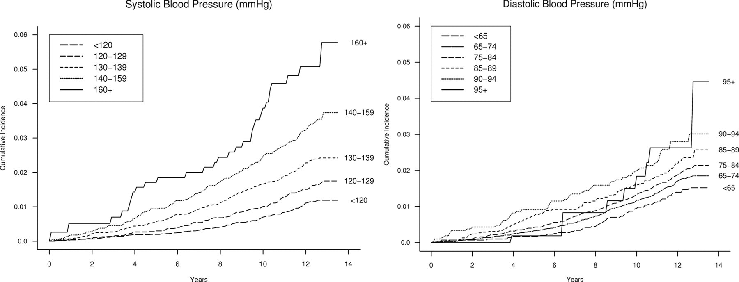
Effect of Systolic and Diastolic BP on Atrial Fibrillation

Slide 16
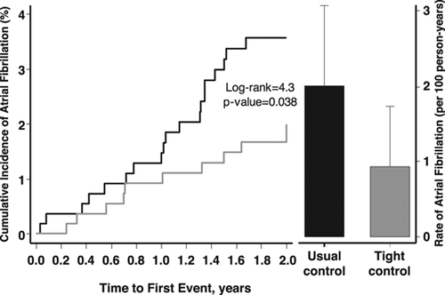
A fib: Usual Control vs Tight Control

Slide 17
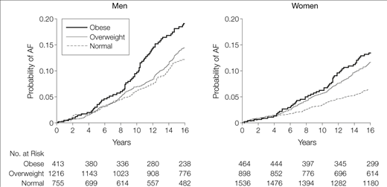
Incidence of Atrial Fibrillation with Weight

Slide 18
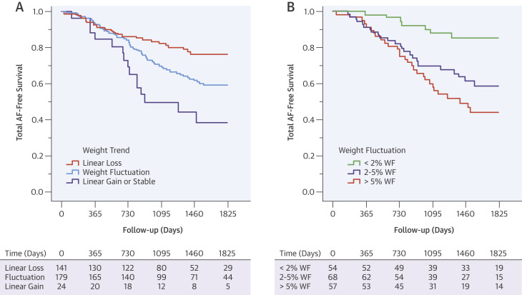
Weight loss and Recurrent Atrial Fibrillation
Sustained weight loss, particularly with avoidance of weight fluctuation, is associated with a dose-dependent reduction in AF burden and maintenance of sinus rhythm.
This occurs in conjunction with favorable changes in the cardiometabolic risk factor profile, inflammatory state, and cardiac remodeling.

Slide 19
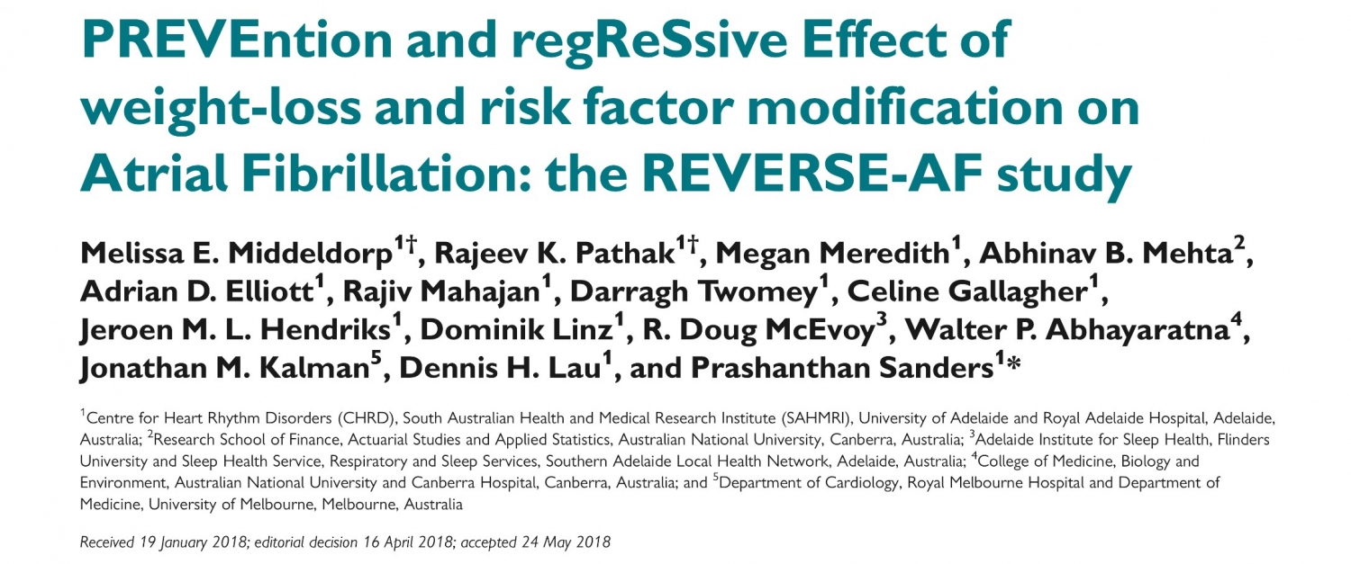
Notes:
Increased weight loss was significantly associated with greater AF freedom: 45 (39%) in Group 1, 69 (67%) in Group 2, and 116 (86%) in Group 3 (P ≤ 0.001). Conclusion Obesity is associated with progression of the AF disease. This study demonstrates the dynamic relationship between weight/risk factors and AF. Weight-loss management and RFM reverses the type and natural progression of AF.

Slide 20
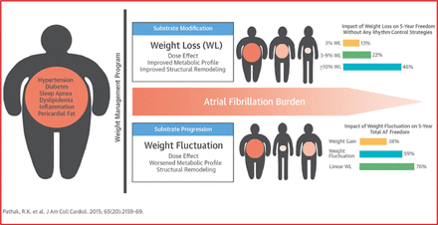
Effect of Weight Fluctuation on A fib

Slide 21
Mechanism of A fib with sedentary lifestyle
Sedentary lifestyle is known to increase risk of AF RFs, including hypertension, obesity, and diabetes mellitus.
Obstructive sleep apnea (OSA) is common in obese individuals and has been associated with sedentary lifestyle.
These conditions have been shown to independently induce structural and electric remodeling of the atrium.
Physical inactivity also increases systemic inflammation, which may induce atrial remodeling and has been associated with AF.
Finally, sedentary lifestyle is associated with autonomic dysfunction and elevated sympathetic tone, which enhances afterdepolarization triggering and AF susceptibility.

Slide 22
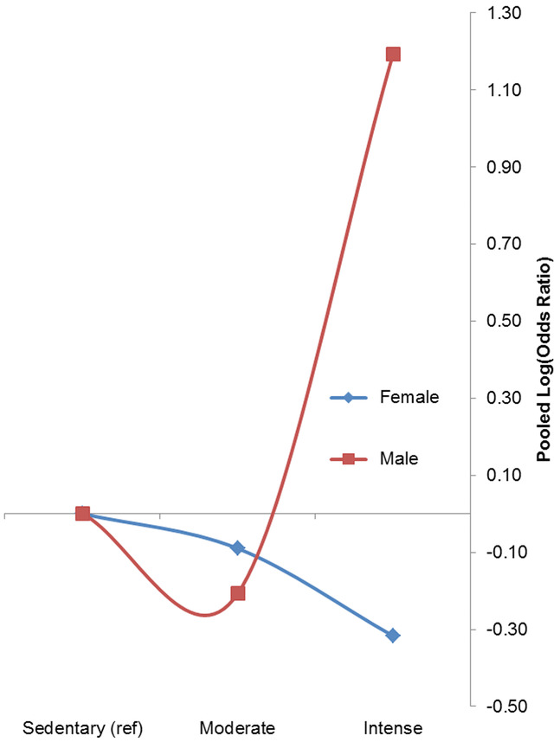
Association between Level of Physical Activity and risk of AF in Men and Women
Different response in men and women
In women, there is decrease in incidence of A fib as exercise intensity increases
In men, there is improvement of risk for A fib, which worsens as duration of intense exercise increases

Slide 23
Diabetes and Risk of A fib
The FHS showed that men and women with diabetes mellitus had a 40% and 60% increased risk of AF, respectively.
A causal association is supported by evidence that worse glycemic control and longer duration of diabetes mellitus are associated with increased AF risk
The estimated risk of AF increases by 3% per additional year of diabetes mellitus.
The risk of AF in patients with diabetes mellitus for >10 years was 64% but only 7% in those with diabetes mellitus ≤5 years

Slide 24
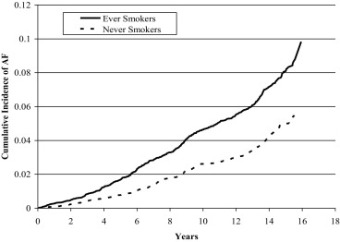
Smoking and Risk of Atrial Fibrillation
Smoking is thought to increase AF susceptibility through indirect and direct mechanisms.
  Ischemia
  endothelial dysfunction
  Oxidative stress
  Inflammation, and
  thrombosis.
  CHF
  Reduced lung function and chronic obstructive pulmonary disease also increase vulnerability to AF
Smoking and nicotine also have been shown to directly contribute to the AF substrate
Notes:
former and current smokers exhibited a 32% and 105% increased risk of developing AF compared to never smokers.

Slide 25
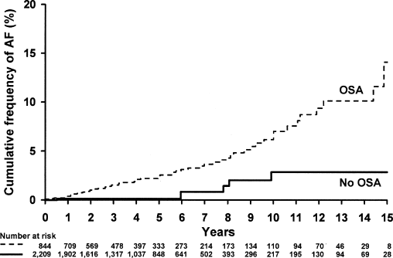
Obstructive Sleep Apnea and Atrial Fibrillation
Sympathetic activity induced by hypoxia
Transient blood pressure rises.
Vigorous inspiratory efforts during apnea accentuate the fluctuation of intrathoracic pressure increasing left atrial volume (stretch) and pressure.
Oxidative stress signaling and systemic inflammatory mediators may promote atrial remodeling
Notes:
AF associated with OSA tends to be refractory to cardioversion and catheter ablation particularly in patients with untreated OSA, highlighting the expansive atrial remodeling associated with OSA
The Sleep Heart Health Study found a 4-fold increase in the prevalence of AF with OSA,

Slide 26
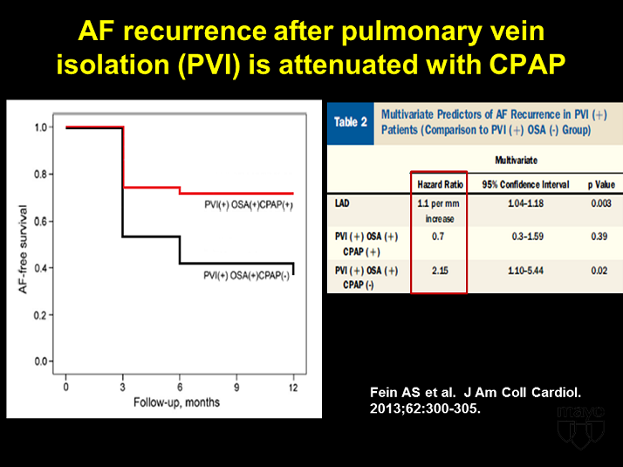

Slide 27
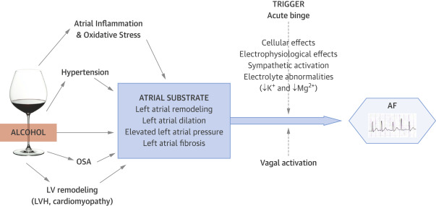
Mechanism of Alcohol causing AF

Slide 28
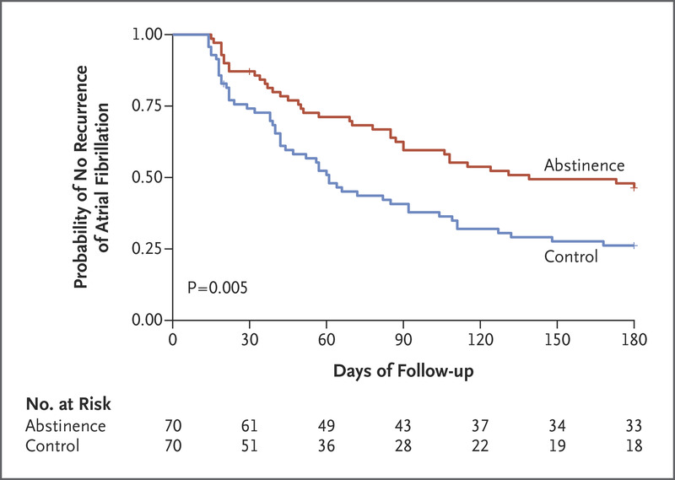
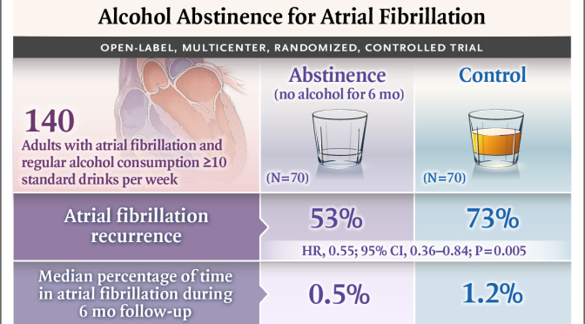
Alcohol and Atrial Fibrillation

Slide 29
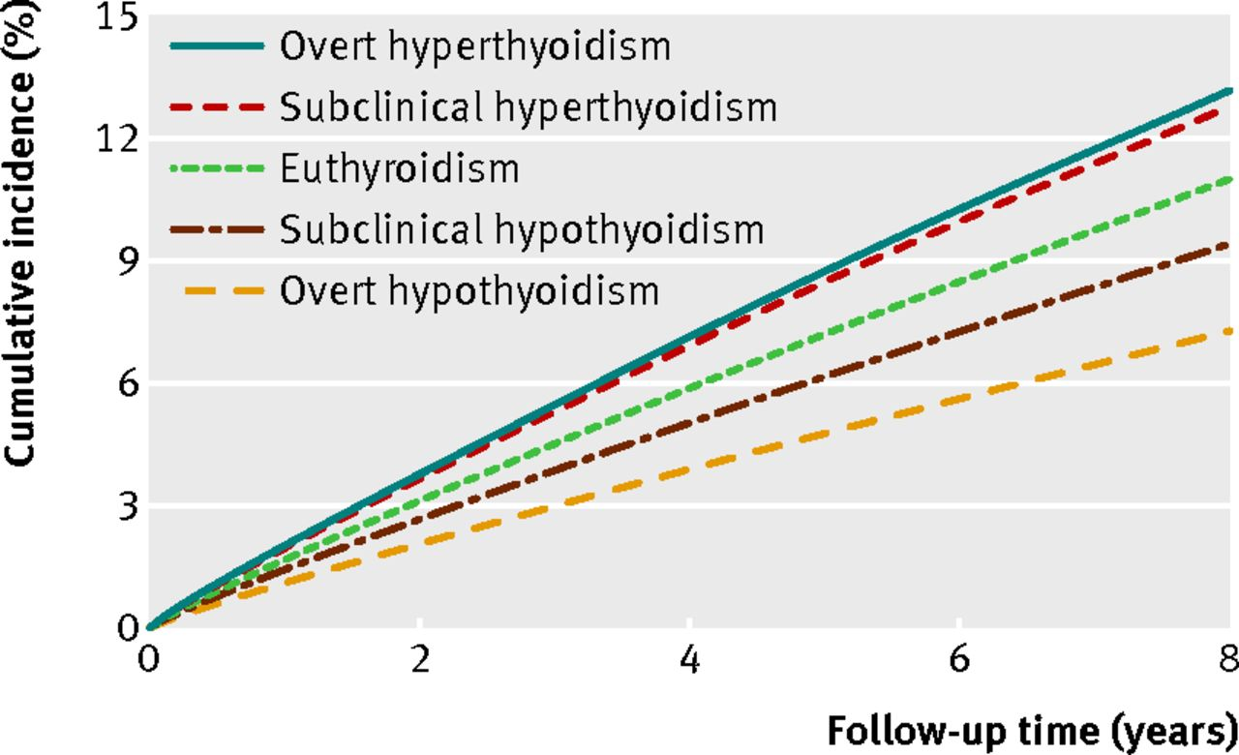
Thyroid Disease and AF

Slide 30

Let us take a Coffee Break

Slide 31
HRS 2020: Frequent Coffee Consumption is Associated With Lower Incidence of Arrhythmias
Antioxidants,
Improved metabolism
Enhanced exercise performance
Increased alertness and concentration.
Studies have also shown regular coffee consumption can also yield positive heart health results, lowering the risk of heart disease and stroke.
With evidence showing caffeine’s positive impact on general heart health, there is a need to better understand the relationship between regular coffee consumption and arrhythmias.

Slide 32


Slide 33
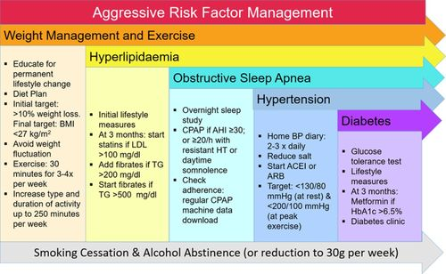

Slide 34
Thank You

