Slide 1
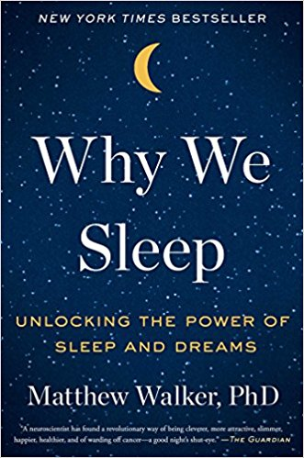
Sleep: Is important to your health!
https://abcnews.go.com/GMA/video/sleep-deprivation-effects-body-34909695
Matthew Walker Sleep Researcher

Slide 2
Week 1 : Stages of sleep 1, 2 3 &4 then 90 min REM
Week 2: Do dreams have meaning REM sleep?
Week 3: Did you dream? Keep dream diary to share
Week 4: Understanding your sleep habits & sleep disorders
Week 5: Identifying sleep thieves
a few tips for dealing with sleep thieves like caffeine and alcohol, computer screen, lights
.
Week 6: “Managing stress”
create a sleep friendly bedroom that helps them to de- stress.
Week 7: “What if I still can’t sleep?” Are sleeping pills safe?

Slide 3

Week 8 : What did you learn about sleep?
Week 9: Matthew Walker revisits
Week 10: Jeopardy
Fill out questionnaires online!
Thank you for participating!
This Photo by Unknown Author is licensed under CC BY-SA-NC

Slide 4
Alter State of Consciousness
What are Circadian Rhythms?
Sleep
  Why do we need to sleep?
  Are you a night owl or early bird?
  Sleep disorders
    Genetics & Stress

Slide 5
Circadian Rhythms
Changes in energy level, mood, & efficiency through the day
Controlled by the hypothalamus
In the absence of outside cues, people fall into a 25 hour rhythm
Outside cues draw us into a 24 hr. rhythm
Jet Lag: Results from changing time zones too quickly for the circadian rhythms to change

Slide 6
Temperature Rhythm

Slide 7
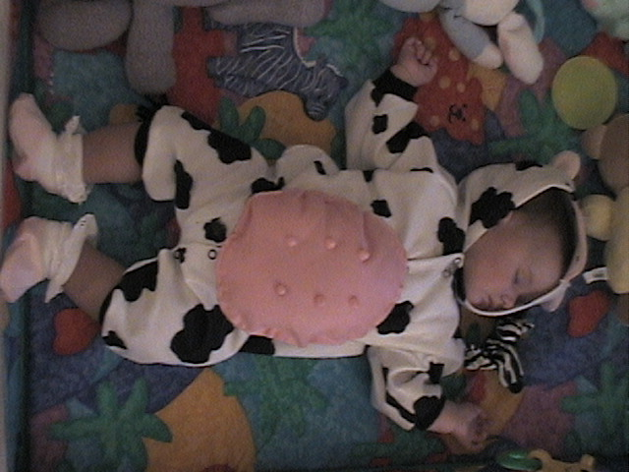

Slide 8
Alertness Rhythm
Alertness
Time of Day
Draw a chart indicating when you are most alert in am to pm & complete questionnaire! Are you a night or morning owl?

Slide 9
Night owl or Early bird
What time would you get up if you were entirely free to plan your own day?
A. 5 to 6:30 a.m. (5 points)
B. 6:30 to 7:45 a.m. (4 points)
C. 7:45 to 9:45 a.m. (3 points)
D. 9:45 to 11 a.m. (2 points)
E. 11 a.m. to noon (1 point)

Slide 10
How dependent are you on being woken up by an alarm clock?
A. Not at all (4 points)
B. Slightly dependent (3 points)
C. Fairly dependent (2 points)
D. Very dependent (1 point)
How easy do you find getting up in the mornings?
A. Not at all (1 point)
B. Not very easy (2 points)
C. Fairly easy (3 points)
D. Very easy (4 points)

Slide 11
How alert do you feel during the first half-hour after having woken in the morning?
A. Very poor (1 point)
B. Fairly poor (2 points)
C. Fairly good (3 points)
D. Very good (4 points)
How is your appetite during the first half-hour after having woken in the morning?
A. Very poor (1 point)
B. Fairly poor (2 points)
C. Fairly good (3 points)
D. Very good (4 points)

Slide 12
During the first half-hour after having woken in the morning, how tired do you feel?
A. Very tired (1 point)
B. Fairly tired (2 points)
C. Fairly refreshed (3 points)
D. Very refreshed (4 points)
How is your appetite during the first half-hour after having woken in the morning?
A. Very poor (1 point)
B. Fairly poor (2 points)
C. Fairly good (3 points)
D. Very good (4 points)

Slide 13
Your scores!
Score 6-10 Night owl
Score 11-16 Mid-day
Score 17-28 Morning owl

Slide 14
Characteristics of Waking and Sleep Cycles
Stage 1 sleep – Light sleep that occurs just after dozing off, characterized by brain waves called theta waves
Stage 2 sleep – Typically follows stage 1 sleep, characterized by brief bursts of brain activity called sleep spindles as well as K-complex responses to stimuli such as noises
Stage 3 sleep – Typically follows stage 2 sleep, characterized by an EEG tracing 20 to 50% of which consists of delta waves—virtually no eye movements during stage 3 sleep
Stage 4 sleep – Deepest level of sleep, characterized by an EEG tracing exceeding 50% delta waves and virtually no eye movements

Slide 15
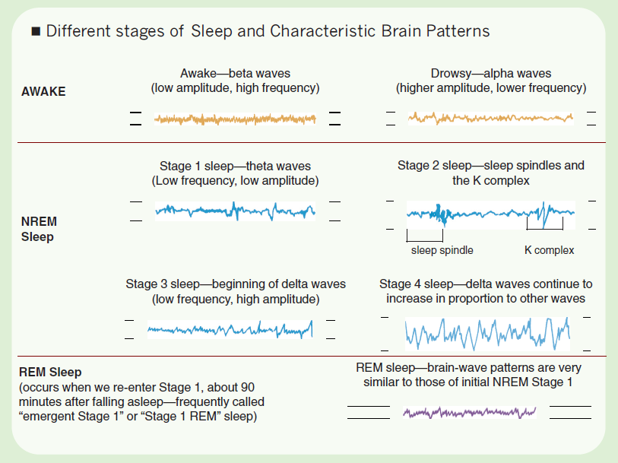

Slide 16
Sleep
4 successive stages of non-REM sleep plus REM sleep
Each has a distinctive EEG

Slide 17



Stage 1
Very light sleep
Alpha waves are replaced with random activity
Hypnogogic images may appear
Alert:
Relaxed:
Stage 1:

Slide 18

Stage 2
Sleep is deeper.
Stage 2:
Spindles appear in EEG

Slide 19

Stage 3
Sleep is deeper yet.
Stage 3:
Spindles disappear, delta waves appear

Slide 20

Stage 4
Very deep sleep
Stage 4:
Continuous delta waves
Children produce growth hormone primarily in stages 3 & 4

Slide 21
REM Sleep
Rapid eye movements take place here
EEG resembles waking pattern
Signals from the motor cortex to the body are blocked
Dreaming occurs

Slide 22
Sleep Cycles
For the first two cycles, people progress down to stage 4, remain there awhile, then return to stage 2 & enter REM
In later cycles:
  Stage 4 seldom occurs
  Amount of REM steadily increases
  Most get 1 1/2 hours of REM & Stage 4 per night

Slide 23
Sleep Cycles
Awake
Stage 1
Stage 2
Stage 3
Stage 4
1
2
3
4
5
6
7
8
Hour of sleep

Slide 24
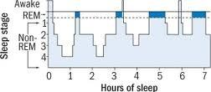

Slide 25
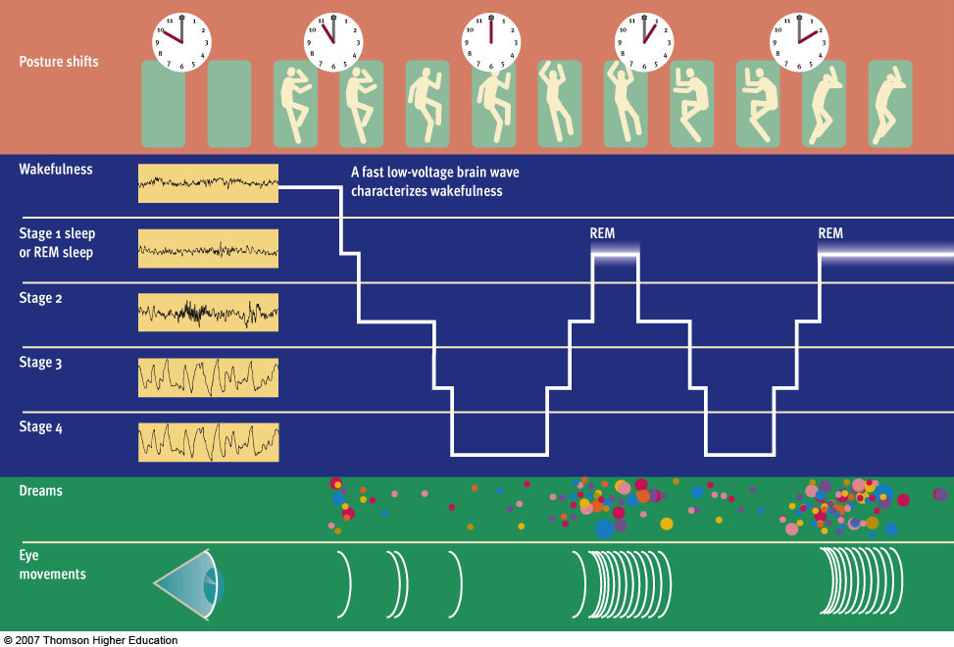
Figure 5.3 An overview of the cycle of sleep

Slide 26
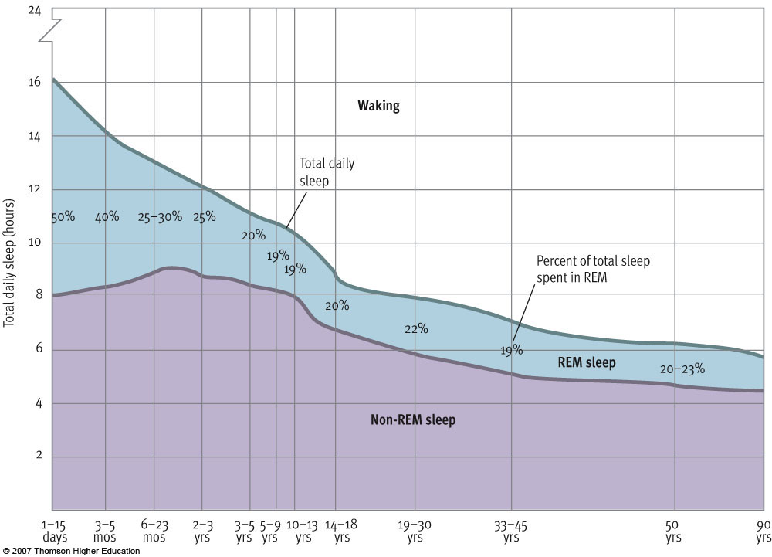
Figure 5.4 Changes in sleep patterns over the life span

Slide 27
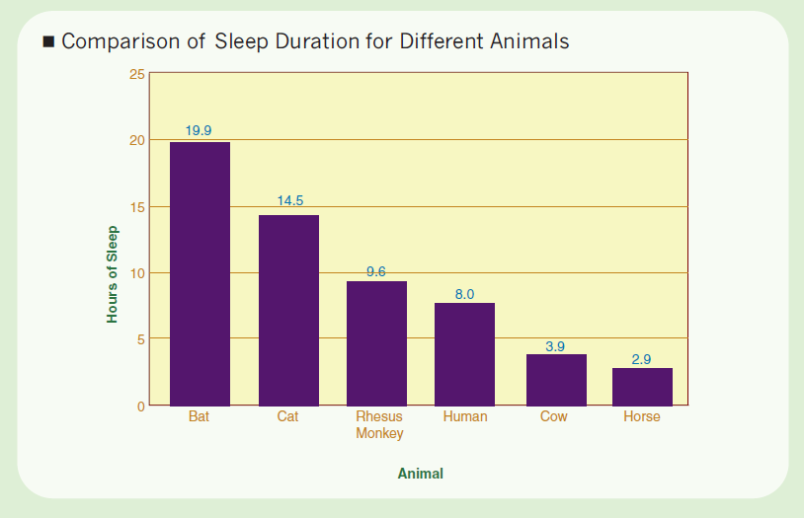

Slide 28
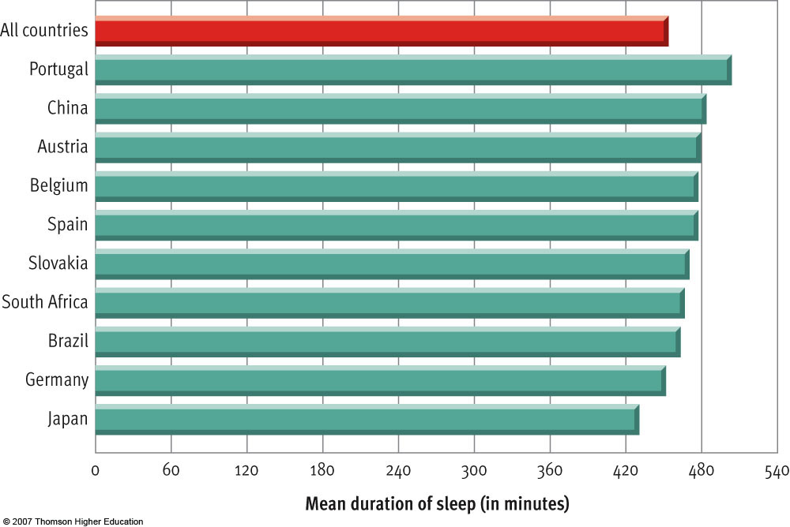
Figure 5.5 Cultural variations in how long people tend to sleep

Slide 29
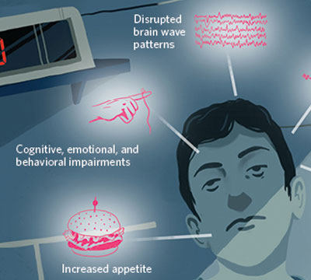
Sleep & your Health
“In the studies we’ve done, almost every variable we measured was affected. There’s not a system in the body that’s not affected by sleep,” says University of Chicago sleep researcher Eve Van Cauter.

Slide 30

Mathew Walker PhD

Slide 31
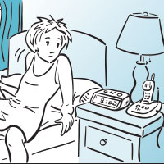
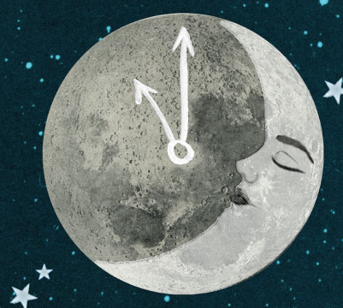
Relationship Problems? Try Getting More Sleep

Slide 32
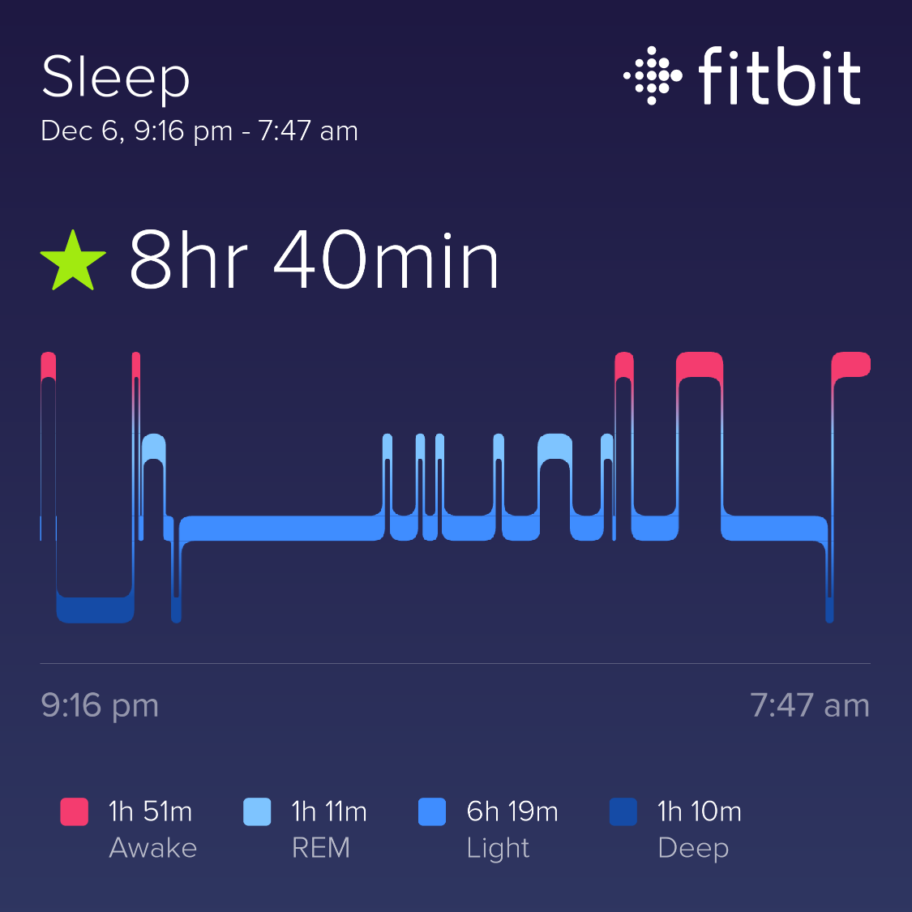

Slide 33
Sleep Deprivation
Poor memories
Gain weight
Increase stress hormone cortisol
Depression
Deprived 11 days may cause death ☹

Slide 34
REM Sleep
Functions of REM:
  Memory Consolidation
  Clearing of unnecessary memories
Story-like dreams occur in REM sleep; dreams appear to unfold in real time
Everyone dreams, even if they don't recall doing so; we tend to remember only the dreams that occur just before waking

Slide 35
What Happens if we are deprived of REM?
Poor memory & performance
Increases stress hormone Cortisol
REM Rebound- have more dreams
Microsleeps
Drugs that block REM
Alcohol, Valium & sleeping pills

Slide 36
REM & Dreaming
80% recall dreams following REM
7% recall during other stages
Dream in real time
External stimuli influences dreams

Slide 37
Dream Content
Usually of common events
Reoccurring Dream- Unresolved problem
Lucid Dreams- Vivid dreams

Slide 38
Dream Meaning
Freud: Dreams reflect the unconscious
Manifest content: Events in the dream
Latent Content: Unconscious Wishes

Slide 39
More Recent Theories of Dreams
Information Processing
Crick: Erase unimportant information to free space
•Activation Synthesis Hypothesis
Hobson’s Theory- Random Neural
Firing- Pons-Geniculilate-Occipital lobe

Slide 40
REM Facilitates Memory
Consolidate learned Information
NO REM poor memory
•Theta Rhythms
During REM Stimulate the Hippocampus

Slide 41
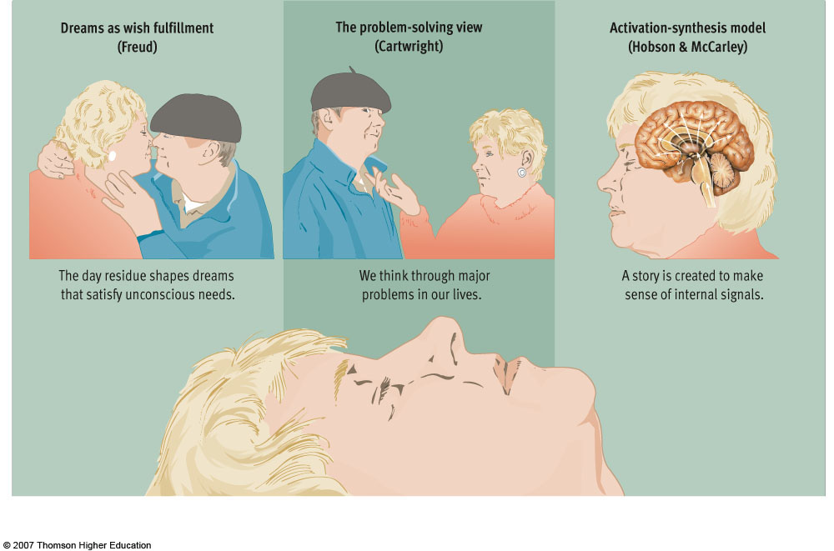
Figure 5.8 Three theories of dreaming
Notes:
Why do we dream? Sigmund Freud proposed that dreams are a form of wish fulfillment. According to this theory, dreams express wishes that people are too anxious to be aware of when they are awake. Rosalind Cartwright, among others, proposes that dreams are a form of problem solving in which the constraints of waking consciousness are relaxed and people are better able to imagine solutions. Hobson and McCarley propose another theory, in which the lower parts of the brain send random neural signals to the cerebral cortex, which in turn tries to turn these random signals into some kind of story.

Slide 42


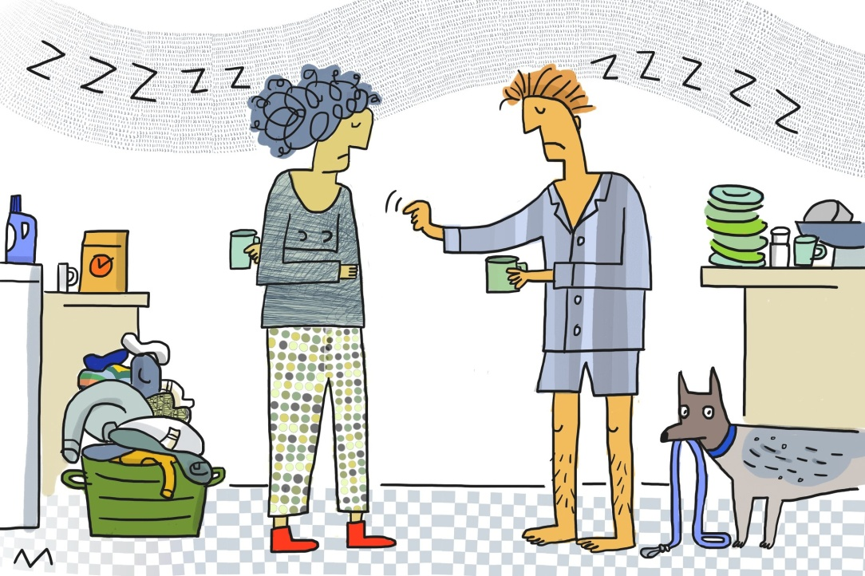
Sleep Problems

Slide 43
Sleep Disturbances
Sleep Walking
Occurs in Stage 4 sleep
Person is not conscious
It is not dangerous to awaken a sleepwalker
Strong genetic component
http://www.funnyordie.com/videos/3e024b10db/bizket-the-sleepwalking-dog

Slide 44
Sleep Disturbances
Nightmares
Vivid, disturbing dreams that occur in REM sleep
More frequent when people are under emotional stress

Slide 45
Sleep Disturbances
Sleep Talking
Common, esp. among children
The talker often makes no sense, but sometimes speaks or even shouts intelligible phrases

Slide 46
Sleep Disturbances
Narcolepsy
Involves brain abnormality
Person may suddenly fall into REM sleep without warning
Cataplexy- Loss of muscle tone
Treatment- Amphetamines

Slide 47
Cause of Narcolepsy (cont)
Dogs!
http://www.metacafe.com/watch/yt-LbmbQkX7czo/skeeter_the_narcoleptic_poodle/
Siegel and colleagues found considerable damage to the basal forebrain and the amygdala
Basal forebrain: group of structures in the brain that is associated with learning, and when stimulated gives rise to sleep.
http://www.youtube.com/watch?v=wN1_yS6_5T4
Dog-sheep below
http://www.youtube.com/watch?v=we9_CdNPuJg&list=RD02wN1_yS6_5T4

Slide 48
Sleep Disturbances
Sleep Apnea sleep apnea video
A dangerous condition where the person stops breathing while asleep
Treated with devices that keep airways open
http://www.youtube.com/watch?v=mtPwbi_SeWA

Slide 49
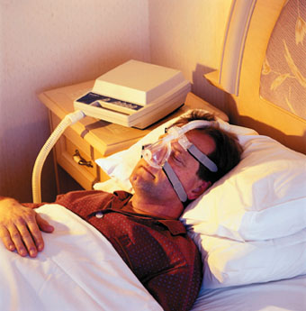
Treatment for Sleep apnea
Change Diet
Or Surgery!

Slide 50
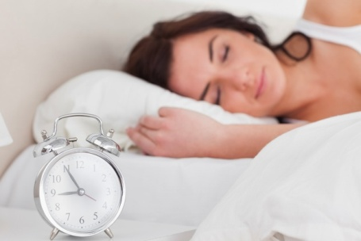
Sleep Disturbances- most common
Insomnia
Impairment in functioning due to inability to sleep
One major cause is worry about having insomnia
Treatment Ambien or over the counter pills

Slide 51
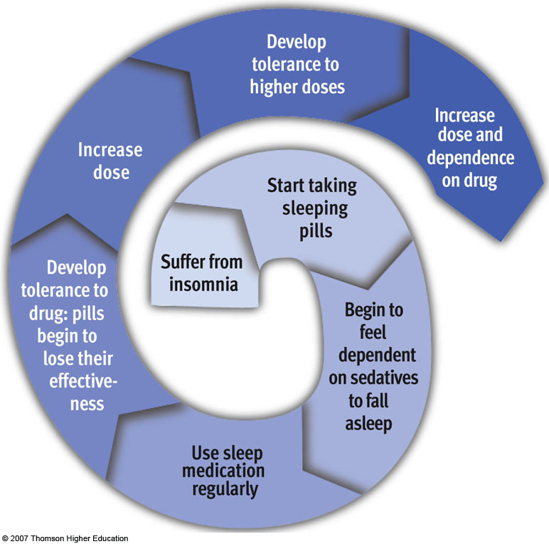
Figure 5.6 The vicious cycle of dependence on sleeping pills

Slide 52
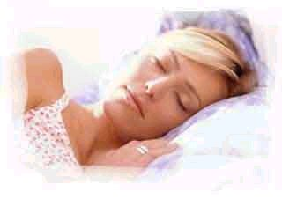
Kleine-Levin Syndrome
Sleep for Days
When a wake, patient appears to be in a trancelike state
•More common in Young Females

Slide 53
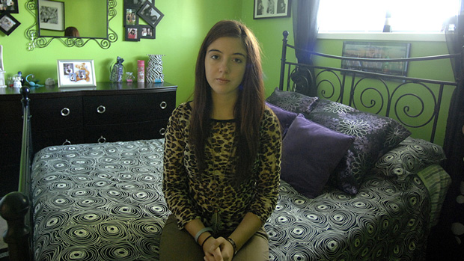
'Sleeping Beauty' syndrome
Teen with sleeps for days
Kaitlyn Terrana diagnosed with mysterious Kleine-Levin syndrome
Posted: Oct 8, 2012 5:19 PM ET
http://www.youtube.com/watch?v=i3RJos0Ax_o

Slide 54
Fatal Familial Insomnia
Genetic component but rare found in 50 200,000 families dominant allele
Onset occurs in their 40’s or 50’s
Their children have a 50% of developing it
Video fatal Familial insomnia (genetic)
http://www.youtube.com/watch?v=IJzZcFoT-1A
https://www.youtube.com/watch?v=IJzZcFoT-1A

Slide 55
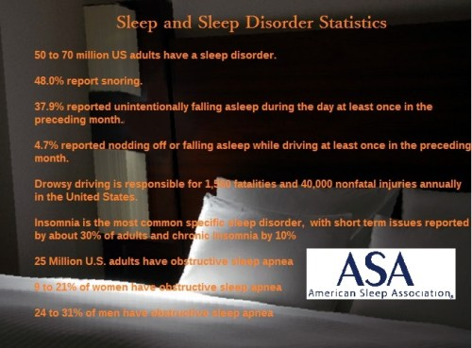

Slide 56
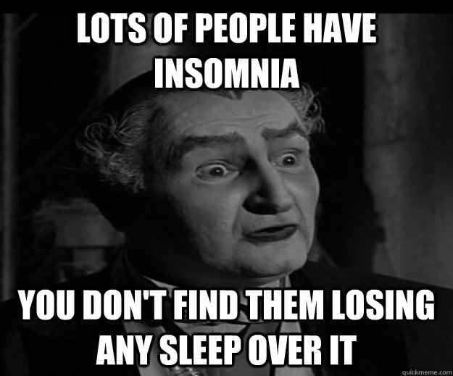
Insomnia is the most common specific sleep disorder,
Short term issues reported by about
30% of adults and
  Chronic insomnia by 10%

Slide 57
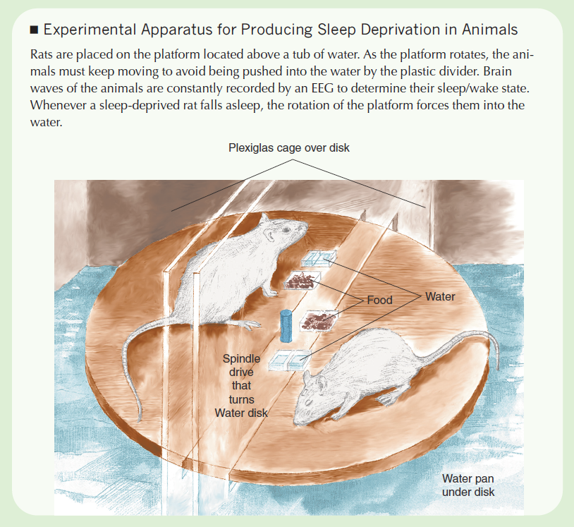

Slide 58
Sleep Apnea
25 Million U.S. adults have obstructive
sleep apnea
9-21% of women have obstructive sleep apnea
24-31% of men have obstructive sleep apnea

Slide 59
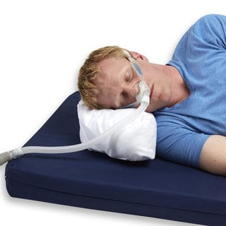
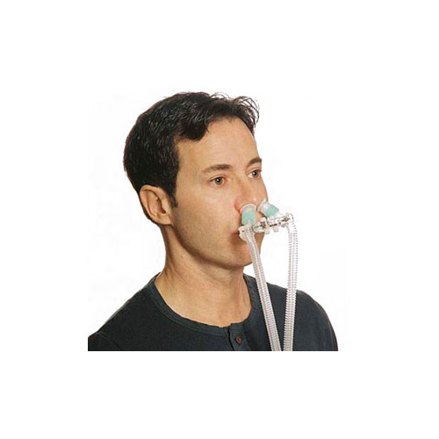
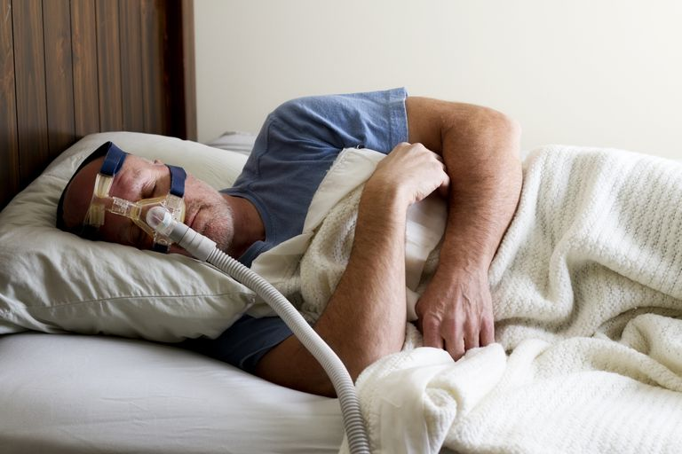
Treatment
Continuous Positive Airway Pressure (CPAP) is the leading therapy for sleep apnea
https://www.youtube.com/watch?v=GzrJCqHCx8U (3min good)
https://www.youtube.com/watch?v=QL-lBcQuYAg
Examples

Slide 60
Sleep Deprivation Statistics:
37% of 20-39 year-olds report short sleep duration
40% of 40-59 year-olds report short sleep duration
35.3% adults report <7 hours of sleep during a typical 24-hour period.
100,000 deaths occur each year in US hospitals due to medical errors and sleep deprivation

Slide 61
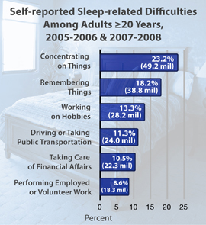

Slide 62
Circadian Rhythm Sleep-Wake Disorders
A patient with one of these disorders does not follow the normal sleep times at night.
follow the normal sleep times at night.
Delayed Sleep-Wake stays up later & wakes up later
Advanced Sleep-Wake wake up hours earlier than most people 3 or 4 am
Shift work
Jet lag

Slide 63
Amount of sleep you need!
Adult: 7 – 9 hours
Teenager: 8 – 10 hours
Child 6 – 12 years: 9- 12 hours
Child 3 – 5 years: 10 – 13 hours (including naps)
Child 1 – 2 years: 11 – 14 hours (including naps)
Infants 4 -12 months: 12 – 16 hours (including naps)

Slide 64
Healthy Sleep Habits
Go to bed at the same time every night!
Do not drink caffeine after 3 pm!
Do not drink excessive alcohol (reduces REM)
Do not take sleeping pills if possible!
If you cannot fall asleep within 1.5 hours leave your bedroom & read until you can fall asleep
Try NOT to exercise too late it may increase your heart rate!!!!

Slide 65

Do not stress before you sleep!
Don’t think about work in bed!
Don’t worry about issues you cannot control!
Recycled thoughts need to be stopped! Yes, distract yourself by thinking of something positive!

Slide 66
Matthew Walker
Why we sleep?
https://www.youtube.com/watch?v=_d583swchPA
14 min Ted talks
https://www.youtube.com/watch?v=KpyoDML2eUI
(5min) news good

Slide 67
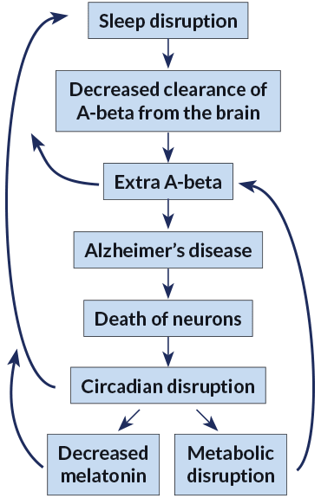
The brain may clean out Alzheimer’s plaques during sleep
Vol. 194, No. 2, July 21, 2018, p. 22

Slide 68
New Evidence Mice & Humans
To Holtzman’s surprise, time of day mattered — a lot. A-beta levels were highest when the animals were awake but fell when the mice were sleeping (SN: 10/24/09, p. 11).

Slide 69
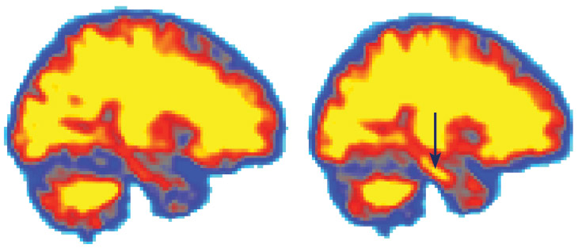
HARD DAY'S NIGHT Scientists measured accumulation of amyloid-beta
in people who were rested (left)
and then again after 31 hours without sleep (right).
In this PET scan of one volunteer’s brain, levels of A-beta,
which is linked to Alzheimer’s, rose in the hippocampus
(yellow at arrow) after sleep deprivation.

Slide 70
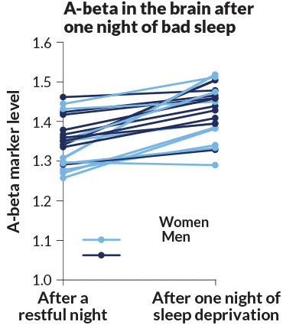

Slide 71
Foods that help you sleep!
Walnuts
The walnut is one of the best foods you can eat right before bed. That’s because eating walnuts causes the human brain to secrete melatonin, the chemical responsible for regulating the body’s internal clock.
Cherries- Help with sleep
You workout while you sleep
  Another reason to get a full 8 hours

Slide 72
Dr. Axe’s Food Recommendations
Food Is Medicine!
  Foods high in the amino acid tryptophan
    Milk, Turkey
    A study published in Sports Medicine out of France was conducted to improve the sleep of elite soccer players The study found that by consuming carbohydrates — such as honey and whole grain bread — and some forms of protein, especially those that contain serotonin-producing tryptophan etc
  Calcium for Relaxation
  European Neurology Journal, calcium levels are at their highest during our deep rapid eye movement (REM) sleep periods

Slide 73
Foods continue..
Magnesium May Help You Get the Slumber You Need- induces deep sleep & reduces leg cramps!
  Half a banana with a few almonds
  Crackers with almond butter
  Gluten-free oatmeal with honey and dark cherries
  Small glass of warm goat’s milk kefir with turmeric and a dash of cinnamon
  Small glass of tart cherry juice

Slide 74
Sleep Well naturally
Essential Oils for Sleep
Passion Flower for Calming and Restful Sleep
  Clinical trials have shown that passion flower can reduce anxiety as effectively as the prescribed drug known as benzodiazepine Xanax..
St. John’s Wort May Help Provide Sleep Through Less Depression

Slide 75
Problems with Sleeping Pills
Valium (benzodiazepine) Barbiturates (dangerous) Ambien (reduces REM)
  Changes in appetite
  Gas, constipation and/or diarrhea
  Dizziness and problems with balance
  Drowsiness during the day
  Dryness in the mouth or throat area
  Headache
  Feelings of weakness

Slide 76
Summary
Stay away from synthetics and stimulants, and try the following natural sleep aids instead:
Tryptophan and serotonin foods
Calcium (yogurt Milk)
Magnesium (walnuts, cherries, bananas)
Essential oils
Passion flower
Melatonin (gummies 2.5mg) St. John’s wort * Ask Doctor before taking anything

Slide 77
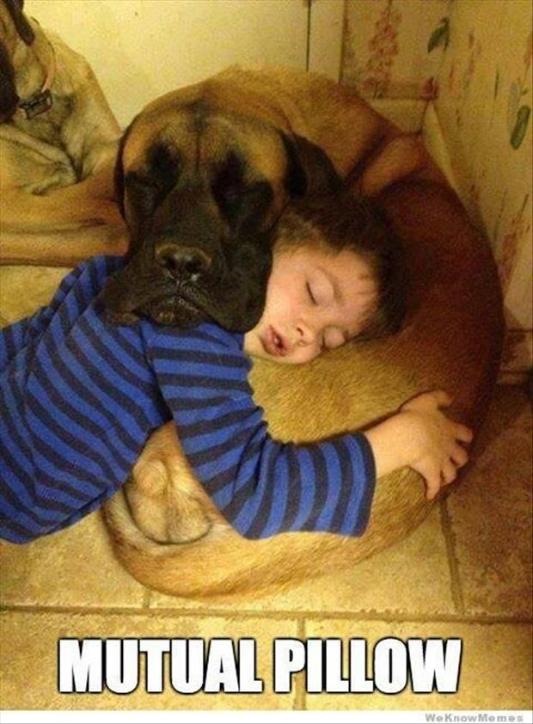
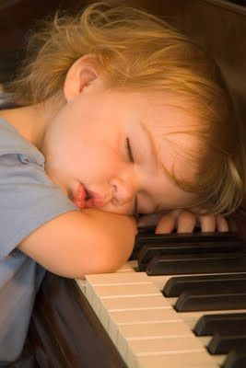
Sleep Positions
Back- good for spine but may snore
Side-good but not for Sciatic nerve
Stomach- Not good for your body!
https://draxe.com/sleep-positions/

Slide 78
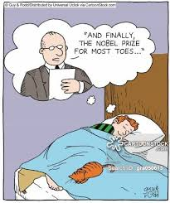
Sleep..
The spine elongates and realigns
Heart rate decreases
Collagen increases to repair damaged skin
Muscle and tissue repair
Your immune system gets a boost
The digestive system gets a rest

Slide 79
Strange sleep habits?
Tom Cruise's snores are apparently so bad that he sleeps in a soundproof "snoratorium.“
Michael Phelps sleeps in a chamber with air comparable to that at an elevation of 8,500 to 9,000 feet
Eminem (singer) takes it to another level by wrapping tinfoil around his windows to get a better nights sleep

Slide 80

Sleep habits..
Martha Stewart sleeps 4 hours night
Marissa Mayer
  Yahoo's CEO is a workaholic, clocking as many as 130 hours- To catch up, she recharges by taking weeklong vacations every four months.
Mariah Carey-
  Sleeps 10 hours a day with 20 humidifiers in her room?

Slide 81
Sleep Habits..
Da Vinci followed an extreme form of a polyphasic sleep schedule called the Uberman sleep cycle, which consists of 20-minute naps every four hours.
Novelist Emily Brontë walked around in circles until she fell asleep.
Churchill Every day at 5 p.m., would drink a weak whiskey & soda before taking a two-hour nap.
Lyndon Johnson – worked 7-2pm then napped worked 4-9pm.

Slide 82
Meditation: Pure Consciousness or Relaxation
Meditation = practices that train attention to heighten awareness and bring mental processes under greater voluntary control
Yoga, Zen, transcendental meditation (TM)
Potential physiological benefits
  Similar to effective relaxation procedures
Notes:
Meditation is an ancient discipline which has recently become an area of growing interest.
Some of the most widely practiced forms of meditation are listed here. All three of these are rooted in Eastern religions; however, many who meditate do so separately from religious practice.
Effects of meditation include decreased heart rate, respiration rate, etc., and a relaxed EEG, with predominant theta and alpha rhythm patterns. New research using the CT scan to track blood flow in the brain in experienced Tibetan Buddhist meditators shows high activity in the prefrontal cortex (an area important for focused attention) and low activity in parts of the parietal lobe that are known to process information about the body’s location in space…this may explain some of the transcendent experiences reported by many meditators.
Meditation results in a potentially beneficial physiological state whereby bodily arousal is suppressed, but it is unclear how meditation differs from other systematic relaxation training procedures which produce very similar effects.

Slide 83
Sleep & Dreams
Evolutionary & Biological Reasons
A lack of sleep leads to illness
Explaining Dreams is difficult
May lead to personal growth?

Slide 84
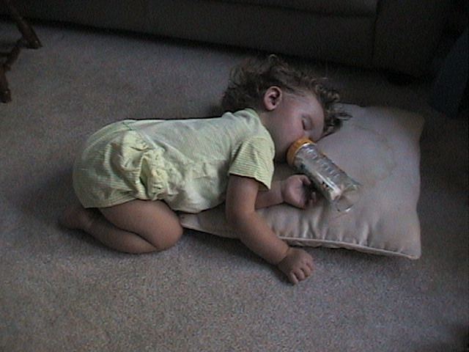
The End
http://jeopardylabs.com/play/sleep-dreams4
http://jeopardylabs.com/play/sleep-dreams4
http://jeopardylabs.com/play/sleep-dreams4
http://jeopardylabs.com/play/sleep-dreams4
Get some sleep! Jeopardy?

