Slide 1
Watch Your Step!!
Fall Prevention CWP
Ananya Bukkapatnam, Soumya Bukkapatnam

Slide 2
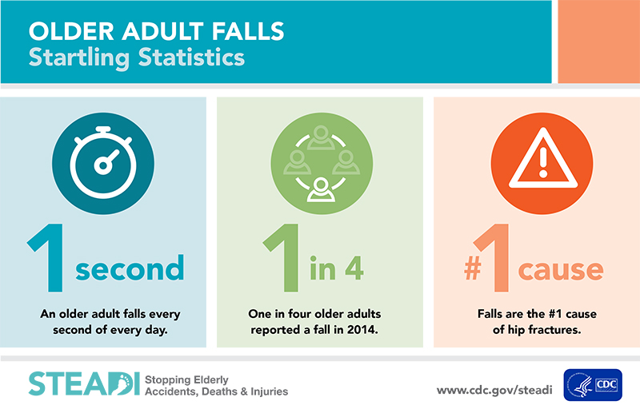

Slide 3
Five Main Causes of Falls in the Elderly
Decline in fitness
Medications
Impaired Vision
Environmental Hazards
Behavioral Hazards

Slide 4
Decline in Fitness
The lack of strength in your legs can cause you to lose you balance and fall. It can also cause for you to lose coordination.

Slide 5
How You Can Fix That
Work on your balance
Build strength and muscle in your legs
Keep yourself and fit
Come to virtual classes here
Build arm strength so you can pick yourself up if you fall

Slide 6
Impaired Vision
Not having your glasses on or suddenly feeling dizzy are some of the leading causes to falls in the elderly.

Slide 7
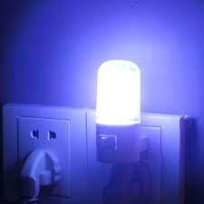
How You Can Fix That
Have your glasses near your bed, in case you need to get up in the middle of the night
Make sure there is adequate lighting, where you are not relying on muscle memory to go somewhere
If you feel dizzy, just take a seat.

Slide 8
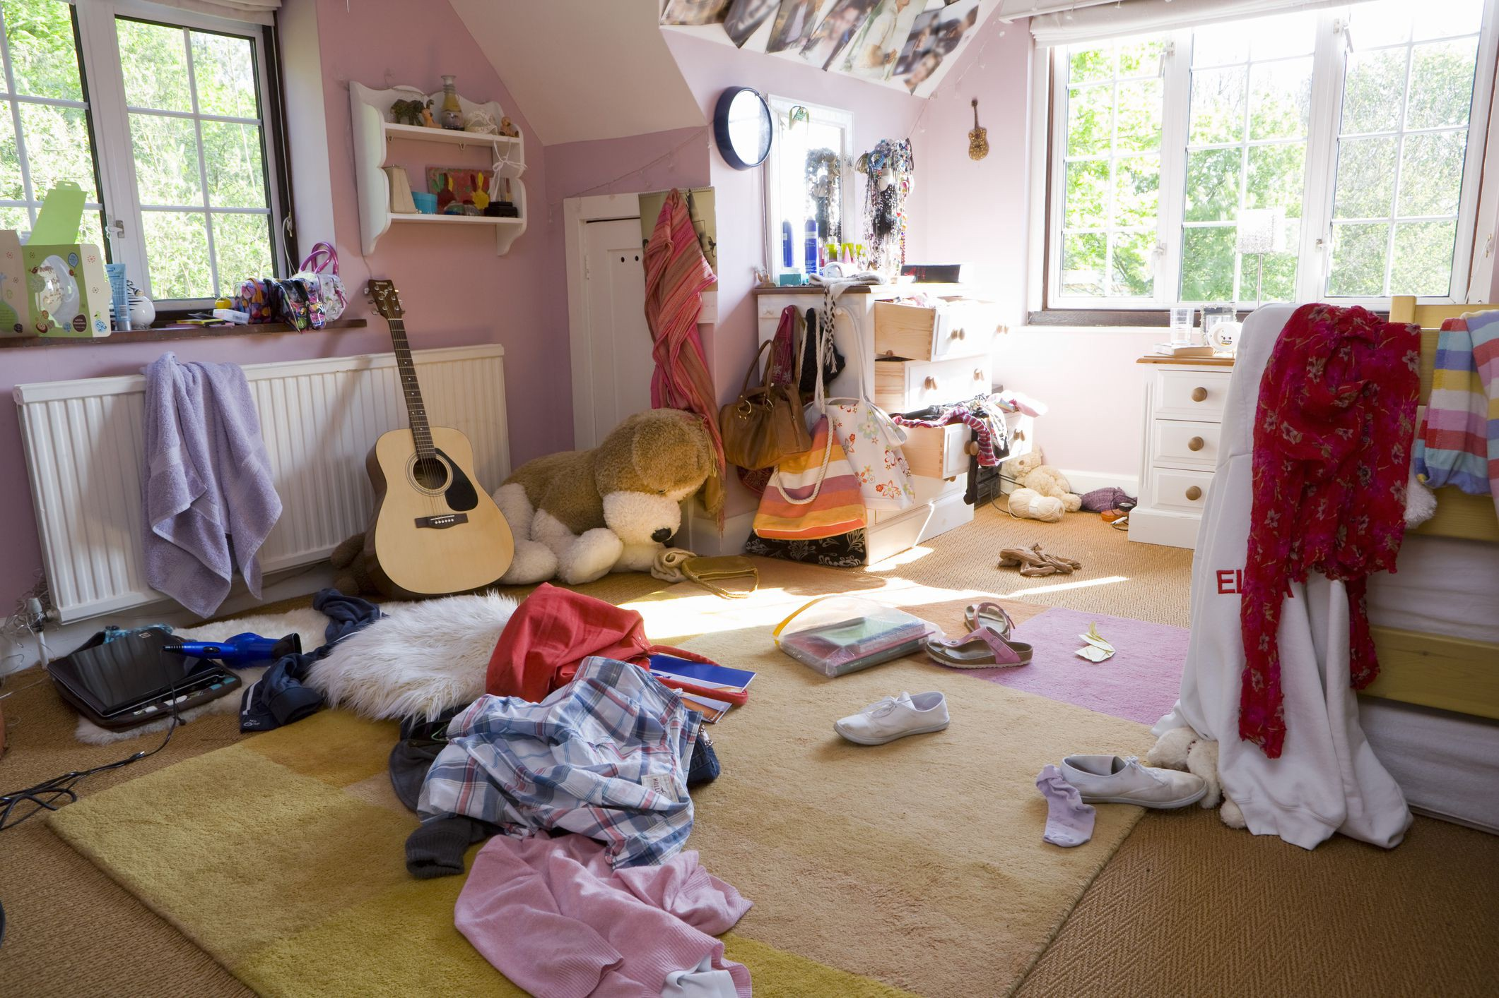
Environmental Hazards
Be aware of your surroundings. Something as simple as a banana peel of the ground, or having you shoelaces untied can cause a fall.
Here is a list of items to beware of:
Carpet corners
Ropes
Fruit/ vegetable peels
Small items

Slide 9
How You Can Fix That
Don’t leave small items on the floor that you would trip on.
Pick your feet up and walk.
Hold onto the railing on the stairs or at places where you might fall.
Consider investing in motion sensor lights to place in your bedroom to illuminate the path if you need to use the restroom in the dark.

Slide 10
How You Can Fix That (Continued)
Get socks with a grip on the sole to help with balance
Make sure your laces are tied if you are going outside
Watch your step! Make sure you can see where you are going.

Slide 11
Your At Home Checklist

Slide 12
Bedroom
Ensure lamps are easy to reach
Plug in night lights
Install a phone on the floor in case of an emergency, such as a major fall.

Slide 13
Floors
Use non skid rugs
Coil or tape extension cords or wires
Keep pathways clear of excessive furniture or items you can trip on like ropes or fruit/vegetable peels

Slide 14
Stairs
Fix loose or uneven steps
Install handrails on both sides and lights
Attach non-slip rubber to tread to steps

Slide 15
Kitchen
Keep often-used items in easy-to-reach places
Never use anything other than a non skid step-stool as a step stool

Slide 16
Bathrooms
Install grab bars next to toilets and inside showers
Use non-slip mats
Consider a shower chair

Slide 17
Behavioral Hazard
Rushing to do work before gathering your balance can be the cause of a fall.

Slide 18
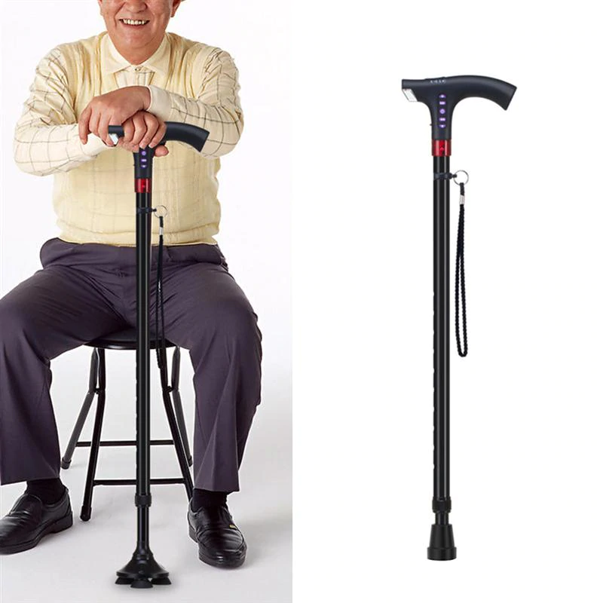
How You Can Fix That
Make sure you have everything in control
Take a minute before you move - there is no rush.
Get into the habit of using something for support

Slide 19
How to Fall
Let your bottom fall first. It will cushion the fall.
Then fall on your back.
Lastly your arms hit the ground.
If nothing, at least tuck in your head. It is the most important and a lot of the damage is irreversible.

Slide 20
How to Get Up If You Fall
Check to see if/ where you are hurt.
If you are hurt immediately call for help (Use help to get up. Call a neighbor or a family member who is fit enough to maintain their balance while picking you up). If it is not serious, do NOT call 911!

Slide 21
How to Get Up If You Fall and Are NOT Hurt
If you are not hurt, SLOWLY roll on your side to a chair/table/sofa, something that can support your weight.
Hold firmly onto the chair/table/sofa with both hands, and get into a crawling position.

Slide 22
How to Get Up If You Fall and Are NOT Hurt (continued)
3. Pick you more dominant leg, and bring it to a 90 degree position to your side with the help of the chair.
4. Finally use that leg and the chair to hoist yourself up.
REMEMBER TO TAKE YOUR TIME. DON’T RUSH THROUGH THE STEPS!!!!

Slide 23
