Slide 1
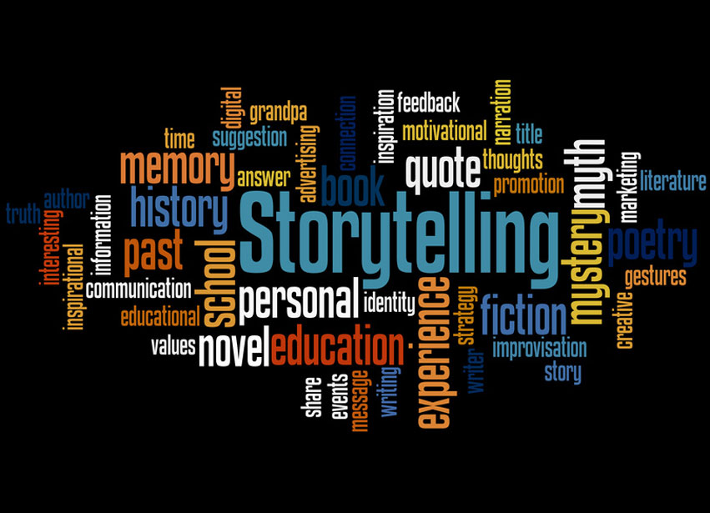
The Value of Telling Your Story
Sharon Myers RN, MA
Notes:
You all are encouraged as part of your self –discovery project to write some small stories that reflect

Slide 2
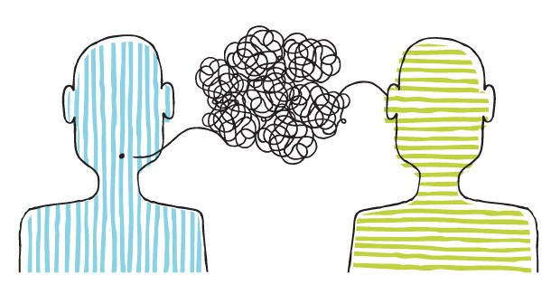
What is a Story?
The telling of a happening or connected series of happenings, whether true or fictitious; account; narration.

Slide 3
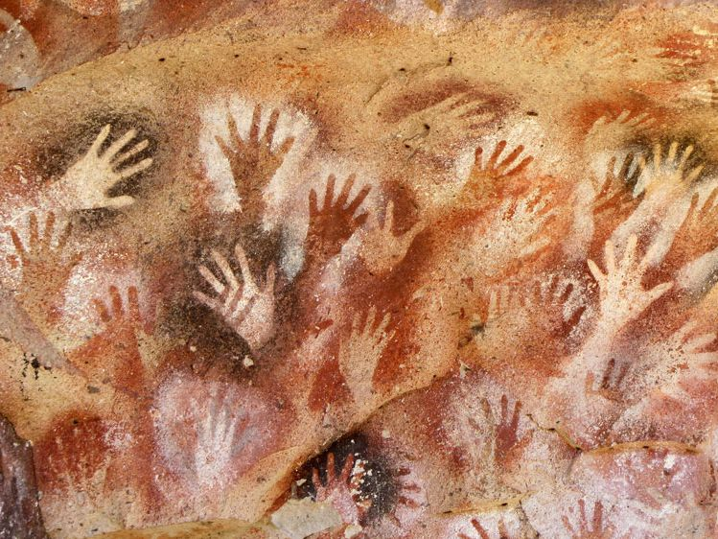

The History of Storytelling
All cultures have told stories.
Earliest evidence of stories were cave drawings in Lascaux & Chavaux, France.
-The drawings date as far back as 30,000 years ago
-They depict animals, humans, and other objects.
Oral storytelling ( shared through oral/voice) takes many forms: poems, chants, rhymes, songs, myths, legends, fables, religion, prayers, proverbs and others…
Notes:
Some of them appear to represent visual stories. It is even possible that the scenes depicted on those cave walls were associated with some kind of oral storytelling.

Slide 4
”There’s Nothing But Story”
Stories are everywhere. Much of our lives are devoted to telling stories.
The stories are in our thoughts, verbally shared and in written word or format.
“Telling stories is a human universal trait. It develops spontaneously without training in childhood”- Brian Boyd
We have been telling stories for as long as history can see, and we will likely continue to do so for the rest of our lives.
Notes:
So where are the stories? They are definitely in our heads, we share brief stories throughout our day as we interact with others, and then of course written type stories are everywhere

Slide 5
Examples of Typical Stories
Doctors appointment
Covid public policies
Stories about family history and traditions
Story of why you are listening to this lecture today
*Personal stories we carry in our heads about who we are and why we do what we do

Slide 6
Why Do Humans Tell Stories?
Survival-The passing down of wisdom.
Empathy - Stories can also let us see how others think and feel. The more compelling the story, the more empathetic people become.
Memory- Stories allow us to put things we experience into our memory storage. By telling a story rather than merely reciting dry facts, we remember the details more clearly.
Connection to Others-Stories help us find common ground and connect with other people and our environment
Control- Helps us find order and make sense of the events in a random world. Connecting the dots.
Notes:
Survival- All the traditions and rituals that a part of religions are part of the survival need of the religion and the human species. But this is also true for stories about traditions that are part of our societal structure as well.
Empathy- The more compelling the story , the more empathetic people become. For example the stories of the Me Too movement and some of the stories being told help to draw people in – Women's USA gymnastics team
Memory- Memory Researchers recommend we use brief stores to help us store new information.

Slide 7
Connecting the Dots

Slide 8
Connecting the Dots Helped Patients with Heart Failure Be Adherent to Medical Advice

Slide 9
Making Connections- Narrative examples
“Once I started getting all this water off of me, well it was cleared up. I wasn’t coughing. I was thinking, I know this is all smokers cough, and it wasn’t . It was fluid on my lungs”
“In the hospital they had me on a strict diet (low sodium), and it helped me get the water off. That helped me notice what would make me feel better”
“ “He was looking at the comparison of my heart when I was really sick and then my heart after I was on my medication. He said it appeared my heart had gone back to normal size. It locked it in to where I don’t even think about having a pickle”

Slide 10
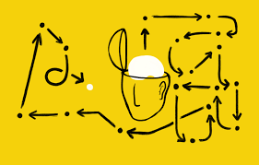
Stories Have a Major Influence on Why We Do What We Do…
The transformational power of how you talk about your life:
We’ve all create our own personal histories, marked by highs and lows, that we share with the world — and we can shape them to live with more meaning and purpose.
How you talk about the major events of your life
has a profound impact on your personality.
The way you tell this story, even just to yourself, helps shape who you are. How you interpret your life, and tell its story, has profound effects on what kind of person you become.
If you change parts of your life story, could you become a healthier, happier person?
Notes:
Tell story about me moving so much and the story I tell about how it affected me.
Flexible, resilient, good at making friends.

Slide 11
Our Stories…
We all carry around a book in our head that has main events, pivotal turning points and memories from our lives.
These narratives exist whether we choose to give them much conscious attention or not.
They lend meaning to our existence and provide the foundation for our sense of identity.
You are your story.

Slide 12
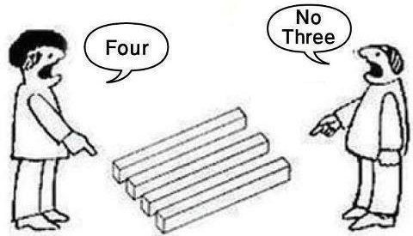
You Are Your Story
You Are Your Personal Narrative
Dan McAdams- Researcher on Narrative Identity at Northwestern University
Alongside our goals and values and character/personality traits, our personal narratives reflect a stable aspect of our personalities
The way we tell our personal stories have implications for our mental health and overall wellbeing
Those who tell stories with redemptive meaning (of overcoming suffering and adversity) and personal agency (ability to grow and effect change) have better mental health, overall well being and maturity
Notes:
Sons graduation from college story

Slide 13
You Are Your Story
You Are Your Personal Narrative
Narrative Therapy- Helping people to re-interpret their personal stories in a more constructive (and true) light. NOTICING
The book in your head is not the final edition.
We can edit, revise and interpret the stories we tell about our lives
Modify your story as you tell it, and perhaps you can change some of your negative patterns and your overall sense of self, happiness, satisfaction, peacefulness, confidence, how you interact with others, judgement etc.
Notes:
/Share the Example of therapy patient – father who died in front of him.
Present, stood strong, called for help etc.

Slide 14
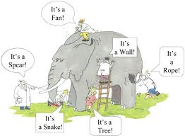
How We See Ourselves, Depends On
What We Are Looking At

Slide 15
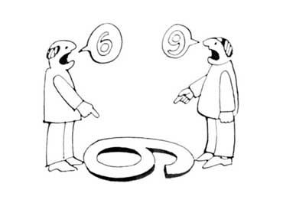
Changing Our Story
Even making small story edits to our personal narratives can have a big impact on our lives.
Through the telling and discussion of your story, you may end up editing and reinterpreting your story, and come to notice another side.
Telling your story out loud or in writing makes you more likely to be able to describe events from different perspectives, and see multiple explanations.
Telling your story helps you to see the depth
and complexity in your decisions, and life choices.
Notes:
Story of Christmas letters- helped me make sense of a chaotic life. Helped me find humor, Helped me connect with others and not feel alone. Helped me see my children and myself in a new way. Helped me see a beginning, middle and end.

Slide 16
Think of An Event or Time in Your Life Which is Making You Feel Stuck or That May Be Creating an Ongoing Negative Narrative in Your Head…
What happened and when? Who was involved?
What were you and others thinking and feeling, and why was this event especially important for you?
What does this event say about who you are, how you have developed over time or who you might be­come?
When you are finished writing your account, take a step back and look at the story as a whole and as a close friend who loves you would look at it.
What major themes, feelings, or lessons does this friend see in your story?
What does your friend say about the the story of the event and about the kind of person you are and might become?
What might your friend say about your story as it relates to your values, passions, aspirations, patterns, reactions and any positive impact you could have on others?

Slide 17
Story Prompts
(An activity to do with family, friends or just in a journal)
Take us on a walk around the neighborhood or rural area when you lived as a child.
Can you take us with you to visit a place you went only once or twice but have always wanted to go back again?
Can you remember a night your parents never found out about?
Can you remember a time you tried to cook something and it did not turn out?
What was your most precious childhood possession?
Can you remember a pet you once had that you no longer have?
Can you tell us about the person for whom you are named or something else about your name?

Slide 18
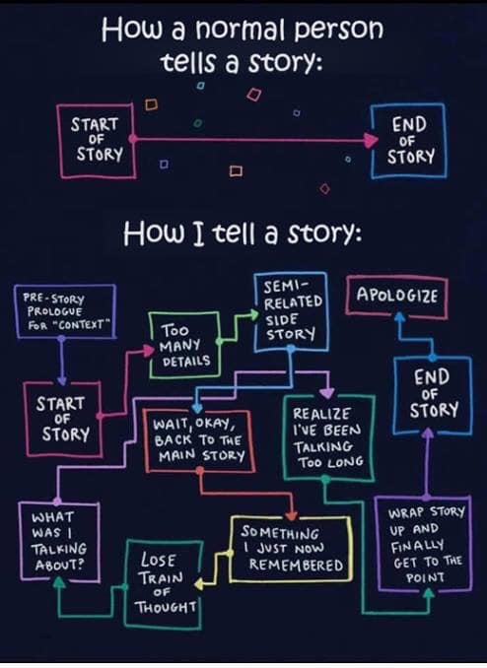
And it doesn’t matter how you tell your story…

Slide 19
In Conclusion…
Stories are everywhere
They help us connect the dots and make meaning in our chaotic world
Telling your stories out loud or writing about them can help us discover new ways of viewing our story line
Telling stories can help us get unstuck and evolve and grow
Asking yourself how a friend might view your story line and conclusions might help you see another view of yourself and your life

