Slide 1
Prevention of Cardiovascular Disease
2024 Update
Radhika Nandur Bukkapatnam MD MAS FACC
Sep 5, 2024

Slide 2
IMPACT OF CARDIOVASCULAR DISEASE
Even though there have been improvements in atherosclerotic cardiovascular disease (ASCVD) outcomes, it is still the leading cause of morbidity and mortality globally.
Leading cause of death in the US, cost >200 billion/y
Mostly due to uncontrolled RF
Most Americans that had an MI had atleast one RF

Slide 3
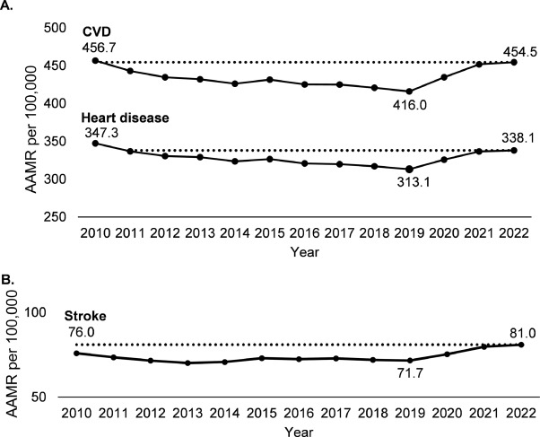
Impact of the Problem
Despite stabilization of the public health emergency, declines in CVD mortality rates reversed in 2020 and remained high in 2022, representing almost a decade of lost progress and over 228,000 excess CVD deaths.
This underscores the importance of prioritizing prevention and management of CVD to improve outcomes.

Slide 4
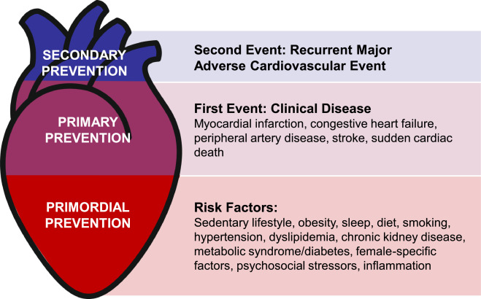

Slide 5
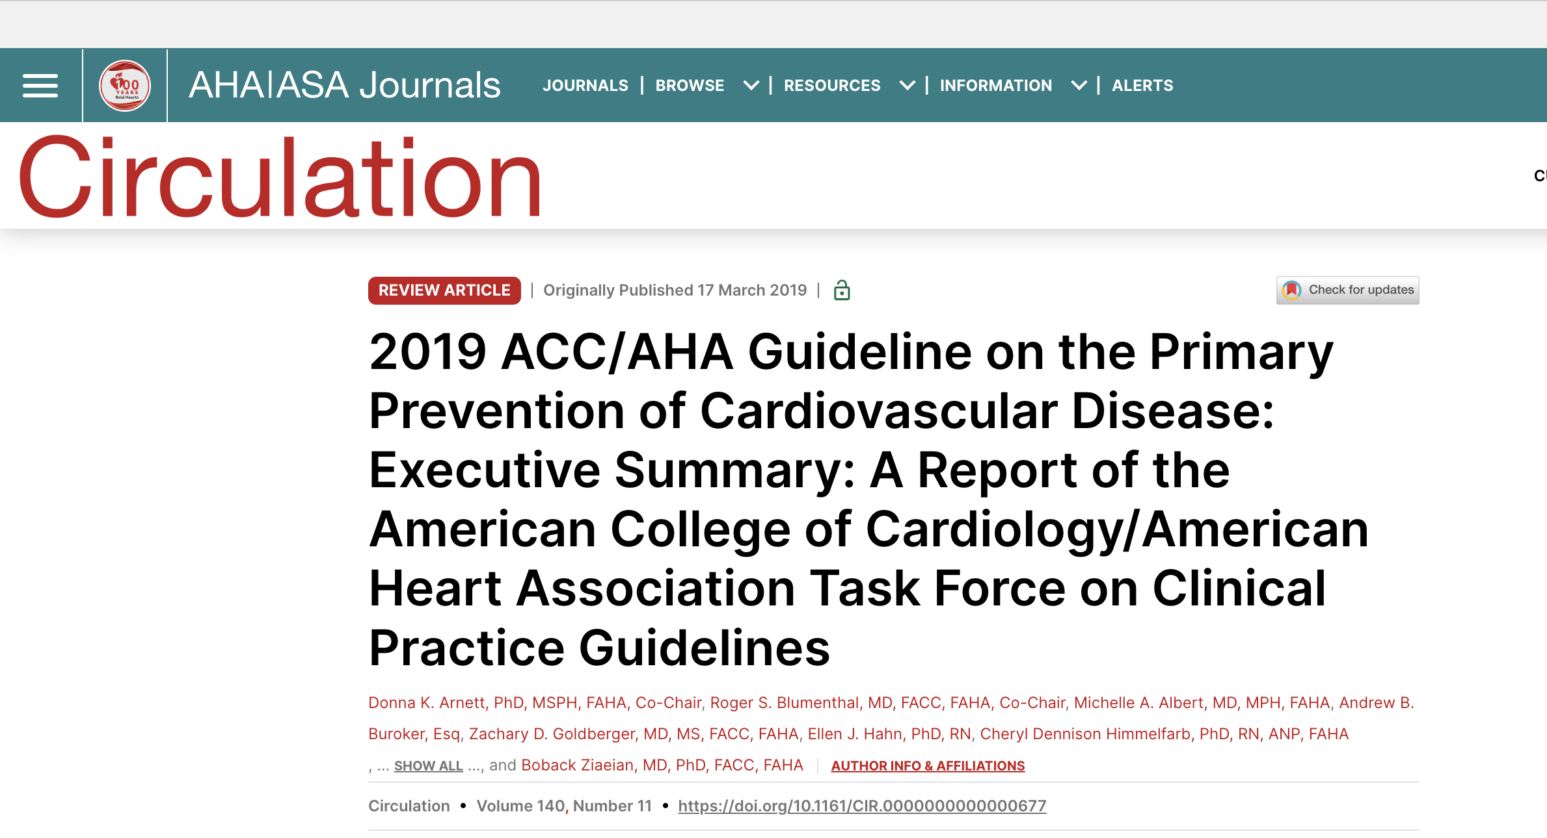

Slide 6
RISK ASSESSMENT
The best way to prevent coronary artery disease, vascular disease, heart failure and atrial fibrillation is to control risk factors.

Slide 7
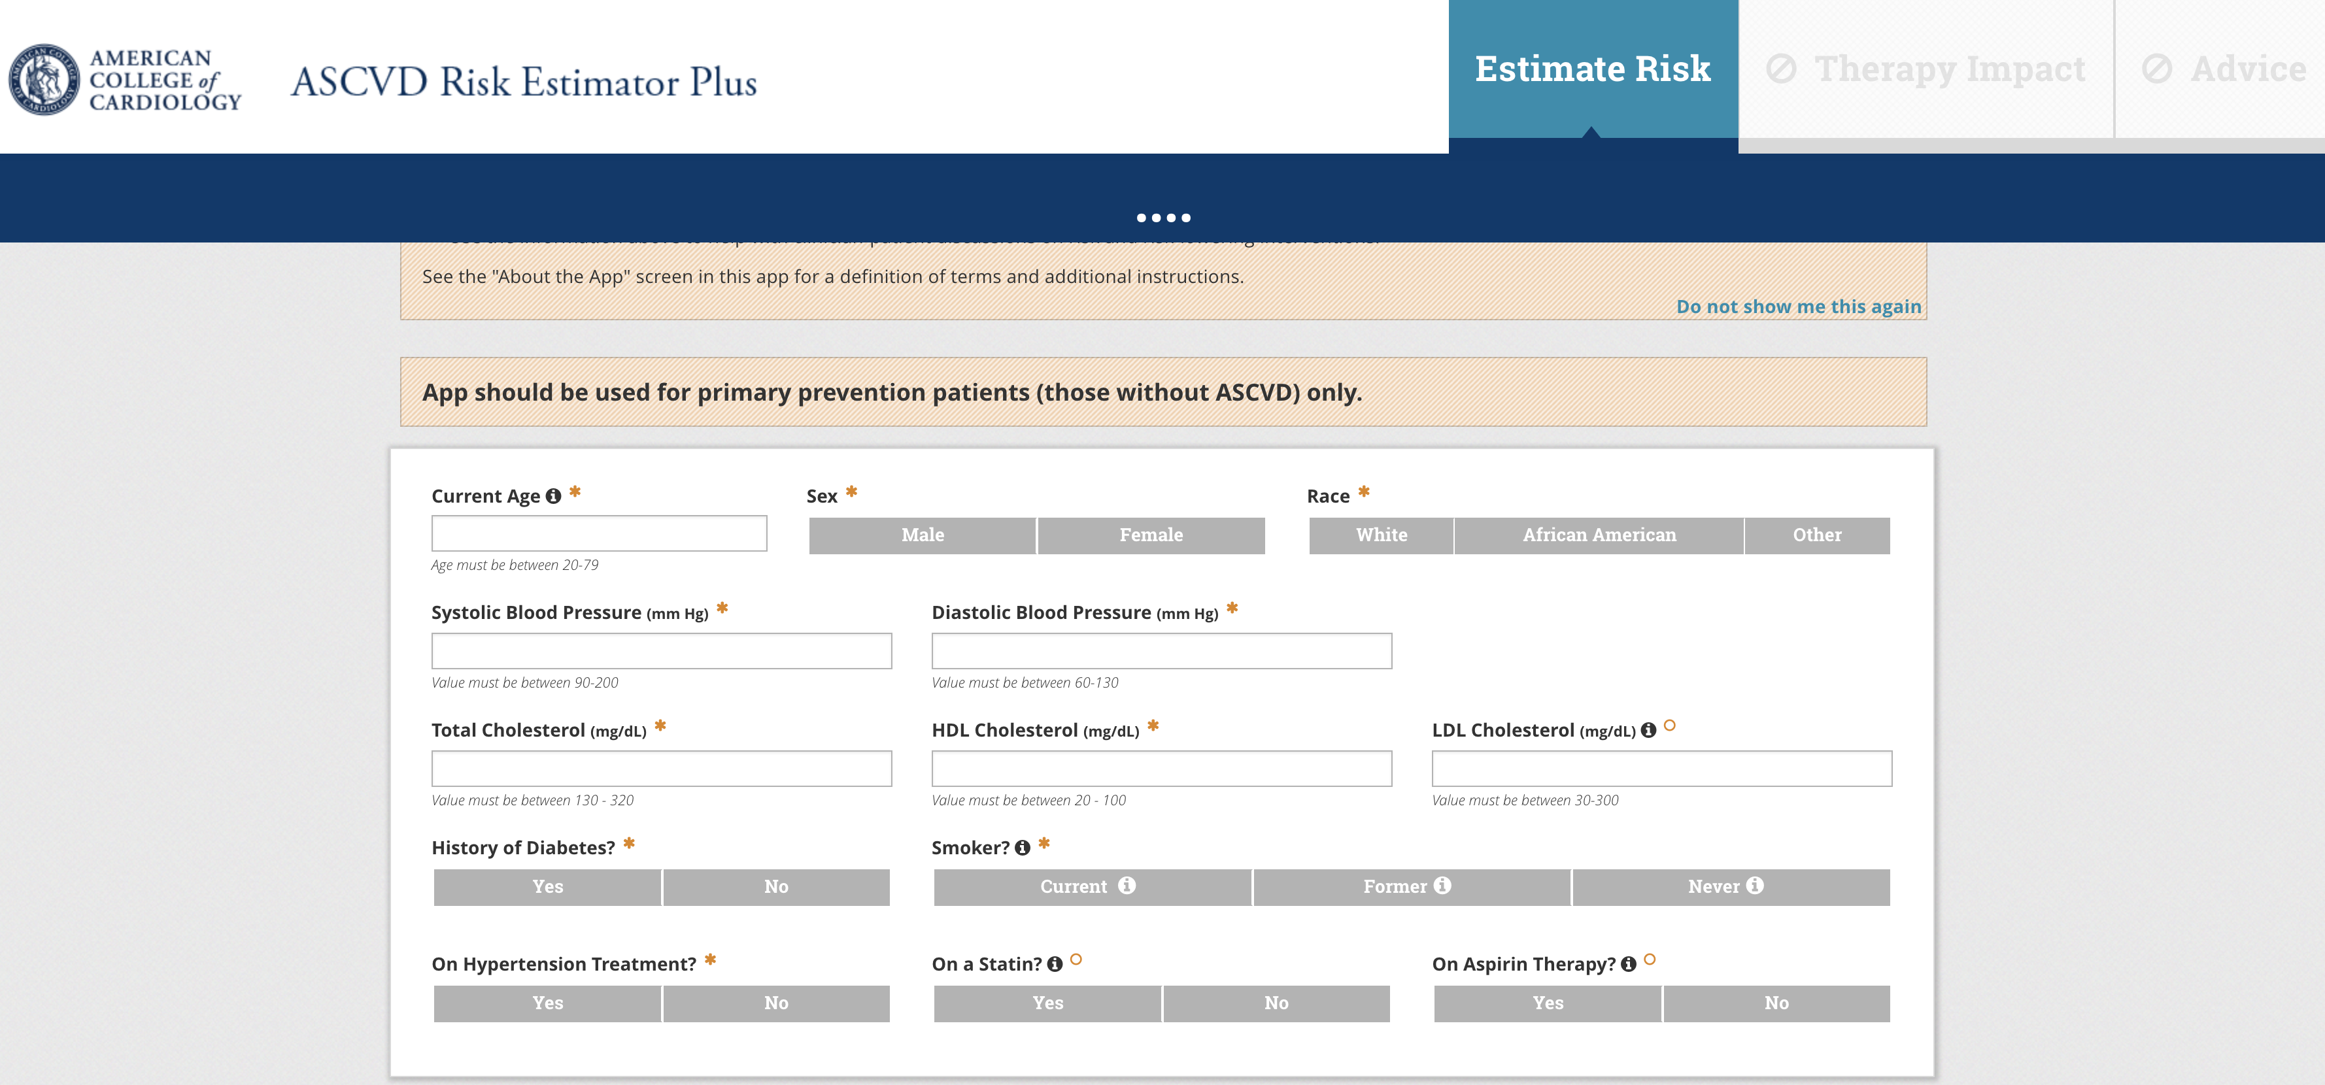
Adults between the age of 40-75 years, should have a screening 10 year ASCVD risk estimation, and informed discussion about diet/ BP meds and lipids.

Slide 8
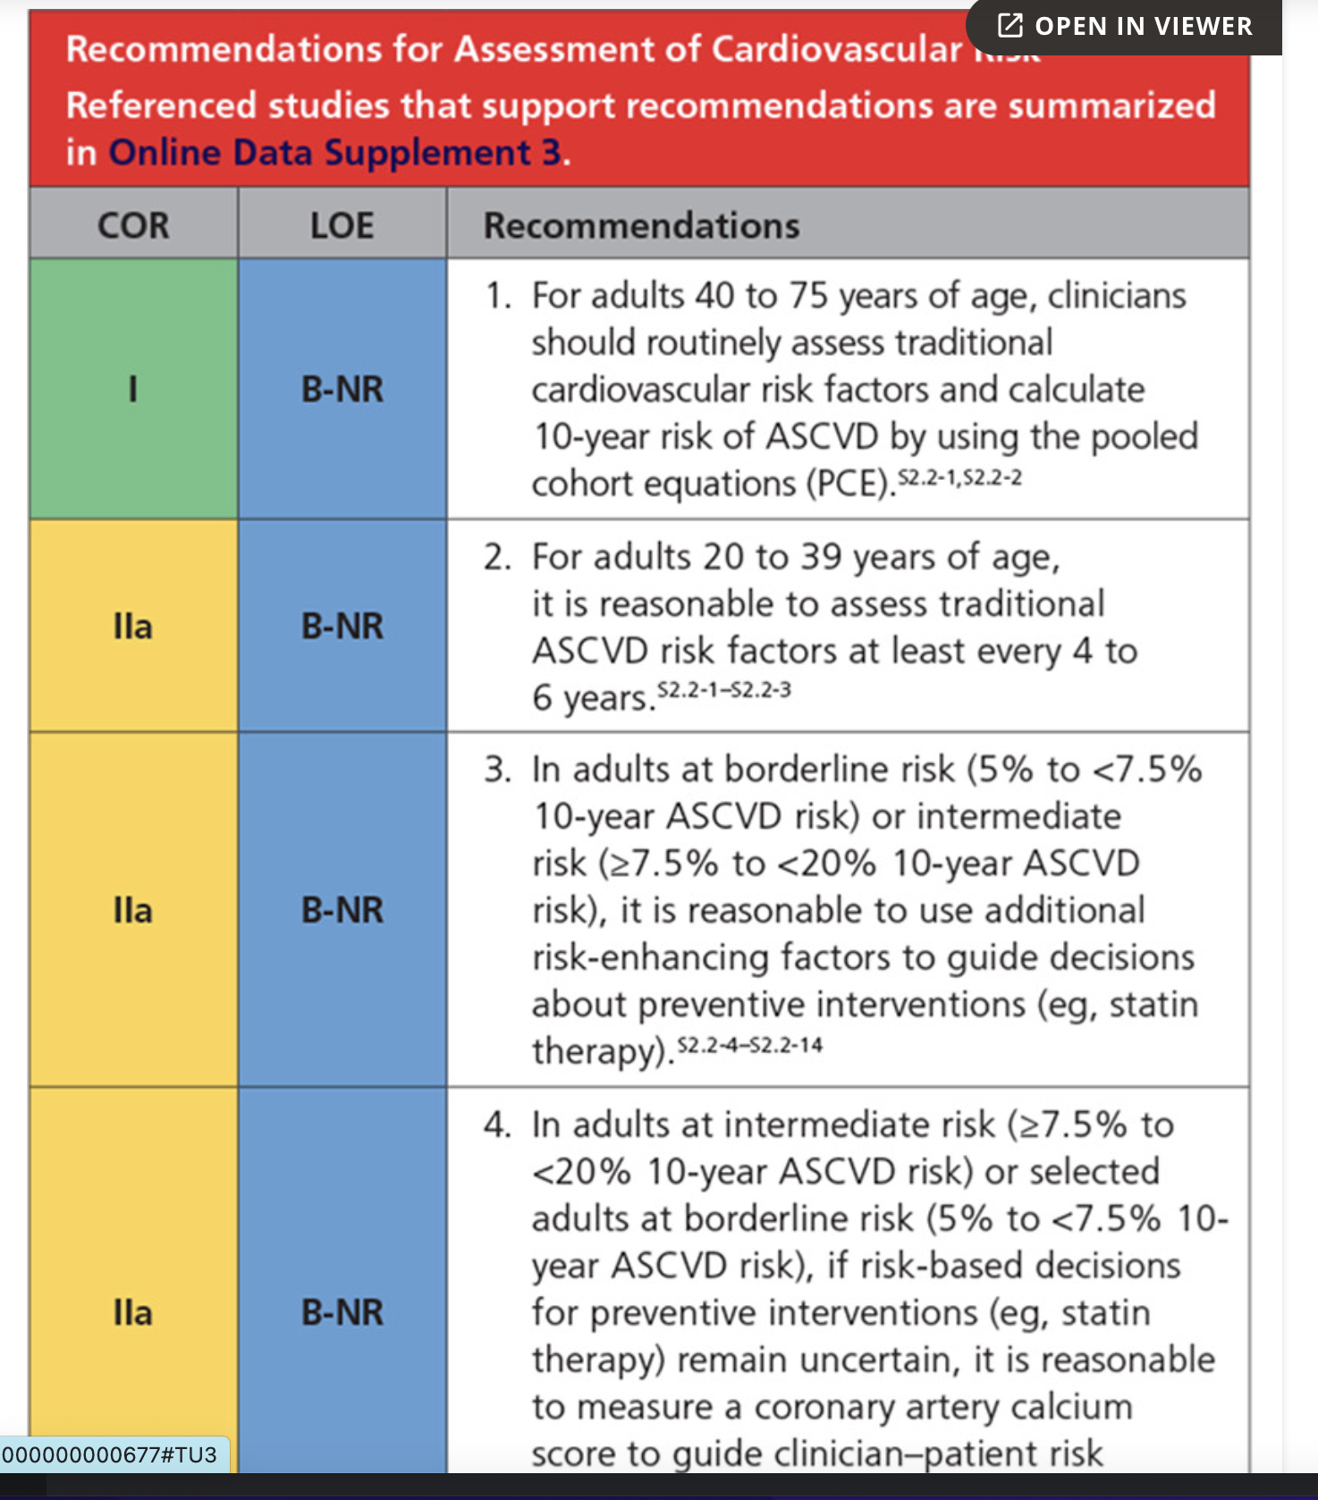
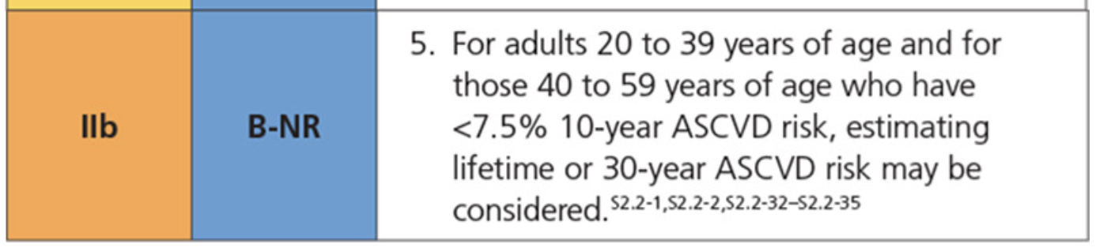

Slide 9
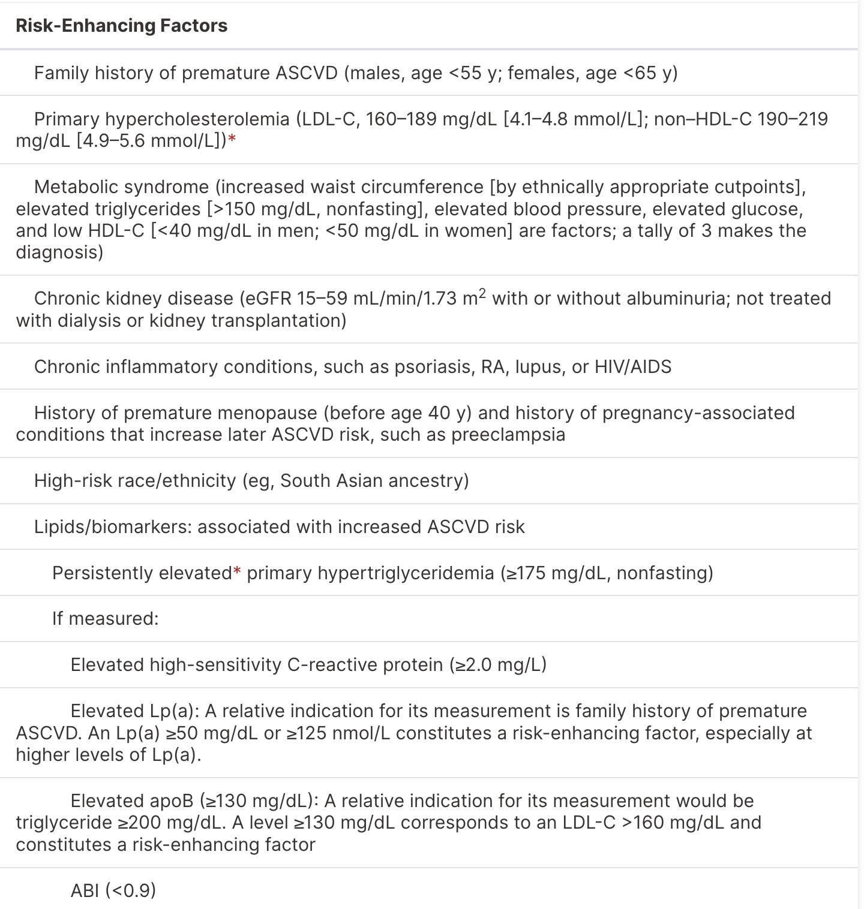

Slide 10
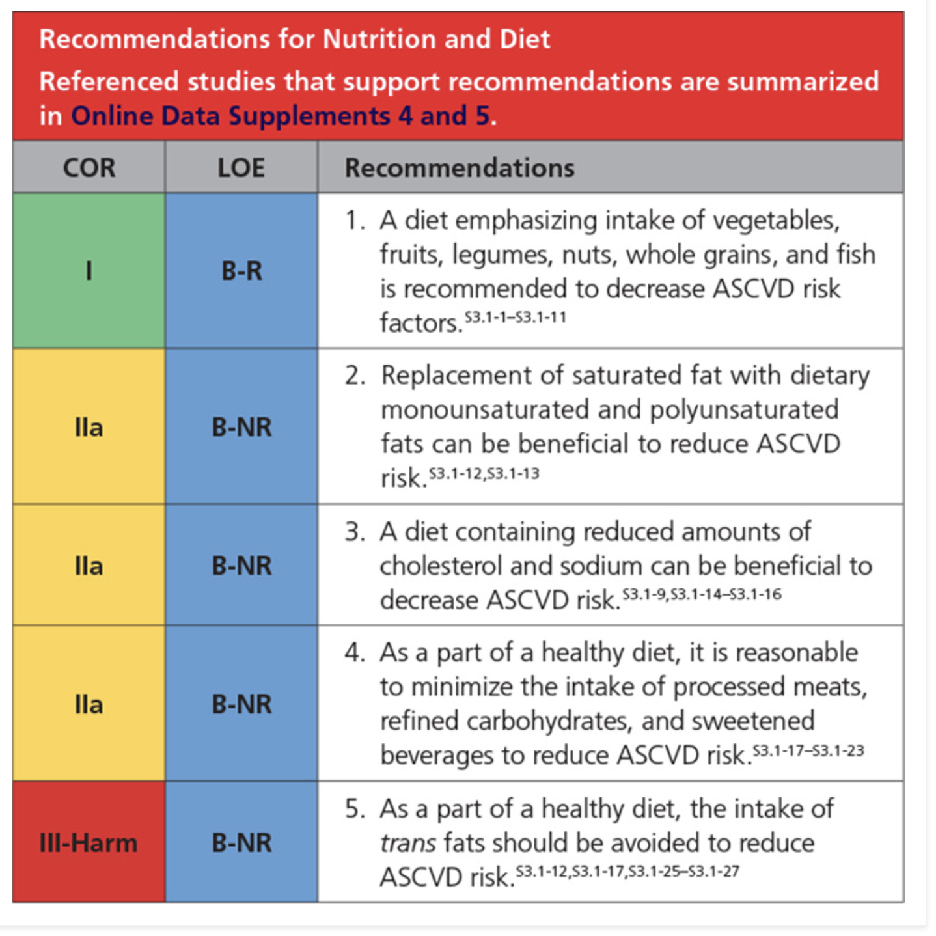
DIET

Slide 11
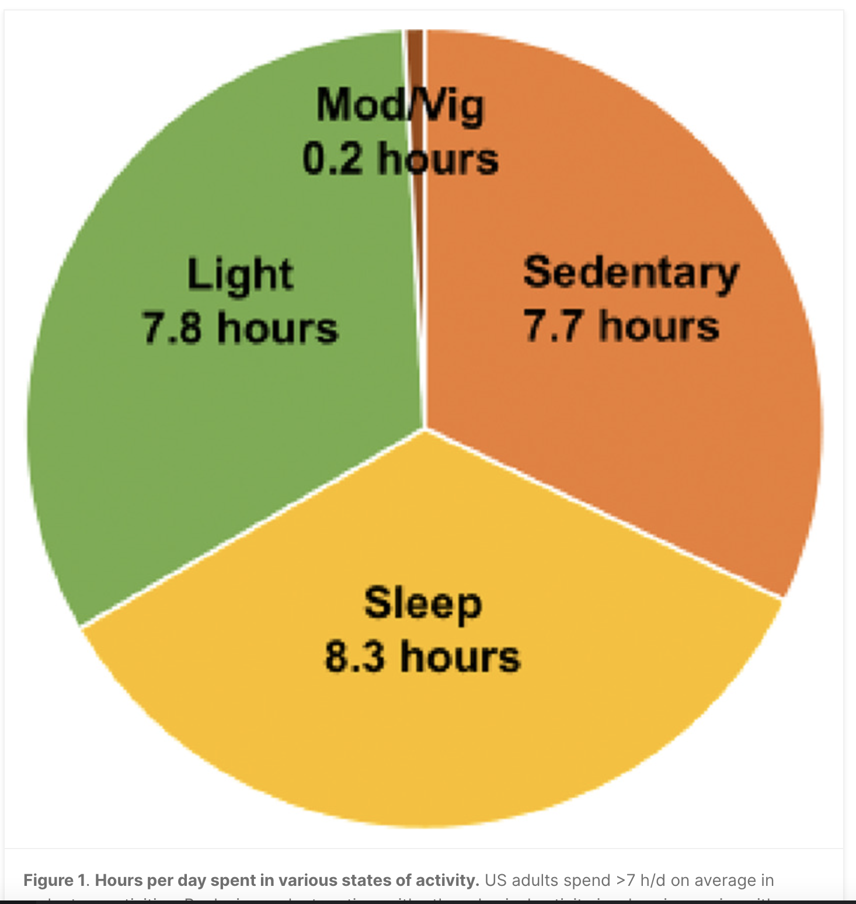

Slide 12
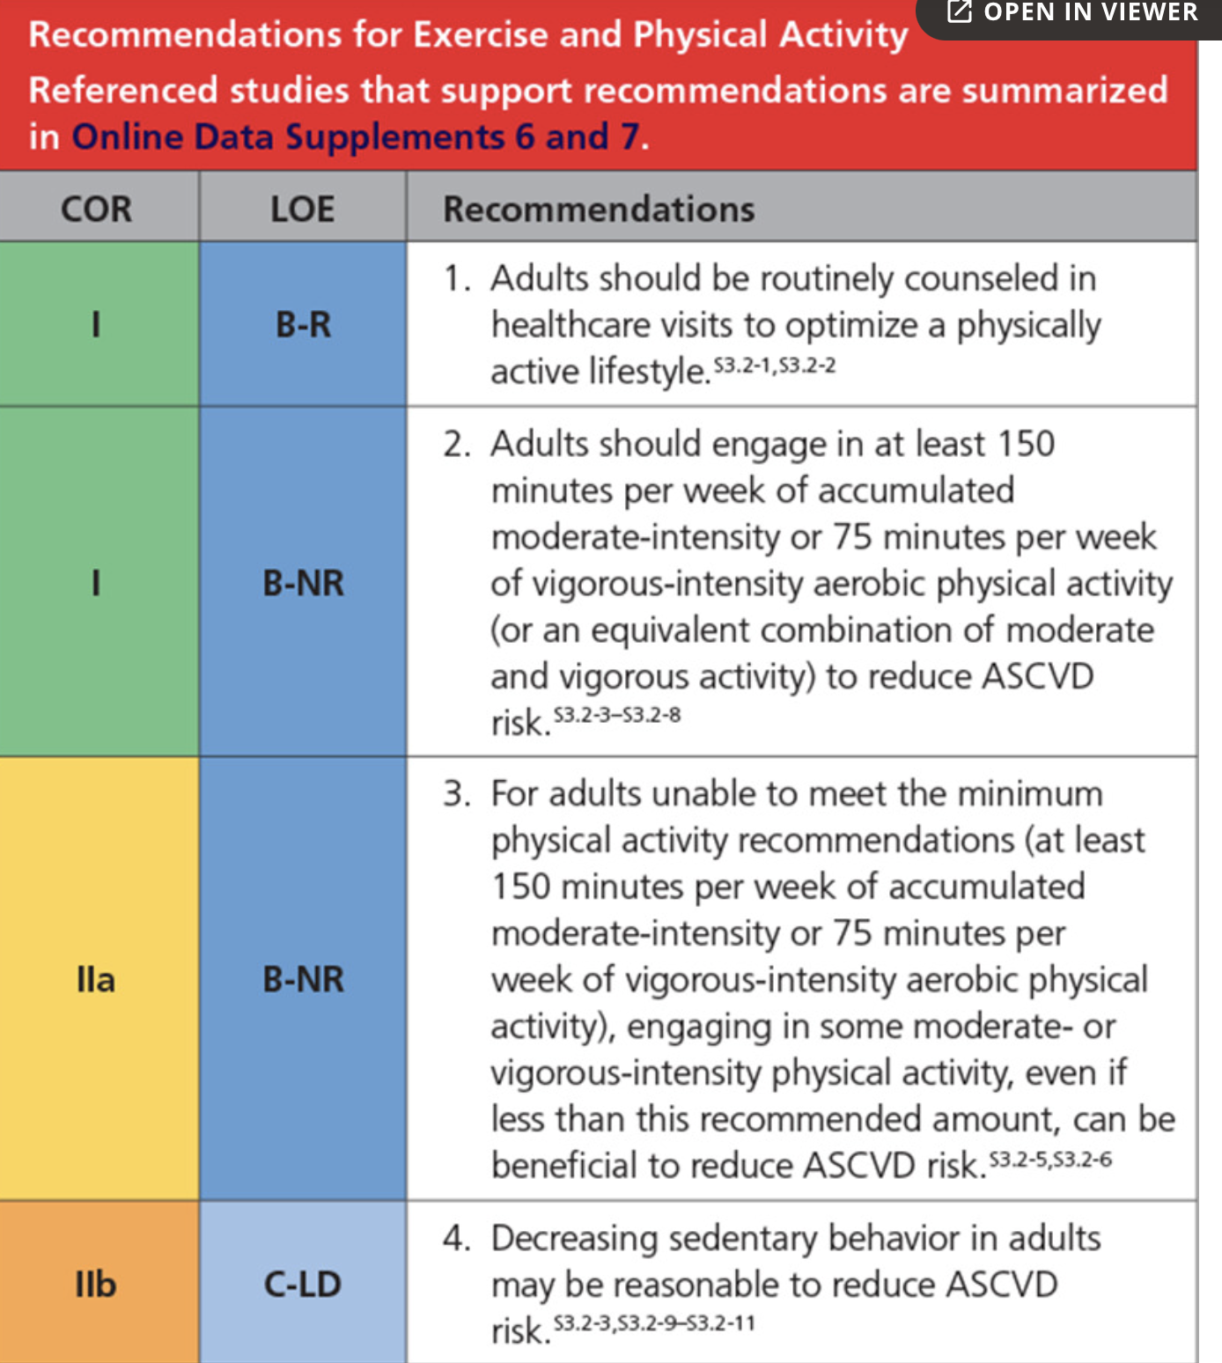
Exercise

Slide 13
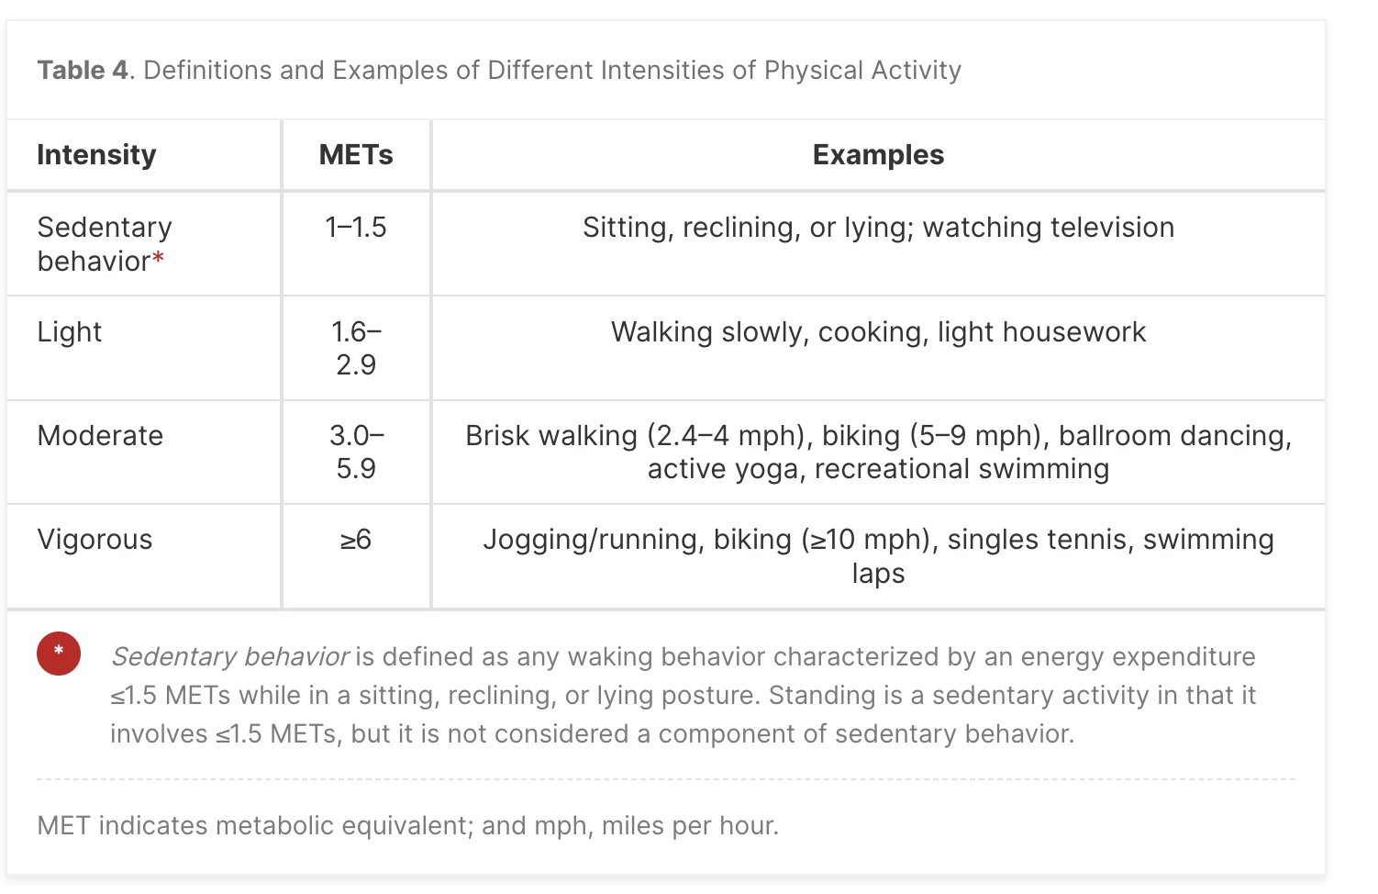

Slide 14
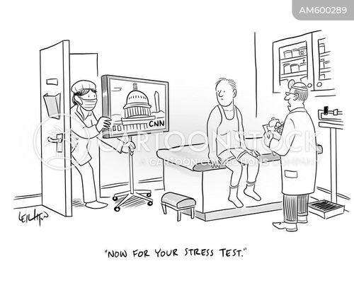

Slide 15
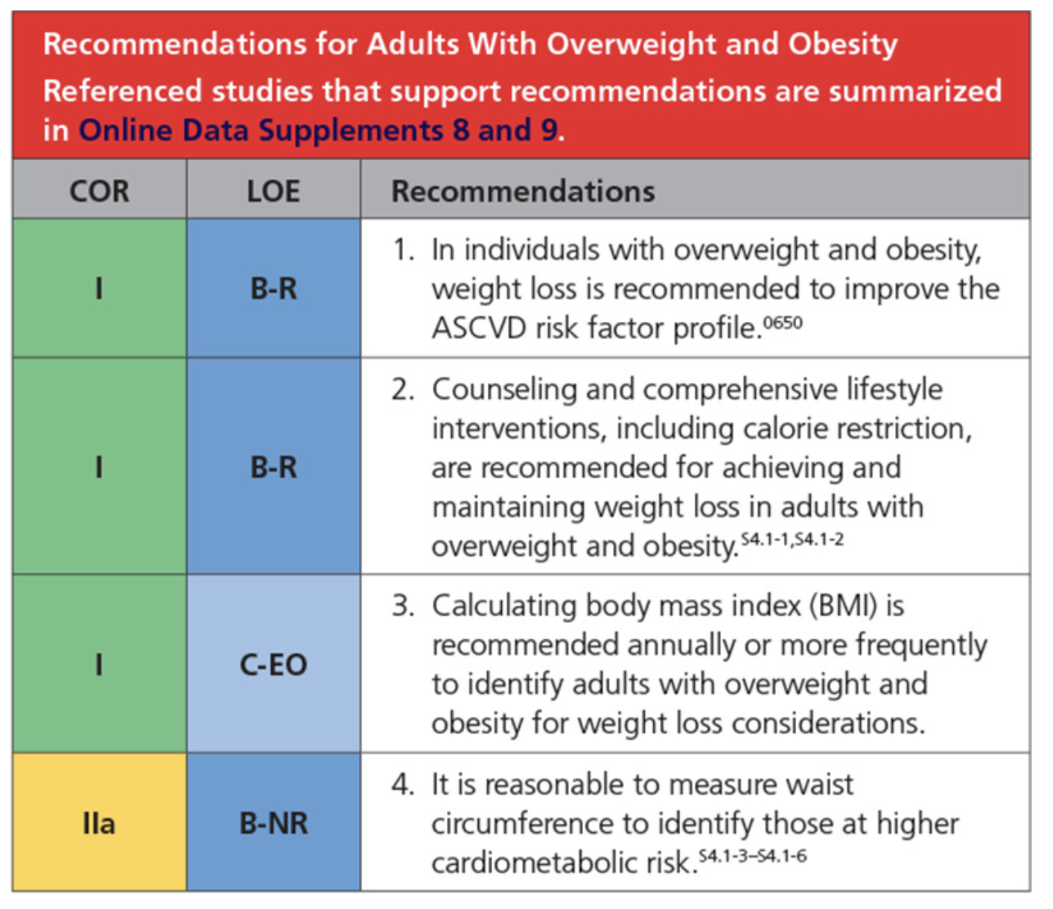
Obesity

Slide 16
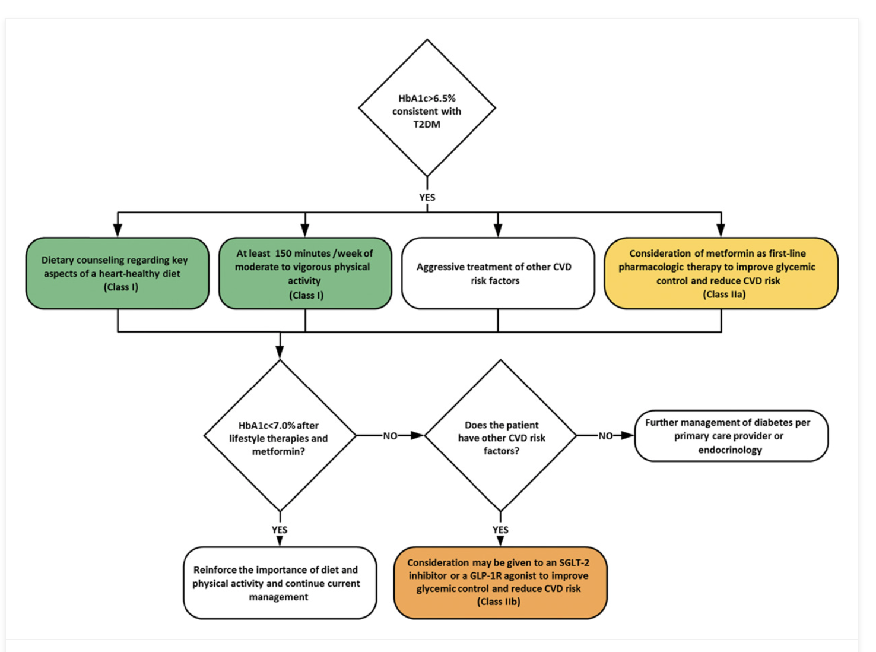
DIABETES

Slide 17
Statins

Slide 18
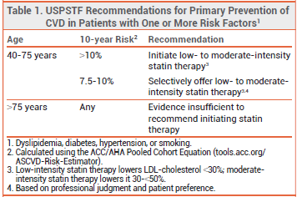

Slide 19
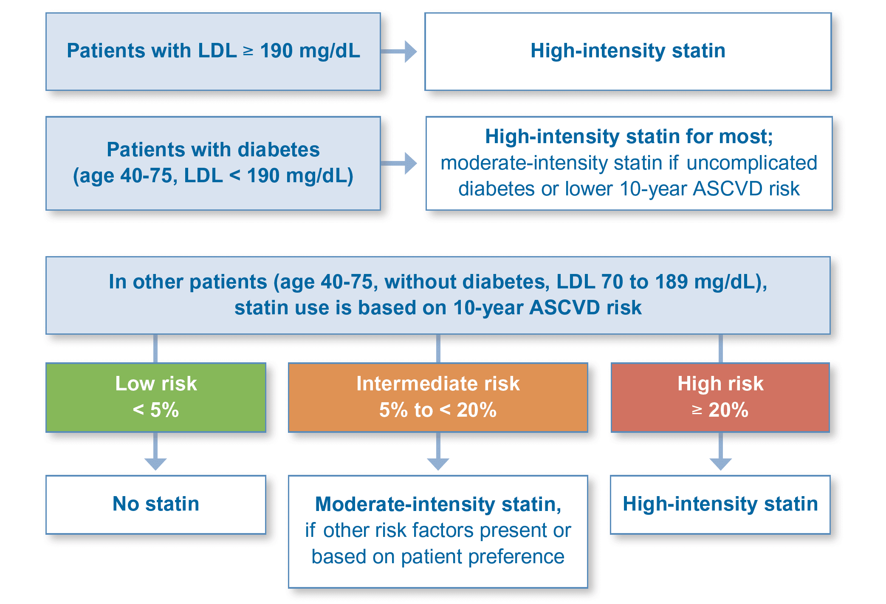

Slide 20
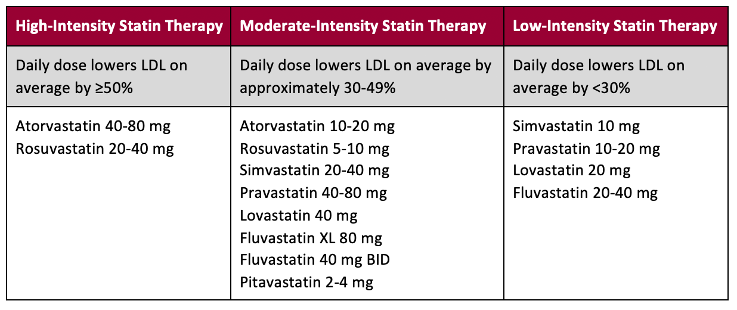
Types of Statins

Slide 21
Hypertension
An elevated blood pressure is defined as a systolic blood pressure 120–129 mmHg and a diastolic blood pressure <80 mmHg.
Hypertension is defined as a systolic blood pressure ≥130 mmHg or a diastolic blood pressure ≥80 mmHg.
Hypertension is common among people with either type 1 or type 2 diabetes.
Hypertension is a major risk factor for ASCVD, heart failure, and microvascular complications.
Studies have shown that antihypertensive therapy reduces ASCVD events, heart failure, and microvascular complications.

Slide 22
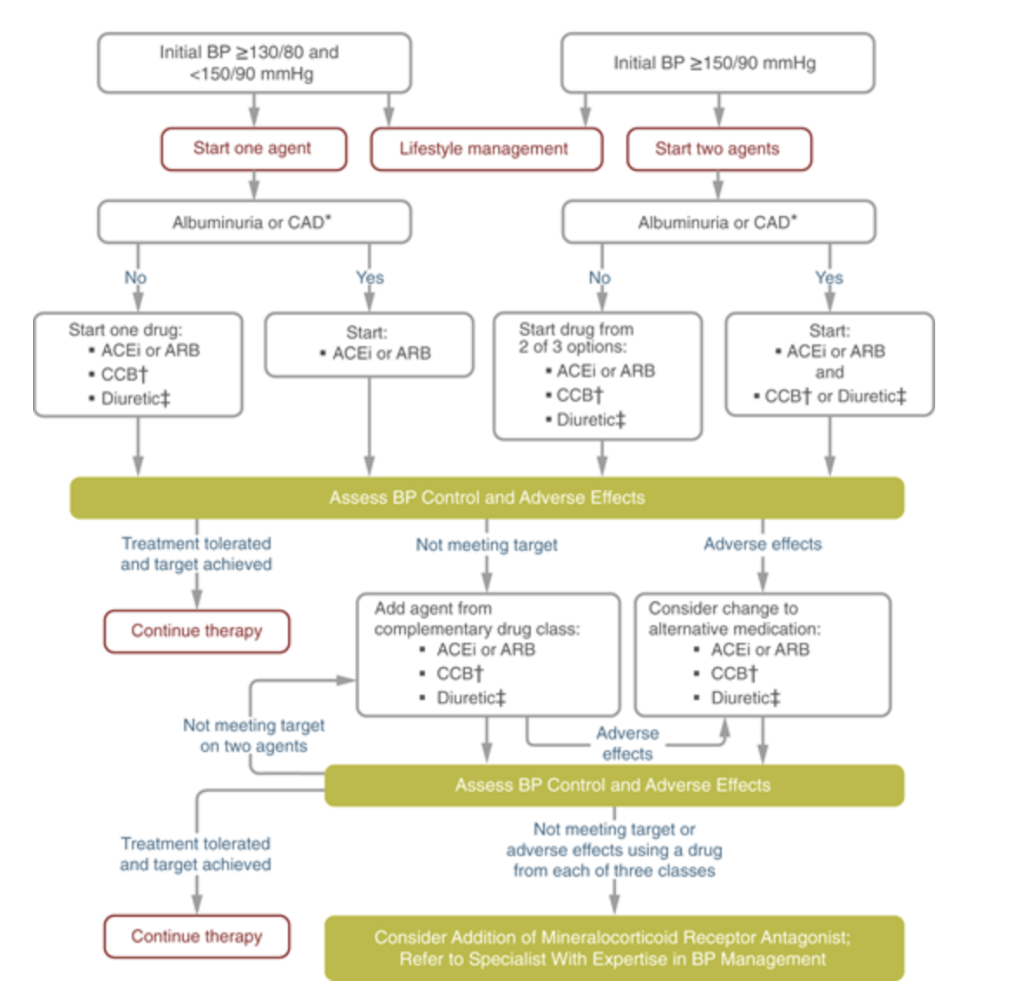

Slide 23
Pharmacologic Interventions
Individuals with confirmed office-based blood pressure ≥130/80 mmHg
Individuals with confirmed office-based blood pressure ≥150/90 mmHg:two drugs
ACE inhibitors or angiotensin receptor blockers (ARBs) are recommended first-line therapy for hypertension in people with diabetes and coronary artery disease. A

Slide 24
Multiple-drug therapy, combinations of ACE inhibitors and ARBs and combinations of ACE inhibitors or ARBs (including ARBs/neprilysin inhibitors) with direct renin inhibitors should not be used.
An ACE inhibitor or ARB, at the maximum tolerated dose indicated for blood pressure treatment, is the recommended first-line treatment for hypertension in people with diabetes and urinary albumin-to-creatinine ratio ≥300 mg/g creatinine A or 30–299 mg/g creatinine.
For adults treated with an ACE inhibitor, ARB, mineralocorticoid receptor antagonist (MRA), or diuretic, serum creatinine/estimated glomerular filtration rate and serum potassium levels should be monitored within 7–14 days after initiation of therapy and at least annually. B

Slide 25
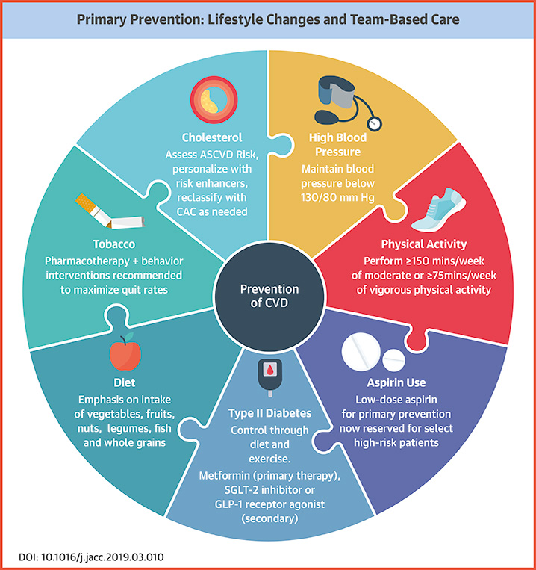

Slide 26
Risk Factors
Nonmodifiable: age, sex, race, FH of CAD
Behavioral RF: smoking, sedentary lifestyle, unhealthy diet, alcohol
Physiological RF: HTN, Obesity, lipids, diabetes

Slide 27
Secondary Prevention

Slide 28
Secondary prevention
CVD events in those with preexisting disease are 5-7 times greater
Diabetes is similar risk as previous HA
Risk factor modification
Categories:
  Stable CAD
  Unstable CAD
  Prior MI
  Prior CABG
  Prior PTCA

Slide 29
Risk predictors for 2 years
BP, Cholesterol, diabetes are predictors of reinfarction, MI
Females have a poorer prognosis
Definite benefit: Cholesterol meds, Aspirin, , smoking cessation, diet and exercise
Probable benefit: Diabetes, low HDL,, Triglycerides
Doubtful: Hormone replacement, antioxidants.

Slide 30
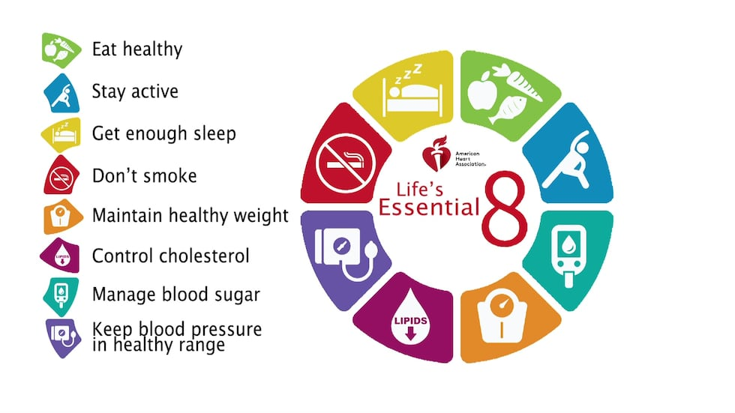

Slide 31
Thank you

