Slide 1
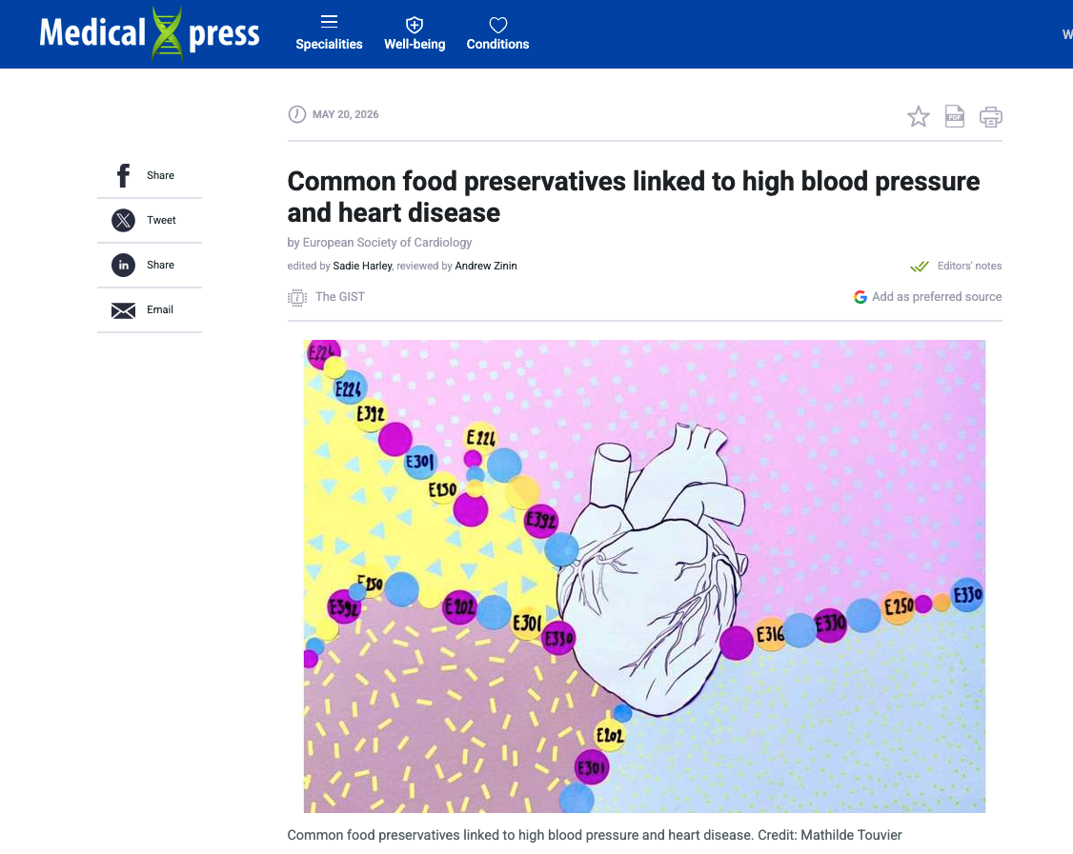
Eating foods that contain common preservative food additives may increase the risks of high blood pressure and cardiovascular disease.

Slide 2
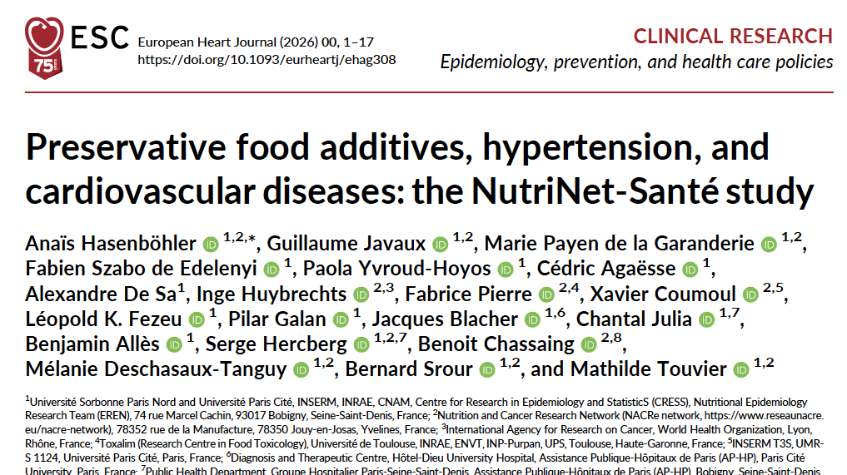
Notes:
French National Institute for Health and Medical Research)

Slide 3
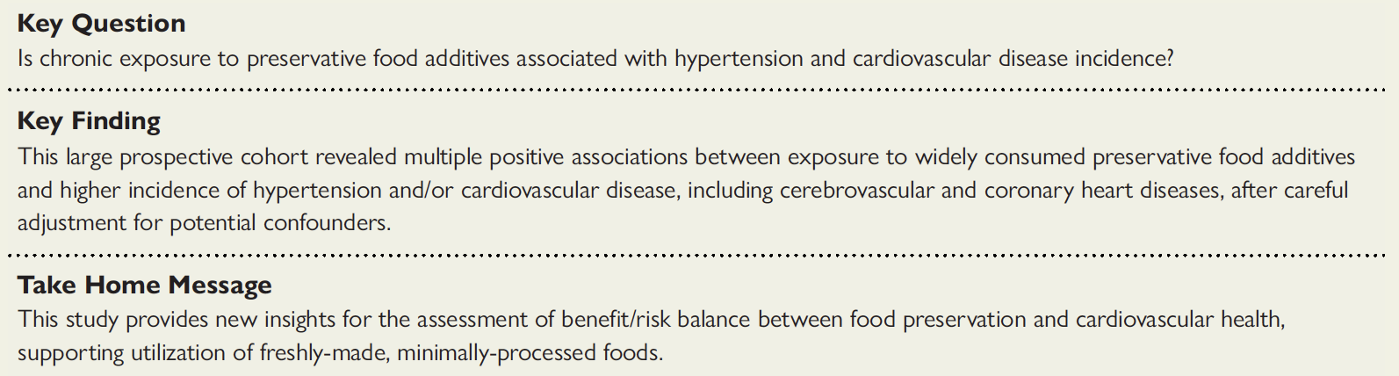

Slide 4
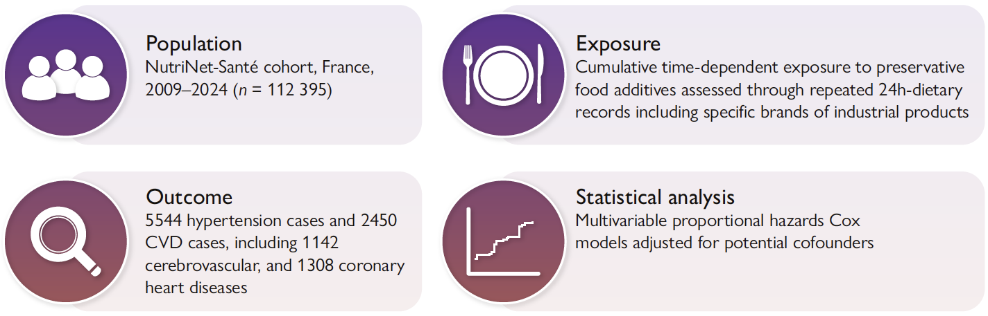

Slide 5
adjusted for age (time scale), sex, height (continuous, m), BMI (continuous, kg/m2), physical activity (categorical IPAQ variable: high, moderate, low), smoking status (never smoked, former smoker, current smoker), number of smoked cigarettes in pack-years (continuous), educational level (less than high school degree, ≤ 3 y after high school degree, > 3 y after high school degree), family history of cardiometabolic disorder/hypertension (yes/no), number of dietary records (continuous), daily intakes of energy without alcohol (continuous, kcal/d), alcohol (continuous, g/d), saturated fats (continuous, g/d), sodium (continuous, mg/d), dietary fibre (continuous, g/d), sugars (continuous, g/d), fruits and vegetables (continuous, g/d), dairy products (continuous, g/d), red and processed meats (continuous, g/d)

Slide 6
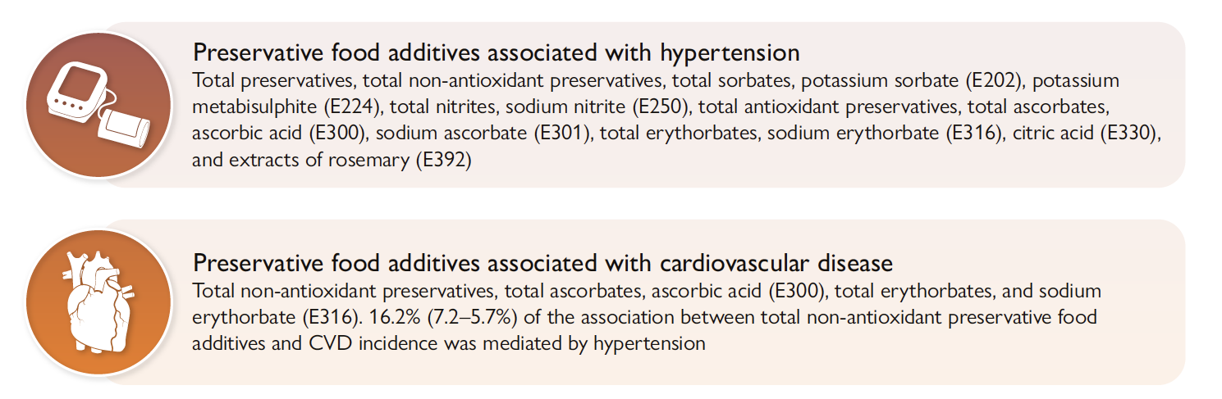
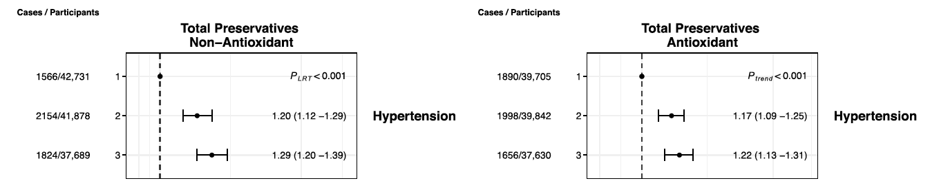

Slide 7
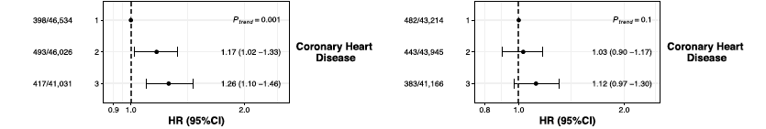

Slide 8
