Slide 1
ATRIAL FIBRILLATION
Radhika Nandur Bukkapatnam MD MAS FACC
3/12/26

Slide 2
2023 ACC/AHA/ACCP/HRS Guidelines for the Diagnosis and Management of Atrial Fibrillation

Slide 3
OBJECTIVES
Definition
Burden of the Problem
Diagnosis
Classification
Management
Risk Factors

Slide 4

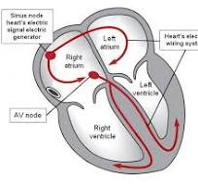
Electrical System of the Heart

Slide 5
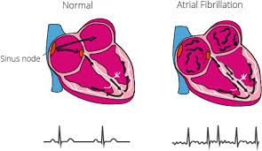
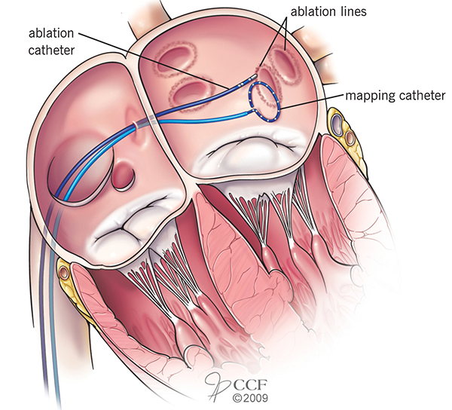
DEFINITION
Irregular, chaotic heart rhythm that comes from the left atrium or the pulmonary veins.
Paroxysmal
Persistent
Chronic

Slide 6


Slide 7
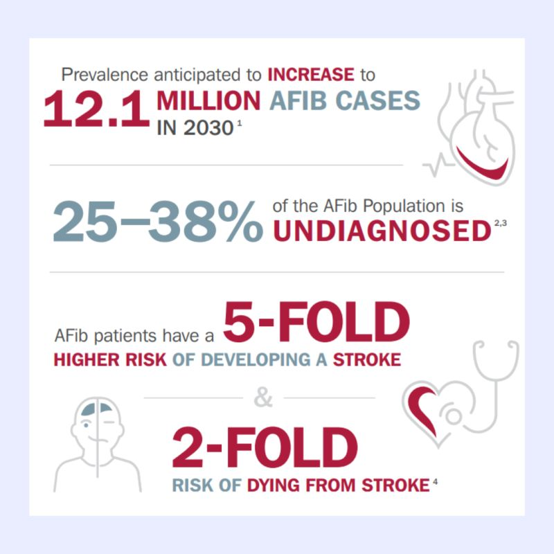

Slide 8
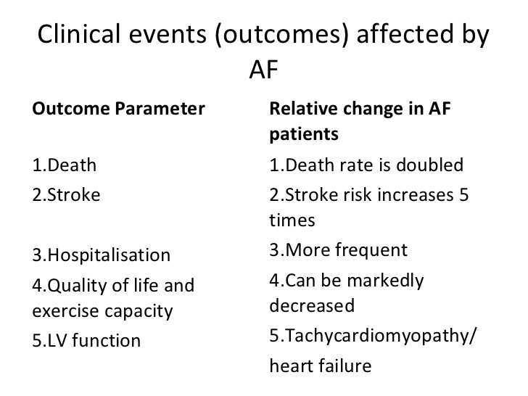

Slide 9
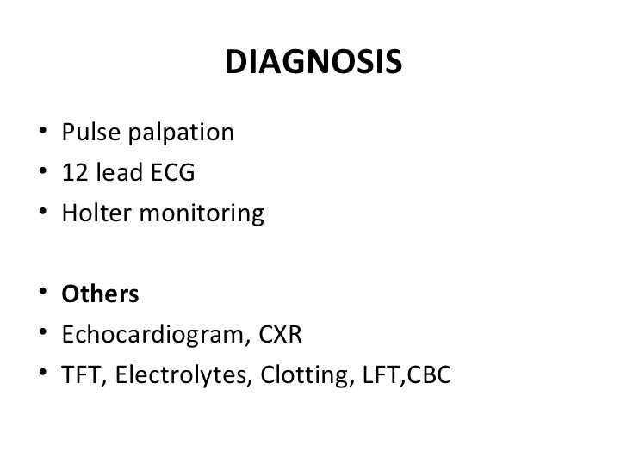

Slide 10

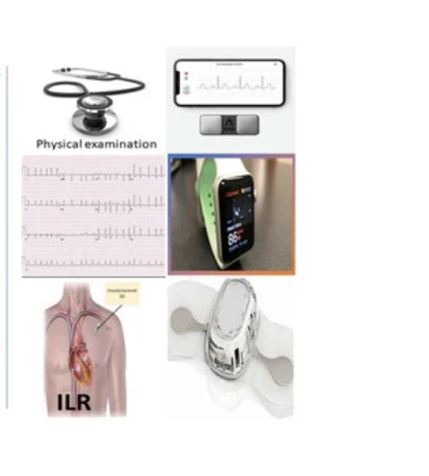

Slide 11
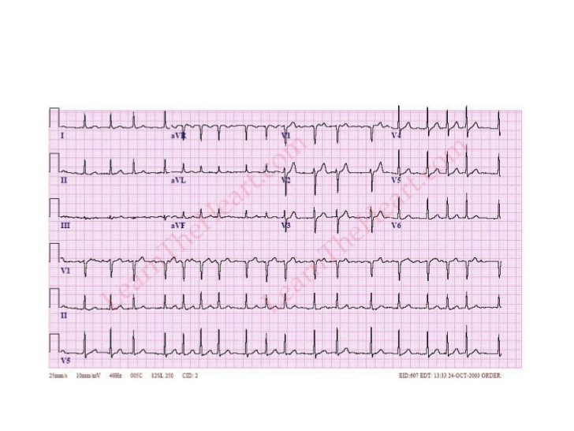
Atrial Fibrillation

Slide 12
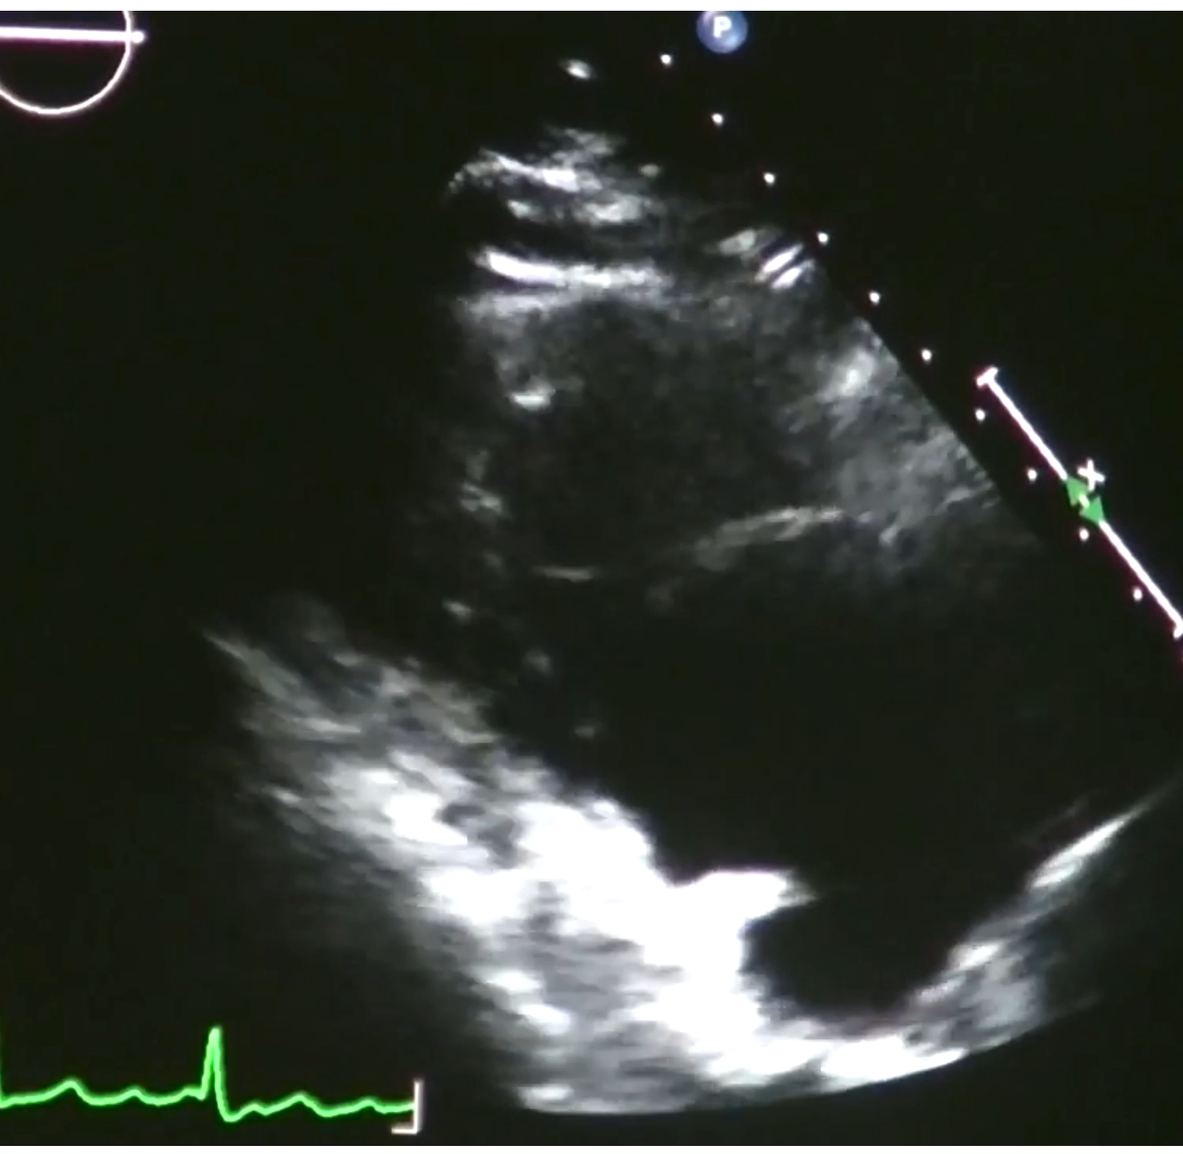

Slide 13
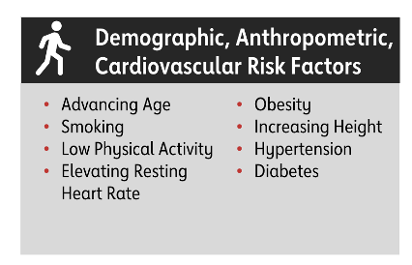
Risk Factors for A fib

Slide 14
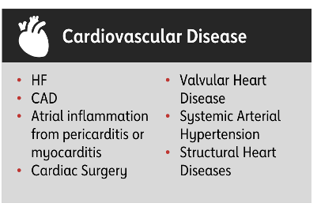


Slide 15
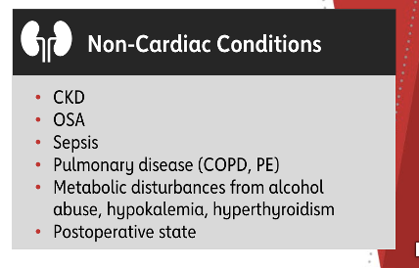

Slide 16
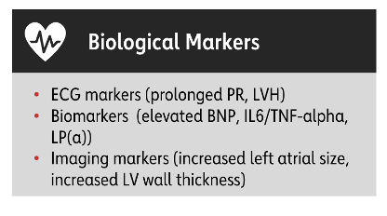

Slide 17


Slide 18
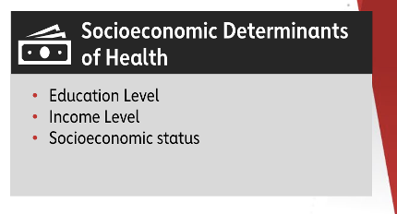

Slide 19
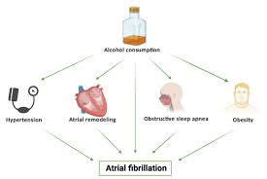

Slide 20
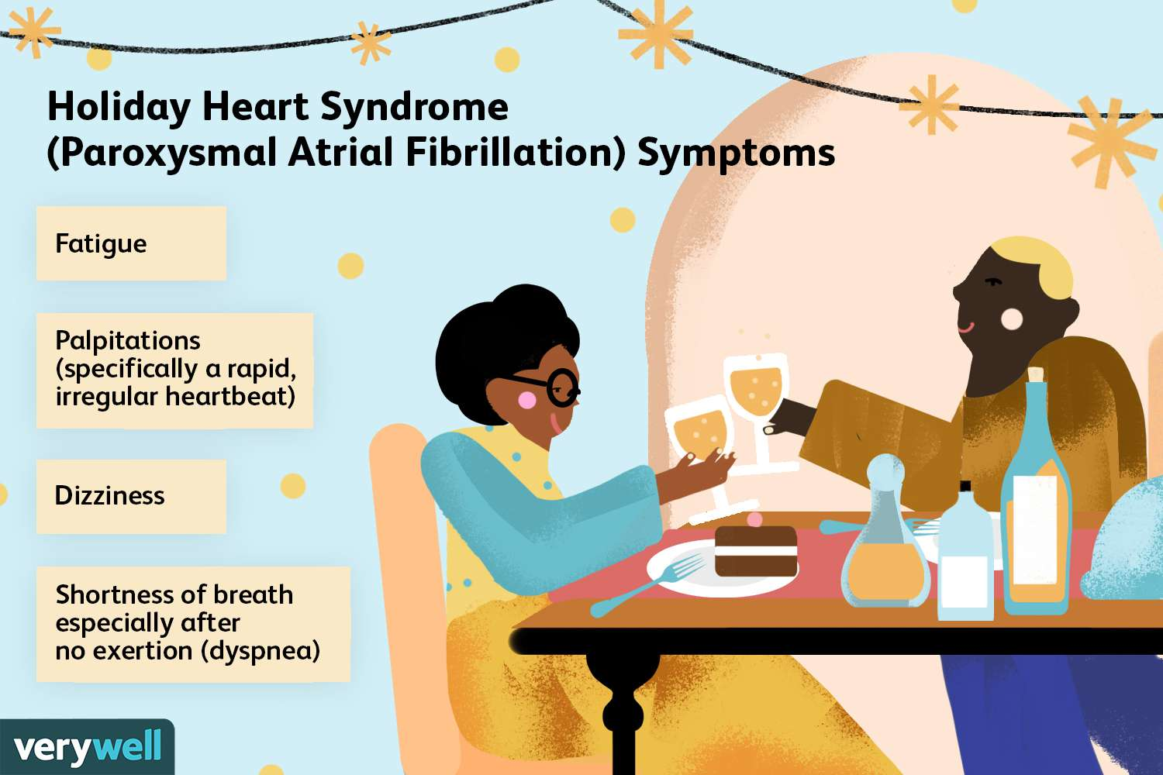

Slide 21
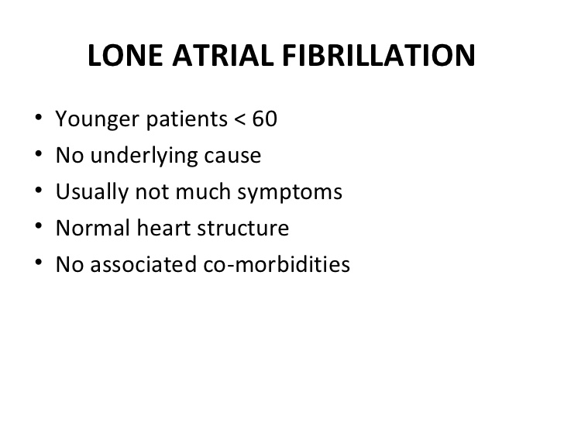

Slide 22
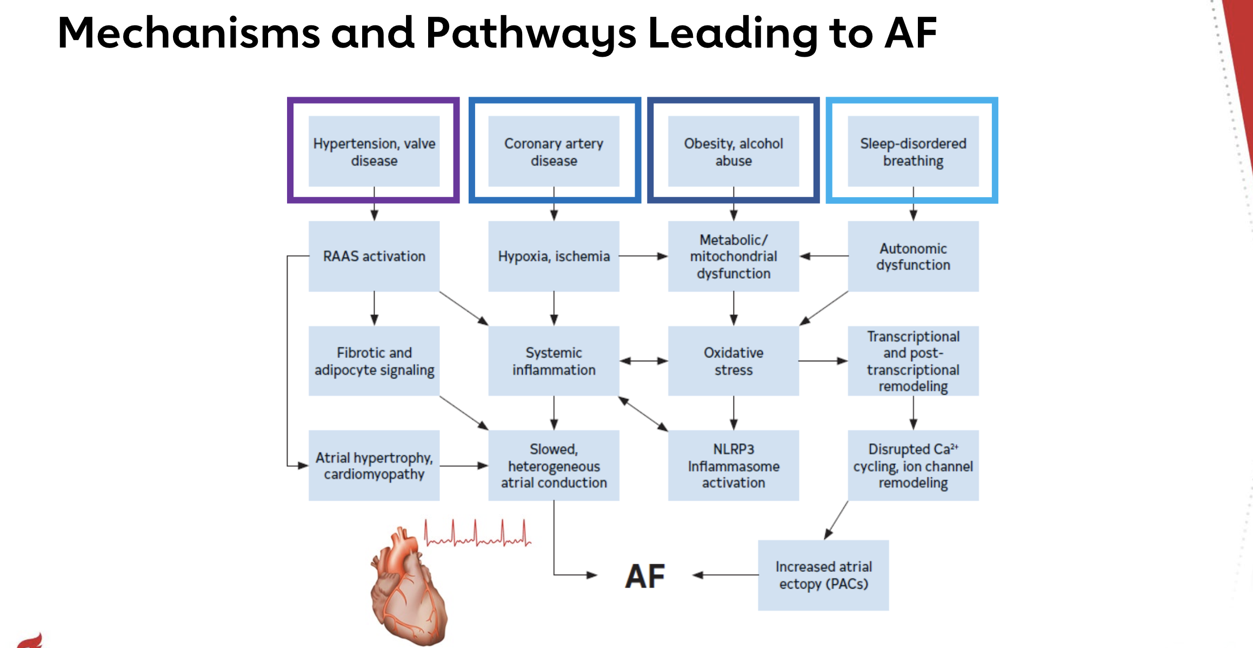

Slide 23
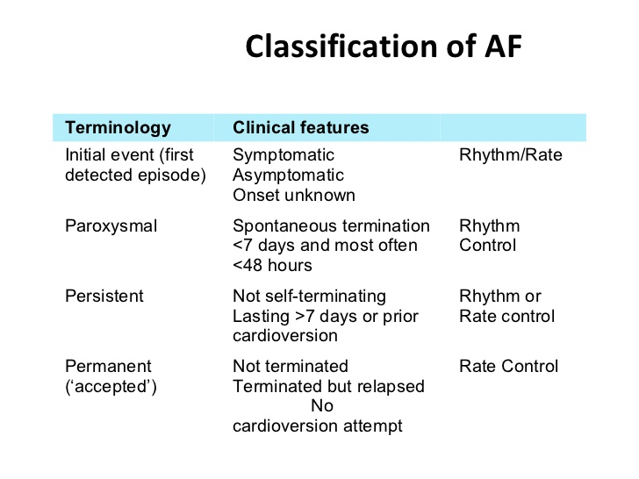

Slide 24
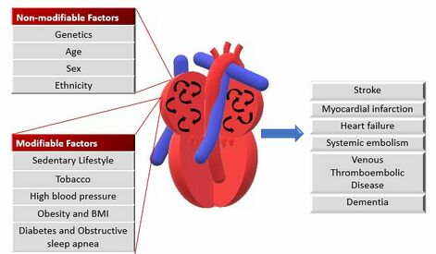

Slide 25
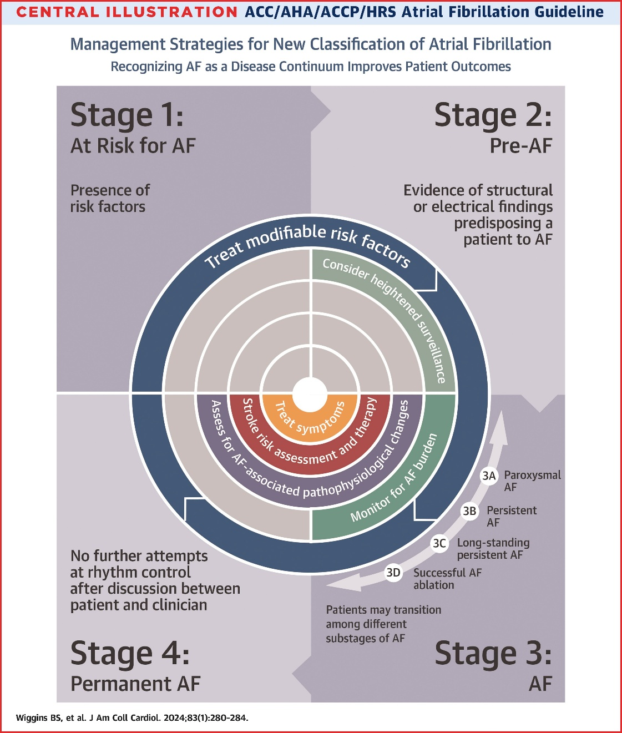
STAGES of ATRIAL FIBRILLATION

Slide 26
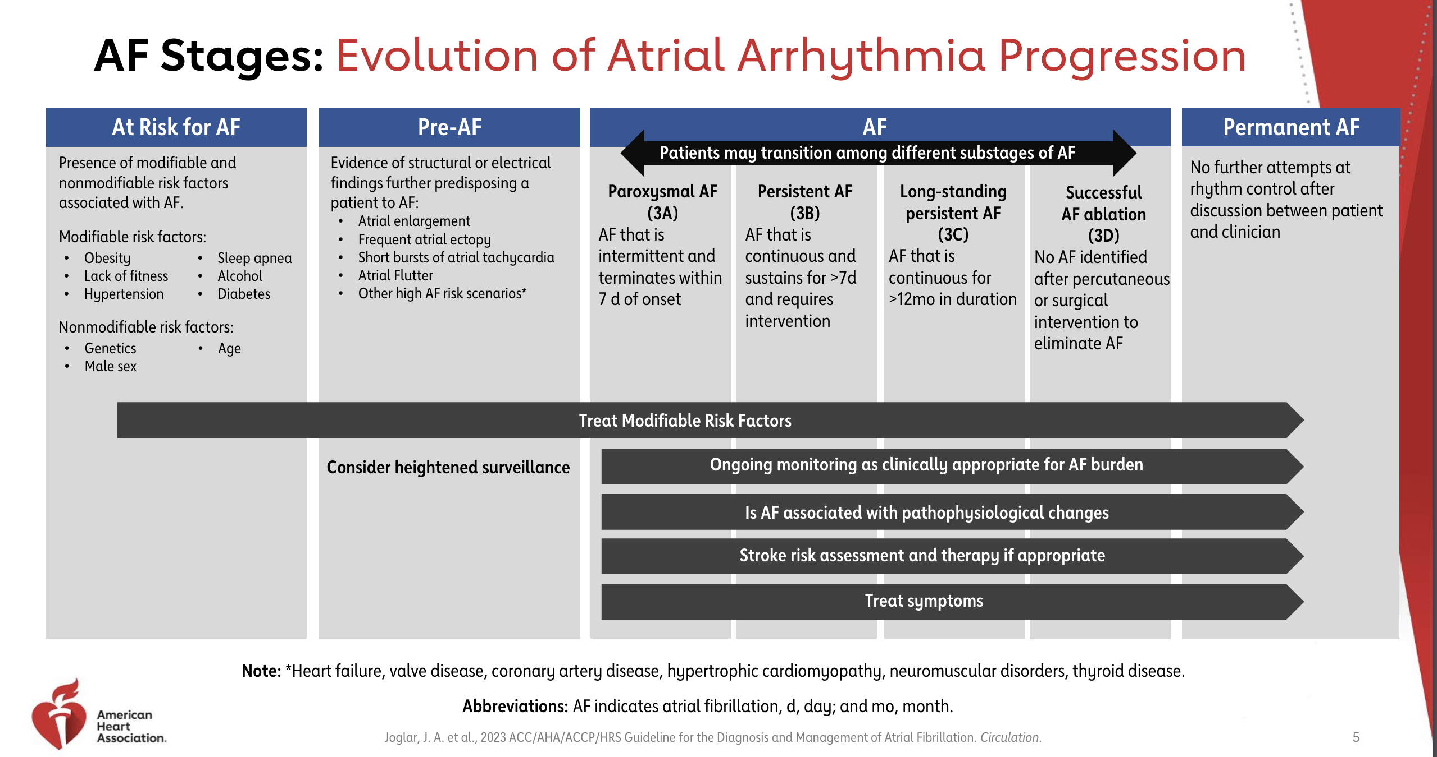

Slide 27
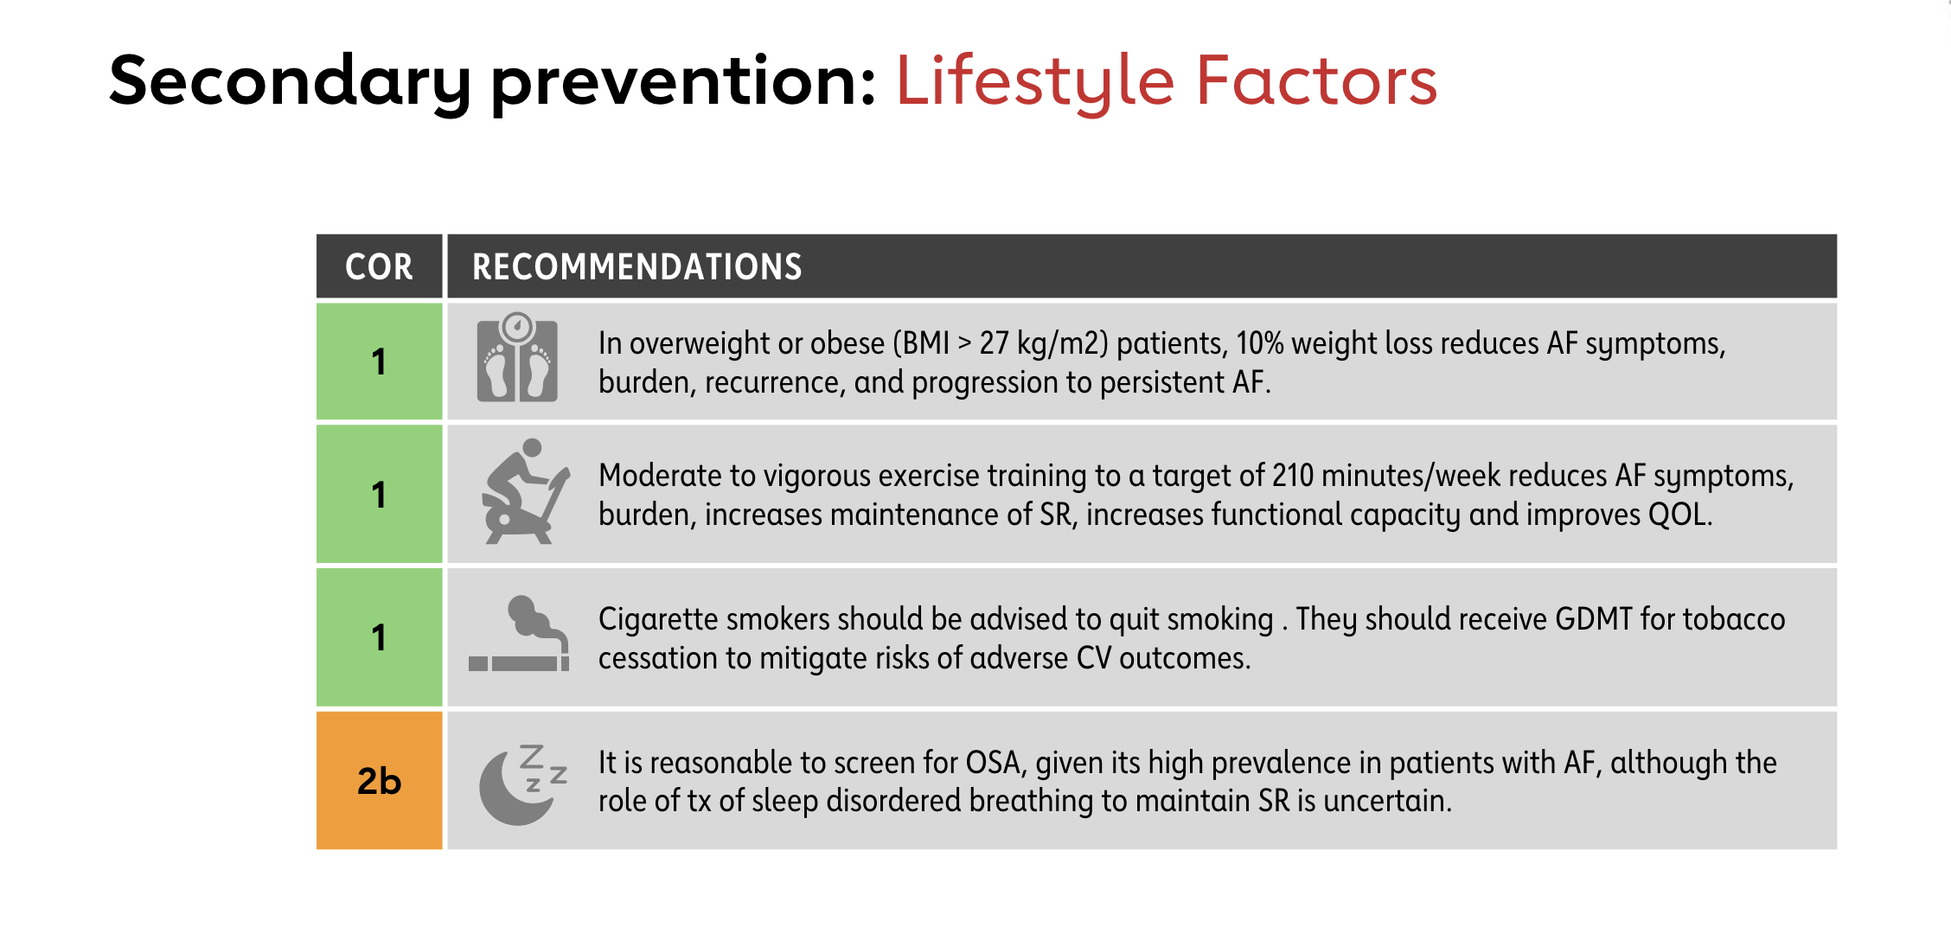

Slide 28
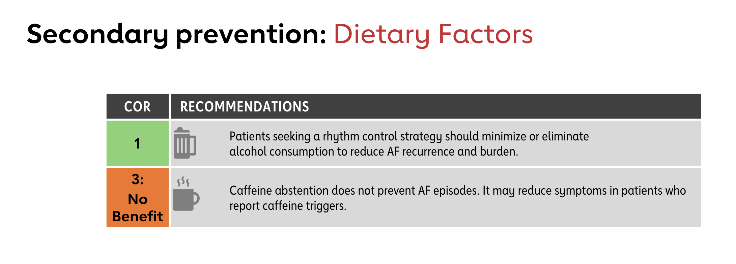

Slide 29
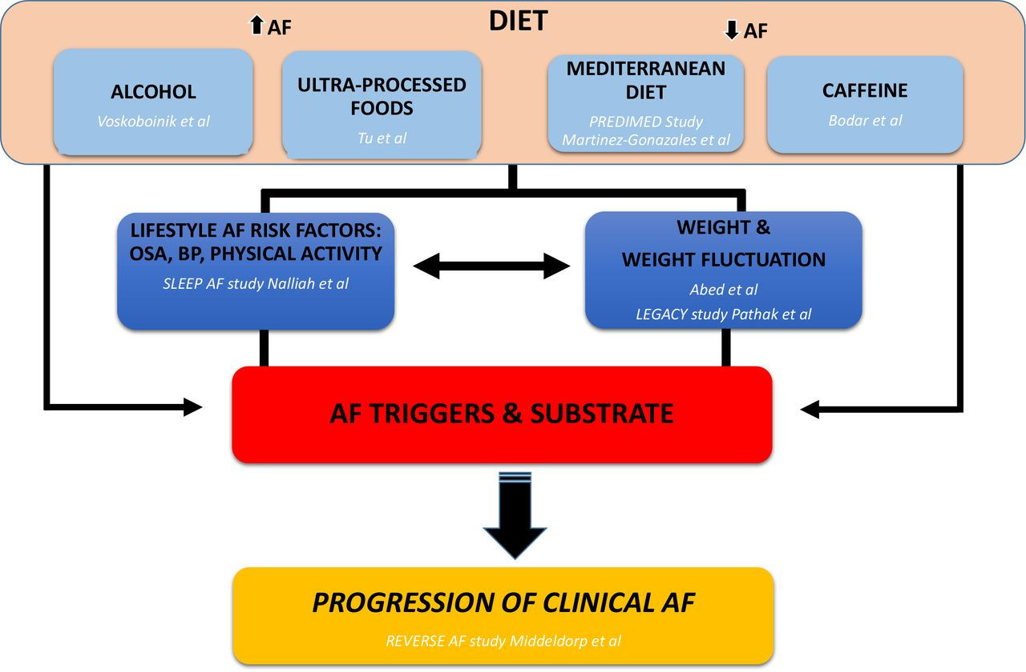

Slide 30
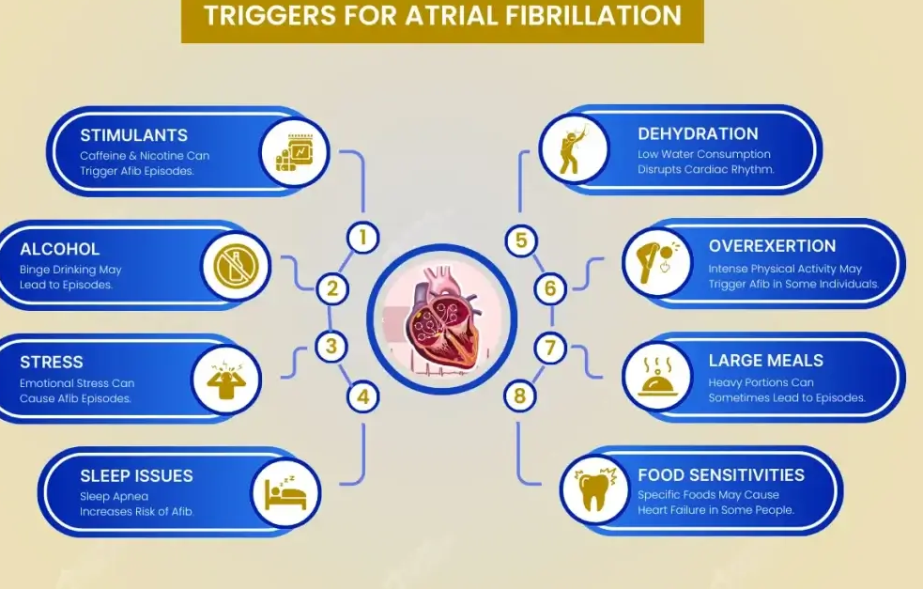

Slide 31
MANAGEMENT OF A FIB
Acute Management
Stroke Prevention
Rate control: For symptoms and to prevent decompensation
Rhythm control: To prevent stroke, dementia, CHF
Prevention

Slide 32
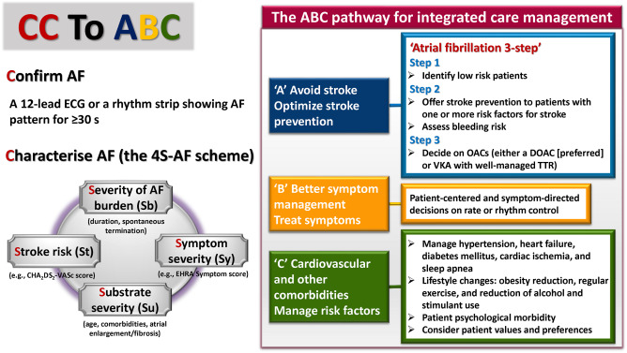

Slide 33
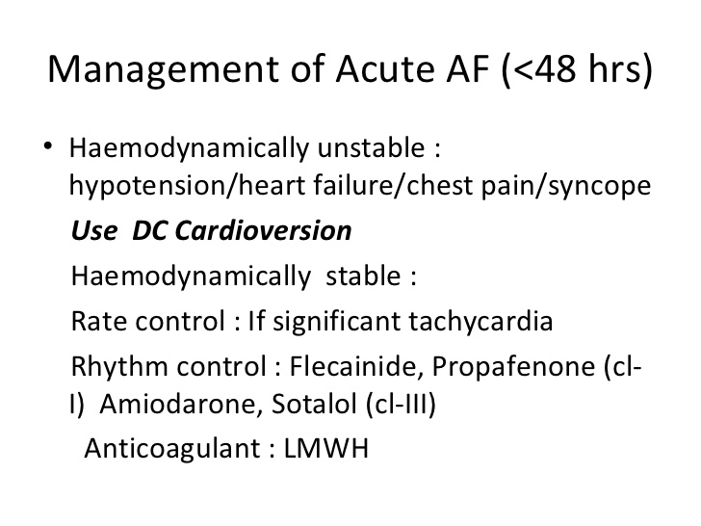
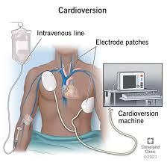

Slide 34
STROKE PREVENTION

Slide 35
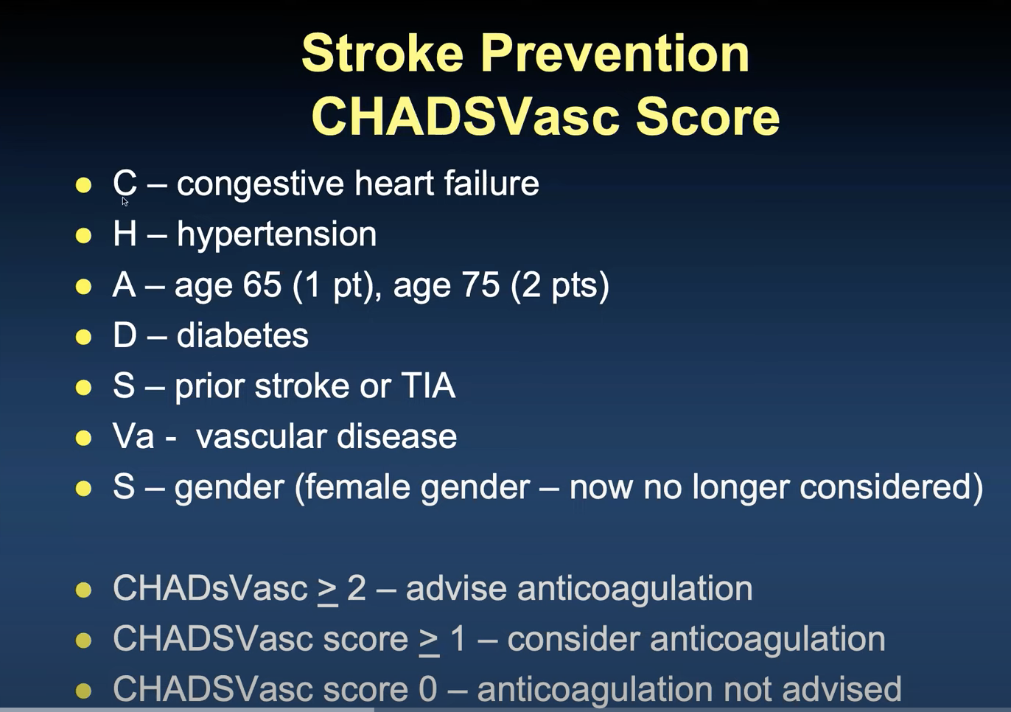

Slide 36
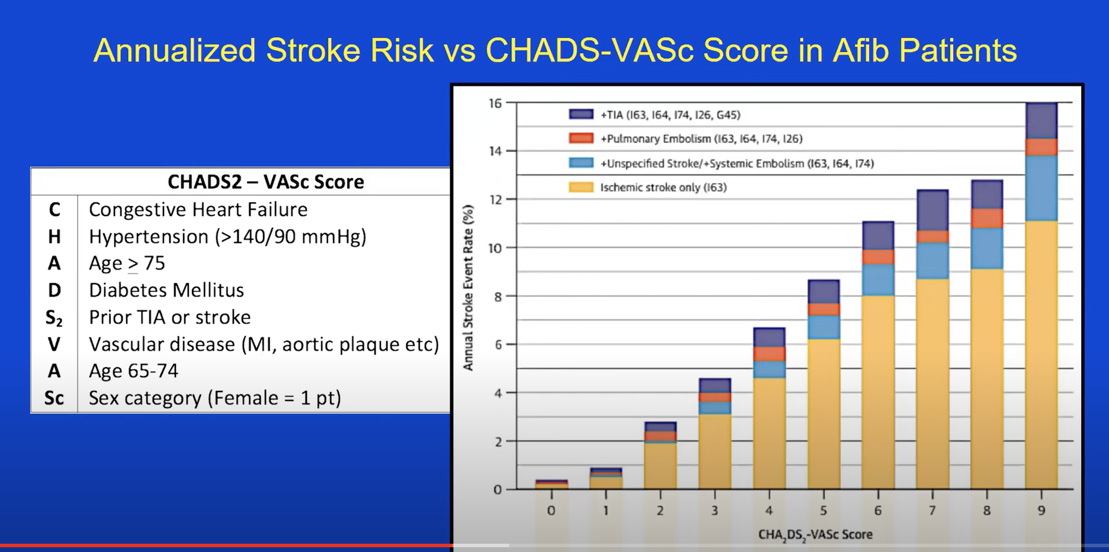

Slide 37
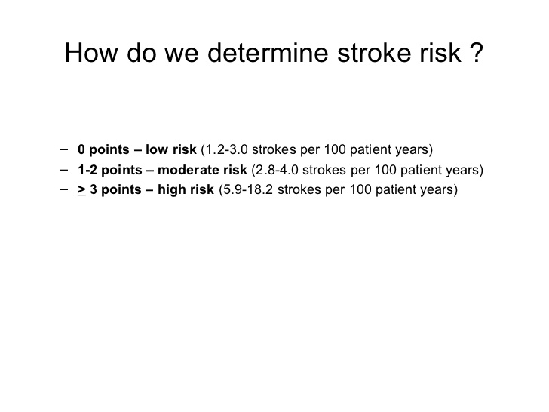

Slide 38
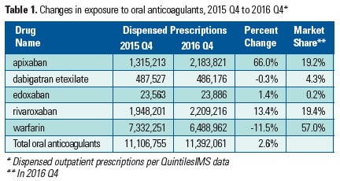
Types of Blood Thinners
z

Slide 39
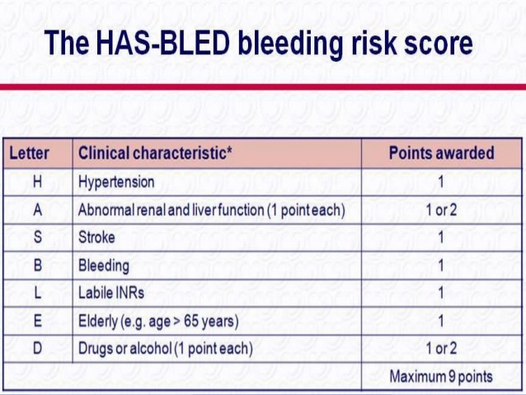

Slide 40
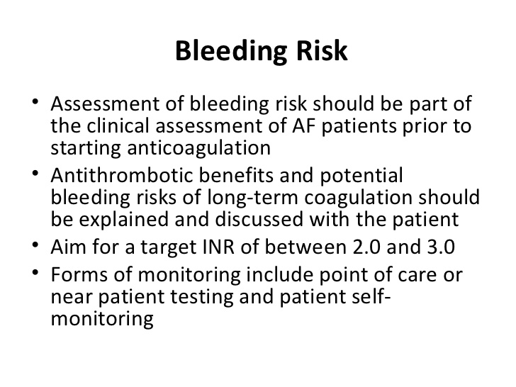

Slide 41
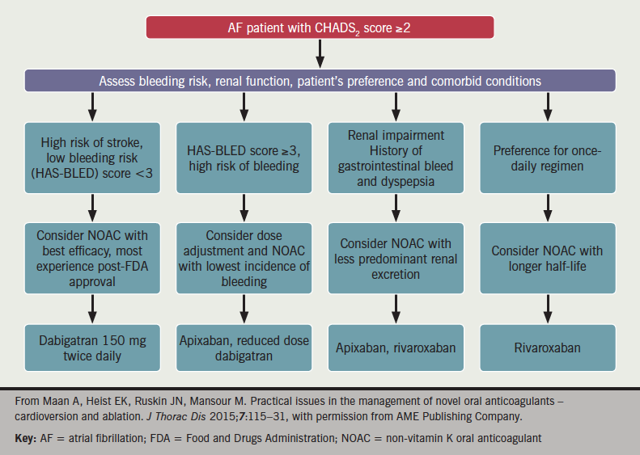
How do we choose blood thinners

Slide 42
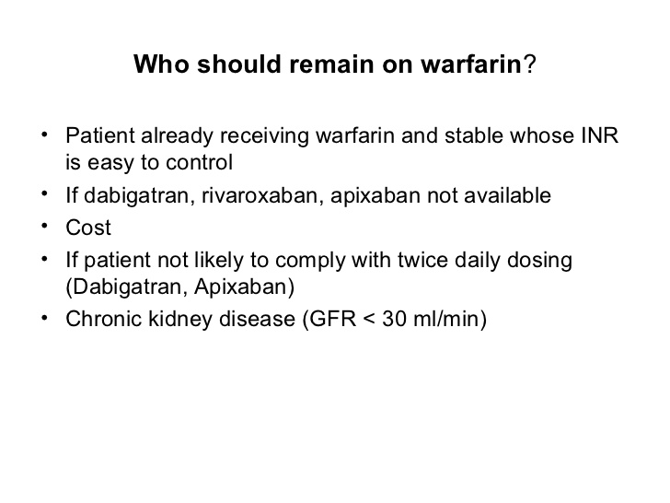

Slide 43
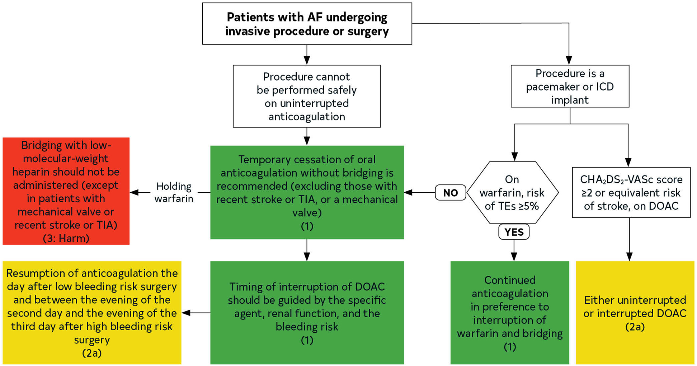

Slide 44
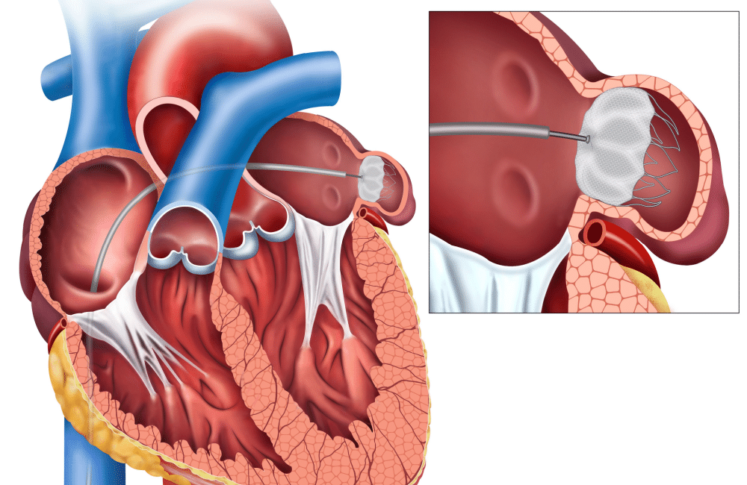
WATCHMAN DEVICE: CLOSURE OF LEFT ATRIAL APPENDAGE

Slide 45
RATE and RHYTHM CONTROL

Slide 46
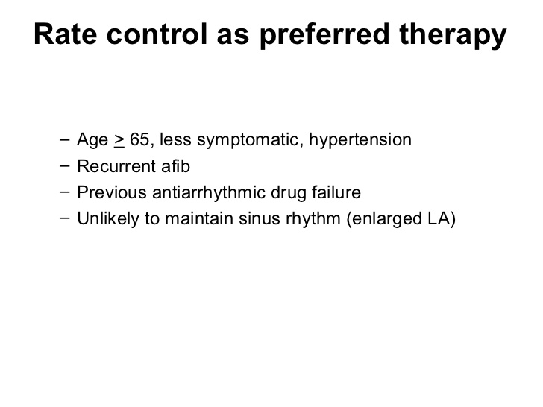

Slide 47
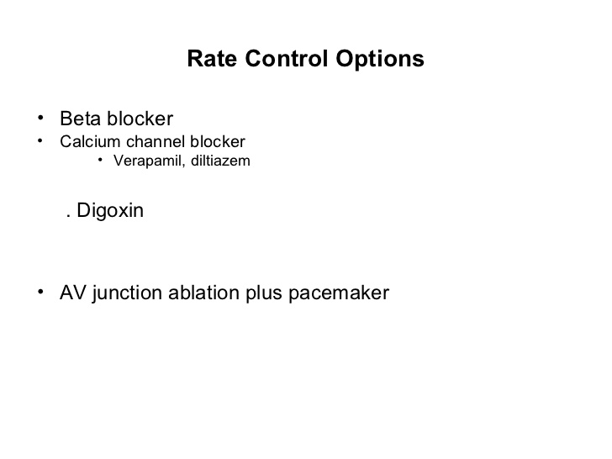

Slide 48
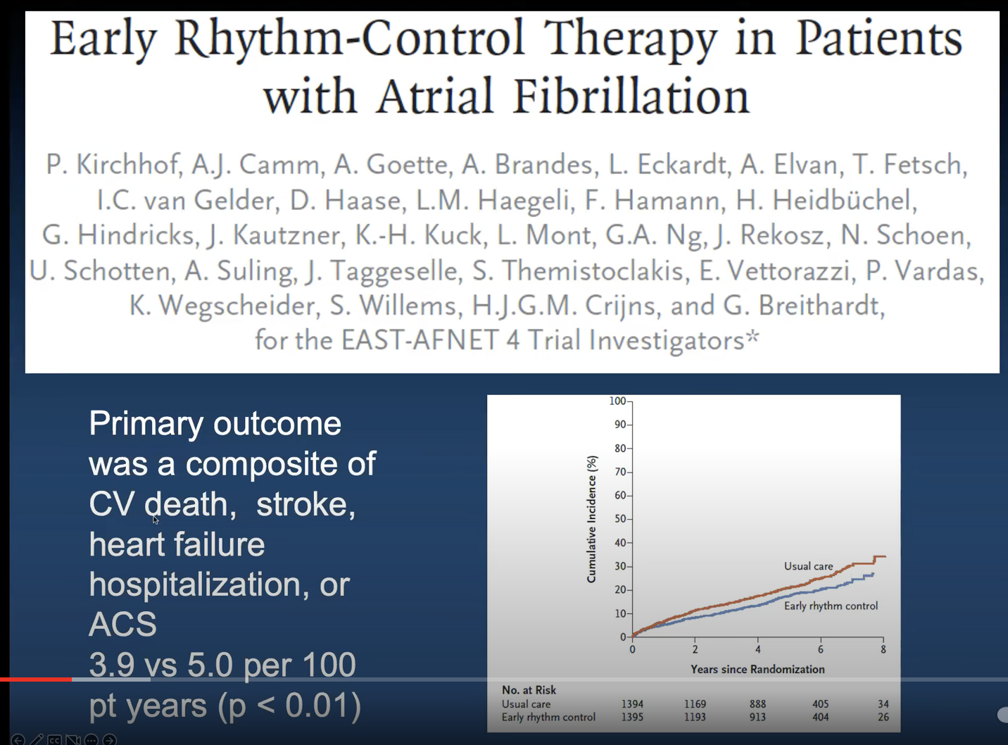

Slide 49
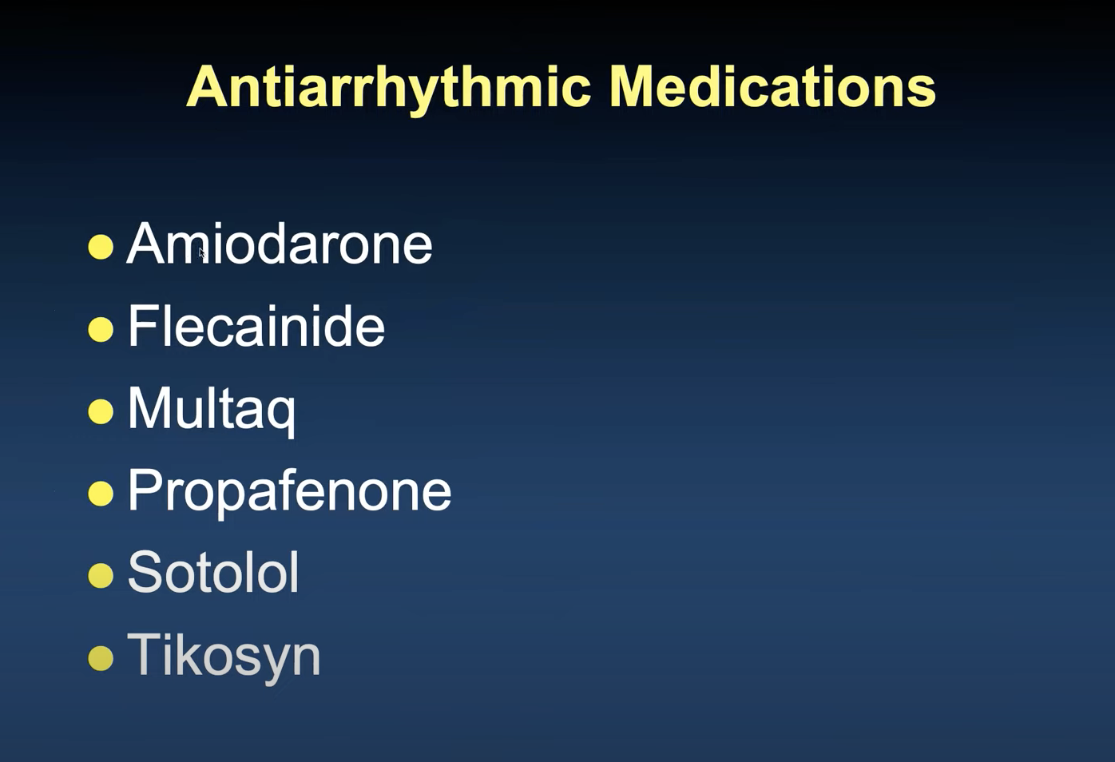

Slide 50
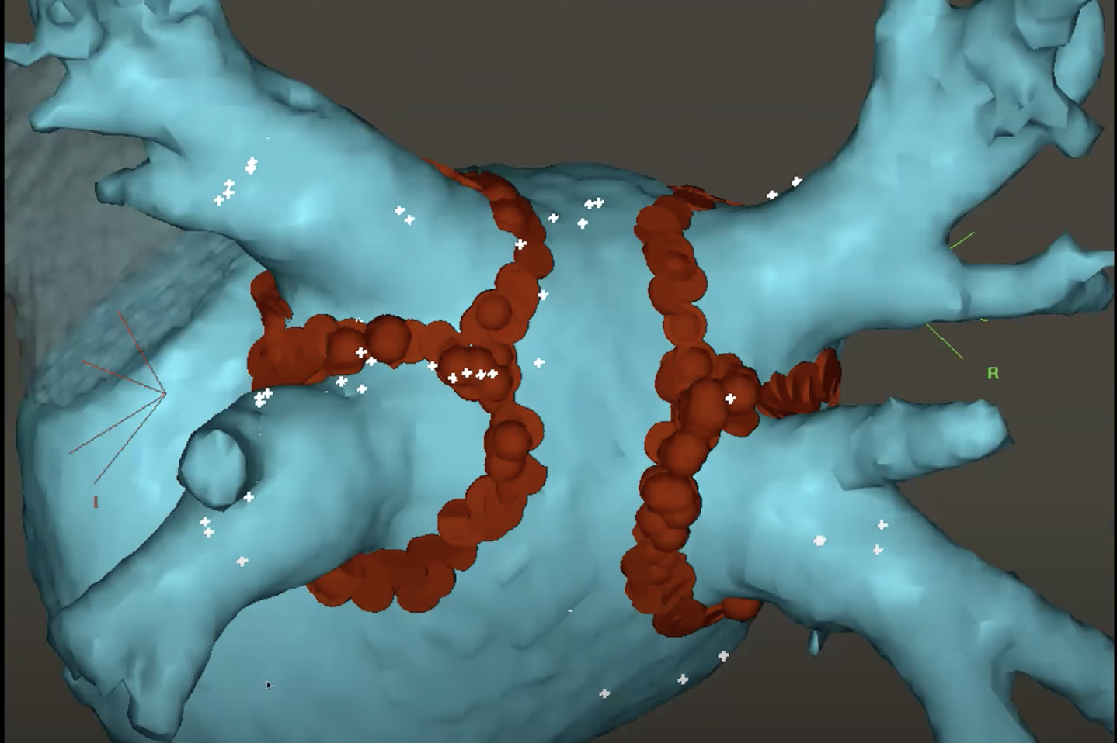

Slide 51
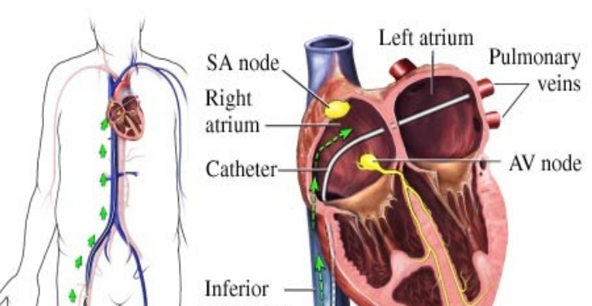
A fib Ablation
z

Slide 52
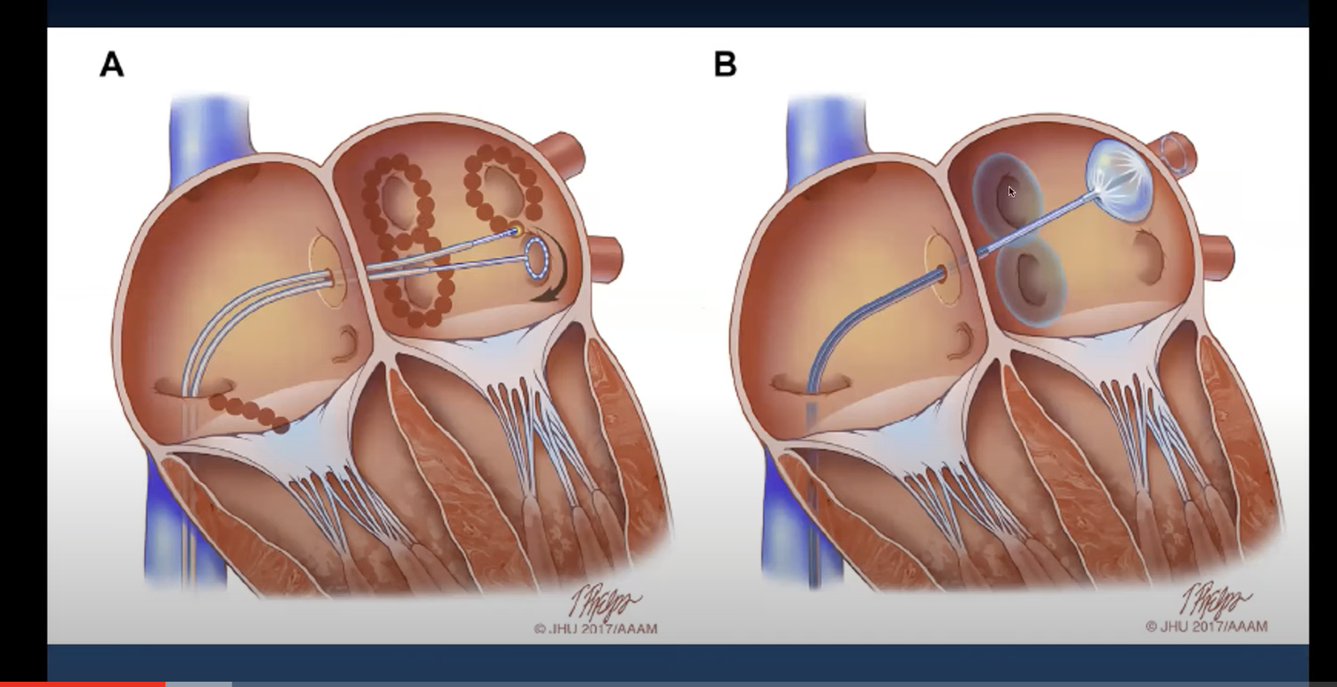
ABLATION

Slide 53
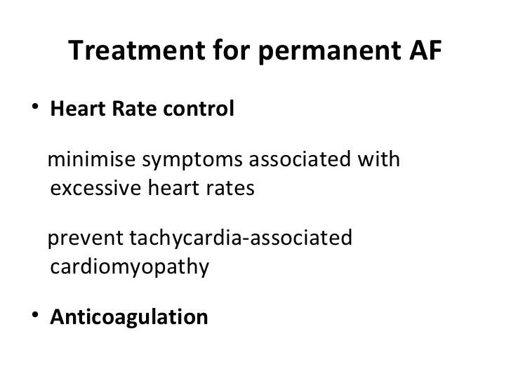

Slide 54
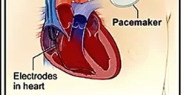
Pacemaker with AV nodal Ablation
z

Slide 55
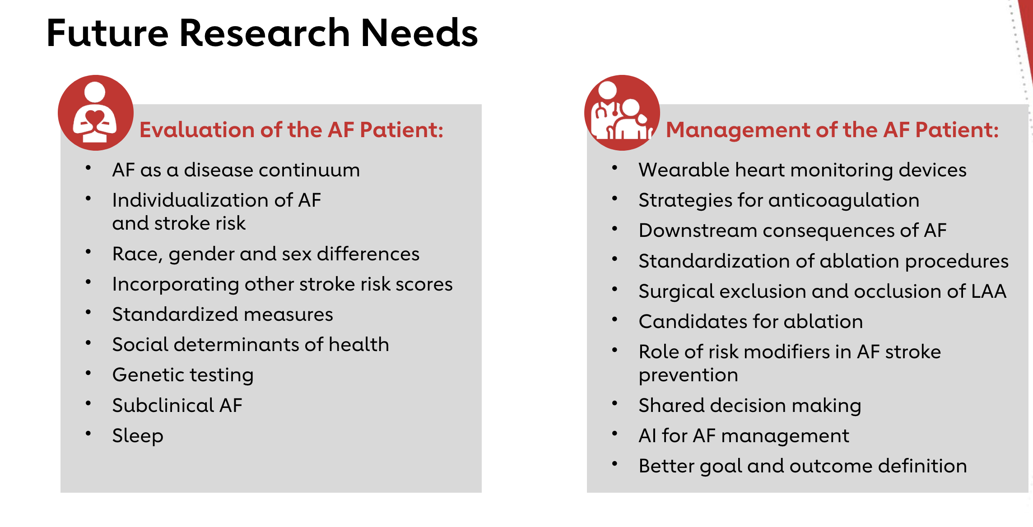

Slide 56
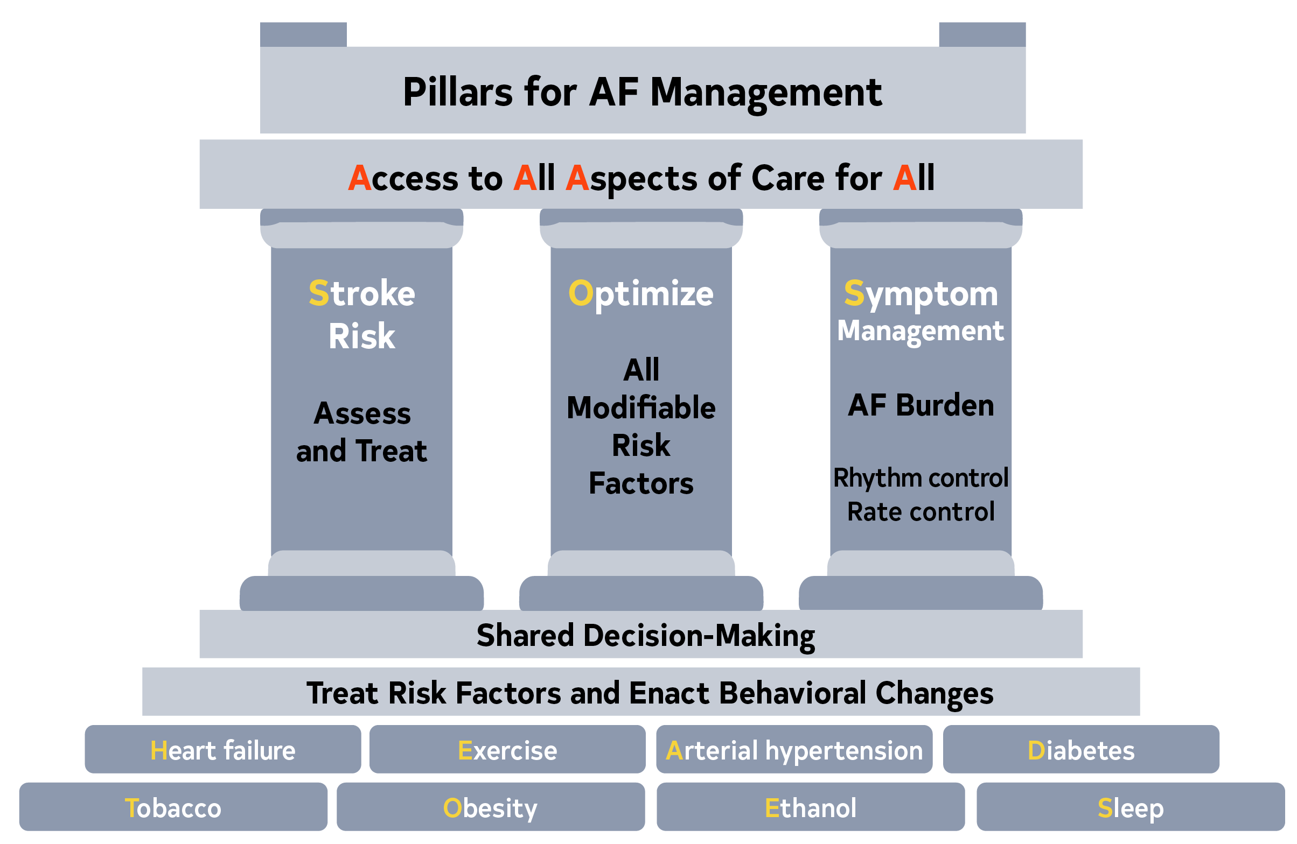
Figure 5. Pillars for AF Management
AF indicates atrial fibrillation.

Slide 57


Slide 58
Thank You

