Slide 1
Diuretics in Heart Disease
Radhika Nandur Bukkapatnam
March 12, 2021

Slide 2
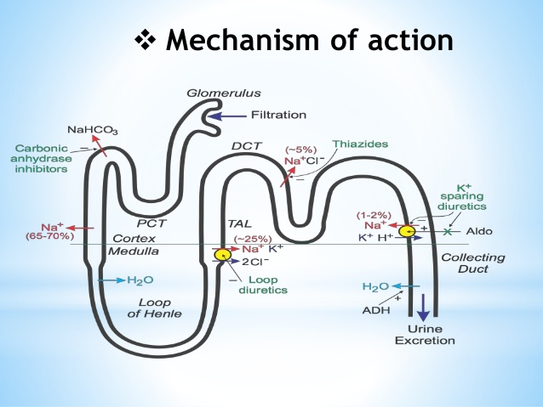

Slide 3
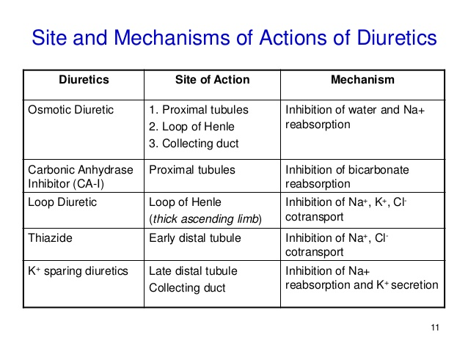

Slide 4
Osmotic Diuretics (All over the nephron)
Mannitol
Used in brain hemorrhages and shocks of certain kinds
Side effects (SE): Complicates CHF and dehydration
New blood sugar medications: GLP 1 inhibitors: Trulicity, Byetta
Used in weight loss, heart failure
Can increase infections

Slide 5
Carbonic anhydrase Inhibitors (Proximal)
Acetazolamide
Used in altitude sickness
Meniere’s disease
Sleep apnea
Glaucoma
SE: Encephalopathy, renal stones
Hypokalemia (Low Potassium), hypophosphatemia (low Potassium)

Slide 6
Loop Diuretics (Loop of Henle)
Torsemide
Furosemide
Bumetenide
Ethacrynic acid (non Sulfa)
Used in CHF, pedal edema
SE: Low Sodium, Potassium, Magnesium, acute renal failure
  Hearing loss

Slide 7
Thiazide Diuretics (Distal)
Hydrochlorothiazide (HCTZ)
Chlorthalidone
Indapamide
Metolazone
Removes Sodium, Potassium and Increase Calcium
Causes diabetes, gout, sulfa related itching.
Can cause low BP , low sodium and potassium

Slide 8
Potassium sparing diuretics
Spironolactone
Eplerenone
Triamterene
Potassium in retained and sodium removed in the distal tubule
Used in Hypertension
Systolic heart failure (Improves Ejection fraction)
Used in Cirrhosis of the liver

Slide 9
Efficiency
High Efficiency Diuretics
  Furosemide
  Torsemide
  Bumetenide
  Metolazone
Moderate Efficiency Diuretics
  HCTZ
  Chlorthalidone
  Indapamide
Low Efficiency Diuretics
  Mannitol
  Acetazolamide

Slide 10
Diuretics in Hypertension
Hydchochlorothiazide (must check potassium, and watch for gout): First line therapy, esp AA
Chlorthalidone (does not remove much gluid)
Indapamide (causes low Potassium)
Aldactone (Can raise Potassium, hair growth, dizziness)

Slide 11
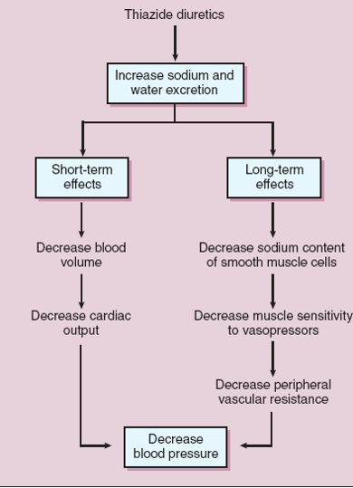

Slide 12
Diuretics in CHF
Diuretics cause forced diuresis in normal functioning kidneys
These are the only drugs that provide rapid symptomatic relief
They aid the working of Betablockers and ACE inhibitors and ARBs
They relieve symptoms, but do not cure the underlying cause
Mix loop diuretics with potassium sparing diuretics
Mix loop diuretics with Metloazone and Potassium

Slide 13
Side effects of Loop and Thiazide diuretics
Hypokalemia
Hyponatremia
Hypomagnesemia
Hypo and hypercalcemia
GI/ CNS side effects
Acute renal failure
Gout
Hearing loss

Slide 14
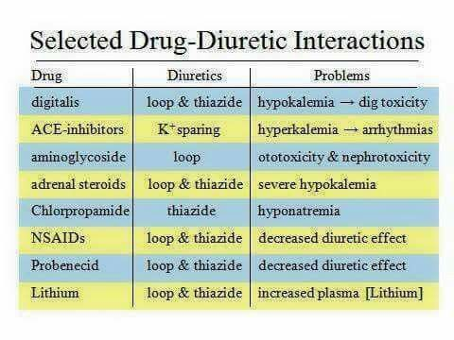

Slide 15


Slide 16
Thank you

