Slide 1
Pharmacological Recommendations for Primary Prevention of Cardiovascular Disease 2022
01/21/2022
Radhika Nandur Bukkapatnam MD

Slide 2
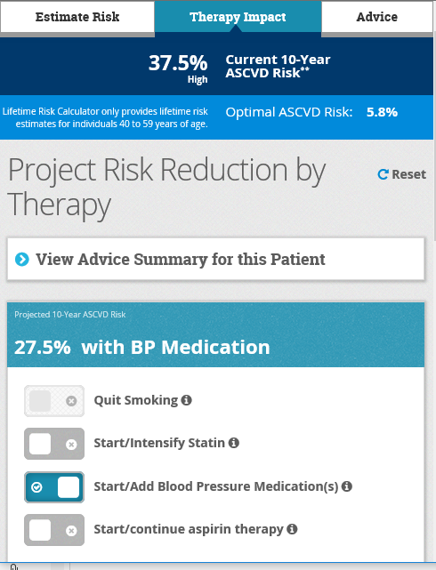
ASSESSMENT of CARDIOVASCULAR RISK Major Risk Factors
Tobacco
Dyslipidemia
Family history of premature ASCVD
Chronic inflammatory diseases
Hypertension
Type 2 diabetes mellitus [T2DM])

Slide 3
ASSESSMENT Of CARDIOVASCULAR RISK
For adults 40 to 75 years of age, clinicians should routinely assess traditional cardiovascular risk factors and calculate 10-year risk of ASCVD by using the pooled cohort equations
For adults 20 to 39 years of age, it is reasonable to assess traditional ASCVD risk factors at least every 4 to 6 years
In adults at
borderline risk 5% to <7.5% or
intermediate risk 7.5—20%
For CVD risk over the next 10 years, we use risk enhancers to decide about medical therapy in ADDITION to diet and lifestyle

Slide 4
Risk Enhancing Factors
Family history of premature ASCVD (men <55 years, women <65 years)
Low-density lipoprotein cholesterol (LDL-C) ≥160 mg/dl
Non-high-density lipoprotein cholesterol (non-HDL-C) ≥190 mg/dl
Chronic kidney disease (estimated glomerular filtration rate [eGFR] <60 ml/min/1.73 m²)
Metabolic syndrome
Pre-eclampsia
Premature menopause (<40 years)
Inflammatory diseases including rheumatoid arthritis, lupus, psoriasis, HIV;
South Asian ancestry
Biomarkers including
Fasting triglycerides ≥175 mg/dl
Lp(a) ≥50 mg/dl
High-sensitivity C-reactive protein ≥2 mg/L
Apolipoprotein B >130 mg/dl
Ankle-brachial index (ABI) <0.9

Slide 5
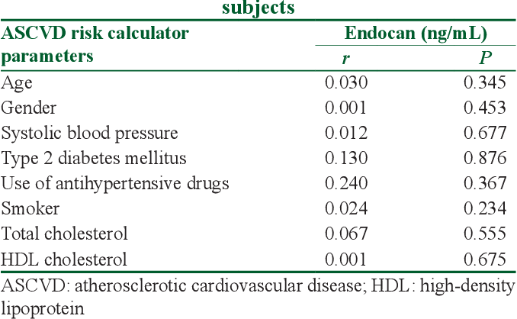

Slide 6
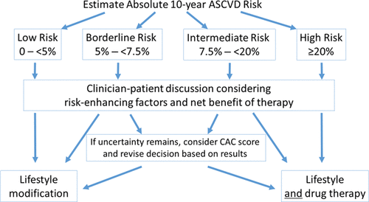
Why do we calculate ASCVD Risk?
It helps focus on the right goal, reducing CVD risk
Predicts events better
Reducing risk by 10% over 10 years:
Prevents 250,000 new cases of CVD
Reduces 35,000 deaths
Saves 2.7 billion dollars
Targets those at maximum risk, thereby reducing disparities

Slide 7
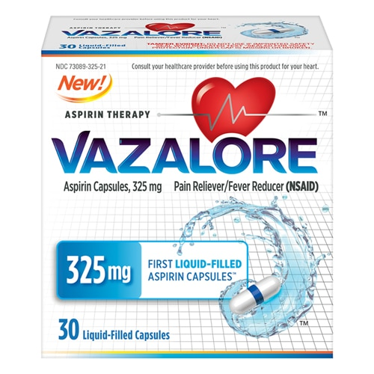
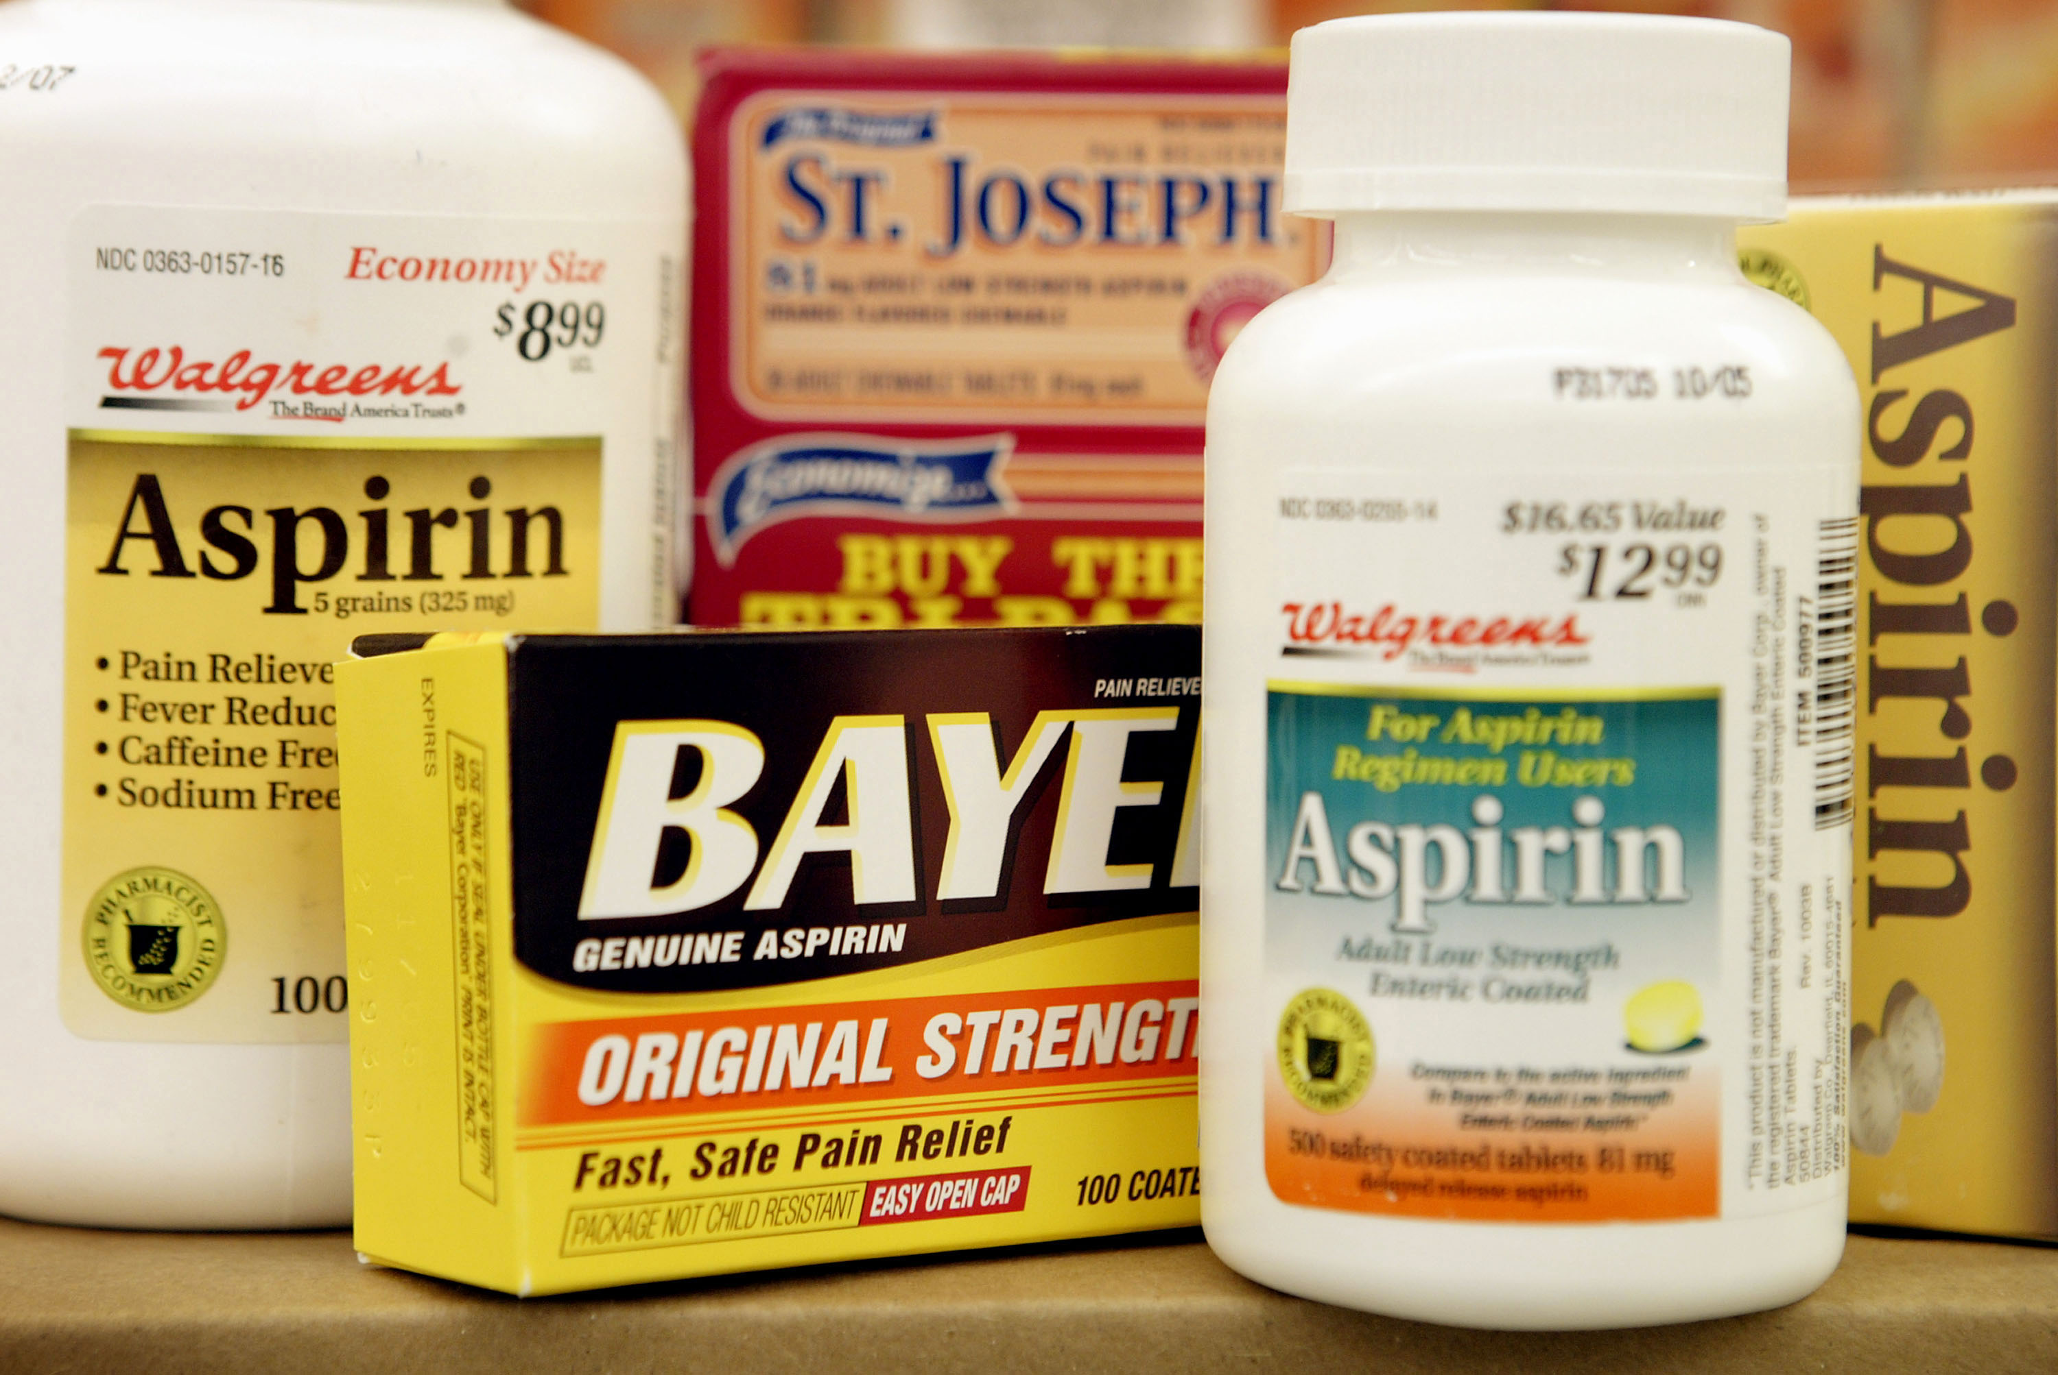
Aspirin

Slide 8
Aspirin:ACC/AHA Guideline on the Primary Prevention of Cardiovascular Disease Oct 12, 2021
Low-dose aspirin might be considered for primary prevention of atherosclerotic cardiovascular disease (ASCVD) in select higher-risk adults ages 40 to 70 years who are not at increased risk of bleeding.
Low-dose aspirin should not be administered on a routine basis for primary prevention of ASCVD among adults younger than 70 years.
Low-dose aspirin should not be administered for primary prevention among adults at any age who are at increased bleeding risk.

Slide 9
US Preventive Services Task Force
This recommendation only applies to people who are at higher risk for CVD, have no history of CVD, and are not already taking daily aspirin
When deciding whether patients should start taking aspirin to prevent a first heart attack or stroke, clinicians should consider age, heart disease risk, and bleeding risk
Increased risk of bleeding including a history of GI bleeding or peptic ulcer disease, bleeding from other sites, age >70 years, thrombocytopenia, coagulopathy, chronic kidney disease, and concurrent use of nonsteroidal anti-inflammatory drugs, steroids, and anticoagulants

Slide 10
Lipid Lowering Agents

Slide 11
Lipid Lowering Therapies
Diet
Weight loss
Niacin: Mainly in pts with elevated Lp (a) or low HDL
Statins
Zetia (non statin)
Fibric acid derivates (“fibrates”): Lowers Triglycerides
Cholesterol binding agents
PCKS 9 inhibitors

Slide 12
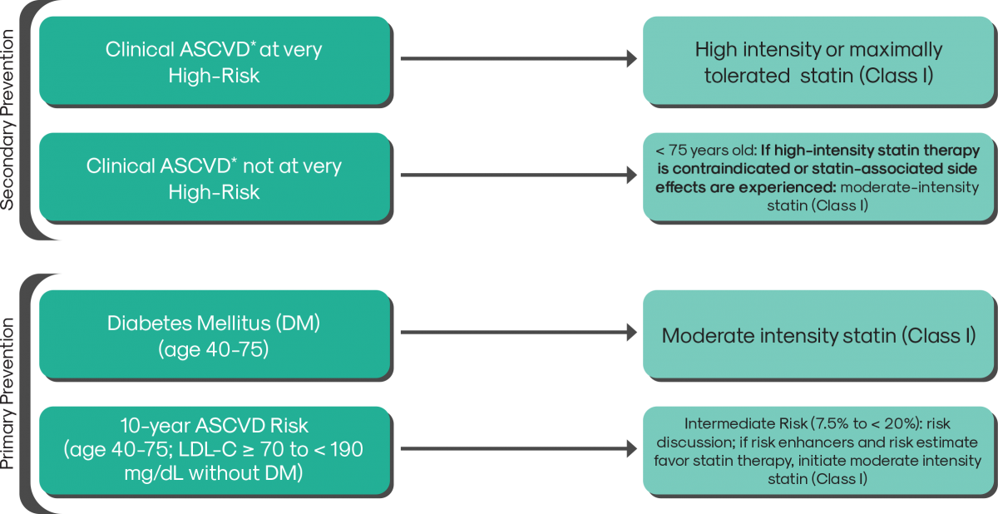

Slide 15
PCKS 9 Inhibitors

Slide 16
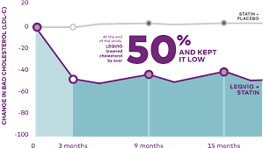

Slide 17
Hypertension
In the United States, hypertension accounts for more ASCVD deaths than any other modifiable risk factor

Slide 18
Risk Associated with Hypertension
The prevalence of stage I hypertension defined as systolic BP (SBP) ≥130 or diastolic BP (DBP) ≥80 mm Hg among US adults is 46%, higher in blacks, Asians, and Hispanic Americans, and increases dramatically with increasing age.
Log-linear association between SBP levels <115 to >180 mm Hg and DBP levels <75 to 105 mm Hg and risk of ASCVD.
In that analysis, 20 mm Hg higher SBP and 10 mm Hg higher DBP were each associated with a doubling in the risk of death from stroke, heart disease, or other vascular disease.
An increased risk of ASCVD is associated with higher SBP and SBP has been reported across a broad age spectrum, from 30 to >80 years of age

Slide 21
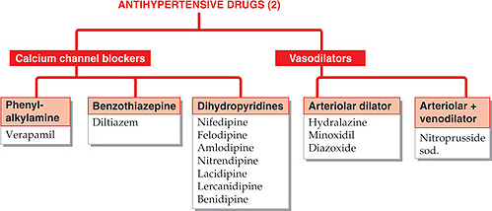

Slide 22
Diabetes Mellitus

Slide 23
Diabetes and Lifestyle
T2DM, defined as a hemoglobin A1c (HbA1c) >6.5%, is a metabolic disorder characterized by insulin resistance leading to hyperglycemia.
The development and progression are heavily influenced by dietary pattern, physical activity, and body weight.
Heart-healthy diet lowers CVD events and CVD mortality: Mediterranean, DASH, and vegetarian/vegan diets that achieve weight loss and improve glycemic control.
At least 150 minutes/week of moderate to vigorous physical activity (aerobic and resistance) in T2DM lowers HbA1c about 0.7% with an additional similar decrease by weight loss.

Slide 24
Drugs that affect CVD Risk
Metformin: old drug: resulted in a 32% reduction in micro- and macrovascular diabetes-related outcomes, a 39% reduction in myocardial infarction, and a 36% reduction in all-cause mortality
Sodium-glucose cotransporter 2 (SGLT-2)
Glucagon-like peptide-1 receptor (GLP-1R) agonists

Slide 25
Sodium-glucose cotransporter 2 (SGLT-2)
Sodium-glucose cotransporter 2 (SGLT-2) inhibitors act in the proximal tubule to increase urinary excretion of glucose and sodium, leading to a reduction in HbA1c, weight, and BP and in randomized clinical trials, significant reduction in ASCVD events and heart failure

Slide 26
Examples of SGLT-2 Inhibitors

Slide 27
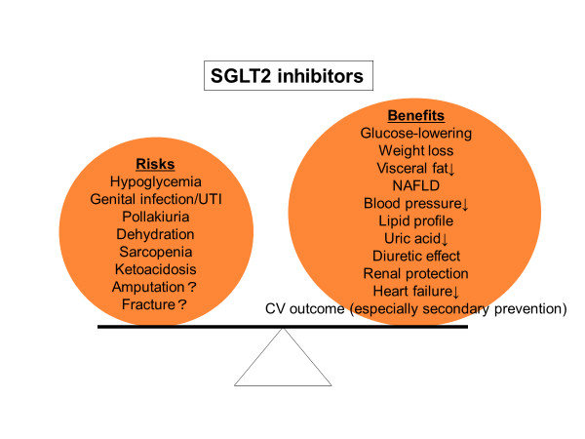

Slide 28
Glucagon-like peptide-1 receptor (GLP-1R) agonists
The glucagon-like peptide-1 receptor (GLP-1R) agonists increase insulin and glucagon production in the liver, increase glucose uptake in muscle and adipose tissue, and decrease hepatic glucose production.
GLP-1R agonists have been found to significantly reduce the risk of ASCVD events in adults with T2DM at high ASCVD risk.
In patients with T2DM and additional risk factors for CVD, it may be reasonable to initiate these two classes of medications for primary prevention of CVD.

Slide 29
Mechanism of Action of GLP 1 Agonists

Slide 30
Examples of GLP-1 Agonists

Slide 31
Beneficial Effects on Cardiovascular system

Slide 33
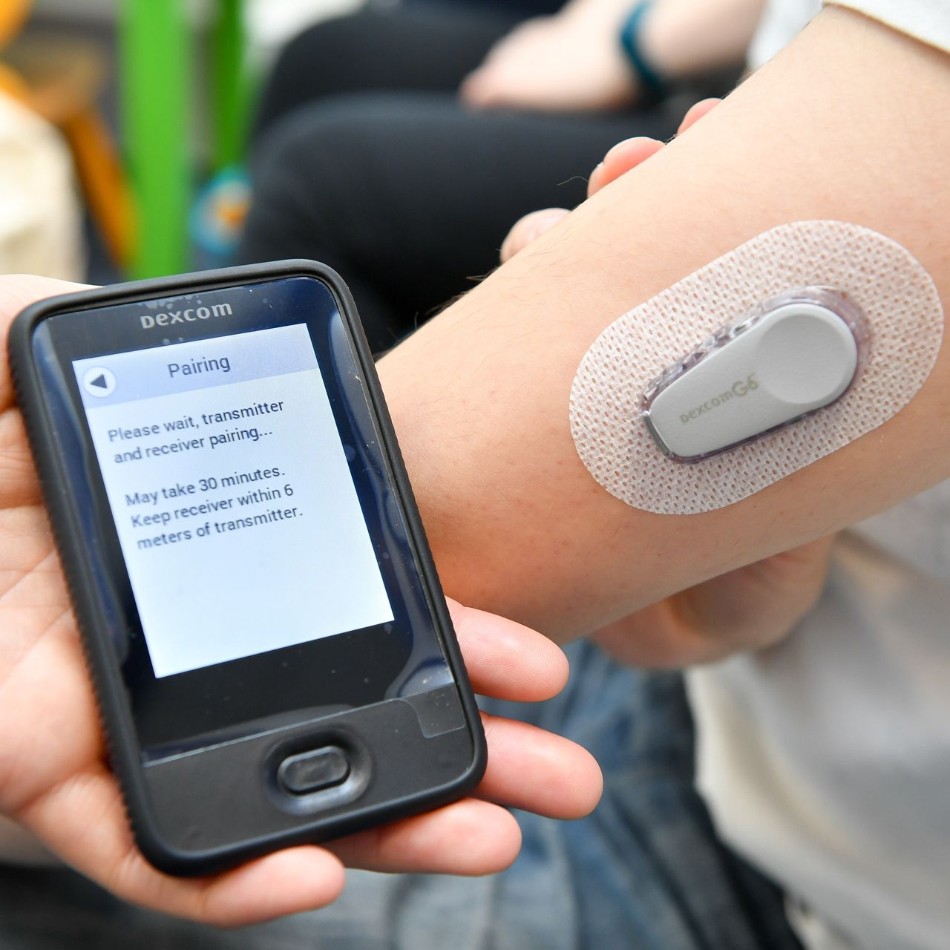
Continuos Glucose Monitoring Devices

Slide 34
Thank you

