Slide 1

Tips on Caring for the Caregiver
CSUS Cardiovascular Wellness Program
Psychosocial Wellness Series
By Linda Goode LCSW

Slide 2
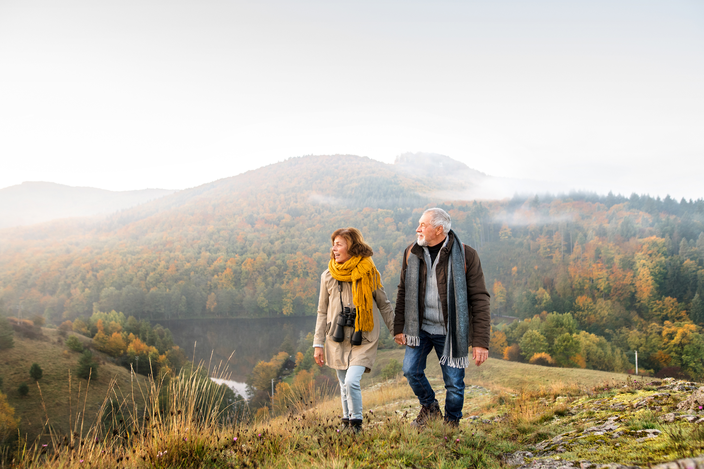
Imagine you are taking a journey together with someone you love through the ups and downs of life….

Slide 3
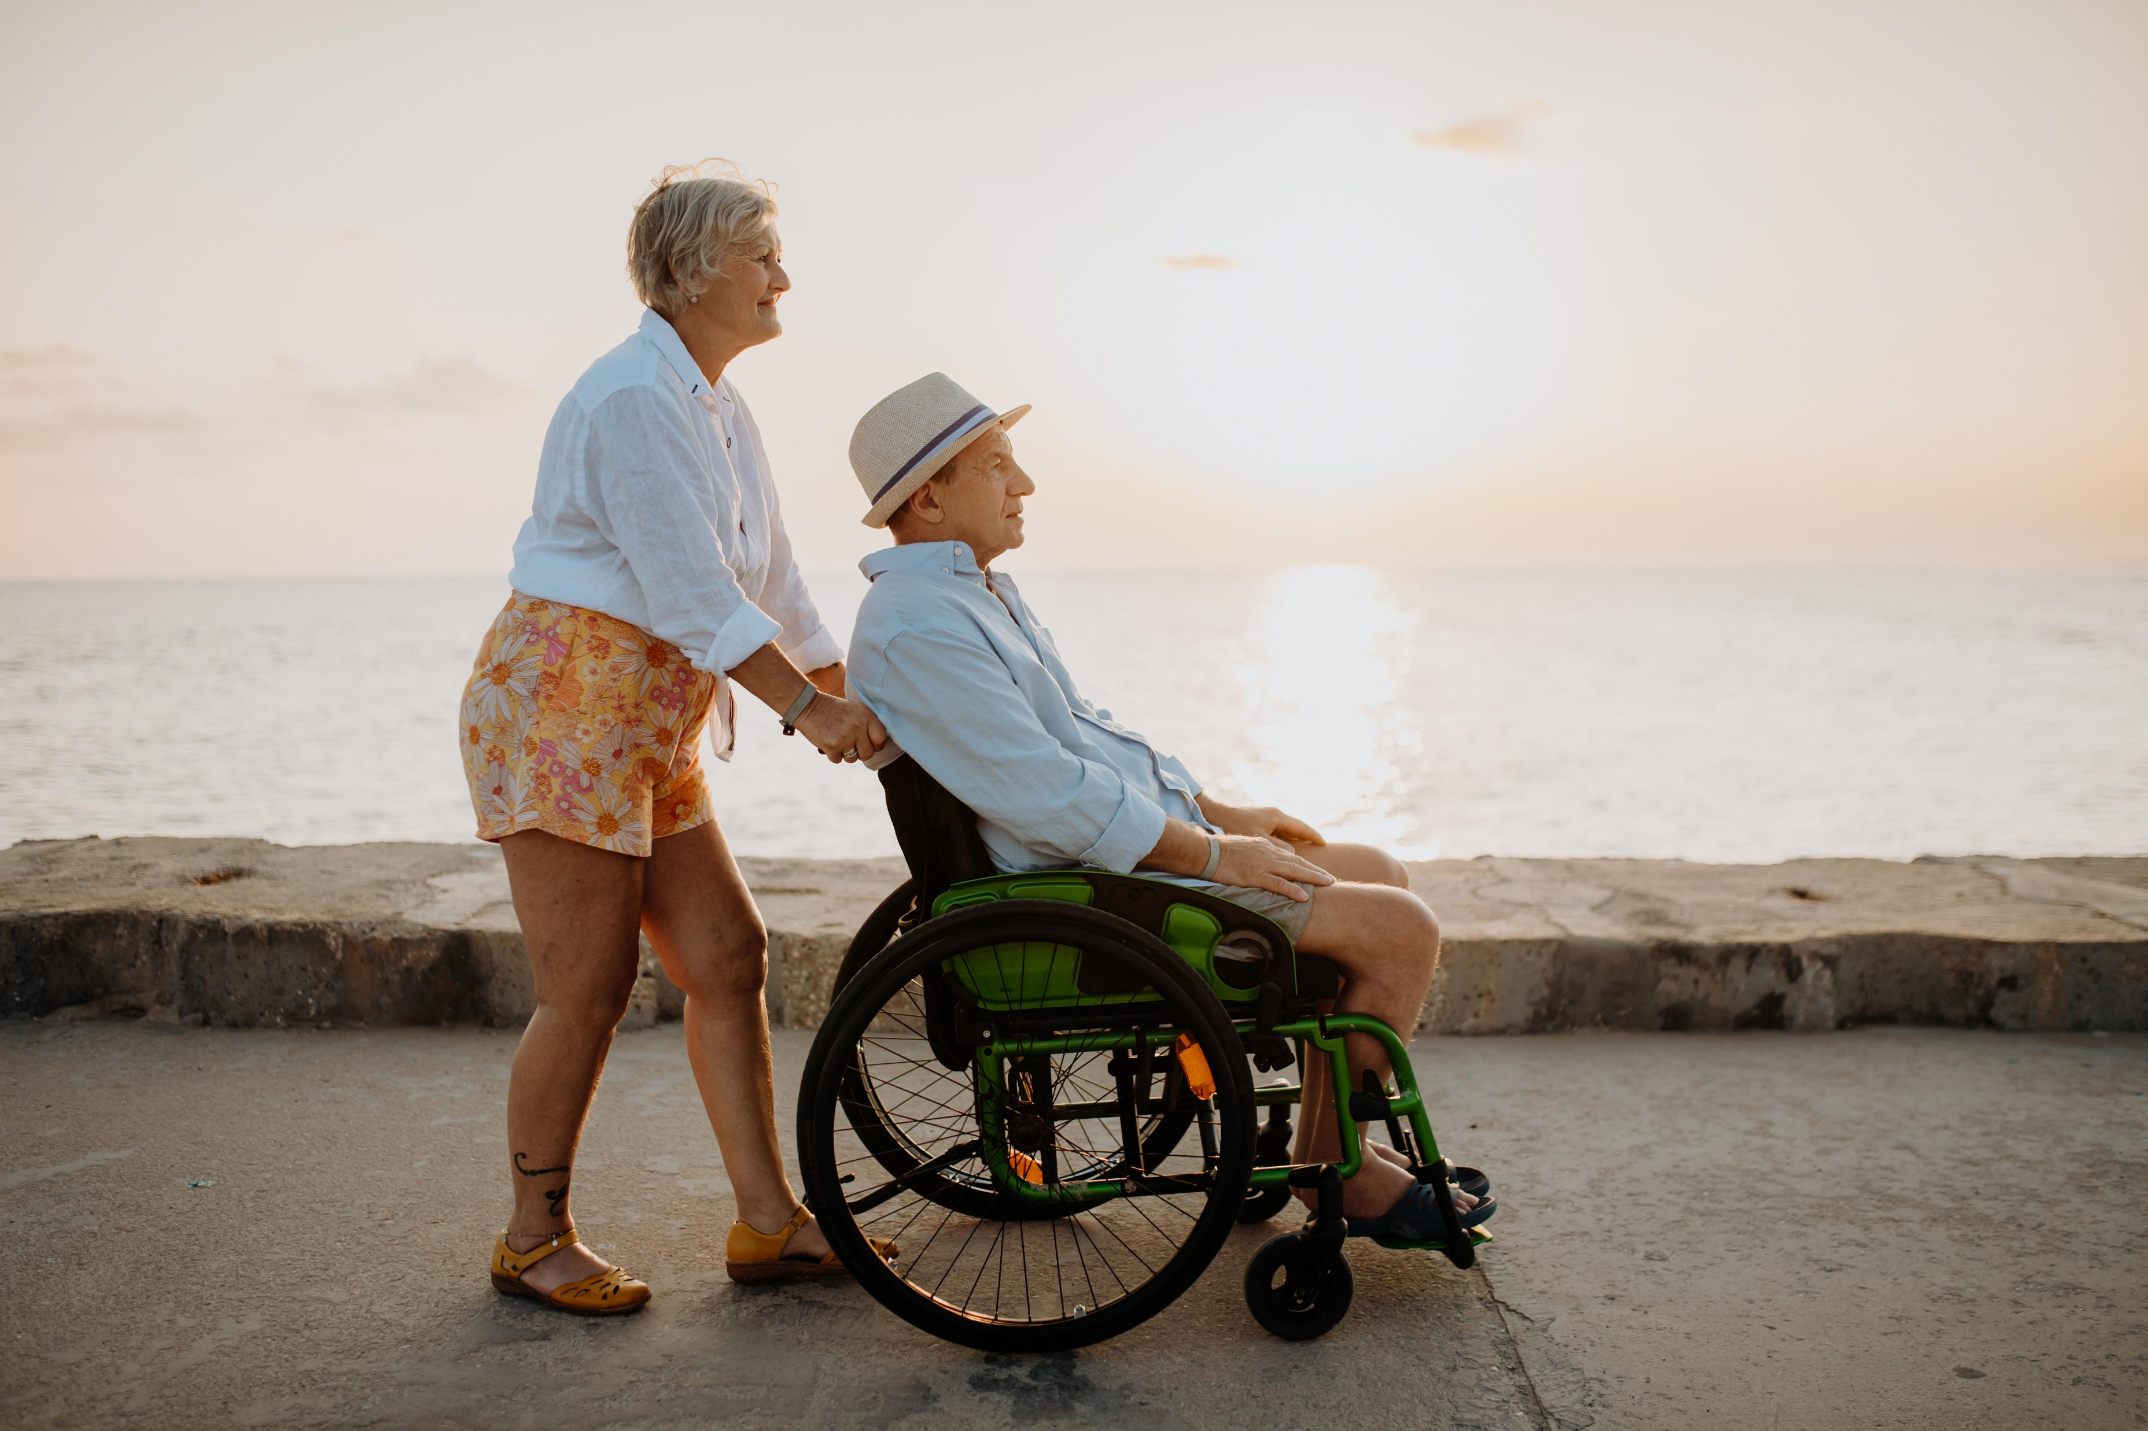
Then one day they cannot walk beside you anymore… and they need your help everyday.
Maybe this has already happened to you like thousands of other people.

Slide 4
As Roslyn Carter said…
“There are only four kinds of people in the world — those who have been caregivers, those who are currently caregivers, those who will be caregivers, and those who will need caregivers

Slide 5
You are not alone.
To help put this into perspective:
​A new AARP Public Policy Institute report finds that 59 million family caregivers provide care equivalent to the amount of work done by 23.8 million full-time workers.​
Family caregivers now average 27 hours of care per week, and 57 percent are in high-intensity roles, an indication that more are taking on complex medical tasks once handled by direct care and health care professionals.

Slide 6
How can the caregiver take care of themselves on the Journey?
Caregiving is often something we do in our homes for our loved ones, so many people do not think of it as a job.
This can lead to caregivers not taking breaks, forgoing time off, and forgetting to eat meals or take care of their own health.
Your loved one can still be important to you, even if you give yourself permission to think of the caregiver work you do for them as a job.
Framing it this way, helps keep perspective on taking care of basic needs like 10 minute breaks, meal breaks, and asking friends, family or paid caregivers to take a shift so you can have a day off or vacation.

Slide 7
Take care of your own basic needs
Caregiving can start as simple tasks but can also become complex very fast, often at the least convenient time.
Because of this, it is important to prioritize your own needs first so that you can be at your best, and have energy to help others.
Like the airline attendants say, “put on your oxygen mask first so you can then help your family members with theirs”.
This means that taking your own medications as prescribed, eating meals, getting enough sleep, taking breaks, going to your own appointments, and asking for help when needed are top priorities.

Slide 8
Practice staying in present in the moment:
Many times our minds think we can accomplish more than we can in real life.
Our intellect plans tasks with a clear path “like the crow flies”; however, life as a caregiver rarely follows a straight path.
Things happen that are unexpected, people drop things, may have accidents, get confused and come down with the flu to name a few.
Staying in the present moment, and the present task one thing at a time helps us stay focused and make adjustments quicker if the unexpected happens.
Practice the present moment: Mindfulness, breathing exercises, one task at a time, self compassion exercises, simple reminders and mantras “of one thing at a time”.

Slide 9
Notice Stress, and try to reduce it when possible
Caring for a loved one can be stressful and use physical, spiritual, and emotional energy.
Constant giving can empty your internal gas tank, and leave you feeling empty, fatigued, and irritable. If this goes on too long it can lead to burn out.
Pay attention to your internal gas gauge, rest when you get tired, and ask for help when you feel drained.
Make sure to fill your tank back up by eating nutritious foods, getting enough sleep and taking breaks.
Off load stress through exercise, yoga, spending time with a pet, going for walks, start a gratitude journal, spending time with a friend.
Attend a caregiver support group, online or in person. and break tasks into smaller steps if needed.
Acknowledge that needing help is normal and take steps to reduce stress, such as setting limits, breaking tasks into manageable steps and setting realistic goals.

Slide 10
Connect to Social Support
Help from family, friends, gardener, housekeepers or professional caregivers can make a difference.
Help can come in different ways: a listening ear on the phone,
Simple neighborly tasks, and a delivery services can make a
difference.
Look into caregiver support groups, either online or in-person, to share experiences and gain emotional support

Slide 11
Strengthen your Mental and Spiritual Well-being
Attend a faith based activity of your choice either online or in person
Practice Mind-body activities like yoga, tai chi, or breath awareness to reduce stress.
Practice self-compassion that includes honest reflection on the challenges of caregiving and give yourself time for rest and personal care.
Get some laughs, and lighthearted entertainment. See a play, watch comedy, or a funny movie.
Dr Kristin Neff has Self Compassion for the Caregiver videos online.

Slide 12
Time Management
Organize tasks: Use lists, calendars, or planners to manage responsibilities efficiently and share information with others if needed.
Make a detailed list of all of the everyday tasks that you do to maintain your home and provide caregiving.
Group tasks into categories such as housekeeping, gardening, shopping, transportation, hands on caregiving, and healthcare.
Consider if there is another service that could provide help with tasks in a specific categories, and seek help to fill that role.
Set limits when needed: say no to energy draining requests when possible.
Simplify whenever possible

Slide 13
A Caregiver’s Bill of Rights….I have the right . . .
To take care of myself. This is not an act of selfishness. It will give me the capacity to take better care of my relative.
To seek help from others even though my relative may object. I recognize the limits of my own endurance and strength.
To maintain facets of my own life that do not include the person I care for, just as I would if he or she were healthy. I know that I do everything that I reasonably can for this person, and I have the right to do some things for myself.
To get angry, be depressed, and express other difficult feelings occasionally.
To reject any attempt by my relative (either conscious or unconscious) to manipulate me through guilt, anger, or depression.
To receive consideration, affection, forgiveness, and acceptance for what I do for my loved one for as long as I offer these qualities in return.

Slide 14
Caregivers Bill of Rights Continued…
To take pride in what I am accomplishing and to applaud the courage it has sometimes taken to meet the needs of my relative.
To protect my individuality and my right to make a life for myself that will sustain me in the time when my relative no longer needs my full-time help.
To expect and demand that as new strides are made in finding resources to aid physically and mentally impaired older persons in our country, similar strides will be made toward aiding and supporting caregivers.
To ___________________________________________________
(Add you own statement of rights to this list. Read the list to yourself every day.)
— Jo Horne, author of Caregiving: Helping an Aging Loved One

Slide 15
Maintain Long-Term Sustainability
Remember it is a journey not a sprint.
Pace yourself, Break things into smaller tasks, and ask for help
Taking care of your physical, mental, and spiritual health, will help continue providing quality caregiving.
Taking care of yourself helps keep relationships positive, improves focus, maintains your health, and prevents burnout, which all help you show up for your loved one when needed.

Slide 16

What Caregiver Tips have you found helpful?

Slide 17
References
https://www.caringbridge.org/resources/care-for-the-caregiver
Source: AARP and National Alliance for Caregiving, “Caregiving in the US 2025”;
AARP Public Policy Institute, “Valuing the Invaluable 2026”
theworlddata.com
digitalcaregivers.com
worldmetrics.org

