Slide 1
Common virus affecting the heart and other systems
Radhika nandur bukkapatnam md mas
Jan 30, 2025

Slide 2

Virus
Viruses are microscopic organisms that can infect hosts, like humans, plants or animals. They’re a small piece of genetic information (DNA or RNA) inside of a protective shell (capsid).
Respiratory illnesses
GI illnesses
Sexually transmitted
Skin
Oncovirus
misc

Slide 3
Respiratory virus
Influenza
Corona virus
Measles
Rsv
Adenovirus: Common cold

Slide 4
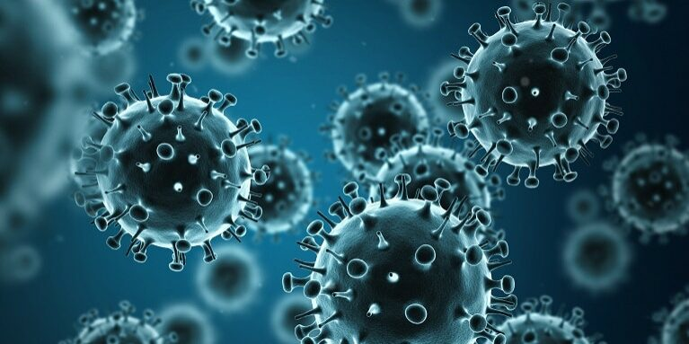
Influenza virus
Droplet spread
Bird flu: sick birds or dairy cows
CDC estimates that for the 2023-2024 season, there were at least 34 million illnesses, 380,000 hospitalizations, and 17,000 deaths in the US, including 199 pediatric deaths
Fevers, aches, upper resp symptoms, cough, pneumonia
Precipitates congestive heart failure
Tamiflu (1-2 days)
Prevention: Annual vaccines

Slide 5
Flu and heart disease
People with heart disease and stroke have a higher risk of developing serious flu complications.
Studies showed that risk of heart attack was 6 times higher within a week of flu infection
Among people hospitalized for flu, ~12% had an acute cardiovascular event
Keep adequate supply of regular medications
Call for help

Slide 6
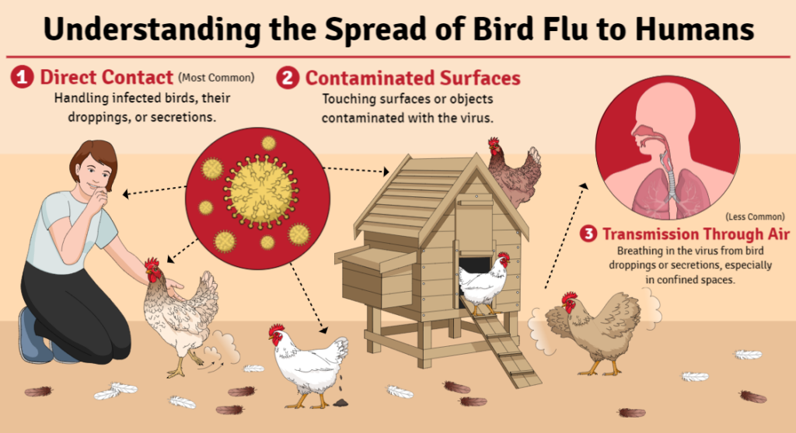

Slide 7
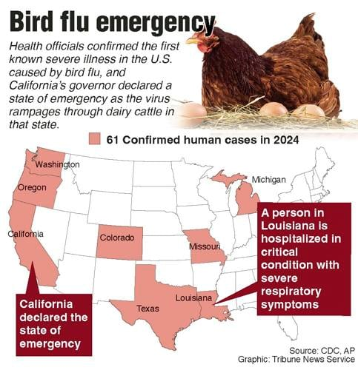

Slide 8
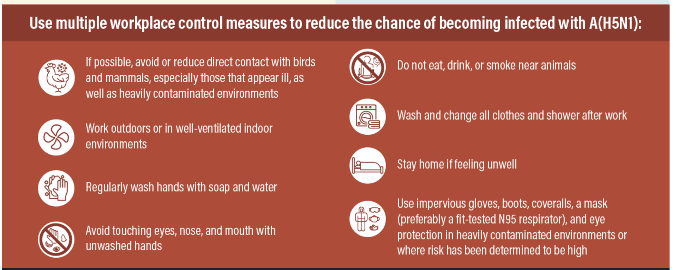
prevention

Slide 9
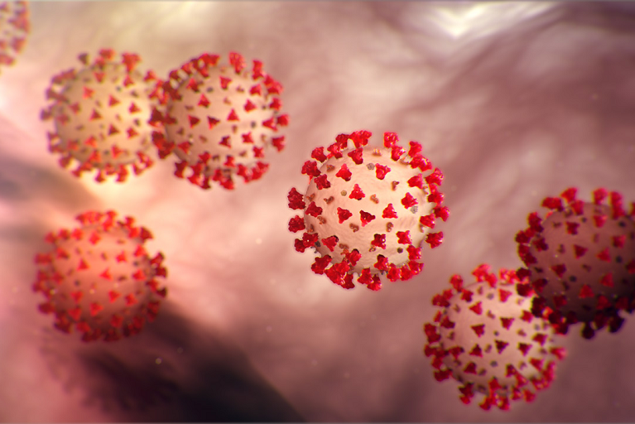
Corona virus
Large family of viruses that include COVID 19 and SARS.
Common cold to serious illness, other symptoms
Diagnosis: lab and home tests
Prevention: vaccines, avoid exposure, wash hands

Slide 10
Systemic effects of covid-19
Respiratory: immune response to the virus
Nervous system:
Microvascular disease: fog
Neuropathy
Unmasks neurodegenerative disease: parkinsons
Worsening migraines
GI: GERD, irritable bowel syndrome
Kidneys: decreased function

Slide 11
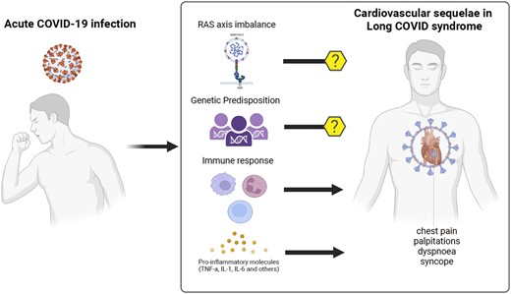
Cardiovascular effects of covid 19
Rare cause of myocarditis
Atrial fibrillation
Pulmonary embolism
Coronary plaque
DVT
Long-term: Coronary artery DISEASE EQUIVALENT

Slide 12
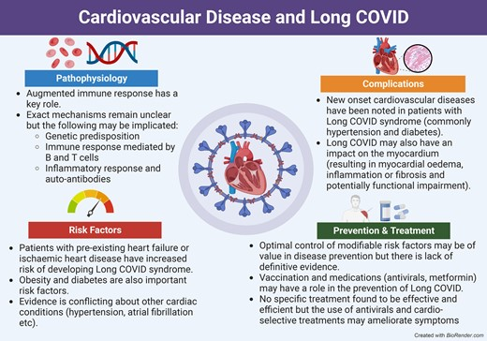

Slide 13
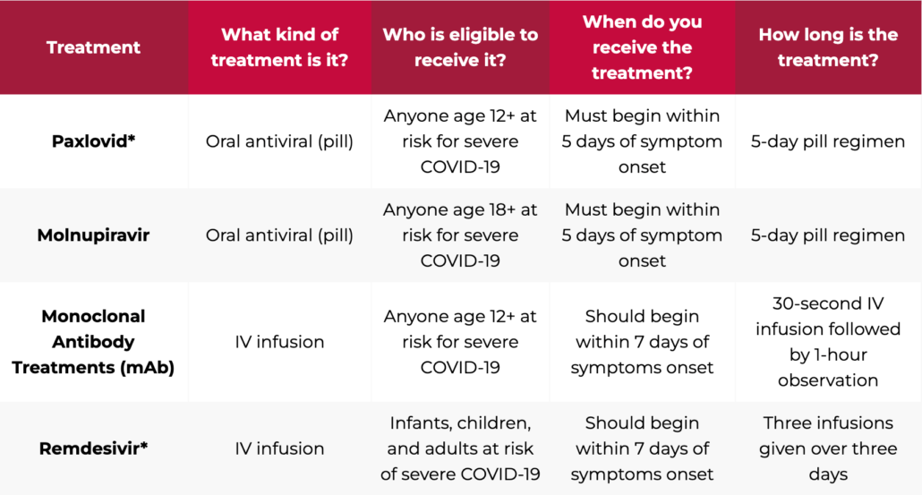
Treatment of covid 19

Slide 14
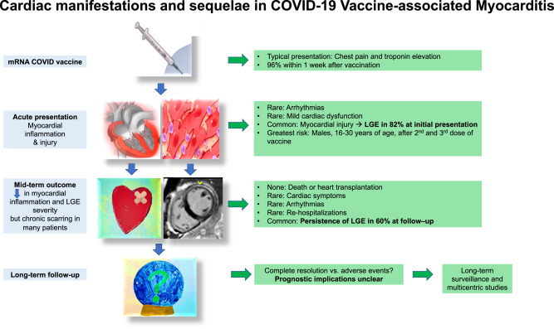
vaccines

Slide 15
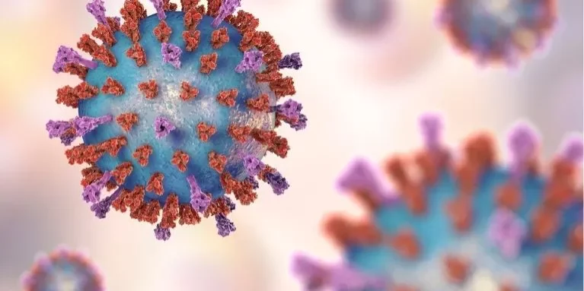
respiratory Syncytial virus
Respiratory syncytial virus (RSV) is a common virus that infects the nose, throat, lungs, and breathing passages. It spreads through droplets from an infected person when they cough, sneeze, or kiss. You can also catch it by touching surfaces with the virus on them and then touching your eyes, nose, or mouth.
Can live for hours on surfaces
Each year in the US, RSV is estimated to cause 100,000-160,000 hospitalizations in adults age 60 years and older
RSV Vaccine: Adults: A single dose of RSV vaccine is recommended to protect all adults age 75 years and older and adults age 60-74 years who have certain risk factors.

Slide 16
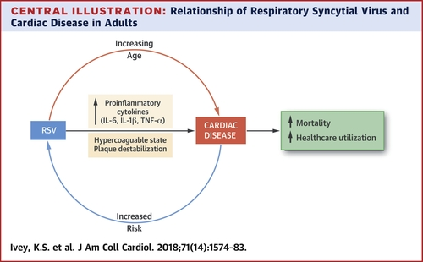
RSV and Cardiovascular effects
While most cases of RSV will remain mild, serious complications can occur. This includes bronchitis, pneumonia and worsening conditions like asthma, chronic obstructive pulmonary disease and congestive heart failure. Studies have shown that up to 22% of hospitalized adults experience cardiovascular complications, such as worsened congestive heart failure, new arrhythmia and stroke

Slide 17
treatment
Tylenol, fluids, rest
If HR is high or short of breath, to the hospital
Prevention: One vaccine

Slide 18
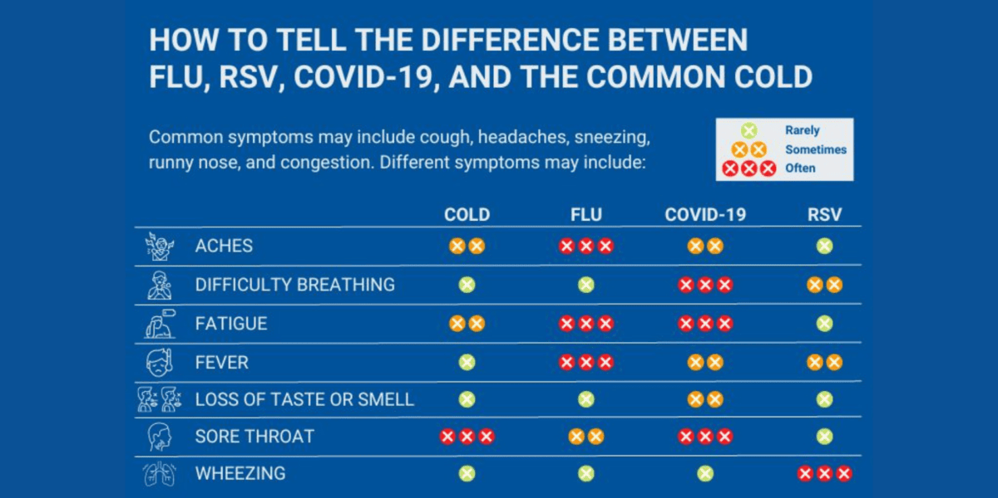

Slide 19
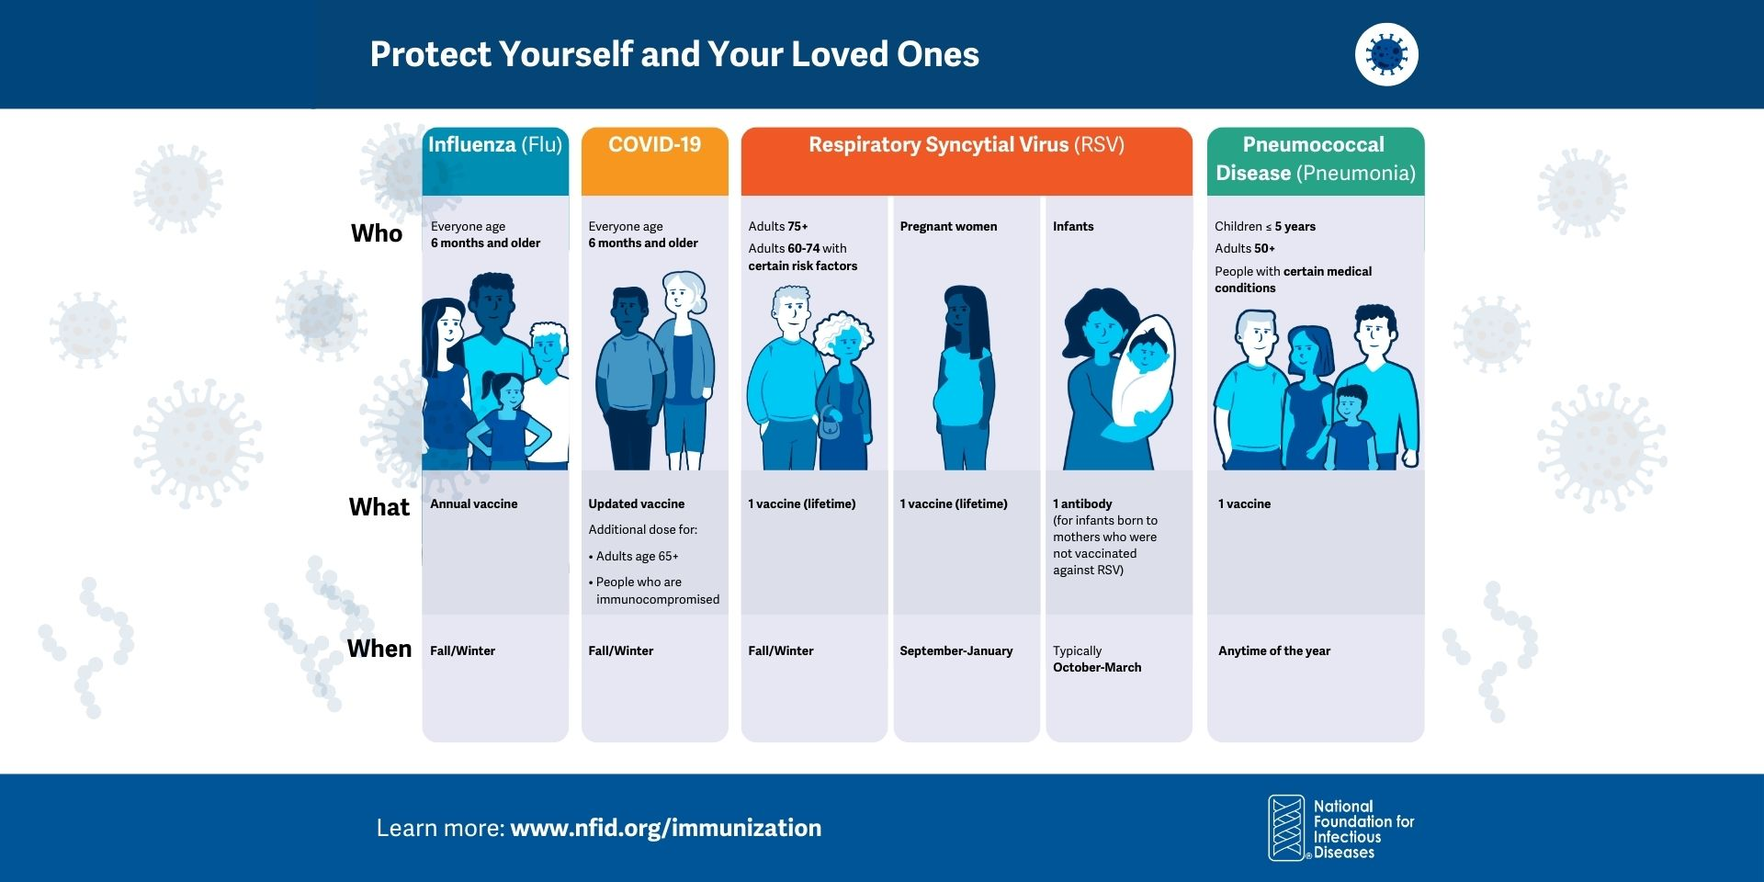

Slide 20
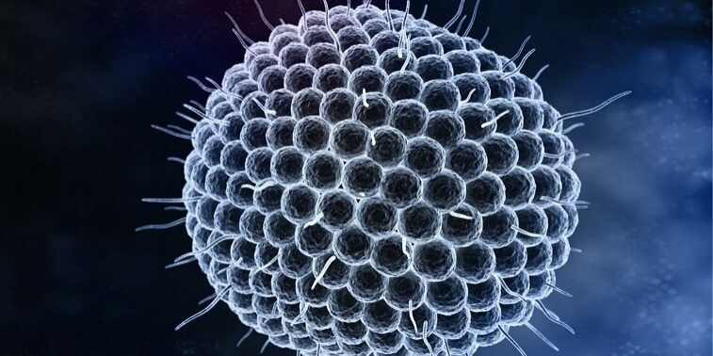
chickenpox
Chickenpox is a disease caused by the highly contagious varicella zoster virus. It is spread by coughing and sneezing, and by direct contact with skin lesions
Chickenpox can lead to severe complications, including bacterial infection of the skin from the lesions, swelling of the brain, and pneumonia
Causes shingles
1 out of every 3 people in the United States will develop shingles in their lifetime. Anyone who has suffered from chickenpox may develop shingles; however, the risk of shingles increases as a person gets older.
2 part vaccine for adults over 50 yrs

Slide 21
Cardiovascular effects of shingles
A total of 519,880 patients were followed from 2003-2013, during this period there were 23,233 cases of shingles.
Patients with shingles were more likely to be female and common risk factors for stroke and heart attack, such as old age, high blood pressure, diabetes and high cholesterol.
Shingles was found to raise
the risk of a composite of cardiovascular events including heart attack and stroke by 41 percent,
the risk of stroke by 35 percent and
the risk of heart attack by 59 percent. The risk for stroke was highest in those under 40 years old, a relatively younger population with fewer risks for atherosclerosis. The risks of both stroke and heart attack were highest the first year after the onset of shingles and decreased with time. However, these risks were evenly distributed in the shingles-free group.

Slide 22
GI source
Norovirus
Hepatitis virus
Polio virus

Slide 23
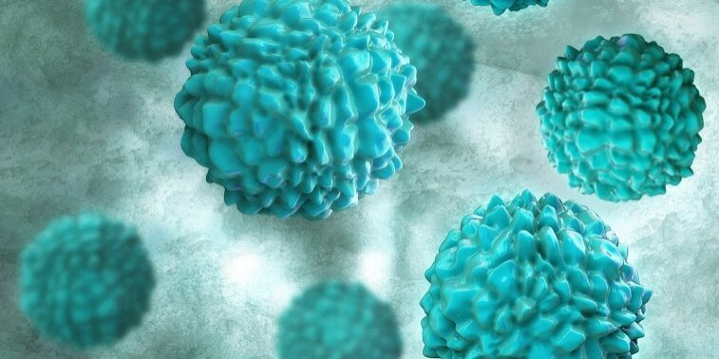
Norovirus
Norovirus is a common and highly contagious virus that causes inflammation in the stomach and intestines, a condition known as gastroenteritis.
Cruises
Handwashing helps prevent
Hydration

Slide 24
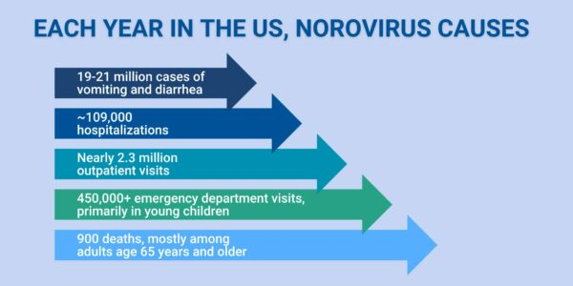
Dehydration due to diarrhea
Arrhythmias
Cardiogenic shock
Gastroenteritis promotes the development of systemic inflammation and a hypercoagulable state; these complications may contribute to the pathogenesis of coronary artery thrombosis

Slide 25
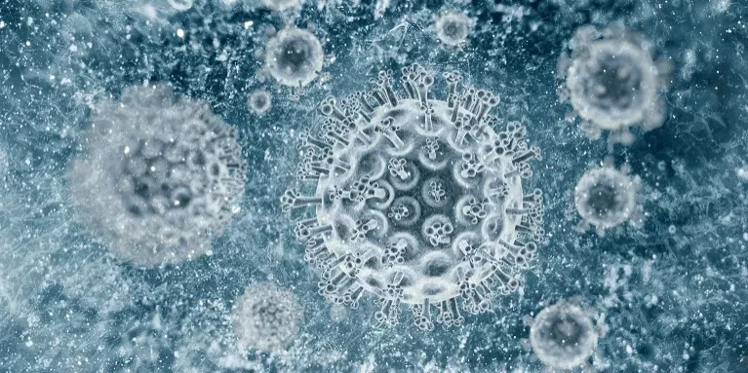
hepatitis
Hepatitis is an inflammation of the liver. The liver is a vital organ, and when it is inflamed or damaged, its function can be affected, including the ability to process nutrients, filter the blood, and fight infections.
Hepatitis A is usually a short-term infection and does not become chronic.
Hepatitis B and hepatitis C can begin as short-term, acute infections, but they also have the potential to lead to chronic disease and long-term liver problems.
Vaccines: Hep B all adults

Slide 26

polio
Polio is a highly contagious infectious disease caused by a virus that invades the nervous system. Poliovirus spreads through contact with the stool (feces) of an infected person or droplets from a sneeze or cough
In some people, the poliovirus can result in paralysis (usually the legs), which can lead to permanent disability. The poliovirus can cause death when it paralyzes the muscles that help people breathe.
About 1-5 out of 100 people who are infected with poliovirus infection will develop meningitis (an infection of the spinal cord or brain).
Vaccine

Slide 27
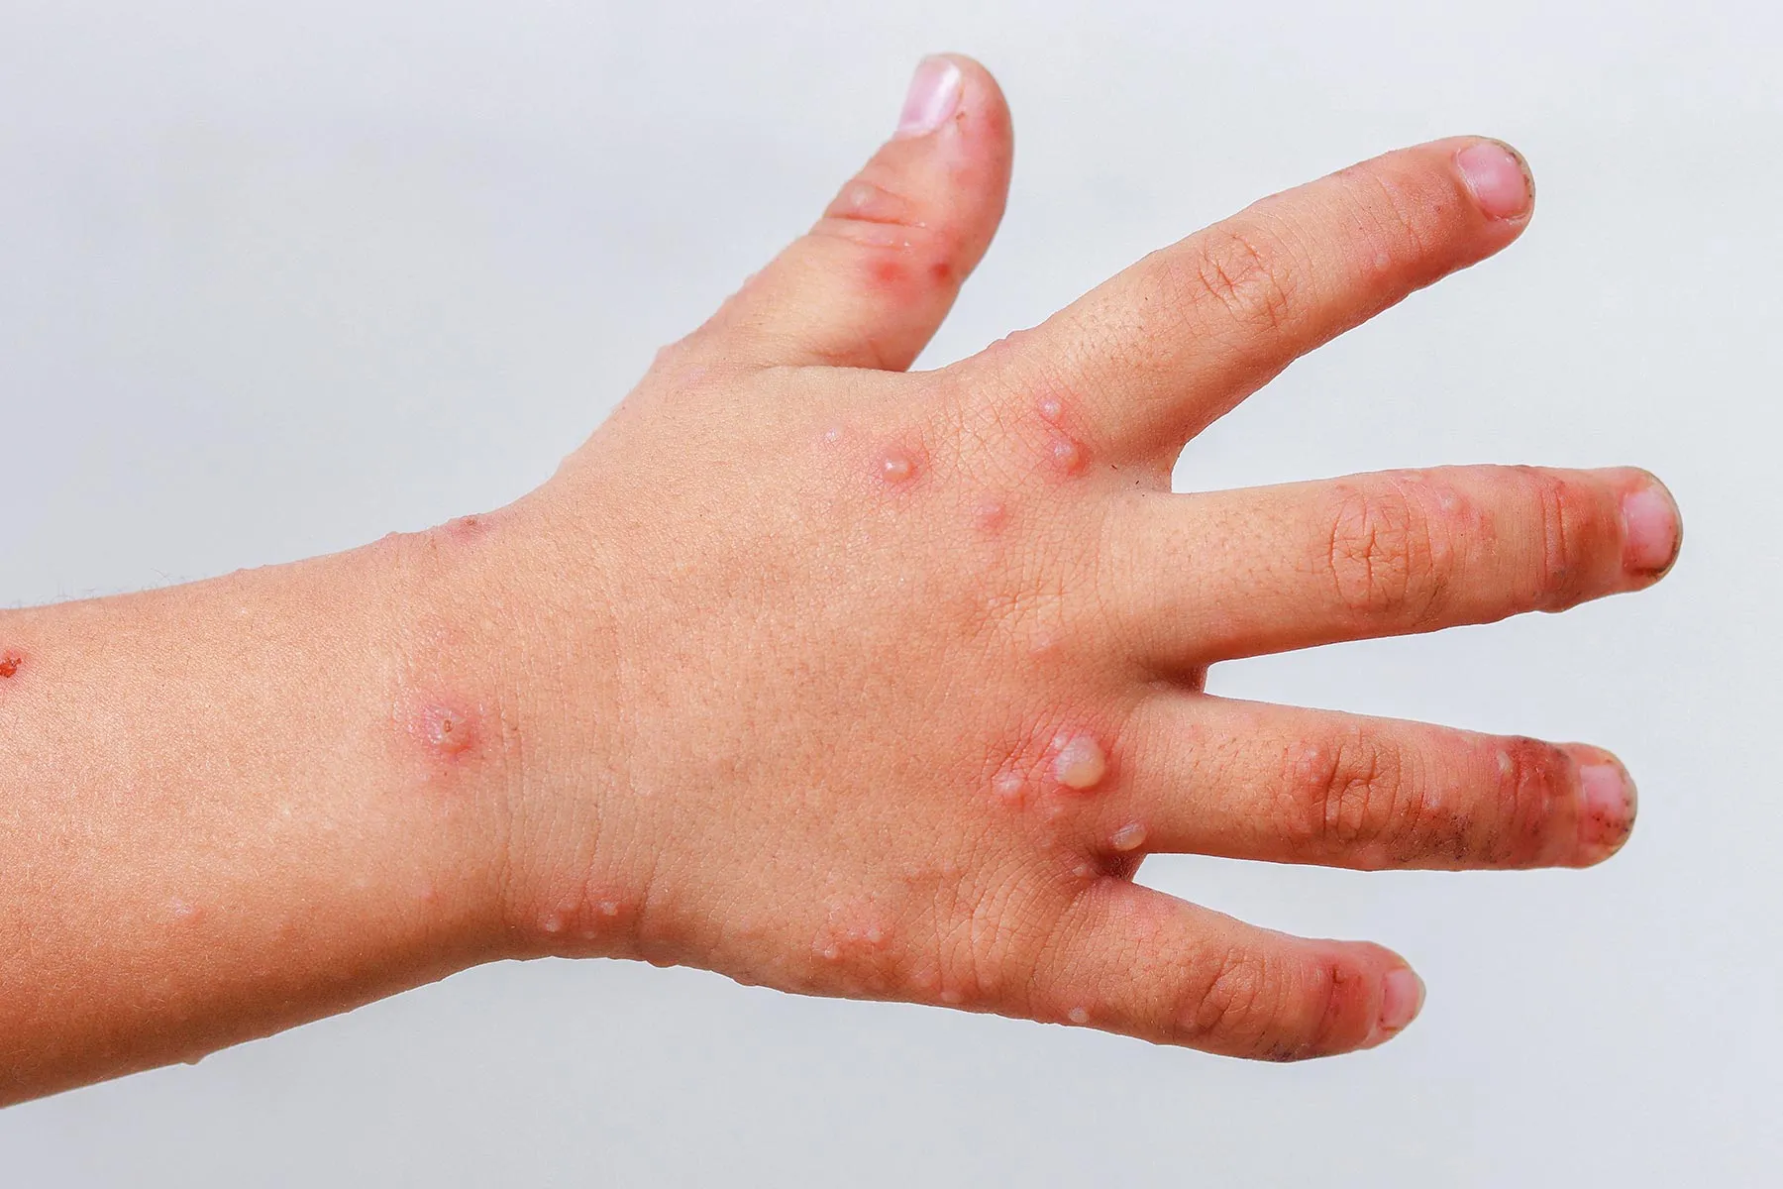
Coxackie virus
Coxsackievirus is one of the four types of viruses known as enteroviruses.
Enteroviruses are made up of a single strand of genetic material called ribonucleic acid (RNA).
Coxsackievirus causes illnesses such as hand, foot, and mouth disease (HFMD), muscle infections, heart infections, and meningitis, which is an infection of the brain and spinal cord.

Slide 28
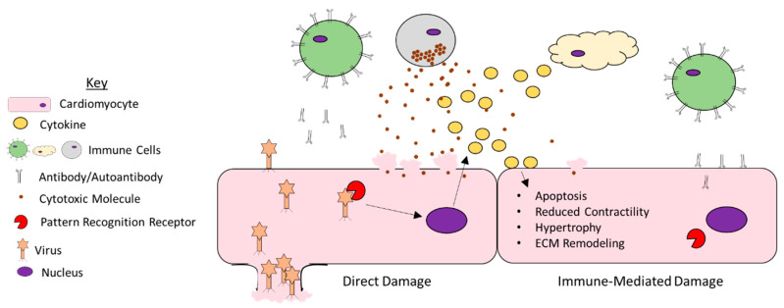
Viral cardiomyopathy
Direct damage by the offending agent
Secondary immune response triggered by the offending agent
Expression of cytokines in the myocardium, which leads to an inflammatory process
Premature or aberrant induction of apoptosis:
coxsackievirus group B, HIV, CMV, Epstein-Barr virus, hepatitis, and influenza viruses.

Slide 29
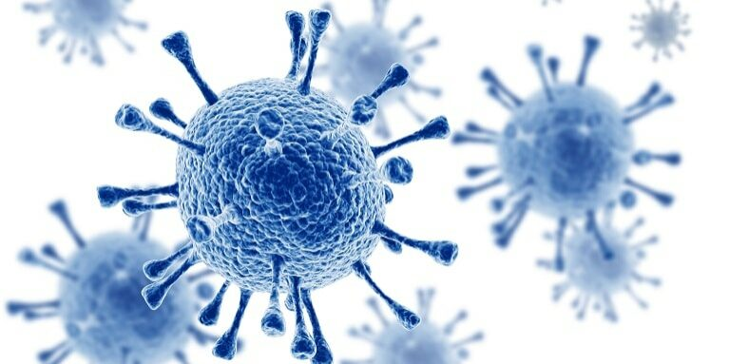
HIV
recent studies link HIV with
premature aging of the coronary arteries
myocardial infarction
thromboembolic incidents
pulmonary hypertension cardiomyopathies
myocarditis
heart failure

Slide 30
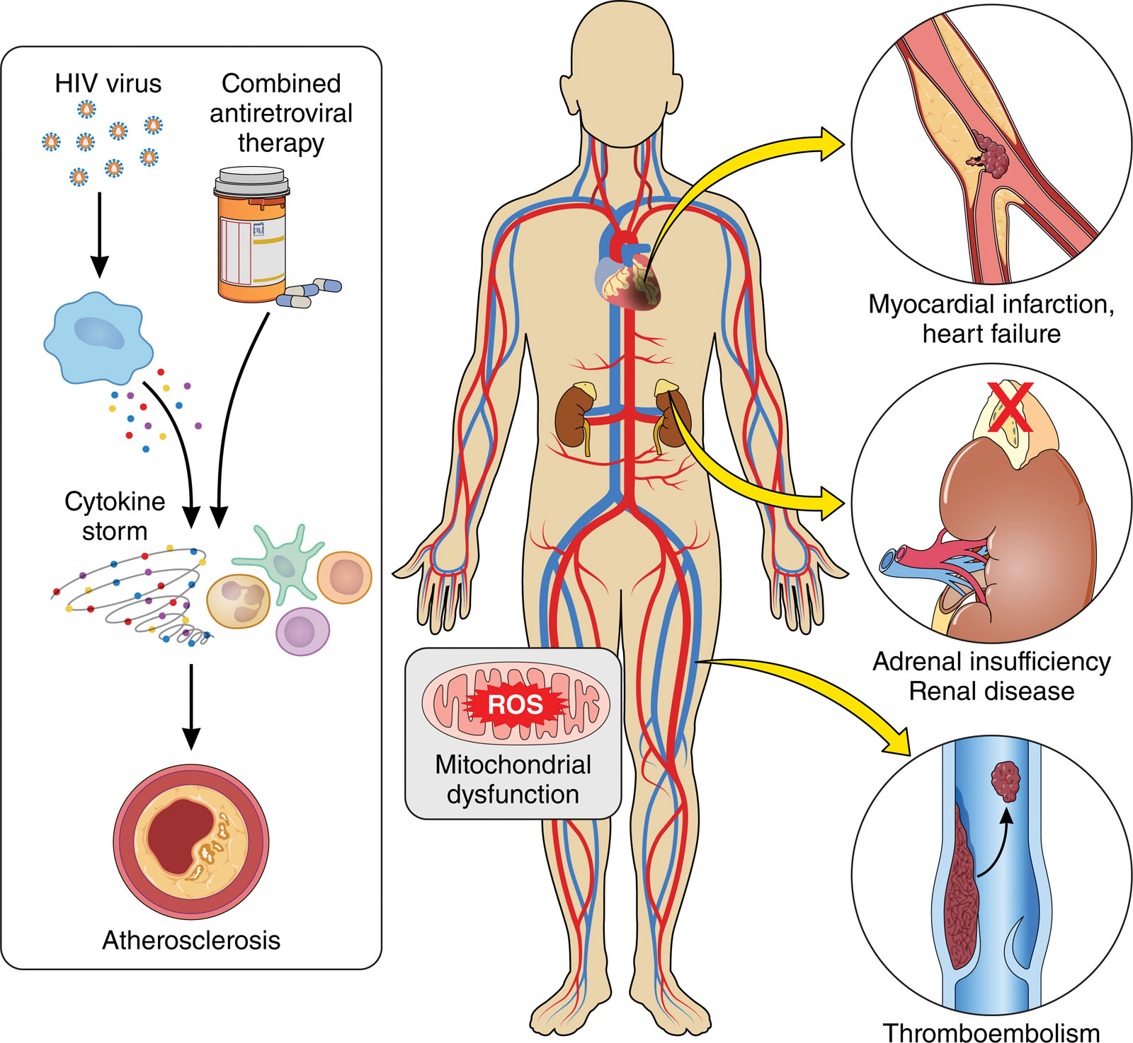

Slide 31
References
https://www.cdc.gov/flu/whats-new/2023-2024-flu-heart-study.html
Vasiliki Tsampasian, Maria Bäck, Marco Bernardi, Elena Cavarretta, Maciej Dębski, Sabiha Gati, Dominique Hansen, Nicolle Kränkel, Konstantinos C Koskinas, Josef Niebauer, Luigi Spadafora, Manuel Frias Vargas, Giuseppe Biondi-Zoccai, Vassilios S Vassiliou, Cardiovascular disease as part of Long COVID: a systematic review, European Journal of Preventive Cardiology, 2024;, zwae070, https://doi.org/10.1093/eurjpc/zwae070
https://covid19communicationnetwork.org/covid19resource/if-you-test-positive-for-covid-19-speak-with-your-provider-about-your-eligibility-for-treatment-options-like-antiviral-medications
https://www.heart.org/en/news/2024/10/09/covid-19-may-increase-heart-attack-and-stroke-risk-for-years
Paknahad MH, Yancheshmeh FB, Soleimani A. Cardiovascular complications of COVID-19 vaccines: A review of case-report and case-series studies. Heart Lung. 2023 May-Jun;59:173-180. doi: 10.1016/j.hrtlng.2023.02.003. Epub 2023 Feb 8. PMID: 36842342; PMCID: PMC9905103.
https://www.heart.org/en/health-topics/rsv
Ivey, K, Edwards, K, Talbot, H. Respiratory Syncytial Virus and Associations With Cardiovascular Disease in Adults. JACC. 2018 Apr, 71 (14) 1574–1583.
Martens CR, Accornero F. Viruses in the Heart: Direct and Indirect Routes to Myocarditis and Heart Failure. Viruses. 2021 Sep 24;13(10):1924. doi: 10.3390/v13101924. PMID: 34696354; PMCID: PMC8537553

Slide 32
Thank you

